Slide 1
Crash course in nuclear power generation
Ruaridh Macdonald
PhD Student, Nuclear Science and Engineering (NSE)
Alumni Mentor

Slide 2
Who’s this guy
Ruaridh (Rory) Macdonald
PhD student in NSE (Course 22)
Undergrad at MIT (‘12); Mission 2012 student
PhD: Nuclear weapons verification
Masters: Toughened small, solid fuel, fluoride salt cooled reactors
Undergrad: Fast reactor design; nuclear data; computational methods
GRT at Simmons

Slide 3
Plan for talk
Brief introduction to how a plant works (5 mins)
Nuclear fuel cycle (10 mins)
Thorium vs. Uranium (5 mins)
Disclaimers: Won’t present different reactor designs
Won’t say too much about safety / accidents
I may say some inaccurate things
Feel free to send me questions:
rmacd@mit.edu

Slide 4
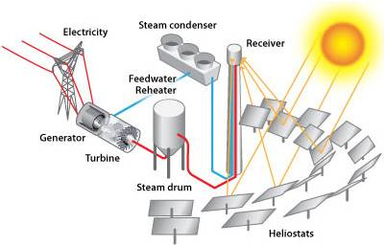
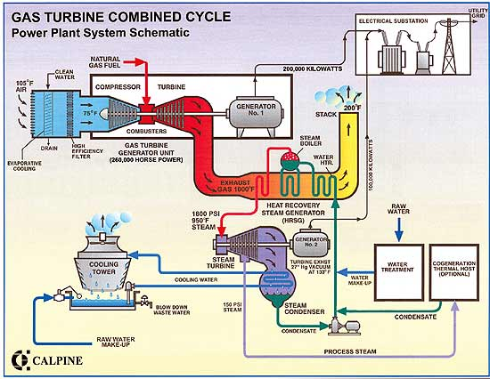
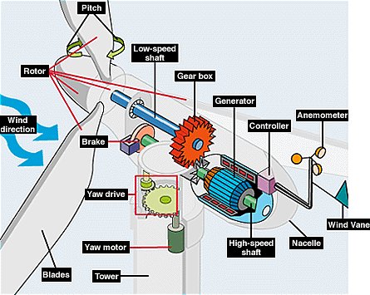
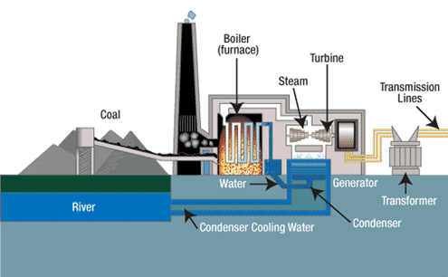
What’s Power All About?
All electricity is about making electrons move
The easiest way to do that is to spin a magnet
(Almost) All industrial power is about creating rotary motion. Normally using hot gas for a turbine
B
e⁻
e⁻

Slide 5
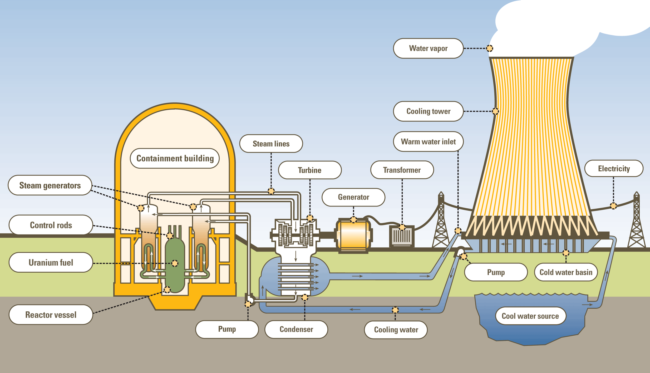
Nuclear Power Plant vs. Coal Plan

Slide 6
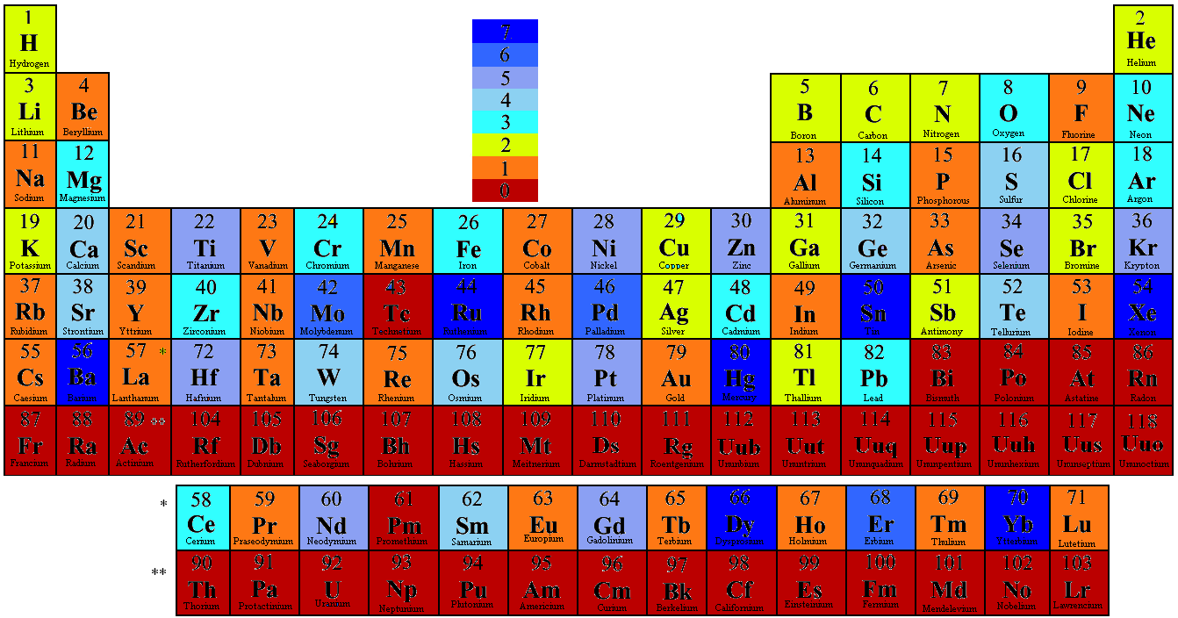
Nuclear Heat
Nuclear power generates heat from fission of heavy isotopes
Uranium 233, 235 (238)
Plutonium 239
n⁰
U-235
?
U-236*
n⁰
x2-3
?

Slide 7
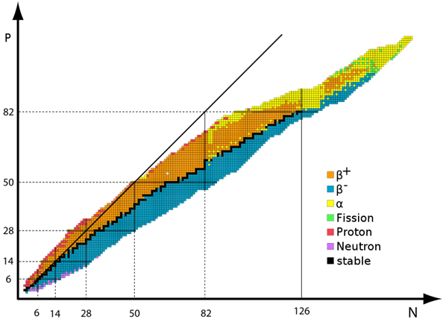
Nuclear Heat
Nuclear power generates heat from fission of heavy isotopes
Uranium 233, 235, (238)
Plutonium 239
n⁰
U-235
?
U-236*
n⁰
x2-3
?

Slide 9
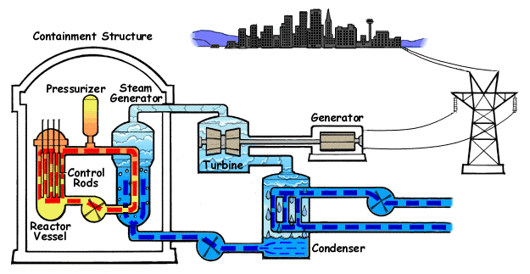
Plant Operation
Water coolant removes heat from fuel assembly (~200 / core)
Fuel assembly made of fuel rods (~0.5 ton fuel / assembly)
Assemblies come in a variety of shapes (hex, circle, square)

Slide 10
Plant Operation
Multiple options exist for the coolant:
Light water, heavy water, CO2, helium, fluoride salts, lead, sodium, organic fluids, …
In a thermal reactor, the coolant also ‘slows down’ neutrons.
Thermal or fast reactors
Reactors are designed to be stable systems
If you increase the power / temperature, the reactor physics will try to reduce power
In some designs the opposite happens if you try to decrease power
Designs focus on passive safety. Makes it very difficult / expensive to change designs
Nuclear plants are designed for stable power (95%+ capacity factor)
Modern plants can change output (50-100% @ 5%/min, depending on design)

Slide 11
Fuel Cycle Options
Once through Cycle – Store all of the fuel assembly as waste
Closed Cycle – ‘Recycle’ most of the fuel for reuse. Store the rest;
Mixed / hybrid Cycle – ‘Recycle’ some of the fuel
Choices driven by:
Technical abilities of different nations
Types of reactor available
Reprocessing tech. available
Politics of nuclear material control
Reprocessing isolates high purity Pu-239 for nuclear weapons

Slide 12
Nuclear Fuel
Natural uranium is only made of 0.71% U-235, our main fuel. The rest is U-238
Not all countries have uranium deposits
It can be extracted from seawater (3.3E8 litres / kg U)
You have to enrich it after mining. 20% is legal limit.
Most plants use 3-5%. Most US permits are for 5%. Some reactors use nat. U
After being in the reactor the fuel will contain lots of new isotopes
U-238, U-235, Pu-239, Pu-other - can be reused in new fuel
Fission products - radioactive daughter particles
Minor actinides - heavy particles created by non-fission absorption
Most of these are radioactive but to different degrees and for different amounts of time
Different strategies for storage

Slide 13
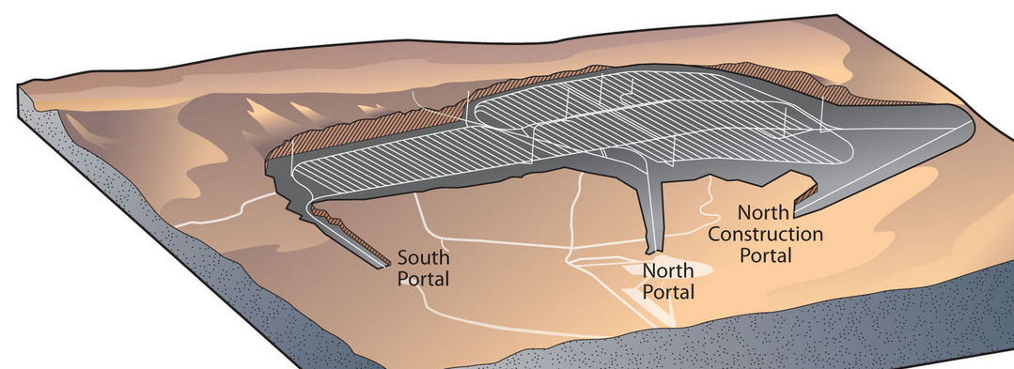
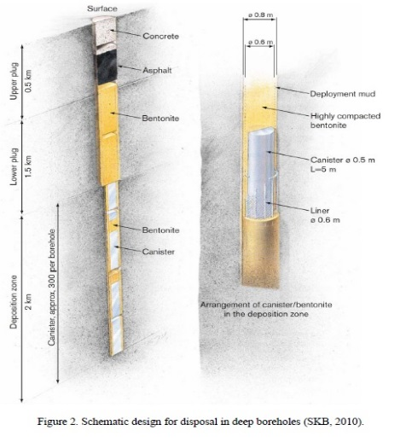
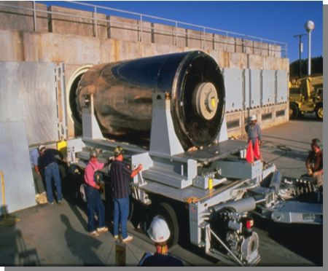
Waste Storage
Immediately after use - Spent fuel pool
After 1->2 years - Interim storage
After 10+ years - Multiple options
Geological Repository
Deep borehole
On-site storage

Slide 14
Once through
Simplest fuel cycle
Weapons material is never available
Produces the most waste
Least efficient use of fuel material
Still a good choice compared to other power sources
Politically accepted
Cheapest upfront cost

Slide 15
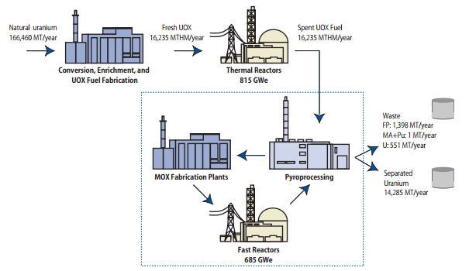
Closed Cycle
Weapons material is never isolated
Produces very little waste
Effectively unlimited fuel supply
Politically difficult
Lots of R&D $$ needed

Slide 16
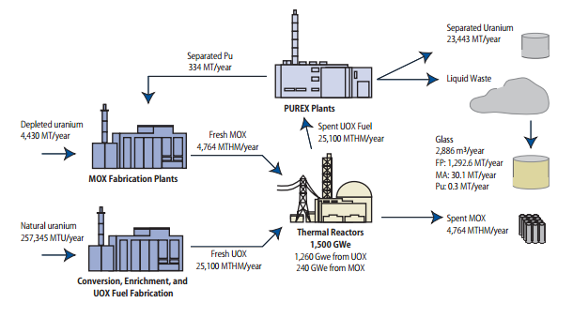
Mixed / hybrid Cycle

Slide 17
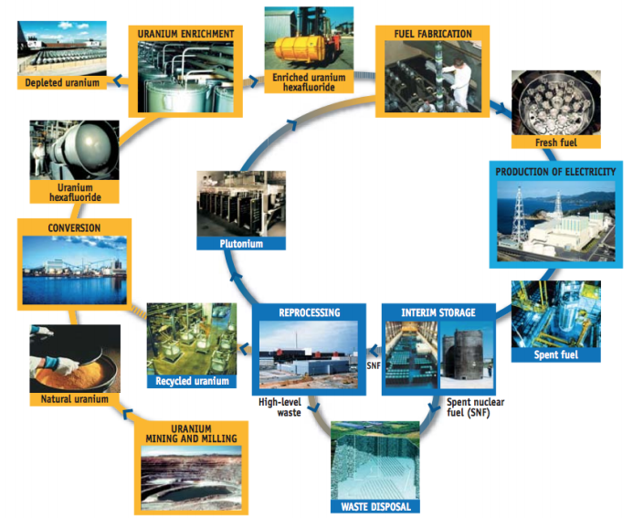
Full Cycle

Slide 19
Thorium
Thorium is mostly Th232
It is not fissile. It absorbs a neutron to become U233, which is fissile
It needs another fissile material to maintain a chain reaction
It is three times more abundant than uranium in the Earth’s crust
Thorium reactors can be fast or thermal breeder reactors
It produces the most neutrons per fission
Has higher thermal conductivity and melting point
Easier to run the reactor safely
Fewer minor actinides are produced
Remaining ones have shorter half life

Slide 20
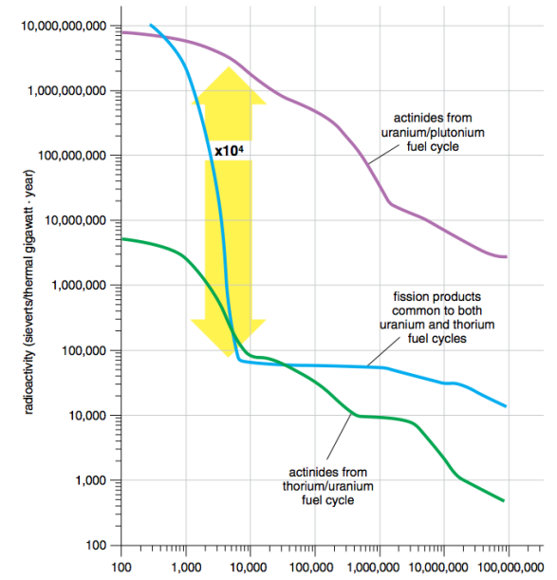

Slide 21
Thorium vs. Uranium
U-233 is more likely to fission when irradiated than U-235 or Pu-239
~ Prob[fission if neutron hits U-233]
~ Prob[not-fission if neutron hits U-233]
U-233
U-235
Pu239
U-233
U-235
Pu239
Incoming neutron energy (MeV)
Incoming neutron energy (MeV)

Slide 22
Thorium
While the waste is shorter lived, some of it posses a significant health risk
High energy gamma radiation -> more difficult to shield
Most of this is from U-232 daughters, originally created from Th-232
This makes it difficult to reprocess the fuel as different facilities are needed
However, it also makes it more difficult to use Th in a weapon
Once U-233 is made, it has superior performance
However, neutrons are needed to get there
This requires fuel to stay in reactor for longer -> difficult with some designs
This makes Th unappealing in a once through cycle

