Slide 1
Hybrid Liquid-Air Transpired Solar Collector
Model Development and Sensitivity Analysis
Abdul Qadir¹, Research Assistant
Peter Armstrong², Associate Professor
Mechanical Engineering Program
Masdar Institute of Science and Technology
Abu Dhabi, UAE
IMECE2010-40571
Vancouver, BC 17 November 2010
1] aqadir@masdar.ac.ae
2] parmstrong@masdar.ac.ae

Slide 2
Motivation: Dehumidification
UAE urban development in humid coastal regions
Abundant solar resource
Current UAE policies encourage
Renewable energy
Energy efficiency

Slide 3
ADWEA 2008 Daily Loads (AD Island)
Weather Sensitivity
X
- xx
yy
X
- xx
yy
Notes:
Cooling represents about 40% of electrical energy use in Abu Dhabi…over 50% of building energy use
Cooling energy: associated with OAT (60%), humidity (20%), solar radiation (20%) and internal gains (unknown)
Loads can be reduced 50%
Equipment energy use can be reduce 30-75%
In total, new building electrical energy use can be reduced by 80% using off-the-shelf solutions
Retrofits are more costly and some technologies cannot easily be retrofit

Slide 4
Growth in Peak Demand
Peak electricity demand growth estimates for Abu Dhabi (2007-2012)
Recent revised estimates are significantly higher
(Ref: Abu Dhabi Water and Electricity Company, 2007)

Slide 5
Motivation: Dehumidification
X
- xx
yy
X
- xx
yy

Slide 6
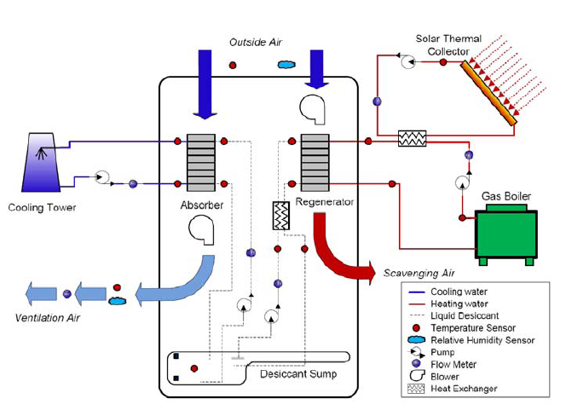
Conventional Solar-Powered Dehumidification
Notes:
Central elements: Absorber and Desorber (or Regenerator)---Absorber : remove heat of vaporization---Desorber: supply heat of vaporization
By using liquid desiccant the absorber can operate between room and ambient temperature instead of at dew point of desired supply air humidity
…and we have heat-driven instead of vapor-compression driven process
Low-grade heat—typically 70C—well within the range of conventional FPC…especially where Tamb~40C!
NOTE need enough scavenging airflow to keep Pvap low but this means more heat lost in the regenerator exhaust!
Sometimes we will see an (expensive) air2air HX (scavenging air recuperator)

Slide 7
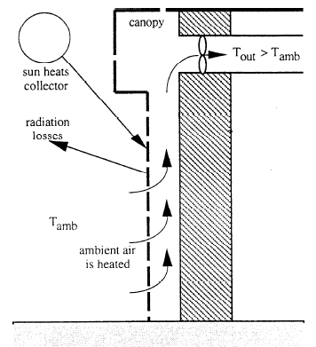
Low-Cost Unglazed Solar Collector
Notes:
Or…an UG Transpired air heating collector could be used to heat scavenging air.
In northern climates ventilation air may be heated by a very low-cost, building-integrated collector such as this.
Convection losses are largely eliminated by capturing boundary-layer air. Thermal boundary layer never really develops as it is continuously drawn into the wall
Free convection essentially zero. Forced convection is also negligible at low wind speeds.
Radiation losses dominate but even these are relatively low at room temperature. RESULT: efficient low-cost solar collector for ventilation air application

Slide 8
Unglazed Hybrid Liquid-Air Collector
Perforated absorber plate
Transpired air
Heated water and air to desiccant regenerator
Fan
Notes:
Combine the air and water heating solar collectors into one low-cost (unglazed) collector
Can this operate with reasonable efficiency at 70C?

Slide 9
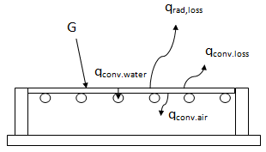
Heat Balance Model

Slide 10
Modeling Assumptions
One-Dimensional Flow of Air, Water and Heat
Uniform Porosity to Approximate Many Small Holes
T(x) Can Be Modeled By Fin Equation
Fin Boundary Conditions: Fluid Uniform Temperatures; Uniform AbsorbedSolar Flux
4. T(y) Can Be Modeled By Non-Linear ODE
Note That (1-3) Apply to Differential Control Volume

Slide 11
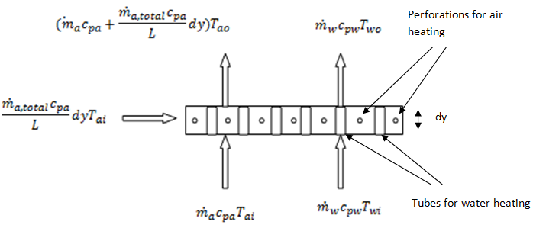
Differential Control Volume Heat and Mass Balances

Slide 12
Convective Heat Transfer Relations
Convection Loss From Plate (Kutscher)
Face velocity, wind speed, perforation pitch
NTU-Effectiveness Model of Perforations (Kutscher)
Convective coupling of Plate to Airstream Behind
Non-uniform temperature difference: bracketing analysis
Pitch>>BL thickness use standard flat plat Nu=f(Re,Pr,D/L)
Pitch<<BL thickness assume no coupling

Slide 13
Sensitivity Analysis
Ratio of Air to Total Thermal Capacitance Rate
Total Thermal Capacitance Rate
Absorber Emissivity
Back Coupling

Slide 14
Sensitivity Analysis
Notes:
Fig 3

Slide 15
Sensitivity Analysis
Notes:
Fig 4

Slide 16
Sensitivity Analysis
Notes:
Fig 5

Slide 17
Sensitivity Analysis
Notes:
Fig 6

Slide 18
Sensitivity Analysis
Notes:
Fig 7

Slide 19
Sensitivity Analysis
Notes:
Fig 8

Slide 20
Sensitivity Analysis
Notes:
fig9

Slide 21
Sensitivity Analysis
Notes:
Fig 10

Slide 22
Sensitivity Analysis
Notes:
Fig 11

Slide 23
Sensitivity Analysis
Notes:
Fig 12

Slide 24
Sensitivity Analysis
Notes:
Fig 13

Slide 25
Sensitivity Analysis
Notes:
Fig 14

Slide 26
Future Work
Experimental Verification
Regenerator and Absorber Models
System Optimization
Model Refinement and Collector Optimization

Slide 27
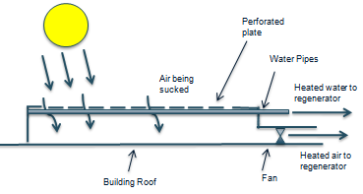
X
Perforated absorber plate
Transpired Air
Heated water and air to desiccant regenerator
Fan
Notes:
Combine the air and water heating solar collectors into one low-cost (unglazed) collector

Slide 28
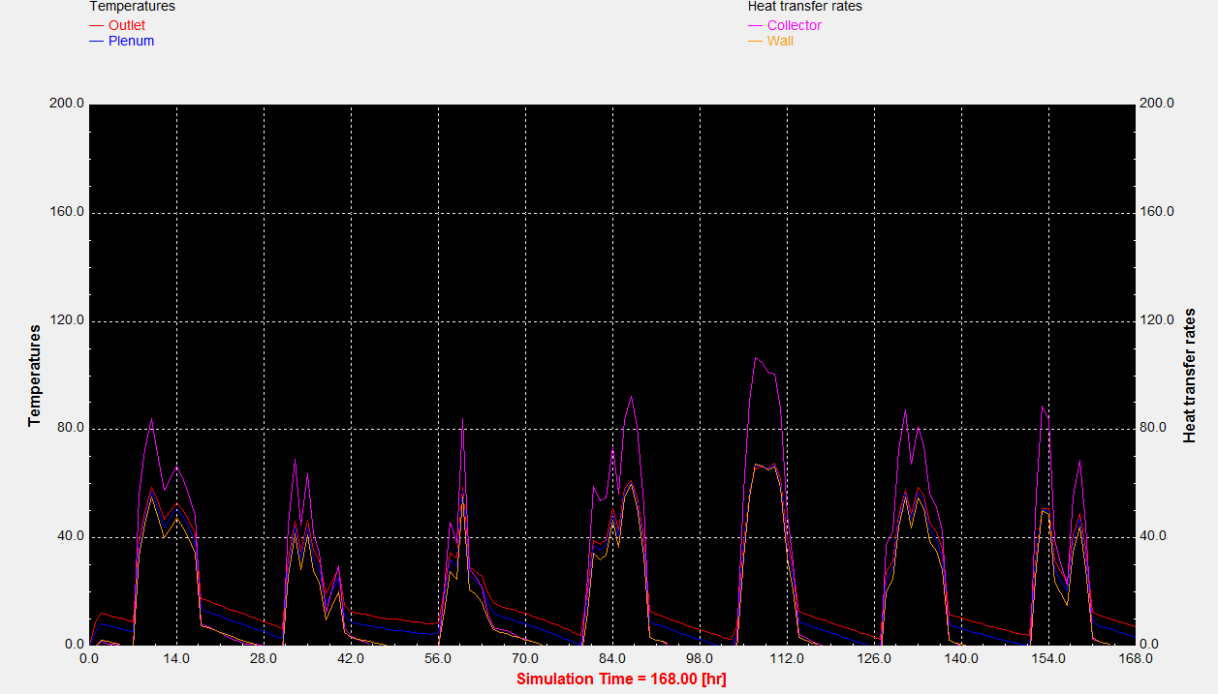
Unglazed Transpired Air Collector(UTAC) for Desiccant Regeneration
Advisor: Dr. Peter Armstrong Student: Abdul Qadir
Research Objectives
-Develop through simulation and testing, an UTAC which can deliver an outlet air temperature of 70˚C in order to regenerate a desiccant for desiccant cooling and dehumidification cycles.
Investigate a hybrid UTAC to produce hot water & air.
- Develop an integrated model and test the performance of a desiccant cooling cycle coupled with a UTAC.
Broader Impacts
Could replace the gas burners which are currently used to regenerate desiccants.
Cost effective way to integrate solar technology to an existing cooling infrastructure.
Can significantly reduce the electricity consumption by removing latent cooling load from the cooling system, especially in humid climates like Abu Dhabi’s.
Perforated absorber plate
Transpired Air
Heated air to desiccant cycle
Building Roof
Fan
Figure 1: Schematic of the UTAC configuration
Figure 2: Initial TRNSYS simulation results

Slide 29
X
X
- xx
yy
Perforated absorber plate
Transpired Air
Heated air to desiccant cycle
Building Roof
Fan

