Slide 1
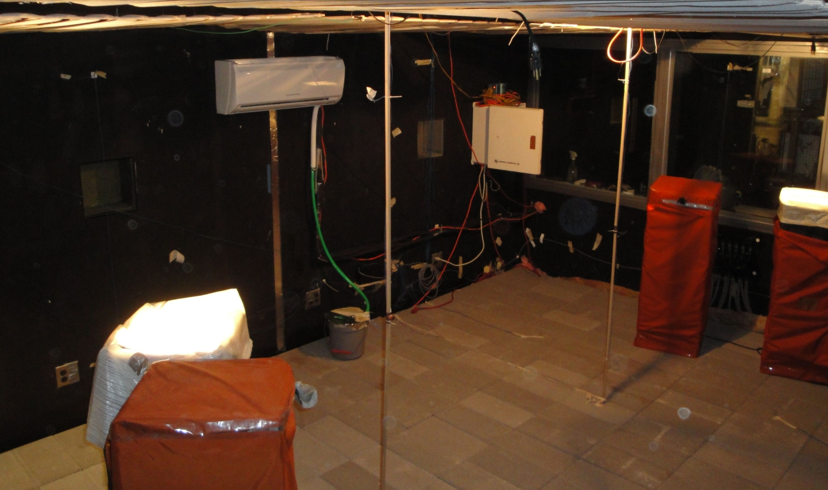
Data-Driven Model Predictive Control
OF Low-Lift Chillers Pre-Cooling
Thermo-Active Building Systems
Nick Gayeski, PhD Building Technology, MIT
IBPSA Model Predictive Control Workshop June 2011
Advisors: Dr. Leslie K. Norford, Dr. Peter R. Armstrong

Slide 2
Objective and Topics
Objective: To achieve significant cooling energy savings with data-driven model-predictive control of low-lift chillers pre-cooling thermo-active building systems (TABS)
Low-lift cooling systems (LLCS)
Modeling and optimization for LLCS
  Low-lift chiller performance
  Data-driven thermal model identification
  Model-predictive control to pre-cool thermo-active building systems
Experimental assessment
Ongoing research

Slide 3
1. Low lift cooling systems (LLCS)
Low lift cooling systems leverage the following technologies to reduce cooling energy:
Variable speed compressor
Hydronic distribution with variable flow
Radiant cooling
Thermal energy storage (TES) e.g. Thermo-active building systems (TABS)
Model-predictive control (MPC) to pre-cool TABS
Dedicated outdoor air system (DOAS)

Slide 4
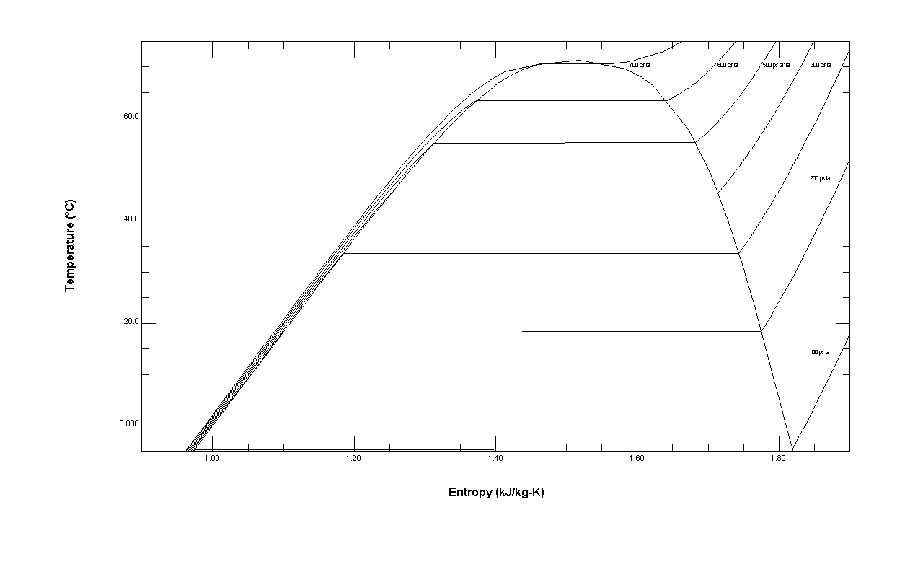
Low lift vapor compression cycle requires less work
Low-lift refers to a lower temperature difference between evaporation and condensation
700 psia
Vapor compression cycle for refrigerant R410A
at an instant in time
600
500
400
300
60
Predictive pre-cooling of TABS and variable speed fans
200
40
T - Temperature (°C)
Variable speed compressor and load spreading
20
Radiant cooling and variable speed pumping
100
0
1
1.2
1.4
1.6
1.8
S - Entropy (kJ/kg-K)
Notes:
Temperature-entropy diagram of a vapor compression cycle for R410A
Cooling effect is the area below the bottom part of the cycle
Work is the area inside the polygons.
Low-lift operation shrinks the polygon = less work.
This is just an instant of time, low-lift controls seeks to operate at these conditions more of the time

Slide 5
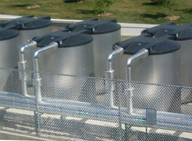
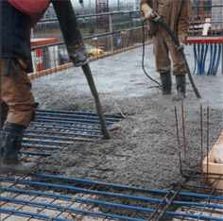
MPC of LLCS enables lower lift chiller operation
Load forecasts
Identify building temperature response models
Predict 24-hour optimal chiller control schedule
Building data
Charging
active TES
Variable capacity chiller
Direct zone cooling
Pre-cooling passive TES
Occupied zone
Pre-cool thermo-active building system
Notes:
Starting at the left side of the diagram, forecasts of loads on the building and measured data about the building are used to train data-driven temperature response models.
These models, along with a model of chiller performance, can be used to predict an optimal control supervisory schedule for the chiller
This control can include both direct cooling of spaces, and pre-cooling thermal energy storage, which enables night-time operation at low-lift operation.
In my research, I investigated concrete-core cooling, which also serves as the radiant cooling system within the zone. Concrete-core systems, in theory, have a high thermal storage efficiency relative to other TES. Also, like other radiant cooling systems they allow for high evaporating temperatures, further enabling low-lift operation.

Slide 6
Simulation studies show significant LLCS cooling energy savings potential
Simulated energy savings: 12 building types in 16 cities relative to a DOE benchmark HVAC system
Total annual cooling energy savings
37 to 84% in standard buildings, on average 60-70%
-9 to 70% in high performance buildings, on average 40-60%
Katipamula S, Armstrong PR, Wang W, Fernandez N, Cho H, Goetzler W,Burgos J, Radhakrishnan R, Ahlfeldt C. 2010. Cost-Effective Integration of Efficient Low-Lift Baseload Cooling Equipment FY08 Final Report. PNNL-19114. Pacific Northwest National Laboratory. Richland, WA.

Slide 7
Topics
Model-predictive control of low-lift cooling systems to achieve significant cooling energy savings
Low-lift cooling systems (LLCS)
Modeling and optimization for LLCS
  Low-lift chiller performance
  Data-driven thermal model identification
  Model-predictive control to pre-cool thermo-active building systems
Experimental assessment
Ongoing research

Slide 8
2. Modeling and Optimization for LLCS
Optimize control of a low-lift chiller over a 24-hour look-ahead schedule to minimize daily chiller energy consumption
To pre-cool a thermo-active building system to achieve high chilled water temperatures and space efficient thermal energy storage
Informed by a chiller performance model that predicts chiller power and cooling rate at future conditions for a chosen control schedule
Informed by data-driven zone temperature response models and forecasts of climate conditions and loads

Slide 9
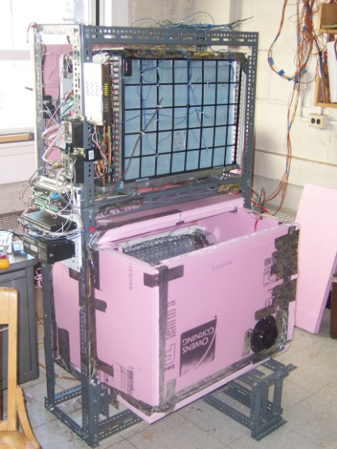
2.1 Low lift chiller performance
Low lift operation
COP ~ 5-10
Typical operation
COP ~ 3.5
EER
51
34
17
Experimental testing at 131 steady state conditions
Heat balance < 7 percent error

Slide 10
Empirical models accurately represent chiller cooling capacity and power
4 variable-cubic polynomial models derived from experimental measurement or physics-based simulation

Slide 11
MPC with TABS enables more low-lift operation, resulting in higher chiller COPs
Night time
operation
Radiant
cooling
Load
spreading
T_{e} = Evaporating temperature ºC, T_{o} = Outdoor air temperature ºC

Slide 12
2.2 Zone temperature model identification
LLCS control requires zone temperature response models to predict temperatures and chiller performance
Data-driven models from measured building data predict temperature response
  Zone operative temperature (T_{o})
  The temperature in the TABS concrete-core (T_{cc})
  Return water temperature (T_{chwr}) and ultimately chiller evaporating temperature (T_{e}) from which chiller power and cooling rate can be calculated
24-hour ahead forecasts of outdoor climate and internal loads

Slide 13
Existing data-driven modeling methods can be applied to predict zone temperature
T_{o} = operative temperature
T_{x} = outdoor air temperature
T_{a} = adjacent zone air temperature
Q_{i} = heat rate from internal loads
Q_{c} = cooling rate from mechanical system
a,b,c,d,e = weights for time series of each variable
(Inverse) comprehensive room transfer function (CRTF) [Seem 1987]
Steady state heat transfer physics constrain CRTF coefficients

Slide 14
Evaporating temperature must be predicted from TABS temperature response
Chiller power and cooling rate depend on TABS thermal state and cooling rate because they determines chilled water return temperature and evaporating temperature
Predict concrete-core temperature (T_{cc}) using a CRTF like transfer function model
Predict return water temperature (T_{chwr}) using a low-order transfer function model in T_{cc} and cooling rate Q_{c} (or a heat exchanger model)
Superheat relates T_{chwr} to evaporating temperature (T_{e})

Slide 15
2.3 Pre-cooling control optimization
Optimize chiller operation over 24 hours to minimize energy consumption and maintain thermal comfort
Employ direct pattern search¹ to minimize the objective function by selecting an optimal schedule of 24 compressor speeds², one for each hour
Employ chiller model to calculate cooling rate and power consumption for the next 24 hours
Employ temperature response models to predict zone temperatures to ensure comfort is maintained over 24 hours
Lewis et al 1999, SIAM J. of Optimization or MATLAB Optimization Toolbox

Slide 16
Optimization minimizes energy, maintains comfort, and avoids freezing the chiller
P_{w,t} = system power consumption as a function of past compressor speeds and exogenous variables
= weight for operative temperature penalty
P_{To,t} = operative temperature penalty when OPT exceeds ASHRAE 55 comfort conditions
P_{Te,t} = evaporative temperature penalty for temperatures below freezing
= Vector of 24 compressor speeds, one for each hour of the 24 hours ahead

Slide 17
Optimize compressor speeds every hour with updated building data and forecasts
Pattern search initial guess at current hour
24-hour-ahead forecasts of outdoor air temperature, adjacent zone temperatures, and internal loads
Pattern search algorithm determines optimal compressor speed schedule for the next 24 hours
Operate chiller for one hour at optimal state

Slide 18
Topics
Model-predictive control of low-lift cooling systems to achieve significant cooling energy savings
Low-lift cooling systems (LLCS)
Implementing MPC for LLCS
  Low-lift chiller performance
  Data-driven thermal model identification
  Model-predictive control to pre-cool thermo-active building systems
Experimental assessment of LLCS
Ongoing research

Slide 19
4. Experimental assessment of LLCS
Foundational research shows dramatic savings from LLCS, but
Assumes idealized thermal storage, not real TES or TABS
Chiller power and cooling rate are not coupled to thermal storage, as it can be for a TABS system
How real are these savings? What practical technical obstacles exist?
Experimentally implement and test LLCS with MPC pre-cooling TABS
Check relative savings of LLCS to a base case system similar to comparisons in the PNNL simulation research

Slide 20
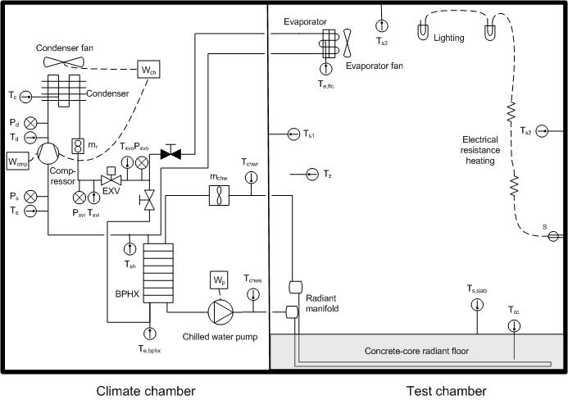
Experimental chamber schematic
IDENTICAL FOR LLCS AND BASE CASE SSAC

Slide 21
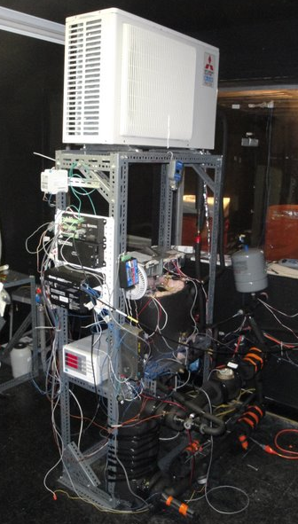
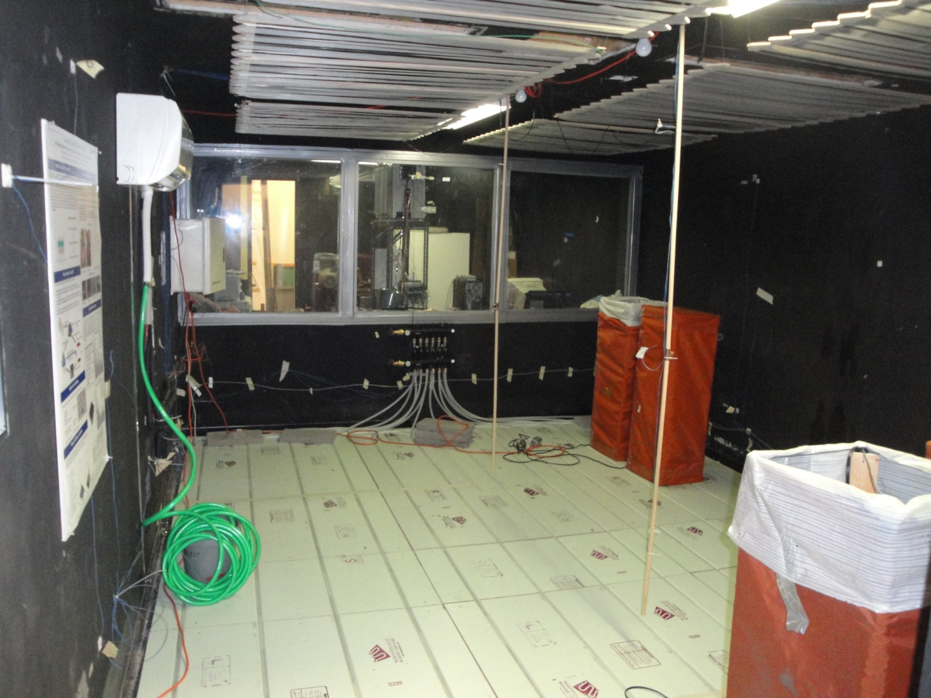
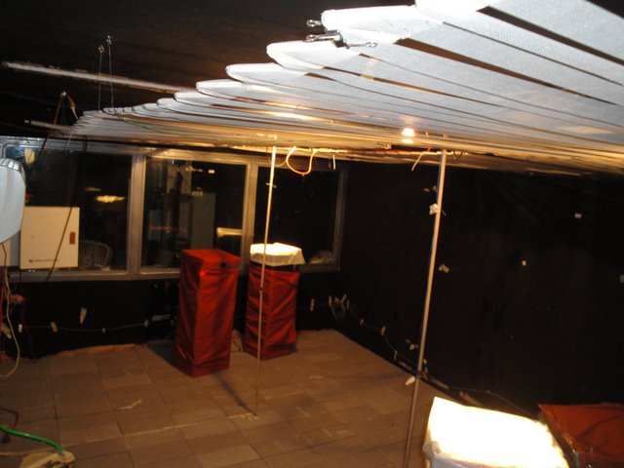
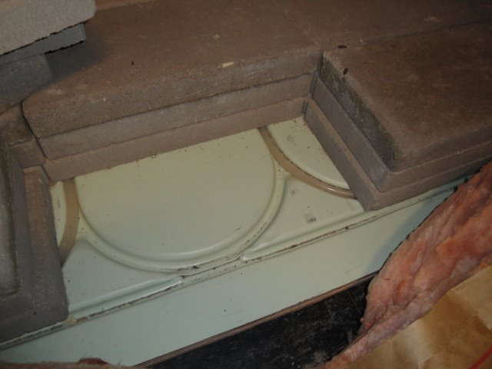
Climate chamber
Test chamber

Slide 22
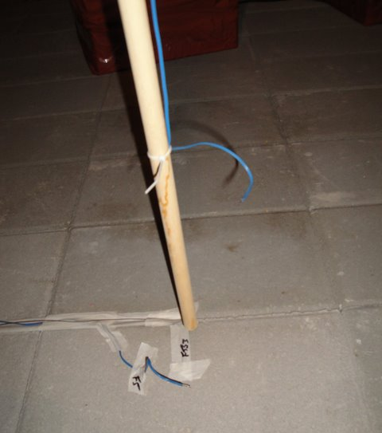
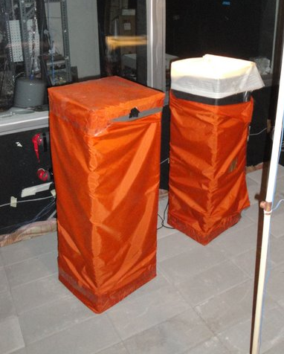
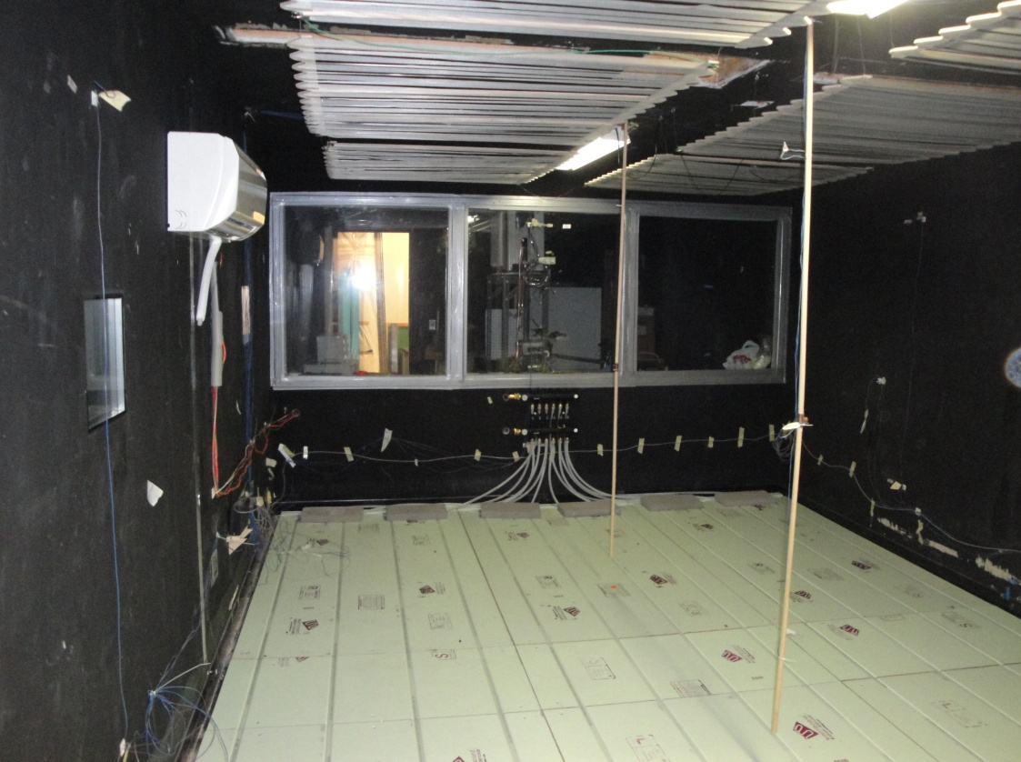
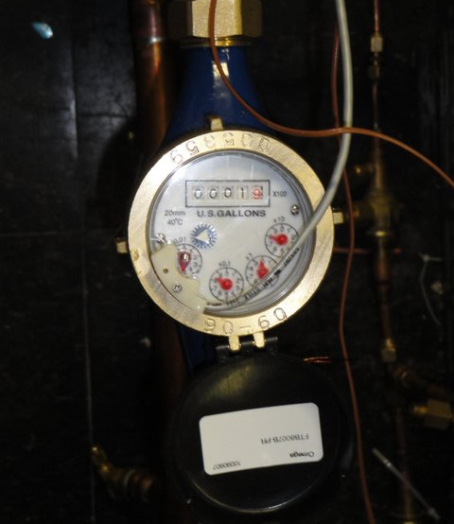
Test chamber data-driven CRTF models
Temperature sensors measure/approx: T_{o}, T_{x}, T_{a}, T_{cc}, T_{chwr}
Power to internal loads: Q_{i}
Radiant concrete floor cooling rate: Q_{c}

Slide 23
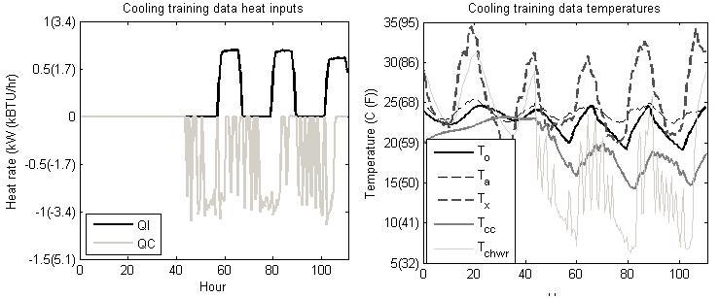
Models trained with a few day’s data
Sample training
thermal load data
Sample training temperature data

Slide 24
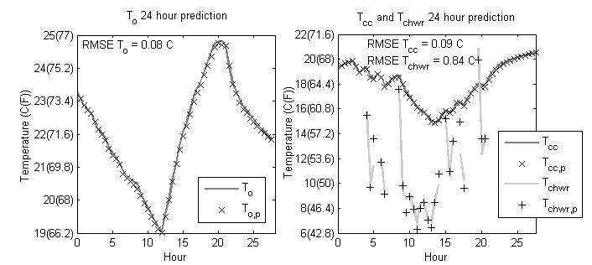
Transfer function models accurately predict zone temperatures 24-hours-ahead
24 hour operative temperature prediction
24-hour TABS and chilled water temperature prediction

Slide 25
Tested LLCS for a typical summer week in two climates, Atlanta and Phoenix
Atlanta typical summer week with standard efficiency loads
Phoenix typical summery week with high efficiency loads
Based on typical meteorological year weather data
Assuming two occupants and ASHRAE 90.1 2004 loads (standard) or 30% better (high)
Run LLCS for one week after steady-periodic response is achieved

Slide 26
Model-predictive control optimizes chiller compressor speed at each hour

Slide 27
Pre-cooling redistributes cooling load, allowing lower lift, but maintains comfort

Slide 28
Comparing experimental results to PNNL simulation studies
Select a base-case system as a point of comparison to the PNNL simulation studies.
Low fan energy split-system air conditioner SEER 16 with conventional controls is representative of case with high efficiency distribution, conventional chiller operation
Test base-case subject to the same conditions as the LLCS but with thermostatic control achieving same mean temperature
Compare energy savings in the experimental tests with the PNNL simulations

Slide 29
Comparing savings in experiment to PNNL simulation studies
Atlanta typical summer week results | Experimental Savings (%) | Simulation Savings (%)
Low-lift cooling system | 25 | 26
VSD chiller w/ radiant cooling | -- | 0
Split system air conditioner | 0 | --
Phoenix typical summer week results | Experimental Savings (%) | Simulation Savings (%)
Low-lift cooling system | 19 | 29
VSD chiller w/ radiant cooling | -- | 0
Split system air conditioner | 0 | --

Slide 30
Critiquing the experimental LLCS tests
Improve TABS design by decreasing chilled water pipe spacing permitting higher evaporating temperatures
Better matching of system capacity and loads using a smaller chiller or adding a false load
Improve chamber insulation to achieve closer to adiabatic boundary conditions
Comparison to more configurations of systems and control scenarios, comparisons to identical simulations
Improvements are likely to yield better LLCS performance

Slide 31
5. Ongoing research
  Extend to multi-zone TABS systems where multiple zone temperature and TABS responses are predicted simultaneous
  Allow TABS pre-cooling and direct cooling at the same time using radiant ceiling panels or efficient zone sensible cooling
  Construct a full-scale demonstration project at Masdar City, Abu Dhabi and a location in the United States
  Expand simulations using the Building Control Virtual Test Bed by coupling simulation environments required for TABS response and low-lift chiller simulation

Slide 32
Summary
Developed a method for data-driven MPC of low-lift chillers pre-cooling TABS leveraging curve-fit chiller modeling and CRTF zone temperature modeling
Implemented these methods in an experimental test chamber leveraging curve-fit chiller modeling and CRTF zone temperature modeling
Compared performance to a split-system air conditioner as a basis for comparison to predominant technology and to spot-check against PNNL simulations
Notes:
Cost savings relative to roughly

Slide 33
Thank you! Questions welcome
Nicholas Gayeski, PhD
Research Affiliate Partner and Co-Founder
Massachusetts Institute of Technology KGS Buildings, LLC
gayeski@mit.edu nick@kgsbuildings.com
617-835-1185
Thank you to my advisors: Prof. Leslie K. Norford, Prof. Peter R. Armstrong, and Prof. Leon Glicksman
Thank you to: Srinivas Katipamula and PNNL
Mitsubishi Electric Research Laboratory
Martin Family Society of Fellows
Massachusetts Institute of Technology
Masdar Institute of Science and Technology

