Slide 1
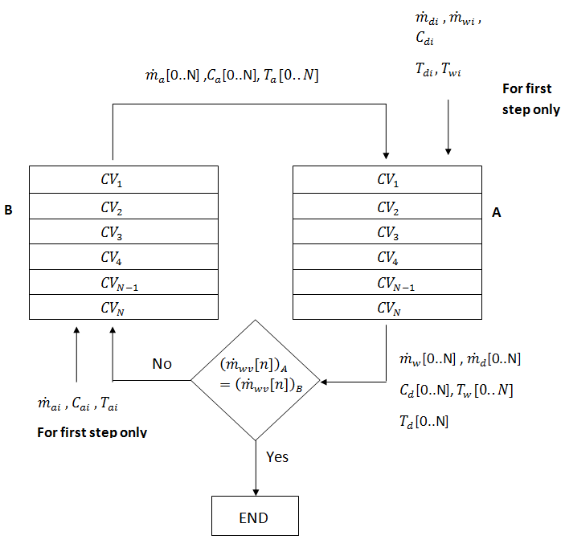
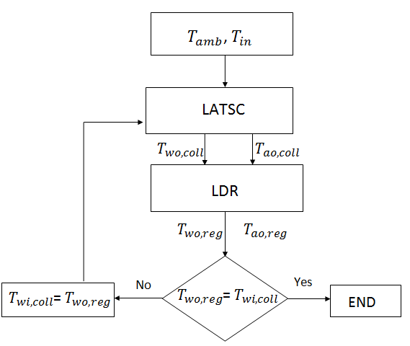
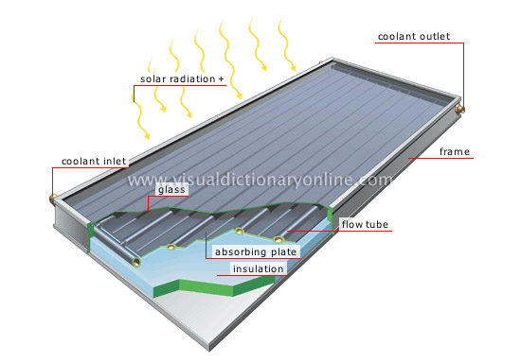
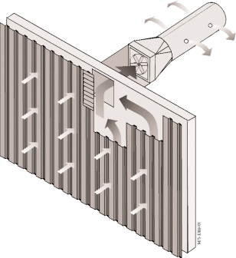
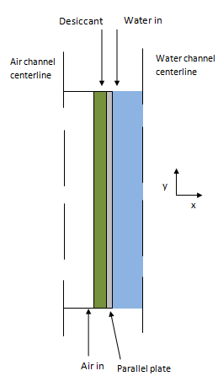
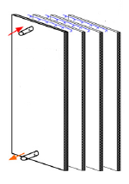
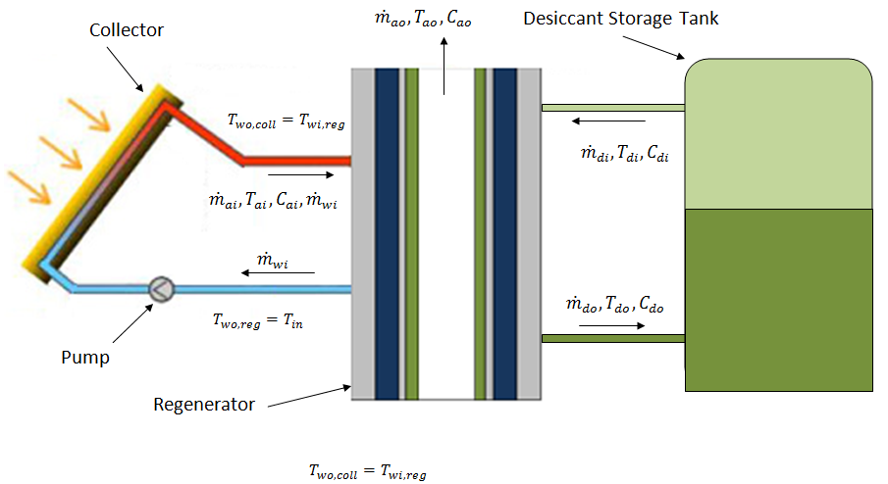
Optimal Liquid Desiccant Regeneration by a Low Cost Unglazed Air and Water Heating Collector
Abdul Qadir and Peter Armstrong
Masdar Institute of Science and Technology
Abstract
Solving Method
System performance of a novel Liquid-Air Transpired Solar Collector (LATSC) and a falling film type, parallel plate liquid desiccant regenerator (LDR) using lithium chloride as the desiccant is evaluated. A brief overview of the LATSC is provided followed by the development of a numerical model for the LDR. The LASTC and LDR are then coupled and a sensitivity analysis is performed on the system. The combined LATSC-LDR system is optimized for typical Abu Dhabi weather conditions. It is found that at LiCl desiccant solution entering and leaving concentrations of 0.2 and 0.4 the optimal water thermal capacitance rate per unit collector area, air thermal capacitance rate per unit collector area, and desiccant mass flow rate per unit collector area are 38.66 W/m²K, 10.98 Wm²K, and 0.0001665 kg/s-m² respectively. The system efficiency under these conditions is almost 23%.
The counter-flow configuration of the LDR means that the conditions at all nodes must be solved simultaneously. One simple approach is to split the regeneration process in to two cycles, A and B. In cycle A, the air temperature and concentration for each node are kept constant while the water and desiccant temperatures and concentrations are evaluated for each node. These values are then plugged in to the nodes of cycle B, while the air temperatures and concentrations are evaluated for each node. The process is repeated until the water vapor transferred to the air at each node is equal in both cycles (i.e. for all i as shown in Figure 4). To simultaneously solve for collector and regenerator water outlet temperatures, the LATSC and LDR models are evaluated iteratively as shown in Figure 5.
Liquid Air Transpired Solar Collector
The LATSC (Qadir and Armstrong, 2011) consists of a uniformly perforated absorber plate with tubes bonded or integral to the plate such that water flows parallel to the air moving behind the plate and toward the top of the collector where both air and heated water exit.
Flat plate collector
Transpired Collector
LATSC
Water heating
Efficient at desired heating temperature
Figure 4: Solving LDR
Figure 5:Solving combined model
Air heating
Convection suppression
Low cost
Figure 1: LATSC concept
The LATSC can be thought of as a conventional transpired air heating collector (Kutscher, et al., 1993) but with addition of tubes or channels to heat water. Conversely, one can liken the LATSC to a conventional unglazed flat plate collector (Burch, et al., 2005) but with the addition of perforations on the plate and a plenum behind the absorber plate to allow movement of the air from the front to behind the plate and then to the outlet duct. In operation, water is heated in the tubes while air is sucked through the absorber plate and is heated at the same time.
Optimization
The objective of the optimization is to regenerate the liquid desiccant entering at 0.2 concentration to a concentration of 0.4 while maximizing the desiccant flow rate. Thus an objective function, to be minimized, was defined as:
(1)
The optimum air and water thermal capacitance rates and desiccant mass flow rate per unit regenerator area can be found using a genetic algorithm (MATLAB) for any given condition, for example the typical Abu Dhabi conditions in Table 1. The optimum operating parameters found for this condition are given in Table 2.
Liquid Desiccant Regenerator
A liquid desiccant regenerator (LDR) model was developed to test the performance of the LATSC for one of its potential applications
The regenerator consists of many parallel plates containing internal channels through which the hot water flows from top to bottom. Desiccant is distributed uniformly at the top of the regenerator plate and it flows down the air side of the plate as a thin film. Air is injected from the bottom and it moves towards the top giving the LDR a counter flow configuration. There exists a plane of symmetry at the center of each air side and water side channel about which symmetry of physical properties and chemical composition of the water, air and desiccant are encountered in the negative and positive x-direction
Table 1: Conditions to Optimize For
Table 2: Optimal Flow Solution
Parameter | Value
Solar Radiation | 850 W/m²
Wind Speed | 4 m/s
Humidity | 0.02 kg_{w}/kg_{da}
Temperature | 27.5ºC
Parameter | Value
Water thermal capacitance rate | 38.66 W/m²K
Air thermal capacitance rate | 10.98 Wm²K
Desiccant flow rate | 0.0001665 kg/s-m²
Figure 2: LDR configuration
Combined Model
The schematic of the coupled model is illustrated in Figure 5. There are separate loops for the flow of water, desiccant and air in the coupled system. The water and desiccant solution flow in a closed loop while the air and the moisture in the desiccant flow in an open loop. The air enters the collector at T_{amb} and leaves at mass flow rate . Air then moves to the regenerator at T_{ao} and in passing gains mass by evaporation of water from the desiccant, leaving the regenerator with a mass flow rate of and temperature of T_{ao,reg}.
The desiccant solution is pumped from the top of a stratified tank in-to the regenerator with a concentration of C_{di}, temperature T_{di} and mass flow rate . The desiccant solution loses mass in the regenerator as the water evaporates into the air stream leading to an exit temperature, T_{do} and concentration C_{do}., with mass flow rate .
References and Acknowledgement
Burch, J. ... (2005)
Kutscher, C.F., et al., Unglazed transpired solar collectors: heat loss theory, Journal of Solar Energy Engineering, 115 (1993) 182-188.
Qadir, A., Armstrong, P.R., Liquid-air transpired solar collector: model development and sensitivity analysis (in review), ASME Journal of Solar Energy Engineering, (2011).
The authors are grateful to the Government of Abu Dhabi for funding this research through the Masdar Initiative. Thanks to Drs. Shamim and Afshari for helpful comments. To Dr. Mekias for help with the multi-core work station, EES and MATLAB setup. And Profs. Klein & Beckman for help with EES.
Figure 3: Combined LATSC and LDR model

