Slide 1
Modeling a PCM storage unit for solar thermal cooling in Masdar City
Irene Rubalcaba Montserrat
RSC Members:
Dr. Matteo Chiesa
Dr. Peter Armstrong
Dr. Ali Abbas
Notes:
Thank you for coming to my defense.. The title of my thesis is “Modeling a PCM storage unit for solar thermal cooling in Masdar City
My research committee members are Dr. Chiesa, Dr. Armstrong and Dr. Abbas.

Slide 2





Solar cooling system
Solar Field
Charging mode
Discharging mode
Generator
Cooling System
Heat Exchanger
Condenser
PCM
Storage
Unit
Pump
Evaporator
Pump
Drum
Absorber

Slide 3
Power profile from the Beam Down [kW]
21st of March 2011

Slide 4
Supply and demand disparity storage opportunity

Slide 5
Supply and demand disparity storage opportunity
Extra heat to store
Storage use

Slide 6
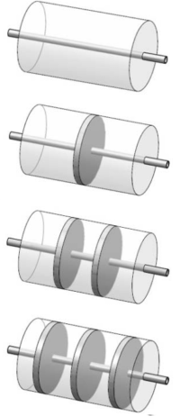
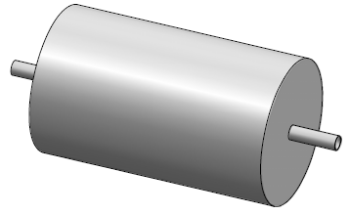
STORAGE MODELING Geometry
CYLINDRICAL STORAGE COMPARTMENT
Length=11m
COPPER PIPE
Length=11m
Outside Diameter= 0.012m
Thickness=1mm

Slide 7
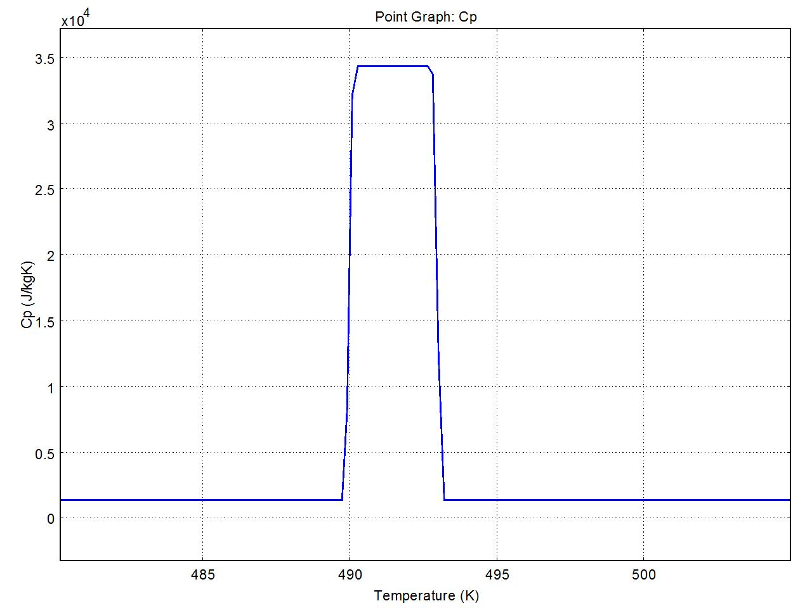
Modeling phase change using COMSOL
Melting range = ΔTm
ΔTm = 490 to 493 K
Cp= 1330 + Latent heat/ΔT
FULLY SOLID
Cp = 1330 [J/KgK]
FULLY LIQUID
Cp = 1330 [J/KgK]

Slide 8




Numerical modeling
Problem Type: Transient Thermal Fluid
Model Used: Time depending - Non Isothermal flow
Incompressible Navier- Stokes:
Heat Transfer by conduction and convection:
Geometry is considered 2D axial symmetry

Slide 9
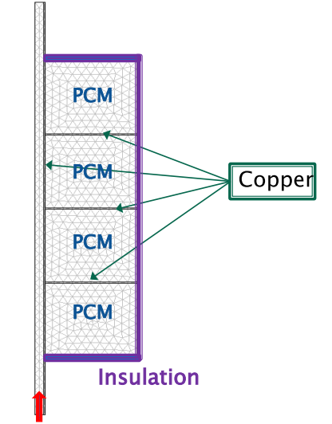
2D Axial symmetry model
Maximum Energy Storage
Capacity:
400 [MJ] + Sensible Heat

Slide 10
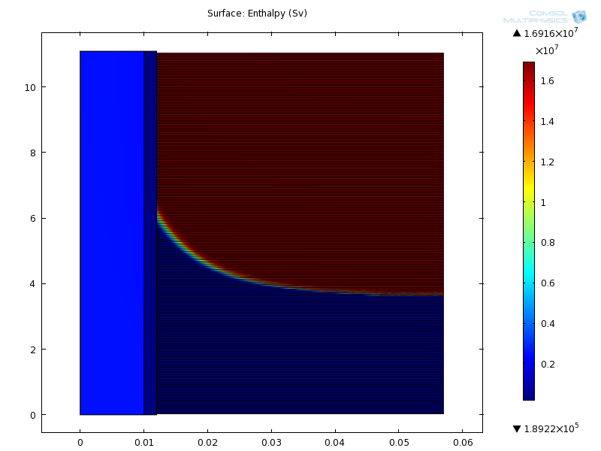
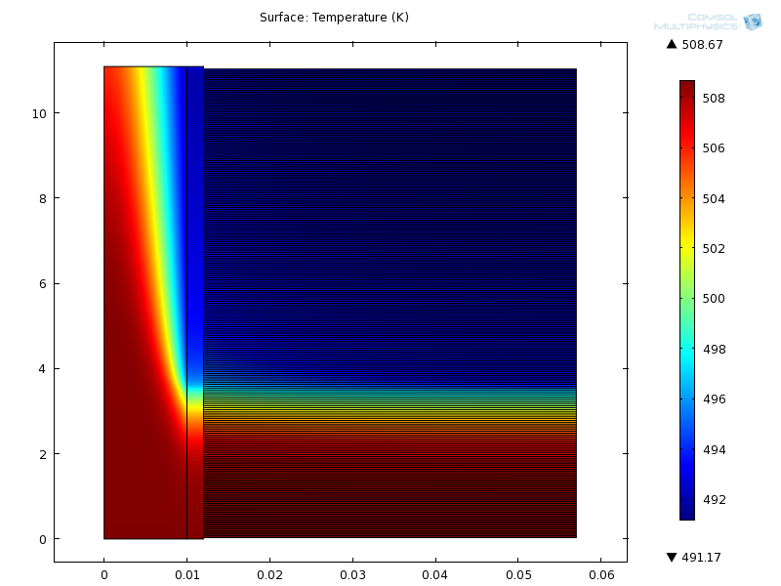
Numerical Results for 44 tubes after 20700 seconds - 5.75 hr
Enthalpy
Temperature

Slide 11
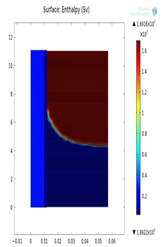
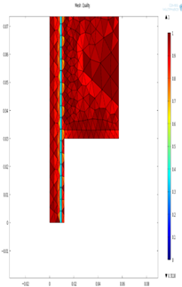
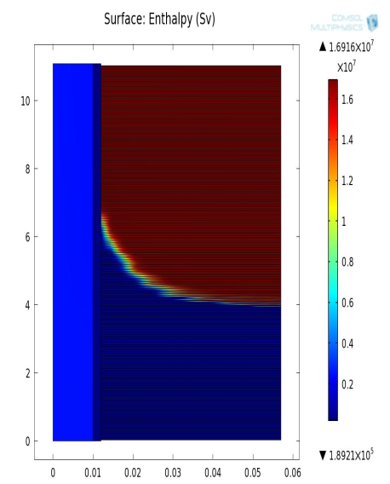
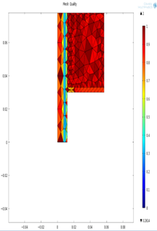
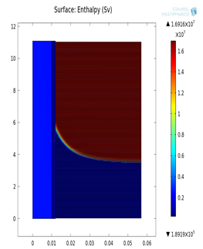
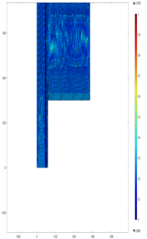
Mesh Sensitivity
Mesh Type | Extremely Fine | Normal | Coarser
Number of elements | 536,068 | 88,946 | 82,327

Slide 12



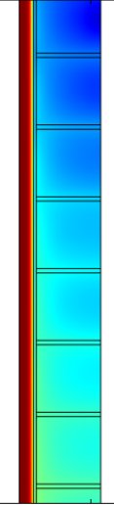
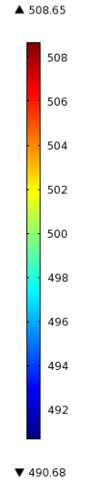
Effect of fins
No fins
5 Fins
10 Fins
20 Fins

Slide 13

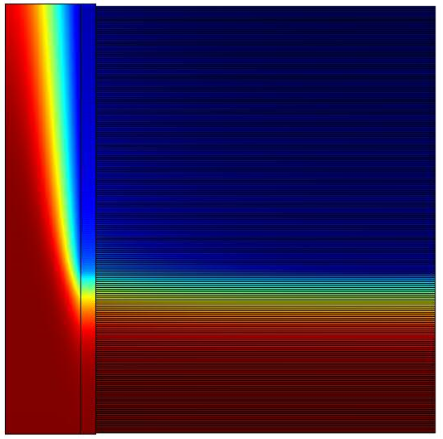
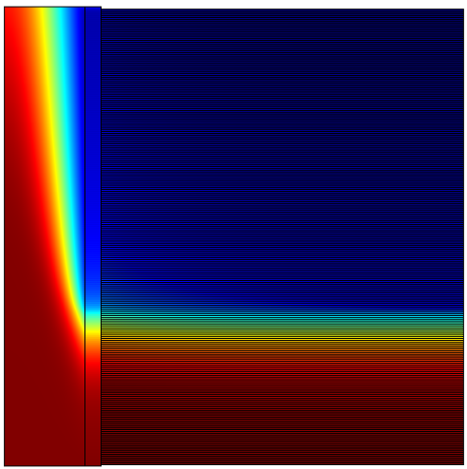
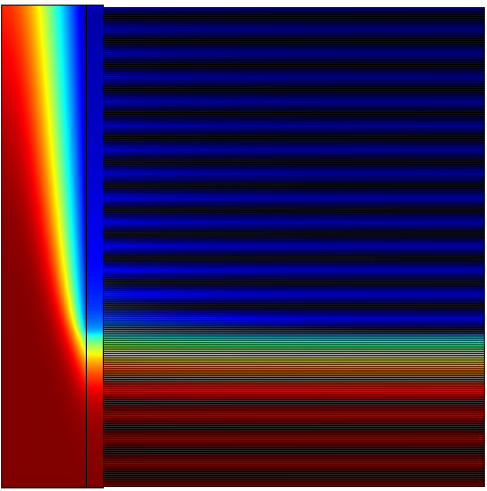
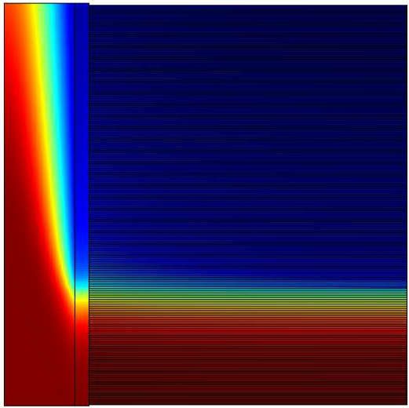
Effect of inlet velocity
v= 0.0932 m/s
v= 0.0832 m/s
v= 0.07992 m/s
v= 0.07629 m/s

Slide 14
Solidification temperature outlet

Slide 15


Final Design
Material= KNO3-NaNO3(eu)
81 tubes
L =11m
ri= 1 cm
r0= 3 cm
Total volume= 5.7m³
Total PCM mass = 4.209 tons
Maximum storage capacity
= 400[ MJ] + sensible heat
Symbol | Description | Value | Units
 | Latent heat of fusion of the PCM | 95000
 | Density of the PCM | 1880
 | Specific heat of the PCM | 1330
 | Thermal conductivity of the PCM | 4
α_{pcm} | Thermal diffusivity
 | Melting Temperature of the PCM | 493 / 220 | K / C

