Slide 1

HEAT STORAGE FOR CSP
Masdar Institute of Science and Tehcnology
Laboratory for Energy and Nano-Science (LENS)
Solar Energy Group
The Beam-Down Solar Thermal Concentrator Experimental Characterization
and Modeling
Marwan Mokhtar

Slide 2
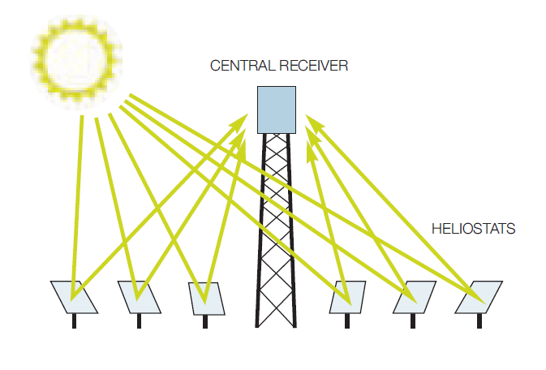
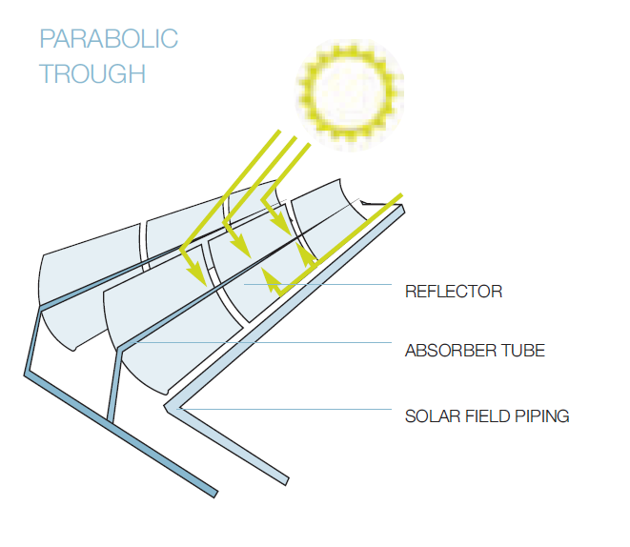
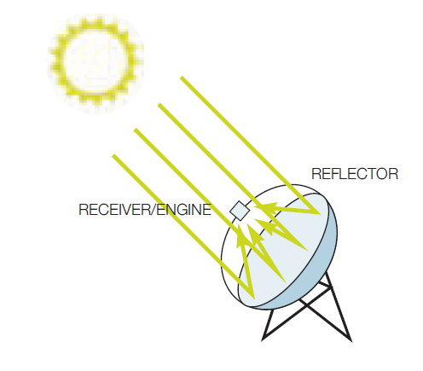
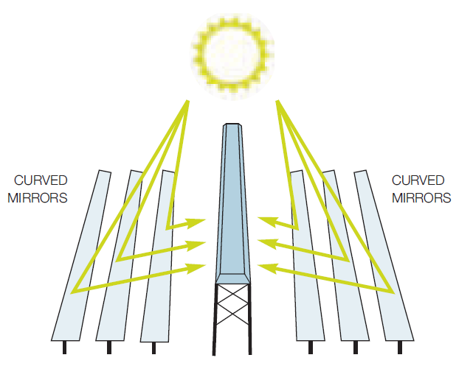
Concentrated Solar Power (CSP)
Notes:
Higher efficiency of power towers due to point focus
The beam down is a point focus technlogy

Slide 3
Overview : Beam-Down Pilot Plant
Optical Design
Cavity Receiver
Ground Level Receiver
Segmented Secondary Reflector
Lower Wind Load
Lower Thermal Stress
Ganged-Type Heliostats
Three Banks of Mirrors
Lower Blocking and Shading
Courtesy of TokyoTech
Notes:
1)Ground Level receiver
2)All radiation coming from one direction cavity receiver
#) mainly extra reflection

Slide 4
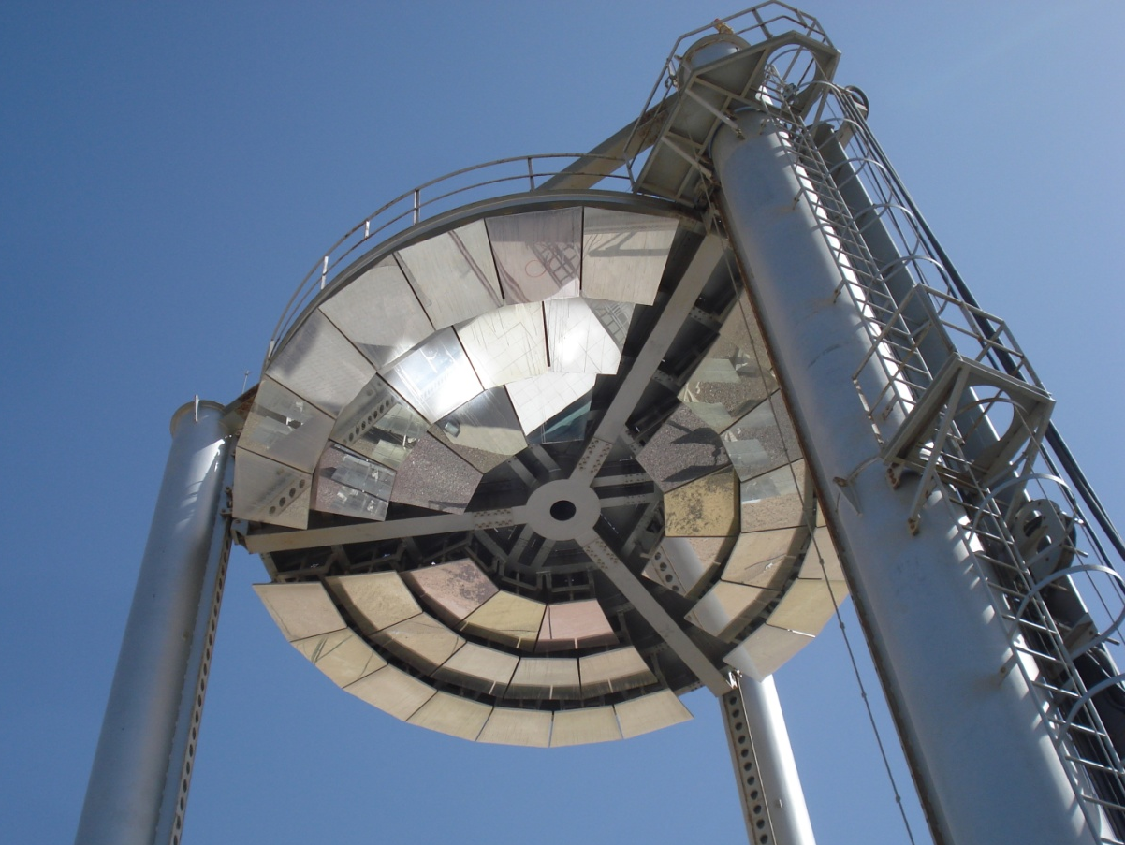
Overview : Beam-Down Pilot Plant
Optical Design
Cavity Receiver
Ground Level Receiver
Segmented Secondary Reflector
Lower Wind Load
Lower Thermal Stress
Ganged-Type Heliostats
Three Banks of Mirrors
Lower Blocking and Shading
Notes:
1)Ground Level receiver
2)All radiation coming from one direction cavity receiver
#) mainly extra reflection

Slide 5
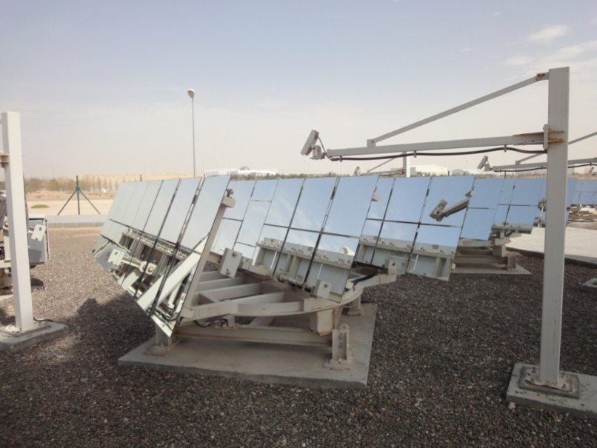
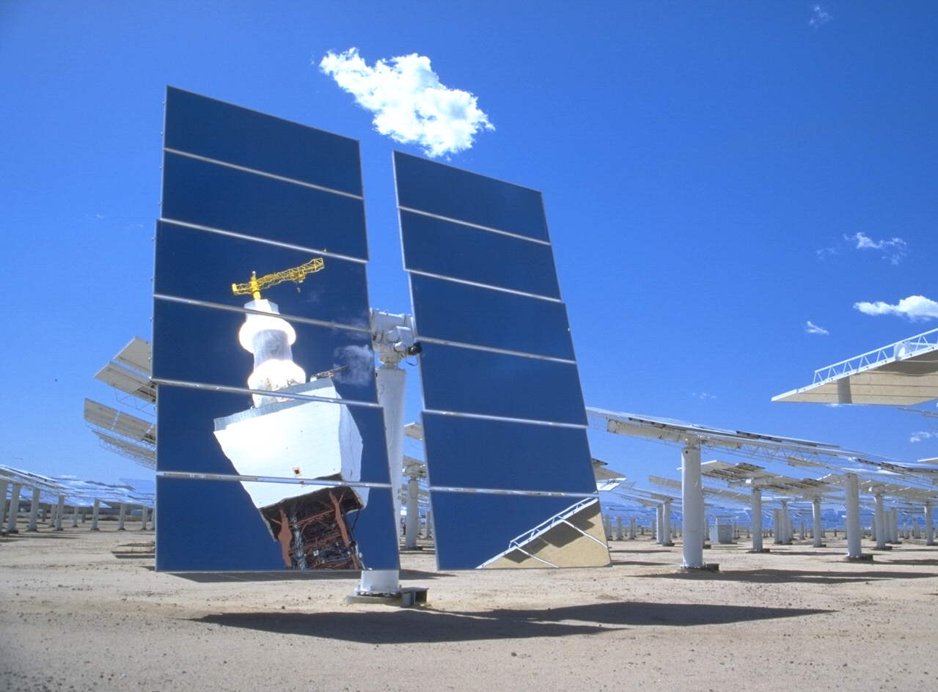
Overview : Beam-Down Pilot Plant
Optical Design
Cavity Receiver
Ground Level Receiver
Segmented Secondary Reflector
Lower Wind Load
Lower Thermal Stress
Ganged-Type Heliostats
Three Banks of Mirrors
Lower Blocking and Shading
Ganged-Type Heliostat
Conventional Heliostat
Notes:
1)Ground Level receiver
2)All radiation coming from one direction cavity receiver
#) mainly extra reflection

Slide 6
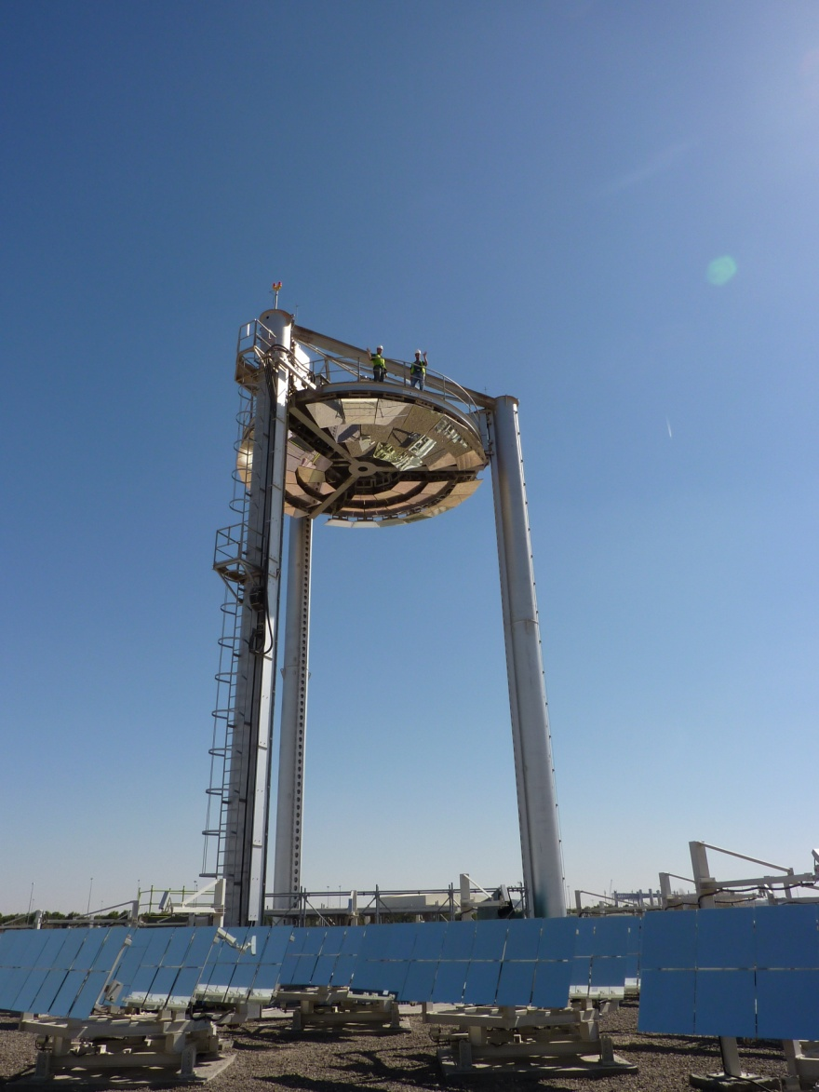
Motivation
Initial Project Objectives
Test design concepts
Simulation model verification
Feasibility of scaling up
LENS Experimental Testing (March 2010)
Inadequacies in the measurement system
Heliostat concentration quality

Slide 7
Outline
Preliminary Experimental Characterization
Concentrated Solar Flux Measurement System
Beam Down Performance Overview
Beam-Down Experimental Characterization & Modeling
Geometrical-Optics Model and Error Analysis

Slide 8
Outline
Preliminary Experimental Characterization
Concentrated Solar Flux Measurement System
Beam Down Performance Overview
Beam-Down Experimental Characterization & Modeling
Geometrical-Optics Model and Error Analysis

Slide 9
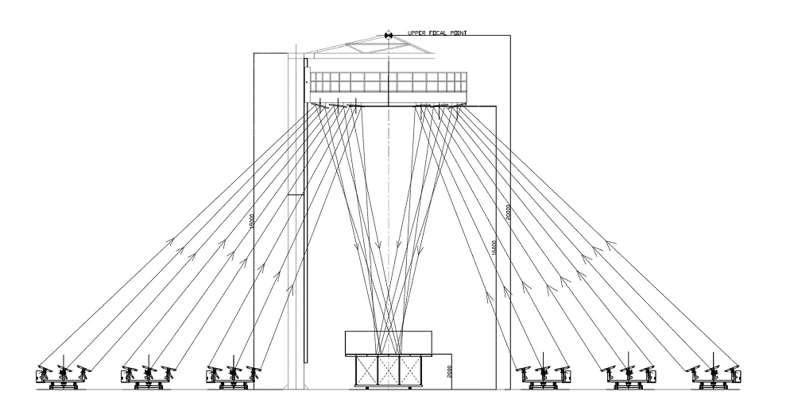
Brief on the Measurement System
Image of Flux Distribution on the Target Taken by the CCD Camera
Notes:
Optical Test
CCD camera
White ceramic tiles for the target

Slide 10
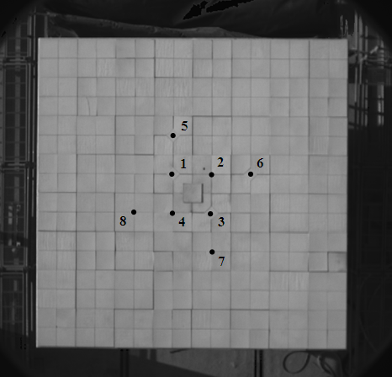
Brief on the Measurement System
Lambertian Target and Embedded Heat Flux Sensors
Notes:
Optical Test
CCD camera
White ceramic tiles for the target

Slide 11
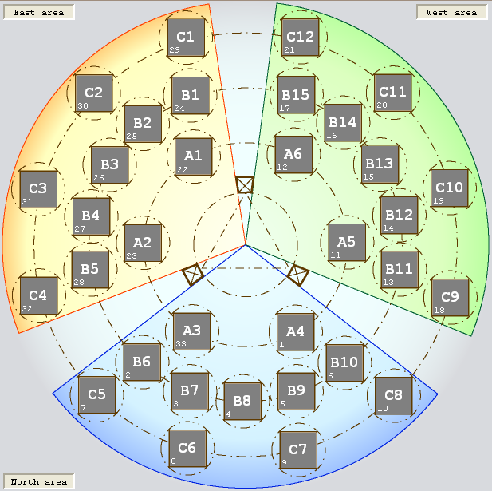
Heliostat Field Performance Test
Optical performance characterization of individual heliostats
Identify problems in the design or/and implementation
6 days of testing
33 heliostats
5 data points per heliostat per day
900 < flux maps to inspect

Slide 12
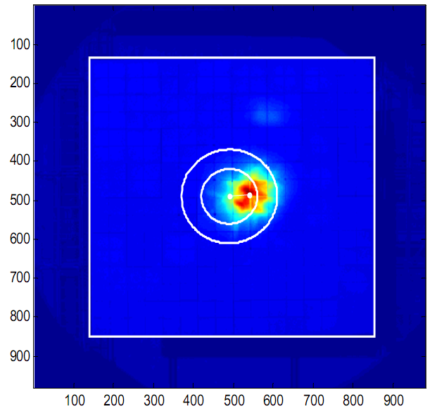
Metrics
Flux Map
Total Energy Content
Flux Distribution
Concentration
Centering
Notes:
)Centering is most probably related to misalignment of the feedback sensor and CR mirror
)Concentration is more serious as it indicates aberrations or canting errors or deformed mirror surfaces
)We are in the process of designing a receiver so total energy of the whole flux map is important rather than just that of the aperture.

Slide 13
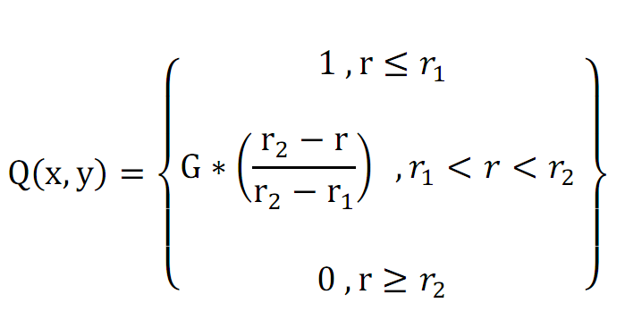
Hypothetical Receiver and Weighted Flux Map
Centroid and distance r
Receiver dimensions (r₁,r₂)
Notes:
-1) 600 maps
0) Design Phase!
1)Physically this can be the aperture of the main high temperature receiver, the radius of this aperture is r1.
2) The region between the two circles (r1<r<r2) for preheating
3) We have chosen a trapezoidal profile

Slide 14
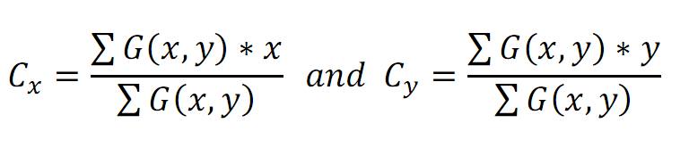
Flux Map Centroid Calculation
Calculation is affected by ambient radiation on the target
Notes:
1) Affected by ambient since we concentrate one heliostat at a time

Slide 15
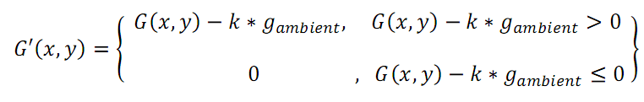
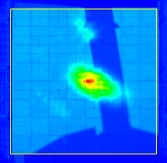
Pre-processing: Flux Map Filtering
Notes:
1) Affected by ambient since we concentrate one heliostat at a time

Slide 16
Calculating the Weighted Flux Map
Centroid and distance r
Receiver dimensions (r₁,r₂)
Notes:
0) Design Phase!
1)Physically this can be the aperture of the main high temperature receiver, the radius of this aperture is r1.
2) The region between the two circles (r1<r<r2) for preheating
3) We have chosen a trapezoidal profile

Slide 17
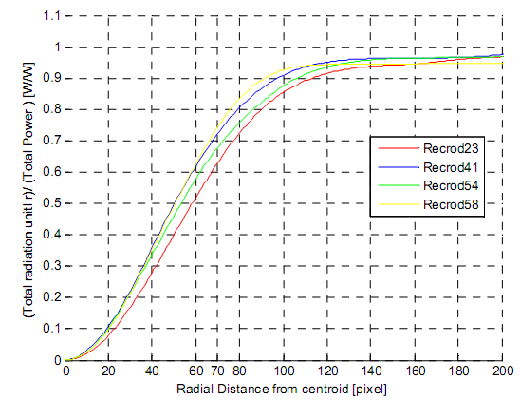
Selecting receiver aperture dimensions (r₁,r₂)
r₁=70=28.5cm → 60%
r₂=120=49.0cm → 90%
Cumulative power intercepted by the receiver from the centroid until the radial distance (r), normalized by the total power.
Notes:
We can see from the figure that by choosing a radius r1=70, for all the shown records more than 60% of the
total power will be intercepted in the inner receiver, and that more than 90% of the power will be intercepted
by the whole receiver.

Slide 18
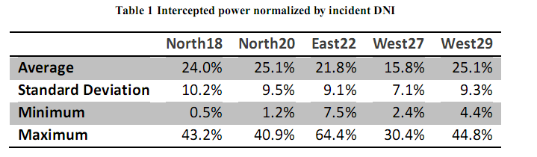
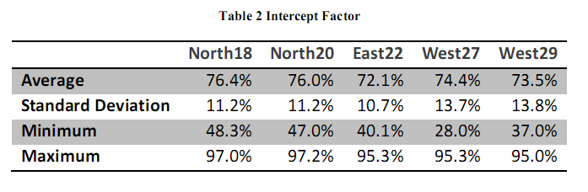
Results : Intercepted power

Slide 19
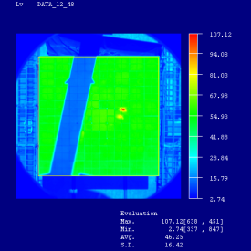
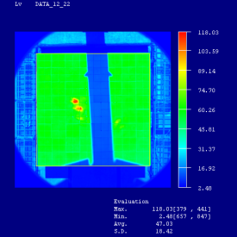
Tower Shading
Notes:
One of the important aspects of this test is the ability to spot irregularities in the heliostat field

Slide 20
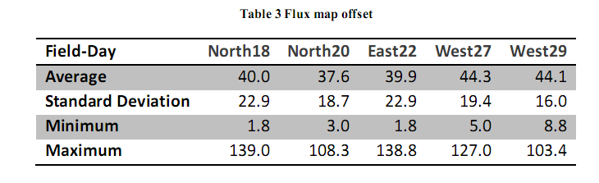
Results : Flux Map Offset

Slide 21
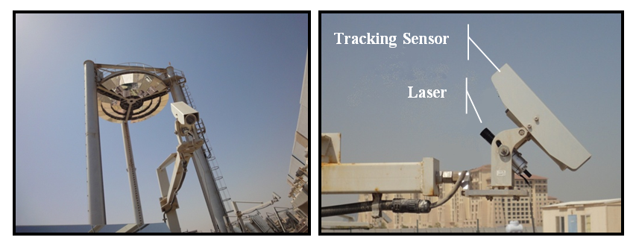
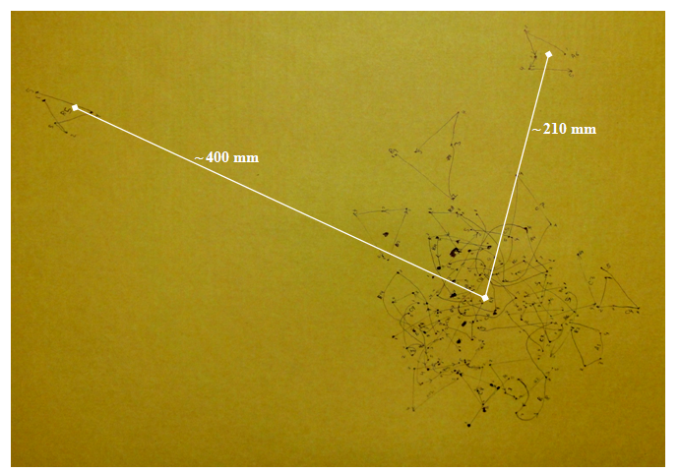
Flux Centering and Optical Alignment

Slide 22
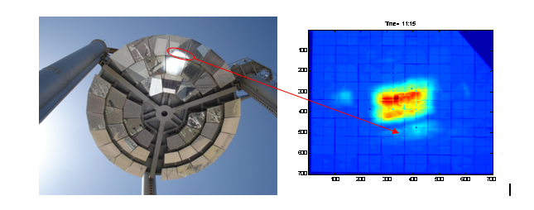
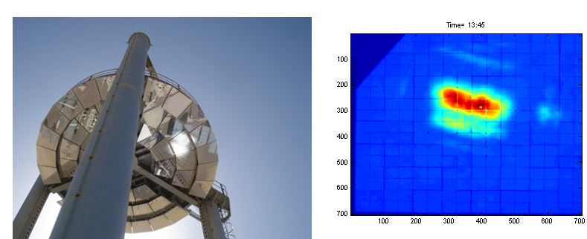
Tracking Sensor Alignment

Slide 23
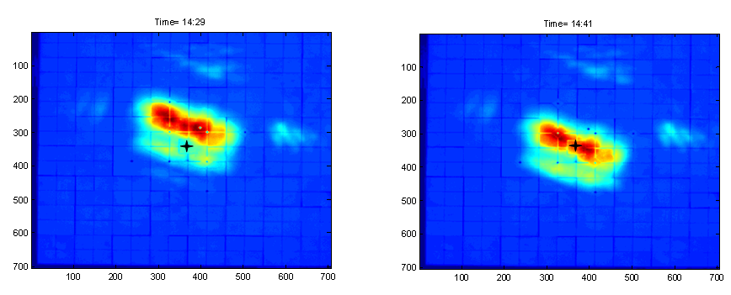
Central Reflector Alignment

Slide 24
Main Observations
1) Inadequacies in the measurement system
2) Heliostat concentration quality

Slide 25
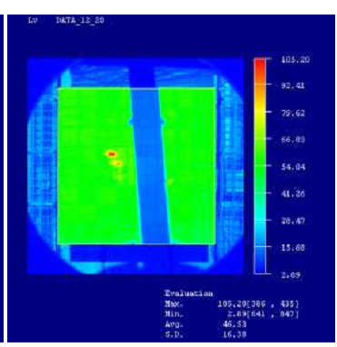
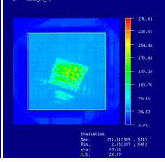
Results : Tower Shading
Shading
Off-centering
Deformation of CR mirrors
Spillage and Heliostat Defocusing
Optical aberrations
Inadequacies in the measurement system
Notes:
One of the important aspects of this test is the ability to spot irregularities in the heliostat field

Slide 26
Outline
Preliminary Experimental Characterization
Concentrated Solar Flux Measurement System
Beam Down Performance Overview
Beam-Down Experimental Characterization & Modeling
Measurement System Inadequacies
Concentration Quality
Geometrical-Optics Model and Error Analysis

Slide 27
Outline
Preliminary Experimental Characterization
Concentrated Solar Flux Measurement System
Beam Down Performance Overview
Beam-Down Experimental Characterization & Modeling
Measurement System Inadequacies
Concentration Quality
Geometrical-Optics Model and Error Analysis

Slide 28
Concentrated Solar Flux Measurement System
Optical Method
Convenient
High Resolution 700x700
Less Accurate
Requires a Uniform Lambertian Target
Measures Luminance (cd/m²)

Slide 29
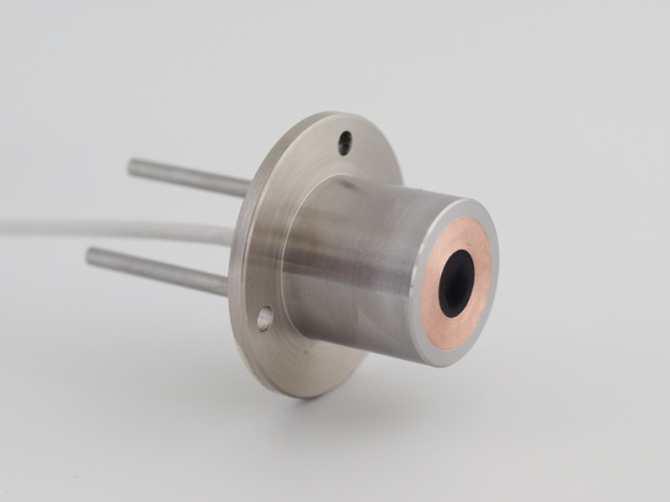
Concentrated Solar Flux Measurement System
Heat Transfer Method
Flux Measured in (W/m²)
Accurate
Reliable
Low Resolution (Point Measurement)
Requires real-time corrections against ambient conditions

Slide 30
Concentrated Solar Flux Measurement System
The combination of the two system will give:
High resolution of optical method
Accuracy of the heat transfer method
The final result is a heat
“Flux Map” in (W/m²)

Slide 31
Problems in the Inherited System
Heat Transfer Method
ON/OFF Cooling system
Response to varying ambient conditions
Manufacturer calibration for different spectrum
Optical Method (Steve’s Thesis)
How Lambertian is the target ?
Degraded Quality of the target
CCD camera temperature response
and the correlation between the two systems (Steve’s Thesis)

Slide 32
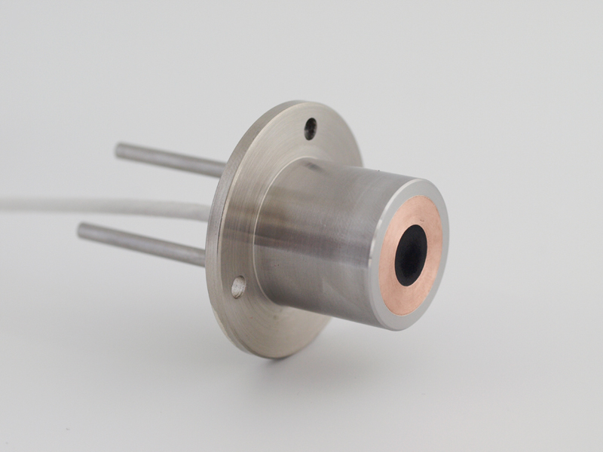
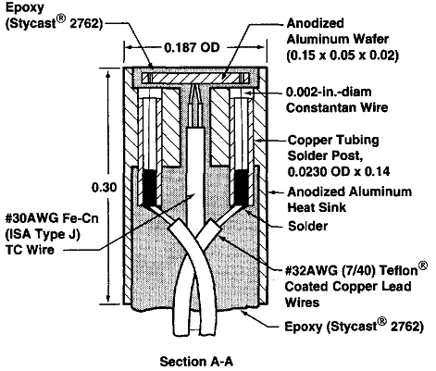

Heat Flux Sensors (HFS)
Courtesy of Kidd and Nelson 1995

Slide 33
Preliminary Testing of HFS
RMSE= 115 W/m²

Slide 34
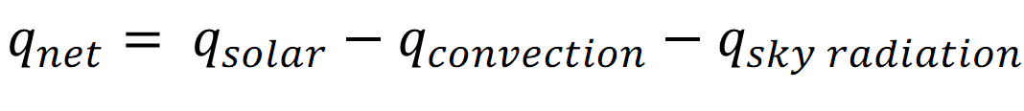

Heat Transfer Model of HFS
G

Slide 35
Temperature Variation in HFS

Slide 36
Heat Transfer Model of HFS
G
We need measurement of
Reference Solar Radiation
Local Wind Speed
Ambient Temperature
Effective Sky Temperature
Cooling Water In/outlet Temperature

Slide 37
Experimental Setup for Calibration

Slide 38
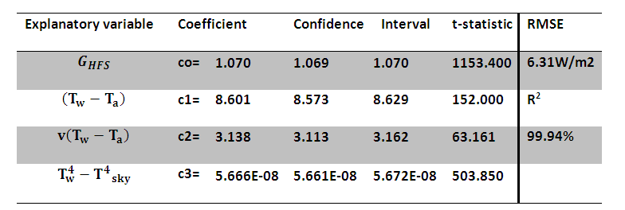
Results of Applying the Regression Model

Slide 39
Results of Applying the Regression Model
RMSE= 6.3 W/m²

Slide 40
Residuals Analysis

Slide 41
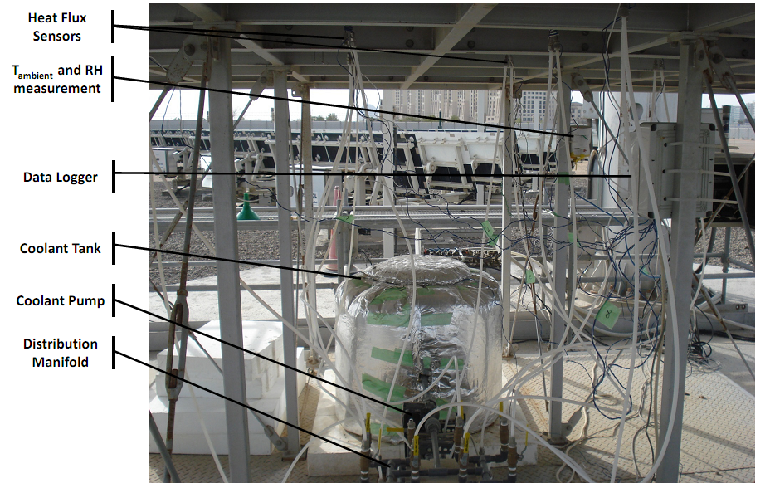
In-Situ Calibration of HFS

Slide 42
In-Situ Calibration of HFS

Slide 43
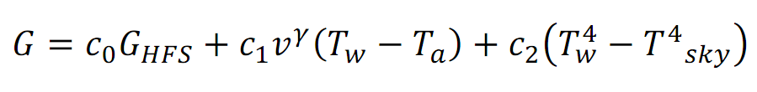
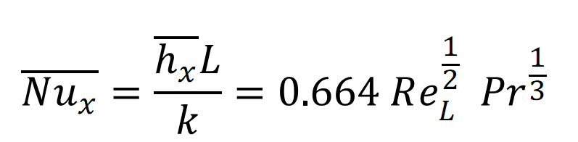
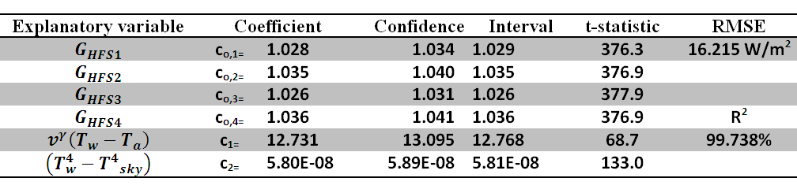
Regression Model
forced to be the same for all sensors

Slide 44
Results of Applying the Regression Model
RMSE= 16.3 W/m²

Slide 45
Residuals Analysis

Slide 46
Outline
Preliminary Experimental Characterization
Concentrated Solar Flux Measurement System
Beam Down Performance Overview
Beam-Down Experimental Characterization & Modeling
Measurement System Inadequacies
Concentration Quality
Geometrical-Optics Model and Error Analysis

Slide 47
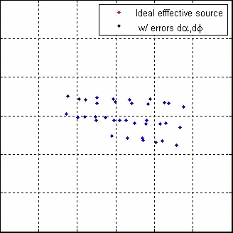
Geometrical Optics Model
Very fast calculation compared to ray tracing
Allows the study of:
Optical aberrations
Optical errors and real sunshapes
Spillage, scattering, canting and other optical design parameters

Slide 48
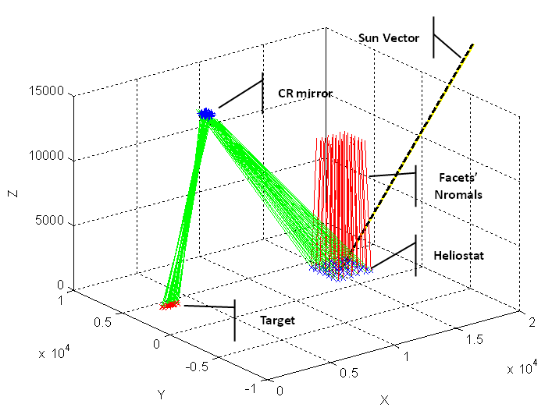
Visualization of the Model

Slide 49
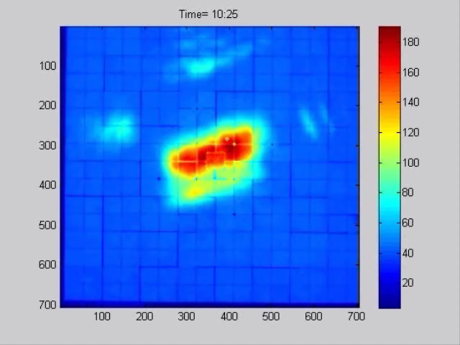
1. Optical Aberrations

Slide 50
1. Optical Aberrations

Slide 51
1. Optical Aberrations

Slide 52
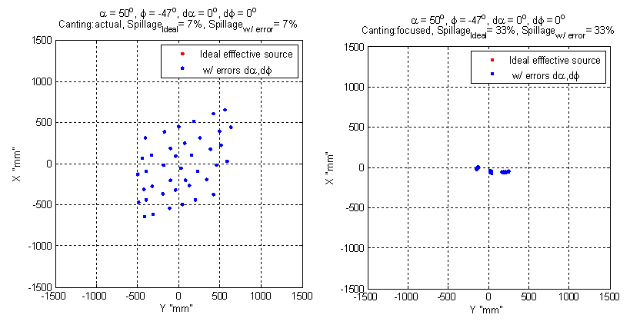
2. Spillage and Heliostat Defocusing

Slide 53
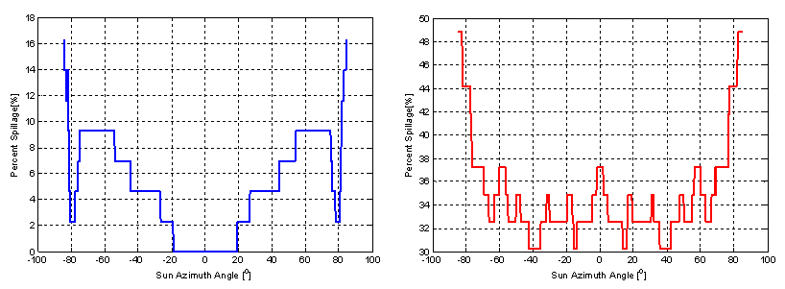
2. Spillage and Heliostat Defocusing

Slide 54
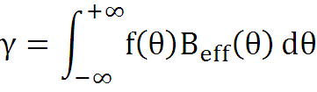
3. Error Analysis
Intercept Factor: Portion of radiation falling on the target that is intercepted by the receiver
Intercept Factor assuming Perfect optics and point sun
Effective Source:
Effect of optical errors combined with sunshape

Slide 55
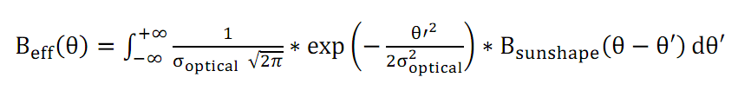
Effective Source
Total Optical Errors 3.74 mrad
CSR = 5%

Slide 56
Deviation due to Effective Source Errors

Slide 57
Outline
Preliminary Experimental Characterization
Concentrated Solar Flux Measurement System
Beam Down Performance Overview
Beam-Down Experimental Characterization & Modeling
Measurement System Inadequacies
Concentration Quality
Geometrical-Optics Model and Error Analysis

Slide 58
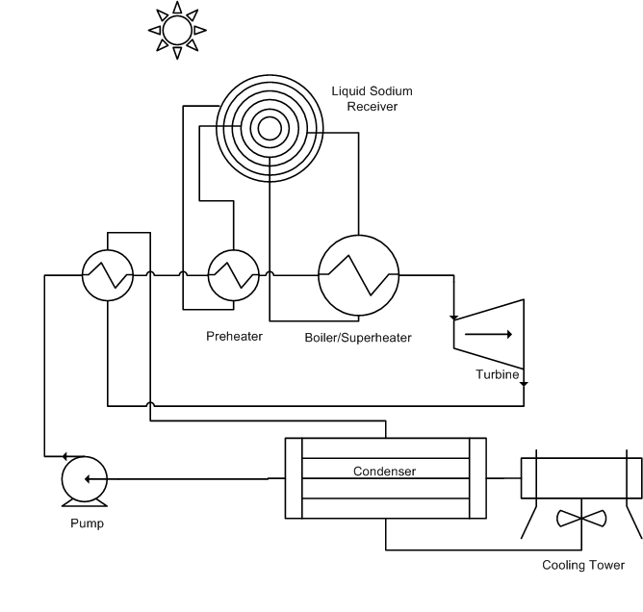
Hypothetical Receiver and Power Block Design

Slide 59
Optimal Receiver Size

Slide 60
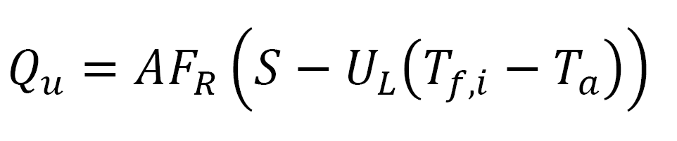
Receiver Heat Loss Model
Liquid Sodium is used as a HTF (MP:371K,BP:1156K)
Heat Removal Factor
Overall Heat Loss

Slide 61
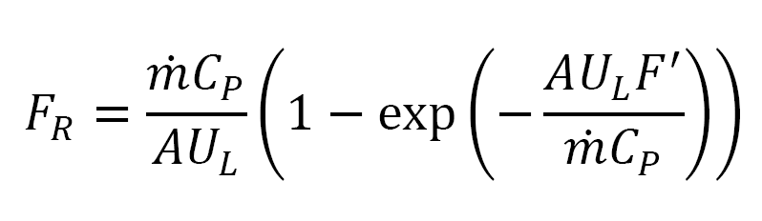
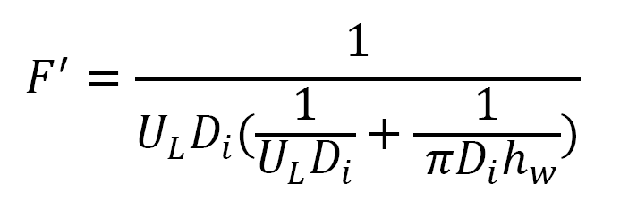
Receiver Heat Loss Model
Heat Removal & Efficiency Factors

Slide 62
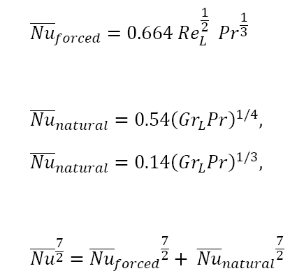



Receiver Heat Loss Model
Radiation Loss
Convection Losses
Losses are function of T_{pm} and m hence an iterative process is required

Slide 63
Optimal Receiver Size

Slide 64
Optical Efficiency

Slide 65
Receiver Collection Efficiency

Slide 66
Overall Thermal Efficiency

Slide 67
Useful Thermal Power Collected

Slide 68
Maximum Possible Work

Slide 69
Outline
Preliminary Experimental Characterization
Concentrated Solar Flux Measurement System
Beam Down Performance Overview
Beam-Down Experimental Characterization & Modeling
Measurement System Inadequacies
Concentration Quality
Geometrical-Optics Model and Error Analysis

Slide 70







Collaboration Team
Notes:
1)Ground Level receiver
2)All radiation coming from one direction cavity receiver
#) mainly extra reflection

Slide 71

LENS Solar Group Members
Abdul Qadir
Ahmad Zayan
Irene Rubalcaba
Marwan M. Mokhtar
Matteo Chiesa
Peter Armstrong
Ragini Kalapatapu
Steven Andrew Meyers
Zaid M. Tahboub
&
The Committee
Dr. Matteo Chiesa
Dr. Peter Armstrong
Dr. Olaf Goebel

Slide 72

HEAT STORAGE FOR CSP
Thank You شكراً

