Slide 1
Modeling a PCM storage unit for solar thermal cooling in Masdar City
Irene Rubalcaba Montserrat
RSC Members:
Dr. Matteo Chiesa
Dr. Peter Armstrong
Dr. Ali Abbas
Notes:
Thank you for coming to my defense.. The title of my thesis is “Modeling a PCM storage unit for solar thermal cooling in Masdar City
My research committee members are Dr. Chiesa, Dr. Armstrong and Dr. Abbas.

Slide 2
Agenda
  Motivation
  Solar cooling system
  Solar data profile
  Cooling load profile
  Storage modeling
  Conclusion
  Areas of Improvement

Slide 3
Why storage?

Slide 4
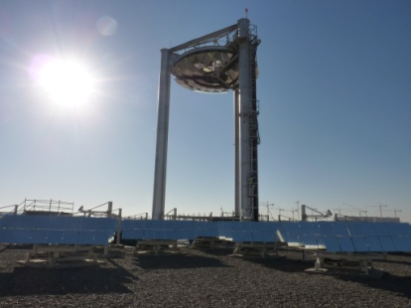
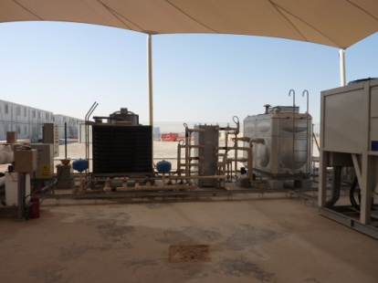
Beam Down and Absorption chiller in Masdar site

Slide 5





Solar cooling system
Solar Field
Charging mode
Discharging mode
Generator
Cooling System
Heat Exchanger
Condenser
PCM
Storage
Unit
Pump
Evaporator
Pump
Drum
Absorber

Slide 6
Power profile from the Beam Down
[kW]
21st of March 2011

Slide 7
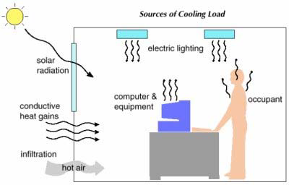
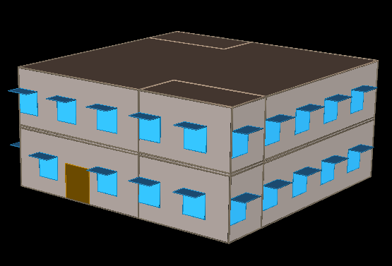
Cooling load estimation using eQUEST
The office building modeled is a two story building with a total floor area of 232 m².
Each floor is divided into office space having a floor area of 195 m², kitchen and restrooms with floor area of 18.58 m².
the office space is designed for a total each occupancy of 85 persons with 4.6 m² per person.

Slide 8
Cooling load estimation
Time | Cooling needed for one building (Q_{evaporator}) [kW] | Cooling needed for 4 buildings [kW] | Ambient temperature [C] | COP | Power needed to the Chiller generator [kW] | Power from the Beam Down [kW] | Power to store [KW]
7:00 AM | 0 | 0 | - | - | 0 | 26.4 | 26.5
8:00 AM | 0 | 0 | - | - | 0 | 61.5 | 61.5
9:00 AM | 0 | 0 | - | - | 0 | 88.9 | 88.9
10:00 AM | 0 | 0 | - | - | 0 | 111.4 | 111.4
11:00 AM | 45.3108 | 181.2 | 27 | 2 | 90.6 | 120.5 | 29.9
12:00 PM | 50.8248 | 203.3 | 27 | 2 | 101.6 | 127 | 25.4
1:00 PM | 53.0282 | 212.1 | 28 | 2 | 106.1 | 128.1 | 22.1
2:00 PM | 47.6328 | 190.5 | 27 | 2 | 95.3 | 112.7 | 17.4
3:00 PM | 46.755 | 187 | 27 | 2 | 93.5 | 84.7 | -8.8
4:00 PM | 45.2459 | 181 | 25 | 2.026 | 89.3 | 53.6 | -35.7
5:00 PM | 37.2483 | 149 | 25 | 2.026 | 73.5 | 19.2 | -54.3
6:00 PM | 29.606 | 118.4 | 25 | 2.026 | 58.5 | 1.1 | -57.4
7:00 PM | 25.0592 | 100.2 | 25 | 2.026 | 49.5 | 0 | -49.5

Slide 9
Cooling load estimation
Time | Cooling needed for one building (Q_{evaporator}) [kW] | Cooling needed for 4 buildings [kW] | Ambient temperature [C] | COP | Power needed to the Chiller generator [kW] | Power from the Beam Down [kW] | Power to store [KW]
7:00 AM | 0 | 0 | - | - | 0 | 26.4 | 26.5
8:00 AM | 0 | 0 | - | - | 0 | 61.5 | 61.5
9:00 AM | 0 | 0 | - | - | 0 | 88.9 | 88.9
10:00 AM | 0 | 0 | - | - | 0 | 111.4 | 111.4
11:00 AM | 45.3108 | 181.2 | 27 | 2 | 90.6 | 120.5 | 29.9
12:00 PM | 50.8248 | 203.3 | 27 | 2 | 101.6 | 127 | 25.4
1:00 PM | 53.0282 | 212.1 | 28 | 2 | 106.1 | 128.1 | 22.1
2:00 PM | 47.6328 | 190.5 | 27 | 2 | 95.3 | 112.7 | 17.4
3:00 PM | 46.755 | 187 | 27 | 2 | 93.5 | 84.7 | -8.8
4:00 PM | 45.2459 | 181 | 25 | 2 | 89.3 | 53.6 | -35.7
5:00 PM | 37.2483 | 149 | 25 | 2 | 73.5 | 19.2 | -54.3
6:00 PM | 29.606 | 118.4 | 25 | 2 | 58.5 | 1.1 | -57.4
7:00 PM | 25.0592 | 100.2 | 25 | 2 | 49.5 | 0 | -49.5

Slide 10
Supply and demand disparity storage opportunity

Slide 11
Supply and demand disparity storage opportunity
Extra heat to store
Storage use

Slide 12
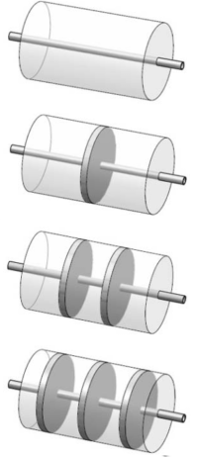
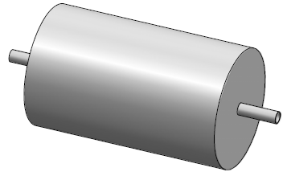
STORAGE MODELING
Geometry
CYLINDRICAL STORAGE COMPARTMENT
Length=11m
COPPER PIPE
Length=11m
Outside Diameter= 0.012m
Thickness=1mm

Slide 13
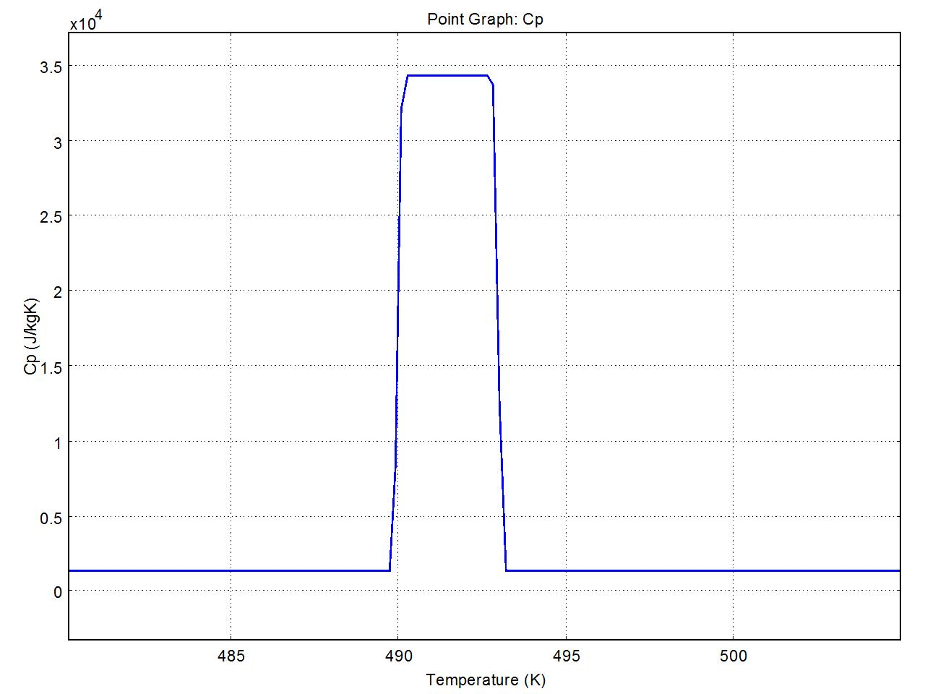
Modeling phase change using COMSOL
Melting range = ΔTm
ΔTm = 490 to 493 K
Cp= 1330 + Latent heat/ΔT
FULLY SOLID
Cp = 1330 [J/KgK]
FULLY LIQUID
Cp = 1330 [J/KgK]

Slide 14




Numerical modeling
Problem Type: Transient Thermal Fluid
Model Used: Time depending - Non Isothermal flow
Incompressible Navier- Stokes:
Heat Transfer by conduction and convection:
Geometry is considered 2D axial symmetry

Slide 15
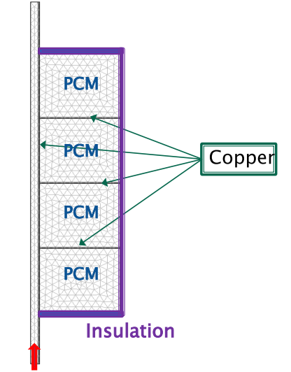
2D Axial symmetry model
Maximum Energy Storage
Capacity:
400 [MJ] + Sensible Heat

Slide 16
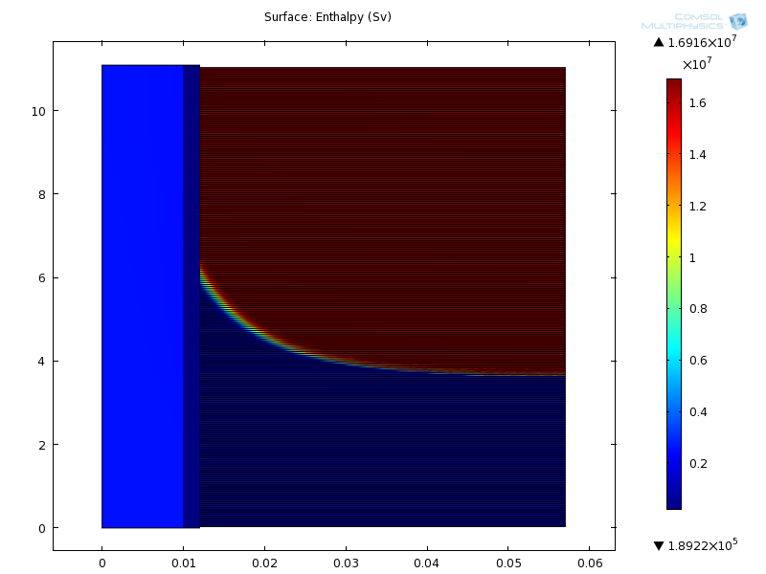
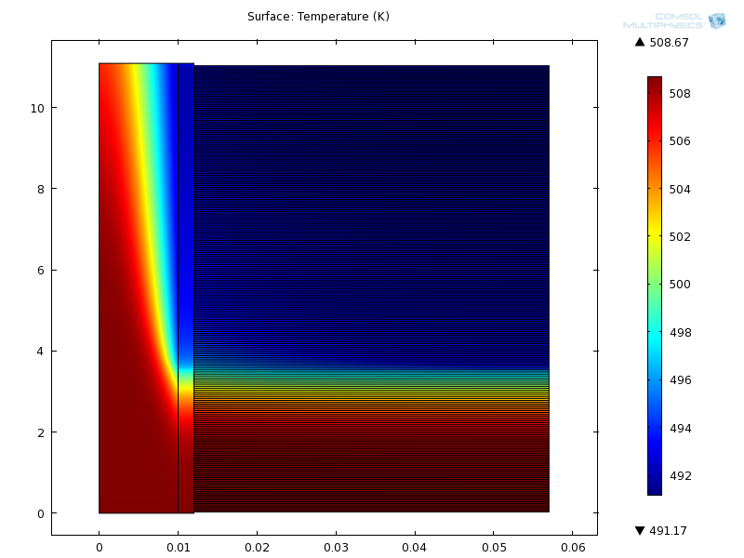
Numerical Results for 44 tubes after 20700 seconds - 5.75 hr
Enthalpy
Temperature

Slide 17
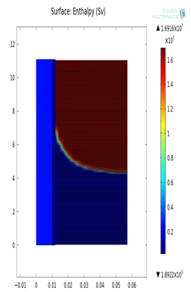
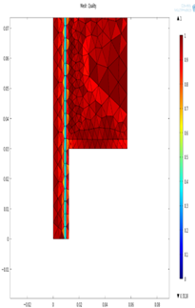
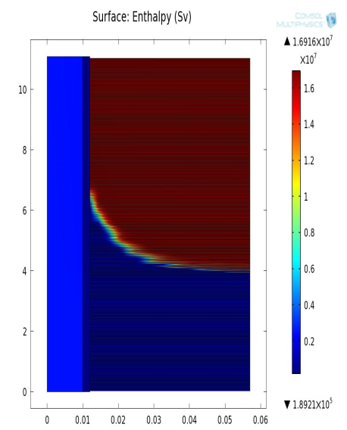
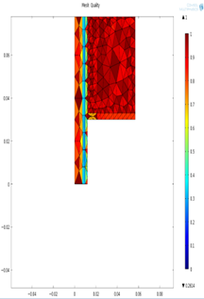
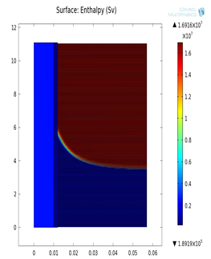
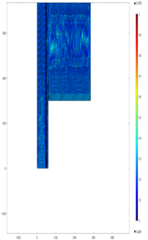
Mesh Sensitivity
Mesh Type | Extremely Fine | Normal | Coarser
Number of elements | 536,068 | 88,946 | 82,327

Slide 18



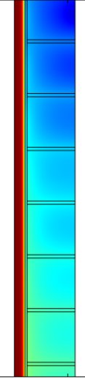
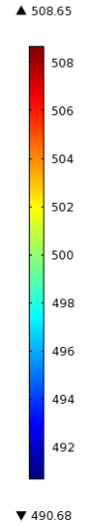
Effect of fins
No fins
5 Fins
10 Fins
20 Fins

Slide 19
Effect of fins
Pipe
A
B
Temperature profile taken along the line AB

Slide 20

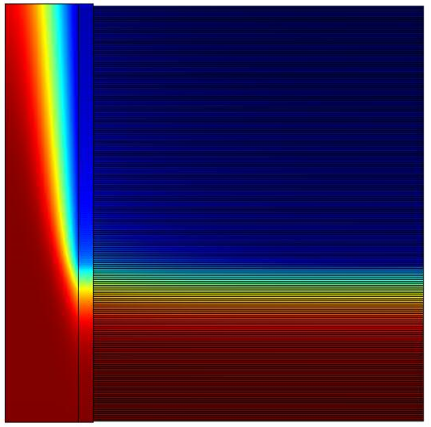
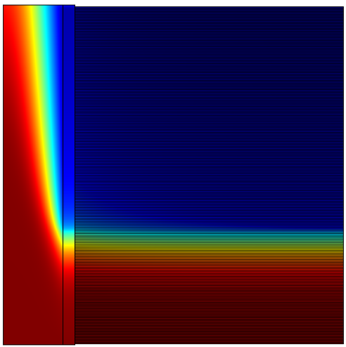
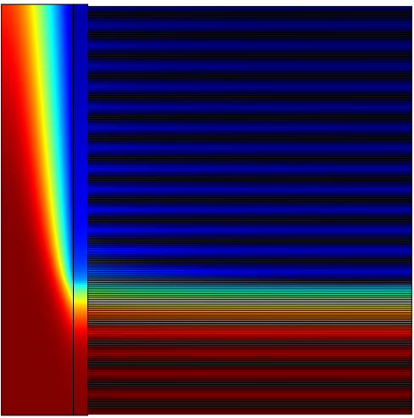
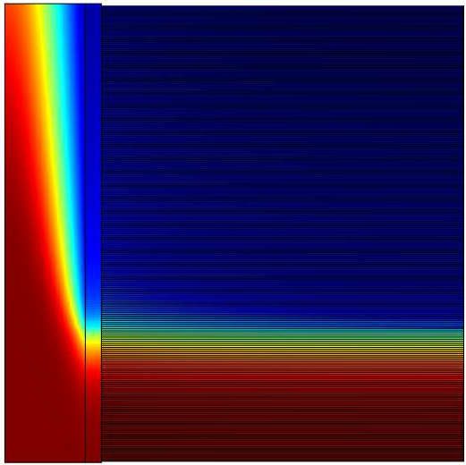
Effect of inlet velocity
v= 0.0932 m/s
v= 0.0832 m/s
v= 0.07992 m/s
v= 0.07629 m/s

Slide 21
Effect of inlet velocity
Pipe
A
B
Temperature profile taken along the line AB

Slide 22
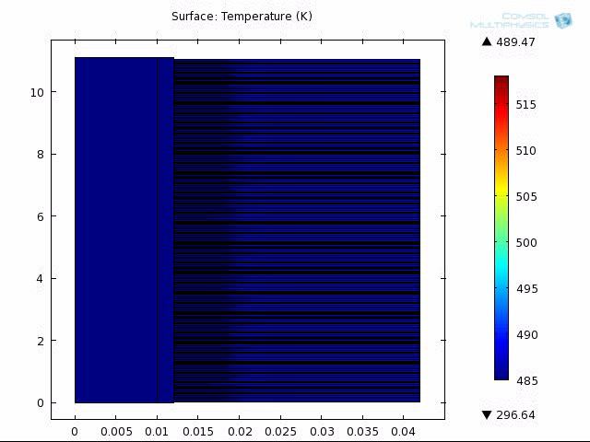
Melting

Slide 23
Solidification temperature outlet

Slide 24


Final Design
Material= KNO3-NaNO3(eu)
81 tubes
L =11m
ri= 1 cm
r0= 3 cm
Total volume= 5.7m³
Total PCM mass = 4.209 tons
Maximum storage capacity
= 400[ MJ] + sensible heat
Symbol | Description | Value | Units
 | Latent heat of fusion of the PCM | 95000
 | Density of the PCM | 1880
 | Specific heat of the PCM | 1330
 | Thermal conductivity of the PCM | 4
α_{pcm} | Thermal diffusivity
 | Melting Temperature of the PCM | 493 / 220 | K / C

Slide 25
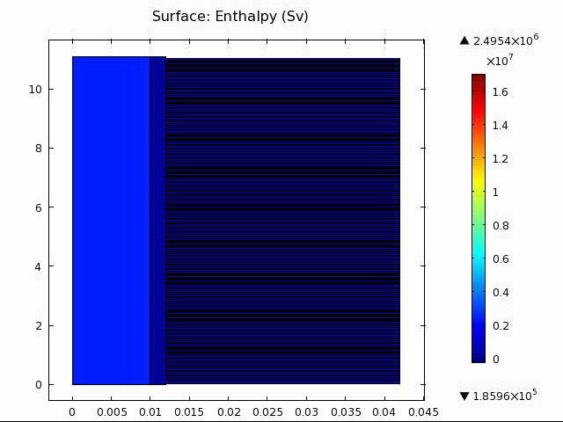
Solidification

Slide 26
Case Study II (4)
Results
Concluding Remarks
Contributions

Slide 27
Areas of Improvement
Extensions to the Model

Slide 28
Questions
?

