Slide 1
Modeling and Experimental Validation of a Low Lift, Vapor Compression Heat Pump
Muhammad Tauha Ali

Slide 2
Outline
Motivation
Experimental Setup
Experimental Validation
Conclusion
Future Work
Vapor Compression Heat Pump Modeling

Slide 3
Motivation

Slide 4
Motivation
Heat Pump Modeling
Experimental Setup
Experimental Validation
Conclusion
Future Work
Motivation
60% cooling share in building load for hot climates
80% sensible cooling load
Ali, M. T., Mokhtar, M., Chiesa, M., & Armstrong, P. (2011). A cooling change-point model of community-aggregate electrical load. Energy and Buildings, 43(1), 28-37.

Slide 5
Motivation
Heat Pump Modeling
Experimental Setup
Experimental Validation
Conclusion
Future Work
Motivation
20-40% savings through variable speed compressor
Use variable speed compressor to provide cooling energy at peak efficiency
Forecast cooling load based on predicted outdoor temperature and radiation
Store predicted cooling energy in building envelope mainly floor slab at times of high chiller efficiency operation
Over 40% increase in efficiency through radiant cooling

Slide 6
Motivation
Heat Pump Modeling
Experimental Setup
Experimental Validation
Conclusion
Future Work
Objectives
Develop a heat pump test stand for testing low-lift cooling technology
Prepare a test chamber with pipe-embedded concrete slab for testing radiant-cooling with pre-cooling control
Develop a heat pump model based on latest physical models of HX with minimum parameter estimation
Comparison of our detailed HX models with simplified models presented in (Zakula, 2010)
Develop optimal compressor and condenser fan speed equations for use in pre-cooling control testing
Assessment of refrigerant oil effect on modeled components of vapor compression cycle
Zakula, T. (2010). Heat pump simulation model and optimal variable-speed control for a wide range of cooling conditions.

Slide 7
Vapor Compression Heat Pump Modeling

Slide 8
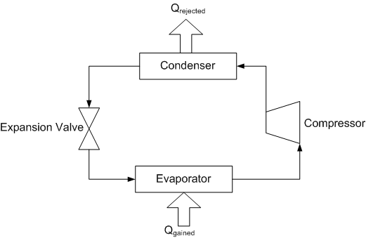
Motivation
Heat Pump Modeling
Experimental Validation
Conclusion
Future Work
Experimental Setup
Vapor Compression Cycle
Condenser
Compressor
Expansion Valve
Evaporator
Evaporator is modeled as a fan-coil HX for Direct Expansion (DX) mode operation
Evaporator is modeled as a brazed-plate HX for chiller mode of operation
Condenser is modeled as a fan-coil heat exchanger (HX)
Isenthalpic expansion is considered in the expansion valve
Armstrong, P. R., Jiang, W., Winiarski, D., Katipamula, S., & Norford, L. K. (2009). Efficient low-lift cooling with radiant distribution, thermal storage, and variable-speed chiller controls—Part II: Annual use and energy savings. HVAC&R Research, 15(2), 402–432

Slide 9
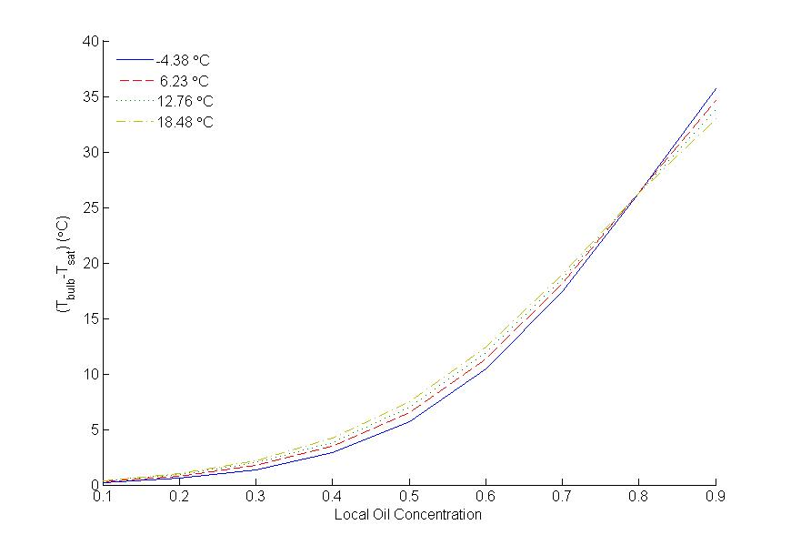

Motivation
Heat Pump Modeling
Experimental Validation
Conclusion
Future Work
Experimental Setup
Oil Effect on Heat Pump
Main purpose of oil is to provide lubrication
General trend of oil:
Decrease heat transfer
Increase pressure drop
For some conditions oil may increase heat transfer
POE/VG68 oil properties are used
Refrigerant-oil mixture properties evaluated through mixture models
Mixture properties are used in heat transfer and single-phase pressure drop correlations developed for pure refrigerant
Adjustment to two-phase pressure drop model for pure refrigerant is done in fan-coil HX to account for higher pressure drop
Modification of saturation temperatures
1% circulating oil mass fraction is considered

Slide 10
Compressor Model
Condenser
Compressor
Expansion Valve
Evaporator
Armstrong, P. R., Jiang, W., Winiarski, D., Katipamula, S., & Norford, L. K. (2009). Efficient low-lift cooling with radiant distribution, thermal storage, and variable-speed chiller controls—Part II: Annual use and energy savings. HVAC&R Research, 15(2), 402–432

Slide 11




Motivation
Heat Pump Modeling
Experimental Validation
Conclusion
Future Work
Experimental Setup
Compressor Model
Mass Flow Model
Back Leakage Correction
Power Model
Clearance Volume Correction
Electrical and Mechanical Loss Correction
where,

Slide 12


Motivation
Heat Pump Modeling
Experimental Validation
Conclusion
Future Work
Experimental Setup
Compressor Model
Compressor Model Parameters
Tdischarge is searched for satisfying convergence equation
Input | Output
Pdischarge | Tdischarge
Psuction | Refrigerant mass flow rate
Evaporator load | Compressor power
Tsuction (optional) | Compressor speed
Evaporator inlet enthalpy (optional)
Model constants
Convergence Equation
where,

Slide 13
Motivation
Heat Pump Modeling
Experimental Validation
Conclusion
Future Work
Experimental Setup
Heat Exchanger Model Assumptions and Approach
Single-phase to two-phase transition calculated to 0.01K accuracy
Two-phase to single-phase transition calculated to 1% vapor quality accuracy
Model assumptions:
Uniform ambient/zone temperature
ε-NTU model is used for heat transfer calculation with appropriate correlations
Darcy-Weisbach equation is used for pressure drop with appropriate friction factor correlations
Uniform air/water distribution over the HX
Effect of U-bends on heat transfer and pressure drop is negligible
Contact resistance between tube and fins/between plates is negligible
Effect of air-side/water-side pressure drop on heat transfer is negligible
HX circuitry arrangement effects on air-side heat transfer are negligible
Radiation heat transfer effects are negligible
Condensation or frosting on the outside of tubes is not considered
Segment-by-segment approach is employedSchmidt method used for fin efficiency calculation
Maximum vapor quality for condenser is 0 while for evaporator is 1-oil concentration

Slide 14
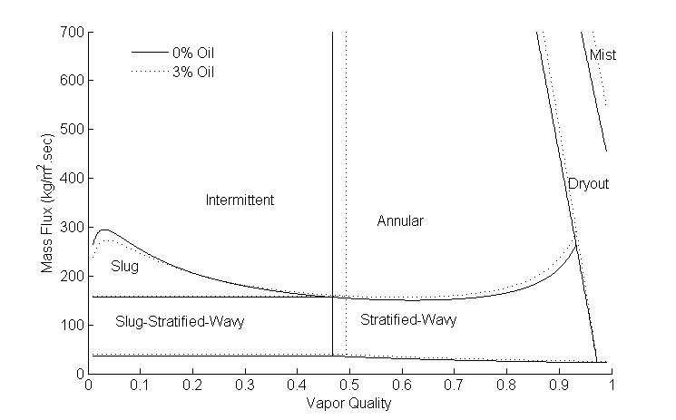
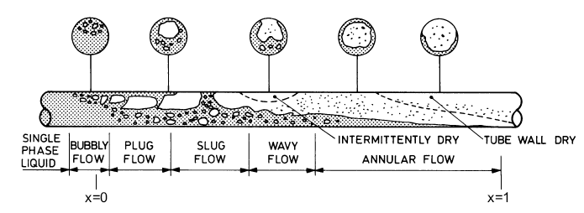
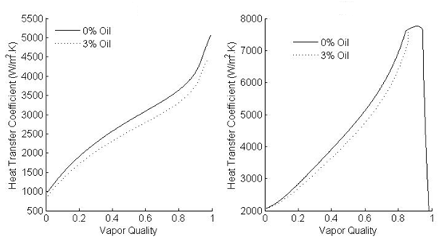
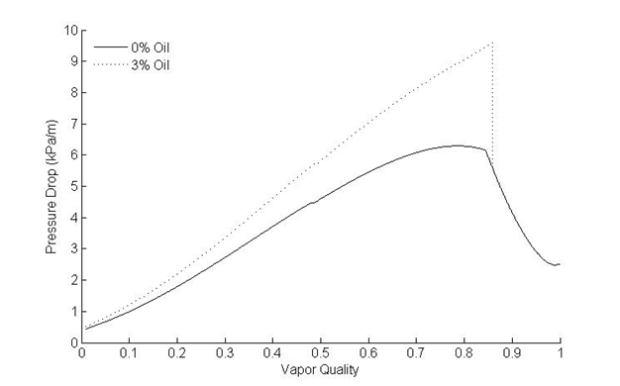
Motivation
Heat Pump Modeling
Experimental Validation
Conclusion
Future Work
Experimental Setup
Two-Phase Heat Transfer and Pressure Drop Model for Fan-Coil HX
Flow pattern map of (Wojtan et al., 2005) is used to identify different flow regimes
Correlations for R410a chevron type brazed-plate HX developed by (Hsieh and Lin, 2002) are used for brazed-plate evaporator
Hsieh, Y. Y., & Lin, T. F. (2002). Saturated flow boiling heat transfer and pressure drop of refrigerant R-410A in a vertical plate heat exchanger. International journal of heat and mass transfer, 45(5), 1033–1044
Condensation
Evaporation
Wojtan, L., Ursenbacher, T., & Thome, J. R. (2005a). Investigation of flow boiling in horizontal tubes: Part I–A new diabatic two-phase flow pattern map. International journal of heat and mass transfer, 48(14), 2955–2969.

Slide 15
Condenser Model
Condenser
Compressor
Expansion Valve
Evaporator
Armstrong, P. R., Jiang, W., Winiarski, D., Katipamula, S., & Norford, L. K. (2009). Efficient low-lift cooling with radiant distribution, thermal storage, and variable-speed chiller controls—Part II: Annual use and energy savings. HVAC&R Research, 15(2), 402–432

Slide 16
Motivation
Heat Pump Modeling
Experimental Validation
Conclusion
Future Work
Experimental Setup
Condenser Model
Condenser Model Parameters
Convergence Equation
Input | Output
Refrigerant mass flow rate | Air volumetric flow rate
Pcondenser inlet | Pcondenser outlet
Tcondenser inlet | Tcondenser outlet
Tambient | De-superheating fraction of condenser
Evaporator load | Condensation fraction of condenser
Compressor Power | Condenser Effectiveness
Condenser Details
Condenser Details
Tube diameter | Tube thermal conductivity
Tube thickness | Fin thickness
Tube length | Fin width
Tube transversal pitch | Fin pitch
Total number of tubes | Fin thermal conductivity
Number of stream divisions | Condenser height
Number of tubes after streams merge | Condenser length
Number of tube rows
Air volumetric flow rate is searched for satisfying convergence equation

Slide 17
Evaporator Model
Condenser
Compressor
Expansion Valve
Evaporator
Armstrong, P. R., Jiang, W., Winiarski, D., Katipamula, S., & Norford, L. K. (2009). Efficient low-lift cooling with radiant distribution, thermal storage, and variable-speed chiller controls—Part II: Annual use and energy savings. HVAC&R Research, 15(2), 402–432

Slide 18

Motivation
Heat Pump Modeling
Experimental Validation
Conclusion
Future Work
Experimental Setup
Fan-Coil Evaporator Model
Evaporator Model Parameters
Convergence Equation
Input | Output
Refrigerant mass flow rate | Air volumetric flow rate
Pevaporator inlet | Pevaporator outlet
Tevaporator inlet | Tevaporator outlet
Inlet vapor quality | Evaporation fraction of evaporator
Tzone | Evaporator Effectiveness
Evaporator load
Evaporator Details
Evaporator Details
Tube diameter | Tube thermal conductivity
Tube thickness | Fin thickness
Tube length | Fin width
Tube transversal pitch | Fin pitch
Total number of tubes | Fin thermal conductivity
Number of stream divisions | Evaporator height
Number of tube rows | Evaporator length
Air volumetric flow rate is searched for satisfying convergence equation

Slide 19
Motivation
Heat Pump Modeling
Experimental Validation
Conclusion
Future Work
Experimental Setup
Brazed-Plate Evaporator Model
Evaporator Model Parameters
Convergence Equation
Input | Output
Refrigerant mass flow rate | Water volumteric flow rate
Pevaporator inlet | Pevaporator outlet
Pevaporator inlet | Tevaporator outlet
Inlet vapor quality | Twater outlet
Twater inlet | Evaporation fraction of evaporator
Evaporator load | Evaporator Effectiveness
Evaporator Details
Evaporator Details
Plate length | Number of plates
Plate thickness | Enlargement factor
Plate width | Corrugation pitch
Channel thickness | Chevron angle
Port diameters
Water volumetric flow rate is searched for satisfying convergence equation

Slide 20
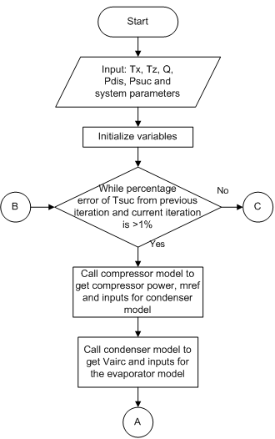
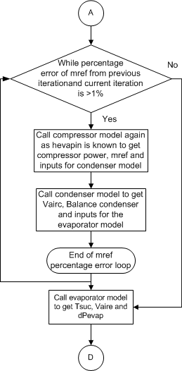
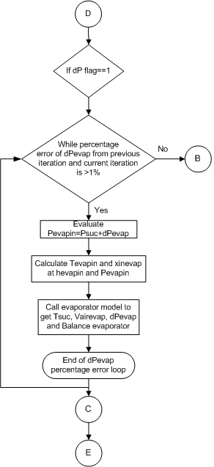
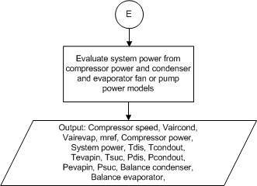
Motivation
Heat Pump Modeling
Experimental Validation
Conclusion
Future Work
Experimental Setup
System Model

Slide 21
Motivation
Heat Pump Modeling
Experimental Validation
Conclusion
Future Work
Experimental Setup
Summary of Component Models in (Zakula, 2010)
Tsaturation of pure refrigerant is used for two-phase region
ε-NTU model is used for heat transfer calculation with simple correlations
Darcy-Weisbach equation is used for pressure drop with simple friction factor correlations
Constant specific heat of oil is considered in compressor model
Refrigerant mass flow rate, Tevaporator inlet and evaporation zone fraction is searched in the evaporator model to satisfy the convergence equation
Pcondenser inlet and condensation zone fraction is searched in the condenser model to satisfy the convergence equation
Oil effect is considered only for two phase pressure drop
Zone-by-zone approach is employed in HX

Slide 22
Experimental Setup

Slide 23
Motivation
Heat Pump Modeling
Experimental Setup
Experimental Validation
Conclusion
Future Work
Experimental Setup
Conversion and instrumentation of conventional split unit to chiller
Implementation of control over expansion valve, condenser fan and compressor speed
Calibration of pressure transducers
Energy balance for instrumentation verification
Instrumentation of test chamber
Condenser fan characterization
Insulation and air-tightening of test chamber with pipe embedded slab

Slide 24
Motivation
Heat Pump Modeling
Experimental Setup
Experimental Validation
Conclusion
Future Work
Test Stand Schematic

Slide 25
Motivation
Heat Pump Modeling
Experimental Setup
Experimental Validation
Conclusion
Future Work
Devices Control
Sensor-less control over 6-pole permanent magnet motor of compressor
Direct torque control or Linear V/f control
Hall-effect sensor based control over brushless DC motor of condenser fan
Analog input for control signal
PID control on linear expansion valve (LEV) based on suction superheat through stepper motor
In-house stepper motor control circuit built by Arslan Khalid (MI)
Time based digital input for control signal
Serial input for control signal

Slide 26




Motivation
Heat Pump Modeling
Experimental Setup
Experimental Validation
Conclusion
Future Work
LEV Control
Full open to full close in 965msec for pulse frequency of 333.33Hz determined by trial and error
Valve Tuning through Ziegler-Nicholas method
Ultimate gain: 8.5
Ultimate period: 90sec
Valve position control equation:
where,
The integral term S(t) is zeroed when the valve reach its limits
LEV is brought to initial position after a day to eliminate position drift error because of inaccuracy in estimation of full open to full close timing

Slide 27
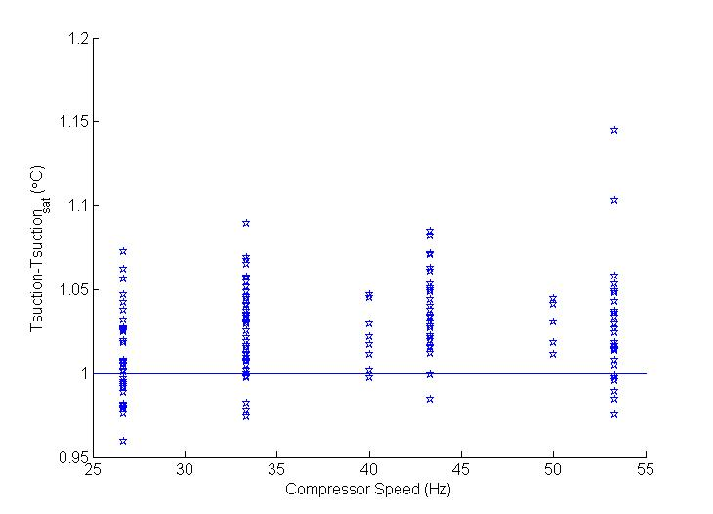
Motivation
Heat Pump Modeling
Experimental Setup
Experimental Validation
Conclusion
Future Work
LEV Control Accuracy
PID Control Parameters
Proportional Constant (K_{c}) | 5
Integral Time (T_{i}) | 45
Derivative Time (T_{d}) | 11.25

Slide 28
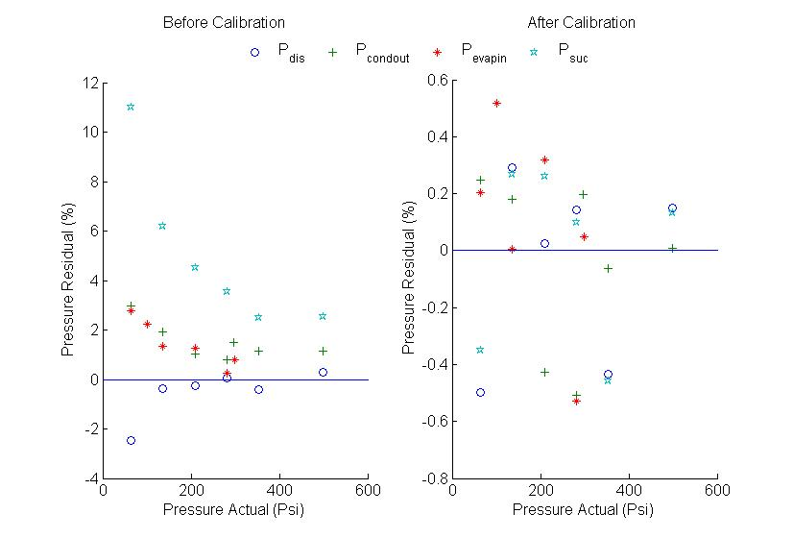
Motivation
Heat Pump Modeling
Experimental Setup
Experimental Validation
Conclusion
Future Work
Pressure Transducer Calibration
4 pressure transducers are installed for measuring:
Discharge pressure
Condenser outlet pressure
Evaporator inlet pressure
Suction pressure
Dead weight tester is used for calibration

Slide 29
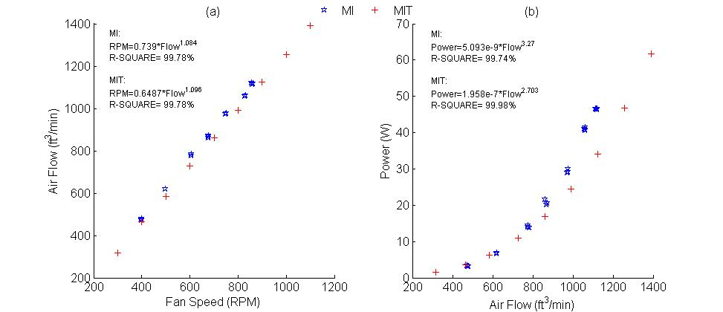
Motivation
Heat Pump Modeling
Experimental Setup
Experimental Validation
Conclusion
Future Work
Condenser Fan Characterization
Flow hood testing for condenser fan characterization
Relationship between fan speed, air flow and power was determined
Fan laws
Speed α Flow
Speed α Power³

Slide 30

Motivation
Heat Pump Modeling
Experimental Setup
Experimental Validation
Conclusion
Future Work
Energy Balance for Instrumentation Verification
Compressor Energy Balance
Condenser Energy Balance
Fan-Coil Evaporator Energy Balance
Plate Evaporator Energy Balance
System Energy Balance

Slide 31
Motivation
Heat Pump Modeling
Experimental Setup
Experimental Validation
Conclusion
Future Work
Experimental Data Sets
Experimental data set consists of the data obtained from the test stand built at MI and the test stands used in (N. N. T. Gayeski, 2010; N. Gayeski, Zakula, PR Armstrong, & L. Norford, 2010).
The data sets from (N. N. T. Gayeski, 2010; N. Gayeski, Zakula, PR Armstrong, & L. Norford, 2010) are represented by “MIT DX” and “MIT Chiller” depending on mode of operation
The data sets obtained from the test stand at MI are represented by “MI DX” and “MI Chiller” depending on mode of operation
Constant heat load was maintained for data sets “MIT DX” and “MIT Chiller” by using a resistive heater
The heat load on the evaporator varied in the case of “MIT Chiller” and “MI DX” data sets depending on simulated or real outdoor conditions.
Gayeski, N. N. T. (2010). Predictive pre-cooling control for low lift radiant cooling using building thermal mass.
Gayeski, N., Zakula, T., Armstrong, PR, & Norford, L. (2010). Empirical Modeling of a Rolling-Piston Compressor Heat Pump for Predictive Control in Low Lift Cooling. ASHRAE Transactions, 116(1)

Slide 32
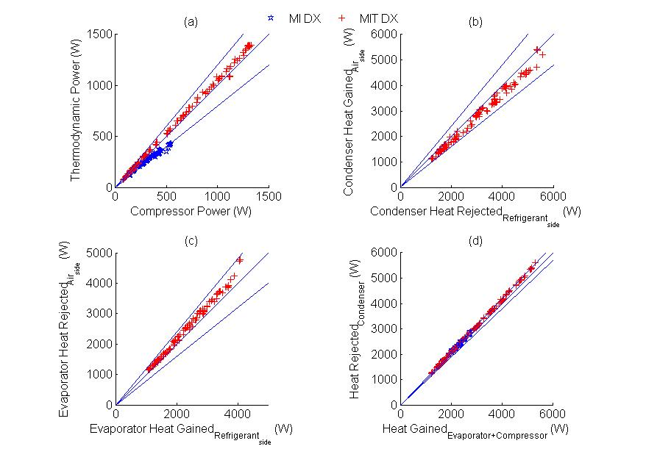
Motivation
Heat Pump Modeling
Experimental Setup
Experimental Validation
Conclusion
Future Work
Direct Expansion (DX) Mode Testing
Lines at ±20% are shown for (a), (b) and (c)
Lines at ±5% are shown for (d)

Slide 33
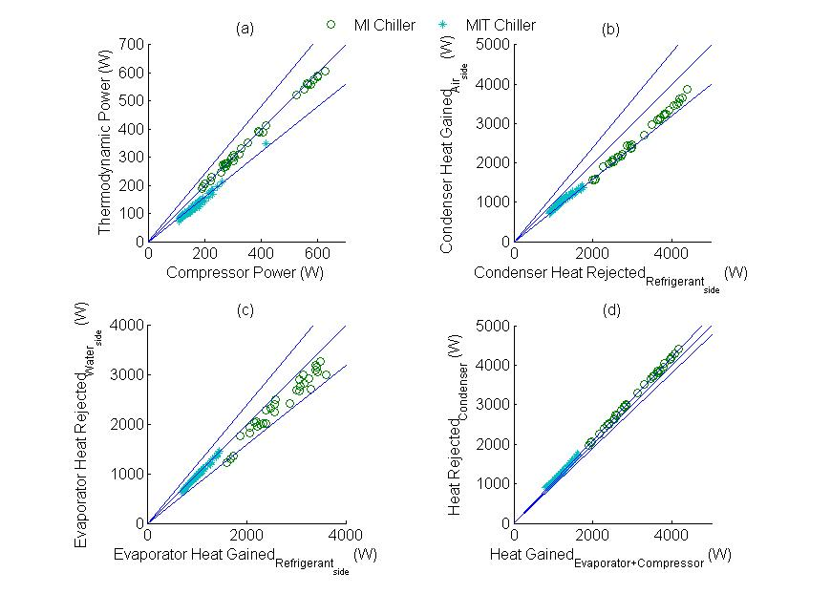
Motivation
Heat Pump Modeling
Experimental Setup
Experimental Validation
Conclusion
Future Work
Chiller Mode Testing
Lines at ±20% are shown for (a), (b) and (c)
Lines at ±5% are shown for (d)

Slide 34
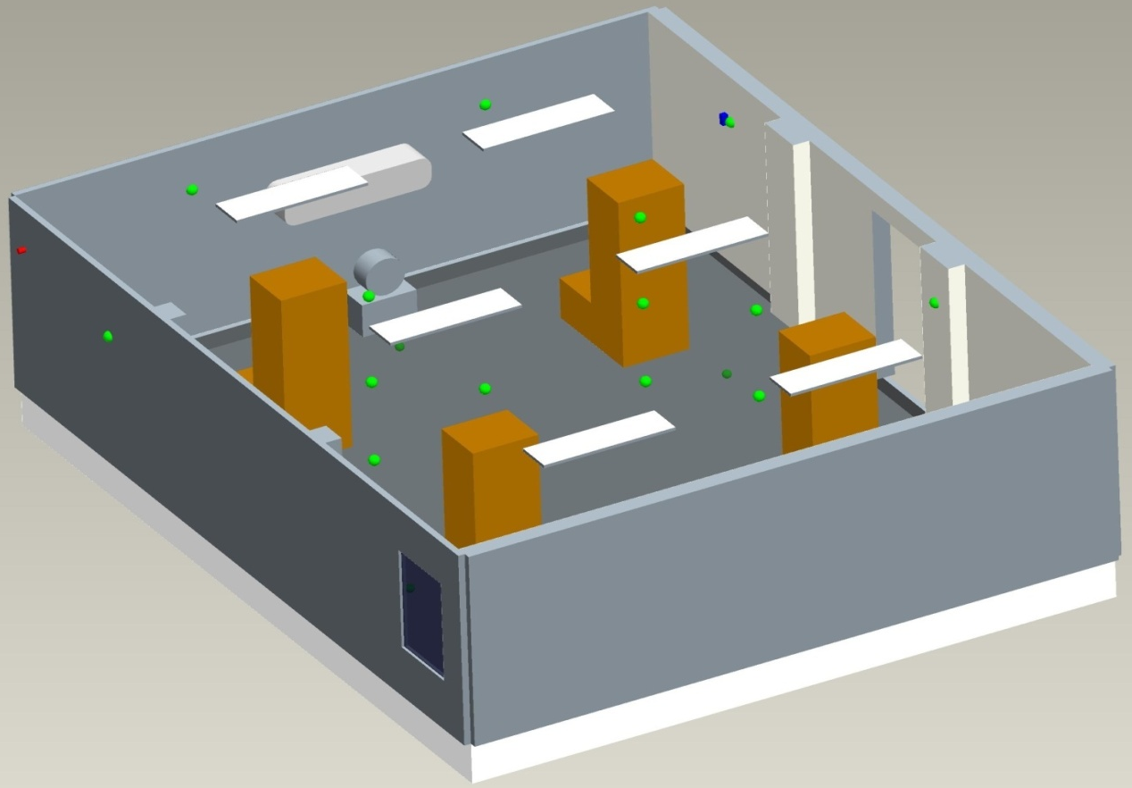
Thermal Loads Representing Electronic Equipment
W
N
Radiant Slab Test Chamber
Pyranometer
Humidity Sensor
Indoor Unit
S
Door
E
Tube Lights
Fan
Polystyrene Insulation
5875x7145x1900 mm room
670x960 mm window with blinds on south wall
250mm insulation beneath slab
50mm insulation around slab perimeter
4 boxes of 500x600x1650 mm for representing human sensible load of 60W each
4 boxes of 500x600x400 mm for representing equipment load of 100W each
6 Tube Light fixtures of 56W each
Thermal de-stratification fan of 60W
Fan-coil indoor unit
Counter flow PEX pipe configuration
150mm thick concrete slab embedded with 25mm PEX piping
100mm insulation on indoor side walls and ceiling
West and south walls are exposed to outdoors
Thermal Loads Representing Sensible Load of Humans
Thermocouples
Window

Slide 35
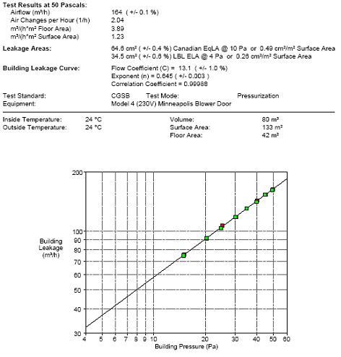
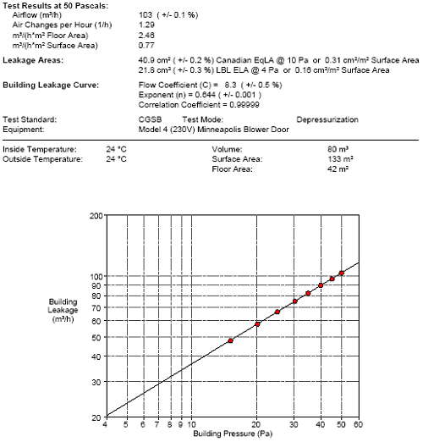
Motivation
Heat Pump Modeling
Experimental Setup
Experimental Validation
Conclusion
Future Work
Blower Door Testing of Test Chamber
Before Caulking
After Caulking

Slide 36
Motivation
Heat Pump Modeling
Experimental Setup
Experimental Validation
Conclusion
Future Work
Radiant Slab Test Chamber Instrumentation
20 thermocouples for measuring zone temperatures
2 on each wall
4 columns of 3 thermocouples supported by stands for thermal loads
20 thermocouples for measuring slab temperatures
4x3 grid at 50mm height from bottom of slab
2 columns of 5 thermocouples at 25mm distance
Humidity sensor
2 pyranometers on west and south walls
2 thermocouples on outside of west and south walls
Thermal Loads Representing Electronic Equipment
W
Humidity Sensor
N
Pyranometer
Indoor Unit
S
Door
E
Tube Lights
Fan
Polystyrene Insulation
Thermal Loads Representing Sensible Load of Humans
Thermocouples
Window

Slide 37
Experimental Validation

Slide 38
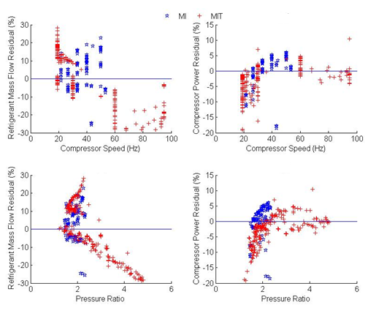
Motivation
Heat Pump Modeling
Experimental Validation
Conclusion
Future Work
Experimental Setup
Compressor Model
Coefficients, t-statistics and RMSE of mass flow and power model
 | Coefficients | t-statistics
C1 (Vswept m³) | 9.200E-06 | —
C2 (Vclearance fraction %) | 1.156E-01 | 1.941E+02
C3 (Back flow m³/kPa.s) | 1.524E-05 | 2.633E+06
C4 | -9.001E-02 | -2.726E+00
C5 | 1.054E+00 | 2.869E+01
C6 | -1.592E-01 | -1.774E+02
RMSPE % (RMSE (kg/s)) | 13.16 (1.745E-03)
RMSPE % (RMSE (kW)) | 5.24 (1.897E-02)

Slide 39
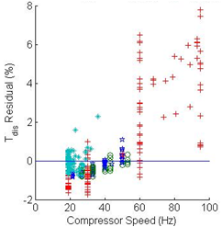
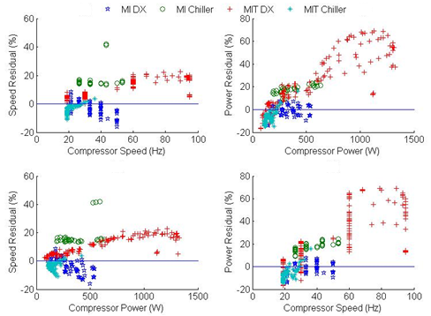
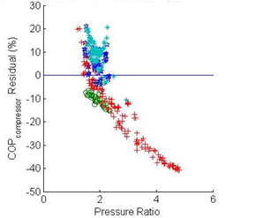

Motivation
Experimental Validation
Conclusion
Future Work
Experimental Setup
Heat Pump Modeling
Compressor Model

Slide 40
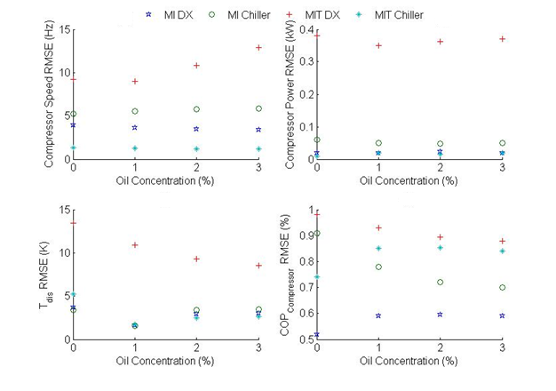
Motivation
Experimental Validation
Conclusion
Future Work
Experimental Setup
Heat Pump Modeling
Oil Concentration Effect on Compressor Models Parameters

Slide 41
Motivation
Experimental Validation
Conclusion
Future Work
Experimental Setup
Heat Pump Modeling
Compressor Model
Comparison of Output Parameters of Current Model and Model of (Zakula, 2010)
 | Current Model |  |  |  | Model of (Zakula, 2010)
Parameter | MI DX RMSPE (RMSE) | MI Chiller RMSPE (RMSE) | MIT DX RMSPE (RMSE) | MIT Chiller RMSPE (RMSE) | MI DX RMSPE (RMSE) | MI Chiller RMSPE (RMSE) | MIT DX RMSPE (RMSE) | MIT Chiller RMSPE (RMSE)
Compressor Speed % (Hz) | 8.565 (3.67) | 13.413 (5.53) | 12.286 (8.983) | 6.271 (1.23) | 14.016 (6.273) | 14.012 (5.808) | 20.601 (15.69) | 5.962 (1.173)
Compressor Power % (kW) | 6.626 (0.021) | 11.731 (0.054) | 34.627 (0.353) | 10.074 (0.016) | 15.181 (0.062) | 10.646 (0.047) | 24.803 (0.248) | 10.508 (0.016)
Tdischarge % (K) | 0.519 (1.682) | 0.476 (1.565) | 2.947 (10.897) | 0.51 (1.704) | 2.367 (7.716) | 0.908 (3.031) | 3.22 (12.038) | 1.48 (4.866)
COP Compressor % (kW/kW) | 7.379 (0.591) | 10.372 (0.777) | 23.176 (0.931) | 11.422 (0.845) | 20.815 (1.159) | 9.537 (0.734) | 18.469 (0.832) | 12.001 (0.87)
Zakula, T. (2010). Heat pump simulation model and optimal variable-speed control for a wide range of cooling conditions.

Slide 42
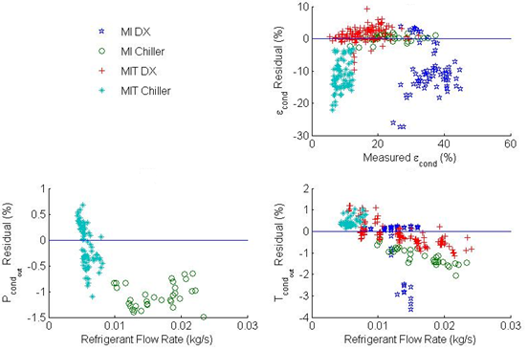

Motivation
Experimental Validation
Conclusion
Future Work
Experimental Setup
Heat Pump Modeling
Condenser Model

Slide 43
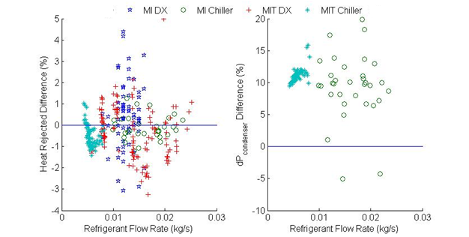
Motivation
Experimental Validation
Conclusion
Future Work
Experimental Setup
Heat Pump Modeling
Condenser Model
Effect of Oil Concentration on Model at 1% and 0%
Effect of Oil Concentration on Model at 1% and 0%

Slide 44
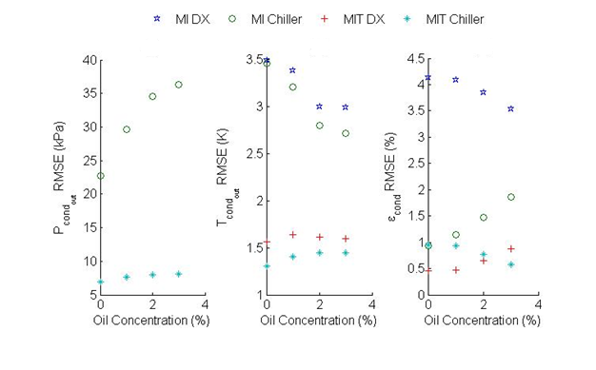
Motivation
Experimental Validation
Conclusion
Future Work
Experimental Setup
Heat Pump Modeling
Oil Concentration Effect on Condenser Models Parameters

Slide 45
Motivation
Experimental Validation
Conclusion
Future Work
Experimental Setup
Heat Pump Modeling
Condenser Model
Comparison of Output Parameters of Current Model and Model of (Zakula, 2010)
 | Current Model |  |  |  | Model of (Zakula, 2010)
Parameter | MI DX RMSPE (RMSE) | MI Chiller RMSPE (RMSE) | MIT DX RMSPE (RMSE) | MIT Chiller RMSPE (RMSE) | MI DX RMSPE (RMSE) | MI Chiller RMSPE (RMSE) | MIT DX RMSPE (RMSE) | MIT Chiller RMSPE (RMSE)
Pcondenser outlet % (kPa) | — | 1.934 (47.578) | — | 0.443 (8.319) | — | 2.376 (62.385) | — | 3.559 (65.842)
dPcondenser% (kPa) | — | 281.756 (51.557) | — | 54.309 (8.319) | — | 236.265 (72.91) | — | 422.866 (65.842)
Tcondenser outlet % (K) | 1.48 (4.588) | 0.773 (2.377) | 0.745 (2.256) | 0.366 (1.097) | 0.496 (1.545) | 0.183 (0.567) | 0.316 (0.974) | 0.306 (0.92)
dTcondenser % (K) | 27.615 (4.588) | 10.657 (2.377) | 8.422 (2.256) | 5.097 (1.097) | 10.514 (1.545) | 2.354 (0.567) | 2.122 (0.974) | 4.368 (0.92)
Condenser Effectiveness % (%) | 3.32 (1.016) | 2.025 (0.657) | 1.182 (0.289) | 6.969 (0.506) | 3.841 (1.54) | 3.033 (0.642) | 2.489 (0.396) | 0.714 (0.066)
Zakula, T. (2010). Heat pump simulation model and optimal variable-speed control for a wide range of cooling conditions.

Slide 46
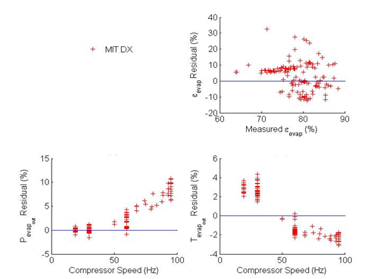

Motivation
Experimental Validation
Conclusion
Future Work
Experimental Setup
Heat Pump Modeling
Fan-Coil Evaporator Model

Slide 47
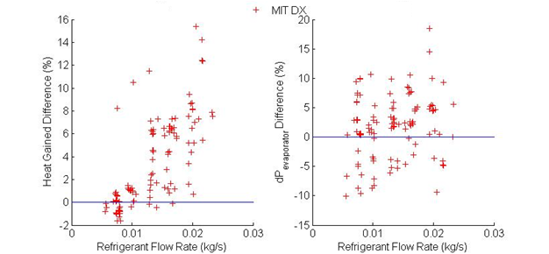
Motivation
Experimental Validation
Conclusion
Future Work
Experimental Setup
Heat Pump Modeling
Fan-Coil Evaporator Model
Effect of Oil Concentration on Model at 1% and 0%

Slide 48
Motivation
Experimental Validation
Conclusion
Future Work
Experimental Setup
Heat Pump Modeling
Fan-Coil Evaporator Model
Comparison of Output Parameters of Current Model and Model of (Zakula, 2010)
 | Current Model | Model of (Zakula, 2010)
Parameter | MIT DX RMSE (RMSPE) | MIT DX RMSE (RMSPE)
Pevaporator outlet % (kPa) | 3.865 (28.82) | 4.096 (36.402)
dPevaporator % (kPa) | 34.464 (28.922) | 99.44 (36.527)
Tevaporator outlet % (K) | 2.322 (6.618) | 0.464 (1.309)
dTevaporator % (K) | 852.593 (6.618) | 139.417 (1.309)
Evaporator Effectiveness % (%) | 6.53 (5.135) | 1.262 (1.007)
Zakula, T. (2010). Heat pump simulation model and optimal variable-speed control for a wide range of cooling conditions.

Slide 49
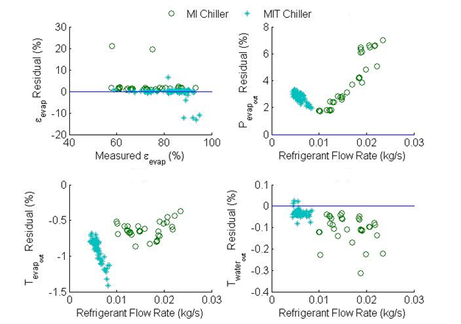

Motivation
Experimental Validation
Conclusion
Future Work
Experimental Setup
Heat Pump Modeling
Brazed-Plate Evaporator Model

Slide 50
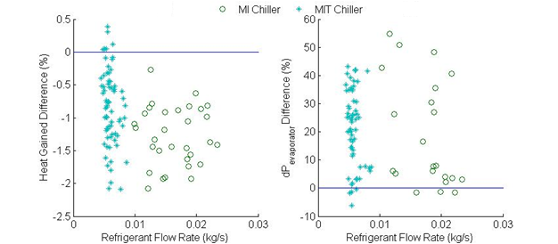
Motivation
Experimental Validation
Conclusion
Future Work
Experimental Setup
Heat Pump Modeling
Brazed-Plate Evaporator Model
Effect of Oil Concentration on Model at 1% and 0%

Slide 51
Motivation
Experimental Validation
Conclusion
Future Work
Experimental Setup
Heat Pump Modeling
Brazed-Plate Evaporator Model
Comparison of Output Parameters of Current Model and Model of (Zakula, 2010)
 | Current Model |  | Model of (Tea Zakula, 2011)
Parameter | MI Chiller RMSPE (RMSE) | MIT Chiller RMSPE (RMSE) | MI Chiller RMSPE (RMSE) | MIT Chiller RMSPE (RMSE)
Pevaporator outlet % (kPa) | 4.211 (55.087) | 2.828 (28.594) | 20.787 (249.967) | 3.248 (32.258)
dPevaporator % (kPa) | 91.995 (55.087) | 95.145 (28.594) | 357.61 (249.967) | 114.693 (32.258)
Tevaporator outlet % (K) | 0.784 (2.299) | 0.777 (2.208) | 0.334 (0.981) | 0.325 (0.925)
dTevaporator % (K) | 103.243 (2.299) | 80.245 (2.208) | 63.05 (0.981) | 36.003 (0.925)
Twater outlet % (K) | 0.336 (0.98) | 0.172 (0.484) | 0.247 (0.722) | 0.036 (0.103)
dTwater % (K) | 50.673 (0.98) | 26.665 (0.484) | 30.573 (0.722) | 6.204 (0.103)
Evaporator Effectiveness % (%) | 0.282 (0.211) | 0.129 (0.109) | 11.367 (5.536) | 3.082 (2.521)
Zakula, T. (2010). Heat pump simulation model and optimal variable-speed control for a wide range of cooling conditions.

Slide 52
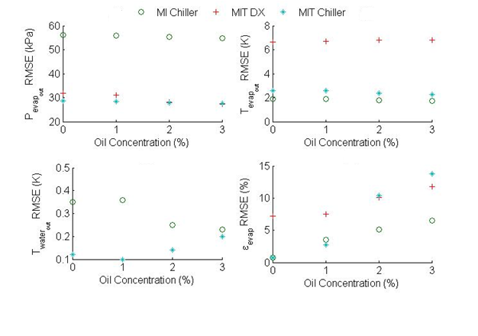
Motivation
Experimental Validation
Conclusion
Future Work
Experimental Setup
Heat Pump Modeling
Oil Concentration Effect on Evaporator Model Parameters

Slide 53
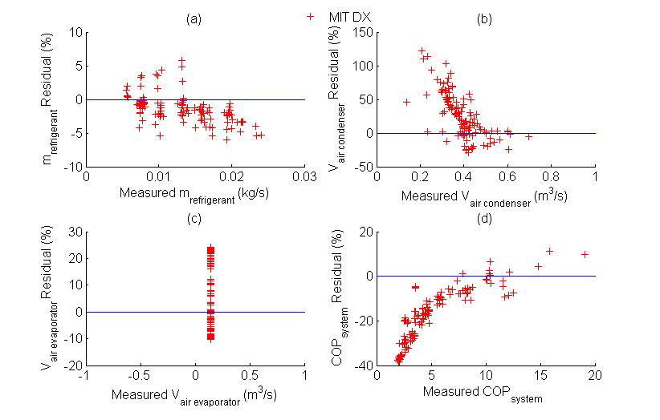
Motivation
Experimental Validation
Conclusion
Future Work
Experimental Setup
Heat Pump Modeling
System Model (DX Mode)

Slide 54
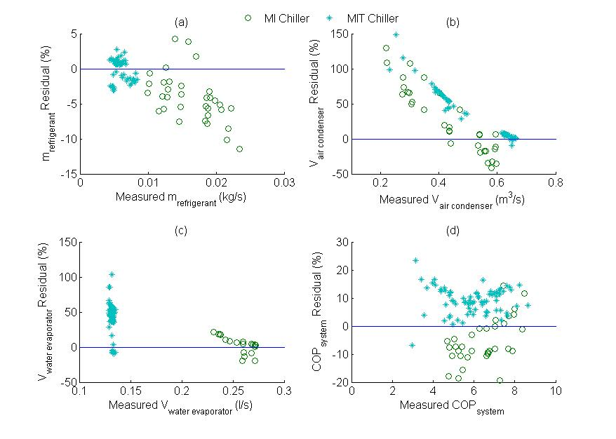
Motivation
Experimental Validation
Conclusion
Future Work
Experimental Setup
Heat Pump Modeling
System Model (Chiller Mode)

Slide 55
Motivation
Experimental Validation
Conclusion
Future Work
Experimental Setup
Heat Pump Modeling
System Model Results
Parameter | MIT DX RMSPE (RMSE) | MI Chiller RMSPE (RMSE) | MIT Chiller RMSPE (RMSE)
Compressor Speed % (Hz) | 9.891 (5.384) | 9.413 (3.808) | 8.703 (1.763)
Mdot % (kg/s) | 2.534 (0.0004) | 5.414 (0.001) | 1.452 (0.00008)
Compressor Power % (kW) | 30.223 (0.298) | 6.734 (0.027) | 12.562 (0.019)
Tdischarge % (K) | 2.413 (8.847) | 0.904 (2.98) | 2.513 (8.157)
Pcout % (kPa) | — | 1.062 (25.427) | 0.416 (7.979)
dPcond % (kPa) | — | 521.883 (25.391) | 50.087 (7.972)
Tcout % (K) | 0.879 (2.661) | 1.678 (5.195) | 0.472 (1.427)
dTcond % (K) | 9.672 (2.661) | 21.118 (5.201) | 6.324 (1.453)
econd % (%) | 4.905 (0.8) | 0.546 (0.1) | 7.791 (0.6)
Teout % (K) | 2.351 (6.677) | 0.376 (1.102) | 0.783 (2.226)
dTevap % (K) | 747.123 (6.677) | 47.09 (1.102) | 82.726 (2.226)
Twaterout % (K) | — | 0.142 (0.416) | 0.182 (0.512)
dTwater % (K) | — | 21.776 (0.43) | 27.938 (0.516)
eevap % (%) | 6.487 (5.2) | 14.821 (11.5) | 4.166 (3.6)
Vaircond % (m³/s) | 62.862 (0.153) | 58.812 (0.175) | 69.304 (0.218)
Vairevap % (m³/s) | 14.229 (0.021) | — | —
Vwaterevap % (l/s) | — | 10.564 (0.026) | 47.814 (0.063)
COP System % | 20.913 (0.721) | 9.235 (0.586) | 10.322 (0.606)

Slide 56
Motivation
Experimental Validation
Conclusion
Future Work
Experimental Setup
Heat Pump Modeling
Optimal Compressor and Condenser Fan Speed Equations
Curve fitting was done on the optimization results for compressor speed and condenser fan air flow rate presented in (Zakula, 2010)
Failure in successful implementation of MATLAB built-in optimization function
High computational time due to Refprop 8.0 and MATLAB interface
Adjustment of results to account for practical limitations in operation
Quadratic model was fitted based on Tambient, Tzone and Evaporator Load
Successive elimination of terms with low t-statistics

Slide 57
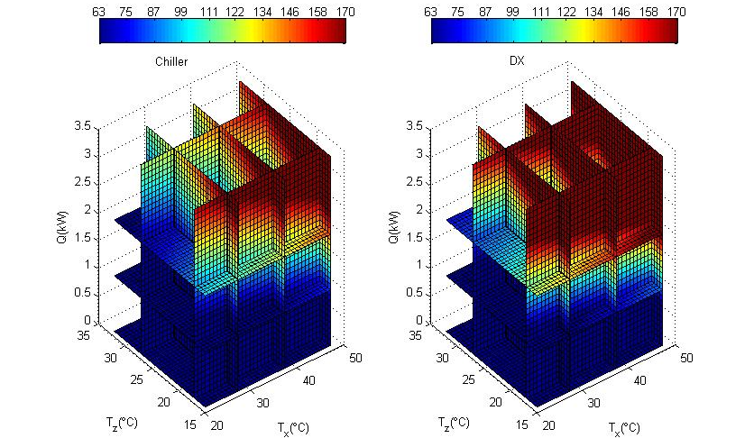
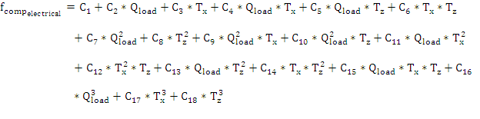
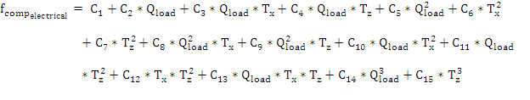
Optimal Operation Compressor Speeds in DX and Chiller Mode Based on Optimization Results of (Zakula, 2010)
Motivation
Experimental Validation
Conclusion
Future Work
Experimental Setup
Heat Pump Modeling

Slide 58
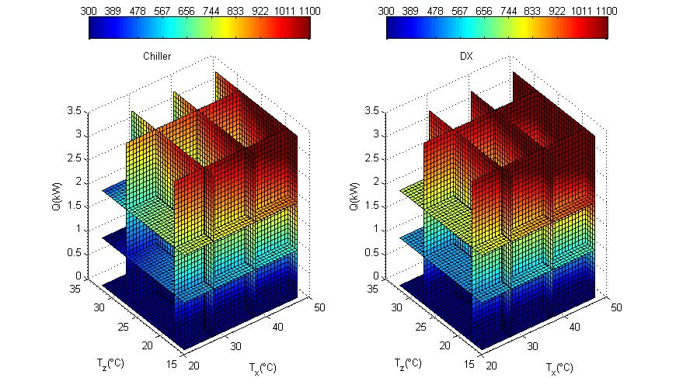
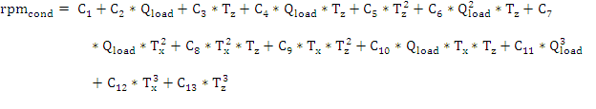
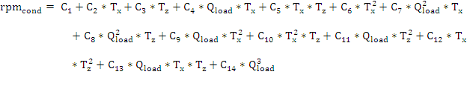
Optimal Operation Condenser Fan Speeds in DX and Chiller Mode Based on Optimization Results of (Zakula, 2010)
Motivation
Experimental Validation
Conclusion
Future Work
Experimental Setup
Heat Pump Modeling

Slide 59
Conclusion

Slide 60
Motivation
Future Work
Experimental Setup
Heat Pump Modeling
Conclusion
Experimental Validation
Conclusion
In the compressor model, it was found that for high compressor speeds heat transfer between suction and discharge becomes important
Refrigerant oil tends to increase heat transfer in the fan-coil condenser and brazed-plate evaporator
The pressure drop was found to increase in the heat exchangers with inclusion of oil
At low refrigerant flow rates, the heat transfer was found to decrease for fan-coil condenser

Slide 61
Motivation
Future Work
Experimental Setup
Heat Pump Modeling
Conclusion
Experimental Validation
Conclusion
The current models predict the experimental data with higher accuracy in case of pressure drop while similar accuracy was estimated for heat transfer in the case of brazed-plate evaporator.
Incorrect oil concentration affects heat transfer estimation significantly at high refrigerant mass flow rates
Two-phase correlations of Hseih and Lin are recommended for modeling two-phase heat transfer and pressure drop in brazed-plate HX.
It was also found that solving for air mass flow rates for satisfying the HX energy balance in the system model results in high inaccuracies at low air mass flow rates despite small error in refrigerant mass flow rates.
It was found that during chiller mode both compressor and condenser speeds are lower than DX mode speeds for delivering the same cooling load for a given outdoor and indoor temperature

Slide 62
Motivation
Future Work
Experimental Setup
Heat Pump Modeling
Conclusion
Experimental Validation
Achievements
A test stand was built from a conventional air conditioning split unit to operate in either chiller mode or DX mode
A test chamber was also prepared for testing of radiant-cooling with pre-cooling control as part of the project
Speed controls were implemented on the compressor and condenser fan to assess the savings in low-lift operation of the heat pump
Superheat control was implemented on the expansion valve to maintain any desired superheat down to 0.5K
Equations for optimal compressor and condenser speeds were developed to be implemented in radiant-cooling operation with pre-cooling control
Development of heat pump model with minimum parameter estimation
Assessment of oil effect on vapor compression components

Slide 63
Motivation
Conclusion
Future Work
Experimental Setup
Heat Pump Modeling
Experimental Validation
Future Work
Development of model for Oil concentration as a function of speed
MATLAB code equations for refrigerant properties
Operation of compressor at higher speeds in the test stand
Testing of pressure transducers on the dead weight tester for assessment of drift and repeatability
Implementation of speed control on evaporator
Implementation of radiant-cooling pre-cooling control in the test chamber using the speed equations presented
Modification of compressor mass flow model to account for leakage at high pressure ratios

Slide 64
Acknowledgement

Slide 65
Thank You for Your Patience

Slide 66





Compressor Model

Slide 67
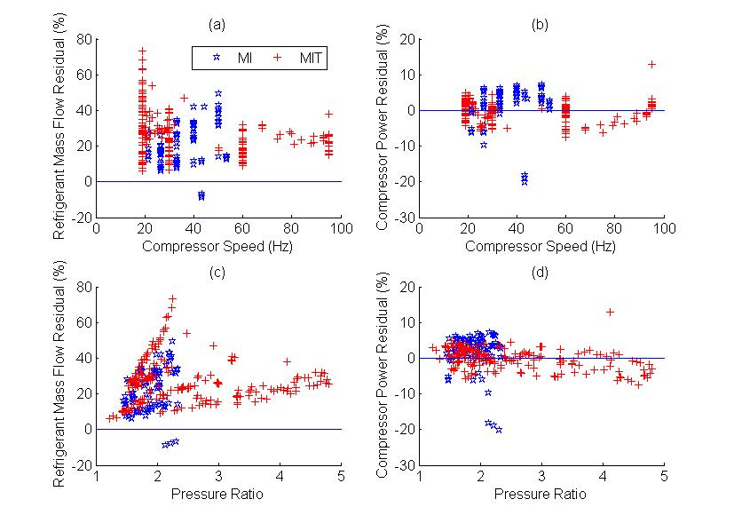
Compressor Model
Coefficients, t-statistics and RMSE of mass flow and power model
 | Coefficients | t-statistics
c1 | 9.200E-06 | —
c2 | 3.888E-12 | 3.726E-08
c3 | 2.803E-14 | 1.609E-06
c4 | 2.501E-04 | 1.300E+05
c5 | 2.222E-14 | 1.455E-03
c6 | 1.409E-03 | 1.180E+05
RMSPE % (RMSE (kg/s)) | 2.935E-03 (27.78)
RMSPE % (RMSE (kW)) | 2.215E-02 (3.888E+00)

Slide 68
Motivation
Heat Pump Modeling
Experimental Validation
Conclusion
Future Work
Experimental Setup
Compressor Model
Coefficients, t-statistics and RMSE of mass flow and power model
 | Coefficients | t-statistics
C1 (Vswept m³) | 9.200E-06 | —
C2 (Vclearance fraction %) | 1.156E-01 | 1.941E+02
C3 (Back flow m³/kPa.s) | 1.524E-05 | 2.633E+06
C4 | -9.001E-02 | -2.726E+00
C5 | 1.054E+00 | 2.869E+01
C6 | -1.592E-01 | -1.774E+02
RMSPE % (RMSE (kg/s)) | 13.16 (1.745E-03)
RMSPE % (RMSE (kW)) | 5.24 (1.897E-02)

