Slide 1
Assessing quality: Learner analytics, or human intuition?
Bror Saxberg
CLO, Kaplan, Inc.
Unless otherwise specified, this work is licensed under a Creative Commons Attribution 3.0 United States License.
Cite as: Saxberg, B. (2012, January). Assessing quality: Learner analytics, or human intuition?. Presentation at Conversations on quality: a symposium on k-12 online learning, Cambridge, MA.
Notes:
Cite as: Saxberg, B. (2012, January). Assessing quality: Learner analytics, or human intuition?. Presentation at Conversations on quality: a symposium on k-12 online learning, Cambridge, MA.
Unless otherwise specified, this work is licensed under a Creative Commons Attribution 3.0 United States License.

Slide 2
Topics
Thought starter questions
Assessing quality
Quality solutions for education
Evidence possibilities

Slide 3
Topics
Thought starter questions
Assessing quality
Quality solutions for education
Evidence possibilities

Slide 4
Assessment of quality
In education, data is often confused with a problem
Other fields think about quality and data – medicine:
What’s empirically known, science, plays a key role
Still complex – outcome measures not easily settled
Art remains – patient interactions, communications

Slide 5
Quality problem solving – other domains
Engineering as model
Clinicians – engineers of biological science
Engineers – draw on various sciences
Learning engineers – draw on learning science
Who are our “learning engineers”?

Slide 6
Quality of an engineering solution?
Often refines the original problem – provides and uses clarity
Guided/constrained by empirical science about the natural world
Fits within constraints – optimizes against some
Often reuses other quality components
Easy to use/implement
Efficiently scalable
Works as designed
Fails gracefully

Slide 7
Topics
Thought starter questions
Assessing quality
Quality solutions for education
Evidence possibilities

Slide 8
Refine the problem– what success matters?
Serious “deliberate practice” during learning
Specific objective mastery
Success in the next courses that need “this”
Retention in systematic learning
Employment – and employer satisfaction
Dana Gioia: “Productive citizen for a free society”

Slide 9
Refine the problem
Instructional Events
(in the learning environment)
Learning Events
(hidden - inside students’ minds)
Student
Performance (observable -indicates knowledge)

Slide 10
Refine the problem
Instructional Events
(in the learning environment)
Learning Events
(hidden - inside students’ minds)
Student
Performance (observable -indicates knowledge)
Knowledge
Motivation
Metacognition

Slide 11
Refine the problem– add science
Instructional Events
(in the learning environment)
Learning Events
(hidden - inside students’ minds)
Student
Performance (observable -indicates knowledge)
Knowledge | Explicit: Information, Explanation, Examples, Demos Implicit: Practice tasks/activities (prompts and response) Diagnosis and feedback | Explicit/Declarative/Conceptual/What Implicit/Procedural/How Knowledge Components (Procedures + Facts, Concepts, Principles, Processes) | Response accuracy/errors Response fluency/speed Number of trials Amount of assistance (hints) Reasoning
Motivation | Orientation/Inoculation Monitoring Diagnosis and treatment: Persuasion, Modeling, Dissonance | Value beliefs Self-efficacy beliefs Attribution beliefs Mood/Emotion | Behavior related to Starting Persisting Mental Effort Self-reported beliefs
Metacognition | Structure Guidance | Planning, Monitoring Selecting, Connecting | Amount of guidance required/requested
See: Koedinger, K.R., Corbett, A.T., and Perfetti, C. (2010). The Knowledge-Learning-Instruction (KLI) Framework: Toward Bridging the Science-Practice Chasm to Enhance Robust Student Learning

Slide 12
Clarify (and use) actual constraints
Topic constraints – what comes before what?
Physical environment – multiple locations?
Time available – multiple blocks?
Media available – multiple types/devices?
Learner skills to draw on
People resources to draw on – multiple?
Costs – capital vs. variable tradeoff?
Real world: What happens when you TRY it?

Slide 13
Topics
Thought starter questions
Assessing quality
Quality solutions for education
Evidence possibilities

Slide 14
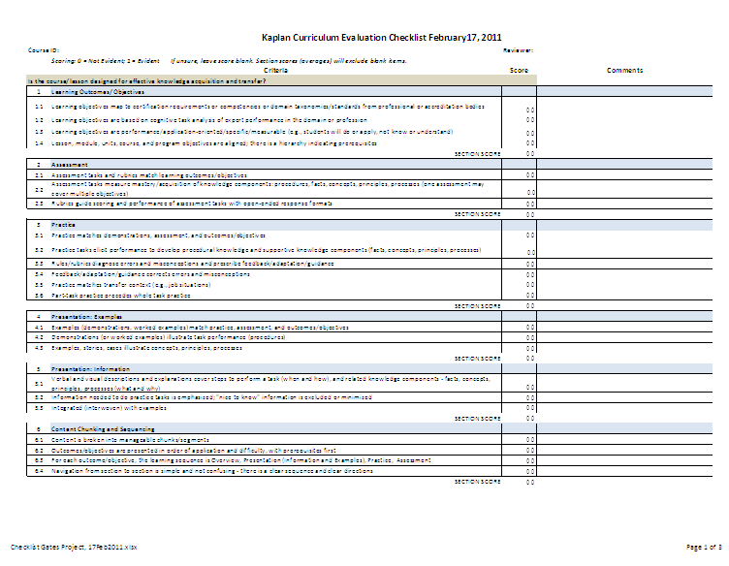
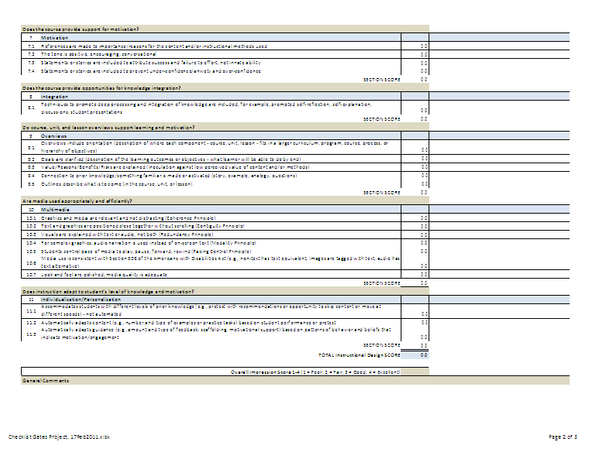
Checklists
Our “Kaplan Way” checklist
Categories on the checklist
Is the course/lesson designed for effective knowledge acquisition and transfer?
Learning outcomes/objectives
Assessments
Practice
Presentation: Examples
Presentation: Information
Content chunking and sequencing
Does the course provide support for motivation?
Does the course provide opportunities for knowledge integration?
Are media used appropriately and efficiently?
Does instruction adapt to student's level of knowledge and motivation?

Slide 15
Monitor actual vs. designed delivery
Usability testing
Systematic behavioral observation
Video/audio with behavioral coding
Engagement data – timeliness, effort, pattern of use
[Highly structured learner surveys]
Learner “liking” surveys
High level, more general observation rubrics
Teacher surveys
Teacher journals
Teacher self-reports

Slide 16
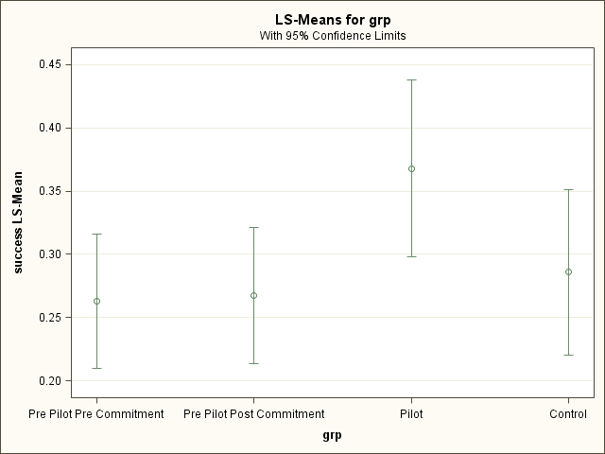
Learning evidence
“Success” = CLA Average >=4 AND passed course AND retained to next term
Controlling for differences in course, students, instructors and seasonality
Statistical Significance
Least Squares Means for effect grp
Pr > |t| for H0: LSMean(i)=LSMean(j)
Dependent Variable: success
i/j | 1 | 2 | 3 | 4
1 |  | 0.8912 | <.0001 | 0.6515
2 | 0.8912 |  | 0.0002 | 0.8104
3 | <.0001 | 0.0002 |  | 0.0256
4 | 0.6515 | 0.8104 | 0.0256
1
2
3
4

Slide 17
Longer term success evaluation
Future course pass rates
Retention improvement
Employment – and employer satisfaction
“Productive citizen of a free society”
Voting?
Justice system?
Civic engagement?

Slide 18
Quality of entire learning process:
Is the process leading to faster achievement of goals that matter to learners’ success?

Slide 19
Appendix: Initial learning engineering readings
Why Students Don’t Like School, Daniel Willingham – highly readable! ;-)
Talent is Overrated, Geoffrey Colvin – highly readable! ;-)
E-Learning and the Science of Instruction, Clark and Mayer, 2nd ed.
“First Principles of Learning,” Merrill, D., in Reigeluth, C. M. & Carr, A. (Eds.), Instructional Design Theories and Models III, 2009.
How People Learn, John Bransford et al, eds.
“The Implications of Research on Expertise for Curriculum and Pedagogy”, David Feldon, Education Psychology Review (2007) 19:91–110
“Cognitive Task Analysis,” Clark, R.E., Feldon, D., van Merrienboer, J., Yates, K., and Early, S.. in Spector, J.M., Merrill, M.D., van Merrienboer, J. J. G., & Driscoll, M. P. (Eds.), Handbook of research on educational communciations and technology (3rd ed., 2007) Lawrence Erlbaum Associates

