Slide 1
Scaling Up in Education
Chris Dede, Harvard University
Unless otherwise specified, this work is licensed under a Creative Commons Attribution 3.0 United States License.
Cite as: Dede, C. (2012, January). Scaling up in education. Presentation at Conversations on quality: a symposium on k-12 online learning, Cambridge, MA.
Notes:
Cite as: Dede, C. (2012, January). Scaling up in education. Presentation at Conversations on quality: a symposium on k-12 online learning, Cambridge, MA.
Unless otherwise specified, this work is licensed under a Creative Commons Attribution 3.0 United States License.

Slide 2
Scaling Up in Education
Adapting an innovation successful in some
local setting to effective usage in a wide range of contexts
  Fast food as example
  Need not be one-size-fits-all; can be personalized, as with apps
In contrast to experiences in other sectors of society, scaling up successful programs has proved very difficult
in education
The more complex the innovation and the greater the influence of setting, the more likely a new practice is to fail crossing the “chasm” from its original setting to other sites
  Avoiding the “replica trap”: the erroneous strategy of trying to repeat everywhere what worked locally, without considering challenges of size and contextual variations in needs/resources
    Problems of magnitude
    Problems of variation—not adoption, but adaptation

Slide 3
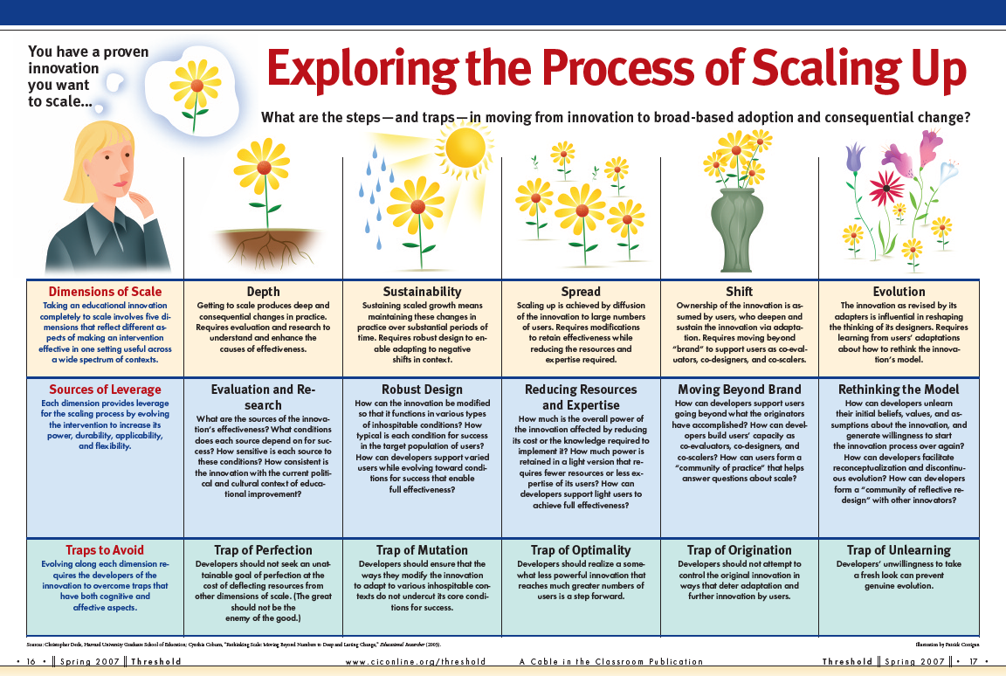

Slide 4
Depth Steps Towards Scale
What are the sources of
the innovation’s effectiveness?
  On what conditions for success
  does each source depend?
  How sensitive is each source to attenuation or
  absence of a particular condition for success?
  How consistent is the innovation with the current political and cultural context
  of educational improvement?

Slide 5
Sustainability Steps Towards Scale
How can I modify the innovation (robust-design) so that it functions in various types
of inhospitable conditions?
  How typical is each condition for success in my target population of users?
  How can I support “robust-design” users
  in evolving towards conditions for success
  that enable full effectiveness?

Slide 6
Spread Steps Towards Scale
How can I modify the innovation to retain effectiveness while reducing resources and expertise required?
How much is the overall power of the innovation affected by reducing its cost or the knowledge required to implement?
  How much power is retained in a “light” version of the innovation that requires fewer resources or less expertise of its users?
  How can I support “light” users to evolve towards sufficient resources and expertise
  to achieve full effectiveness?

Slide 7
Shift Steps Towards Scale
How can I move beyond “brand” to support users as co-evaluators, co-designers, and co-scalers?
How can I support users going beyond
what the originators have accomplished?
  How can I build users’ capacity
  as co-evaluators? As co-designers?
  As co-scalers?
  How can users form a “community of practice” that helps answer questions about scale?

Slide 8
Evolution Steps Towards Scale
How can I unlearn my beliefs, values,
and assumptions about the innovation?
  How willing am I to start the innovation process over again?
  How can I “make the familiar strange” to facilitate reconceptualization and discontinuous evolution?
  How can I form a “community of reflective redesign” with other innovators?

Slide 9
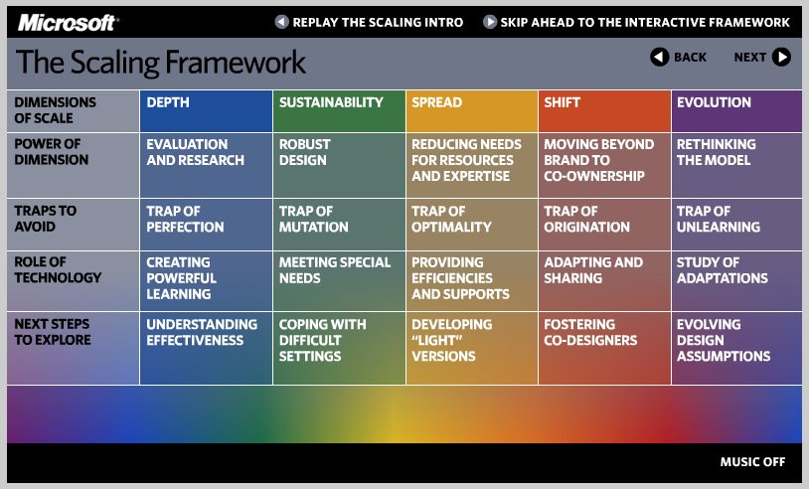
http://www.microsoft.com/education/demos/scale/index.html

Slide 10
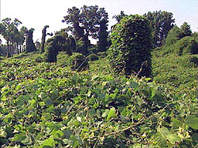
Organic Scaling “like a weed”
Notes:
Other meaning of title: Teachers and students defenestrated
Science lesson for today
Kudzu, the miracle vine, arguably the most successful weed, 1 foot per day under ideal conditions, grows under almost any condns, resists herbicides
Webpages, blogs, and streaming video as info kudzu; cellphones with voice, text, and images communic kudzu, games as entertainment kudzu
Need “kudzu for the mind”
Laugh in face of BBW

