Slide 1
Intelligent tutoring systems (ITS) for online learning
Kurt VanLehn
Computing, Informatics and Decision Science Engineering
Arizona State University
Unless otherwise specified, this work is licensed under a Creative Commons Attribution 3.0 United States License.
Cite as: VanLehn, K. (2012, January). Intelligent tutoring systems (its) for online learning. Presentation at Conversations on quality: a symposium on k-12 online learning, Cambridge, MA.
Notes:
Cite as: VanLehn, K. (2012, January). Intelligent tutoring systems (its) for online learning. Presentation at Conversations on quality: a symposium on k-12 online learning, Cambridge, MA.
Unless otherwise specified, this work is licensed under a Creative Commons Attribution 3.0 United States License.

Slide 2
Outline
Adding an ITS to an online course
Will ITS improve the quality?
  Increasing interaction and complexity of exercises
  The Zone of Proximal Development
Limitations

Slide 3
A typical online course consists of:
Discussion forum
A sequence of modules, each
comprised of a sequence of
  Passive media (text, powerpoint)
  Exercises
  Quiz
Final project
Final exam

Slide 4
Adding an ITS makes these changes:
Discussion forum
A sequence of modules, each
comprised of a sequence of
  Passive media (text, powerpoint)
  Exercises
  Quiz
Final project
Final exam
dynamically adaptive
complex, dynamically scaffolded
unnecessary

Slide 5
How does an ITS work?
It chooses the next activity/task for the student to do based on a model of the student’s current competence, affect and interest.
It conducts stealth assessment
  Shute, V. J. (2011). Stealth assessment in computer-based games to support learning. In S. Tobias & J. D. Fletcher (Eds.), Computer games and instruction (pp. 503-524). Charlotte, NC: Information Age Publishers
If the task is a complex, multi-step activity
  It understands each step the student makes
  It can provide hints & feedback on every step
  Students often control hints & feedback

Slide 6
What is the structure of an ITS?
Tool (e.g., editor) emits student steps
Hint & feedback generator
Comparison
Expected steps
(correct + misconceived)
Student competences, affect, etc
Next task selector

Slide 7
ITS require expected steps
Task must be solvable in advance (by experts)
e.g., For an essay on “Why is the sky blue?”
  ITS insures essay mentions that shorter wavelengths of light are absorbed and re-emitted
  ITS insures essay has good organization, mechanics
e.g., For an essay on “Why are the blues popular?”
  ITS could help only with mechanics
  Because nobody can anticipate argument’s steps
  Unless.... wisdom of crowds

Slide 8
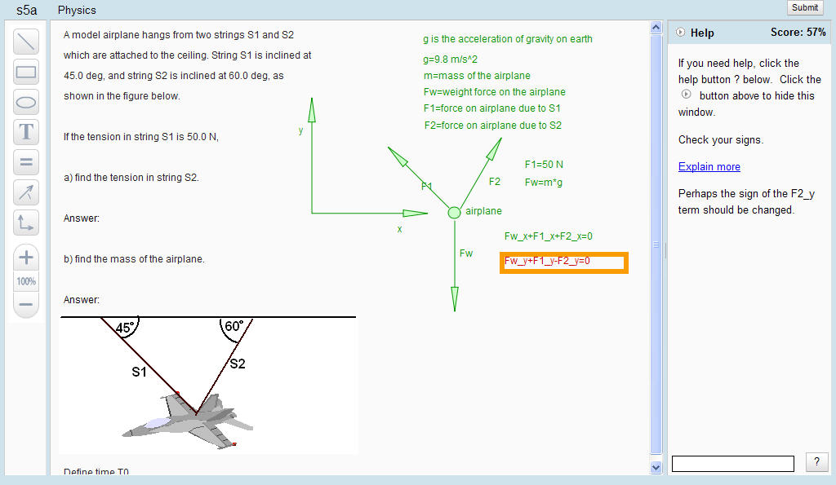
Andes3 is like power-point, but gives
correct (green) vs. incorrect (red) feedback
help messages
Click here for “what’s wrong” and “next step help”
VanLehn, K., Lynch, C., Schultz, K., Shapiro, J. A., Shelby, R. H., Taylor, L., et al. (2005). The Andes physics tutoring system: Lessons learned. International Journal of Artificial Intelligence and Education, 15(3), 147-204.

Slide 9
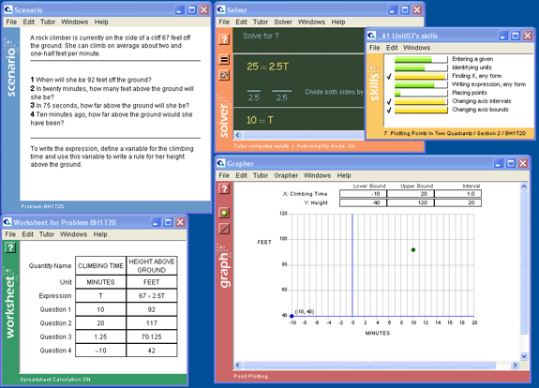
Cognitive Algebra I Tutor has multiple tools www.carnegielearning.com
Problem
Step: Divide both sides
Step: Label a column
Step: Fill in a cell
Step: Plot a point
Step: Define an axis

Slide 10
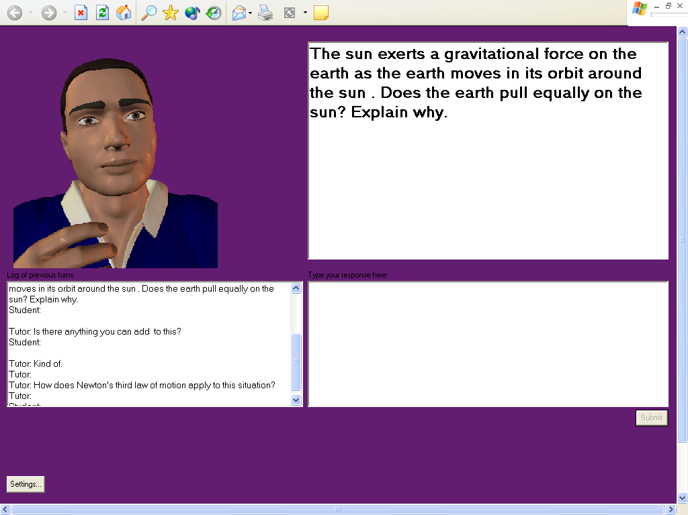
ITS can tutor steps in an argument/essay
Graesser, A. C., Lu, S., Jackson, G. T., Mitchell, H. H., Ventura, M., Olney, A., et al. (2004). AutoTutor: A tutor with dialogue in natural language. Behavioral Research Methods, Instruments and Computers, 36(180-193).
Task
Tutor
No, the sun is much more massive than the earth, so it pulls harder. That is why the earth orbits the sun and not vice versa.
Tutor-student dialogue
Student’s essay

Slide 11
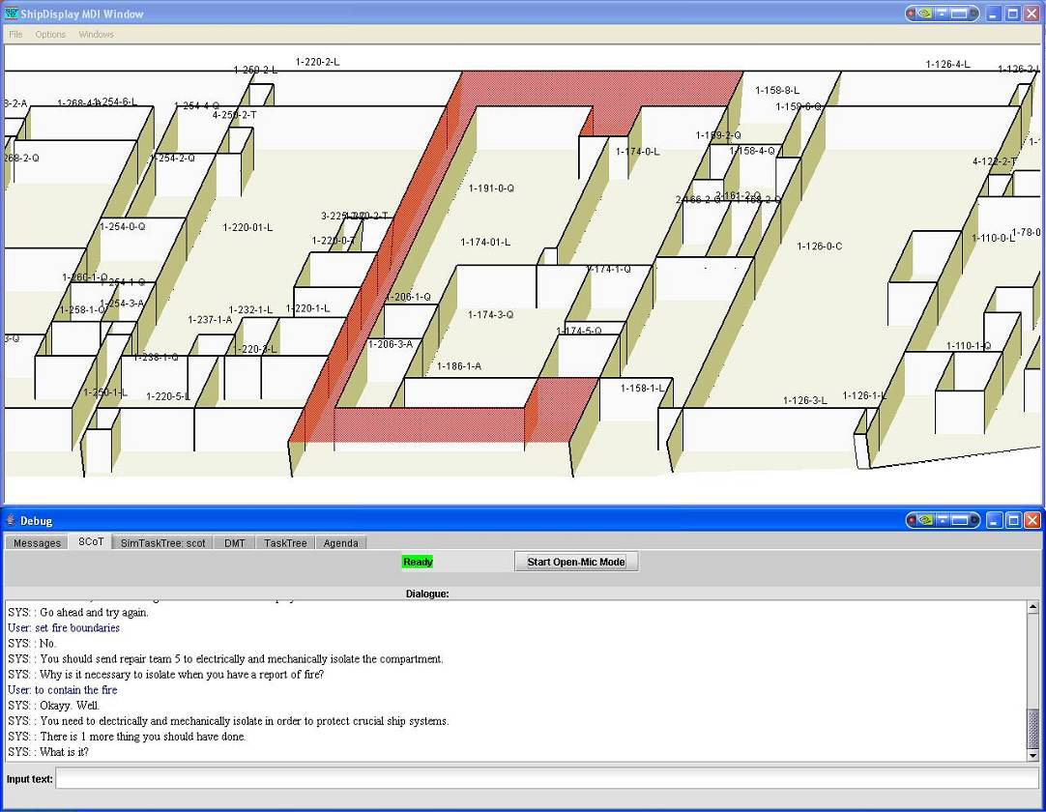
A simulation-based ITS where all feedback is delayed until done fighting fire
Step: Isolate a compartment
Pon-Barry, H., Schultz, K., Bratt, E. O., Clark, B., & Peters, S. (2006). Responding to student uncertainty in spoken tutorial dialogue systems. International Journal of Artificial Intelligence and Education, 16, 171-194.
Debriefing replays steps and discusses

Slide 12
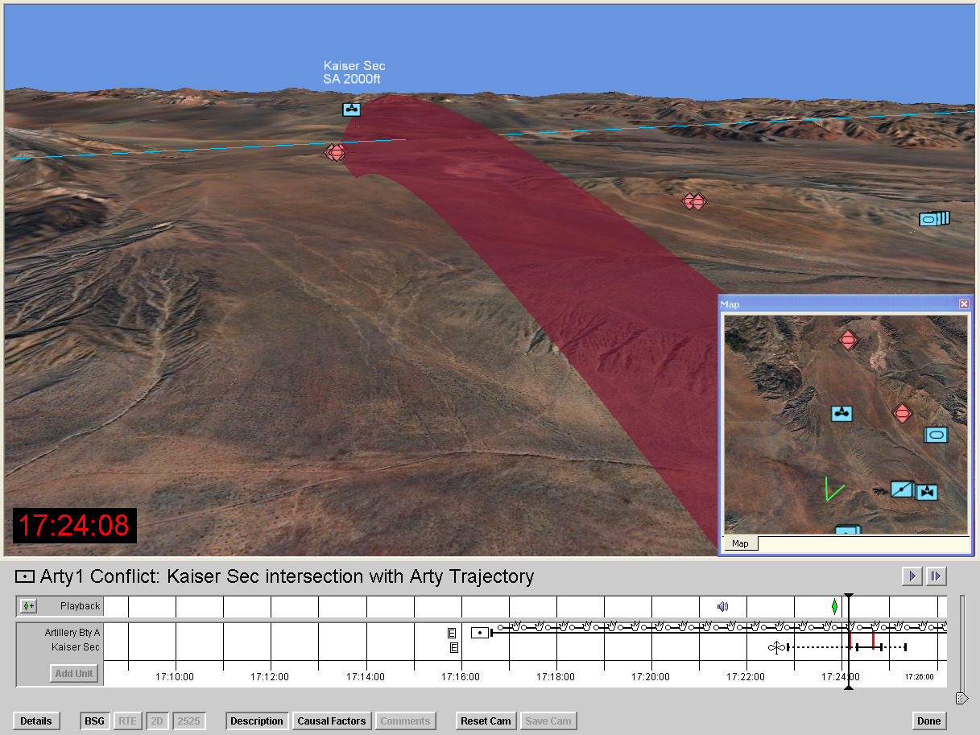
After-action reviews often use a timeline www.stotler-henke.com
ITS marks learning opportunities with red

Slide 13
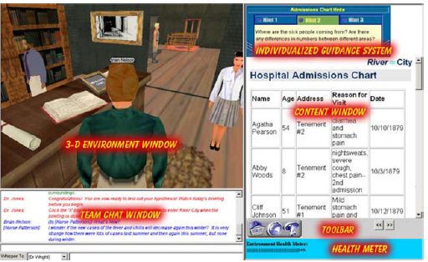
ITS can be an non-player character
Nelson, B. C. (2007). Exploring the use of individualized, reflective guidance in an educational multi-user virtual environment. Journal of Science Education and Technology, 16(1), 83-97.
ITS
ITS

Slide 14
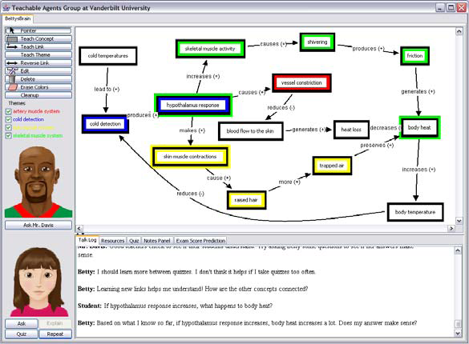
Learning companion(s) can accompany ITS
Schwartz, D. L., Blair, K. P., Biswas, G., Leelawong, K., & Davis, J. (in press). Animations of thought: Interactivity in the teachable agent paradigm. In R. Lowe & W. Schnotz (Eds.), Learning with animations: Research and implications for design. Cambridge, UK: Cambridge University Press.
Concept map editor
ITS
Betty, a teachable agent

Slide 15
What is the structure of an ITS?
Tool (e.g., editor) emits student steps
Hint & feedback generator
Comparison
Expected steps
(correct + misconceived)
Student competences, affect, etc
Next task selector

Slide 16
Adding an ITS makes these changes:
Discussion forum
A sequence of modules, each
comprised of a sequence of
  Passive media (text, powerpoint)
  Exercises
  Quiz
Final project
Final exam
dynamically adaptive
complex, dynamically scaffolded
unnecessary

Slide 17
Outline
Adding an ITS to an online course
Will ITS improve the quality?
  Increasing interaction and complexity of exercises
  The Zone of Proximal Development
Limitations
Next

Slide 18
Micki Chi’s ICAP framework
Chi, M. T. H. (2009). Active-Constructive-Interactive: A conceptual framework for differentiating learning activities. Topics in Cognitive Science, 1, 73-105.
Student engagement activity | e.g., history | e.g., algebra equations | Effectiveness
Passive | Reading the text | Reading an example | Worst
Active | Highlighting the text | Copying an example | OK
Constructive | Answering questions | Solving a problem | Better
Interactive | Discussing questions with a peer or tutor | Solving a problem with a peer or tutor | Best
I > C > A > P

Slide 19
Do computer tutors interact frequently enough?
No tutoring (baseline for comparisons)
Answer-based tutoring
  Hints and feedback on short-answer questions
Step-based tutoring
  Hints and feedback on steps normally taken when using tool
Substep-based tutoring
  Tutor can discuss reasoning behind steps
Human tutoring
CAI
ITS

Slide 20
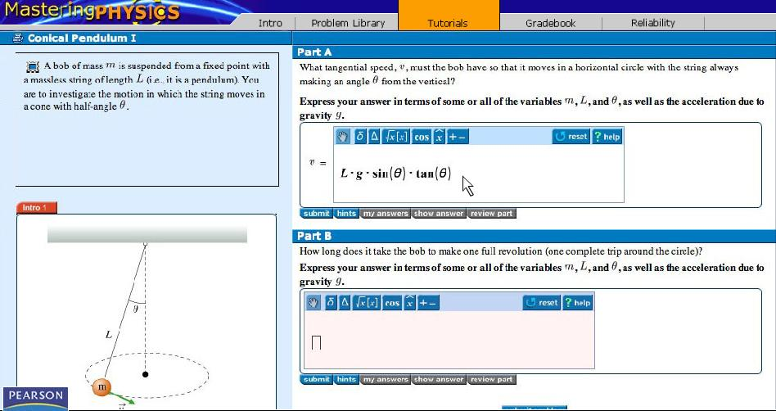
Answer-based tutoring (CAI) www.mastering.com
Solve on paper, enter ANSWER
& get feedback
Hints

Slide 21
Step-based tutoring

Slide 22
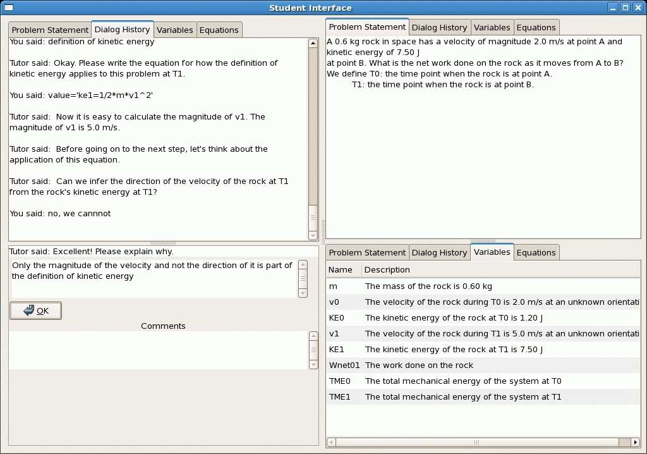
Substep-based tutoring
VanLehn, K., Jordan, P., & Litman, D. (2007). Developing pedagogically effective tutorial dialogue tactics: Experiments and a testbed. Paper presented at the SLaTE Workshop on Speech and Language Technology in Education, Farmington, PA.
Student enters an equation (step)
Tutor asks about reasoning behind the step

Slide 23
A common belief: The more frequent the interaction, the more effective the tutoring
Effectiveness
Increasing frequency of interaction

Slide 24
All possible pairwise comparisons
VanLehn, K. (2011). The relative effectiveness of human tutoring, intelligent tutoring systems and other tutoring systems. Educational Psychologist, 46(4), 197-221.
Tutoring type | vs. other tutoring type | Num. of effects | Mean effect | % reliable
Answer-based | no tutoring | 165 | 0.31 | 40%
Step-based |  | 28 | 0.76 | 68%
Substep-based |  | 26 | 0.40 | 54%
Human |  | 10 | 0.79 | 80%
Step-based | answer-based | 2 | 0.40 | 50%
Substep-based |  | 6 | 0.32 | 33%
Human |  | 1 | -0.04 | 0%
Substep-based | step-based | 11 | 0.16 | 0%
Human |  | 10 | 0.21 | 30%
Human | sub-step based | 5 | -0.12 | 0%

Slide 25
Graphing all 10 comparisons:
But the graph is hard to understand...
Effectiveness
Increasing frequency of interaction

Slide 26
Graphing all 10 comparisons:
Lines raised to make it easier to integrate evidence
Effectiveness
Increasing frequency of interaction

Slide 27
The Interaction Plateau Hypothesis: human = substep = step > answer > none
Effectiveness
Increasing frequency of interaction

Slide 28
Outline
Adding an ITS to an online course
Will ITS improve the quality?
  Increasing interaction and complexity of exercises
  The Zone of Proximal Development
Limitations
Next

Slide 29
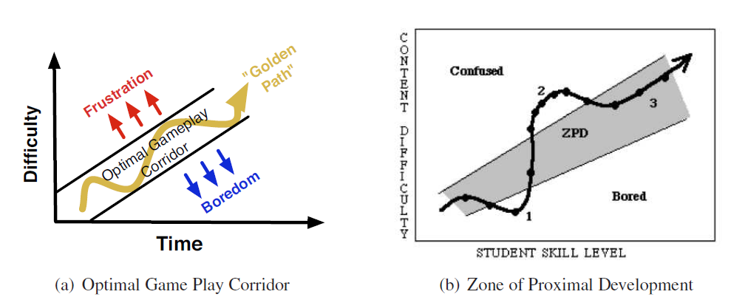
The Zone of Proximal Development (ZPD)

Slide 30
How can we keep students in their ZPDs?
“Mastery (-paced) learning” means continuing to work on a module until you have mastered it.
  Bloom, B. S. (1984). The 2 sigma problem: The search for methods of group instruction as effective as one-to-one tutoring. Educational Researcher, 13, 4-16.
With an ITS, traditional mastery tests are replaced by the stealth assessment

Slide 31
Mastery-paced learning implemented by the red path below
Tool (e.g., editor) emits student steps
Hint & feedback generator
Comparison
Expected steps
(correct + misconceived)
Student competences, affect, etc
Next task selector

Slide 32
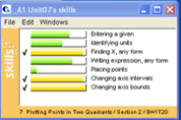
Assessment can be shown to student

Slide 33
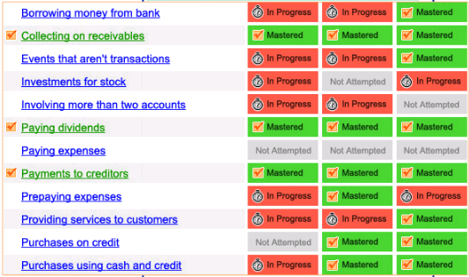
Students may be allowed to work at own pace
Jim
Sue
Juan

Slide 34
Outline
Adding an ITS to an online course
Will ITS improve the quality?
  Increasing interaction and complexity of exercises
  The Zone of Proximal Development
Limitations
Next

Slide 35
An ITS does not do everything
Discussion forum
A sequence of modules, each
comprised of a sequence of
  Passive media (text, powerpoint)
  Exercises
  Quiz
Final project
Final exam
dynamically adaptive
complex, dynamically scaffolded
unnecessary

Slide 36
Some learners do not need and do not like ITS (or any other scaffolding)
Effect size: How much better is Andes than hand-graded paper & pencil homework?

Slide 37
Costs
Graded exercises
Initial Development
  Design exercises ($)
  Solutions & rubric ($)
Per student costs
  Human graders ($$)
  Sold as service
ITS
Initial development
  Design exercises ($)
  Author ITS ($$$)
Per student costs
  nothing
  Sold as service (new)

Slide 38
Thank you!

