Slide 1
Interdisciplinary Consortium for Improving Critical Infrastructure Cybersecurity (IC)³
3 Sept 2014
CYBER SAFETY:
A Systems Thinking and
Systems Theory Approach
to Managing Cybersecurity –
Applied to TJX Case
Hamid Salim
Professor Stuart Madnick
Notes:
1

Slide 2
Agenda
TJX (TJ Max and Marshalls stores) Case
System-Theoretic Accident Model and Processes (STAMP) and Causal Analysis based on STAMP (CAST)
STAMP/CAST Applied to TJX
Contributions
Notes:
Agenda

Slide 3
1. Background of the TJX (TJ Maxx and Marshalls stores) Case

Slide 4
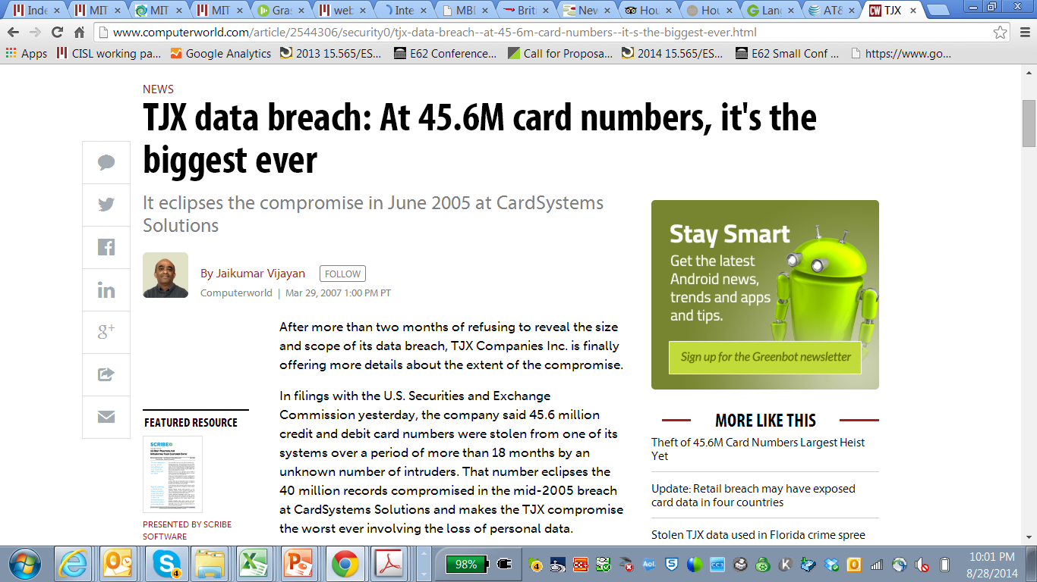
Mar 29, 2007

Slide 5
TJX (TJ Maxx & Marshalls) Case Study – Some Highlights
Major off-price US based retailer, revenues > $25 billion (FY2014)
Victim of largest (by number of cards) cyber-attack in history, when announced in 2007.
Cost to TJX > $170 million, per SEC filings.
Cyber-attack launched from a store on Miami, FL in 2005 by exploiting Wi-Fi vulnerability.
Hackers ultimately reached corporate payment servers and stole current transaction data.
Cyber-attack lasted for over 1.5 years
Sources: Federal/State Court records (primary), TJX SEC Filings, Others (NYT, WSJ, Globe, FTC, Academic papers, Journal articles).

Slide 6
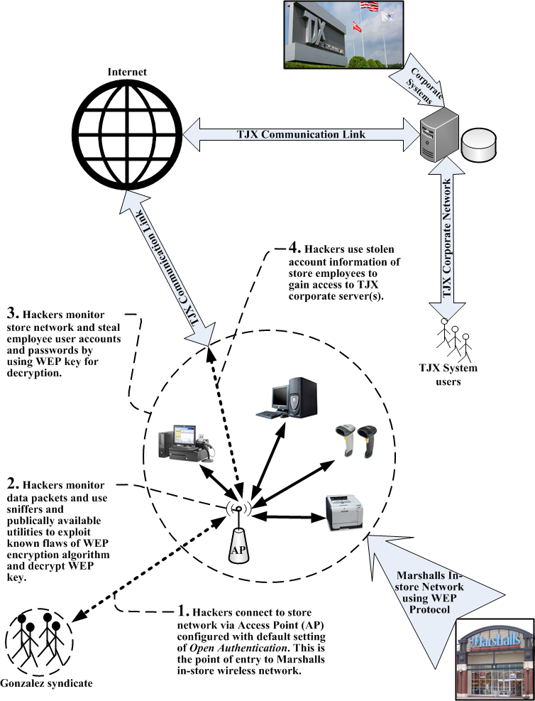
Breaching Marshalls Store
AP- Open authentication vs Shared Key authentication.
WEP publically known weak algorithm compromised.
Sniffers used to monitor data packets.
Hackers steal store employee account information and gain access to TJX corporate servers.

Slide 7
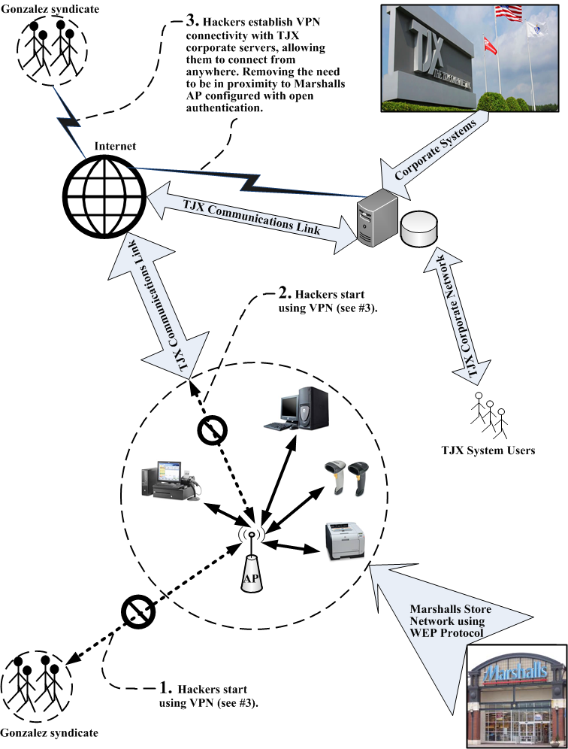
Hackers Establish VPN Connectivity
Hackers use Marshalls AP to install VPN connection.
VPN is between TJX corporate server and hacker controlled servers in Latvia.
Code installed on TJX corporate payment processing server.

Slide 8
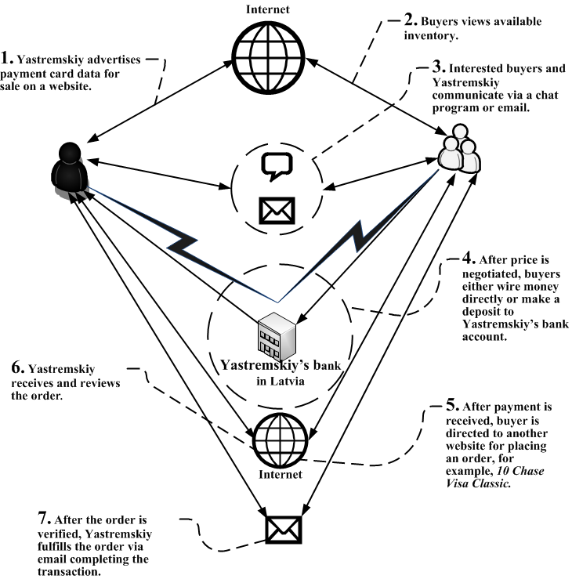
Flow for Sales of Stolen Payment Card Information.
Via Bank in Latvia

Slide 9
2. System-Theoretic Accident Model and Processes (STAMP) and Causal Analysis based on STAMP (CAST)

Slide 10
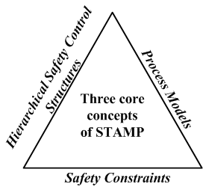
STAMP Model
Notes:
Discuss STAMP and CAST, Why CAST and not STPA

Slide 11
STAMP Hierarchical Control Model

Slide 12
CAST Steps for Analyzing Accidents or Incidents
No. | STAMP/CAST Analysis Steps
1 | Identify the system(s) and hazard(s) associated with the accident or incident.
2 | Identify the system safety constraints and system requirements associated with that hazard.
3 | Document the safety control structure in place to control the hazard and ensure compliance with the safety constraints.
4 | Ascertain the proximate events leading to the accident or incident.
5 | Analyze the accident or incident at the physical system level.
6 | Moving up the levels of the hierarchical safety control structure, establish how and why each successive higher level control allowed or contributed to the inadequate control at the current level.
7 | Analyze overall coordination and communication contributors to the accident or incident.
8 | Determine the dynamics and changes in the system and the safety control structure relating to an accident or incident, and any weakening of the safety control structure over time.
9 | Generate recommendations.
Notes:
Just say that there are 9 steps – don’t try to describe them here.
You will go through all of the steps …

Slide 13
3. STAMP/CAST Applied to TJX

Slide 14
Step #1: Identify System(s) and Hazard(s)
System(s)
TJX payment card processing system
Hazard(s) – at system level
System allows for unauthorized access
Step #2 (1/2): Define System Safety Constraints and Requirements
System Safety Constraints – at system level
Protect customer information from unauthorized access.
Provide adequate training to staff for managing security technology infrastructure.
Minimize losses from unauthorized access to payment system.
Notes:
- At system level

Slide 15
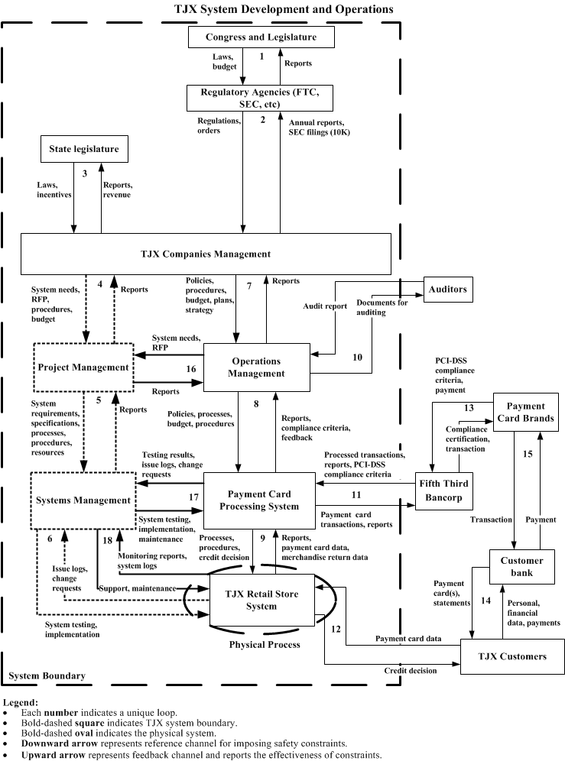
Step #3: Hierarchical Control Structure
Components of Control Structure
Loop numbers
Notes:
Core of analysis
Can change during analysis
Dev and ops sides
IMP: just organizing components provides a clear picture of how the organization (system) operates
Structuring a problem via control loops helps a lot, TJX did not have that.

Slide 16
Step #4: Proximate Event Chain, (1/2)
In 2005 TJX decided not to upgrade to a stronger encryption algorithm and continued using deprecated WEP encryption.
In 2005, hackers use war-driving method to discover a misconfigured Access Point (AP) at a Marshalls store in Miami, FL.
Hackers join the store network and start monitoring data traffic.
In 2005, they exploited inherent encryption algorithm weaknesses at the store, and decrypted the key to steal employee account and password.
Using stolen account information, hackers accessed corporate payment card processing servers in Framingham, MA.
In late 2005 hackers downloaded customer payment card data from TJX corporate transaction processing servers in Framingham, MA using Marshalls store connection in Florida.
In 2006 hackers discover vulnerability, that TJX was processing and transmitting payment card transactions without encryption.
Notes:
Proximal chain of events. Like event chain not effective but helpful with analysis.
In general, these are ‘immediate’ events leading to a loss, in the context of cyber security ‘immediate’ can span months/years (my view).

Slide 17
Step #4: Proximate Event Chain, (2/2)
In 2006 hackers installed a script on TJX corporate servers to capture unencrypted payment card data.
In 2006 hackers used TJX corporate servers as staging area and create files containing customer payment card data and started downloading files using Marshalls store network.
In late 2006 hackers installed a dedicated VPN connection between TJX server in Framingham, MA and a server in Latvia.
In 2006 hackers started moving files directly from TJX server to the Latvian server.
In December 2006, TJX was alerted by a credit card company of possible data breach of TJX systems, initiating an investigation.
In January 2007, TJX announced publically that it was a victim of a cyber-attack.

Slide 18
Step #5: Analyzing the Physical Process (TJX Retail Store System), (1/2)
Notes:
- Start at a physical process level (that is under analysts control)

Slide 19
Step #5: Analyzing the Physical Process (TJX Retail Store System), (2/2)
1. Safety Requirements and Constraints Violated:
Prevent unauthorized access to customer information.
4. Physical Contextual Factors:
TJX was an early adopter of first generation Wi-Fi technology at its over 1200 retail stores in 2000
Requiring a significant learning curve, training, and a new knowledge base in a short span of time.
2. Emergency and Safety Equipment (Controls):
AP authentication
WEP encryption
Use of account id/password
3. Failures and Inadequate Controls:
Access Point (AP) misconfigured
Inadequate monitoring of Wi-Fi .
TJX collecting customer information that was not required
Inadequate encryption technology – WEP
Notes:
1. I will discuss four dimensions. (comment: I see the picture as a foundation for refining this step and coming up with a simple to understand picture in the future)

Slide 20
Step #6: Analysis of Higher Levels of the Hierarchical Safety Control Structure

Slide 21
Step #6: Analysis of Higher Levels of the Hierarchical Safety Control Structure
1. Safety-Related Responsibilities:
Payment card data is encrypted.
TJX systems should be PCI-DSS compliant. (Compliance with PCI-DSS is required by retailers accepting credit cards).
Provide data retention process/procedures.
Systems pass rigorous testing.
4. Process Model Flaws :
Belief that Fifth Third Bancorp’s compliance with PCI-DSS implies compliance by TJX.
Inadequate understanding of full scope of PCI-DSS
2. Context:
TJX not in compliance with PCI-DSS.
3. Unsafe Decisions and Control Actions:
Inadequate compliance with PCI-DSS.
Retained more customer data than needed/for longer periods than required.
Inadequate testing of systems/lack of awareness of PCI-DSS.
Payment data briefly stored and then transmitted unencrypted to the bank.
Visa issued a warning to FT Bancorp that TJX needed to be fully compliant, but (a) Fifth Third Bancorp had limited influence on TJX and (b) Visa had already granted TJX suspended fines until 2008
Notes:
1. Analysis of Payment Card Processing System

Slide 22
Step #7: Coordination and Communication
Disconnect between the views of CIO and his staff, and executive management view cyber security as a technology issue.
Operations Management was aware of the compliance criteria but due to lack or inadequate support from executive management those system needs were not communicated to Project Management.
Payment Card Processing System is controlled by Operations Management (loop #8), and interacts with Fifth Third Bancorp (loop #11). Fifth Third Bancorp relied on TJX to satisfy requirements of PCI-DSS. But TJX had view that PCI-DSS compliance is a technology issue and that First Third Bancorp compliance implies TJX compliance.
CIO prioritized budget spending because CIO was representing a cost center and not revenue generating function, limited CIO influence at executive level.

Slide 23
Step #8: Dynamics and Migration to a High-Risk State
According to Leveson, “most major accidents are a result of migration of a system to a high-risk state over time. Understanding the dynamics of migration will help in redesigning the system.”
A major change contributing to the cyber-attack was TJX’s move from wired to wireless networking (Wi-Fi) in 2000 in a short span of one year.
Initially cyber security risk was low because vulnerabilities were unknown to everyone – experts, businesses, and hackers.
TJX decided against upgrading to a more secure encryption algorithm for cost reasons.
Flaws in managerial decision making process.
Ease of recall bias where recent experiences strongly influence the decision (i.e., no break-ins so far.)

Slide 24
Step #8: Dynamics and Migration to a High-Risk State, (2/2)
Confirmation trap is a decision maker’s tendency to favor/seek information that confirms his/her own beliefs and discount contradicting information.
“My understanding is that we can be PCI-compliant without the planned FY07 upgrade to WPA technology for encryption because most of our stores do not have WPA capability without some changes. WPA is clearly best practice and may ultimately become a requirement for PCI compliance sometime in the future. I think we have an opportunity to defer some spending from FY07’s budget by removing the money for the WPA upgrade, but would want us all to agree that the risks are small or negligible.”
Above is a message from CIO in November 2005 to his staff, requesting agreement on his belief that cyber security risk is low. -- there were only two opposing views, a majority of his staff agreed.
This confirmation trap led to postponing upgrades.

Slide 25
Step #9: Recommendations
According to PCI Security Standards Council, compliance is a business issue requiring management attention and need to integrate PCI-DSS requirements within appropriate components on development and operations parts of the control structure.
Doing so would not ensure full protection against a cyber-attack, but it will help manage the risk more effectively.
Ensure that TJX is shielded from liability, because TJX was fined $880,000* by VISA for non-compliance plus another $41 million
Understand objectives of standards and align them with cyber security and business needs, but PCI-DSS not fully adequate.
Data must be encrypted when sent over a public network, but not when transmitted within TJX, over intranet or behind a firewall.
PCI-DSS did not mandate using stronger encryption WPA until 2006, even though WPA was available in 2003.
Notes:
What a CIO will do on a Monday after seeing this presentation on Friday?
Talk about immediate ROI – 880k
People and process management
Identified where is the value to the company – 880k, pci-dss, upgrades
Recommendations can be applied to existing systems at systemic level.

Slide 26
Step #9: Recommendations
3. Building a safety culture at TJX
Specific steps can include:
Safety critical entities can include encryption technology, hardware components (AP, servers, etc.), data retention/disposal/archival policies, a list of Key Threat Indicators (KTI)* to include in monitoring metric, and prevailing cyber security trends.
Implement a plan to manage these entities with periodic reviews to update the list of safety critical entities.
A dedicated executive role with cyber security responsibilities, will allow for a consistent view of TJX security technology across the organization.
* KTI can be network traffic beyond an established threshold at TJX stores, number of network connections at odd hours of the day, etc.
Notes:
org. changes
Safety cutlure

Slide 27
Comparison of Results from FTC and CTC Investigations and STAMP/CAST Analysis
No. | Recommendation | CPC | FTC | STAMP/CAST
1 | Create an executive level role for managing cyber security risks. | No | * | Yes
2 | PCI-DSS integration with TJX processes. | No | No | Yes
3 | Develop a safety culture. | No | No | Yes
4 | Understand limitations of PCI-DSS and standards in general. | No | No | Yes
5 | Review system architecture. | No | No | Yes
6 | Upgrade encryption technology. | Yes | No | *
7 | Implement vigorous monitoring of systems. | Yes | No | *
8 | Implement information security program. | No | Yes | *
CPC = Canadian Privacy Commission
FTC = Federal Trade Commission
* = Indicates recommendations that are close to STAMP/CAST based analysis but also has differences.

Slide 28
4. Contributions of this Research

Slide 29
Research Contributions
Discussed why traditional approaches are ineffective for managing cyber security risks.
Highlighted need for system thinking and systems engineering approach to cyber security.
Introduced STAMP/CAST in the context of cyber security.
Proposed STAMP/CAST as a new approach for managing cyber security risks.
Applied STAMP/CAST to TJX case providing insights not discovered by other methods.
Recommendations provide a basis for preventing similar events in the future.
http://www.cybersafesystems.com/
hamid.salim@sloan.mit.edu
203-565-4637

