Slide 1
Efficient Asynchronous Accumulators for Distributed PKI
Sophia Yakoubov
Joint work with Leo Reyzin

Slide 2
Outline
Motivation: Distributed PKI
Background: Accumulators
Our Contributions: Asynchronous Accumulators
Definition: verification works even if the accumulator and witness are out of synch
Construction

Slide 3
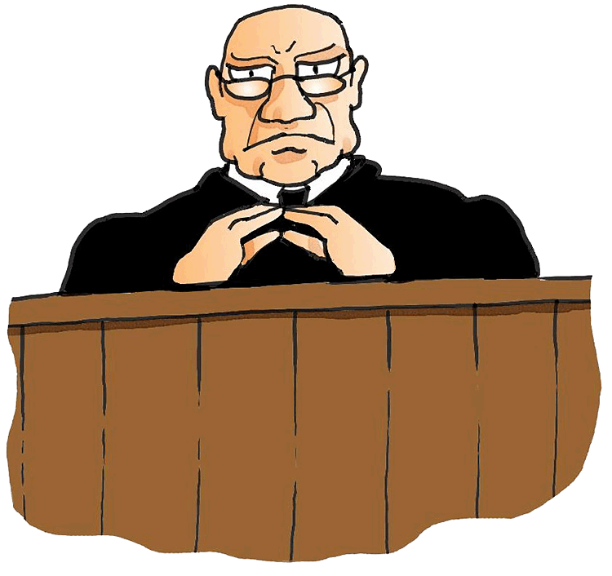
Application: PKI
PKI goals:
Enable Alice to associate Bob’s identity with Bob’s public key
PKI goals:
Accurate Registration
Identity Retention
PK_{B}
(We do not consider revocation here.)
“I’m Bob”
PK_{CA}
PK_{B}
CA
SK_{CA}
Bob,
PK_{B}
“I’m Bob”
PK_{B}
PK_{CA}
SK_{B}
PK_{B}
CA
PK_{CA}
Bob,

Slide 4
Application: PKI
Problem:
Certificate Authorities are a single point of failure!
PK_{E}
“I’m Bob”
PK_{CA}
PK_{E}
CA
SK_{CA}
Bob,
Eve
PK_{E}
“I’m Bob”
PK_{E}
PK_{CA}
SK_{E}
PK_{E}
CA
PK_{CA}
Bob,

Slide 5
Problem: Certificate Authorities are a Single Point of Failure!
Trusting central authorities is a risk.
Verisign
(2010) Was repeatedly infiltrated, potential compromised information includes secret signing keys
Comodo
(2011) Issued erroneous certificates
DigiNotar
(2011) Issued certificate for Google to someone who wasn’t Google
TrustWave
(2012) Issued root certificate to customers, enabling them to issue other certificates
Symantec
(2015) Issued certificates for Google without it’s knowledge

Slide 6
Ensuring Identity Retention: Decentralization via a Public Bulletin Board
Append-only
Consensus protocol ensures that posts are “valid”
Implemented via blockchains
formalized by [PSs16, GKL16]
Validity check performed by miners

Slide 7
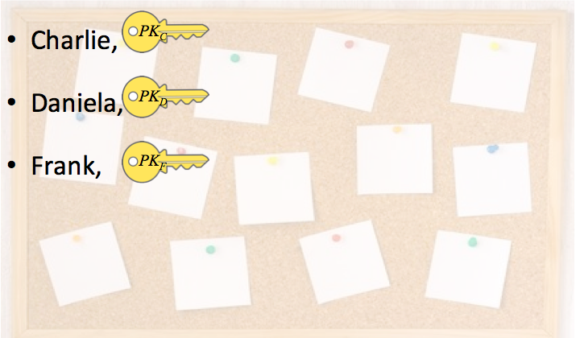
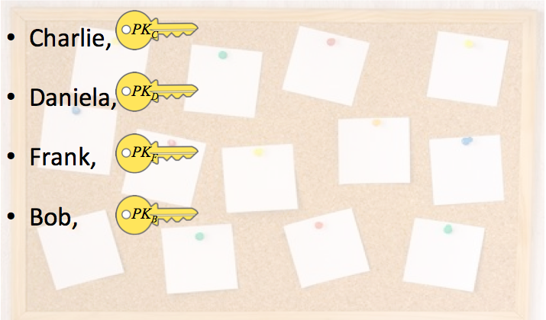
Decentralized PKI
PK_{B}
Bob
Bob,
Look up “Bob”
at location_{B}
Validation: the identity “Bob” has not already been registered
(ensures identity retention)
PK_{B}
“I’m Bob”
location_{B}
SK_{B}
Problem: expensive lookup! Alice needs to search through the entire bulletin board.
Problem: expensive storage / access! Alice needs to maintain online access to the entire bulletin board.

Slide 8
Outline
Motivation: Distributed PKI
Background: Accumulators
[BdM94,CL02,LLX07,Ngu05,DT08,ATSM09,CHKO08…]
Our Contributions: Asynchronous Accumulators
Definitions
Construction

Slide 9
Solution: accumulators
Accumulator: compact commitment to set S
S
membership witness w_{B}
(Bob, PK_{B})
T = S + {(Bob, PK_{B})}
can be used together with w_{B} to verify that (Bob, PK_{B}) is in set T
T

Slide 10
Accumulator Example: Merkle Hash Tree
h(•,•)
h(•,•)
h(•,•)
h(•)
h(•)
h(•)
h(•)
(Charlie, PK_{C})
(Daniela, PK_{D})
(Frank, PK_{F})
(Bob, PK_{B})

Slide 11
Accumulator Example: Merkle Hash Tree
h(•,•)
h(•,•)
h(•,•)
h(•)
h(•)
h(•)
h(•)
(Charlie, PK_{C})
(Daniela, PK_{D})
(Frank, PK_{F})
(Bob, PK_{B})

Slide 12
Accumulator Example: Merkle Hash Tree
h(•,•)
h(•,•)
h(•,•)
h(•)
h(•)
h(•)
h(•)
(Charlie, PK_{C})
(Daniela, PK_{D})
(Frank, PK_{F})
(Bob, PK_{B})

Slide 13
Using Accumulators in the Bulletin Board
Charlie, ,
Daniela, ,
Frank, ,
Bob, ,
PK_{C}
PK_{D}
PK_{F}
PK_{B}
Maintain an accumulator containing all (Name, PK) pairs

Slide 14
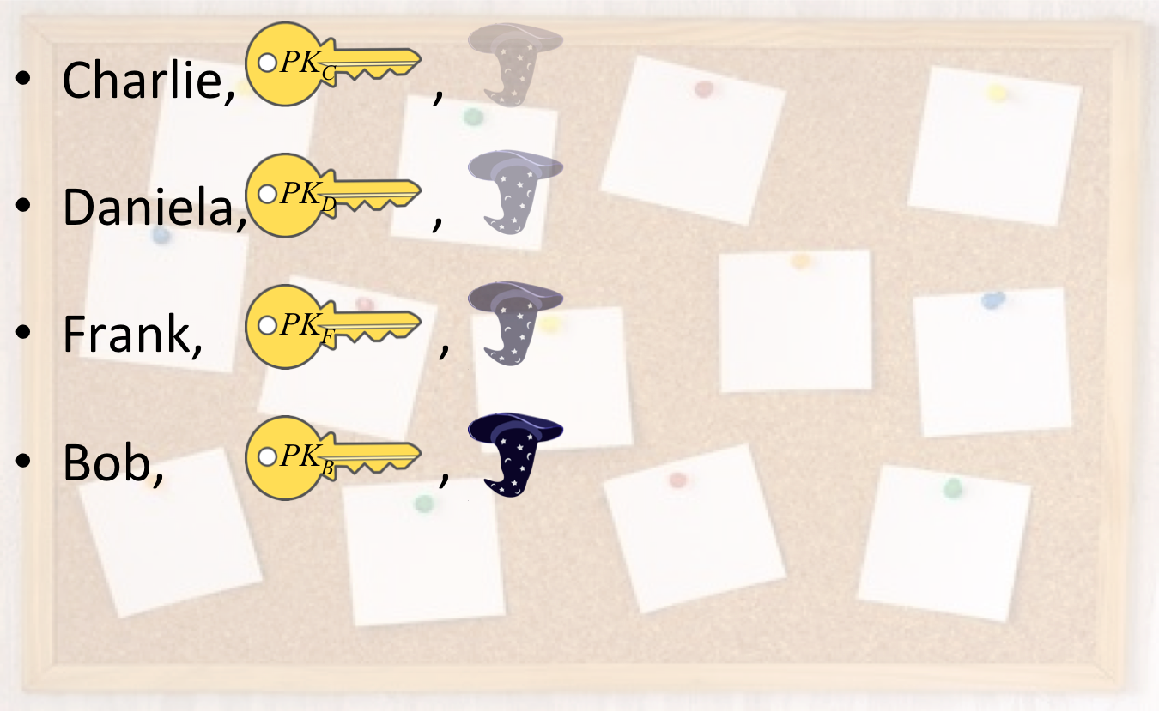
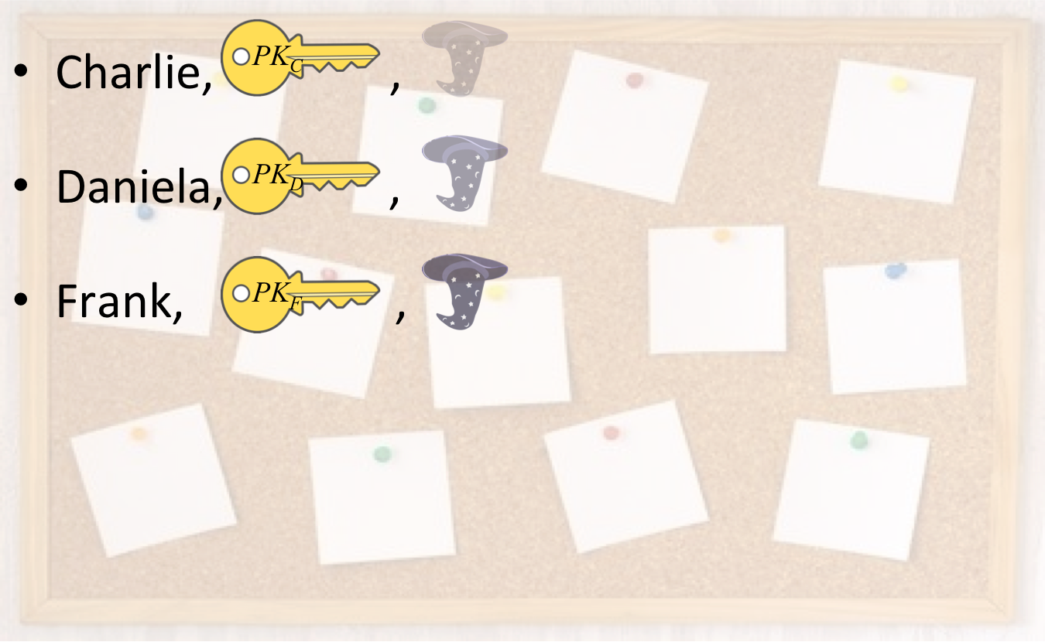
Accumulators in Decentralized PKI
Look up latest
Bob
PK_{B}
Bob,
Look up latest
Validation (e.g. by miners):
Check that the identity “Bob” has not already been registered
Compute the new accumulator value
(Bob, PK_{B})
w_{B}
PK_{B}
SK_{B}
PK_{B}
“I’m Bob”, , w_{B}
w_{B}

Slide 15
Accumulator Example: Merkle Hash Tree
h(•,•)
h(•,•)
h(•)
h(•)
h(•)
(Frank, PK_{F})
(Charlie, PK_{C})
(Daniela, PK_{D})

Slide 16
Accumulator Example: Merkle Hash Tree
h(•,•)
Charlie’s witness changed!
h(•,•)
h(•,•)
h(•)
h(•)
h(•)
h(•)
(Charlie, PK_{C})
(Daniela, PK_{D})
(Frank, PK_{F})
(Bob, PK_{B})

Slide 17
Problem: Synchrony
w_{B}
w_{B}
w_{B}
w_{B}
w_{B}
w_{B}
w_{B}
w_{B}
w_{B}
w_{B}
time
Using existing notion of accumulators…
Bob needs to update his membership witness with every key registration!
Alice needs to download a new accumulator value with every key registration!

Slide 18
Outline
Motivation: Distributed PKI
Background: Accumulators
Our Contributions: Asynchronous Accumulators
Definitions
Low witness update frequency
Old-accumulator compatibility
Construction: Merkle Hash Forrest

Slide 19
Solution: Asynchronous Accumulators - Low Witness Update Frequency
w_{B}
w_{B}
w_{B}
w_{B}
w_{B}
w_{B}
w_{B}
w_{B}
w_{B}
w_{B}
time
Low witness update frequency
w_{B}
w_{B}
w_{B}
w_{B}
time

Slide 20
Solution: Asynchronous Accumulators - Old Accumulator Compatibility
w_{B}
w_{B}
w_{B}
w_{B}
w_{B}
w_{B}
w_{B}
w_{B}
w_{B}
w_{B}
time
w_{B}
w_{B}
w_{B}
w_{B}
w_{B}
w_{B}
w_{B}
w_{B}
w_{B}
w_{B}
time
Old-accumulator compatibility

Slide 21
Outline
Motivation: Distributed PKI
Background: Accumulators
Our Contributions: Asynchronous Accumulators
Definitions
Low witness update frequency (helping Bob)
Old-accumulator compatibility (helping Alice)
Construction: Merkle Hash Forrest

Slide 22
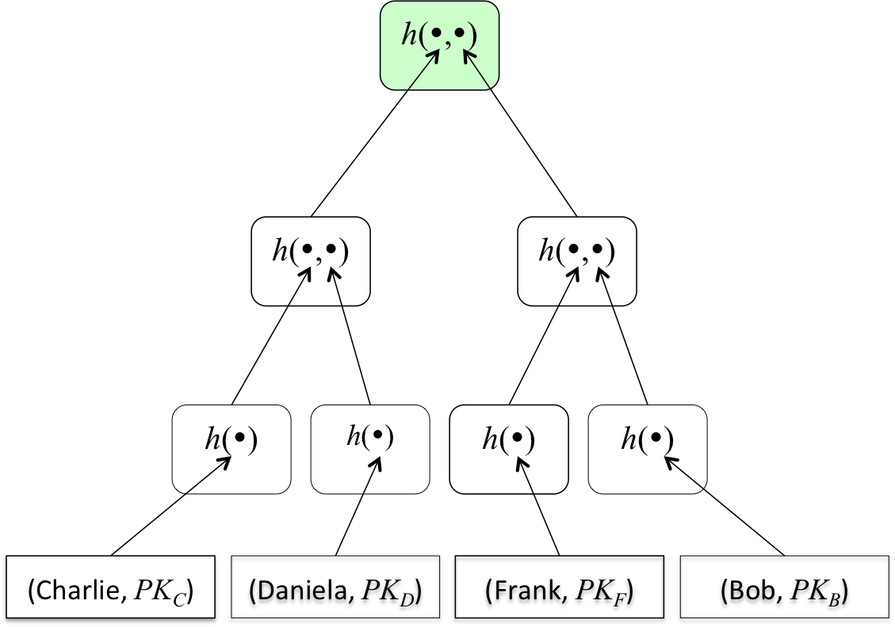
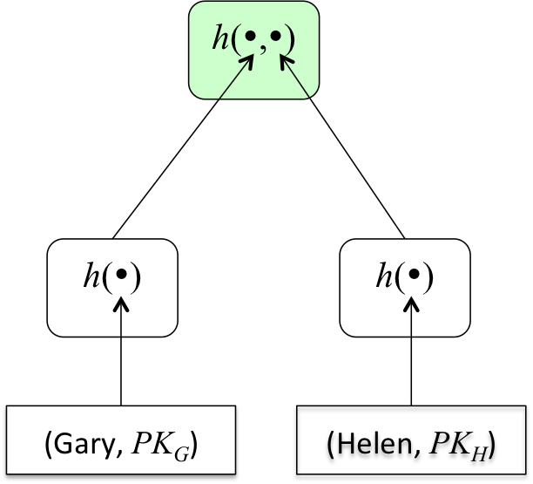
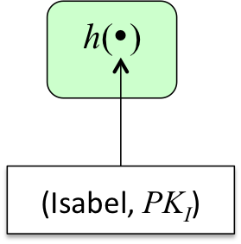
Asynchronous Accumulator: Merkle Hash Forest
Depth 3
Depth 2
Depth 1
At most log(n) complete Merkle trees
Each element is a leaf in one of the trees
As new elements get added, older elements move to bigger trees

Slide 23
Asynchronous Accumulator: Merkle Hash Forest
D = 1
1
This is similar to a binary counter…
1 element

Slide 24
Asynchronous Accumulator: Merkle Hash Forest
D = 2
1
0
This is similar to a binary counter…
2 elements

Slide 25
Asynchronous Accumulator: Merkle Hash Forest
D = 2
D = 1
1
1
This is similar to a binary counter…
3 elements

Slide 26
Asynchronous Accumulator: Merkle Hash Forest
D = 3
1
0
0
This is similar to a binary counter…
4 elements

Slide 27
Asynchronous Accumulator: Merkle Hash Forest
D = 3
D = 1
1
0
1
This is similar to a binary counter…
5 elements

Slide 28
Asynchronous Accumulator: Merkle Hash Forest
D = 3
D = 2
1
1
0
This is similar to a binary counter…
6 elements

Slide 29
Asynchronous Accumulator: Merkle Hash Forest
D = 3
D = 2
D = 1
1
1
1
This is similar to a binary counter…
7 elements

Slide 30
Asynchronous Accumulator: Merkle Hash Forest
1
0
0
0
This is similar to a binary counter…
8 elements

Slide 31
Asynchronous Accumulator: Merkle Hash Forest
D = 1
1
0
0
1
This is similar to a binary counter…
9 elements

Slide 32
Asynchronous Accumulator: Merkle Hash Forest
D = 2
1
0
1
0
This is similar to a binary counter…
10 elements

Slide 33
Asynchronous Accumulator: Merkle Hash Forest
D = 2
D = 1
1
0
1
1
This is similar to a binary counter…
11 elements

Slide 34
Asynchronous Accumulator: Merkle Hash Forest
D = 3
1
1
0
0
This is similar to a binary counter…
12 elements

Slide 35
Asynchronous Accumulator: Merkle Hash Forest
D = 3
D = 1
1
1
0
1
This is similar to a binary counter…
13 elements

Slide 36
Asynchronous Accumulator: Merkle Hash Forest
D = 3
D = 2
1
1
1
0
This is similar to a binary counter…
14 elements

Slide 37
Asynchronous Accumulator: Merkle Hash Forest
D = 3
D = 2
D = 1
1
1
1
1
This is similar to a binary counter…
15 elements

Slide 38
Asynchronous Accumulator: Merkle Hash Forest
1
0
0
0
0
This is similar to a binary counter…
16 elements

Slide 39
Merkle Hash Forest Asynchrony
Low update frequency
A witness only needs to be updated when the tree in question is “carried”!
Old-accumulator compatibility
A witness is append-only; it contains all prior states
D = 3
D = 2
D = 1

Slide 40
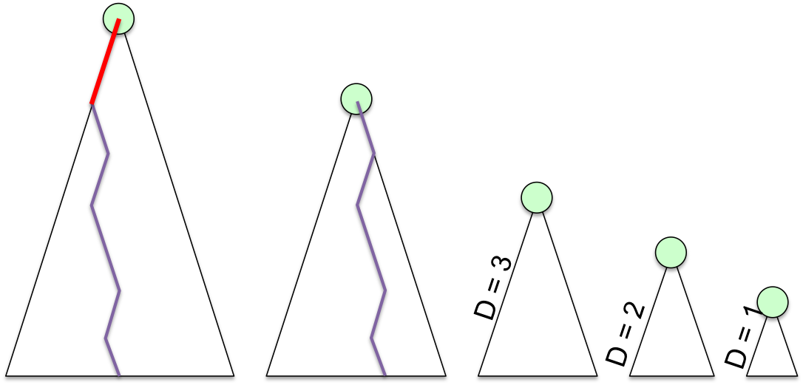
Conclusion
Bulletin boards are good for distributed dictionaries
Namecoin
PKI
Accumulators improve efficiency
no need to have access to the whole board
Asynchronous accumulators reduce the witness maintenance cost
A forest is better than a tree!
More flexibility

