Slide 1
The Election Administration and Voting Survey: A User’s View
Charles Stewart III
MIT
August 8, 2013
version 1.2

Slide 2
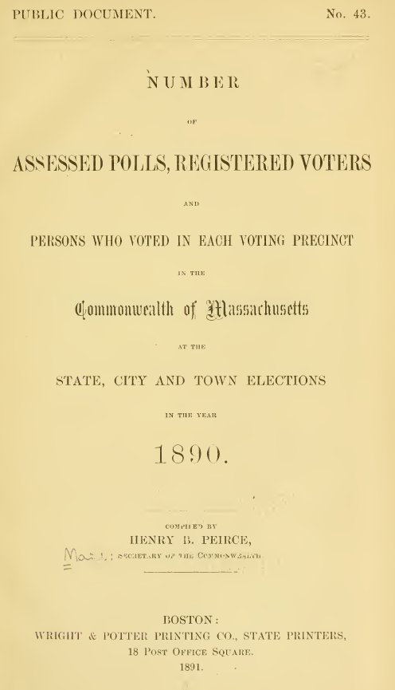
~1880
State
“Blue Books” and Election Statistics
1920
1960
2013

Slide 3
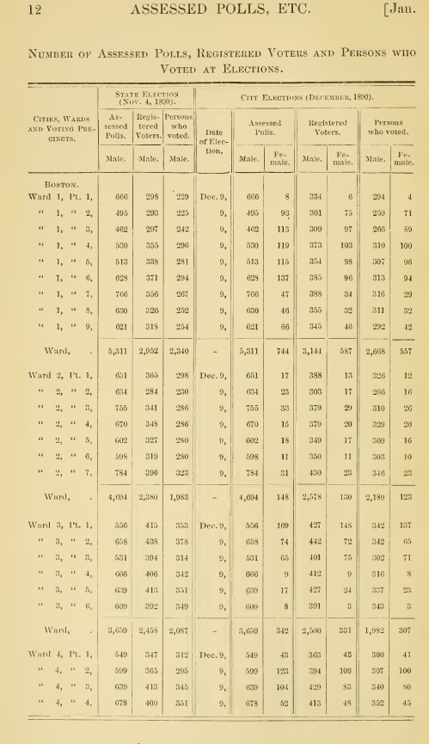
~1880
State
“Blue Books” and Election Statistics
1920
1960
2013

Slide 4
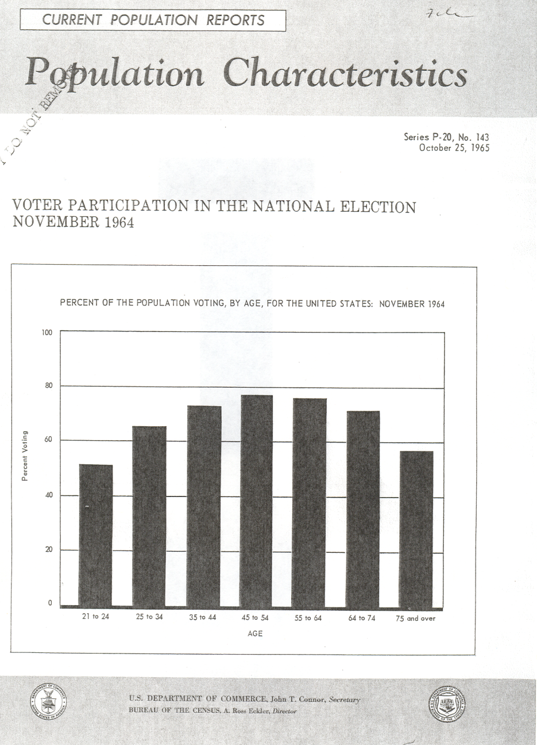
~1880
State
“Blue Books” and Election Statistics
1920
1960
CPS
Voting and Registration Supplement
2013

Slide 5
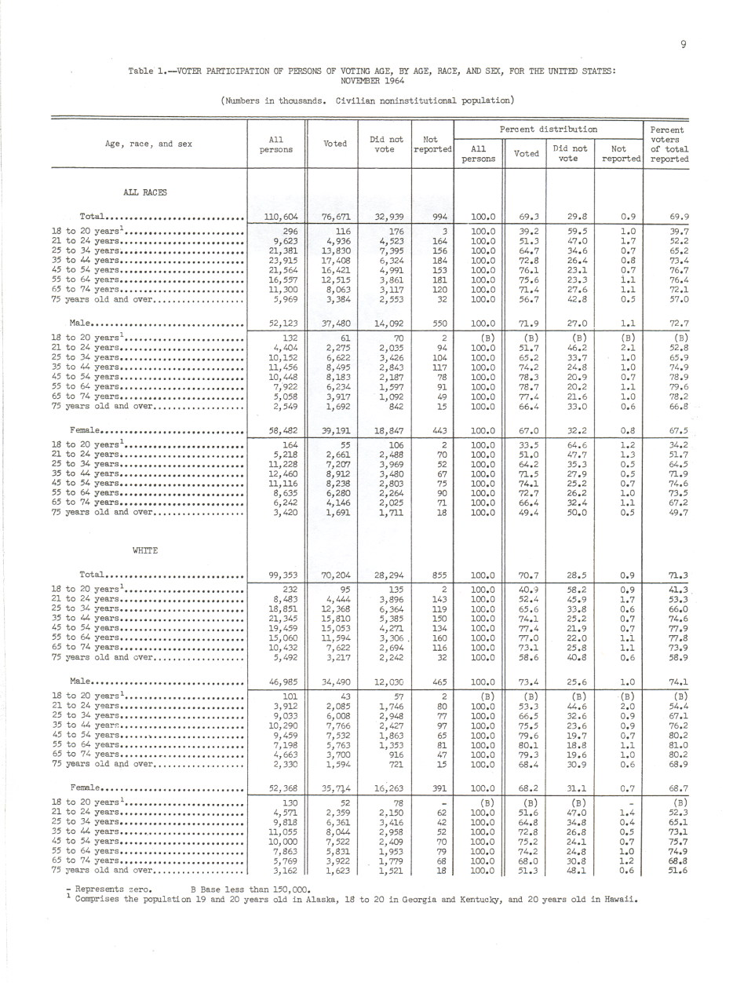
~1880
State
“Blue Books” and Election Statistics
1920
1960
CPS
Voting and Registration Supplement
2013

Slide 6
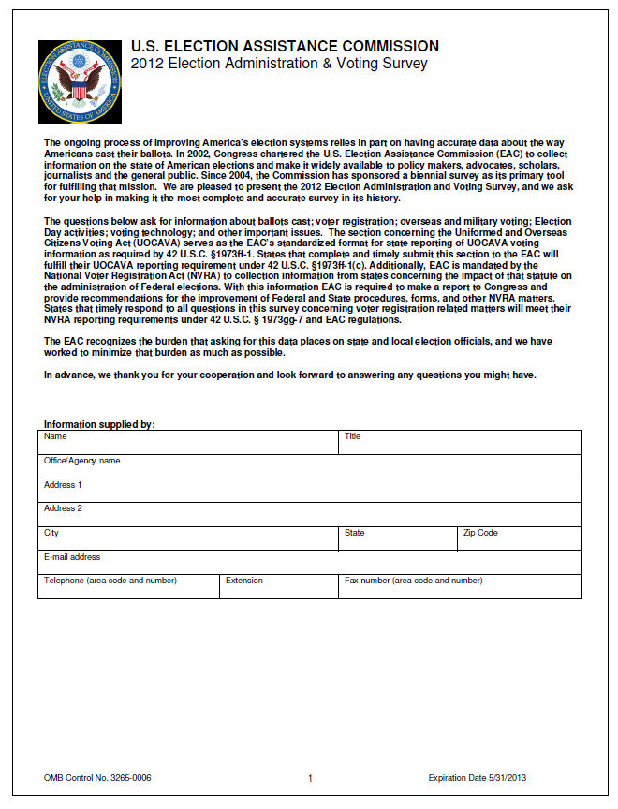
~1880
State
“Blue Books” and Election Statistics
1920
1960
CPS
Voting and Registration Supplement
EAC
Election Administration & Voting Survey
2013

Slide 7
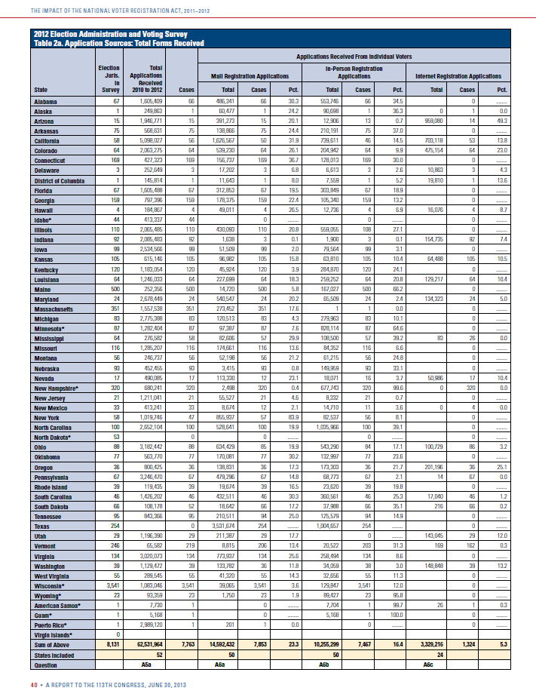
~1880
State
“Blue Books” and Election Statistics
1920
1960
CPS
Voting and Registration Supplement
EAC
Election Administration & Voting Survey
2013

Slide 8
The EAVS
Arises from EAC mandates
Unique data resource
National in scope
State and local data
Allows comparisons
Comprehensive view of election administration
Voter registration
UOCAVA
Domestic civilian absentee ballots
Election administration (precincts, poll workers, etc.)
Provisional ballots
Election Day activities (turnout, election tech.)

Slide 9
Voter registration activity (Table 2)
 | 2007-08 | 2009-10 | 2011-12
Registration forms processed | 60.0m | 45.5m | 59.5m
New registrations processed | 24.5m | 14.4m | 23.6m
New registrations/ forms processed | 42% | 34% | 33%
Removals from lists | 12.3m | 15.0m | 13.7m
Address changes | 23.5m | 21.8m | 30.7m
Address changes / forms processed | 34% | 50% | 44%

Slide 10
National findings from 2012 EAVS
UOCAVA ballots
861k mailed out
601k returned for counting → 70% return rate
Down from 960k mailed out and 702k returned (73% rate) for 2008
3.5% of returned ballots rejected (down from 4.2%)
42% due to lateness (53% in 2008)
14% due to signature problems (12% in 2008)

Slide 11
National findings from 2012 EAVS
Civilian absentee ballots
32.8m mailed out
27.3m returned for counting →83% return rate
Up from 29.2m mailed out and 26.1m returned in 2008 (90% return rate)
Decline in return rates is isolated in jurisdictions with permanent absentee lists (77% vs. 87%)
2.9% of returned ballots rejected (down from 3.1%)
33% due to lateness (22% in 2008)
36% due to signature problems (22% in 2008)

Slide 12
National findings from 2012 EAVS
Election Day logistics
171k precincts (189k in 2008)
99k Election Day voting places (115k in 2008)
2,500 early voting locations (same as 2008)
750k poll workers (877k in 2008)
689 voters/E.D polling place (671 in 2008)
1,111 voters/Early voting center/day

Slide 13
National findings from 2012 EAVS
Provisional ballots
2.6m distributed (2.0% of in-person ballots)
1.9m counted →74% counting rate
Up from 2.1m distributed in 2008 (1.5% of in-person ballots) and 1.4m counted (68% rate)

Slide 14
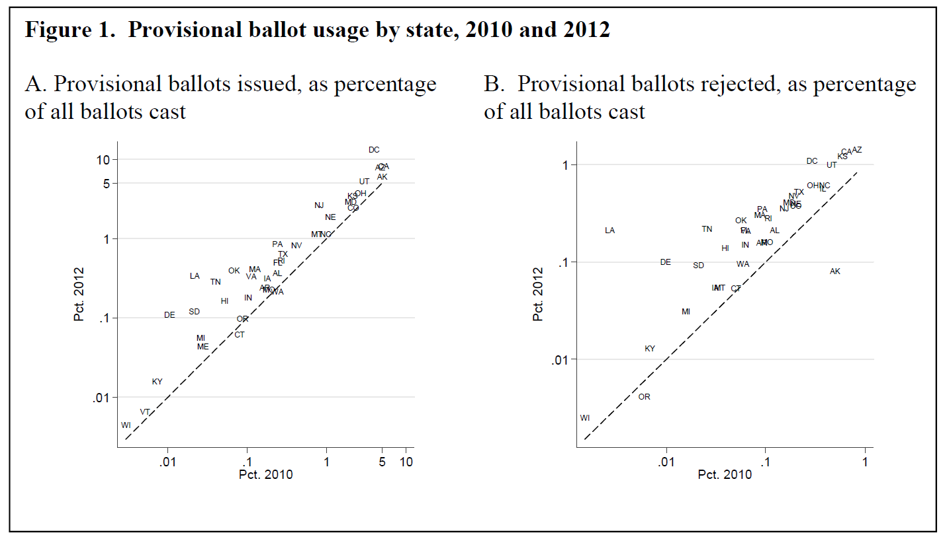
Interstate variability

Slide 15
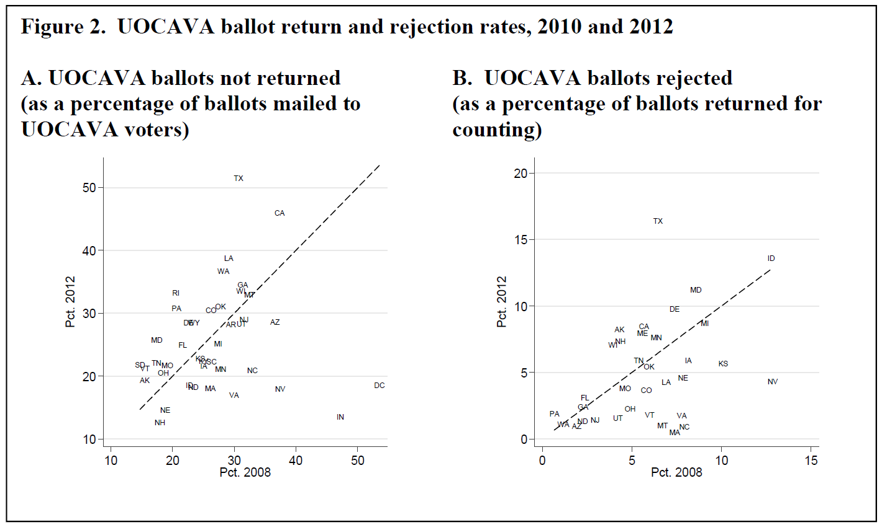
Interstate variability

Slide 16
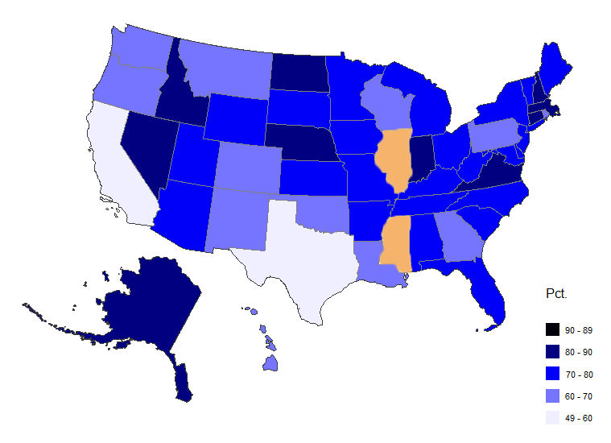
Intrastate variability
UOCAVA ballots returned for counting, nationwide

Slide 17
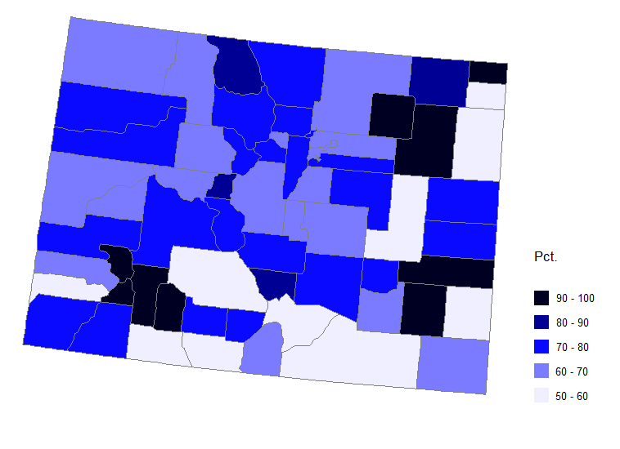
Intrastate variability
UOCAVA ballots returned for counting, Colorado

Slide 19
Closing Thoughts
The use of metrics to guide election administration is growing, but still in its infancy
EAVS only comprehensive, national election administration data gathering effort
EAVS quality is improving
The EAC’s uncertain future threatens the EAVS

