Slide 1
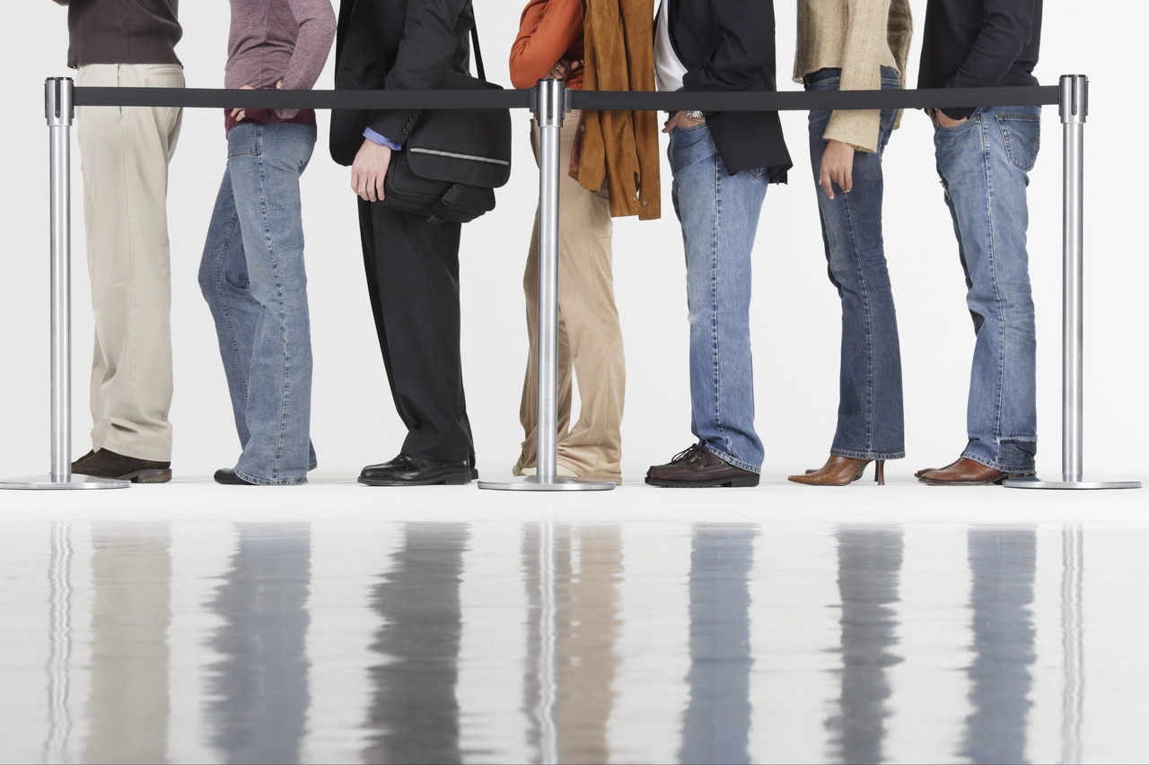
Long Lines at Polling Places
Presidential Commission on Election Administration
Philadelphia, PA
September 2013

Slide 2
Voter’s Eye View of Election Day 2012
Interviewed 10,200 registered voters
1/3 of voters reported NO WAIT
Average wait time – 13 minutes
Florida – 44 minutes
D.C. – 34 minutes
Maryland – 32 minutes
Virginia – 27 minutes
South Carolina – 27 minutes

Slide 3
What is an acceptable wait time?
SIMPLE Voting Act
No voter should be forced to wait in line to vote more than one hour
Notes:
There is no one reason for long lines. The definition of “long lines” is subjective and dependent on the individuals and situation involved. We must reduce the wait times or voters will be frustrated and it could result in voters becoming disinclined to vote.
Richland County 6+ hours
Aiken County – voters complained when wait time was less than two hours

Slide 4
Where do we start?
Following an election:
Survey poll workers
Talk to county election officials
Review data
Audit data from voting machines
Audit data from electronic poll books
Consider voter input received on election day

Slide 5
What causes long lines?
Check-in Process High Turnout
Voting Equipment Long Ballots Poll Books Training Lack of Signage
Provisional Ballots Rush Hour Voting Poll Workers Polling Place Layout Administration Curbside Voting Precinct Size Inefficiencies Photo ID Lack of Resources
Election Day Registration Address Changes

Slide 6
Voter Check-in
Voter registration database problems
Polling place not adequately staffed
First-time voters showing ID
Voters not on list/wrong precinct
Voters without photo ID
Same day registration
Notes:
2 areas where lines can form: check-in table and voting machines/booths

Slide 7
Voting Process
Long ballots
Voters not familiar with ballot – candidates and questions
Voters not familiar with voting machines or equipment
Voters waiting on curbside or ADA machine

Slide 8
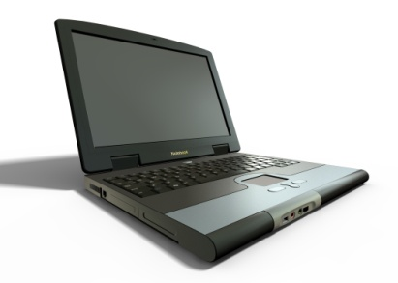
Polling Place Technologies
Not enough voting machines/booths
Voting machine(s) not working
Electronic poll book issues at check-in
Not enough electronic poll books
Technology confusing to poll managers

Slide 9
Poll Workers
Not enough poll workers
Inadequate training of poll workers
Lack of training documentation or reference manuals
Late arrival or no shows
Highly technical process
performed infrequently

Slide 10
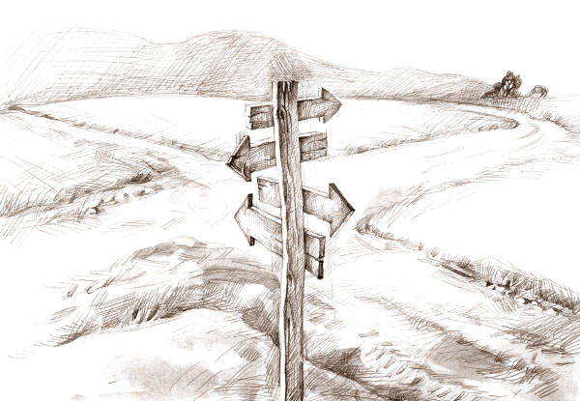
Polling Place/Precinct
Changing polling place locations
Fewer or consolidated polling places
Problems getting access to precinct to set up
Poor polling place layout/flow
Lack of organization
Insufficient signage
Poor queue management
High turnout

Slide 11
What can we do?
Address precinct size, number of poll managers per precinct and number of voting machines/equipment
Study audit data from voting systems and electronic poll books
Conduct time and motion studies
Queue management theories
Voter education

Slide 12
What can we do?
Leverage technology
Use of electronic poll book technology
Technology can instantly check whether someone has already voted and present the voter with the proper ballot
Use of polling place ‘wait time’ systems
Utilize a problem resolution table at polling place
Effective ballot design techniques

Slide 13
Recommendations
Establish guidelines; allow for flexibility
Provide for alternative voting methods:
Early voting
Vote centers
Explore new voting technologies (personal electronic devices)
Provide adequate resources

