Slide 1
Language Access, Electoral Administration, and Americans of Asian Descent
Presentation before the Presidential Commission on Election Administration
Philadelphia, PA Taeku Lee
4 September 2013 UC-Berkeley

Slide 2
1. Asian Americans are arguably the most rapidly growing segment of the US population.

Slide 3
18 Million and Growing
Source: U.S. Census Bureau

Slide 4
Highest Growth Rate from 2000 to 2010
Source: U.S. Census Bureau

Slide 5
Largest Contributor to Migration Today
Source: U.S. Census Bureau 2011

Slide 6
2. Asian Americans are heavily foreign-born and linguistically diverse.

Slide 7
A Heavily Immigrant Population
Source: U.S. Census Bureau 2011

Slide 8
Ethnically and Linguistically Diverse
Asian Languages:
Chinese, Japanese, Korean, Mon-Khmer/Cambodian, Hmong, Thai, Lao, Vietnamese, Tagalog-Pilipino, Dravidian (Tegulu, Tamil, Malayam)
Indic Languages:
Hindi, Urdu, Gujarati, Punjabi, Bengali, Marathi
“Other Asians” includes Laotians (1.9%), Pakistanis (1.7%), Cambodians (1.6%), Hmong (1.4%), Thai (1.1%), Taiwanese (0.6%), Indonesian (0.4%), Bangladeshi (0.4%), among others.

Slide 9
Language Other than English at Home
Source: 2011 ACS
Source: 1980, 1990, 2000 Census; 2010 ACS

Slide 10
Limited English Proficiency*
* % in who report speaking a language other than English at home and who English less than “very well”)
Notes:
In law, “Limited-English proficient” is defined as “unable to speak or understand English adequately enough to participate in the electoral process.”

Slide 11
3. Asian Americans are underrepresented in US elections (especially in voter registration) and language is a factor.

Slide 12
A Growing Share of the Electorate
Data: Current Population Survey Voting and Registration Supplements.

Slide 13
But Underrepresented Among Voters
Data: Current Population Survey Voting and Registration Supplements.

Slide 14
The Registration Gap
 | Whites | Blacks | Asians | Latinos
Citizen (among adults) | 98 | 94 | 68 | 63
Registered (among citizen) | 74 | 70 | 55 | 59
Turnout (among registered) | 90 | 93 | 86 | 84
Data: Current Population Survey Voting and Registration Supplements.

Slide 15
Language as a Barrier to Registration
Data: 2004, 2008, 2012 Current Population Survey Voting and Registration Supplements.

Slide 16
Language Compared to All Barriers
Data: 2004 and 2008 Current Population Survey Voting and Registration Supplement.

Slide 17
4. Needs assessment in a data-poor environment: evidence from two 2012 surveys.

Slide 18
Two Representative Surveys
2012 National Asian American Survey:
6,257 interviews from late-July to early October 2012
9 Asian languages, English, and Spanish.
48% chose a non-English interview language.
87% of those reported speaking English less than “very well.”
2012 AAPI Post-Election Survey
6,609 interviews in Nov. and Dec. 2012.
9 Asian languages, English, and Spanish.
46% chose a non-English interview language.
82% of those reported reported speaking English less than “very well.”

Slide 19
English Proficiency and Registration
Voter Registration, by LEP
Intent to Register, by LEP
Source: 2012 National Asian American Survey

Slide 20
Language and Electoral Participation
Voter Turnout, by LEP
Contact during Election, by LEP
Source: 2012 AAPI Post-Election Survey

Slide 21
Accuracy of English-only Polling
Source: 2012 AAPI Post-Election Survey
Notes:
Those surveyed in English were significantly more likely to have voted for Obama.

Slide 22
Need for In-Language Materials
79% of AAPI citizens who are LEP would make use of in-language election materials if made available to them.
Source: 2012 National Asian American Survey

Slide 23
Gaps in Section 203 Compliance
Source: 2012 AAPI Post-Election Survey
Notes:
Section 203 of the Voting Rights Act requires covered jurisdictions who meet a threshold to provide language assistance during the voting process. Our survey data indicates large gaps in the actual provision of such assistance. Among those living in covered jurisdictions, only 55 percent said that “translated election documents or bilingual election workers” were available at the polls. This proportion was higher among those who voted by mail (69 percent), but still well short of the language assistance required by law.

Slide 24
5. Monitoring Compliance: the 2012 Advancing Justice project.

Slide 25
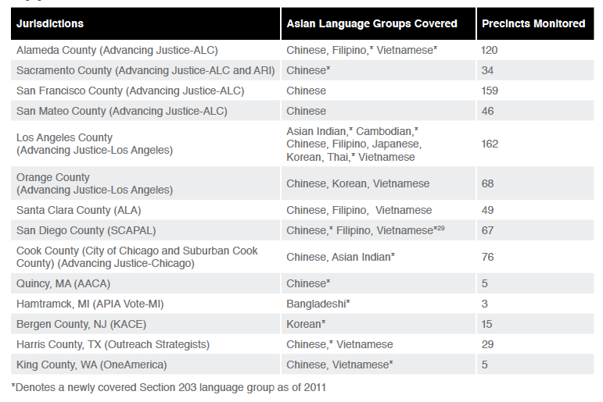
2012 AAAJ Compliance Study
Source: Asian Americans Advancing Justice 2012 report

Slide 26
Missing or Poorly Placed Translations
Jurisdictions | % Precincts with at least one missing or poorly displaced translated material
MEAN (all precincts) | 45%
Quincy, MA | 100%
Hamtramck, MI | 100%
Harris County, TX | 83%
Los Angeles County, CA | 57%
…
Orange County, CA | 29%
Alameda County, CA | 27%
San Francisco County, CA | 9%
King County, WA | 0%
Source: Asian Americans Advancing Justice 2012 report

Slide 27
Gaps in Bilingual Assistance
Jurisdictions | % missing 1> Asian language-speaking poll worker | % with bilingual poll workers missing badges
MEAN (all precincts) | 23% | 43%
Hamtramck, MI | 67% | 100%
Harris County, TX | 45% | 88%
Alameda County, CA | 45% | 5%
Orange County, CA | 38% | 47%
…
San Diego County, CA | 13% | 18%
San Mateo, CA | 17% | 5%
San Francisco Co, CA | 1% | 3%
King County, WA | 0% | 0%
Source: Asian Americans Advancing Justice 2012 report

Slide 28
Poll Workers’ Interaction
Jurisdictions | Cordial to LEP Voters | Waited for LEP Voters to Approach
MEAN (all precincts observed) | 61% | 35%
Hamtramck City, MI | 0% | 100%
Orange County, CA | 88% | 46%
San Diego County, CA | 80% | 44%
San Mateo County, CA | 77% | 41%
…
San Francisco Co, CA | 70% | 23%
Quincy City, MA | 40% | 20%
King County, WA | 55% | 18%
Alameda County, CA | 40% | 12%
Source: Asian Americans Advancing Justice 2012 report

Slide 29
Access to Provisional Ballots
Jurisdictions | % where option of provisional ballots not offered with missing names
MEAN (all precincts) | 14%
Cook Co/Chicago, IL | 47%
Quincy City, MA | 40%
Santa Clara County, CA | 26%
San Mateo County, CA | 17%
…
Harris County, TX | 5%
Orange County, CA | 5%
San Francisco County, CA | 4%
San Diego County, CA | 3%
LA County, CA | 2%
Source: Asian Americans Advancing Justice 2012 report

Slide 30
Summary
Asian Americans are a rapidly growing population.
They are underrepresented in elections.
Language access is a factor in this under-participation, especially with vote registration.
There is a demand for in-language materials.
There are significant gaps in accommodation and wide variance across Section 203 precincts in compliance.

Slide 31
Recommendations
Establish minimum federal standards inclusive of language access.
e.g., accurate and full translation, adequate recruitment and training of poll workers.
Monitor compliance of standards.
Gather and analyze better data: standardized, tracking, reporting.
Create outreach and education programs in the community.
Collaborate with community organizations and crowdsource to identify flashpoint precincts.

