Slide 1
Right Protection via Watermarking with Provable Preservation of Distance-based Mining
Spyros Zoumpoulis
Joint work with Michalis Vlachos, Nick Freris and Claudio Lucchese
Mathematical & Computational Sciences
August 18, 2011
IBM ZRL

Slide 2
Problem
Spyros Zoumpoulis
Watermarking with Preservation of Distance-based Mining
Want to distribute datasets, but maintain ownership rights
Want to maintain ownership rights, but also maintain ability to distill useful knowledge out of data
new graph
Transformations
Distance D
Watermarking
Rights Protection
original
distance graph
How can we guarantee that the results on the modified and the original datasets are the same?

Slide 3
Problem
Spyros Zoumpoulis
Watermarking with Preservation of Distance-based Mining
Want to distribute datasets, but maintain ownership rights
Want to maintain ownership rights, but also maintain ability to distill useful knowledge out of data
new graph
Distance D
Watermarking
original
distance graph
Change intensity
of transformation

Slide 4
Roadmap
Spyros Zoumpoulis
Watermarking with Preservation of Distance-based Mining
4
Trajectory Datasets
Objective
Watermarking Scheme
Detection Process
Theoretical Guarantees on Distance Distortion
Preservation of Nearest Neighbors and Minimum Spanning Tree
Algorithms for NN and MST Preservation
Fast algorithms for NN and MST Preservation
Experiments – Preservation, Speed-up and Resilience against Attacks
Conclusion

Slide 5
Roadmap
Spyros Zoumpoulis
Watermarking with Preservation of Distance-based Mining
5
Trajectory Datasets
Objective
Watermarking Scheme
Detection Process
Theoretical Guarantees on Distance Distortion
Preservation of Nearest Neighbors and Minimum Spanning Tree
Algorithms for NN and MST Preservation
Fast algorithms for NN and MST Preservation
Experiments – Preservation, Speed-up and Resilience against Attacks
Conclusion

Slide 6
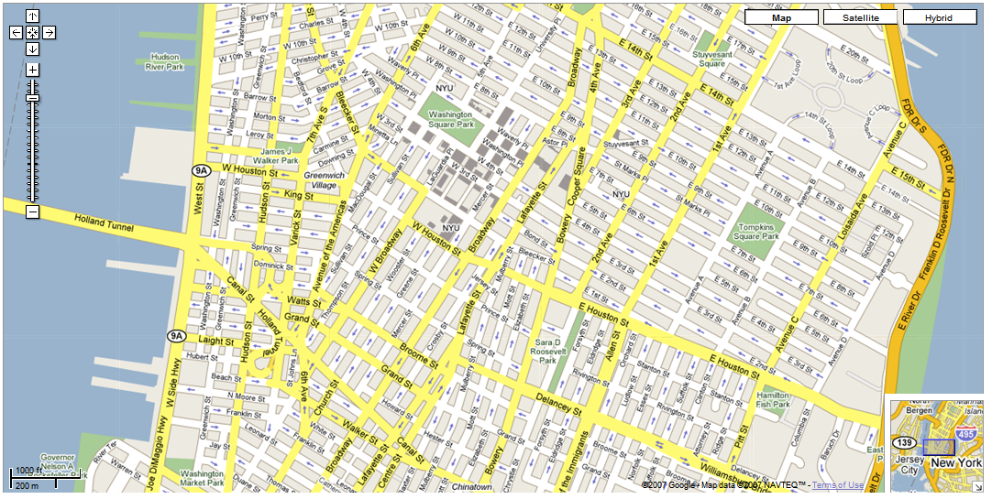
Trajectory Datasets
Spyros Zoumpoulis
Watermarking with Preservation of Distance-based Mining
6
Easily collected: smartphones, GPS-enabled devices, etc.
Epidemiology
Transportation
Emergency situations
…

Slide 7
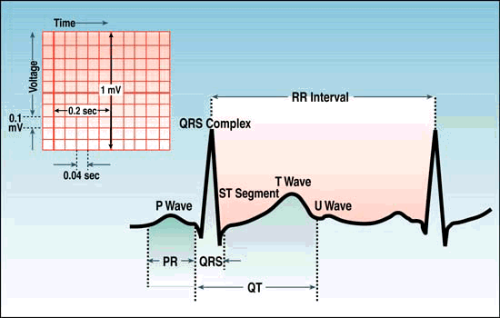
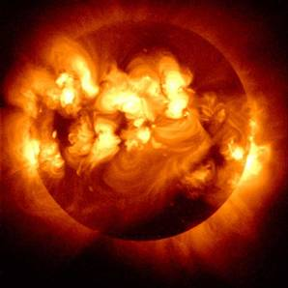
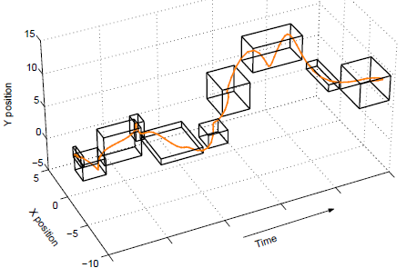
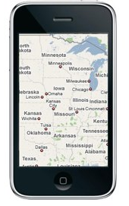
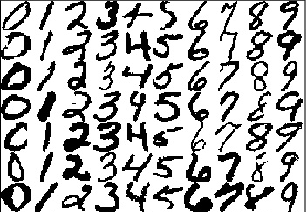
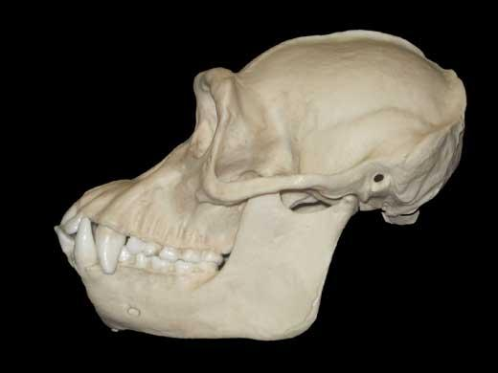
Trajectory Datasets
Spyros Zoumpoulis
Watermarking with Preservation of Distance-based Mining
7
Medical
Motion/Video
1986
2006
Astronomical
Mobility
Microsoft
Yahoo
Financial
Handwriting
Images/Shapes

Slide 8
Roadmap
Spyros Zoumpoulis
Watermarking with Preservation of Distance-based Mining
8
Trajectory Datasets
Objective
Watermarking Scheme
Detection Process
Theoretical Guarantees on Distance Distortion
Preservation of Nearest Neighbors and Minimum Spanning Tree
Algorithms for NN and MST Preservation
Fast algorithms for NN and MST Preservation
Experiments – Preservation, Speed-up and Resilience against Attacks
Conclusion

Slide 9
Objective
Spyros Zoumpoulis
Watermarking with Preservation of Distance-based Mining
9
Watermark dataset strongly enough so as to right-protect it, weakly enough so that spatial relations between objects are not distorted:
Maintain dataset’s mining utility via distance-based mining operations
We focus on two topological properties: Nearest Neighbors and Minimum Spanning Tree
Scheme should
Provide an ownership determination mechanism for dataset
Introduce imperceptible visual distortions on objects
Be robust to malicious data transformations
Allow for appropriate tuning of watermarking power, so that distance relations are preserved
O₂
O₄
O₁
O₃

Slide 10
Roadmap
Spyros Zoumpoulis
Watermarking with Preservation of Distance-based Mining
10
Trajectory Datasets
Objective
Watermarking Scheme
Detection Process
Theoretical Guarantees on Distance Distortion
Preservation of Nearest Neighbors and Minimum Spanning Tree
Algorithms for NN and MST Preservation
Fast algorithms for NN and MST Preservation
Experiments – Preservation, Speed-up and Resilience against Attacks
Conclusion

Slide 11
Watermarking Scheme
Spyros Zoumpoulis
Watermarking with Preservation of Distance-based Mining
11
Oscars: Academy voting members get watermarked DVD’s months before official release
+ watermark A
+ watermark B
…
If the movie is leaked on the internet, by examining the movie one can deduce the source of the leak
+ watermark N

Slide 12
Watermarking Scheme
Spyros Zoumpoulis
Watermarking with Preservation of Distance-based Mining
12
Object , where
,
Multiplicative watermark embedding ,

Slide 13
Watermarking Scheme
Spyros Zoumpoulis
Watermarking with Preservation of Distance-based Mining
13
Frequency Domain
Frequency Domain
Phase
same
Phase
DFT
Magnitude
modified
Magnitude
IDFT
watermarked magnitudes
original trajectory
watermark
p (embedding power)
watermarked trajectory
By construction, mechanism provides resilience to geometric data transformations (rotation, translation, scaling)

Slide 14
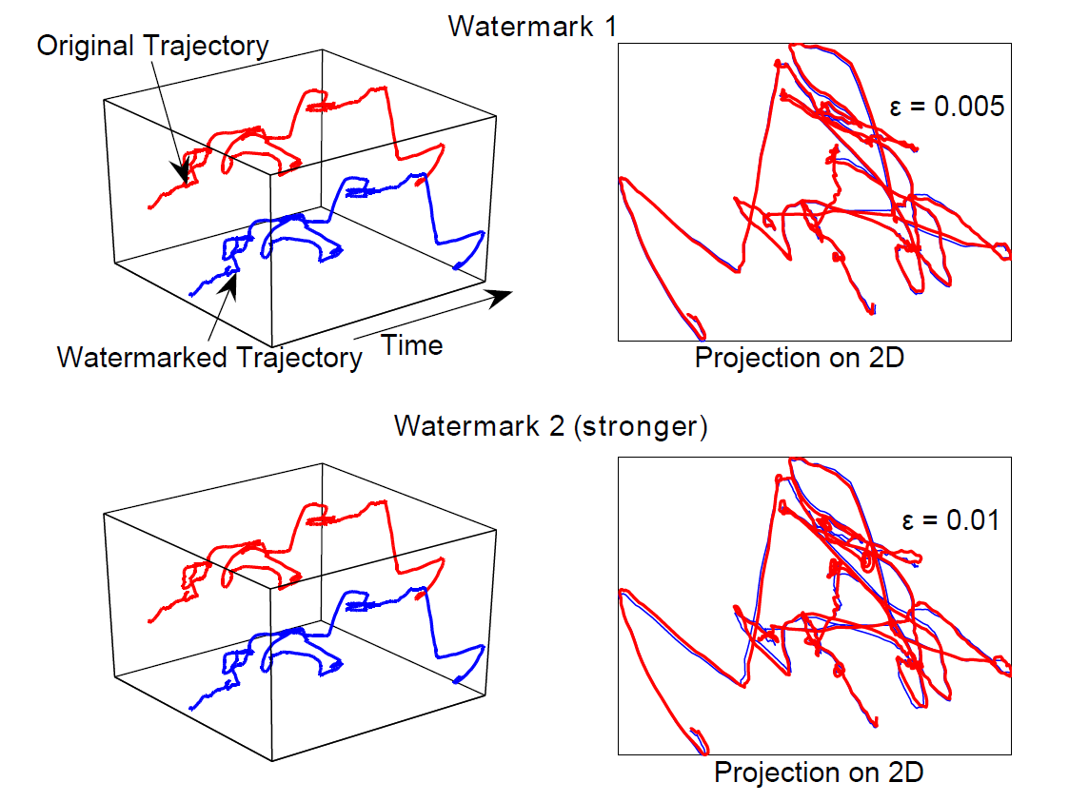
Watermarking Scheme
Spyros Zoumpoulis
Watermarking with Preservation of Distance-based Mining
14

Slide 15
Roadmap
Spyros Zoumpoulis
Watermarking with Preservation of Distance-based Mining
15
Trajectory Datasets
Objective
Watermarking Scheme
Detection Process
Theoretical Guarantees on Distance Distortion
Preservation of Nearest Neighbors and Minimum Spanning Tree
Algorithms for NN and MST Preservation
Fast algorithms for NN and MST Preservation
Experiments – Preservation, Speed-up and Resilience against Attacks
Conclusion

Slide 16
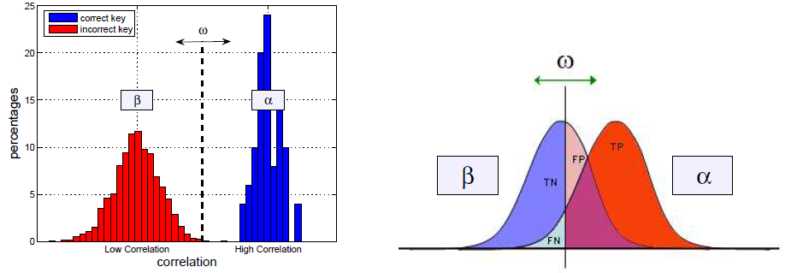
Detection Process
Spyros Zoumpoulis
Watermarking with Preservation of Distance-based Mining
16
Given a watermarked dataset and a watermark W, need a measure of “how likely” it is that the dataset was watermarked with W (and not another watermark)
Detection correlation:
Correlation between watermark W’ and dataset watermarked with W is
Threshold rule: decide was watermarked with W if
Collect correlation statistics, approximate distributions with normals

Slide 17
Roadmap
Spyros Zoumpoulis
Watermarking with Preservation of Distance-based Mining
17
Trajectory Datasets
Objective
Watermarking Scheme
Detection Process
Theoretical Guarantees on Distance Distortion
Preservation of Nearest Neighbors and Minimum Spanning Tree
Algorithms for NN and MST Preservation
Fast algorithms for NN and MST Preservation
Experiments – Preservation, Speed-up and Resilience against Attacks
Conclusion

Slide 18
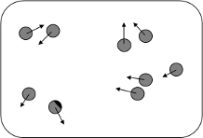
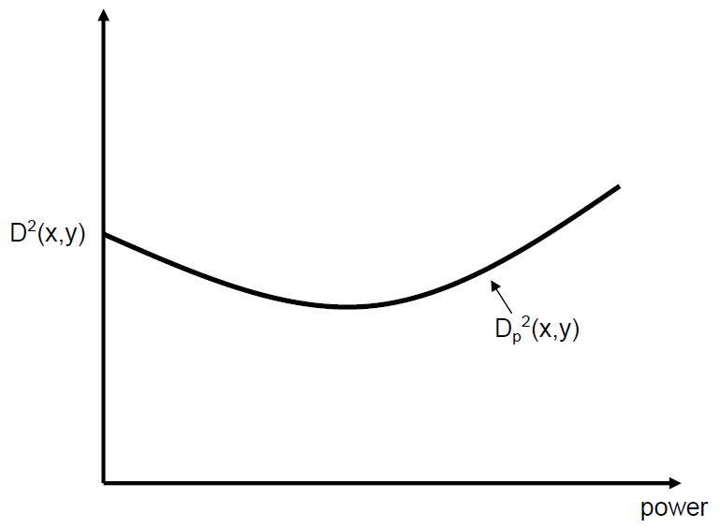
Theoretical Guarantees on Distance Distortion
Spyros Zoumpoulis
Watermarking with Preservation of Distance-based Mining
18
Goal: preservation of spatial relations between objects
Distance before watermark:
Distance after watermark:

Slide 19
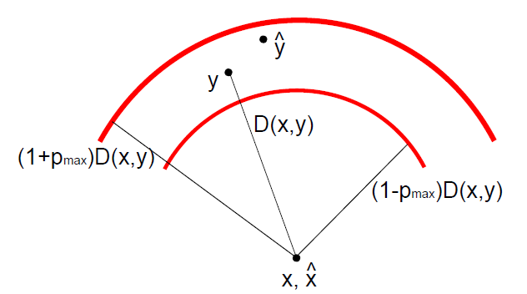
Theoretical Guarantees on Distance Distortion
Spyros Zoumpoulis
Watermarking with Preservation of Distance-based Mining
19
Theorem. Given , for any dataset S and objects, , we have
uniformly, for all watermarks consistent with S and embedding powers
Sketch of proof. LB: UB:
subject to

Slide 20
Roadmap
Spyros Zoumpoulis
Watermarking with Preservation of Distance-based Mining
20
Trajectory Datasets
Objective
Watermarking Scheme
Detection Process
Theoretical Guarantees on Distance Distortion
Preservation of Nearest Neighbors and Minimum Spanning Tree
Algorithms for NN and MST Preservation
Fast algorithms for NN and MST Preservation
Experiments – Preservation, Speed-up and Resilience against Attacks
Conclusion

Slide 21
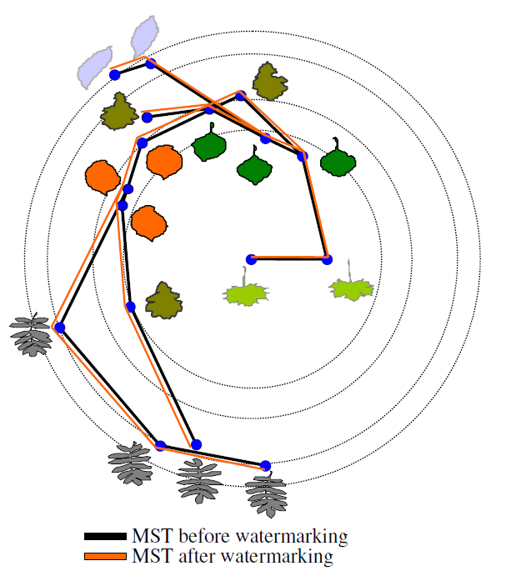
Preservation of Nearest Neighbors and Minimum Spanning Tree
Spyros Zoumpoulis
Watermarking with Preservation of Distance-based Mining
21
is continuous in p, : for p sufficiently small, any topological property will be preserved
We focus on Nearest Neighbors and Minimum Spanning Tree because of importance in data analysis
Given dataset S and object with Nearest Neighbor , x preserves its NN after the watermarking if
Given dataset S and objects s.t. (x, y) is an edge of an MST T, (x, y) is preserved in the MST after the watermarking if
where are the connected components T is split into after edge (x, y) has been removed
NN(x)
y
z
x

Slide 22
Roadmap
Spyros Zoumpoulis
Watermarking with Preservation of Distance-based Mining
22
Trajectory Datasets
Objective
Watermarking Scheme
Detection Process
Theoretical Guarantees on Distance Distortion
Preservation of Nearest Neighbors and Minimum Spanning Tree
Algorithms for NN and MST Preservation
Fast algorithms for NN and MST Preservation
Experiments – Preservation, Speed-up and Resilience against Attacks
Conclusion

Slide 23
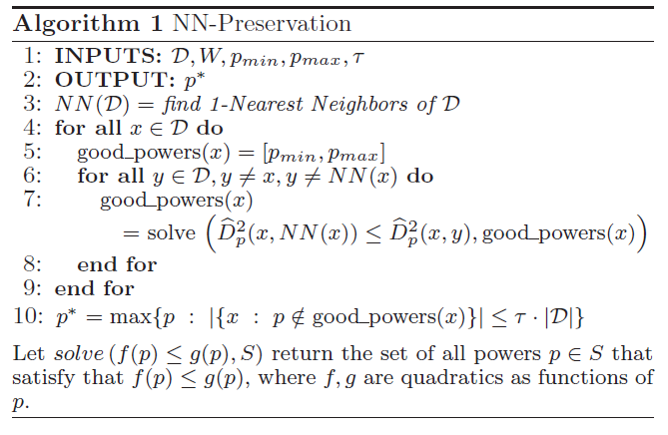
NN-Preservation Algorithm
Spyros Zoumpoulis
Watermarking with Preservation of Distance-based Mining
23
NN-P Watermarking Problem. Given dataset D and watermark W, find the largest s.t. that at least a fraction 1-τ of the objects in D preserve their NN after the watermarking with W

Slide 24
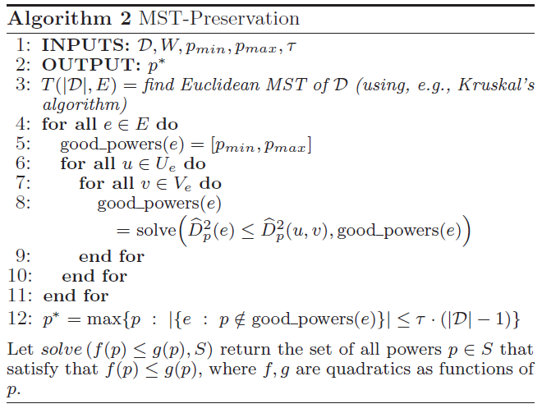
MST-Preservation Algorithm
Spyros Zoumpoulis
Watermarking with Preservation of Distance-based Mining
24
MST-P Watermarking Problem. Given dataset D and watermark W, find the largest s.t. that at least a fraction 1-τ of the edges of an MST of D are preserved in the MST after the watermarking with W

Slide 25
Roadmap
Spyros Zoumpoulis
Watermarking with Preservation of Distance-based Mining
25
Trajectory Datasets
Objective
Watermarking Scheme
Detection Process
Theoretical Guarantees on Distance Distortion
Preservation of Nearest Neighbors and Minimum Spanning Tree
Algorithms for NN and MST Preservation
Fast algorithms for NN and MST Preservation
Experiments – Preservation, Speed-up and Resilience against Attacks
Conclusion

Slide 26
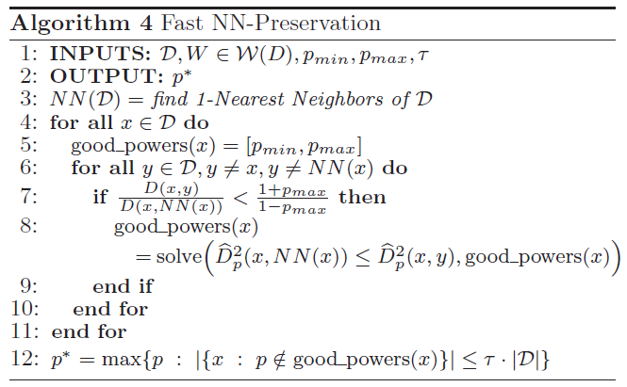
Fast NN-Preservation Algorithm
Spyros Zoumpoulis
Watermarking with Preservation of Distance-based Mining
26
Corollary. Given , for any dataset D and objects D, if
then y does not violate the NN of x after the watermarking, for all watermarks consistent with D and powers
y₃
NN(x)
ρ
y₂
x
y₁

Slide 27
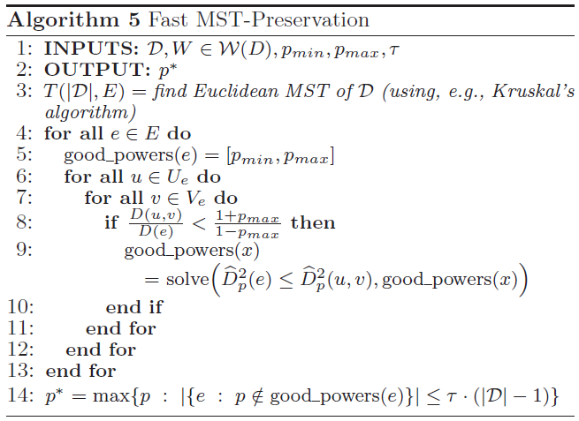
Fast MST-Preservation Algorithm
Spyros Zoumpoulis
Watermarking with Preservation of Distance-based Mining
27
Corollary. Given , for any dataset D and edge e in an MST of D, objects , if
then (u,v) does not violate the MST at edge e after the watermarking, for all watermarks consistent with D and powers

Slide 28
Roadmap
Spyros Zoumpoulis
Watermarking with Preservation of Distance-based Mining
28
Trajectory Datasets
Objective
Watermarking Scheme
Detection Process
Theoretical Guarantees on Distance Distortion
Preservation of Nearest Neighbors and Minimum Spanning Tree
Algorithms for NN and MST Preservation
Fast algorithms for NN and MST Preservation
Experiments – Preservation, Speed-up and Resilience against Attacks
Conclusion

Slide 29
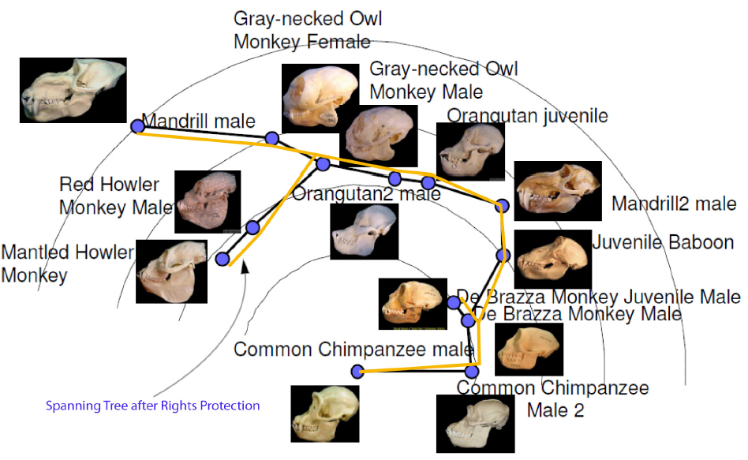
Experimental Results - Preservation
Spyros Zoumpoulis
Watermarking with Preservation of Distance-based Mining
29
Evaluate our technique using visualization. Example of MST preservation:
MST on original data
MST on watermarked data
Spanning Tree After Rights Protection

Slide 30
Experimental Results – Speed-up of 2-3 orders of magnitude
Spyros Zoumpoulis
Watermarking with Preservation of Distance-based Mining
30
Compare number of operations and time for exhaustive vs. Fast algorithms
Computations of coefficients of quadratics
Prune >99.9638% of operations for NN preservation
Prune >99.9978% of operations for MST preservation
for datasets of ~1000 objects
Quadratic inequalities solved
Prune >99.9789% of operations for NN preservation
Prune >99.9987% of operations for MST preservation
for datasets of ~1000 objects
Running time after pre-processing
NN Preservation: 0.5 s vs. 3.7 min
MST Preservation: 2.8 min vs. 1.4 hrs
for datasets of ~1000 objects

Slide 31
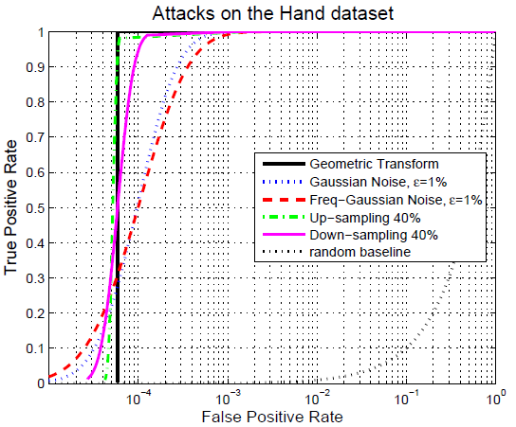
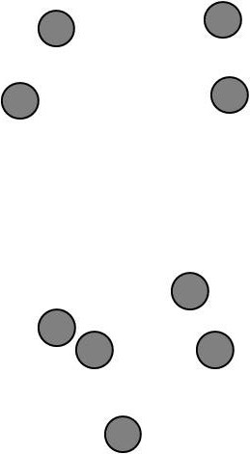
Experimental Results – Resilience against Attacks
Spyros Zoumpoulis
Watermarking with Preservation of Distance-based Mining
31
Recipient of data may transform data to obfuscate ownership
Attacks considered
Geometric transformations (global rotation, translation, scaling)
Gaussian noise addition (space domain and frequency domain)
Downsampling/Upsampling
→ Robustness

Slide 32
Roadmap
Spyros Zoumpoulis
Watermarking with Preservation of Distance-based Mining
32
Trajectory Datasets
Objective
Watermarking Scheme
Detection Process
Theoretical Guarantees on Distance Distortion
Preservation of Nearest Neighbors and Minimum Spanning Tree
Algorithms for NN and MST Preservation
Fast algorithms for NN and MST Preservation
Experiments – Preservation, Speed-up and Resilience against Attacks
Conclusion

Slide 33
Conclusion
Spyros Zoumpoulis
Watermarking with Preservation of Distance-based Mining
33
Tradeoff: rights protection vs. preservation of mining utility
Presented algorithms that identify the max embedding power that preserves NN and MST
Transformations
Proved fundamental tight bounds on distance distortion due to watermarking
Compression
Leveraged analysis to propose efficient algorithms for NN and MST preservation
Anonymization
Rights Protection
Technique preserves distance properties, is resilient to malicious attacks
How can we guarantee that the results on the modified and the original datasets are the same?
Future work
Other data transformations
Provide a unified framework for preservation of general mining algorithms under general data transformations

Slide 34
Preservation of Nearest Neighbors and Minimum Spanning Tree
Spyros Zoumpoulis
Watermarking with Preservation of Distance-based Mining
34
MST preservation does not imply NN preservation…
…and vice versa

