Slide 1
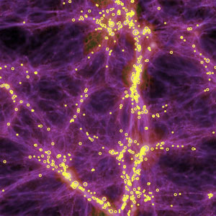
CARL SAGAN
Bob Davis

Slide 2
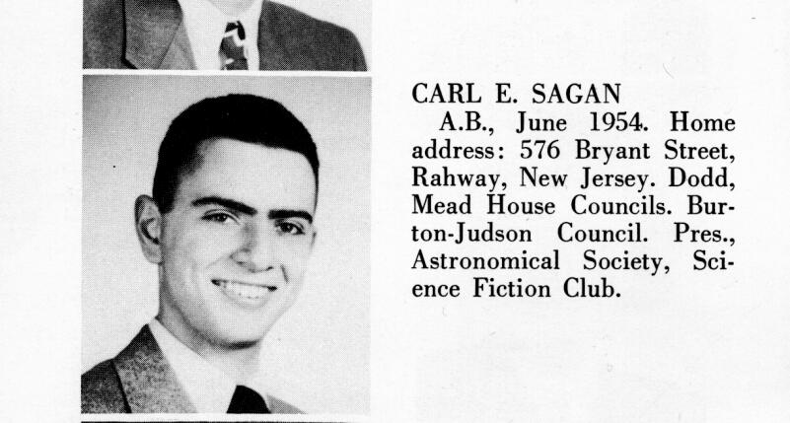
Early Life
Born Nov. 9, 1934 in Brooklyn, NY
Parents were Russian Jews
Grew up in New Jersey
Mother religious, father skeptical

Slide 3
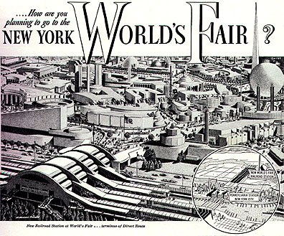
1939 World’s Fair
Saw multiple science experiments
Saw new technology called “television”
Time capsule- planted the seeds for Pioneer Plaque idea

Slide 4
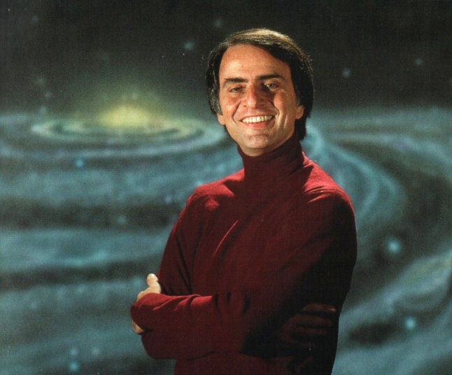
School and Teaching
University of Chicago: BA 1954, BS 1955, MA science and physics 1956, Dr. of Philosophy in astronomy and Astrophysics, 1960
Lectured and researched at Harvard until 1968
1971: became director of Planetary Studies at Cornell

Slide 5
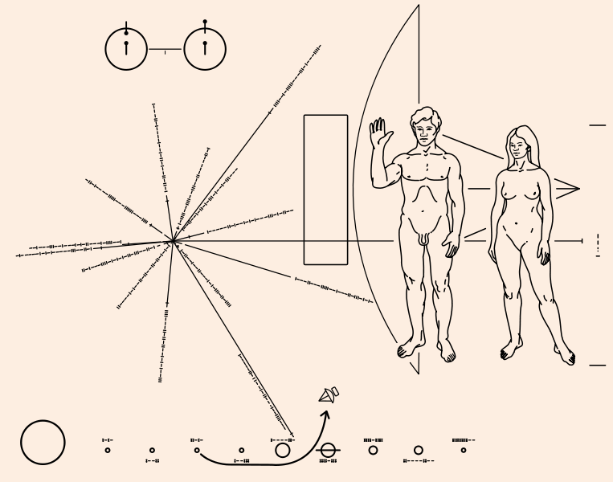
Work with Space Program
Worked as advisor for NASA
Designed experiments for robotic space probes to do
Created the Pioneer Plaque: our message to the Universe

Slide 6
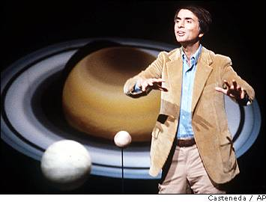
Contribution to Science
One of first to suggest pools of liquid on surface of Titan and under surface of Europa
Seasons on Mars
Venus is Very Hot- he linked it to man made global warming in 1960s!

Slide 7
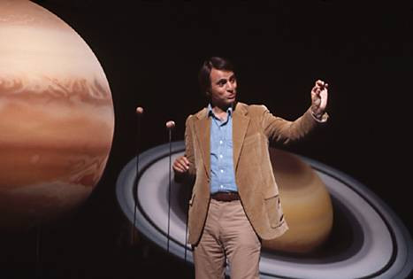
Pop Science
Television Series and Specials such as “Cosmos: A Personal Voyage ”
Books such as “Pale Blue Dot
Explained science in an understandable way
Legitimized SETI

Slide 8
A Glorious Dawn

