Slide 1
MIT 3.071 Amorphous Materials 4: Phase Change Data Storage
Juejun (JJ) Hu
hujuejun@mit.edu

Slide 2
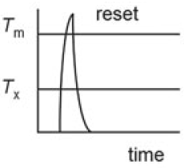
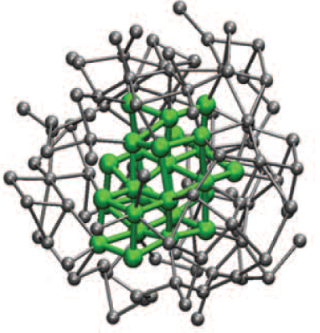
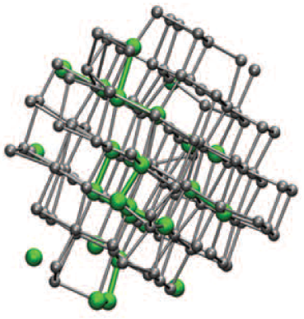
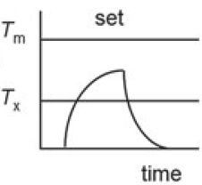
Phase change materials
Amorphous
Crystalline
Reset
Set
High electrical resistivity
Low electrical resistivity
Low optical reflectance
High optical reflectance

Slide 3
Key performance metrics
Data retention
Programming speed
Recording density
Endurance (cycle lifetime)
Power consumption
Good glass stability
Fast crystallization
Size dependence of material properties, driver size
Phase and interface stability
Enthalpy of melting, heat capacity
Low thermal conductivity
Trade-off

Slide 4
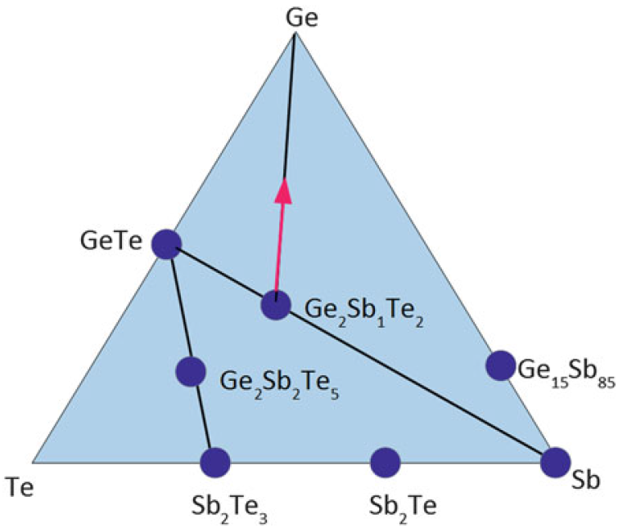
Ge-Sb-Te (GST) phase change alloy
Pseudo-binary alloy: (GeTe)_{x}(Sb₂Te₃)_{y}
Main commercial composition
Stressed rigid 3-D network
Fast switching compositions
Ge₁₅Sb₈₅, Sb₂Te
High thermal stability alloys
(Ge₂Sb₁Te₂)_{x}(Ge)_{y}
GeTe₄
Isostatic compositions
Amorphous: covalent
Crystal: resonant bonding
SbTe₄
Phys. Rev. B 81, 174206 (2010);
Solid-State Electron. 111, 27 (2015).

Slide 5
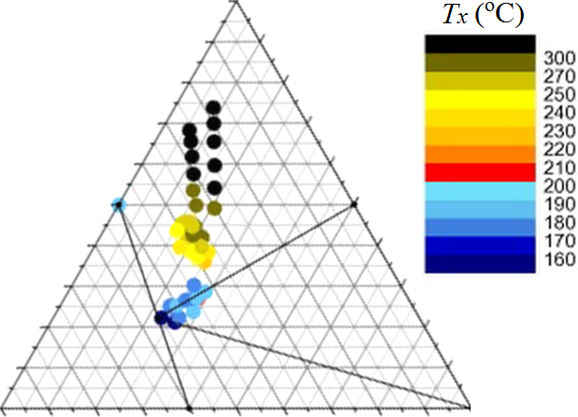
Ge-Sb-Te (GST) phase change alloy
Pseudo-binary alloy: (GeTe)_{x}(Sb₂Te₃)_{y}
Main commercial composition
Stressed rigid 3-D network
Fast switching compositions
Ge₁₅Sb₈₅, Sb₂Te
High thermal stability alloys
(Ge₂Sb₁Te₂)_{x}(Ge)_{y}
Ge
GeTe
Amorphous: covalent
Crystal: resonant bonding
Te
Sb₂Te₃
Sb
Phys. Rev. B 81, 174206 (2010);
Solid-State Electron. 111, 27 (2015).

Slide 6
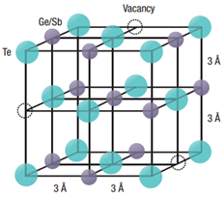
Structure of cubic Ge₂Sb₂Te₅ (225) alloy
Strong electron delocalization due to resonant bonding
Nat. Mater. 6, 824-832 (2007)

Slide 7
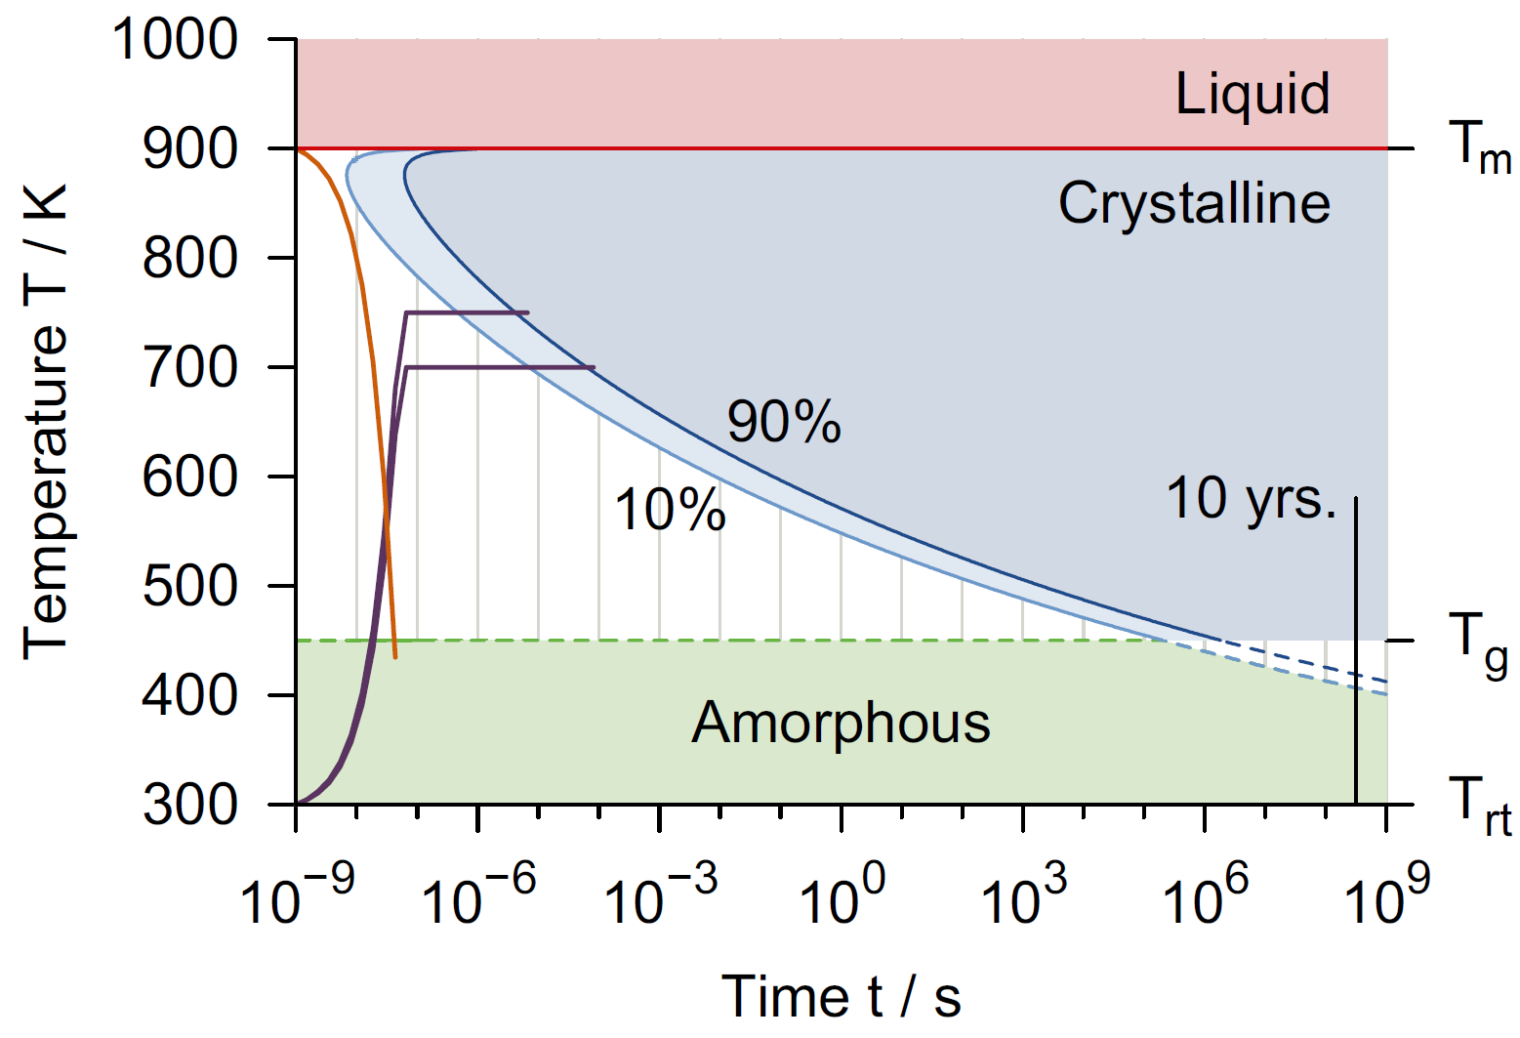
T-T-T diagram of GST phase change alloys
Emerging Non-Volatile Memories, Springer (2014)
Notes:
Typical quench rate to get amorphous GST phase is 1E10 K/s

Slide 8
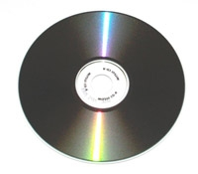
Re-writable CDs and DVDs
Modulation of optical reflectance via laser-induced phase change

Slide 9
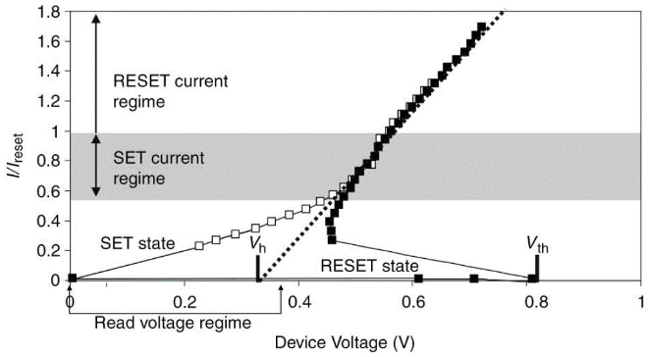
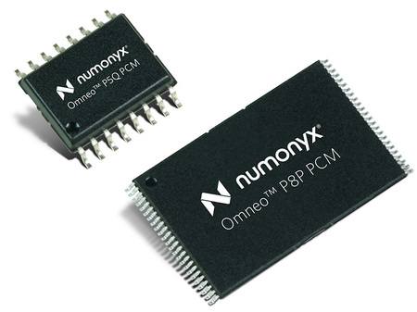
Phase change memory (PCM)
1970
Gordon Moore
IBM, Micron, Samsung, …
Discovery of threshold switching in chalcogenides
256-bit phase change memory demo
Discovery of rapid switching pseudo-binary GST material
Non-volatile phase change memory module commercialized
1968
Ovshinsky
1987
Yamada et al.

Slide 10
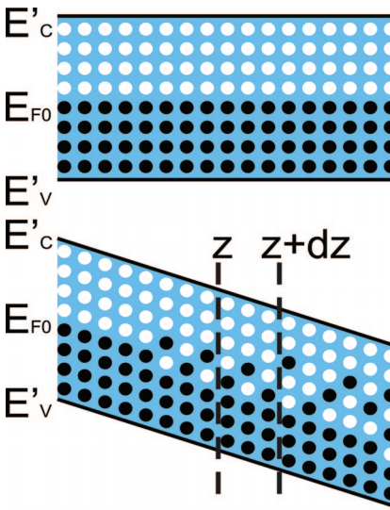
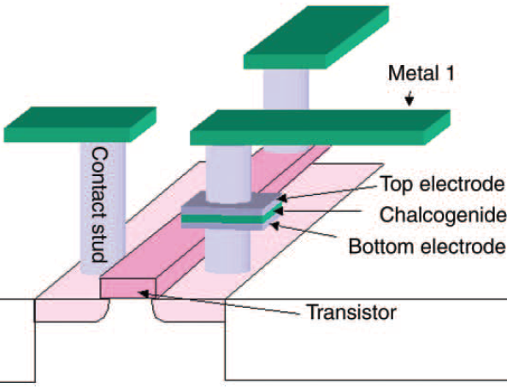
Phase change memory (PCM)
Electrodes used for both programming and read-out
Threshold switching: electric field driven bistability
Transient behavior: electronic in nature, no structural change
Contributes to reduced SET voltage
S. Hudgens and B. Johnson, MRS Bull. (2004); Phys. Rev. B 78, 035308 (2008).
Notes:
Threshold switching mechanism: in Poole-Frenkel conduction, the electric field increases the probability of a carrier that occupies one trap to get to another one nearby. At low fields, this requires extended states. At the threshold field, however, also direct tunneling becomes possible, leading to the conductivity increase. Another model presumes that threshold switching stems from a field- and carrier density-dependent generation mechanism, thus providing a positive feedback once a critical fi eld is attained. At low fields, however, recombination counterbalances the generation. There are various possible microscopic models that could account for this phenomenological effect such as impact ionization.

Slide 11
Where does PCM stand against competitors?
https://news.hpe.com/beyond-dram-and-flash-part-2-new-memory-technology-for-the-data-deluge/

Slide 12
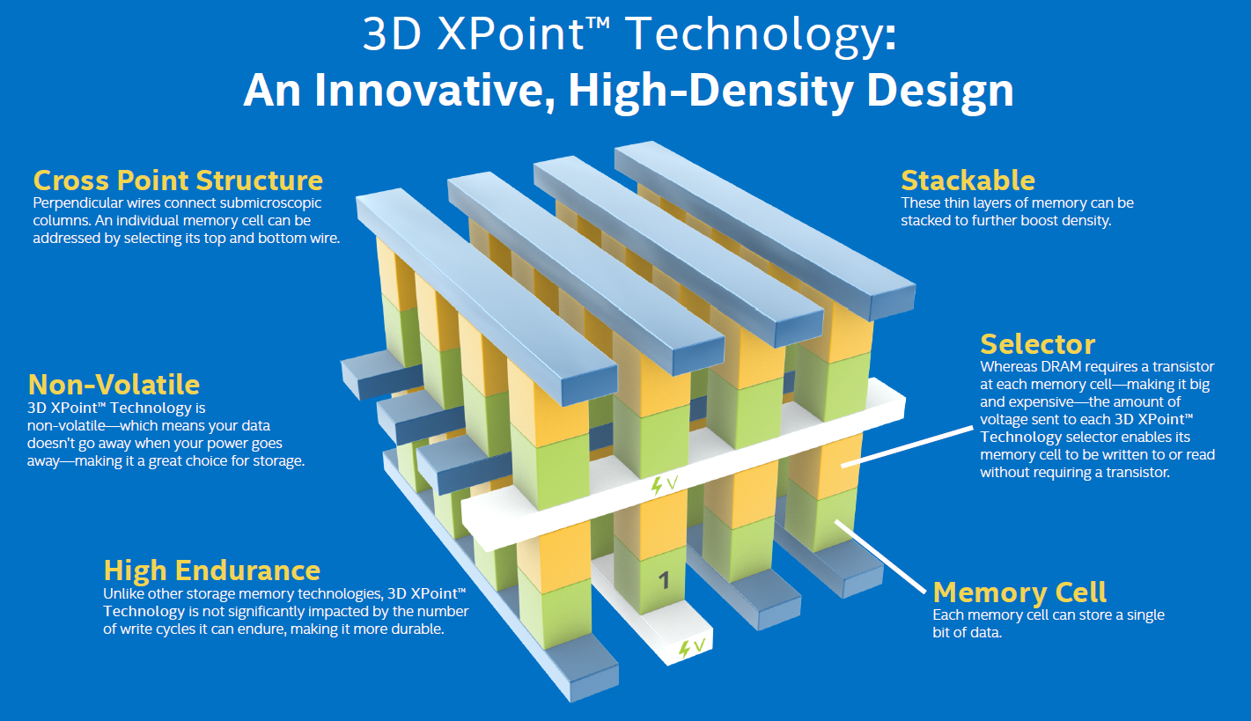
3D XPoint (a likely PCM technology)
https://www.intel.com/content/www/us/en/architecture-and-technology/intel-optane-technology.html

Slide 16
Applications beyond data storage: optics
Large optical property contrast in GeTe due to change of bonding type from crystalline (resonance) to amorphous (covalent) phase
Chem. Rev. 110, 240-267 (2010).

Slide 17
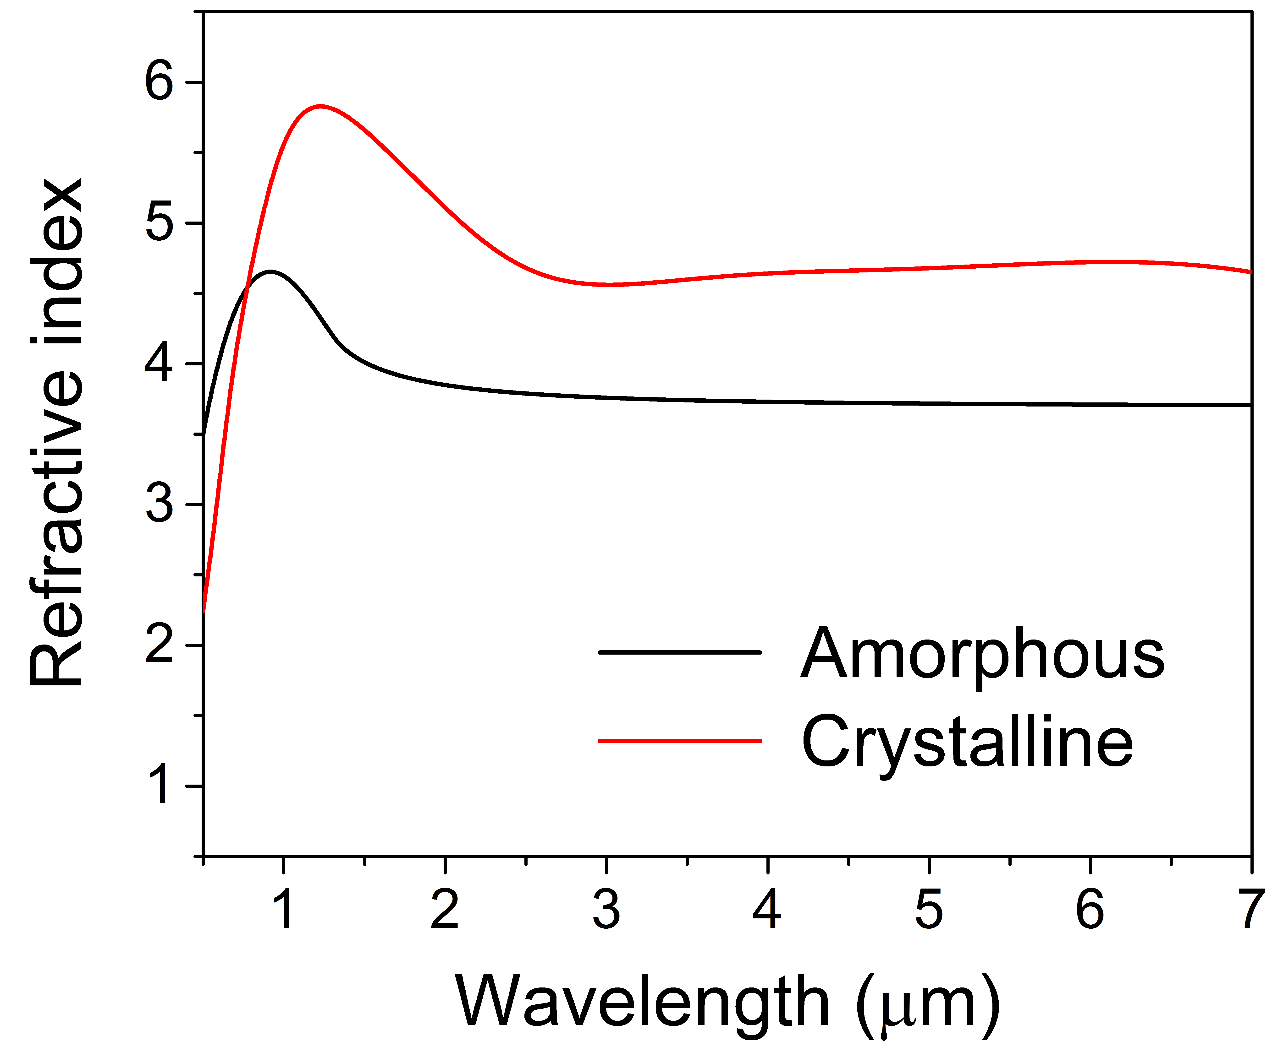
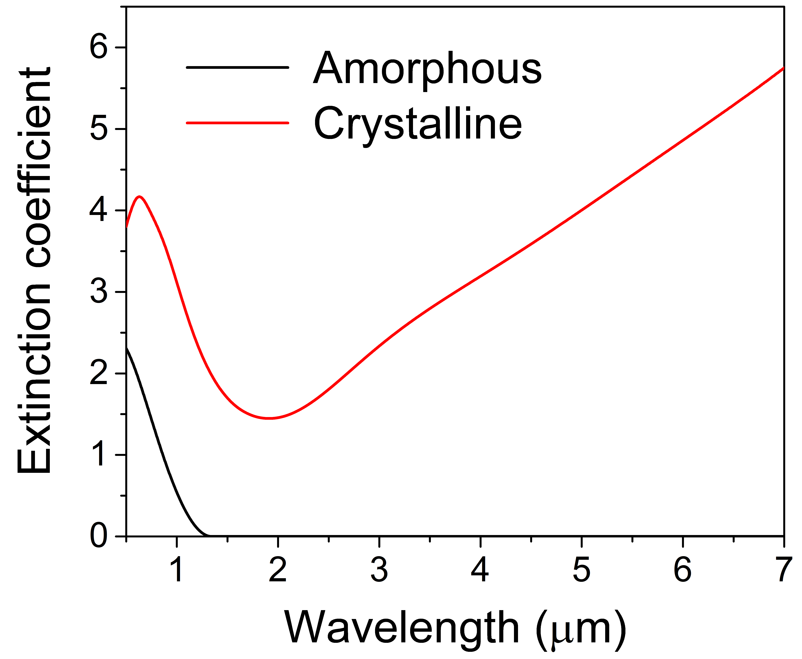
Optical properties of Ge₂Sb₂Te₅ (225) alloy
Amorphous state: low-index, reduced loss
Crystalline state: high-index, high loss
Data courtesy of V. Liberman @ Lincoln Laboratory

Slide 18
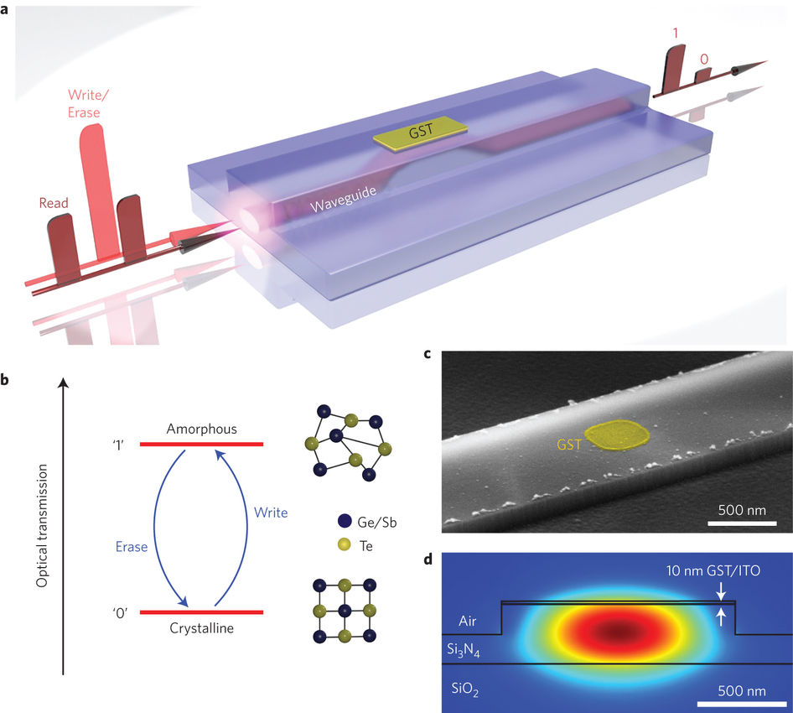
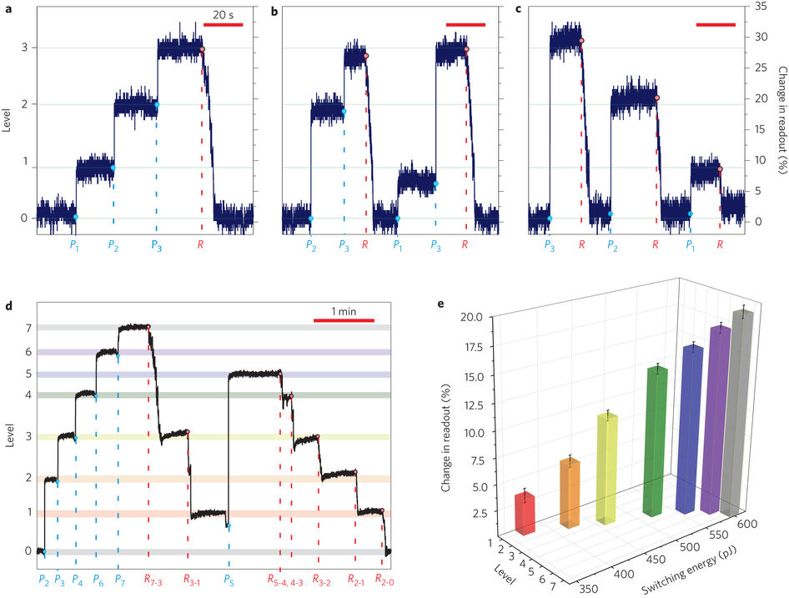
All-optical, multi-level on-chip memory
Nat. Photonics 9, 725 (2015).

Slide 19
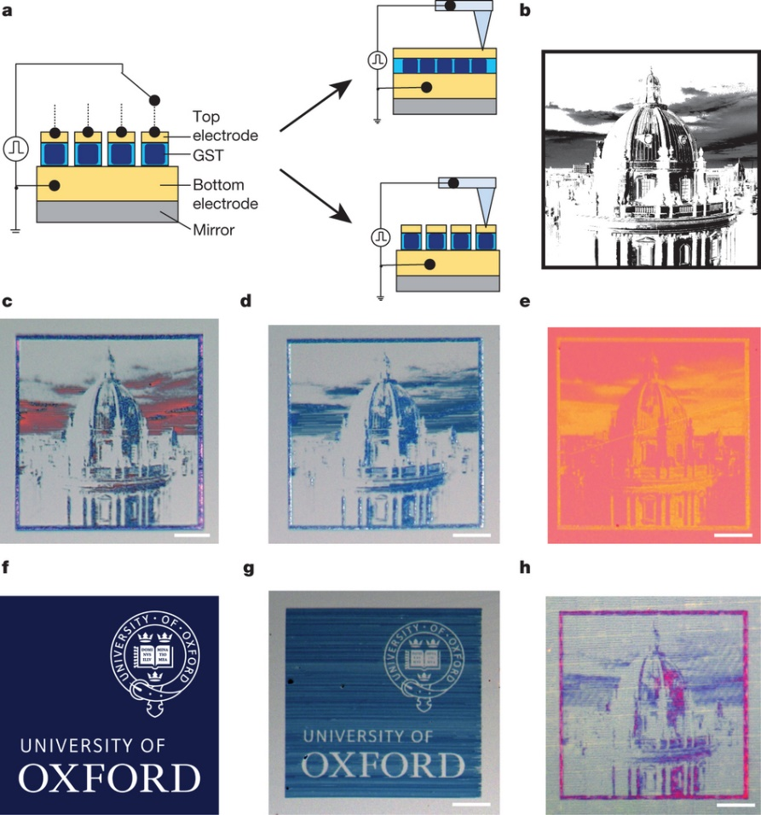
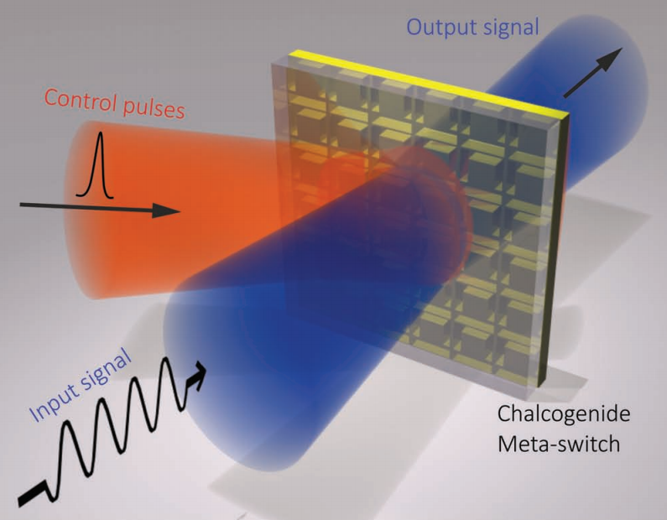
Optical switching and non-volatile display
Optical switch
Applications involving bistable states
Electronic paper display
Nature 511, 206 (2014); Adv. Mater. 25, 3050 (2013).

Slide 20
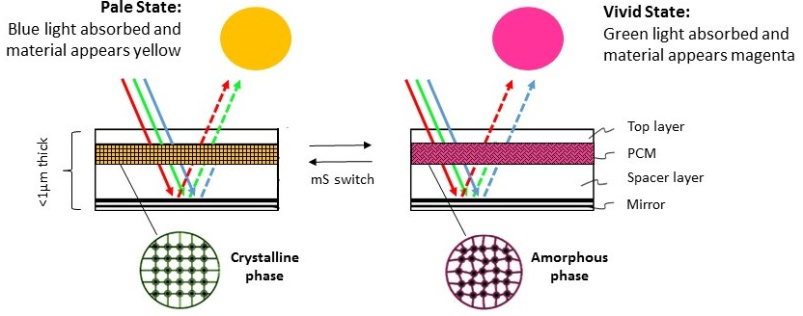

Slide 21
Further readings
Phase Change Materials: Science and Application, Springer (2009).
Google book link
Emerging Non-Volatile Memories, Springer (2014).
Download link (MIT certificate required)
“Phase change materials and phase change memory,” MRS Bull. 39, 703 (2014).

