Slide 1
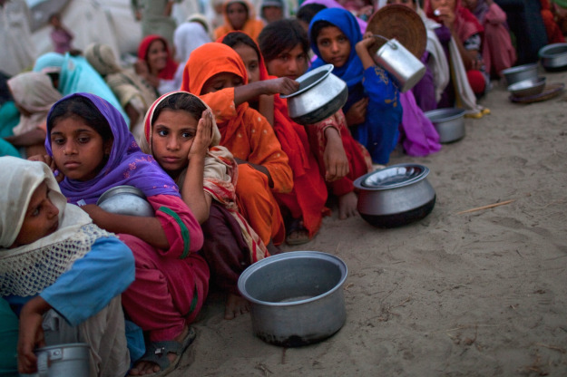
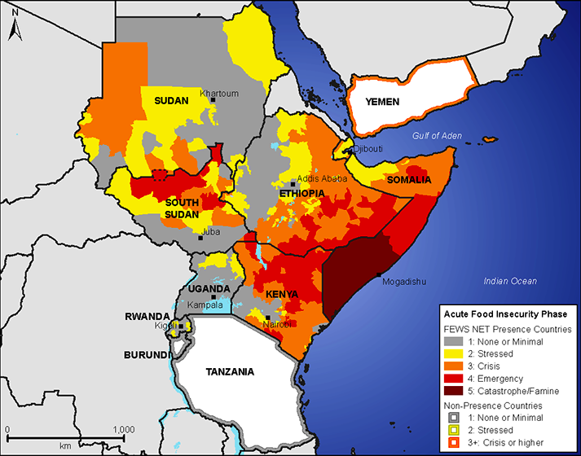
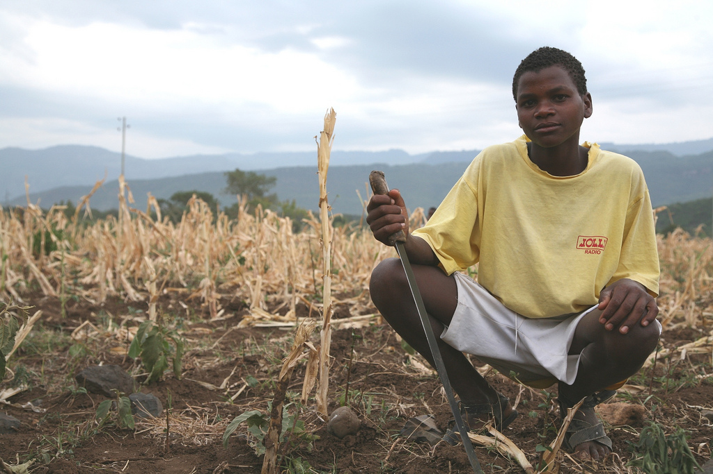
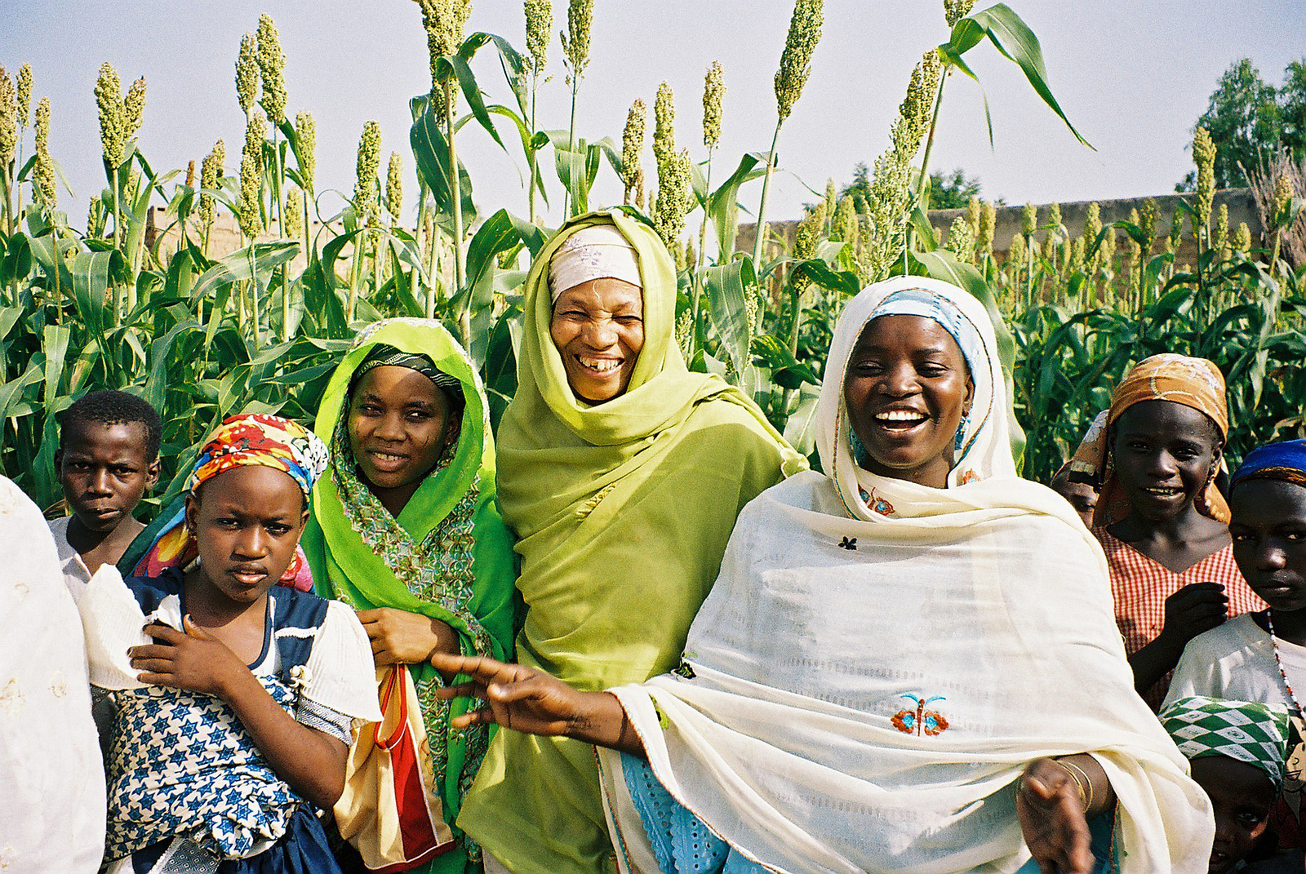
Mission 2019:
Global Food Security in the 21st century

Slide 2
Friday, Sept. 11
Divide into 7 groups of ~5-6 students
Share what you found interesting/surprising/important from the reading and/or presentation Wednesday.
Come up with a single list of potential groups for the class to tackle this year’s mission.
Come up with a single question that your group feels it needs to answer to better understand the problem or potential solutions.
Write your list of groups and your question on the board.

