Slide 1
Log-Structured File System (LFS)
6.033 Review Session
May 19, 2014

Slide 2
Background
Problem:
Sequential HD access is cheap, random access is expensive (true in 1991 and today)
Standard UNIX file system does lots of random access for small file writes (small reads OK due to caching)
Solution:
Design a new kind of file system that always writes data sequentially at the “end” of the disk

Slide 3
Data Structures in LFS
Same as in UNIX File System
Superblock (fixed position on disk)
Inode
Blocks containing file data or directory listings
Indirect Block
Used to Maintain Log Structure
Inode map (replaces the “itable”/“inode table” in the UNIX FS; no longer in a fixed position on disk)
Used to optimize cleaning
Segment summary
Segment usage table
Used to handle crash recovery
Checkpoint region (fixed position on disk, incl. pointers to inode map blocks)
Directory change log

Slide 4
Data Structures in LFS
Same as in UNIX File System
Superblock (fixed position on disk)
Inode
Blocks containing file data or directory listings
Indirect Block
Used to Maintain Log Structure
Inode map (replaces the “itable”/“inode table” in the UNIX FS; no longer in a fixed position on disk)
Used to optimize cleaning
Segment summary
Segment usage table
Used to handle crash recovery
Checkpoint region (fixed position on disk, incl. pointers to inode map blocks)
Directory change log

Slide 5
Create file1/file2 in dir1/dir2: Without LFS

Slide 6
Create file1/file2 in dir1/dir2: Without LFS
= Disk Seek

Slide 7
Create file1/file2 in dir1/dir2: With LFS

Slide 8
Create file1/file2 in dir1/dir2: With LFS
Boom.
= Disk Seek

Slide 9
Create file1/file2 in dir1/dir2: With LFS
= Disk Seek

Slide 10
What’s the Catch?
Eventually we’ll reach the end of the disk
As files are deleted, freed data blocks leave “holes” in the previously contiguous log
If we simply fill in the holes, we’re be back to standard UNIX FS performance (probably worse)

Slide 11
Free Space Management Solutions

Slide 12
Free Space Management Solutions
LFS uses combination; copy-and-compact 512KB “segments” but thread compacted segments into open spaces in the log
Why 512KB? Makes seek time neglibible.

Slide 13
Data Structures in LFS
Same as in UNIX File System
Superblock (fixed position on disk)
Inode
Blocks containing file data or directory listings
Indirect Block
Used to Maintain Log Structure
Inode map (replaces the “itable”/“inode table” in the UNIX FS; no longer in a fixed position on disk)
Used to optimize cleaning
Segment summary
Segment usage table
Used to handle crash recovery
Checkpoint region (fixed position on disk, incl. pointers to inode map blocks)
Directory change log

Slide 14
Data Structures in LFS
Same as in UNIX File System
Superblock (fixed position on disk)
Inode
Blocks containing file data or directory listings
Indirect Block
Used to Maintain Log Structure
Inode map (replaces the “itable”/“inode table” in the UNIX FS; no longer in a fixed position on disk)
Used to optimize cleaning
Segment summary: Information that allows block liveness to be determined
Segment usage table: Statistics used to rank which segments to clean first
Used to handle crash recovery
Checkpoint region (fixed position on disk, incl. pointers to inode map blocks)
Directory change log

Slide 15
Data Structures in LFS
Same as in UNIX File System
Superblock (fixed position on disk)
Inode
Blocks containing file data or directory listings
Indirect Block
Used to Maintain Log Structure
Inode map (replaces the “itable”/“inode table” in the UNIX FS; no longer in a fixed position on disk)
Used to optimize cleaning
Segment summary: Information that allows block liveness to be determined
Segment usage table: Statistics used to rank which segments to clean first
Used to handle crash recovery
Checkpoint region (fixed position on disk, incl. pointers to inode map blocks)
Directory change log

Slide 16
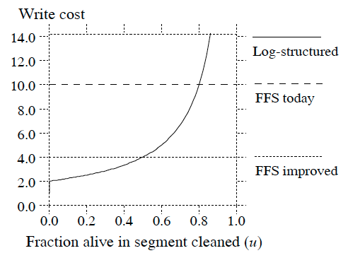
Performance Characteristics

Slide 17
Performance Characteristics

