Slide 1
You’ve Been Warned (Phishing Study paper)
6.033 Review Session
May 19, 2014

Slide 2
Background
“Phishing is the act of attempting to acquire sensitive information (usernames, passwords credit card numbers etc.) by masquerading as a trustworthy entity in electronic communication.” (Wikipedia definition)
The paper, from 2008, studies the effectiveness of 3 different phishing warning messages that had been integrated into web browsers at the time, and interviews users about their thought process.

Slide 3
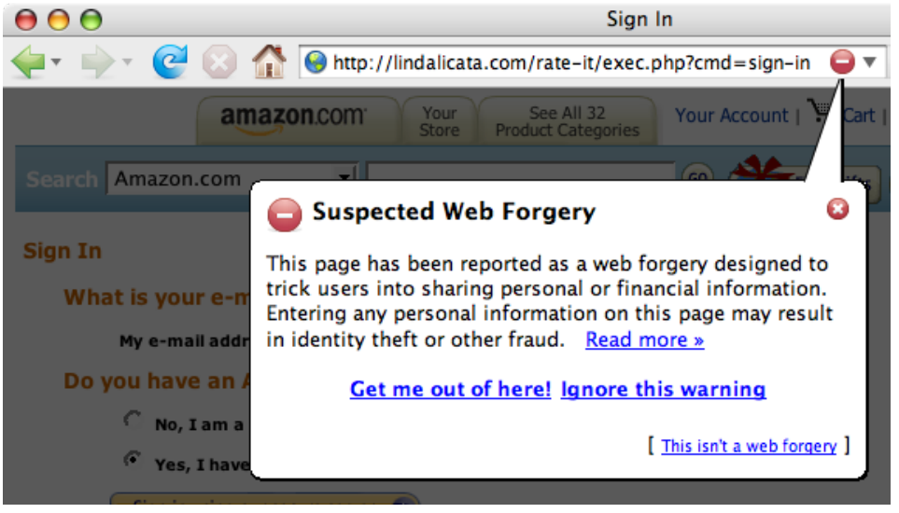
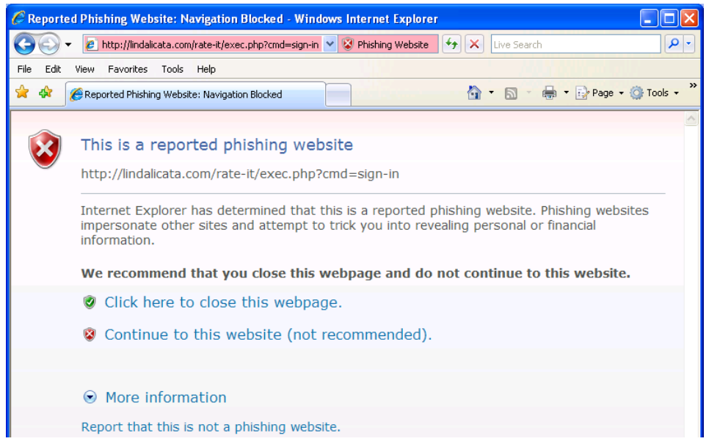
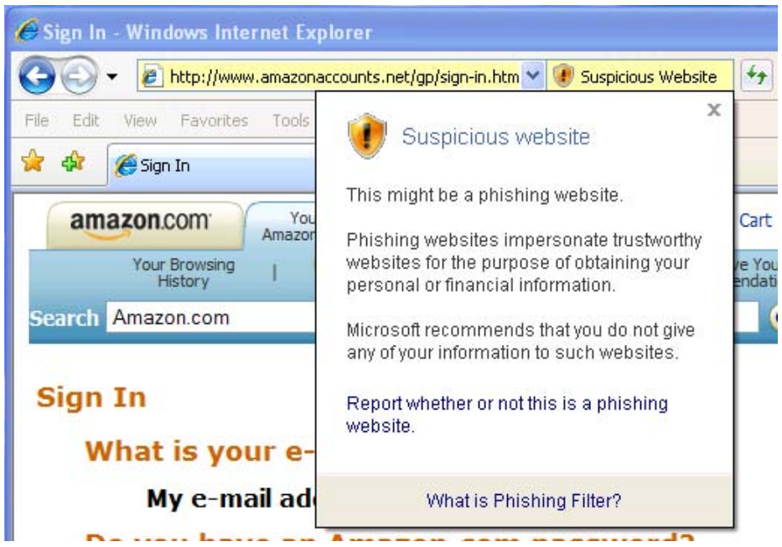
Phishing Warnings Under Study

Slide 4
Study
Recruit people from “All over Pittsburgh”.
Tell them we’re doing an “Online Shopping Study” (which the researchers were in fact doing simultaneously)
Put subjects in the lab, ask them to buy a box of paperclips ($6.50 incl. shipping) from Amazon or eBay using their own credit card and email account.
Immediately after purchase is complete, send a simulated spear-phishing email to the subject
“Amazon needs some more information to complete your international shipment; plz click link below and enter your username/password to avoid order getting canceled.”

Slide 5
(no warning)

Slide 6
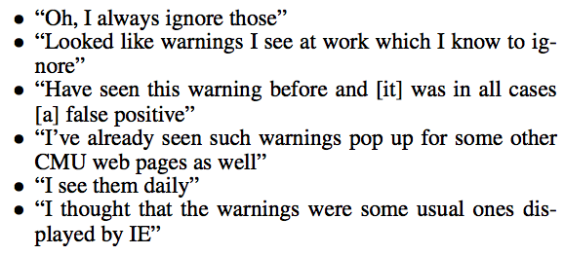
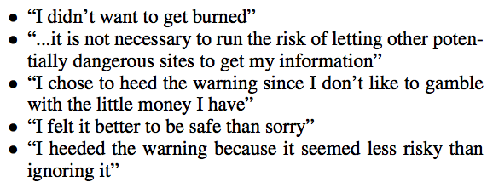
Warning Comprehension
vs.

Slide 7
Conclusions
97% clicked the links in the emails (before warnings were shown)
With active warning, 79% did not enter username/password in phishing site
With passive warning, only 13% did not enter username/password
Even when interviewed afterwards about the attack, subjects had problem understanding what had happened (e.g. that Amazon or eBay did not in fact send the phishing email)

