Slide 1
Spanner
Lixin Shi
6.033 Quiz2 Review
(Some slides from Spanner’s OSDI presentation)

Slide 2
Key Points to Remember
Major Claims
Globally distributed data with configurable control
Consistent commit timestamps
Consistency Model: external consistency
TrueTime API
Set of supported read/write operations
Paxos write
Relaxed read w/wo time stamp

Slide 3
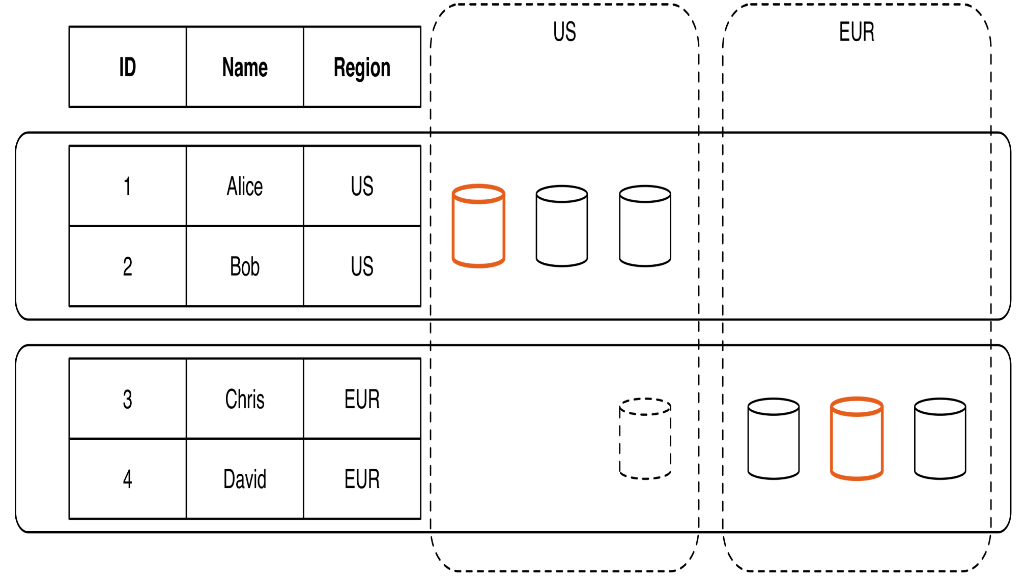
Globally Distributed Data
Cross-Datacenter
Distribution
User Configurable

Slide 4
Transaction Model
Two-Phase locking with start/commit
Transactional write and lock-free read
Globally sortable time stamp with each commit
Bounded error between time stamp and wall-clock time
start
commit
t
T₁: s₁
s₁: Timestamp

Slide 5
External Consistency
If a transaction T₁ commits before another transaction T₂ starts, then T₁'s commit timestamp is smaller than T₂
A real-world approximation of global wall-clock time consistency
start
commit
start
commit
t
t
T₁: s₁
T₁: s₁
T₂: s₂
T₂: s₂
x
s₁ < s₂
s₁ < s₂

Slide 6
TrueTime API
“Global wall-clock time” with bounded uncertainty
TT.now()
time
earliest
latest
2*ε

Slide 7
Commit Wait
Acquired locks
Release locks
T
Pick s = TT.now().latest
s
Wait until TT.now().earliest > s
Commit wait
average ε
average ε
What this gives you:
absolute start time < s < absolute commit time

Slide 8
From TrueTime to Consistency
Recall: what TrueTime gives you:
If there are two transactions:
start
commit
t
T₁: s₁
s₁ needs to be in this range
start
commit
t
s₁ < s₂
T₁: s₁
T₂: s₂
s₁ range
s₂ range

Slide 9
Supported Read/Write Operations
Read-Write transaction
Paxos write
Commit wait
Read transaction with timestamp s
Lock-free
Every replica tracks t_{safe}
Read from any replica with t_{safe} >= s
Other variants of read
Standalone read: read with t.now().latest
Read with bounded timestamp

Slide 10
GFS
Lixin Shi
6.033 Quiz2 Review
(Some slides from GFS’s SOSP presentation)

Slide 11
Design Assumption/Facts
Hardware fails very often.
Large files (>=100MB) are typical.
For read operations: large streaming reads + small random reads.
For write operations: Record appends are the prevalent form of writing.
Need to handle concurrency.
Design choice: high bandwidth >> low lantency

Slide 12
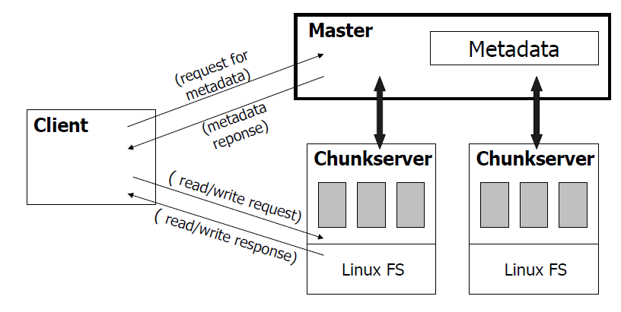
Architecture

Slide 13
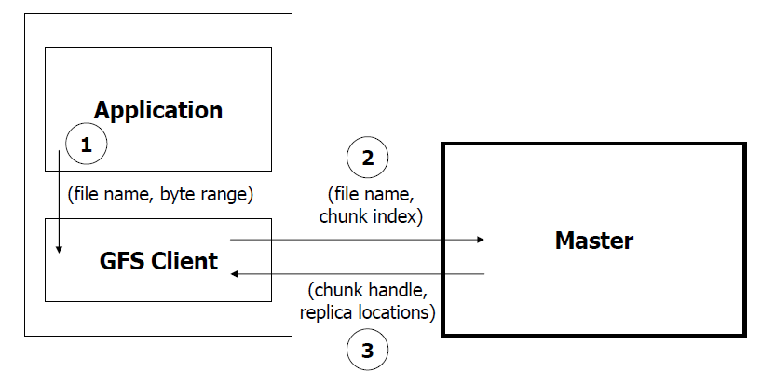
Read Algorithm

Slide 14
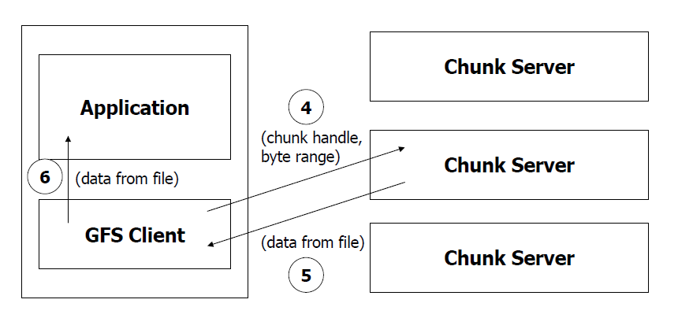
Read Algorithm (cont.)

Slide 15
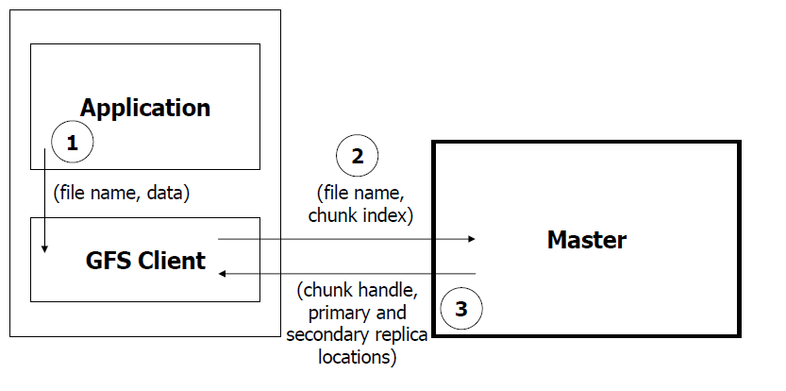
Write Algorithm

Slide 16
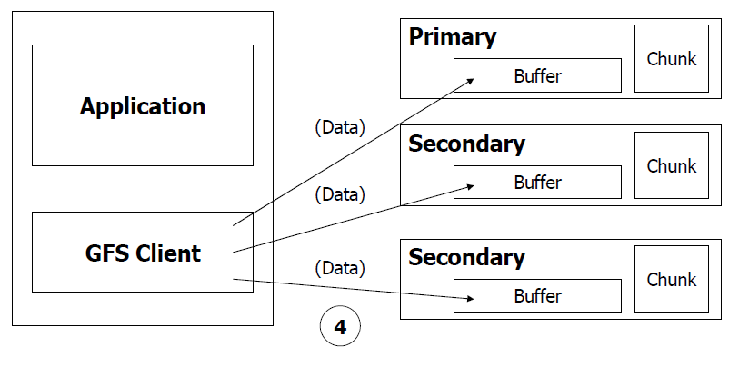
Write Algorithm (cont.)

Slide 17
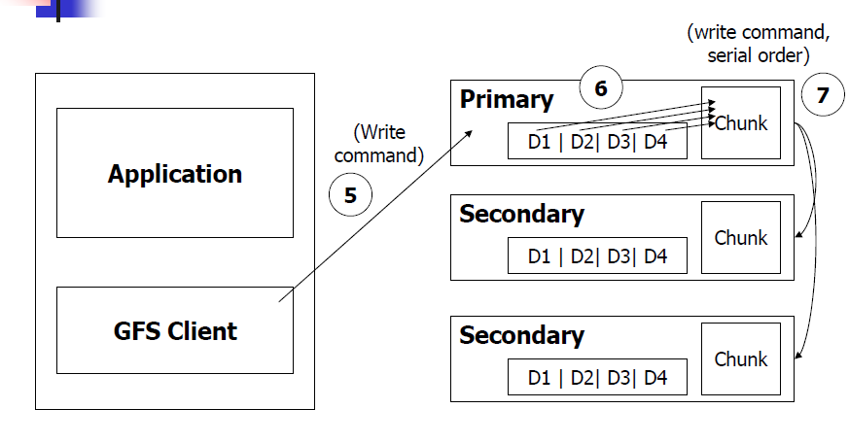
Write Algorithm (cont.)

Slide 18
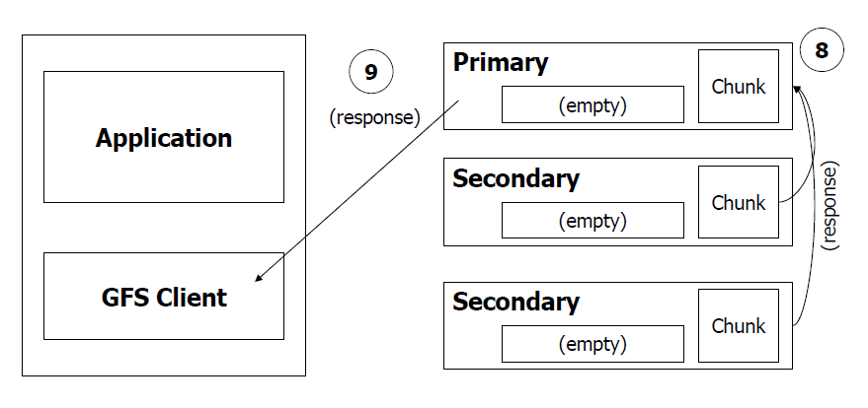
Write Algorithm (cont.)

Slide 19
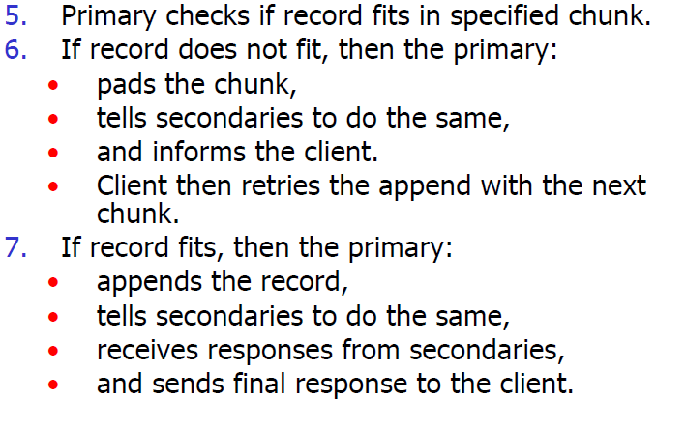
Atomic Record Appends
Atomic!
A few changes from the write algorithm:

