Slide 1
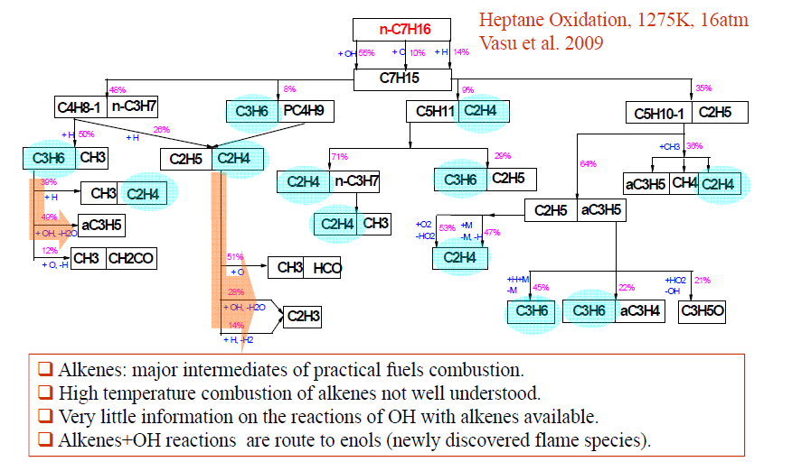
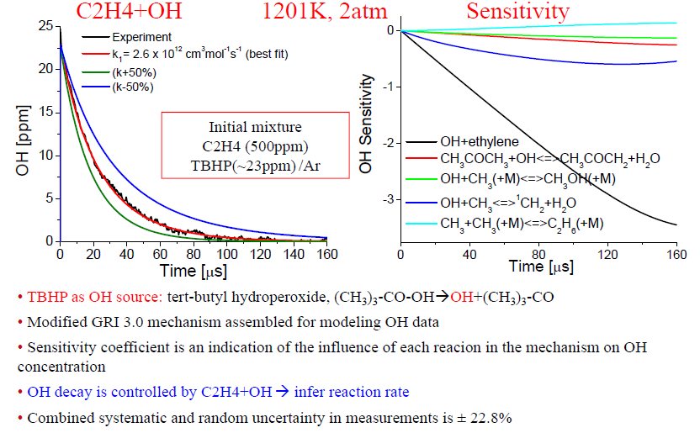
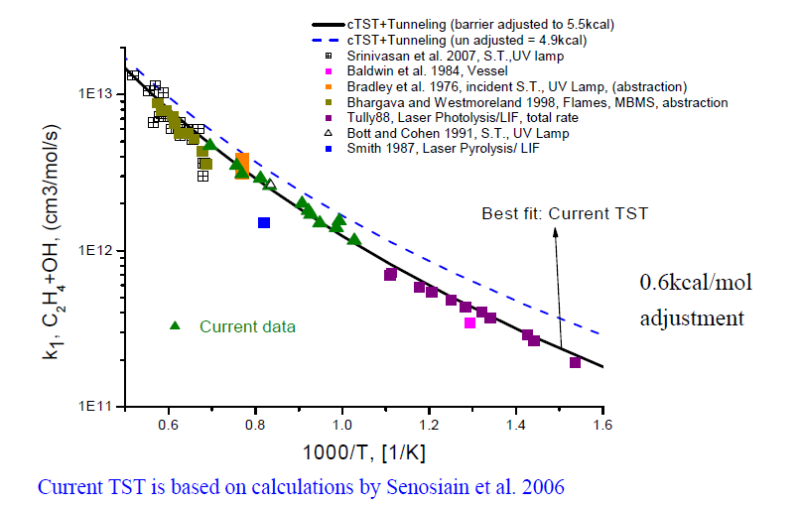
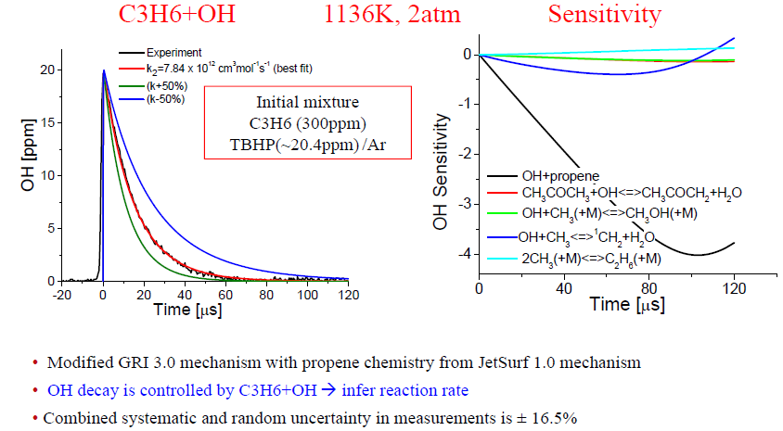
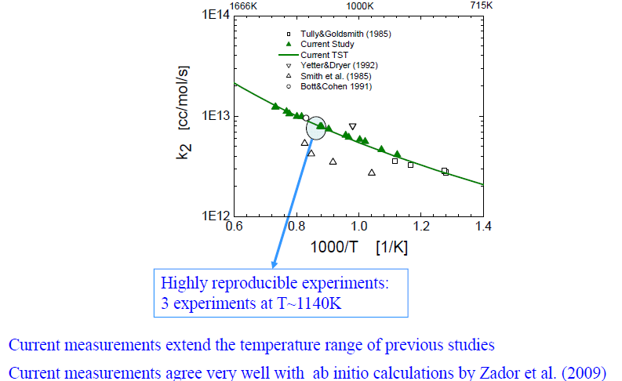
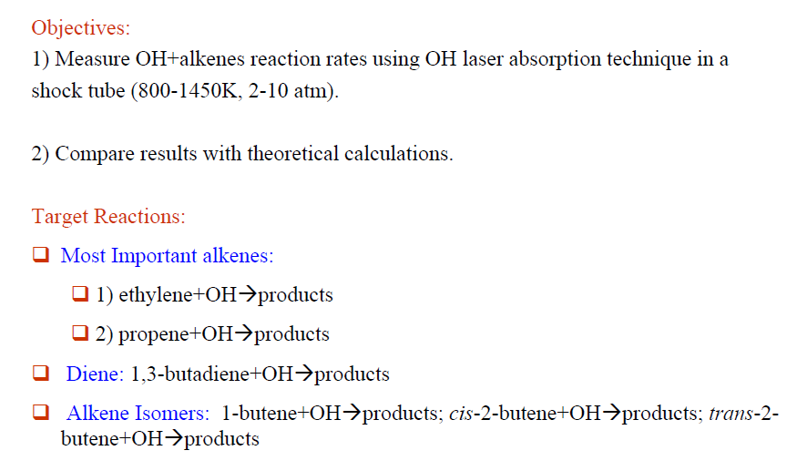
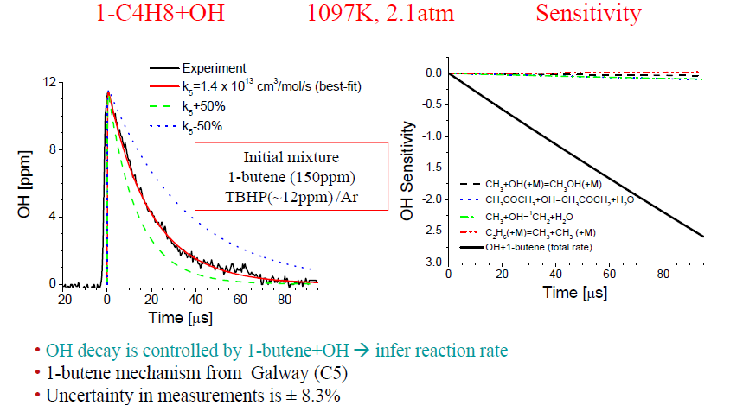
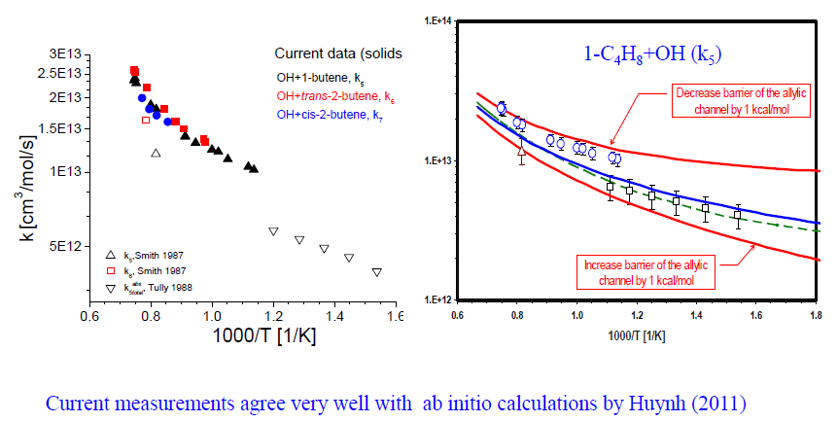
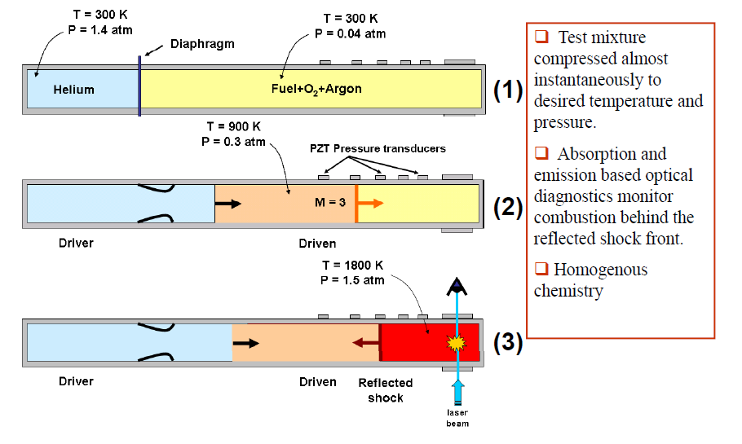
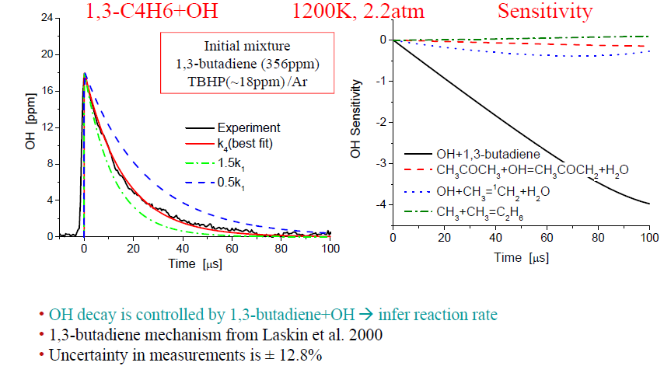
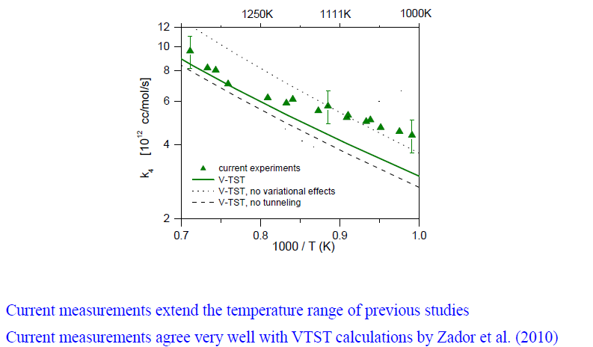
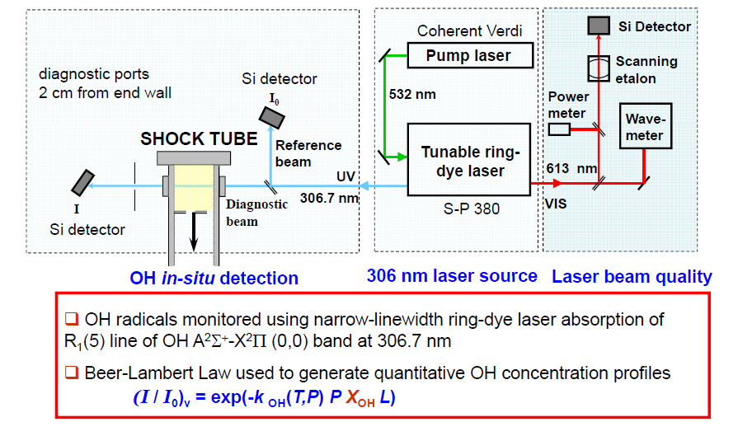
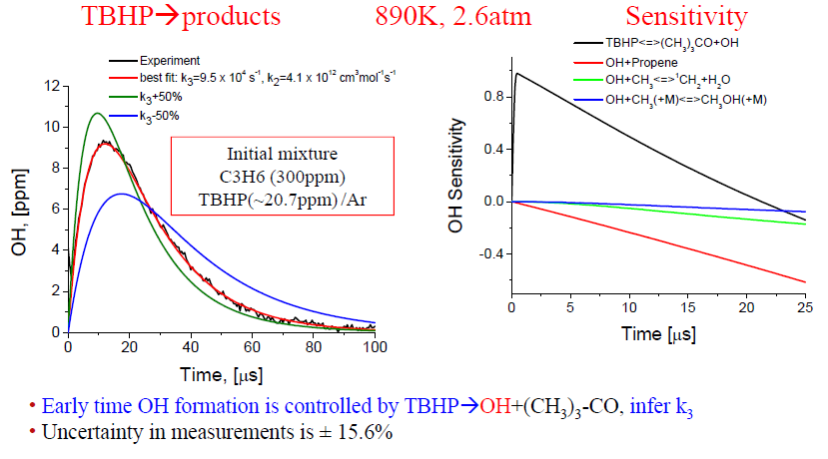
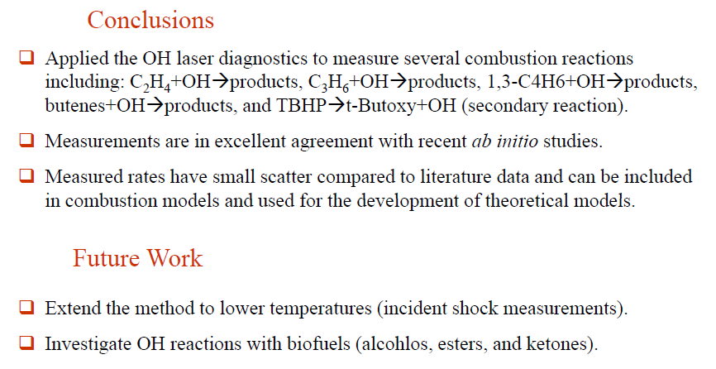
HIGH-TEMPERATURE REACTIONS OF
OH WITH LINEAR ALKENES UP TO C4
Subith S. Vasu*, David F. Davidson, Ronald K. Hanson, and David M. Golden
Mechanical Engineering Department, Stanford University, Stanford, CA 94305
* Present address: Sandia National Laboratories, Livermore, CA 94551, svasu@sandia.gov
Sponsor: DOE Office of Basic Energy Sciences
1. Motivation
5. Results: Kinetic Analysis
6. Results: Arrhenius Plots
2. Current Work
3. Shock Tube Overview
4. Experimental Set-up
7. Results: Secondary Reaction
8. Conclusions and Future Work

