Slide 1
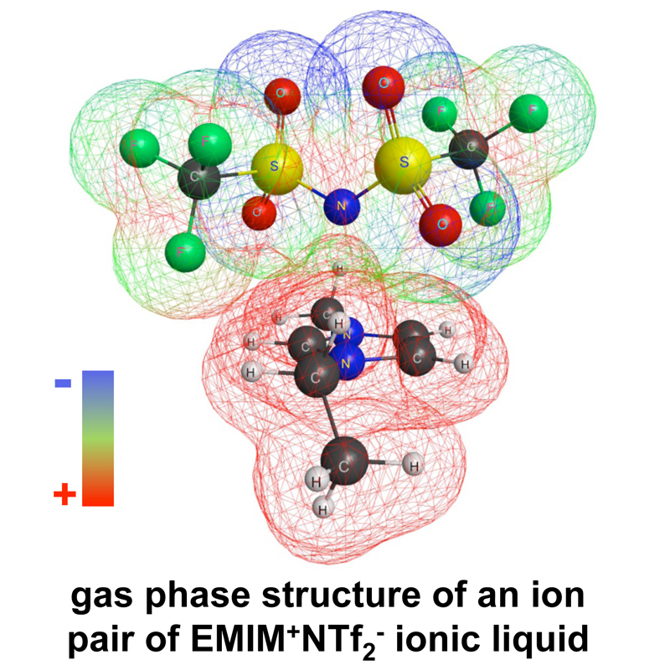
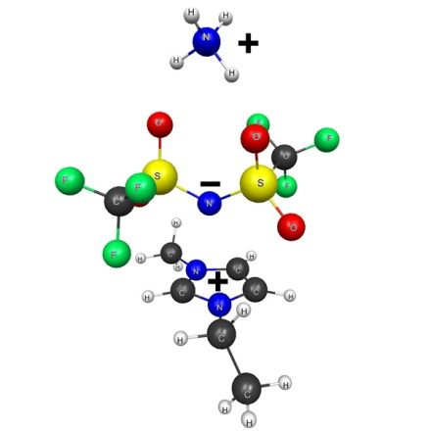
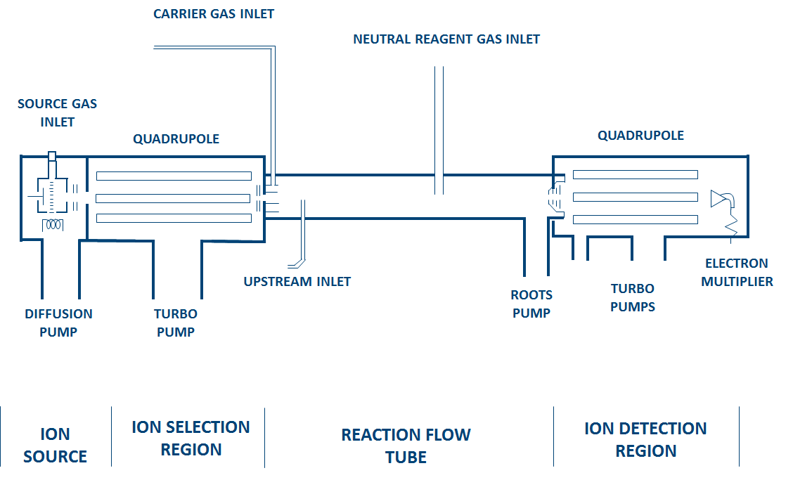
Selected-Ion Flow Tube Mass Spectrometric Investigations of the Reactions Between Several Different Ions and Ionic Liquid Vapors
Steven D. Chambreau,^{1,a} Jerry A. Boatz,^{1,b} Ghanshyam L.Vaghjiani,^{1,b}
Jeffrey F. Friedman,^{2,c,d} Nicole Eyet,^{2,d,e} A. A. Viggiano²
¹Space and Missile Propulsion Division, Propulsion Directorate, Air Force Research Laboratory, AFRL/RZSP, Edwards Air Force Base, CA 93524
² Space Vehicles Directorate, Air Force Research Laboratory, AFRL/RVBXT, Hanscom Air Force Base, MA 01731
Introduction
Results
Extremely low vapor pressures of ionic liquids (IL)
Detection of IL vapors very difficult
Many ILs are thought to vaporize as intact ion pairs: C⁺A⁻
Evaporated ion pairs are easily dissociated upon ionization:
C⁺A⁻ → C⁺ + A· + e⁻
Can we attach a third ion to the ion pair for detection?
Can we look for ion exchange/charge transfer reactions?
139
125
169
152
155
179
139
96
125
82
62
Experimental: SIFT Spectroscopy
453
HEATED IONIC LIQUID VAPOR INLET
Conclusions
Cooling facilitates detection of ion + ion pair products
See ion addition or ion exchange reactions: (NTf₂⁻)
See charge transfer reactions: (dca⁻)
T = 170 K
Future Work
Acknowledgements
Kinetics measurements
Branching ratios
ab initio calculations
Role of impurities
Mike Berman/AFOSR
Tom Hawkins
Stefan Schneider
ªERC, Inc
^{b}Propellants Branch, email: ghanshyam.vaghjiani@edwards.af.mil
^{c}University of Puerto Rico
^{d}Boston College
^{e}St. Anselm College
PA Public Affairs Clearance Number .

