Slide 1
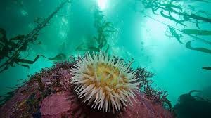
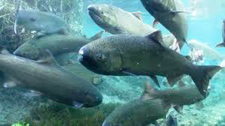
Why is water a good place to live?
The Special Properties of Water.

Slide 2
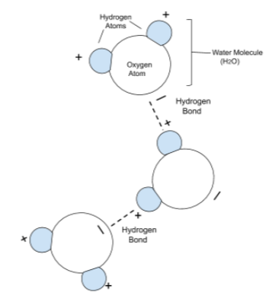
Liquid Water is a stable place to live...
Water really molecules stick together.
Due to its shape and make up, water molecules are polar molecules.
Water molecules are attracted to others with their Hydrogen (+) side pulling on the Oxygen(-) end of a neighboring molecule.
This pull forms a bond between the molecules known as a “Hydrogen bond” which makes it difficult to separate these molecules and go from the liquid state to gas. It requires a lot of energy to evaporate water.
Water remains a liquid at a wide temperature range. ..
from 0 to 100 ºC.
Liquid water is a stable place to live.

Slide 3
Liquid Water is a stable place to live...
It’s not easy to change its temperature.
Water has a high heat capacity.
Water is very good at soaking up heat without raising its temperature.
Since water needs to absorb a lot of heat to raise its temperature... it can take a long time to lose this heat and lower the temperature of water.
It’s difficult to change the temperature of water. Bodies of water do not experience rapid fluctuations in temperature which is less stressful on aquatic organisms.
The strong pull between water molecules requires a lot of energy to increase their motion.. and raising water’s temperature.

Slide 4
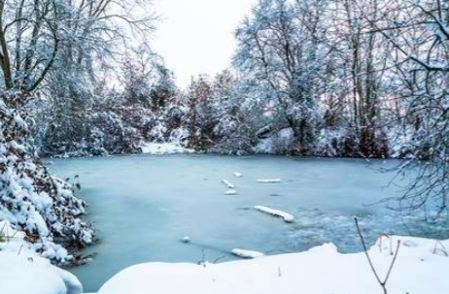
Ice floats! Water’s solid form is less dense than its
liquid state.. a very unique property.
Aquatic life can survive in the water beneath a frozen surface during colder months.
The ice provides protection from
predators of the air.
the ice shields aquatic life from extreme cold temperatures.

Slide 5
So why does ice float ?
Water Molecules as Ice.
Water Molecules
in the liquid state.
When it gets cold, molecules lose their energy
The Hydrogen bonds between molecules become stronger. Rigid bonds happen between molecules resulting in open space between molecules.
Molecules spread out.... Ice expands.
Higher kinetic energy as a liquid results in loose (weak) bonds between molecules.

Slide 6
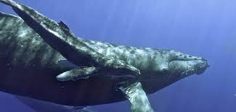
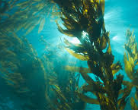
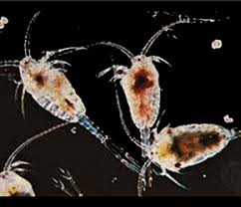
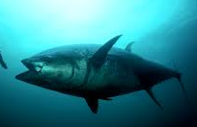
Water is dense.. but not thick ..
At 1 gram for every milliliter, water has a lot of mass per unit volume. A 5 gallon of bucket of water weighs approximately 40 pounds.
By having a lot of mass per unit volume, water can
exert a lot of buoyant force.
In this way:
Water can physically support the great weight of
large aquatic animals such as whales.
Aquatic plants and seaweeds can be held upright to
capture sunlight for photosynthesis.
Creatures from microscopic plankton to fish do not have
to expend a lot of energy being neutrally buoyant and staying off the bottom of their bodies of water.

Slide 7
Water’s density is the result (once again) of its strong
intermolecular forces, which pull water molecules tightly together.
But water isn’t thick or viscous..it remains very fluid, even when cold.
Molecules are tightly packed but water flows easily and organisms can move freely through water with little energy.
.. Think about water’s fluidity and how this is so important for the systems for circulation in plants and animals.
Water molecules are small and simple. They don’t become “tangled up” or “stuck” when tightly packed or pushed aside as things move through them.

Slide 8
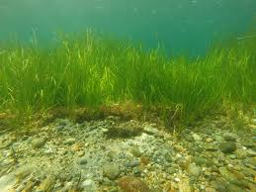
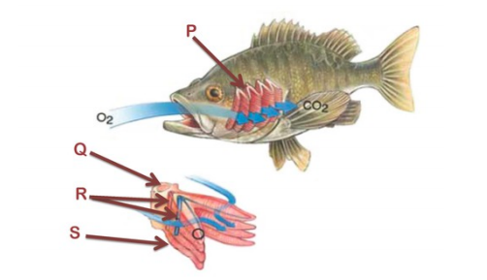
Water is the “Universal Solvent.”
Nothing dissolves more materials than water.
Water is even able to dissolve many important gases.
What about “breathing” underwater?
Water can dissolve Oxygen molecules for organisms to carry out respiration Water dissolves Carbon Dioxide molecules for photosynthesis.

Slide 9
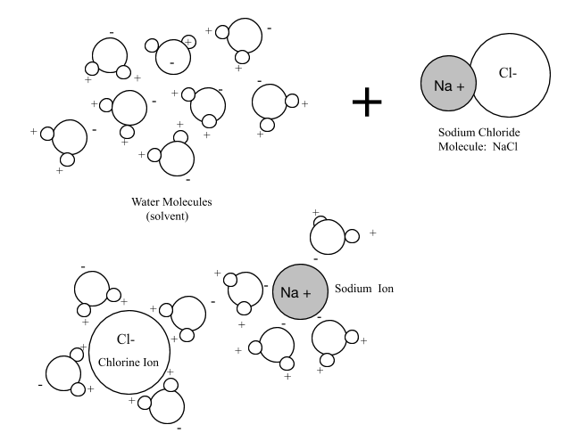
Since water is a polar molecule, it is especially good at dissolving compounds formed with ionic bonds such as the salt, Sodium Chloride. Water dissolves such compounds by breaking up ionically bonded molecules into their ions.
Once they’re dissolved, water keeps these materials in solution . In this way water can move or transport dissolved materials, which so important for living things.
With this ability essential molecules needed for the construction of and chemical processes in living things can be easily accessible by living things right from the water especially the smaller simpler organisms found at the base of the food chain.
Think about this... with water’s ability to dissolve so many materials, it remains transparent.. so important for animals that rely on vision or plant life which rely on sunlight.

Slide 10
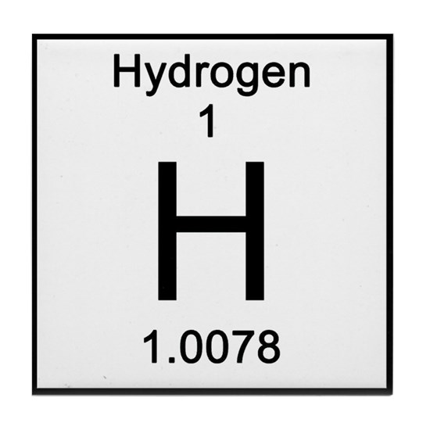
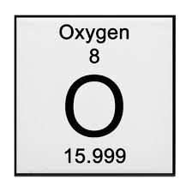
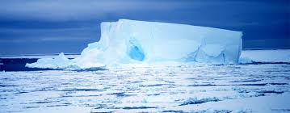
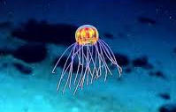
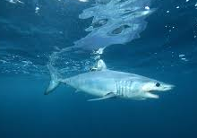
Water is a simple
compound with
simple molecules.
It is the most valuable material on our planet.
Its properties are truly unique and special.
Life began in our ocean...
Water is great place to live.

