Slide 1
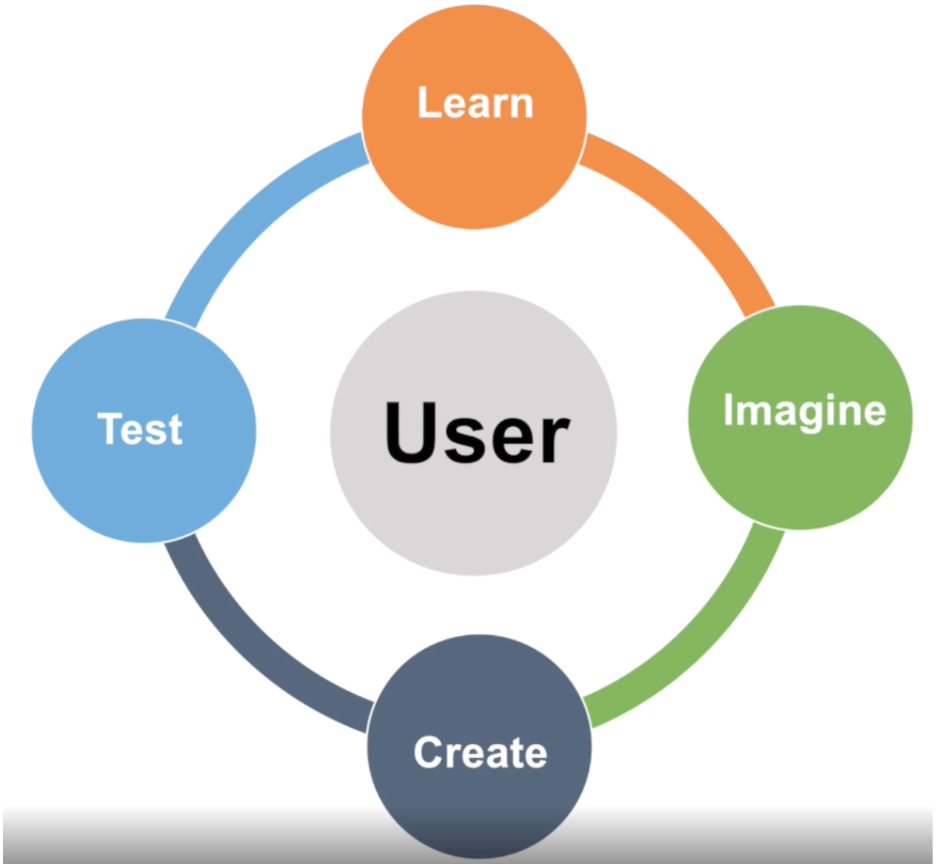
After reading the Moneythink Case Study, identify what steps were done in each phase. Add more lines if needed.

