Slide 1
11.521 - Spatial Database Management and
Advanced Geographic Information Systems
First Half:
  11.523 - Fundamentals of Spatial Database Management
Second Half:
  11.524 - Advanced Geographic Information System Project
  Instructor: Joe Ferreira, jf@mit.edu
  TA: Rounaq Basu, rounaq@mit.edu
  Technical Instructor: Eric Huntley, ehuntley@mit.edu
  Tuesday, Lab: 4-7 PM in Room W31-301 (Armory across street)
  (First meeting, tomorrow, Feb. 3, for intro lab)
  Thursday, Lecture: 5-6:30 PM in 9-540A
  Friday, extra supervised lab time: 1:00-3:00 in 9-554
Class homepage: http://mit.edu/11.521

Slide 2
Other Class: Intro to Spatial Analysis & GIS
11.205 + 11.520: 1st and 2nd half of Spring
  Fall MCP classes repeated in Spring with similar content
  11.205 = Intro to Spatial Analysis (1st half of semester)
    11.205 meets MCP spatial analysis requirement
  11.520 = Workshop on GIS (2nd half of semester)
  Taught concurrently with 11.188 (undergrad class)
11.188: Urban Planning and Social Science Lab
  Lecture: Wednesdays, 2:30 - 4 pm in City Arena (9-555)
  Lab: Mondays, 2: 30 – 5 pm in W31-301 (Armory)
    Also, extra lab time, Friday 1-3:00 pm in 9-554
  Full-semester is required undergraduate lab
Other Class homepage: http://mit.edu/11.188

Slide 3
11.521 - Spatial Database Management and
Advanced Geographic Information Systems
First half (11.523)
Intro to ‘big data’ urban analytics:
  Hands-on intro to spatial analysis, database management, and distributed GIS
  Geoprocessing, SQL, database engine, map mashups, geostats
Planning applications involving parcel- to metro-scale analyses of land use and transportation, spatial structure, neighborhood dynamics, & urban indicators.
  Weekly labs & homework exercises using enterprise GIS, map mashups, SQL, …
  E.g, construct East Boston land value maps from parcel records and real estate sales transactions
Second half (11.524)
Class projects - Use 11.523 skills on ‘real world’ projects & data
  With Boston’s metro area planning council (MAPC)
    Comparing land use patterns near transit stations
    Developing rent profile of Cambridge and Somerville
  With Singapore ‘future urban mobility’ project
    Explaining transit use differences among neighborhoods
    Visualizing housing relocation and transit use patterns
Class homepage: http://mit.edu/11.521

Slide 4
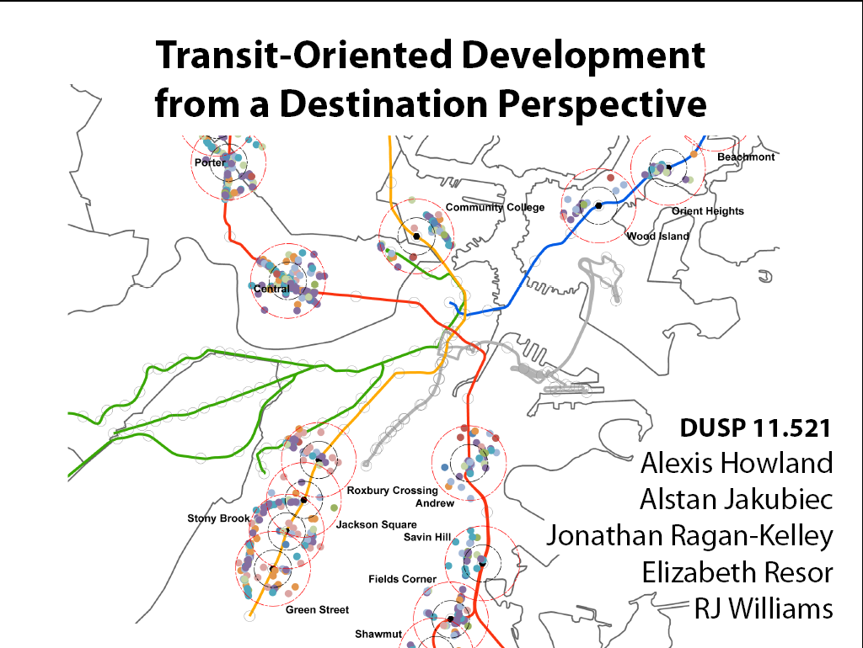

Slide 5
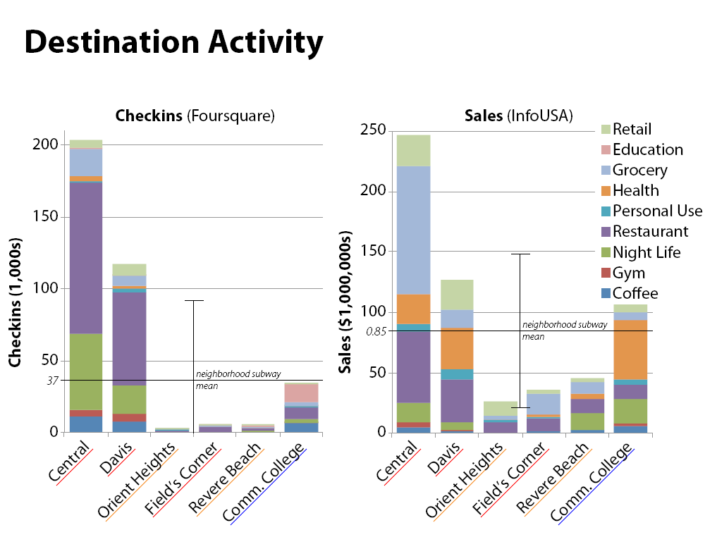
MIT 11.521 (Spring, 2013) Boston TOD project

Slide 6
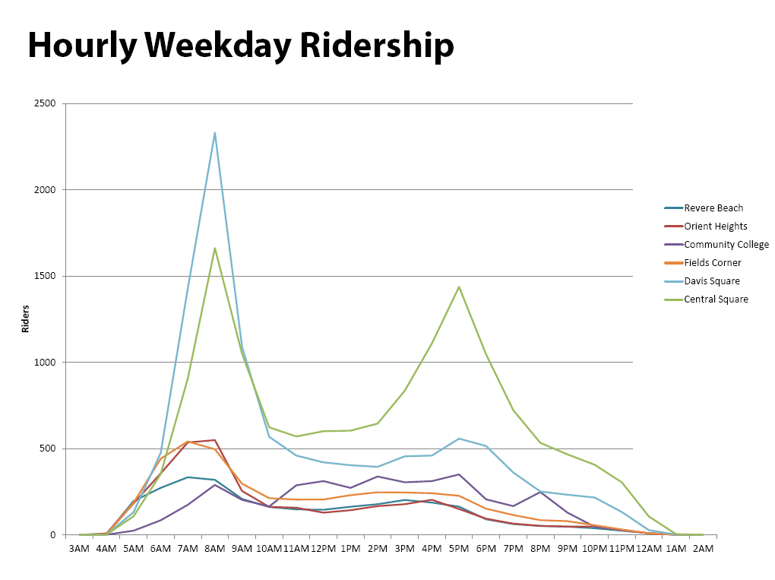
MIT 11.521 (Spring, 2013) Boston TOD project

Slide 7
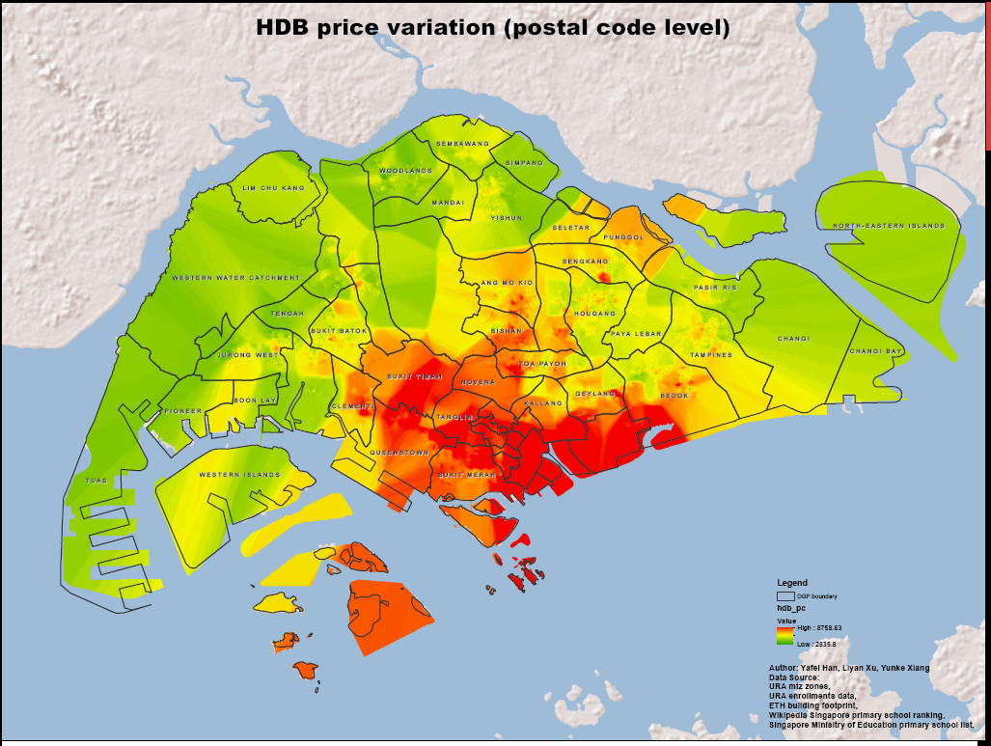
MIT 11.521 (Spring, 2013) Singapore HousingPrices

Slide 8
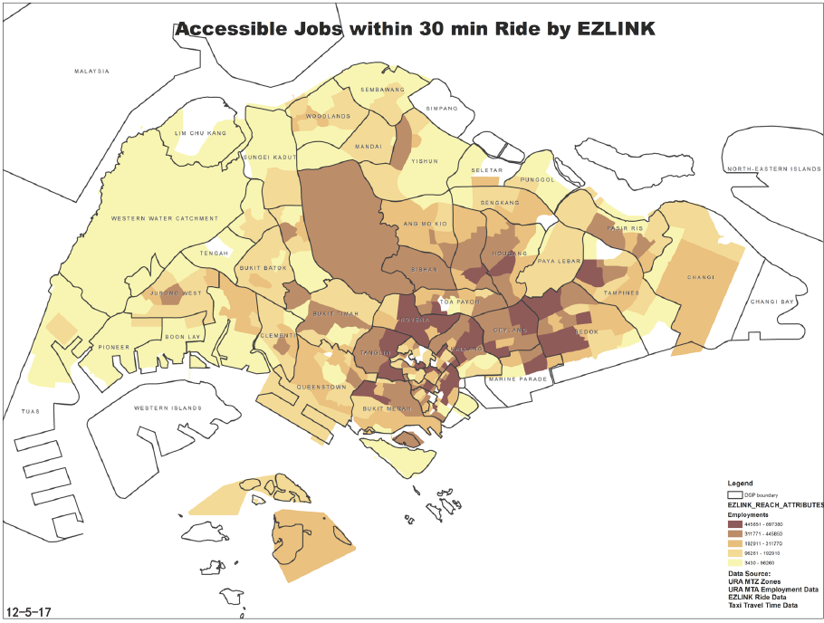
MIT 11.521 (Spring, 2013) Singapore Job Accessibility

Slide 9
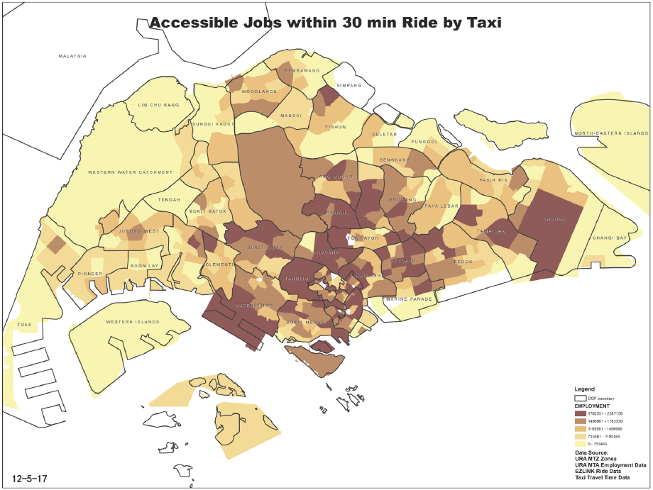
MIT 11.521 (Spring, 2013) Singapore Job Accessibility

Slide 10
Vehicle miles traveled (per day, per household)
Massachusetts Driving Patterns and Carbon Tax Implications
Spring 2014:
Kassie Bertumen
Ben Golder
Elizabeth Irvin
Diego Laserna

Slide 11
11.521 - Spatial Database Management and
Advanced Geographic Information Systems
First Half:
  11.523 - Fundamentals of Spatial Database Management
Second Half:
  11.524 - Advanced Geographic Information System Project
  Instructor: Joe Ferreira, jf@mit.edu
  TA: Rounaq Basu, rounaq@mit.edu
  Technical Instructor: Eric Huntley, ehuntley@mit.edu
  Tuesday, Lab: 4-7 PM in Room W31-301 (Armory across street)
  (First meeting, tomorrow, Feb. 3, for intro lab)
  Thursday, Lecture: 5-6:30 PM in 9-540A
  Friday, extra supervised lab time: 1:00-3:00 in 9-554
Class homepage: http://mit.edu/11.521

Slide 12
Other Class: Intro to Spatial Analysis & GIS
11.205 + 11.520: 1st and 2nd half of Spring
  Fall MCP classes repeated in Spring with similar content
  11.205 = Intro to Spatial Analysis (1st half of semester)
    11.205 meets MCP spatial analysis requirement
  11.520 = Workshop on GIS (2nd half of semester)
  Taught concurrently with 11.188 (undergrad class)
11.188: Urban Planning and Social Science Lab
  Lecture: Wednesdays, 2:30 - 4 pm in City Arena (9-555)
  Lab: Mondays, 2: 30 – 5 pm in W31-301 (Armory)
    Also, extra lab time, Friday 1-3:00 pm in 9-554
  Full-semester required undergraduate lab
Other Class homepage: http://mit.edu/11.188

