Slide 1
DRAFT:
Coal 1/☹ = ☺ ?
Potential for a Coalvolution!
Alex Slocum
May 15, 2017 slocum@mit.edu
Waste naught want naught!
Think like a small farmer:
Dig a hole
Extract the coal
Create upper and lower lake
Pumped Storage Hydro you can make
Process coal ash,
and generate cash:
extract valuable “toxic” metals & last,
ballast floating wind turbines fast
1/☹ = ☺

Slide 2
“Renewable” Coal?
Most countries in the world think coal by itself is too dirty for the environment
  Yet many still burn it
  Most forecasts show that in the next several decades coal use will be a small fraction of todays
    Wind, solar, and batteries just keep coming down in price…
Are there other opportunities coal can enable that make the system more valuable
  Opportunities that will help evolve today’s coal companies into tomorrow’s renewable companies?
    Symbiotic opportunities:
    Abandoned coal mines as reservoirs for pumped hydro energy storage
    Extract “toxic” metals for industrial use
    Make cement from CO2 and fly ash
    Use fly ash as ballast in floating offshore wind turbines

Slide 3
Yes?
Pumped Hydro energy storage
  Old (and new) mines used as lower reservoirs for giant pumped hydroelectric energy storage systems
Cement
  Replace up to 50% of Portland cement with ash
    To rebuild Nation’s infrastructure we will need a lot of concrete
Strategic “toxic” metals
  Solution mining of existing ash ponds
  Extraction of metals from the ash slurry as it is pumped from power plants to ash ponds
Ballast Floating Wind Turbines
  Now 5700 tonnes of Concrete needed as dead weight ballast
    = Fly and bottom ash associated with 2000 people over 10 years

Slide 4
Pumped Hydro
An upper lake stores potential energy by pumping water up to the lake
  Energy extracted by water flowing down through a turbine
A lower lake collects the water from the turbine and holds it till ready to pump back up
Many sites already operating in the US:
  http://www.industcards.com/ps-usa.htm
Coal companies could invest in wind farms and transform old mines into pumped hydro batteries
  They can be profitable power companies of the past, present, and future

Slide 5
Coal mines as energy storage systems?
Deep mines can be used as lower reservoirs for pumped hydroelectric systems
Aquabank, a company not too long ago
  http://kennebecestuary.org/wp-content/uploads/2011/02/RiverbankPowerCorp.pdf
  Ahead of its time?
Now the Germans are doing it:
  https://www.bloomberg.com/news/articles/2017-03-17/german-coal-mine-to-be-reborn-as-giant-pumped-hydropower-battery

Slide 6
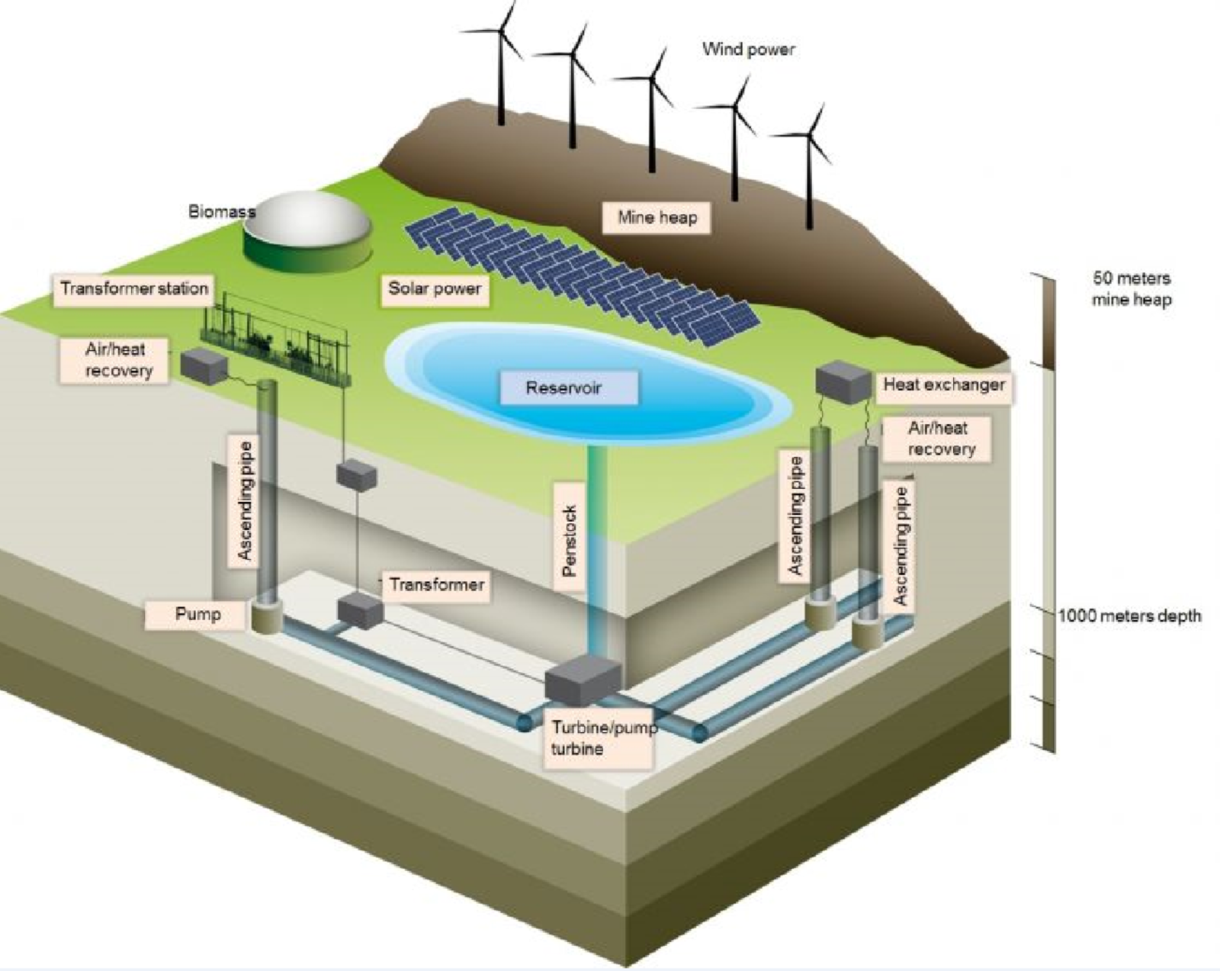
How it works

Slide 7
Coal and Wind Together!
Mine the coal and use the hole as part of a pumped hydro energy storage system
  Miners can also build the pumped hydro plants
Build wind energy farms whose excess power is stored in the pumped hydro system
Wind energy employment up 16% in 2016 employing 102,500 people
  http://www.renewableenergyworld.com/ugc/articles/2017/04/20/answering-the-call-wind-powers-jobs--growth-in-americas-heartland.html?cmpid=enl_rew_renewableenergynews_2017-04-26&email_address=slocum@mit.edu&eid=294542998&bid=1735537
Coal companies become integrated energy system companies employing many more than just miners
Coal property owners earn money from their land into perpetuity
  They get paid for the coal and lease income for wind turbines and pumped hydro plants
Lead the renewable energy & storage pack or be trampled by it!
  https://www.scientificamerican.com/article/battery-storage-poised-to-expand-rapidly/
  “Experts, utility experts and even mining companies agree that the Trump administration’s deregulation policies will not revive the coal industry.“
    https://www.greentechmedia.com/articles/read/rick-perry-on-reviving-coal-and-staying-in-the-paris-climate-deal?utm_source=Daily&utm_medium=Newsletter&utm_campaign=GTMDaily

Slide 8
Coal Jobs + Wind Jobs = LOTSA Jobs!
Mine the coal, create a hole and many other jobs too!
In wind, solar and pumped hydro
  Good paying construction, manufacturing, installation, and technical service!
  https://www.bls.gov/green/wind_energy/

Slide 9
First Order Analysis is Promising!
Coal mined each year (tons) | 900,000,000
tonnes | 817,200,000
cost per ton of coal mined | $31.00
total value of coal mined | $27,900,000,000
Pumped Hydro energy storage system at coal mine sites
Height difference between upper and lower reservoir (m) | 200
Round trip efficiency of pumped hydro system | 0.8
Energy storage potential (Joules) | 130,752,000,000,000
GigaWatt-hours electric energy storage | 36.3
Wholesale value of peak power from energy stored ($/kWh) | $0.10
Cycles per day | 1
Daily value of energy stored | $3,632,000
Annual value | $1,325,680,000
Years of operation to equal annual value of coal mined | 21
Wind Power tied to coal power where excess power goes to pumped hydro plants
GW peak windpower per GWh energy stored in coal mine pumped hydro plants | 0.2
GW wind to be annual installed to match storage created at coal mines | 7.3
Size of wind turbine (peak MW) | 3.0
Net annual 24/7 renewable electric power potential from evolved coal companies GW) | 2.54
capacity factor | 0.35
Number of wind turbines to be installed by evolving coal companies | 2,421

Slide 10
Watch your Ash!
In 2001, about 900 million tonnes (Mt) of coal was burned
  107 Mt of coal combustion products (CCPs) generated
  Fly ash represents more than 58% of CCPs
    CCPs produced, followed by flue gas desulfurization (FGD) material (24%), bottom ash (16%), and boiler slag (2%).
      https://minerals.usgs.gov/minerals/pubs/commodity/coal/coalmyb01.pdf
A lot of “toxic” heavy metals are in ash:
  http://www.sourcewatch.org/index.php/Heavy_metals_and_coal
But most are critical for modern manufacturing!
  Concentrations (up to hundreds ppm): arsenic, beryllium, boron, cadmium, chromium, hexavalent chromium, cobalt, lead, manganese, mercury, molybdenum, selenium, strontium, thallium, and vanadium
Special polymers have been developed to adsorb (and harvest) metals from seawater and could be applied to clean coal

Slide 11
Symbiotic Ash:
One Industry’s Toxic Metal is Another’s Strategic Metal
Total potential value of metals extracted from ash | $1,150,792,448
Extraction efficiency | 50%
Likely potential value | $575,396,224
Heavy metal | ppm concentration in coal ash | Potential tonnes per year from coal ash | price per tonne | Potential value
Arsenic | 100 | 4,239 | $1,600 | $6,782,209
Beryllium | 15 | 636 | $500,000 | $317,916,031
Boron | 170 | 7,206 | $500 | $3,603,048
Cadmium | 0.2 | 8.5 | $1,000 | $8,478
Chromium | 9 | 381 | $2,000 | $762,998
Cobalt | 3 | 127 | $40,000 | $5,086,656
Lead | 300 | 12,717 | $2,000 | $25,433,282
Manganese | 350 | 14,836 | $8 | $118,689
Mercury | 0.3 | 12.7 | $25,000 | $317,916
Molybdenum | 2 | 85 | $17,000 | $1,441,219
Selenium | 3 | 127 | $75,000 | $9,537,481
Strontium | 800 | 33,911 | $45 | $1,525,997
Thallium | 3 | 127 | $6,000,000 | $762,998,474
Uranium | 1 | 42 | $100,000 | $4,238,880
Vanadium | 20 | 848 | $13,000 | $11,021,089

Slide 12
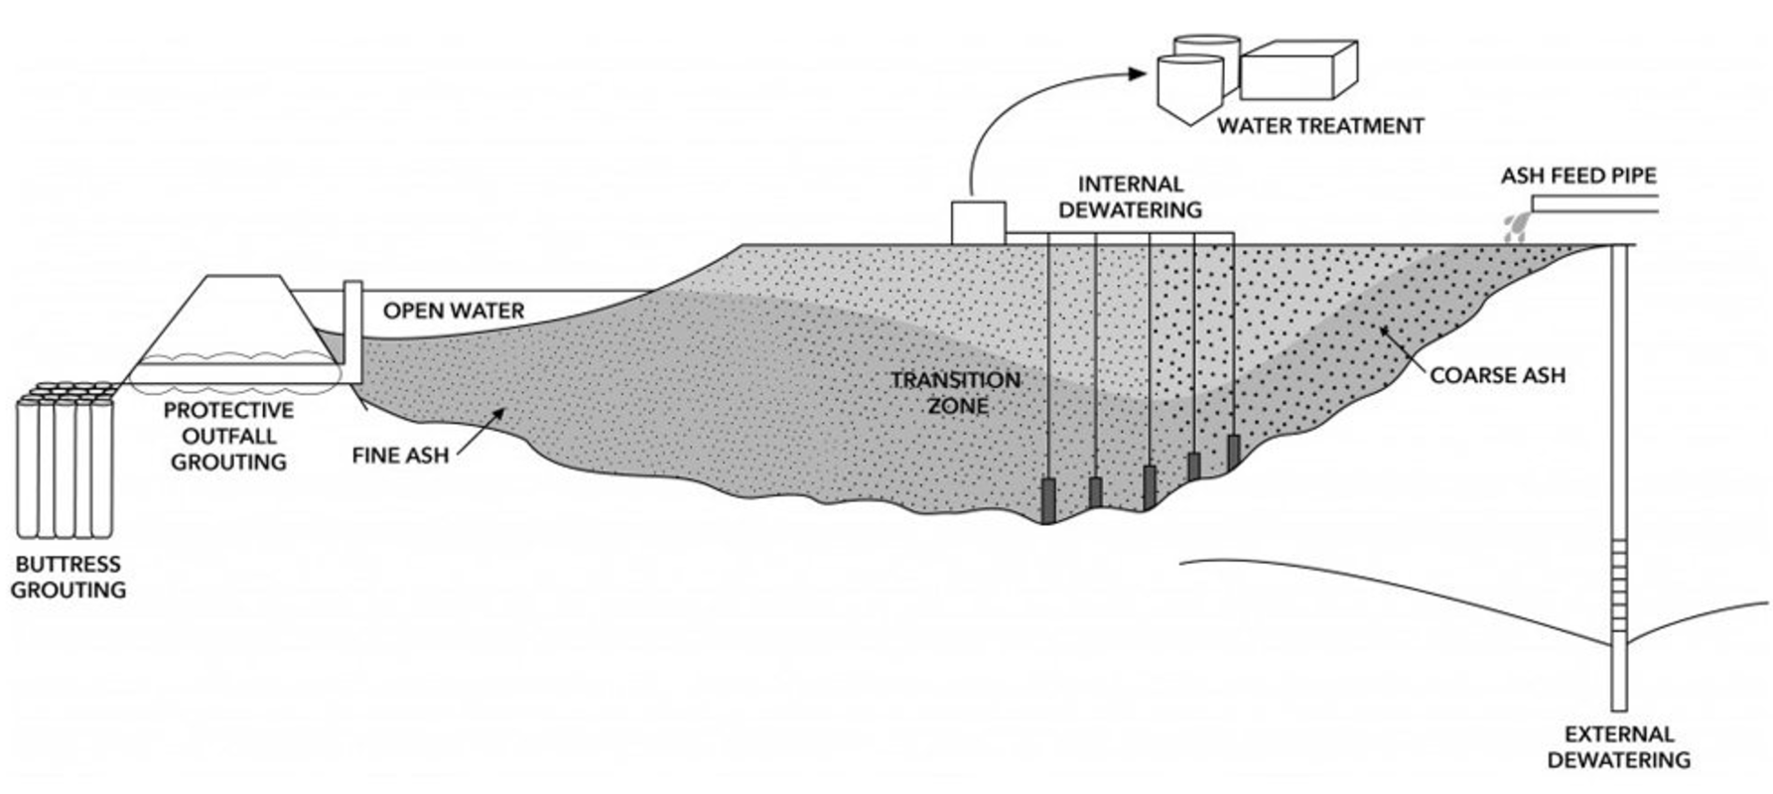
Typical Ash Pond
Can the water management system also be used for in-situ mining the metals from the ash?
http://www.moretrench.com/services/ash-pond-services/?utm_campaign=Coal+Ash+Remarketing&utm_source=google&utm_medium=display&utm_term=&utm_content=1704973x574819641505903592

Slide 13
Cement Manufacturing
Cement is manufactured from a combination of naturally occurring minerals
  Calcium (60% by weight) mainly from limestone or calcium carbonate, silicon (20%), aluminum (10%), Iron (10%) and small amounts of other ingredients
They are heated in a large kiln to over 1500° C (2700° F) to convert the raw materials into clinker.
CO2 is generated from two different sources during the cement manufacturing process:
  Use of fossil fuels in the burning process;
  Calcination, when calcium carbonate is heated and broken down to calcium oxide with the release of CO2

Slide 14
CO₂ from Cement
According to EPA, between 900 and 1100 kg (1984 and 2425 lbs) of CO2 per 1000 kg (2205 lbs) of portland cement produced in the U.S.
  About 1.0 kgCO2/kg cement
According to Portland Cement Association (PCA) members, an average of 927 kg (2044 lb) of CO2 are emitted for every 1000 kg (2205 lb) of portland cement produced in the U.S.
    About 0.93 kgCO2/kg cement
Between 50% and 60% of CO2 emitted is a result of calcination of calcium carbonate raw materials, a necessary part of the manufacturing process.
The remaining CO2 emitted is a result of burning fossil fuels such as coal and natural gas to heat the raw materials in the kiln.
U.S. cement industry accounts for about 1.5% of U.S. CO2 emissions
  https://www.nrmca.org/greenconcreteCONCRETE%20CO2%20FACT%20SHEET%20JUNE%202008.pdf

Slide 15
Cement?
About 40% of ash is now used in concrete, but if a major public infrastructure program ramps up, can we use all of it?
  What are the symbiotic CO2 savings?
Cement production in 2015 (tonnes) | 82,800,000
kg CO2/kg cement | 1
Total CO2 from producing cement (tonnes) | 82,800,000
Infrastructure rebuild
Potential % increase in cement production | 50%
Additional Tonnes of cement for infrastructure | 41,400,000
% of cement that could be replaced by coal ash | 0.5
Tonnes of coal ash used | 20,700,000
Tonnes of cement that does not have to be produced | 20,700,000
Tonnes of CO2 offset | 20,700,000
Tonnes of CO2 produced annualy by burning coal to make electricity | 1,000,033,404
Net effective tonnes of CO2 produced by burning coal for electricity and using ash in cement production | 979,333,404
CO2 savings | 2.1%
MWh/tonne coal burned | 2.20
Tonnes ash (fly and bottom) from one tonne of coal | 0.069
Ash produced (tonnes/MWh) | 0.031
MWh of coal electricity produced | 1,352,398,197
Tonnes of ash produced for all coal power generated | 42,388,804
% of all coal ash produced that could be taken up by extra cement needed for infrastrcture rebuild | 49%

Slide 16
Cement Manufacturing++
ONCE the “toxic” metals have been profitably removed from the ash ☺:
  The market for the ash itself opens up:
    More ash can be used in cement products
      The ash itself can be combined with CO2 from the stacks to create Portland cement
        Several startups have said they can turn CO2 into cement
        Western coal fly ash has ph 8-12 and can be helpful for the process if “toxic” metals removed
    Potentially leading to true “economic clean coal”

Slide 17
Ultimate Symbiotic Use for Ash
Offshore wind slated to become big new (dominant?) power source
  Floating offshore wind turbines need 5700 tons of concrete for ballast!
    A significant part of the total turbine cost
Each person who uses coal based electricity generates about 17-20 tons of fly ash a year.
  5700 tons of ballast need equates to electric needs of 335 people x 2kW avg power = 670 kW continuous.
  Offshore wind capacity factor 40% or 1.7 MW nameplate power
    Most offshore wind will be 5 MW machines
These a market for at least a third of the fly ash to be used “as is” rather than be landfilled
  It probably does not even need to be cleaned up of heavy metals
    Other than to extract them to sell and extract even more value!
“Free” ballast, a perfect symbiotic use!
  Coal and coal power companies should invest in offshore wind!

Slide 18
Ash => Ballast!
The Coal industry as part of its long term evolution should be investing in offshore wind
  Their turbines will be much cheaper because of ballast savings:
Tonnes of Ballast required per floating offshore wind turbine | 5700
$/tonne concrete for ballast | $100.00
Nameplate power capacity of oofshore wind turbine (MW) | 5
GWs of installed offshore wind per year goal | 5
Units to be installed per year | 1000
Tonnes of ash per year for ballast | 5,700,000
% of fly ash produced per year that can be used by offshore wind | 13%
Potential value | $570,000,000
kWhr/person per day | 24
Tonnes of ash/person per year | 0.275
Nameplate size of Floating Wind Turbine turbine (MW) | 5
Tonnes of ballast needed per FWT | 5,700
Capacity factor | 0.4
kWhr per day from turbine | 48000
Number of people served by turbine | 2000
Number of years people's ash needed to meet turbine ballast needs | 10

Slide 19
The White Cliffs of Dover
Storing CO₂ in Useful Products
Challenge:
While several technologies exist for carbon capture and storage (CCS) cost effectiveness and concerns about long term storage stability remain key issues
In the case of cement. Making one ton of cement results in the emission of about one ton of CO₂ or more, depending on the process
Opportunity:
Mineral carbonation (turning CO₂ into carbonic acid and then making carbonates) could be a compelling alternative, especially if some of the costs could be offset by incorporating the end product into “green” building materials or cements
These products would need regulators approval and, more importantly, being accepted by the building industry and consumers.
Key will be ensuring that they have the same properties and similar economics
Value Proposition:
Several technologies are being studied, but regardless of the process heavy metal content will need to meet specific standards, and again the ability to profitably remove them will be key

Slide 20
Deep Thoughts
The current administration and the Coal industry should strongly support wind and solar to go with coal mines that are turned into pumped hydro storage batteries!
  Coal ash mined for strategic minerals and used ash used in concrete to rebuild infrastructure
Help coal companies and coal property owners to evolve into renewables!
READ Andy Grove’s Book “Only the Paranoid Survive”
  We want coal companies and coal property owners to be like Intel!
Coal-based companies have expertise at mining
  Like Intel did in semiconductor processes to make memory, and they re-tooled for microprocessors using existing plants and people
See following slides for deeper discussion of the different “toxic” metals and their uses

Slide 21
More @ahslocum
4/17/2017
Dig out the coal
And leave not just a deep hole
But make a big tank
For pumped hydropower in the bank!
1/☹ = ☺
4/17/2017
What’s is coal ash to extract?
Rare metals to be exact
And also make cement
Harvest every single cent
1/☹ = ☺
4/26/2017
Stay ahead of the pack
Evolve smoke up a stack
Lead, follow, or get out of the way
Renewable’s are here to stay
1/☹ = ☺
4/17/2017
Dig the Coal
And not just make a hole
There is value in the ash
Think and turn it into cash
1/☹ = ☺
5/11/2017
Robber barons beware
Physics doesn’t care
Stick to the old carbon way
And you will rue the day
1/☹ = ☺
5/2/2017
Stay ahead of the pack
Don’t just blow smoke up a stack
Lead, follow, or get out the Way
Renewable’s R here to stay
1/☹ = ☺

Slide 22
Arsenic
Arsenic metal is critical for manufacture of semiconductors in US
  40% (about 2000 tonnes) used in semiconductors
    https://minerals.usgs.gov/minerals/pubs/commodity/arsenic/myb1-2011-arsen.pdf
Arsenic is in the preservation of wood in the form of chromated copper arsenate (CCA)
  CCA accounts for about 90 percent of all the arsenic used in the United States.
  It is added to wood used in houses and other wooden structures.
Most commercial arsenic is obtained by heating arsenopyrite
  Arsenic is mined in China, Chile, Russia, Mexico, and the Philippines
    4,910 tonnes used un US in 2011,
      https://minerals.usgs.gov/minerals/pubs/commodity/arsenic/myb1-2011-arsen.pdf
    In 2011, the United States produced no arsenic and relied mainly on Morocco and China
  Why are we importing Arsenic when we could get it from coal ash?
    3000 tonnes / year from potential from coal ash
    $4.5 million / year potential revenue from direct sale
      How much does the value of coal ash for use in other products increase when the arsenic is removed?

Slide 23
Beryllium
Beryllium is a light metal with the highest melting point, high conductivity, and corrosion resistance
  Primarily used in electrical applications (35% consumer and industrial)
  In alloys for aerospace and other high performance (~30%)
Most commercial beryllium is produced from Beryl through energy intensive sintering or melting
  Produced in US, Russia, China, Kazakhstan, US is neutral on production/consumption
  250 tonnes used in US 2015
    If more available, BeCu alloys could be more widely used
  Why are we mining when we could get it from coal ash?
  2500 tonnes / year from potential from coal ash
  $1.2 billion/ year revenue if you could sell it all

Slide 24
Boron
Boron is a metalloid used in glass, steel, and soap
  80% as borates for glass and ceramics
  Also preservative for wood and meat or fertilizer
  High purity used for semiconductor doping
Most commercial Boron from open pit or solution mining
  Us is net exporter of Boron
  Imports (borates) from Turkey (73%), Bolivia (13%)
  100,000 tonnes used in US in 2000
  Why are we mining when we could get it from coal ash?
  8,000 tonnes / year from potential from coal ash
  $4 million/ year revenue

Slide 25
Cadmium
Cadmium is a metalloid used in alloys, coatings and NiCd batteries
  80% for NiCd batteries
Primarily as zinc production by-product, secondary from recycled NiCd batteries
  US is net exporter
  500 tonnes used in US in 2011
  10 tonnes / year from potential from coal ash
  $10,000/ year revenue

Slide 26
Chromium
Chromium is a hard metal used to produce stainless steel
  Also preservative for wood and meat or fertilizer
  High purity used for semiconductor doping
Most commercial Chromium from open pit or solution mining
  High import reliance, from South Africa (38%), Kazakhstan (16%), significant recycling from Canada and Mexico
  500,000 tonnes used in US in 2014
  400 tonnes / year from potential from coal ash
  $1 million/ year revenue

Slide 27
Cobalt
Cobalt is a hard metal used in superalloys
  50% use for superalloys, mainly aircraft engines
  30% chemical applications
No US mining or refining
  25% from secondary (recycling)
  High import reliance, from South Africa (38%), Kazakhstan (16%), significant recycling from Canada and Mexico
  10,000 tonnes used in US in 2010
  140 tonnes / year from potential from coal ash
  $6 million/ year revenuehttps://link.springer.com/article/10.1007/BF00282962

Slide 28
Lead
Lead is primarily used for batteries
  87% for lead acid batteries
Net exporter, 80% of production from recycling
  Imports from Canada (74%) and Mexico (13%) as metals
  1,500,000 tonnes used in US in 2010
  14,000 tonnes / year from potential from coal ash
  $29 million/ year revenue

Slide 29
Lithium
Lithium is used for high performance batteries
  Rapidly growing market for batteries
Net import, Biggest producer of lithium products
  Imports from Chile (59%) and Argentina (38%) -
  1,000 tonnes used in US in 2010
  3,000 tonnes / year from potential from coal ash
  $18 million/ year revenue if you can sell it

Slide 30
Manganese
Manganese is primarily used in steel production (~50%)
  Construction (28%), machinery (9%), transportation (8%)
No domestic production since 1970
  Imports from Canada (74%) and Mexico (13%) as metals
  720,000 tonnes used in US in 2010
  17,000 tonnes / year from potential from coal ash
  $135,000/ year revenue

Slide 31
Mercury
Mercury is primarily used in chlorine-caustic soda industry
  Overall use rapidly declining in United States due to health concerns
No primary domestic production, some secondary to other (gold) mining and recycling
  Imports from Peru (54%), Chile (17%), Russia, Germany
  300 tonnes used in US in 2010
  14.5 tonnes / year from potential from coal ash
  $360,000/ year revenue

Slide 32
Molybdenum
Molybdenum is primarily used for steel and alloys (75%)
  Us is a net exporter
Molybdenite is roasted to produce molybdic acid for intermediates
  Imports from Chile, Mexico, China, Canada
  48,000 tonnes used in US in 2010
  96 tonnes / year from potential from coal ash
  $1.6 million/ year revenue

Slide 33
Selenium
Selenium is used in glass manufacturing, pigments, catalysts
  Us is a net exporter
Main source as byproduct of copper refining
  Coal has ~100x concentration as copper sources
  Imports from Belgium (39%), Germany (14%), Canada (13%)
  400 tonnes used in US in 2010
  148 tonnes / year from potential from coal ash
  $11 million / year revenue

Slide 34
Strontium
Strontium is used in pyrotechnics, magnets, alloys
  Decline in consumption, primary market was cathode ray tubes
100% imported
  Minerals – Mexico (100%)
  Compounds – Mexico (80%), Germany (12%)
  10,000 tonnes used in US in 2010
  38,000 tonnes / year from potential from coal ash
  $2 million / year revenue

Slide 35
Thallium
Used in medical imaging (radioactive isotope) and chemical applications
  Highly toxic
100% imported
  Russia (74%), Germany (23%)
  1 tonne used in US in 2010
  144 tonnes / year from potential from coal ash
  $800 million / year revenue if you could sell it

Slide 36
Vanadium
Used in iron and steel alloys
  Produced from processing petroleum residues, spent catalysts, ash
High import reliance
  South Africa (26%), Russia (20%), China (19%),
  5,000 tonnes used in US in 2010
  950 tonnes / year from potential from coal ash
  $12.5 million / year revenue if you could sell it

Slide 37
Sorbents to remove metal ions
  Adsorbents proven to remove metal cations from seawater and other solutions
    Could be used used to extract metals from coal ash slurry
      CO2 + water = carbonic acids
      Add carbonic acid to water that carries the ash from the plant
      Leach metals from the ash with the acidic water
        Recover the metals with adsorbants

Slide 38
Sorbents can be used for lots of metals!
Sorbents not limited to uranium
  They typically uptake even more magnesium, calcium, vanadium, iron
Could potentially be tuned to uptake cobalt and lithium!

Slide 39
Amidoxime-based adsorbents
Amidoxime ligand grafted on to polyethylene trunk with a co-monomer to increase hydrophilicity
56-day adsorption capacity (Gill et al., PNNL report 2016) for adsorbent developed by Oak Ridge National Lab:
  AF1 Series: ~4 g uranium/kg adsorbent
  AI8 Series: ~4.15 g uranium/kg adsorbent

Slide 40
Other adsorbents
Chitin from shrimp and crab shells can be made into uranium adsorbing polymer (Barber, Griggs, et al. 2013; Barber 2013)
Adsorption capacity ~ 0.00348 g uranium / kg adsorbent
Increased capacity likely to come with increased resistance to radiation induced grafting of amidoxime ligand (Barber 2014)
Chitin shown to have antimicrobial properties, could reduce biofouling concerns!

Slide 41
The White Cliffs of Dover
Storing CO₂ in Useful Products
Challenge:
While several technologies exist for carbon capture and storage (CCS) cost effectiveness and concerns about long term storage stability remain key issues
In the case of cement, making one ton results in the emission of about one ton of CO₂ or more, depending on the process
Opportunity:
Mineral carbonation (turning CO₂ into carbonic acid and then making carbonates) could be a compelling alternative, especially if some of the costs could be offset by incorporating the end product into “green” building materials or cements
These products would need regulators approval and, more importantly, to be accepted by the building industry and consumers.
Key will be ensuring that they have the same properties and similar economics

Slide 42
The White Cliffs of Dover
Storing CO₂ in Useful Products
Industrial combustion byproducts, such as coal fly ash or paper mill ash, thanks to their chemical composition, could be used for the mineralization reaction.
For example, a recent study by MIT showed that fly ash produced from a single 200 megawatt coal fired power plant is about 40 kton per year and that assuming a calcium oxide content of 17% by weight, this amount of fly ash could sequester about 6.5 kton per year of CO₂, or roughly 0.5% of the CO₂ generated. (Barbero et al. Energy Environ. Sci., 2013, 6, 660)
One of the challenges hindering feasibility is heavy metals content.
The ability to profitably remove heavy metals will therefore be key to make this a viable alternative.

Slide 43
CO₂ Mineralization Reaction
The overall process involves the initial dissolution of CO₂ into water to form carbonic acid (H₂CO₃), which then dissociates to form HCO₃⁻ and CO₃²⁻ ions, via the following reaction sequence:
CO₂ (g) = CO₂ (aq)
CO₂ (aq) + H₂O = H₂CO₃ (aq)
H₂CO₃ (aq) = HCO₃⁻ (aq) + H⁺ (aq)
HCO₃⁻ (aq) = CO₃²⁻ (aq) + H⁺ (aq)
The process then requires divalent cations, such as calcium (Ca) and magnesium (Mg)
to form the carbonates, in this example calcite (CaCO₃) and magnesite (MgCO₃):
HCO₃⁻ (aq) + Ca₂⁺ (aq) = CaCO₃ (s) + H⁺ (aq)
HCO₃⁻ (aq) + Mg₂⁺ (aq) = MgCO₃ (s) + H⁺ (aq)
A source of alkalinity, such as hydroxide ions (OH⁻), is finally needed to neutralize the reaction:
H⁺ (aq) + OH⁻ (aq) = H₂O

Slide 44
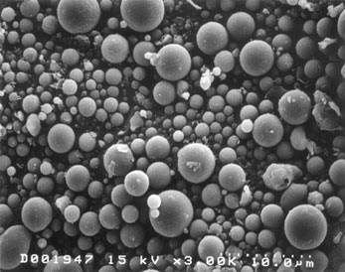
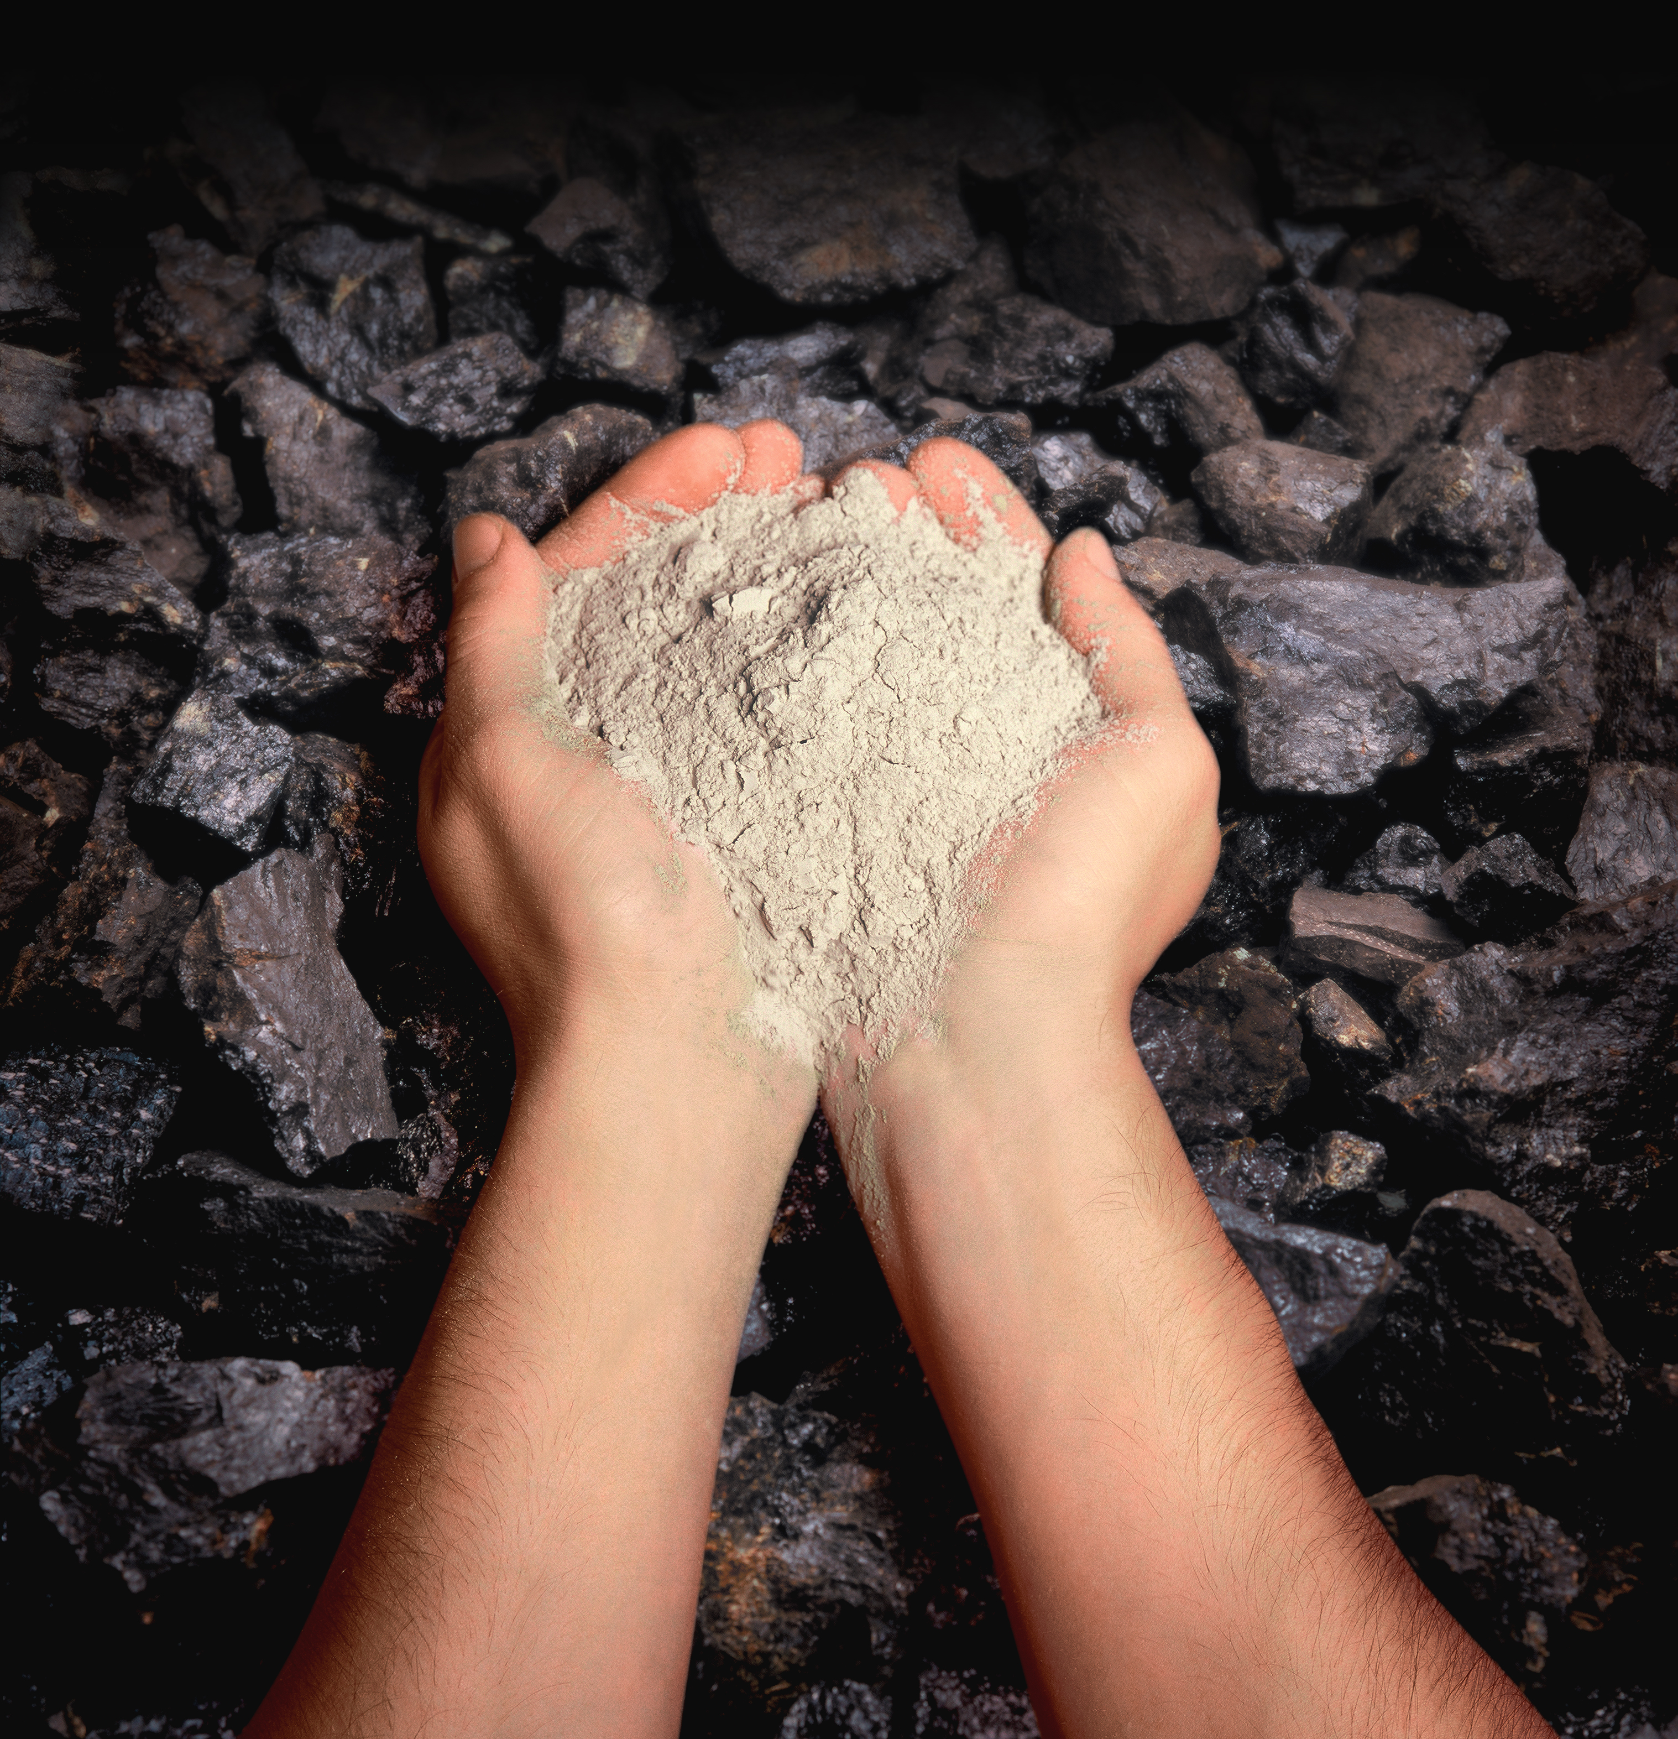

Carbon Fly Ash
Sample Oxide Analyses of Ash and Portland Cement
Compounds | Fly Ash Class F | Fly Ash Class C | Portland Cement
SiO2 | 55 | 40 | 23
Al2O3 | 26 | 17 | 4
Fe2O3 | 7 | 6 | 2
CaO (Lime) | 9 | 24 | 64
MgO | 2 | 5 | 2
SO3 | 1 | 3 | 2
Source: www.fhwa.dot.gov/pavement/recycling/fach01.cfm
Depending on the coal source fly ash can also include one or more of the following elements in trace concentrations (up to hundreds ppm):
arsenic, beryllium, boron, cadmium, chromium, hexavalent chromium, cobalt, lead, manganese, mercury, molybdenum, selenium, strontium, thallium, and vanadium.
Notes:
• Class C more than 20% CaO
• Class F less than 10% CaO

