Slide 1


The Assessment Continuum
Before, in, and after lecture
Gerd Kortemeyer
Michigan State University
Jan 25th, 2012

Slide 2
What makes a good use of technology in education?
Must be integrated into the educational experience!
supporting the goals - not technology for technology sake
not scattered "technology highlights" - consistently applied - students know what to expect and what is expected
moving into the background - not wizz-bang or gimmicky
increasing effective time on task - make the students interact with the materials - do not waste student time
Giving effective and timely feedback to learners and instructors: assessment

Slide 3
Assessment
Assessment: Feedback to learners and instructors
Formative assessment:
  Students can keep track of their own learning
    Students do not fall behind
  Instructors keep track of their students’ learning
    can adapt the teaching to the learning
Summative assessment: exams
  Technology allows for frequent exams

Slide 4
Assessment
Pre-Class Questions
  Students being prepared for lecture
  Just-In-Time Teaching
In-Class Questions
  Clickers
Post-Class Questions
  Homework
  Online Discussions, Helprooms
  Exams
Does this even work?
How is this realistically possible?
  That’s where course and learning content management come in!
Lecture
?

Slide 5
Pre-Class Questions
Students being prepared for lecture
Just-In-Time Teaching

Slide 6
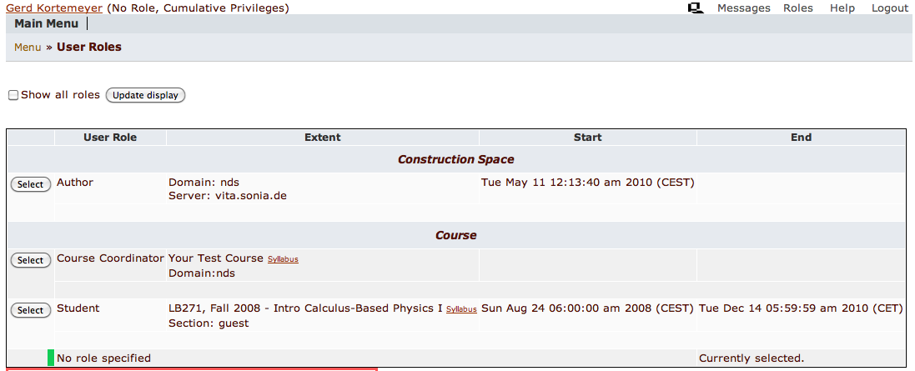
Pre-Class Questions

Slide 7
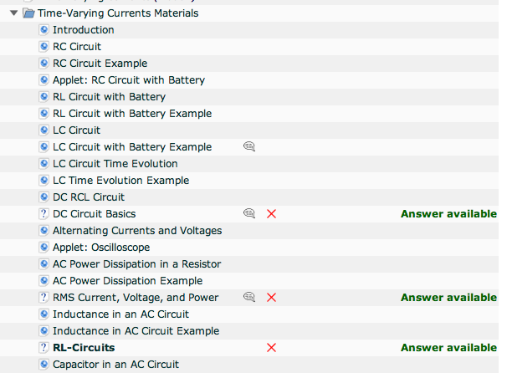
Pre-Class Questions
Easy questions embedded into content
Due before lecture

Slide 8
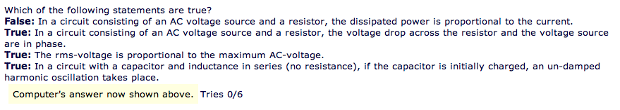
Pre-Class Questions
Make sure students read materials
Questions can be answered just based on the readings
Students come prepared

Slide 9
Just-In-Time
Adapt lecture to student difficulties
When I looked at your homework this morning, I saw that all of you have understood quantum field theory, but many of you still have problems with long division. So this morning, we will …

Slide 10
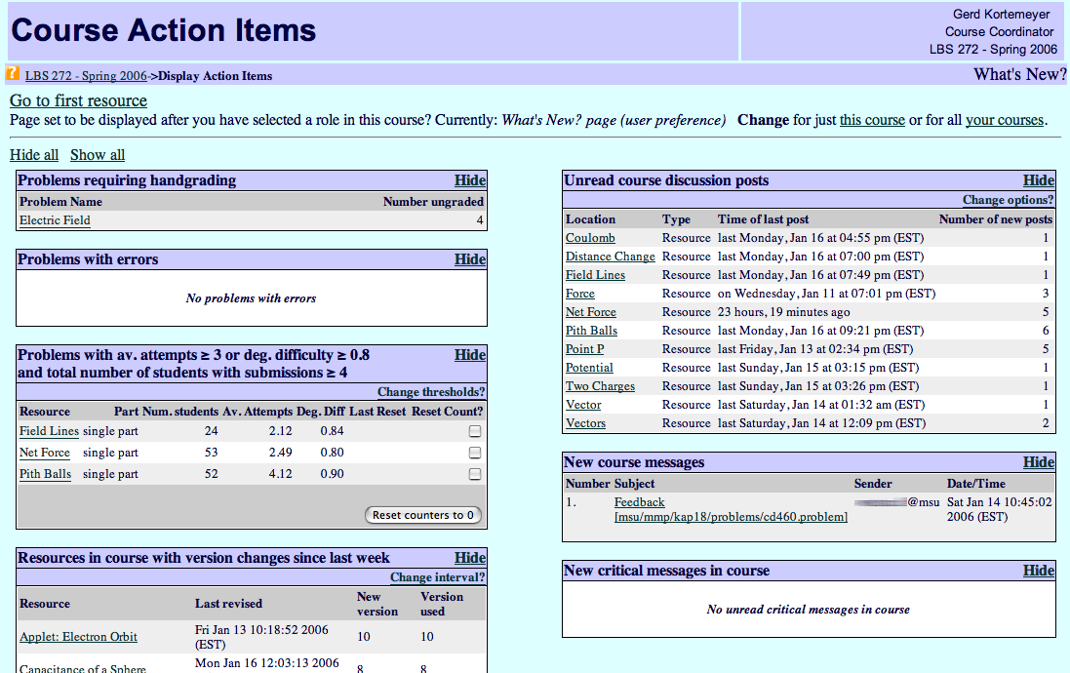
Just-In-Time
Discussions
Difficult problems

Slide 11
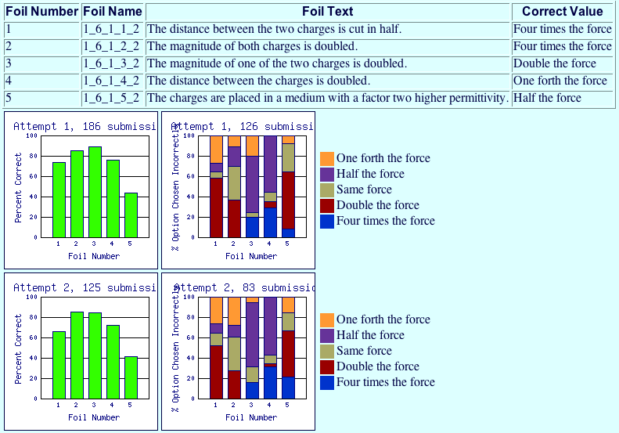
Just-In-Time

Slide 12
In-Class Questions
Clickers

Slide 13
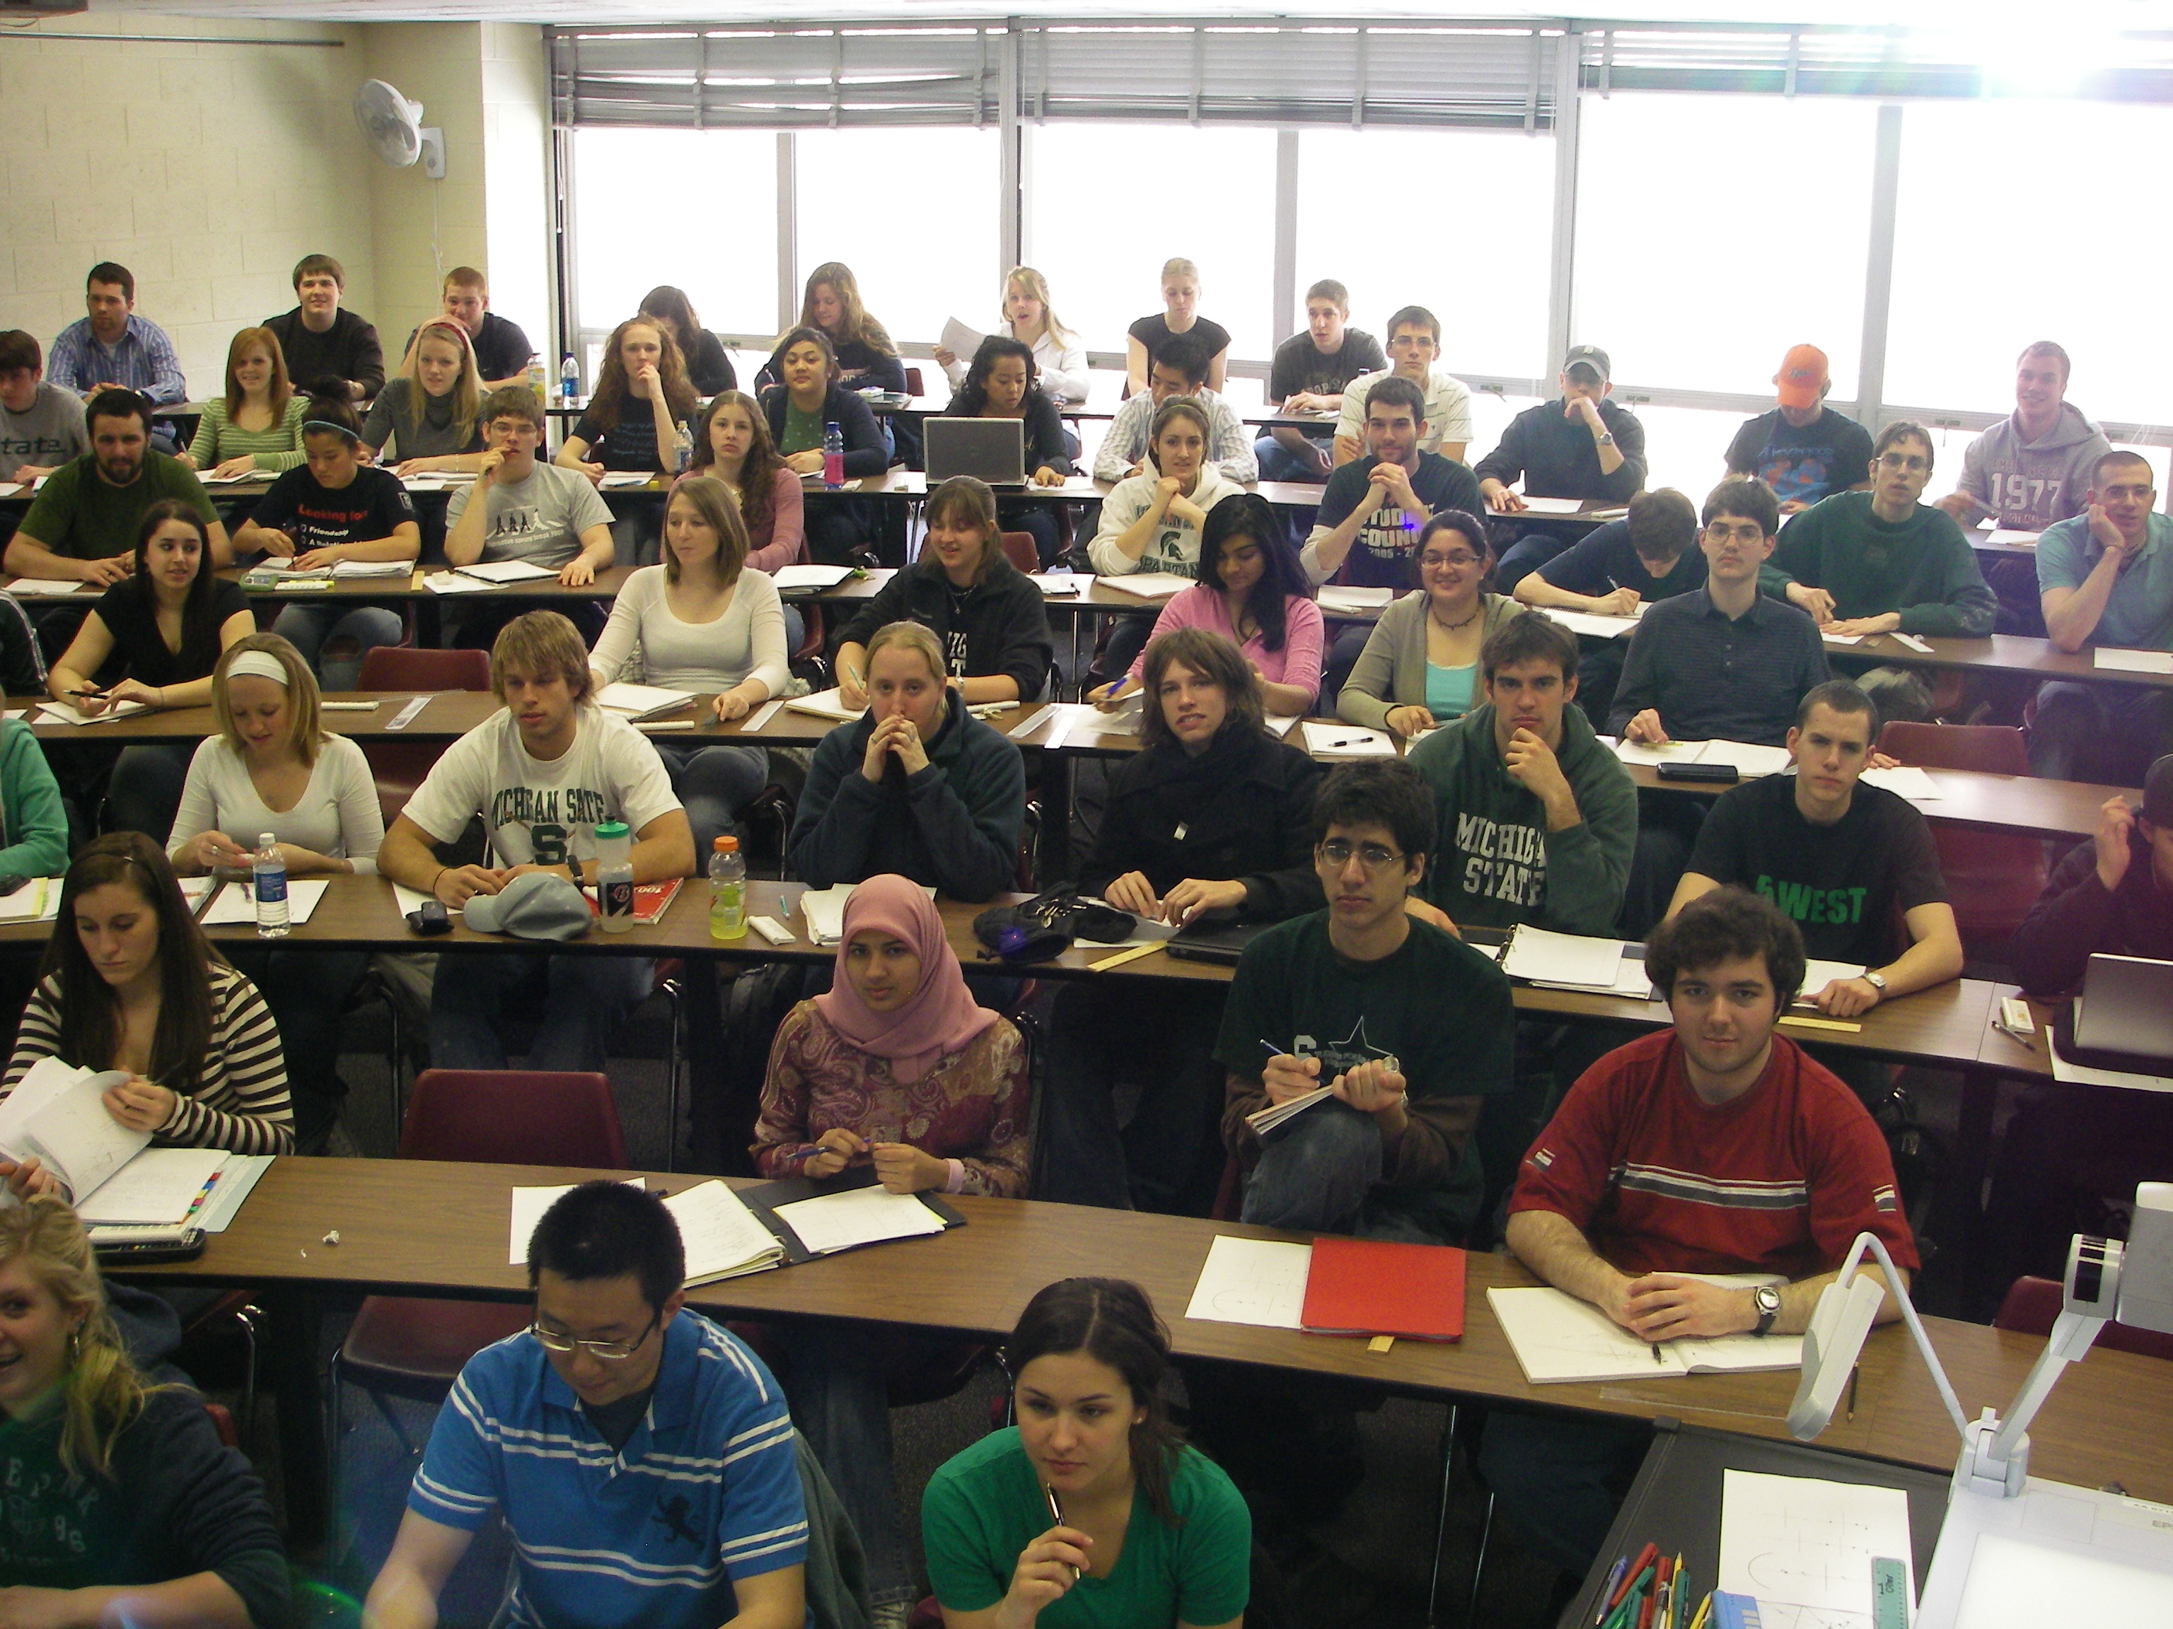
Clickers
That’s clear – no, wait …
Doesn’t he get that we don’t get it?
Yawn!
Looks like everybody but me understands this!
I wonder what’s for lunch
Sadly, too often:
Anonymous crowd in our lecture hall
We don’t know what’s going on in their heads

Slide 14
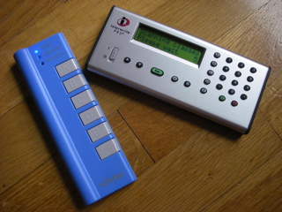
Clickers
RF devices
One per student
Students can answer questions during lecture

Slide 15
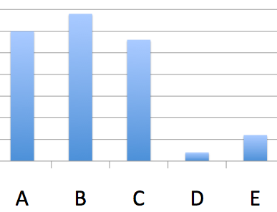
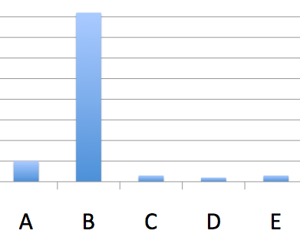
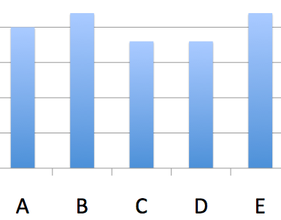
Clicker
Lecture progress depends on voting outcome
  Explain again
  Go on
  Let students discuss
  and vote again

Slide 16
Clicker
Peer-Instruction
Students can sometimes explain concepts better than us to their peers
  We have forgotten what we initially struggled with
Students learn while explaining

Slide 17
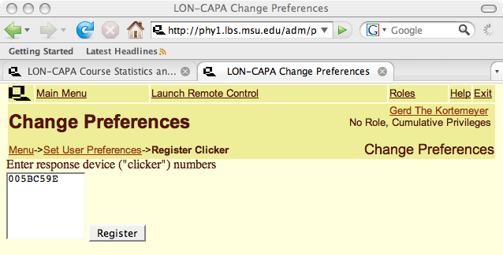
Clicker
Students register in LON-CAPA

Slide 18
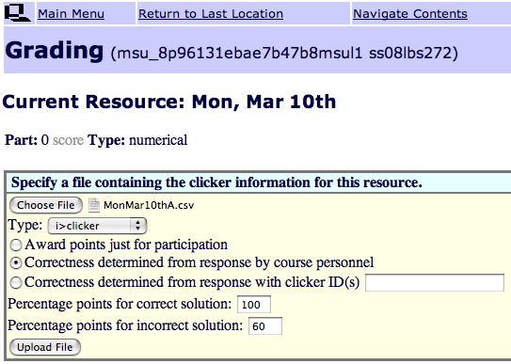
Clicker
Give credit for correct and for incorrect answers

Slide 19
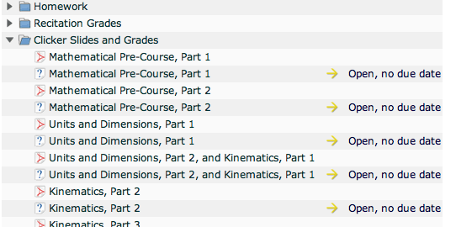
Clicker
Embedded in course, alongside slides

Slide 20
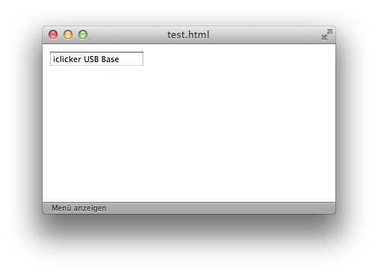
Currently under Development
Currently: uploading of session data
Work-in-progress: running session out of LON-CAPA
Questions
from shared
content
library
(more later)
Item statistics

Slide 21
Post-Class Questions
Homework
Helprooms
Exams

Slide 22
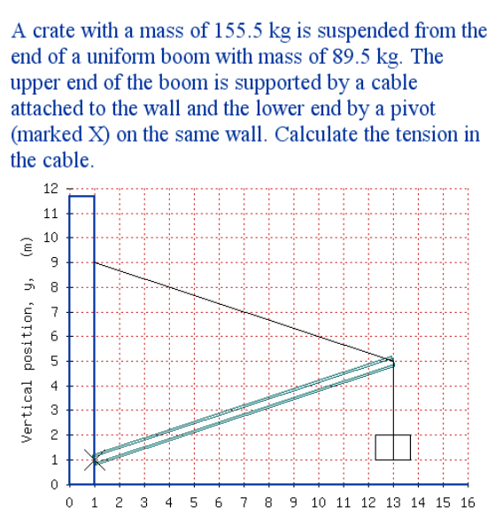
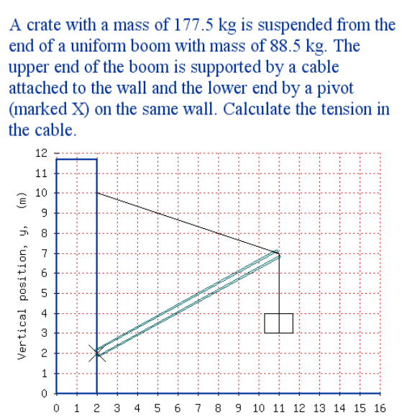
Homework
More sophisticated highly randomizing problems

Slide 23
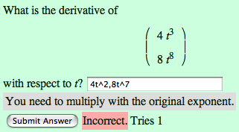
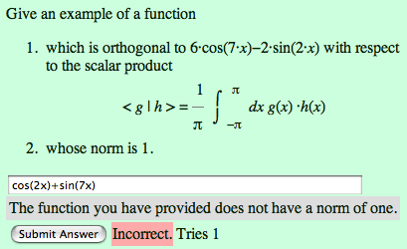
Homework
…special emphasis on math
  including support of
    LaTeX
    Maxima
    R

Slide 24
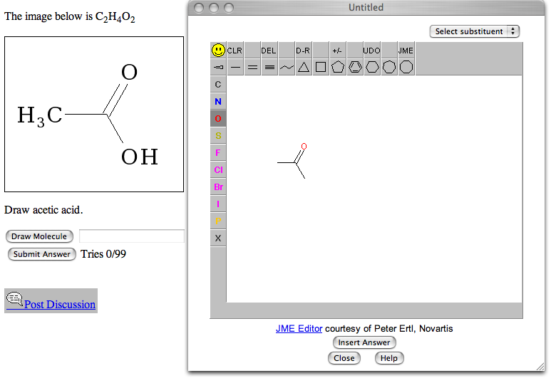
Homework
… chemistry …

Slide 25
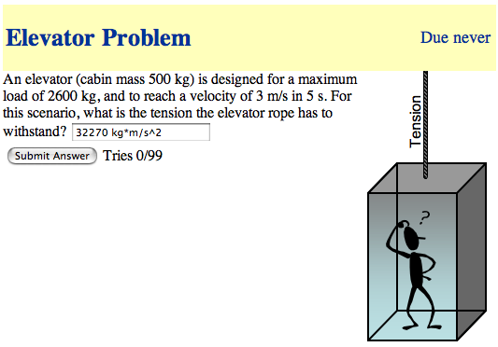
Homework
… physical units …

Slide 26
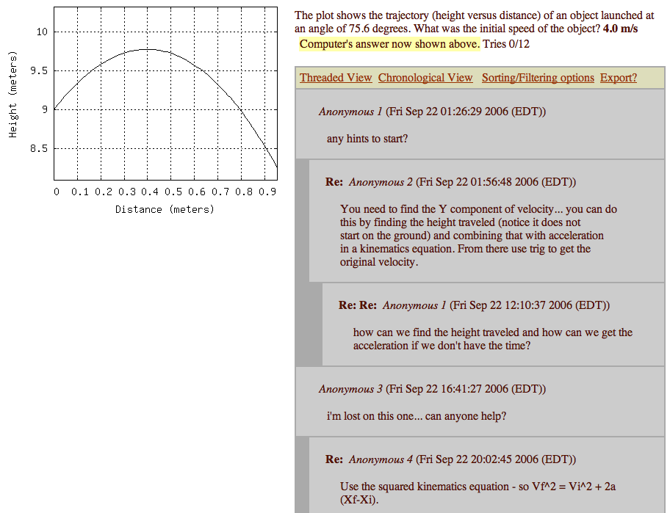
Online Discussions
Discussions
Encouraged, since all students have different versions.
Again: Peer-Instruction.

Slide 27
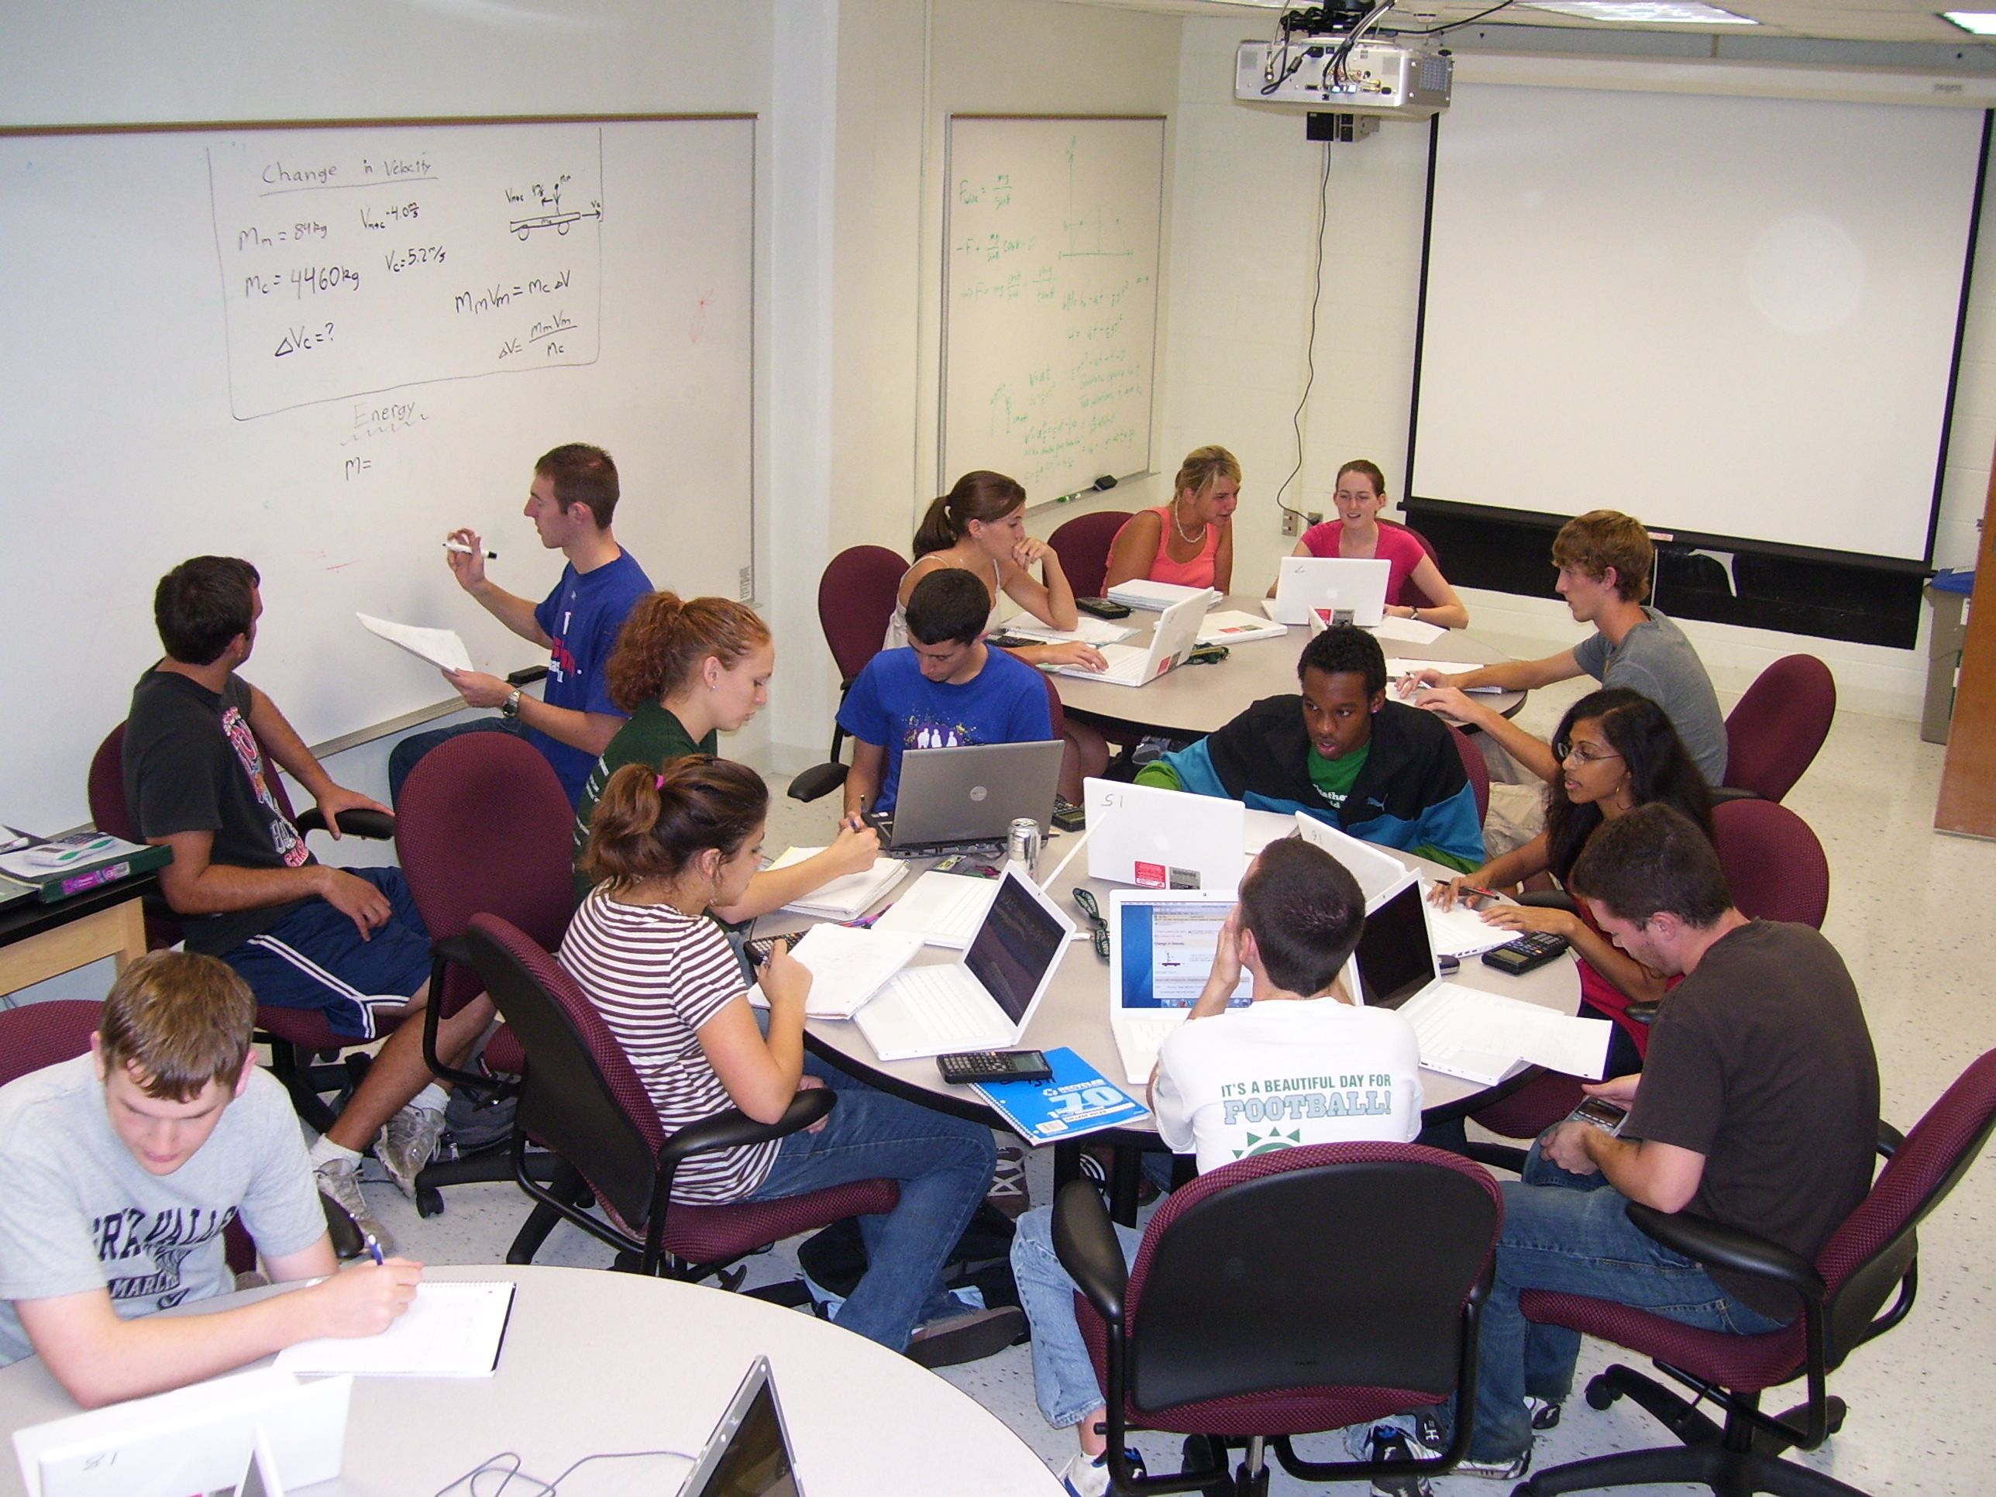
Helprooms
Staffed
with
Learning
Assistants
in the
evenings
Collaborative learning space, peer instruction

Slide 28
Exams
Problems can also be rendered for bubble sheets
Each student has a different exam

Slide 29
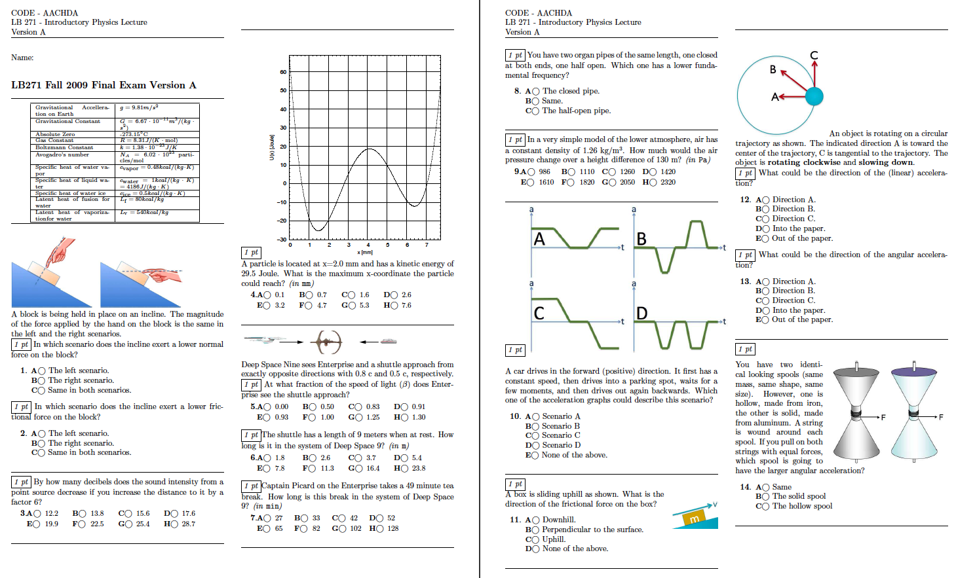
Exams

Slide 30
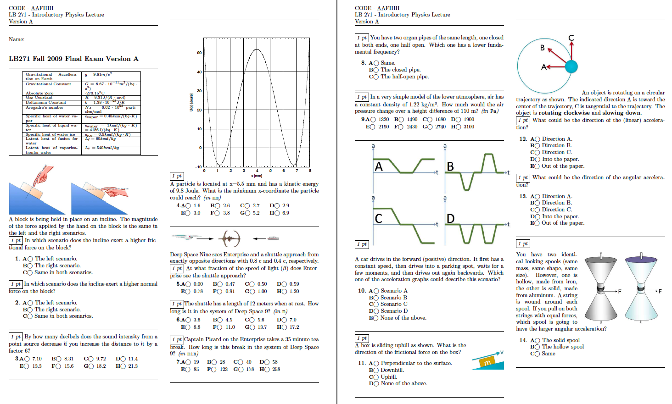
Exams

Slide 31
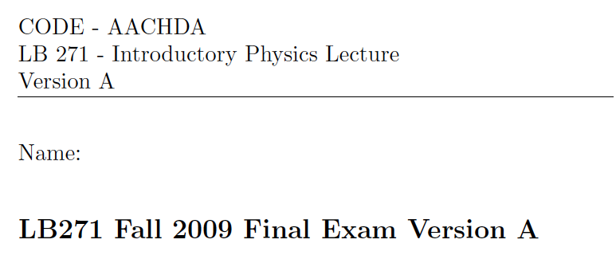
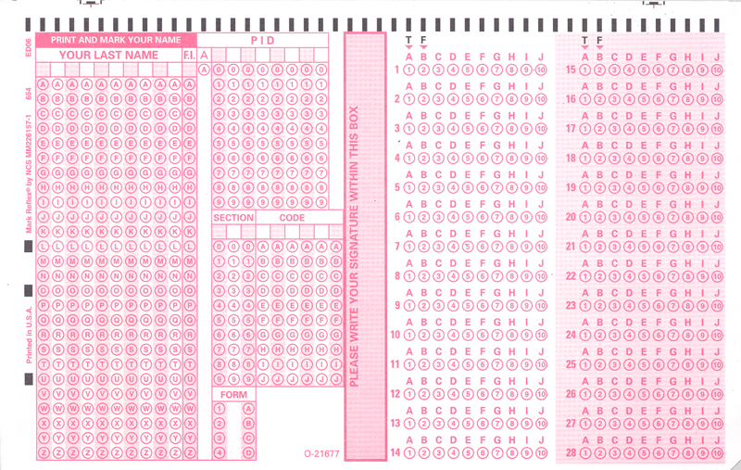
Exams

Slide 32
Before we go on …
… does this even work?

Slide 33
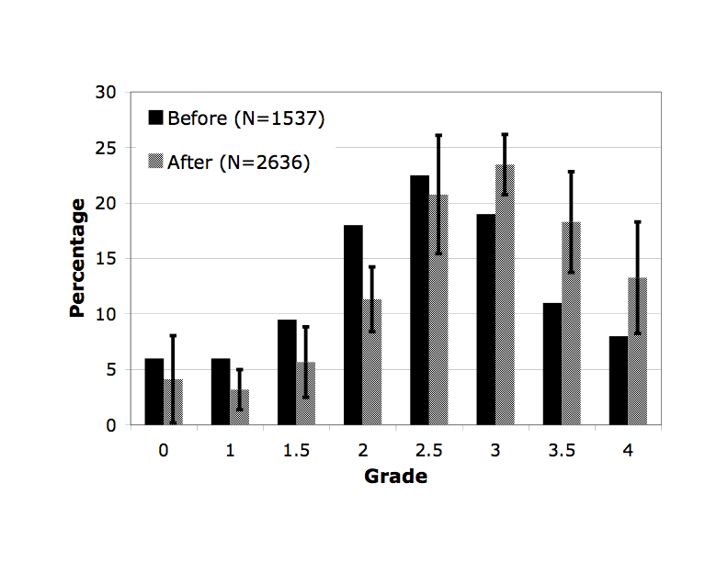
Learning Success
Intro Physics for Scientists and Engineers
Grades in years before and after online homework

Slide 34
Learning Success
Mostly helps students who are on the brink of failing the course.
Fail

Slide 35
How is this realistically possible?

Slide 36
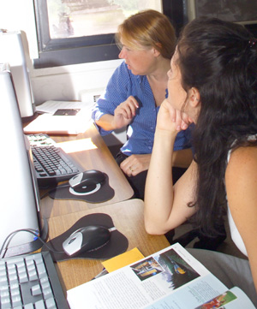
Sharing of Resources
Creating online resources is a lot of work
Doing so for use in just one course is a waste of time and effort
Many resources could be used among a number of courses and across institutions

Slide 37


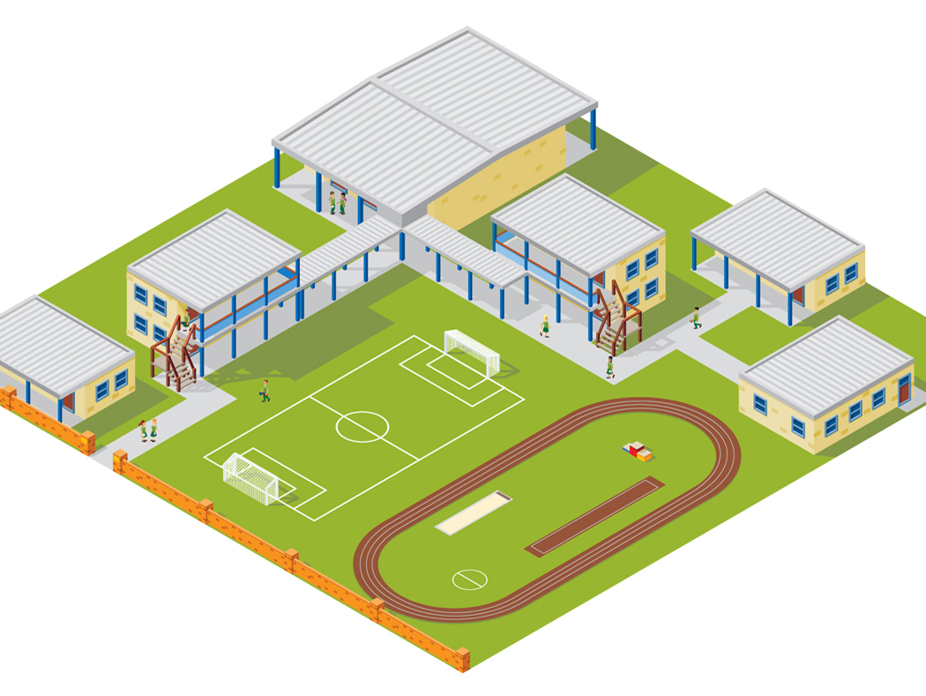



LON-CAPA Architecture
WWW
Web
Instructor
Computer
Interserver
Campus A
Campus B
WWW
Campus C
Inter-Institutional
Network of Servers Connecting Universities and Schools
Student Computer

Slide 38

LON-CAPA Architecture
Campus A
Campus B
Course Management
Course Management
Resource Assembly
Resource Assembly
Shared Cross-Institutional Resource Library

Slide 39
The LON-CAPA Community
Shared content repository with almost 450,000 resources
Almost 200,000 online homework problems

Slide 40
LON-CAPA Enrollment

Slide 41
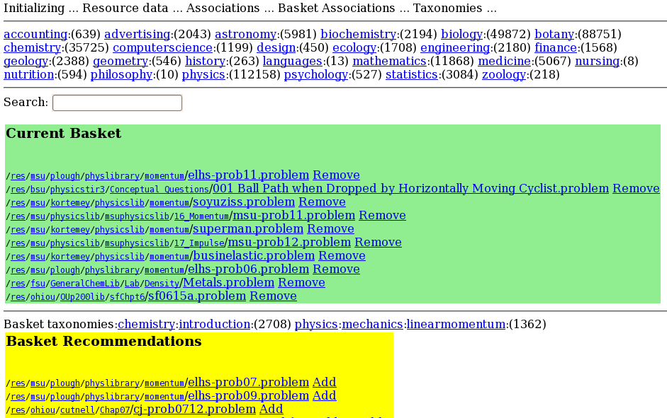
WIP: Recommender

Slide 42
Thank You
Gerd Kortemeyer
Currently on sabbatical:
Pritchard Group (RELATE), MIT Physics
kortemey@msu.edu

