Slide 1
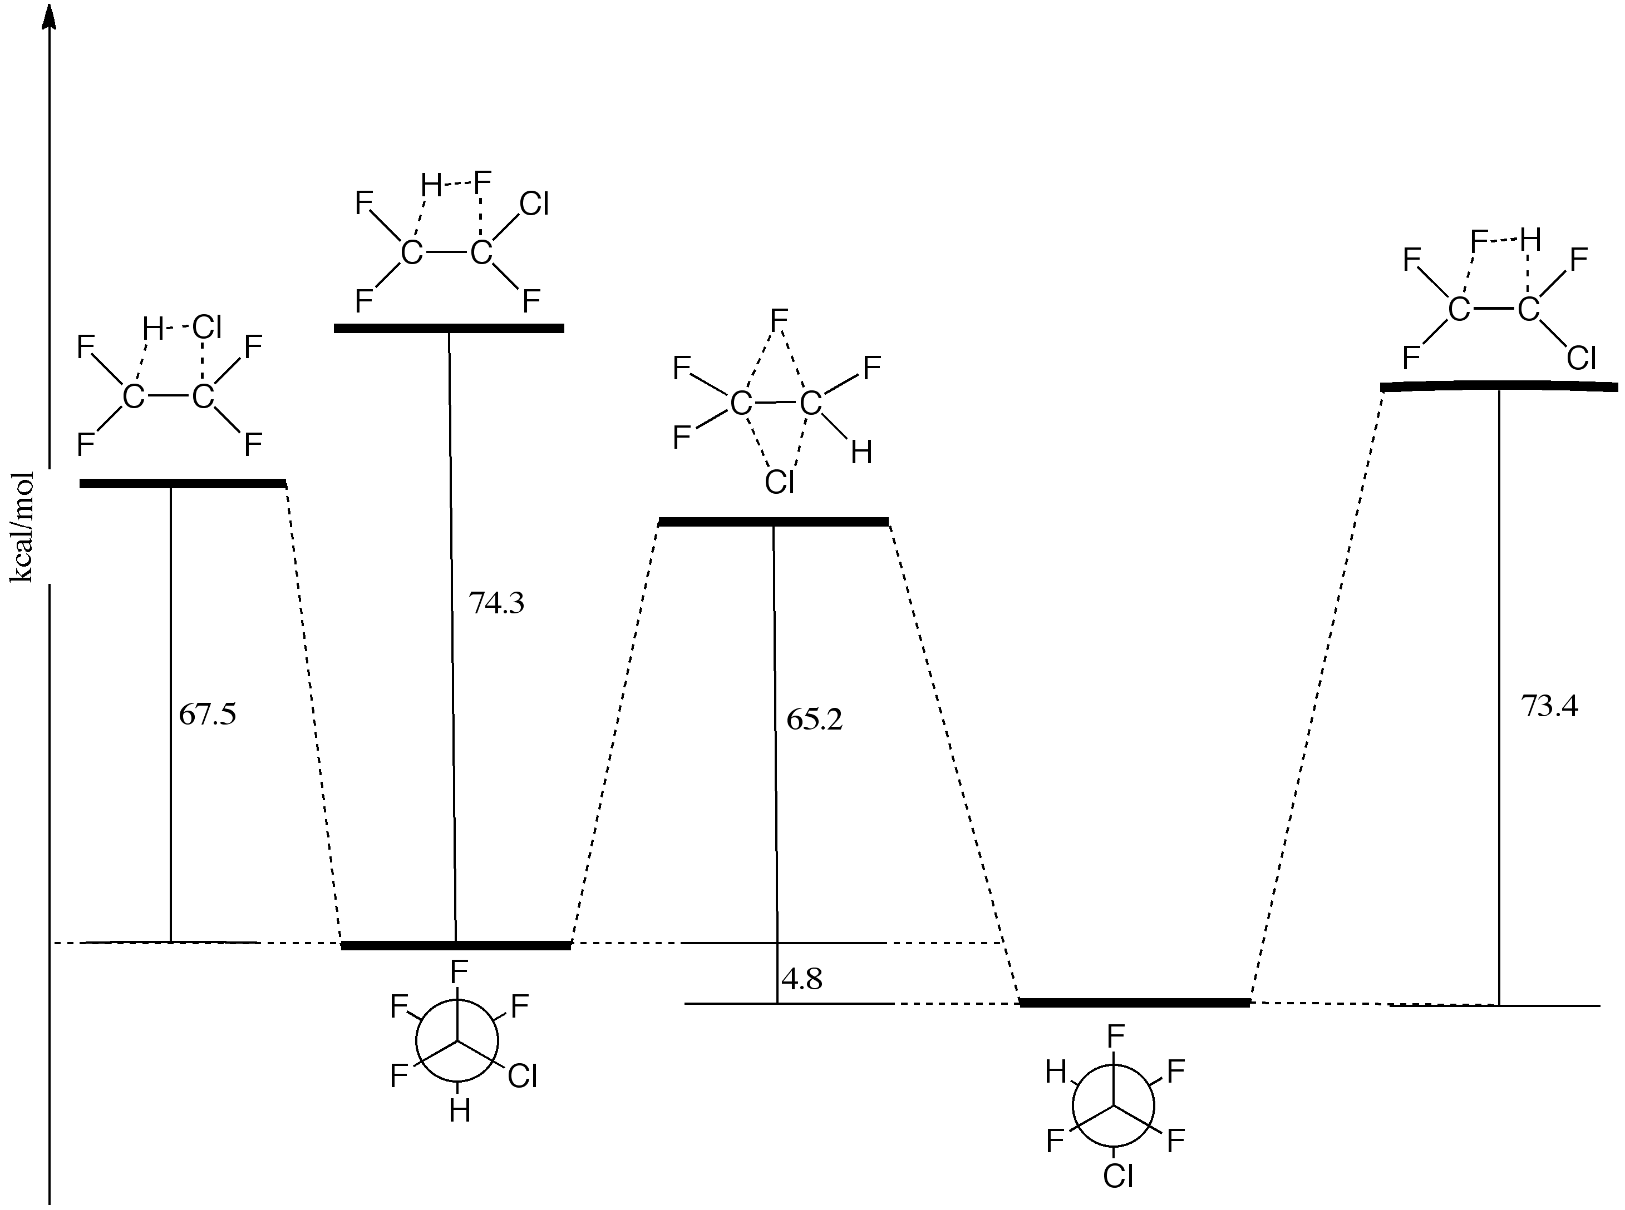
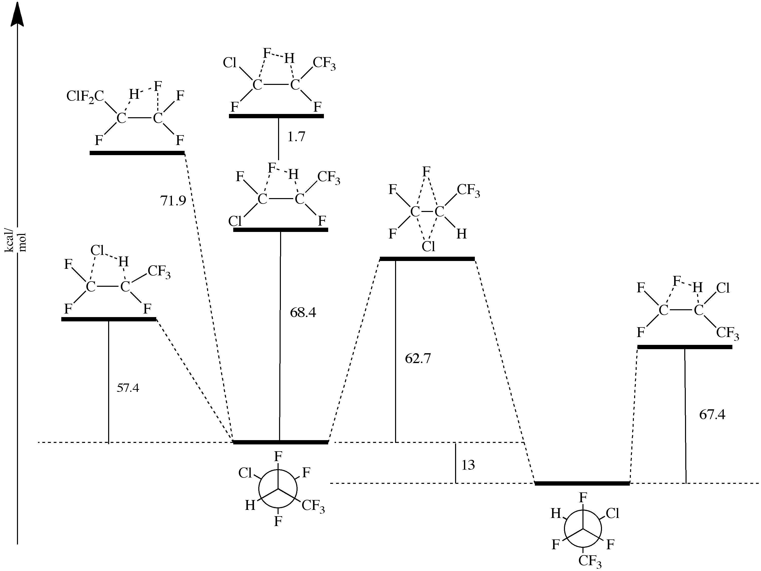
Thermal Reaction Kinetics of 1-Chloro-1,1,2,2-tetrafluoroethane, 2-Chloro-1,1,1,2-tetrafluoroethane,
1-Chloro-1,1,2,3,3,3-hexafluoropropane and 2-Chloro-1,1,1,3,3,3-hexafluoropropane Bansi L. Kalra, Dorcas Mudzingwa, Vesper Hubbard, Dept. of Chemistry, Hollins University, Roanoke, VA 24020 David K. Lewis, Dept. of Chemistry, Connecticut College, 270 Mohegan Avenue, New London, CT 06320
Introduction
Principal unimolecular decomposition process for HCFC is 1,2-HX elimination;
HCl loss favored over HF loss.
For HCFCs with an H and a Cl atom on the same C atom a novel mechanism, intramolecular Cl/F exchange between two neighboring C’s followed by the normal 1,2-HX elimination, has been used to explain the production of HCl [Heard, G.L. ; Holmes, B. E. J. Phys. Chem. A 2001, 105, 1622-1625 and a number of others]
No direct calculations of the HCl elimination Arrhenius parameters have been reported.
Reactions Studied (Set 1)
CF₂Cl-CF₂H → CF₂=CF₂ + HCl [1]
(1-CTFE) (TFE)
CF₃-CFClH → CF₂=CF₂ + HCl [2]
(2-CTFE) (TFE)
CF₂Cl-CF₂H ↔ CF₃-CFClH [3]
(1-CTFE) (2-CTFE)
Observations and Conclusions
Major Products from 1- and 2-CTFE: TFE and HCl at 723-1197K
1-CTFE and 2-CTFE not detected (<1%) in the products of 2-CTFE and 1-CTFE pyrolysis (up to >30% conversion),respectively.
TFE and HCl produced almost equally rapidly from 1-CTFE and 2-CTFE E_{a}[1]=66.7 ± 2.0, E_{a}[2]=67.3± 1.1 kcal/mol log A[1]= 13.28 ± 0.43; log A[2]=13.48 ±0.25
Therefore, F/Cl exchange cannot be the only pathway for TFE and HCl formation from 2-CTFE
Potential Energy Diagrams
(Provided by Prof. Bert Holmes, UNCA, Ashville NC)
Chlorofluoroethanes
Objectives
Study thermal kinetics of HCl elimination from pairs of isomeric CFHCs, one with H and Cl on the same C-atom, and one with H and Cl attached to two neighboring C atoms
Determine Arrhenius parameters for these HX-elimination reactions
Look for evidence of unimolecular isomerization that would confirm the proposed F/Cl exchange reaction
Techniques used
Shock tube and static reactor for heating samples
GC and MS for product mixture analysis
Despite the lower energy barrier
for the F/Cl exchange to produce 2-CTFE from 1-CTFE vs HCl elimination, we do not detect the formation of the more stable 2-CTFE
Chlorofluoropropanes
Reactions Studied (Set 2)
CF₂Cl-CFH-CF₃ → CF₂=CF-CF₃ + HCl [4]
(1-CHFP) (HFP)
↔ CF₃-CClH-CF₃ (2-CHFP) [5]
Observations and Conclusions
Major products: HFP and HCl
E_{a}= 66.8 ±1.0 kcal/mol; log A=14.04 ± 0.23.
Absence of detectable 2-CHFP up to
>20% conversion leads to the conclusion
that F/Cl exchange plays a negligible role
in the elimination of HCl
Acknowledgments
National Science Foundation
Connecticut College and Hollins University
Large energy barriers for the F/Cl exchange
and for HCl elimination inhibit the pyrolysis
or isomerization of 2-CHFP.
7th International Conference on Chemical Kinetics at MIT, 10-14 July 2011
Notes:
7th International Conference on Chemical Kinetics at MIT, 10-14 July 2011

