Slide 1
Foundational Knowledge for Smart Service Systems: Towards an NSF Vision
Pramod Khargonekar
Assistant Director for Engineering
National Science Foundation
MIT Workshop on Smart Service Systems
21 November 2014
Notes:
Workshop website http://web.mit.edu/mitssrc/nsf/index.html

Slide 2
“… making value requires an integrated system of activities—understanding customers, research, development, design, manufacturing, and services—that are all necessary to deliver value to customers. Making value requires that a holistic system of these activities be developed and optimized in the national interest.”
- Charles M. Vest

Slide 3
NSF ENG: Investing in engineering research and education to foster innovations for benefit to society
Research
Education
Innovation
Societal Benefits

Slide 4
The Service Economy
The U.S. service sector is responsible for:
Employing approximately 80% of workers
Creating approximately 80% of GDP
Manufacturing (product) industries are increasingly incorporating value-added service components
We need high-quality, low-cost, and highly personalized solutions in education, healthcare, manufacturing, transportation, and agriculture.
Notes:
“ The majority of output growth is projected to come from the service-providing sectors. Real output in these sectors is expected to rise from $16.2 trillion to $21.6 trillion, 2.9 percent per year, over the 2010–2020 period. This growth rate is faster than the 1.8-percent-per-year rate of increase seen in the 2000–2010 period. The service-providing sectors are expected to increase their share of nominal output from 69.4 percent in 2010 to 71.1 percent in 2020.
The goods-producing sectors, excluding agriculture, are projected to increase their real output by $1.8 trillion to reach $7.4 trillion in 2020, an annual increase of 2.9 percent.”
**"Industry employment and output projections to 2020," published in the January 2012 Monthly Labor Review of the Bureau of Labor Statistics.
Service sector employment was ~79% in 2010, and services contributed ~80% of GDP in 2012, according to sources in the solicitation.
See FY 2014 PFI:BIC solicitation at http://www.nsf.gov/pubs/2013/nsf13587/nsf13587.htm

Slide 5
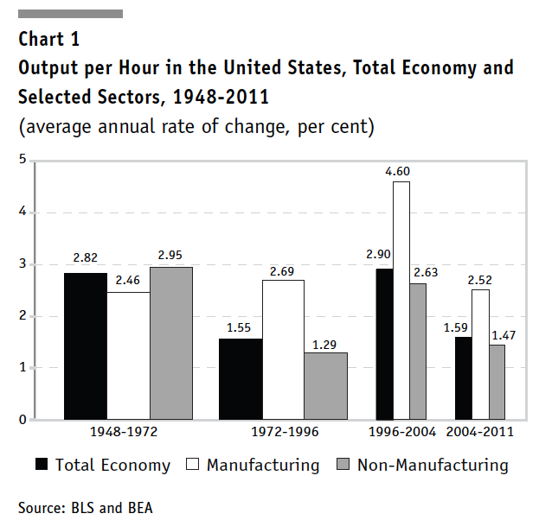
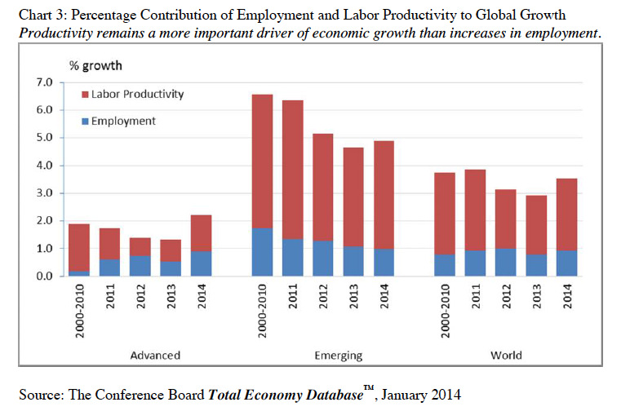
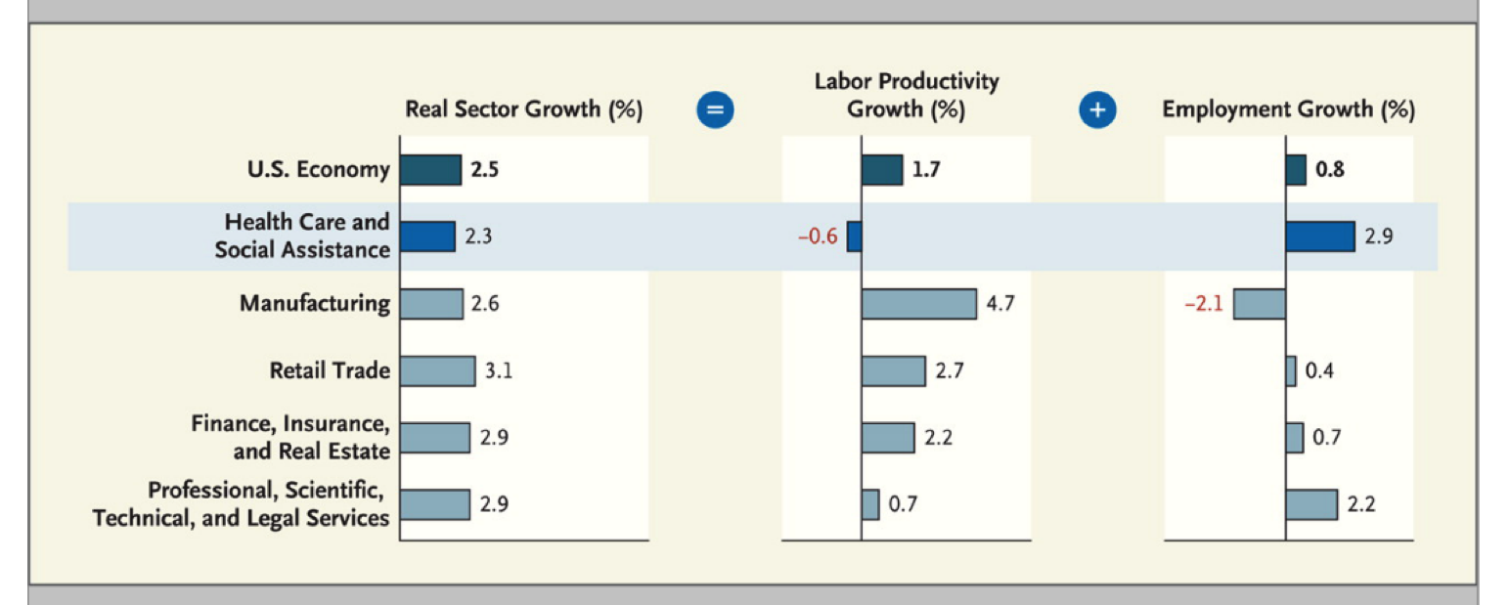
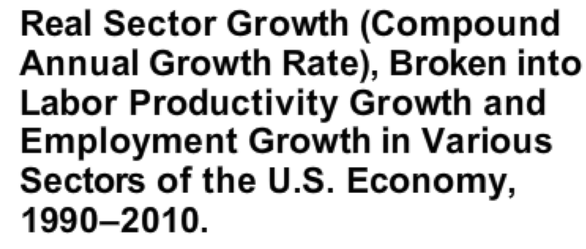
Productivity and Economic Growth
Source: Gordon, International Productivity Monitor, Spring 2013
Source: Kocher and Sahni, N Engl J Med, October 2011

Slide 6
“Manufacturing is performing a magnificent ballet on a shrinking stage.”
-Robert Gordon

Slide 7
Service System – A Working Definition
A cyber-physical-social system
A system for human interactions with physical and informational environments mediated by advanced technologies to add value
7

Slide 8
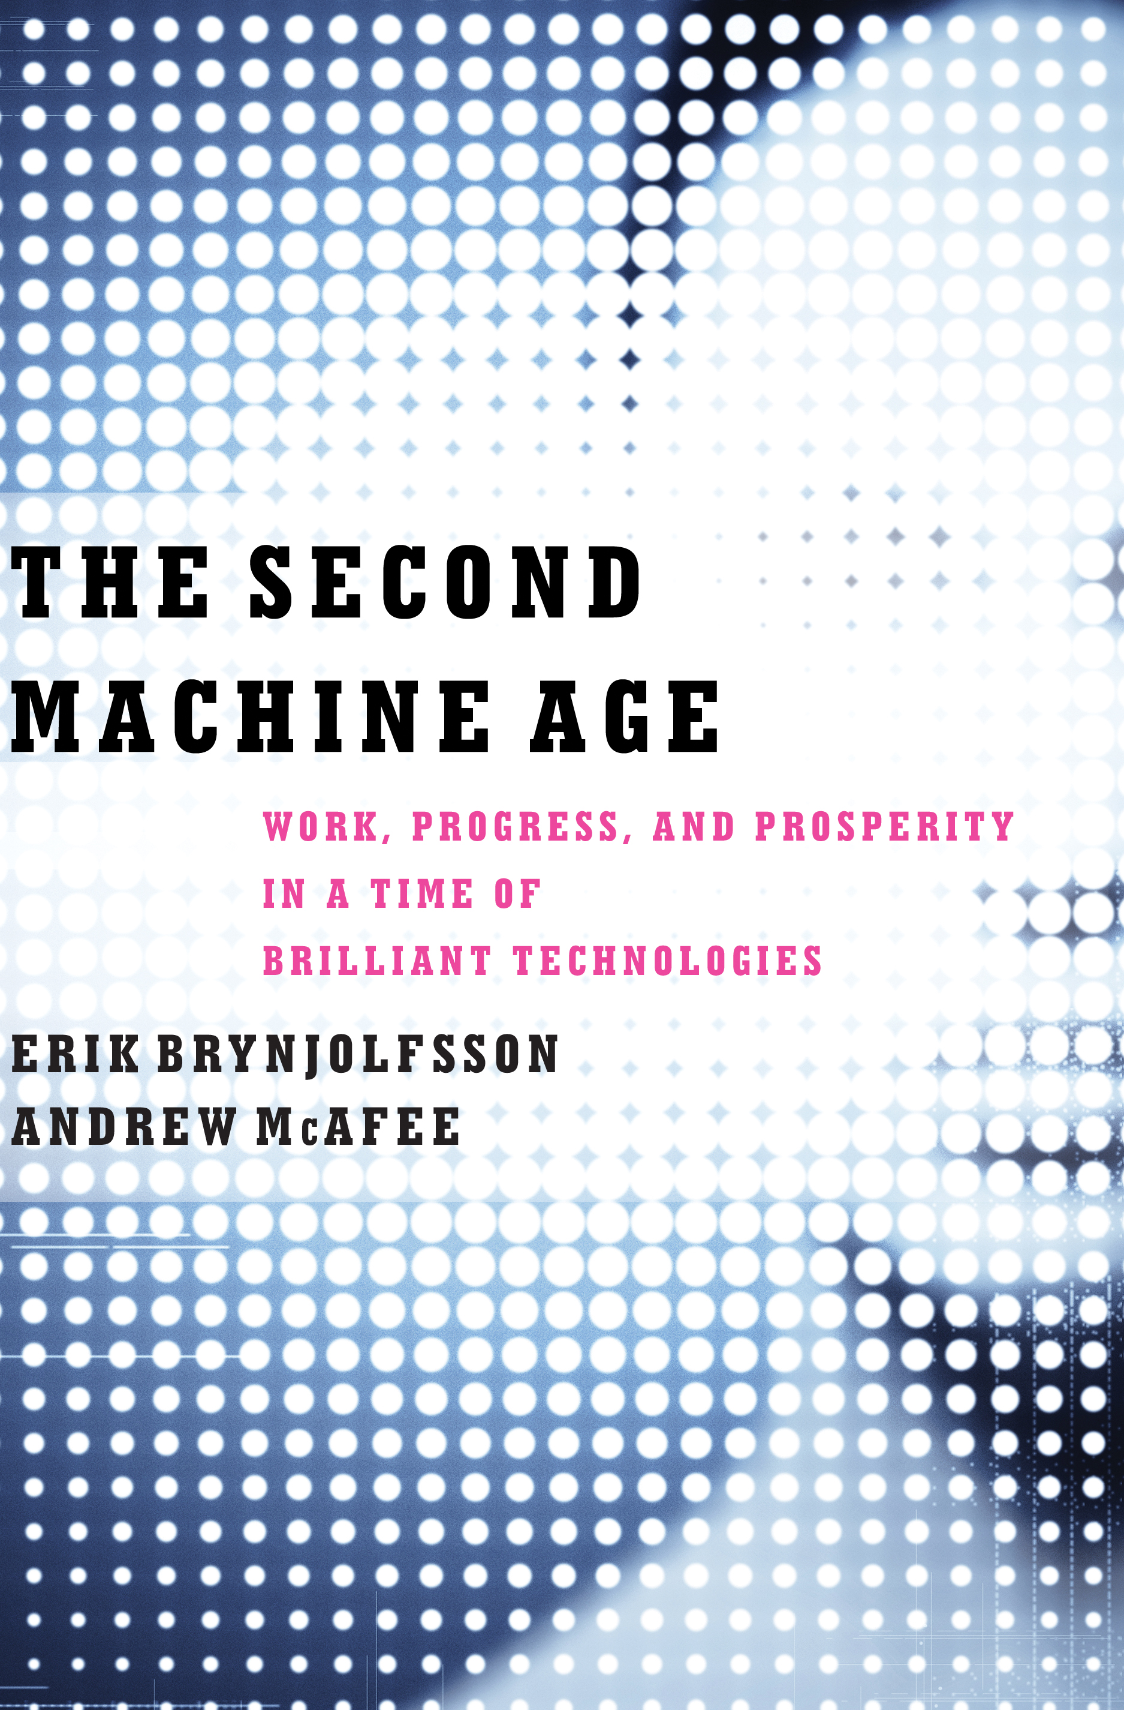
The Second Machine Age
“In short, we’re at an inflection point—a point where the curve starts to bend a lot—because of computers. We are entering a second machine age.”
Image courtesy Erik Brynjolfsson and Andrew McAfee

Slide 9
Advanced Manufacturing – A National Priority
“But in most of the firms in which we carried out our research the traditional line between “manufacturing” and “services” has become so blurred that it no longer serves to distinguish separable and distinct activities or end products.”
- MIT PIE Report
“The Internet of Things has already set in motion the idea of a fourth industrial revolution—a new wave of technological changes that will decentralize production control and trigger a paradigm shift in manufacturing.”
-Markus Löffler, McKinsey
Notes:
© European Union, 2013
Reproduction is authorised provided the source is acknowledged.
http://www.effra.eu/attachments/article/129/Factories%20of%20the%20Future%202020%20Roadmap.pdf

Slide 10
Retail Revolution under Way
“Given the business evolution of Amazon from a bookstore to the store for everything, we had to reinvent automation, following the lean principle of “autonomation”: keep the humans for high-value, complex work and use machines to support those tasks.”

Slide 11
Imagine a (cyber-physical-social) future …
Credit: Nicolle Rager Fuller, NSF
Notes:
IMAGE http://www.nsf.gov/cise/news/cps-perspective.jsp
I know that almost everyone gathered here today are either already a CPS investigator or supports CPS through partnerships of various kinds. However, I want to take this opportunity to take stock of why we are working together, very hard, in this important domain. To look forward imagine what the future –enabled by technologies, will look like.
Imagine a world that is safe, secure, healthy, vibrant, and resilient. Such a world requires technologies, systems, and infrastructures of that are smart, connected, working together and interdependently.
We need to advance large-scale systems and infrastructures such as efficient power grid, intelligent and safe highways, structurally sound bridges that can assess their own health;
We need smart technologies in everyday systems such as smart cars, energy efficient buildings and homes, and smart appliances
And we also need dependable personal technologies such as smart phones and smart/safe medical devices
Already, you are hearing the word “smart” repeated a few times. You will hear it a few more times before this meeting is over. Indeed, “Smart” or in other word “Better” technologies, systems, and infrastructures is what we strive to achieve in the CPS Program.

Slide 12
Research Challenges
Increased complexity
Range of scales – global scale to highly personalized
Faster time scales – near real-time and/or rapid response
Intelligent/learning system
Human-centered

Slide 13
What fundamental knowledge is needed? What research communities should be brought in?

Slide 14
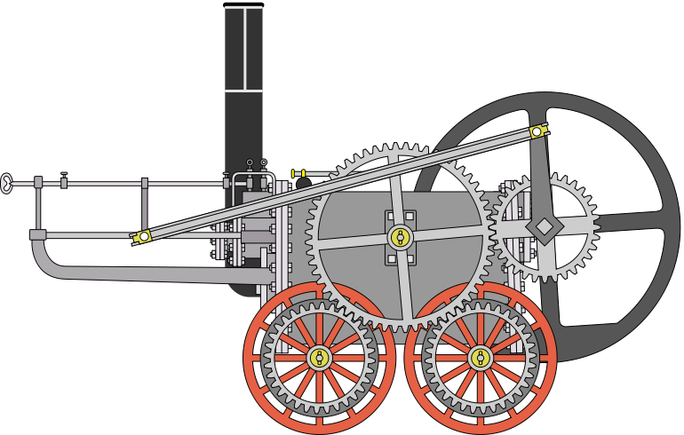
A Thought Experiment
Imagine designing a railway engine at the dawn of the 19th century
No systematic mechanical engineering at that time
Are we in an analogous situation in various service systems?
What might we learn from the experience in the development of different engineering fields?
Locomotive made by Richard Trevithick and Andrew Vivian (1801)
Credit: By Urizzato at en.wikipedia [Public domain], from Wikimedia Commons
Notes:
http://commons.wikimedia.org/wiki/File:Locomotive_trevithick.jpg

Slide 15
Models
Models are fundamental building blocks in all engineering fields
Leverage scientific knowledge in physics, chemistry, biology, and the power of mathematics
What might constitute “models” as we think about engineering for service systems?
What would be the role of social and behavioral sciences in this regard?

Slide 16
Analysis and Design Tools
What analysis and design tools might be developed to systematize the process of engineering service systems?
How do we leverage advances in cyber-physical systems and machine learning?
What are cyber security implications and needs in this context?
How do we put people in the center in framing design questions?
What can we learn from early experiences in infrastructure? and retail?

Slide 17
Example: Learning and Education
Productivity of a teacher has not improved significantly in decades
Major challenges in K-16 education
Growing body of knowledge in learning science and education
Modern information technology tools provide an unprecedented opportunity to transform education into just-in-time, personalized education
Idea of a learning engineer
Plenary session presenters discussed
advances in the fundamental science of learning—the underlying research base as to how individuals learn—and called for the development of a new applied discipline—termed
learning engineering—which was intended to translate these fundamental insights into new learning environments and tools.
Advancing Technology-Enhanced Education: A Workshop Report, IDA STPI, December 2013

Slide 18
Example: Health Care
Aging is one of the mega trends for the next many decades
Cost, quality, access, and efficacy of health care are major societal issues of our time
PCAST report on Systems Engineering for health care
Health care engineers

Slide 19
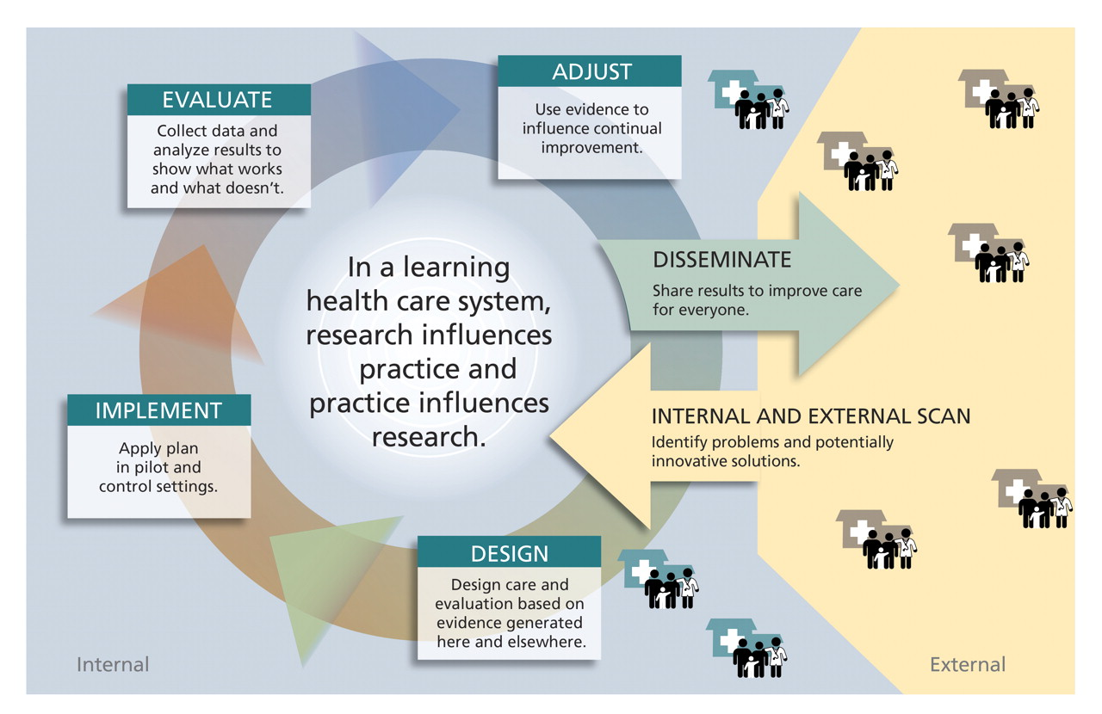
A Learning Health Care System
Would a smart health care engineered systems enable such a learning health care system?
SOURCE: Larson EB, Tachibana C, Wagner EH. “Sparking and sustaining the essential functions of research: What supports translation of research into health care? Answers from the Group Health Experience” In: Inui TS, Frankel RM, editors. Enhancing the Professional Culture of Academic Health Science Centers. London: Radcliffe Publishing. 2012.

Slide 20
Relevant NSF Programs
Service Enterprise Systems (SES)
Engineering and System Design (ESD)
Systems Science (SS)
Communications, Circuits and Sensing Systems (CCSS)
Cyber-Physical Systems (CPS)
Smart and Connected Health
National Robotic Initiative (NRI)
Building Innovation Capacity (BIC)
US Ignite
Smart Cities DCL (NSF 15-015)
Notes:
Smart Cities DCL (ENG and CISE) was just published last week.

Slide 21
“According to our estimates, about 47 percent of total US employment is at risk.”
THE FUTURE OF EMPLOYMENT: HOW
SUSCEPTIBLE ARE JOBS TO
COMPUTERISATION?
Osborne and Frey, 2013, Oxford University
“Our model predicts that most workers in transportation and logistics occupations, together with the bulk of office and
administrative support workers, and labour in production
occupations, are at risk.”

Slide 22
Concluding Thoughts
Is there an opportunity to lay the foundations of “X Engineering” where X would be transdisciplinary and represent some subset of the service sector?
We would like to be bold and creative yet rigorous in our thought processes
We welcome creative ideas, research agendas, and considered advice from the workshop participants

Slide 23
Questions? Ideas, thoughts!
pkhargon@nsf.gov

