Slide 1
Models of Industrial Relations
Dan Siewiorek
Carnegie Mellon University
November 2014

Slide 2
Five models
Traditional Industrial Consortium of established companies
Start-up companies
Industrial Laboratories
State/Academic Partnerships
Academic/Industrial Partnerships

Slide 3
Parallel Data Lab
Focus: faster, cheaper, more secure, more robust, more manageable, and more usable storage systems
Actifio
American Power Conversion
EMC Corporation
Facebook
Fusion-io
Google
Hewlett-Packard Labs
Hitachi
Huawei Technologies Co.
Intel Corporation
Microsoft Research
NEC Laboratories
NetApp, Inc.
Oracle Corporation
Samsung Information Systems America
Seagate Technology
Symantec Corporation
Western Digital

Slide 4

















QoLT Consortium
Thought leaders
LeadingAge
LeadingAge PA
Assisted Living
Federation
of America
Medical Device
Other CMU/Pitt
Departments
Retailers
Suppliers
Visiting Nurse
Association
Consumer
Electronics
Systems Suppliers
Independent Living
Home Care
Assisted Living
Rehabilitation
Skilled Nursing
Acute Care
ACO
Insurer
Architects
Venture Capital
Home Monitoring
Area Agency on Aging
Core Members
Mobility
Solutions
Mobile/Digital
Health
FDA
NCOA
Quantified Self
Personal
Robots
Reimbursement
Expert
AARP
Rehab Equipment
Durable Medical Equipment
AAPD
CMS
MS World
National PACE
Association
Alzheimer’s Association

Slide 5
Five models
Traditional Industrial Consortium of established companies
Start-up companies
Industrial Laboratories
State/Academic Partnerships
Academic/Industrial Partnerships

Slide 6

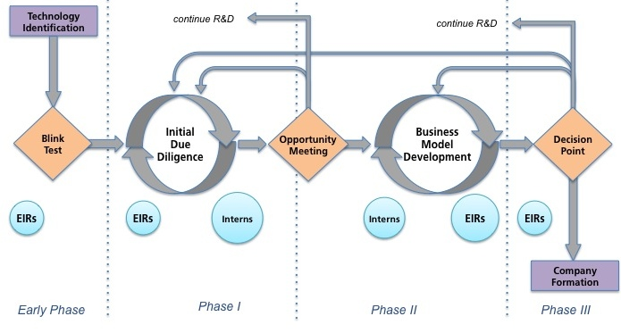
6

Slide 7
Five models
Traditional Industrial Consortium of established companies
Start-up companies
Industrial Laboratories
State/Academic Partnerships
Academic/Industrial Partnerships

Slide 8
Intel Science & Technology Center for Cloud Computing (ISTC-CC)
5-institution community enabling the promise
  led by Carnegie Mellon and Intel
  including Georgia Tech, Princeton, and UC-Berkeley
  homed at Carnegie Mellon; 4 Intel researchers onsite
Focus on critical enabling technologies
  foundations on which future clouds will be built
    complementing evolution of early cloud building blocks
  work with researchers exploring new cloud apps
    e.g., ISTCs on visual, pervasive, and embedded
Broad, aggressive 5-year research agenda

Slide 9
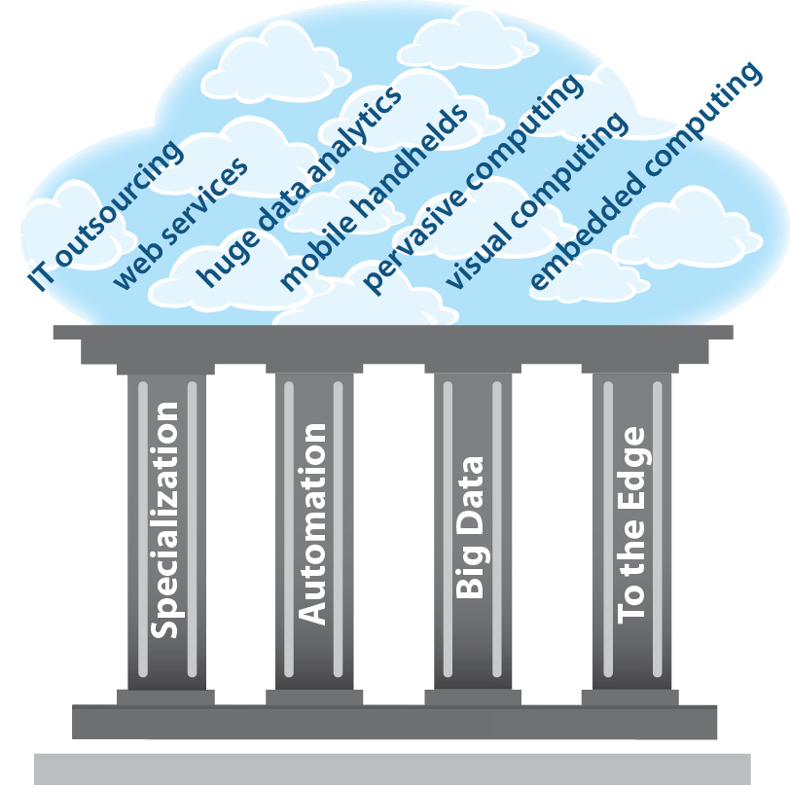
ISTC-CC Pillars Build Foundation

Slide 10
Five models
Traditional Industrial Consortium of established companies
Start-up companies
Industrial Laboratories
State/Academic Partnerships
Academic/Industrial Partnerships

Slide 11






A Commonwealth-University-Industry Partnership for Economic Development through Research, Technology, and Education.
PENNSYLVANIA INFRASTRUCTURE TECHNOLOGY ALLIANCE
www.pitapa.org
PITA is a Commonwealth of Pennsylvania-funded economic development program.
PITA brings companies and university faculty/students together to create and maintain jobs in PA.

Slide 12
Technical Focus Areas
PITA unites the expertise at Carnegie Mellon/LU with the capabilities and needs of PA companies to develop solutions to PA infrastructure problems:
  Transportation Systems
  Telecommunications and Information Technology
  Facilities
  Water Systems
  Energy & Environment
  Public Health & Medicine
  Hazard Mitigation & Disaster Recovery
www.pitapa.org - PENNSYLVANIA INFRASTRUCTURE TECHNOLOGY ALLIANCE

Slide 13
Typical Project
Project must support PITA goals
  Technology Development
  Education and Outreach
Project is lead by faculty at Carnegie Mellon University or Lehigh University
Project partner includes Pennsylvania-based company that contributes through either:
  Direct financial support
  In-kind support (through material donation, equipment usage, technical guidance etc.)
Project must have $2 of leveraged funding for every $1 of PITA funding
Graduate student participates in project, enabling collaboration with PA industry
www.pitapa.org - PENNSYLVANIA INFRASTRUCTURE TECHNOLOGY ALLIANCE

Slide 14
Accomplishments
16 year history
Nearly 1,000 projects with over 350 PA Companies
Over 1,600 students and 350 faculty
11 new company start-ups with PITA support
$166 million economic impact to PA
www.pitapa.org - PENNSYLVANIA INFRASTRUCTURE TECHNOLOGY ALLIANCE

Slide 15
Five models
Traditional Industrial Consortium of established companies
Start-up companies
Industrial Laboratories
State/Academic Partnerships
Academic/Industrial Partnerships

Slide 16

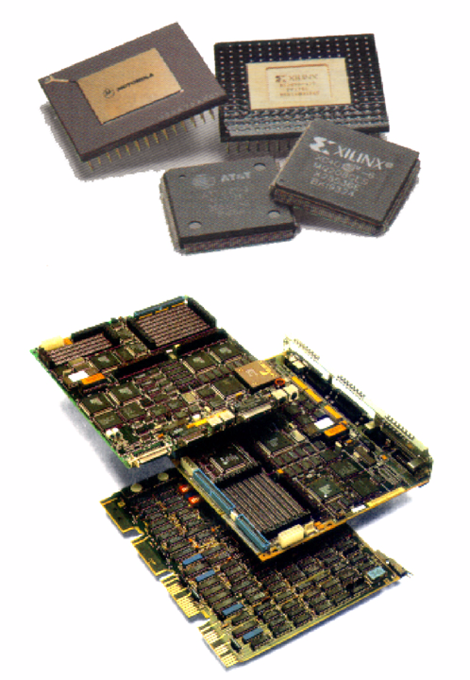
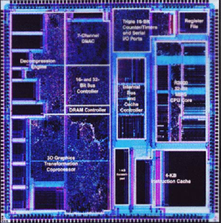
PDG Overview
A Not-for-Profit, Economic Development Initiative
  PDG Mission
    Create jobs related to chip design and embedded system development
  Technology Focus
    System on Chip (SoC), VLSI, and all related technologies
  Market Focus
    Multimedia and networking applications
Processor(s)
Memory
Communication
Analog Interface
Embedded Software

Slide 17



Digital Greenhouse – VALUE PROPOSITION
Research
  3rd in $ U.S.
  with 39 centers
Renowned Universities
1,100 EE, CE & CS graduates/year
Technology
300+ software firms (>10,000 Employees)
Engineering firms >30,000 Employees
Business Environment
15+ Japanese owned companies in the region, with over 8,000 jobs; Within 500 mile radius of 50% of U.S. retail sales
Notes:
Year 1
There was also a lot of work on the value proposition.
When the Digital Greenhouse launched in July 1999, it was based on a business model that leveraged the region’s assets, including:
An advantageous Business environment
a Strong base of existing technology companies
World Class Universities
And a strong history of Research & Development
Page

Slide 18


The Pittsburgh Digital Greenhouse
The Pittsburgh Digital Greenhouse is a Cooperative Initiative by Government, Universities & Industry to Establish Southwestern Pennsylvania as a World Leader in the Digital Video and Digital Networking Markets
Wireless
Mobile
Infotronics
Network
ATM
Multi-media
Year 2003+
Connectivity
Information
Ethernet
Digital TV
Year 2000
Digital Switches
Digital Video
Digital STB
Broadband Network
Multi-Media
Southwestern PA Today
Network Protocol, Design Automation, Software

Slide 19
PDG Research Program
Economic development objectives
  Fund startups
  Develop the region’s infrastructure
  Commercialize technology
    Technology transfer
    Product development
  Serve as focal point for membership
Member directed research projects
  Annual funding of $3-4M; 2 RFP’s per year
  Technology Advisory Board (TAB) selects projects to fund
  Members get shared IP rights
  Average research project is 12 months, $200K
  Definitive project milestones and deliverables

Slide 20
PDG Membership
Member eligibility
  IC designers
  EDA tool vendors
  Embedded software developers
Membership categories
Annual dues based on company’s revenue
  Integrated Device Manufacturers (IDM’s)
  Advanced electronic component and product companies
 | Research |  | Education and Training | Talent Recruitment | Business Support Services | Networking and Marketing
 | 3-year royalty free | Royalty bearing
Affiliate |  |  | ■ | ■ | ■ | ■
Associate |  | ■ | ■ | ■ | ■ | ■
Full | ■ | ■ | ■ | ■ | ■ | ■

Slide 21

Electronic Design Technology
Development Program
Technology Advisory Board
SONY CASIO CADENCE SIMA CORP IMD
OKI CISCO NEO LINEAR VIDEON
PITT PSU CMU
Assess Develop Select Execute Technology
Needs Roadmap Projects Projects Transfer
THE PITTSBURGH DIGITAL GREENHOUSE
INDUSTRY MEMBERS AND OTHERS

Slide 22






























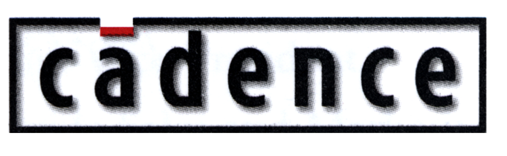








PARTNERS & MEMBERS
Economic Initiatives
Government
Foundations
Universities
Alcoa
Benedum
Heinz
Hillman
McCune
Mellon
Pittsburgh
FireFly Power Technologies
Novocell
I
M
D

Slide 23
Western PA Members
3eTI Wireless network gateways
Accipiter Systems Network modeling & design
ADCUS MCU technology
Aethon Material hauling “Tug” product
AIT Advanced HCI Technologies
Applied Perception Sensing and navigation products
AssistWare Lane departure warning system
Automatika Robotic system engineering
Benchmark Photonics Fiber Monitors and Switches
BitArmor Systems Cybersecurity solutions
Bridge Semi Mixed-Signal ASSP’s
Caracal, Inc. SiC wafers and devices
Compunetix Audio/Video Conferencing
Cycle Time Industrial automation technologies
Desantage PCB design tools
Dielectric Solutions Glass fiber materials
FireFly Electrical power technologies
IC Mechanics MEMS-based Motion Sensors
Identifi RFID chips
IMD Memory Design Services/IP
Laurel Networks Optical Edge Router
Maya Design Product Design/Packaging
Marconi Broadband switches
Neolinear Mixed Signal EDA Tools
Novocell Non-Volatile Memory IP
Oki ASIC Design Center
Plextronics Inherently conductive polymers
RE² Robotic system engineering
RedZone Robotics Construction/field service robots
Saronix Frequency/Timing Control Products
Seagate Hard disc drives
SEEGRID 3D mobile perception technology
SIMA Consumer Audio/Video Products
Spinnaker Networks Network Storage
Steel River Systems DSP Tools/Hardware
Thar Technologies Supercritical fluid technology
TRS Technologies Specialty ceramic materials
Vocollect Wireless Wearables
Xactix MEMS etching equipment

Slide 24
Electronic Design Education Program
Design Complex Industry
Training- Industry Focused
Electronic
Design
Education
Degree
Offerings
EDE
Initial
Offerings:
SOC Design Overview
System Level Design
Structural Chip Design
Physical Chip Design
EDA Tools Courses
CMU
CMU
Provides Training for Engineers and
Managers using System On Chip
(SOC) Design:
  40 hours (week long) courses
  Instructor driven lectures
  Instructor led lab exercises
PITT
PSU

