Slide 1
Transverse Spin Asymmetries in
Elastic Electron Scattering
Andrei Afanasev
Hampton University/JLAB
PAVI 2009
Bar Harbor, Maine, June 25, 2009

Slide 2
Plan of talk
Elastic electron-proton scattering beyond the leading order in QED
Models for two-photon exchange
Single-spin asymmetries
  Diffractive mechanism in ep-scattering via two-photon exchange
  Novel features of a single-spin asymmetry
  Comparison with experiment
Summary

Slide 3
Elastic Nucleon Form Factors
Based on one-photon exchange approximation
Two techniques to measure
Latter due to: Akhiezer, Rekalo; Arnold, Carlson, Gross

Slide 4
Do the techniques agree?
SLAC/Rosenbluth
~5% difference in cross-section
x5 difference in polarization
JLab/Polarization
Both early SLAC and Recent JLab experiments on (super)Rosenbluth separations followed Ge/Gm~const, see I.A. Quattan et al., Phys.Rev.Lett. 94:142301,2005
JLab measurements using polarization transfer technique give different results (Jones’00, Gayou’02)
Radiative corrections, in particular, a short-range part of 2-photon
exchange is a likely origin of the discrepancy

Slide 5
Complete radiative correction in O(α_{em} )
Radiative Corrections:
Electron vertex correction (a)
Vacuum polarization (b)
Electron bremsstrahlung (c,d)
Two-photon exchange (e,f)
Proton vertex and VCS (g,h)
Corrections (e-h) depend on the nucleon structure
Meister&Yennie; Mo&Tsai
Further work by Bardin&Shumeiko; Maximon&Tjon; AA, Akushevich, Merenkov;
Guichon&Vanderhaeghen’03:
Can (e-f) account for the Rosenbluth vs. polarization experimental discrepancy? Look for ~3% ...
Log-enhanced but calculable (a,c,d)
Main issue: Corrections dependent on nucleon structure
Model calculations:
Blunden, Melnitchouk,Tjon, Phys.Rev.Lett.91:142304,2003
Chen, AA, Brodsky, Carlson, Vanderhaeghen, Phys.Rev.Lett.93:122301,2004

Slide 6
Single-Spin Asymmetries in Elastic Scattering
Parity-conserving
Observed spin-momentum correlation of the type:
where k_{1,2} are initial and final electron momenta, s is a polarization vector
of a target OR beam
For elastic scattering asymmetries are due to absorptive part of 2-photon exchange amplitude
Parity-Violating

Slide 7

Normal Beam Asymmetry in Moller Scattering
Pure QED process, e⁻+e⁻→e⁻+e⁻
  Barut, Fronsdal , Phys.Rev.120:1871 (1960): Calculated the asymmetry in first non-vanishing order in QED O(α)
  Dixon, Schreiber, Phys.Rev.D69:113001,2004, Erratum-ibid.D71:059903,2005: Calculated O(α) correction to the asymmetry
SLAC E158 Results (K. Kumar, private communication):
An(exp)=7.04±0.25(stat) ppm
An(theory)=6.91±0.04 ppm

Slide 8

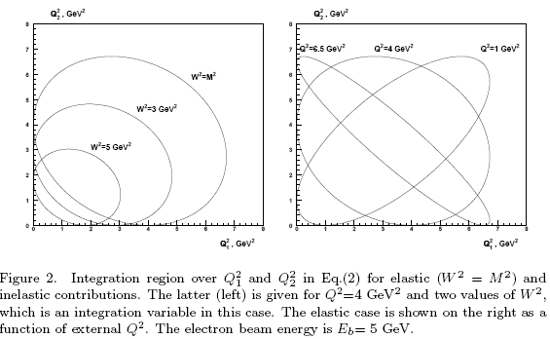
Single-Spin Target Asymmetry
De Rujula, Kaplan, De Rafael, Nucl.Phys. B53, 545 (1973):
Transverse polarization effect is due to the absorptive part of the non-forward
Compton amplitude for off-shell photons scattering from nucleons
See also AA, Akushevich, Merenkov, hep-ph/0208260

Slide 9
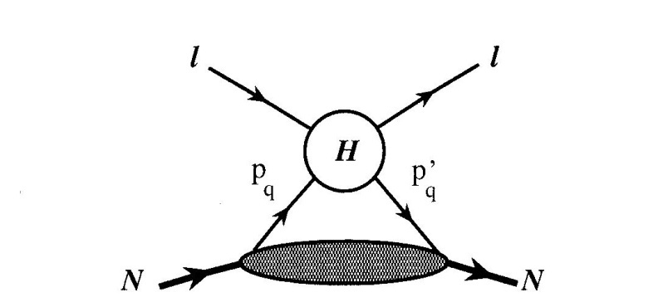
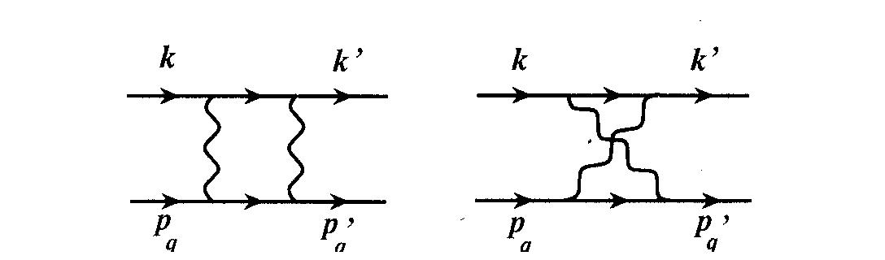
Calculations using Generalized
Parton Distributions
Model schematics:
Hard eq-interaction
GPDs describe quark emission/absorption
Soft/hard separation
  Use Grammer-Yennie prescription
Hard interaction with a quark
AA, Brodsky, Carlson, Chen, Vanderhaeghen,
Phys.Rev.Lett.93:122301,2004; Phys.Rev.D72:013008,2005

Slide 10
Quark+Nucleon Contributions to Target Asymmetry
Single-spin asymmetry or polarization normal to the scattering plane
Handbag mechanism prediction for single-spin asymmetryof elastic eN-scattering on a polarized nucleon target (AA, Brodsky, Carlson, Chen, Vanderhaeghen)
Only minor role of quark mass
Data coming from JLAB E05-015
(Inclusive scattering on normally polarized ³He in Hall A)

Slide 11
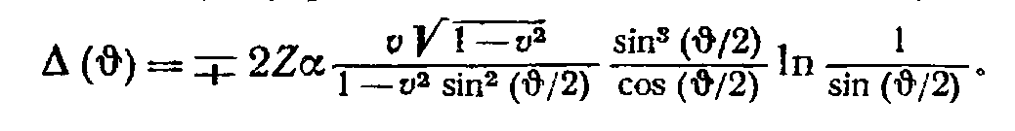
Beam Single-Spin Asymmetry: Early Calculations
Spin-orbit interaction of electron moving in a Coulomb field
N.F. Mott, Proc. Roy. Soc. London, Set. A 135, 429 (1932);
Interference of one-photon and two-photon exchange Feynman diagrams in electron-muon scattering: Barut, Fronsdal, Phys.Rev.120, 1871 (1960)
Extended to quark-quark scattering SSA in pQCD: Kane, Pumplin, Repko, Phys.Rev.Lett. 41, 1689 (1978)

Slide 12
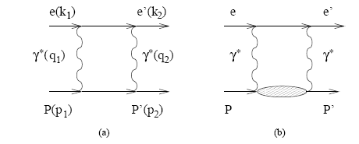
Proton Mott Asymmetry at Higher Energies
AA, Akushevich, Merenkov,
hep-ph/0208260
Transverse beam SSA,
units are parts per million
Asymmetry due to absorptive part of two-photon exchange amplitude; shown is elastic intermediate state contribution
Nonzero effect first observed by SAMPLE Collaboration (S.Wells et al., PRC63:064001,2001) for 200 MeV electrons

Slide 13
Beam Normal Asymmetry from Inelastic Intermediate States (hep-ph/0407167)
Gauge invariance essential in cancellation of infra-red singularity for target asymmetry
Feature of the normal beam asymmetry: After m_{e} is factored out, the remaining
expression is singular when virtuality of the photons reach zero in the loop integral!
But why are the expressions regular for the target SSA?!
Also calculations by Vanderhaeghen, Pasquini (2004); Gorchtein, hep-ph/0505022;
Kobushkin, nucl-th/0508053
confirm quasi-real photon exchange enhancement

Slide 14
Phase Space Contributing to the absorptive part of 2γ-exchange amplitude
2-dimensional integration (Q₁², Q₂²) for the elastic intermediate state
3-dimensional integration (Q₁², Q₂²,W²) for inelastic excitations
`Soft’ intermediate electron;
Both photons are hard collinear
Dominates for backward scattering
Examples: MAMI A4
E= 855 MeV
Θcm= 57 deg;
SAMPLE, E=200 MeV
One photon is
hard collinear
Dominates for
forward scattering

Slide 15
MAMI data on Mott Asymmetry
F. Maas et al., [MAMI A4 Collab.]
Phys.Rev.Lett.94:082001, 2005
Pasquini, Vanderhaeghen:
Phys.Rev.C70:045206,2004
Surprising result: Dominance of inelastic intermediate excitations
Elastic intermediate
state
Inelastic excitations
dominate

Slide 16
Special property of Mott asymmetry
Mott asymmetry above the nucleon resonance region
(a) does not decrease with beam energy
(b) is enhanced by large logs
(AA, Merenkov, PL B599 (2004)48; hep-ph/0407167v2 (erratum) )
Reason for the unexpected behavior: exchange of hard collinear quasi-real photons and diffractive mechanism of nucleon Compton scattering
  For s>>-t and above the resonance region, the asymmetry is given by:
Compare with asymmetry caused by Coulomb distortion at small θ =>
may differ by orders of magnitude depending on scattering kinematics

Slide 17
Input parameters
For small-angle (-t/s<<1) scattering of electrons with energies Ee ,
normal beam asymmetry is given by the energy-weighted integral
σ_{γp} from N. Bianchi at al., Phys.Rev.C54 (1996)1688 (resonance region) and Block&Halzen,
Phys.Rev. D70 (2004) 091901

Slide 18
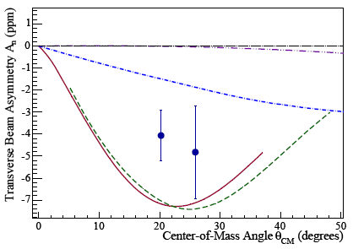
Predictions vs experiment for Mott asymmetry
Use fit to experimental data on σ_{γp} (dotted lines include only one-pion+nucleon intermediate states)
G0 arXiv 0705.1525[nucl-ex]
HAPPEX
Estimated normal beam asymmetry
for Qweak: -5ppm

Slide 19
Predict no suppression for Mott asymmetry with energy at fixed Q²
x10⁻⁶
x10⁻⁹
SLAC E158 kinematics
At 45 GeV predict beam asymmetry parts-per-million (diffraction) vs. parts-per billion (Coulomb distortion)

Slide 20
Comparison with E158 data
SLAC E158:
An=-2.89±0.36(stat)±0.17(syst) ppm
(K. Kumar, private communication)
Theory (AA, Merenkov):
An=-3.2ppm
Need to include QED radiative correction
Good agreement justifies application of this approach to the real part of two-boson exchange (Gorchtein’s talk on γZ box)

Slide 21
Mott Asymmetry on Nuclei
Important systematic correction for parity-violation experiments (~-10ppm for HAPPEX on ⁴He, ~-5ppm for PREX on Pb,), see AA arXiv:0711.3065 [hep-ph] ; also Gorchtein, Horowitz, Phys.Rev.C77:044606,2008
Coulomb distortion: only10⁻¹⁰ effect (Cooper&Horowitz, Phys.Rev.C72:034602,2005)
Five orders of magnitude enhancement in HAPPEX kinematics due to excitation of
inelastic intermediate states in 2γ-exchange (AA, Merenkov; use Compton data from Erevan )

Slide 22
Inclusive Electroproduction of Pions
Reaction p(e_{pol},π)X
  Parity-conserving spin-momentum correlation
  Introduced in Donnelly, Raskin, Annals Phys. 169, 247 (1986)
    Can be shown to be a) due to R_{TL’} response function (=fifth structure function) and b) not to integrate to zero after integration over momenta of the scattered electron
  This is NOT a two-photon exchange effect (but suppressed by an electron mass)
    Order-of magnitude estimate: An(ep->πX)~ A_{LT’}(ep->e’ πN)*m_{e}/E’/sin(θ_{e})
      Use MAMI data A_{LT’}(ep->e’ πN)~7%, from Bartsch et al Phys.Rev.Lett.88:142001,2002 => An(ep->πX)~250ppm
    Detailed calculations in progress by AA and Masao Yamagishi (use MAID, SAID for input on A_{LT’} )

Slide 23
Summary: SSA in Elastic ep-Scattering
Collinear photon exchange present in (light particle) beam SSA
Models violating EM gauge invariance encounter collinear divergence for target SSA
VCS amplitude in beam asymmetry is enhanced in different kinematic regions compared to target asymmetry
Beam asymmetry unsuppressed in forward angles, important systematic effect for PREX, Q_{weak}
Strong-interaction dynamics for Mott asymmetry in small-angle ep-scattering above the resonance region is soft diffraction
  For the diffractive mechanism A_{n} is a) not suppressed with beam energy and b) does not grow with Z (~A/Z)
  Confirmed experimentally (SLAC E158) → first observation of diffractive component in elastic electron-hadron scattering

