Slide 1
Quantum de Finetti theorems for local measurements
methods to analyze SDP hierarchies
Fernando Brandão (UCL)
Aram Harrow (MIT)
arXiv:1210.6367

Slide 2
motivation/warmup
nonlinear optimization --> convex optimization
D(n) = conv {xx^{T} : x∈S^{n}} = density matrices

Slide 3
a harder problem
SepSym(n,n) = conv {xx^{T} ⊗ xx^{T} : x∈S^{n}}
⊂ Sep(n,n) = conv {xx^{T} ⊗ yy^{T} : x,y∈S^{n}} ⊂ D(n²)

Slide 4

polynomial optimization
D(n)_{n} = conv {xx^{T} : x∈S^{n}}
EASY
SepSym(n,n) = conv {xx^{T} ⊗ xx^{T} : x∈S^{n}}
HARD
≈ tensor norms ≈ 2->4 norm ≈ small-set expansion
need to find relaxation!

Slide 5
k-extendable relaxation
want σ∈SepSym(n,n) = conv {xx^{T} ⊗ xx^{T} : x∈S^{n}}
relax to
∀π,π’∈S_{k}
ideally
recover ρ∈ D(n²)
why?
partial trace = quantum analogue of marginal distribution
using ∑_{i}x_{i}² = 1 constraint

Slide 6

why should this work?
physics explanation: “monogamy of entanglement” only separable states are infinitely sharable
math explanation:
as k→∞

Slide 7


convergence rate
run-time = n^{O(k)}
dist(k-extendable, SepSym(n,n)) = f(k,n) = ??
trace dist(ρ,σ) = max_{0≤M≤I} hM,ρ-σi ～ n/k
→ n^{O(n)} time
[Brandão, Christandl, Yard; STOC ‘11]
distance ～ (log(n)/k)^{1/2}
for M that are 1-LOCC → time n^{O(log(n))}
i
ρ
Def of 1-LOCC M = ∑_{i} A_{i} ⊗ B_{i} such that 0 ≤ A_{i} ≤ I 0 ≤ B_{i} ∑_{i} B_{i} = I
Pr[accept | i] = hA_{i}⊗B_{i},ρi / Pr[i]
Pr[i] = hI⊗B_{i},ρi

Slide 8
our results
simpler proof of BCY 1-LOCC bound
extension to multipartite states
dimension-independent bounds if Alice is non-adaptive
extension to non-signaling distributions
explicit rounding scheme
(next talk) version without symmetry
applications
optimal algorithm for degree-√n poly optimization (assuming ETH)
optimal algorithm for approximating value of free games
hardness of entangled games
QMA = QMA with poly(n) unentangled Merlins & 1-LOCC measurements
“pretty good tomography” without independence assumptions
convergence of Lasserre
multipartite separability testing

Slide 9
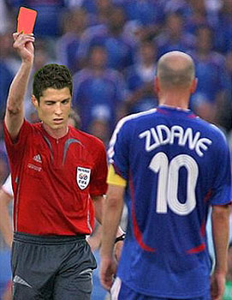
proof sketch
Further restrict to LO measurements
M = ∑_{a,b} Υ_{ab} A_{a} ⊗ B_{b}
ρ
0 ≤ Υ_{ab} ≤ 1
∑_{a} A_{a} = I
∑_{b} B_{b} = I
Pr[a,b] = h½, A_{a} ­ B_{b}i
b
a
Goal: max ∑_{a,b} Pr[a,b] γ_{a,b}
exact solutions (ρ∈SepSym): Pr[a,b] = ∑λ_{i} q_{i}(a) r_{i}(b)
Pr[accept | a,b] = γ_{ab}

Slide 10
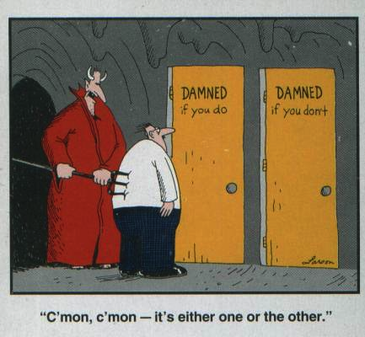
rounding
M = ∑_{a,b} Υ_{ab} A_{a} ⊗ B_{b}
Pr[a,b] = h½, A_{a} ­ B_{b}i
0 ≤ Υ_{ab} ≤ 1
Goal: max ∑_{a,b} Pr[a,b] γ_{a,b}
∑_{a} A_{a} = I
exact solutions (ρ∈SepSym): Pr[a,b] = ∑λ_{i} q_{i}(a) r_{i}(b)
∑_{b} B_{b} = I
relaxation
proof idea
good approximation if Pr[a,b₁] ≈_{ε} Pr[a] ⋅ Pr[b₁]
otherwise H(a|b₁) < H(a) – ε²

Slide 11
information theory
[Raghavendra-Tan, SODA ’12]
log(n) ≥ I(a:b₁ … b_{k})
= I(a:b₁) + I(a:b₂|b₁) + … + I(a:b_{k}|b₁…b_{k-1})
∴ I(a:b_{j}|b₁…b_{j-1}) ≤ log(n)/k for some j
∴ρ≈Sep for this particular measurement
Note: Brandão-Christandl-Yard based on quantum version of I(a:b|c).

Slide 12
open questions
Improve 1-LOCC to SEP would imply QMA = QMA with poly(n) Merlins and quasipolynomial-time algorithms for tensor problems
Better algorithms for small-set expansion / unique games
Make use of “partial transpose” symmetry
Understand quantum conditional mutual information
extension to entangled games that would yield NEXP ⊆ MIP*. (see paper)
More counter-examples / integrality gaps.

