Slide 1

Quantum information and the monogamy of entanglement
Aram Harrow (MIT)
Brown SUMS
March 9, 2013

Slide 2

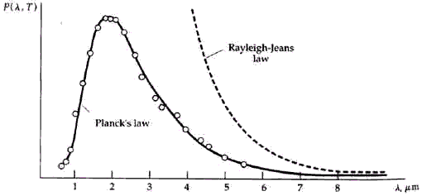
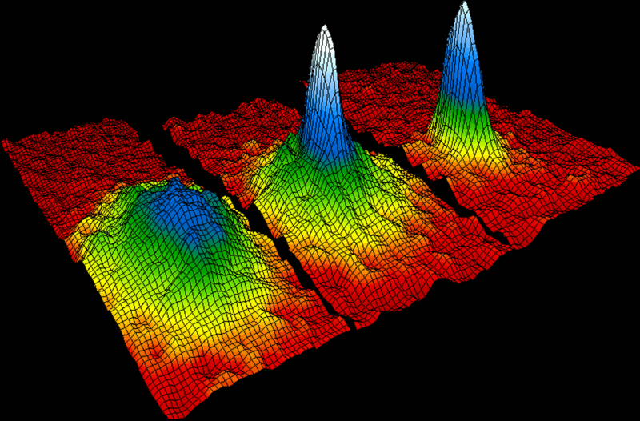
Quantum mechanics
Blackbody radiation paradox:
How much power does a hot object emit at wavelength ¸?
Classical theory (1900): const / ¸⁴
Quantum theory (1900 – 1924):
Bose-Einstein condensate (1995)
QM has also explained:
the stability of atoms
the photoelectric effect
everything else we’ve looked at

Slide 3
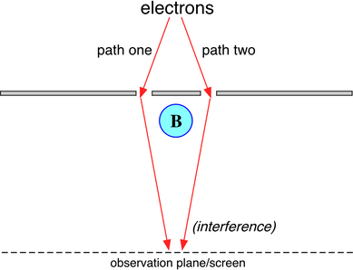
Difficulties of quantum mechanics
Heisenberg’s uncertainty principle
Topological effects
Entanglement
Exponential complexity:
Simulating N objects
requires effort »exp(N)

Slide 4
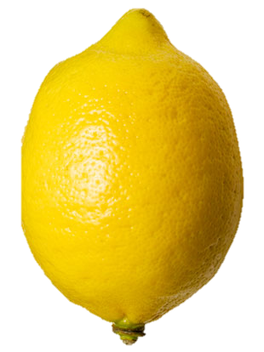
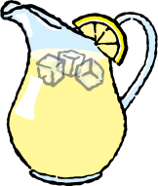
The doctrine of quantum information
Abstract away physics to device-independent fundamentals: “qubits”
operational rather than foundational statements:
Not “what is quantum information” but “what can we do with quantum information.”

Slide 5
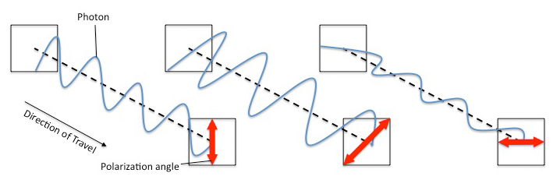
example: photon polarization
Photon polarization states:
Uncertainty principle:
No photon will yield
a definite answer to
both measurements.
Measurement: Questions of the form
“Are you or ?”
µ
Rule: Pr[ | ] = cos²(µ)

Slide 6
Quantum key distribution
State | Measurement | Outcome
 |  | or
 |  | or
 |  | or
 |  | or
Protocol:
1. Alice chooses a random
sequence of bits and encodes
each one using either
or
2. Bob randomly chooses
to measure with either
or
3. They publically reveal their
choice of axes and discard
pairs that don’t match.
4. If remaining bits are
perfectly correlated, then
they are also secret.

Slide 7
Quantum Axioms
Classical probability
Quantum mechanics

Slide 8
Measurement
Quantum state: α∊𝘊^{N}
Measurement: An orthonormal basis {v₁, …, v_{N}}
Outcome:
Pr[v_{i} |α] = |hv_{i},αi|²
Example:
More generally, if M is Hermitian,
then hα, Mαi is observable.
Pr[v_{i} |α] = |α_{i}|²

Slide 9
Product and entangled states
state of
system A
state of
system B
joint state of A and B
probability analogue:
independent random variables
Entanglement
“Not product” := “entangled” ～ correlated random variables
The power of [quantum] computers
One qubit ´
n qubits ´
e.g.

Slide 10
Measuring entangled states
A
B
joint state
Rule: Pr[ A observes and B observes ] = cos²(θ) / 2
General rule: Pr[A,B observe v,w | state α] = |hv­w, αi|²
Instantaneous signalling?
v₁
w₂
Alice measures {v₁,v₂}, Bob measures {w₁,w₂}.
θ
w₁
Pr[w₁|v₁] = cos²(θ) Pr[v₁] = 1/2
Pr[w₁|v₂] = sin²(θ) Pr[v₂] = 1/2
v₂
Pr[w₁| Alice measures {v₁,v₂}] = cos²(θ)/2 + sin²(θ)/2 = 1/2
Notes:
like envelopes

Slide 11
CHSH game
a∊{0,1}
b∊{0,1}
a | b | x,y
0 | 0 | same
0 | 1 | same
1 | 0 | same
1 | 1 | different
Alice
shared
randomness
Bob
y2{0,1}
x2{0,1}
Goal: x⨁y = ab
Max win probability is 3/4. Randomness doesn’t help.

Slide 12
CHSH with entanglement
Alice and Bob share state
Alice measures
Bob measures
x=0
y=0
win prob
cos²(π/8)
≈ 0.854
x=1
b=0
a=0
y=1
x=0
y=0
y=1
a=1
b=1
x=1

Slide 13
CHSH with entanglement
a=0
x=0
b=0
y=0
a=1
x=0
b=1
y=1
Why it works
Winning pairs
are at angle π/8
Losing pairs
are at angle 3π/8
∴ Pr[win]=cos²(π/8)
a=0
x=1
b=0
y=1
a=1
x=1
b=1
y=0

Slide 14
Monogamy of entanglement
a∊{0,1}
b∊{0,1}
c∊{0,1}
Alice
Bob
Charlie
x∊{0,1}
y∊{0,1}
z∊{0,1}
max Pr[AB win] + Pr[AC win] =
max Pr[x⨁y = ab] + Pr[x⨁z = ac]
< 2 cos²(π/8)

Slide 15
Marginal quantum states
Q: What is the state of AB? or AC?
Given a
state of
A, B, C
A: Measure C.
Outcomes {0,1} have probability
AB are
left with
or
General monogamy relation:
The distributions over AB and AC cannot both be very entangled.
More general bounds from considering AB₁B₂…B_{k}.

Slide 16
Application to optimization
Given a Hermitian matrix M:
  max_{α} hα, Mαi is easy
  max_{α,β} hα⨂β, M α⨂βi is hard
Approximate with
A
Computational effort: N^{O(k)}
Key question:
approximation error as a function of k and N
B₁
B₂
B₃
B₄

Slide 17
For more information
General quantum information:
M.A. Nielsen and I.L. Chuang, Quantum Computation and Quantum Information, Cambridge University Press, 2000.
google “David Mermin lecture notes”
M. M. Wilde, From Classical to Quantum Shannon Theory, arxiv.org/abs/1106.1445
Monogamy of Entanglement: arxiv.org/abs/1210.6367
Application to Optimization: arxiv.org/abs/1205.4484

