Slide 1
MIT 3.071
Amorphous Materials
12: Amorphous Silicon Macroelectronics
Juejun (JJ) Hu
hujuejun@mit.edu

Slide 2
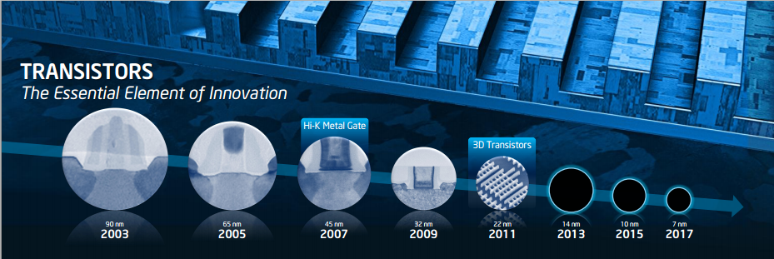
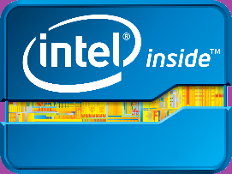
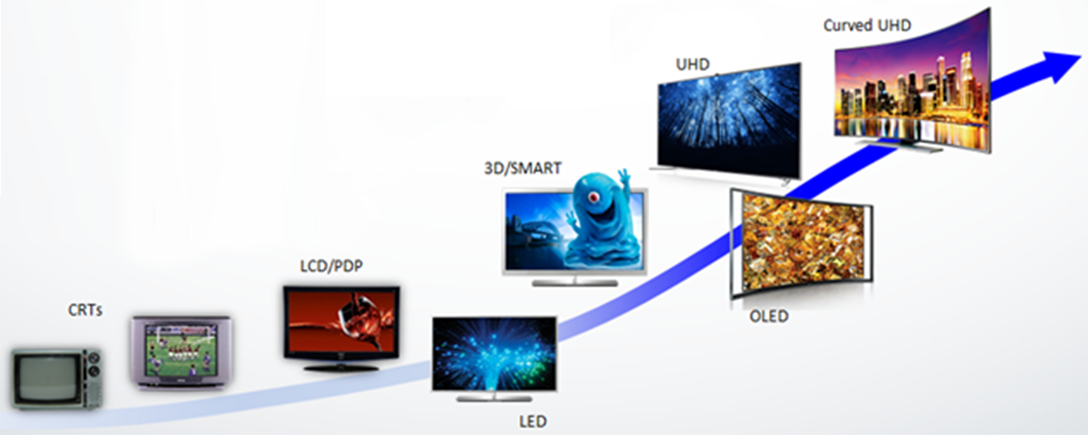
Electron’s travels: from Lilliput to Brobdingnag
Microelectronics
“Smaller is smarter”
Macroelectronics
“Bigger is better”
Image from Wikipedia

Slide 3
Why amorphous silicon?
Large-area, low-temperature, monolithic deposition
  Low-cost, mature plasma-enhanced CVD (PECVD) process
  Dielectrics and passivation layers can be formed using the same process
Doping capacity
  Effective passivation of defects (hydrogenation)
CMOS compatibility
  Leveraging existing infrastructure and knowledge base from the microelectronics industry
“The essence of being human is that one does not seek perfection.”
-- George Orwell

Slide 4
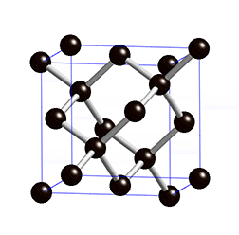
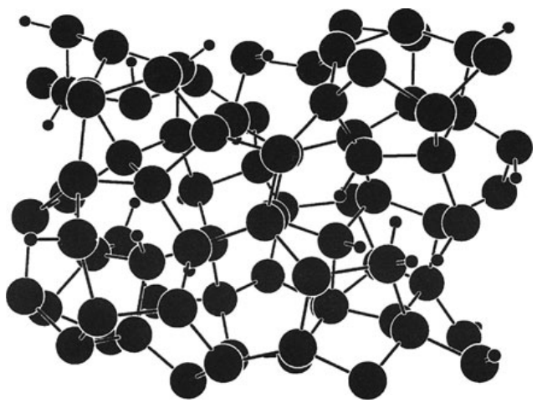
Structure of amorphous silicon
c-Si: diamond structure consisting of 6-member rings formed by 4-fold coordinated Si atoms
a-Si: continuous random network consisting of rings of varying sizes formed by mostly 4-fold coordinated Si atoms
Notes:
Unlike oxide glasses, a-Si does not undergo glass transition under normal conditions (although this view has been challenged, see: http://www.nature.com/nmat/journal/v3/n11/abs/nmat1241.html).

Slide 5
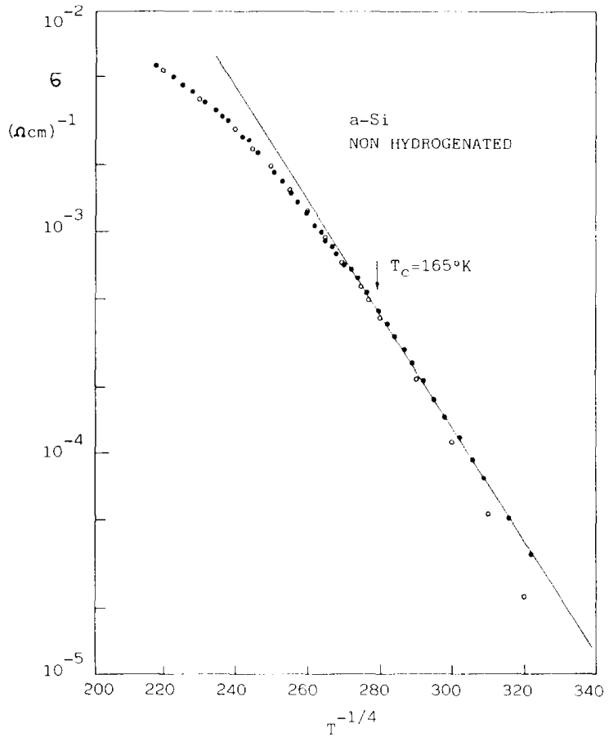
Hydrogen passivation (hydrogenation)
Pure a-Si has large deep level defect density
  Unpassivated dangling bonds: recombination centers
  Fermi level pinning
E
Conduction band
Defect states
E_{F}
N(E_{F}) = 1.4 × 10²⁰ cm⁻³
Valence band
Solid-State Electron. 28, 837 (1985)
DOS
Notes:
Open circles represent the fit for the high-temperature conductivity using the Arrhenius relation

Slide 6
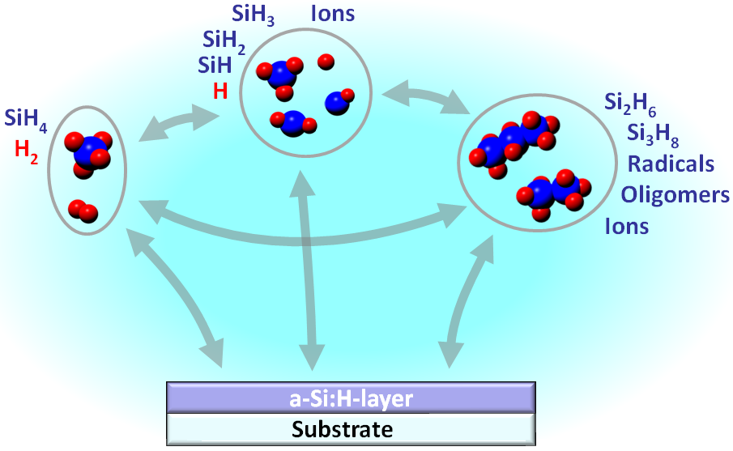
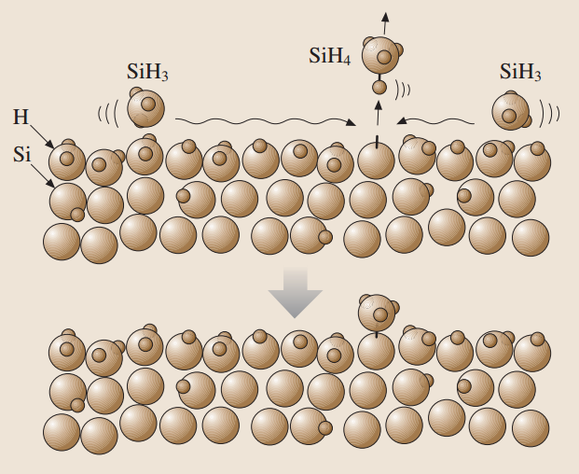
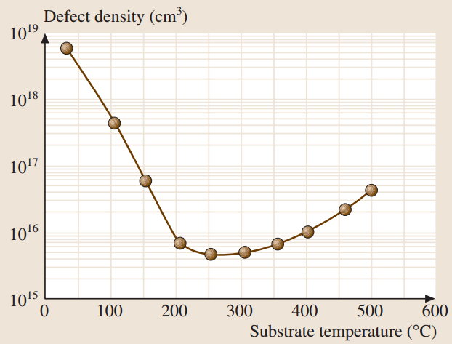
Hydrogen passivation (hydrogenation)
SiH₄ → a-Si:H + H₂
Dangling bond formation on a-Si:H surface due to H removal by adsorbed SiH₃ radicals
Springer Handbook of Electronic and Photonic Materials, Ch. 26
Notes:
PECVD a-Si:H generally contains 5% - 15% H
At low deposition temperature, diffusivity of SiH3 radicals is low, leading to high dangling bond density. At high temperature thermal removal of H increases.

Slide 7
Electronic properties of a-Si:H
 | c-Si (bulk, intrinsic) | a-Si:H (film)
Electron drift mobility | 1400 cm² V⁻¹ s⁻¹ | 1 cm² V⁻¹ s⁻¹
Hole drift mobility | 450 cm² V⁻¹s⁻¹ | 0.003 cm² V⁻¹s⁻¹
Carrier diffusion length | > 10 cm | 0.3 μm
Undoped conductivity | < 10⁻⁵ Ω⁻¹ cm⁻¹ | 10⁻¹¹ Ω⁻¹ cm⁻¹
Doped conductivity | > 10⁴ Ω⁻¹ cm⁻¹ | Up to 10⁻² Ω⁻¹ cm⁻¹
Optical band gap | 1.1 eV | 1.7 eV
Low carrier mobility: carrier trapping and scattering
Substitutional doping by PH₃ (n-type) or B₂H₆ (p-type)
High optical absorption: loss of crystal momentum conservation
Data from R. Street, Technology and Applications of Amorphous Silicon
and http://www.ioffe.rssi.ru/SVA/NSM/Semicond/Si/electric.html
Notes:
Free mobility in a-Si:H is around 10-20 cm² V⁻¹s⁻¹
High resistivity of undoped a-Si:H ensure low leakage current in the TFT off-state
Hydrogenation modifies the Si band structure leading to band gap increase. See for example: Phys. Rev. B 24, 7233 (1981).

Slide 8
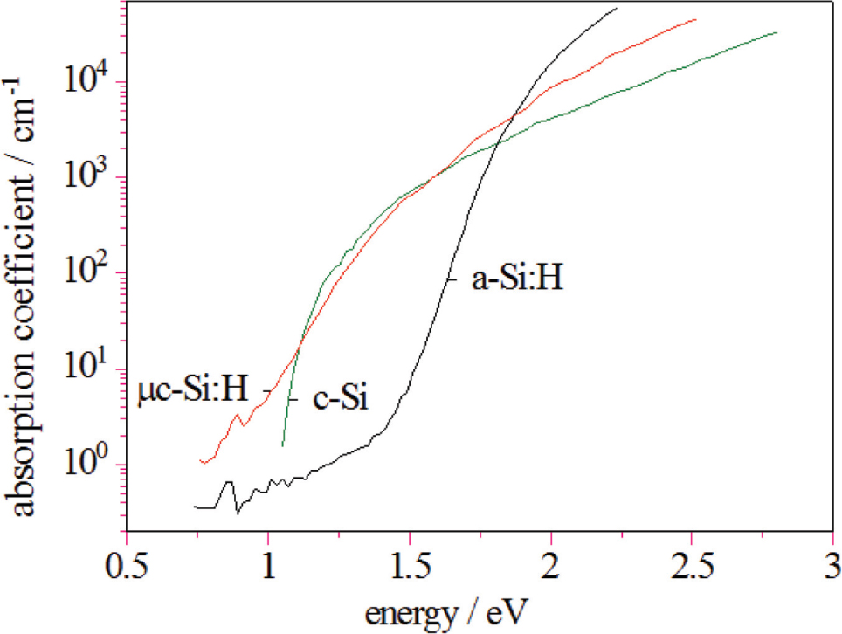
Optical absorption in a-Si:H
Larger band gap and increased optical absorption compared to c-Si
Z. Phys. Chem. 234, 1055 (2020)

Slide 9
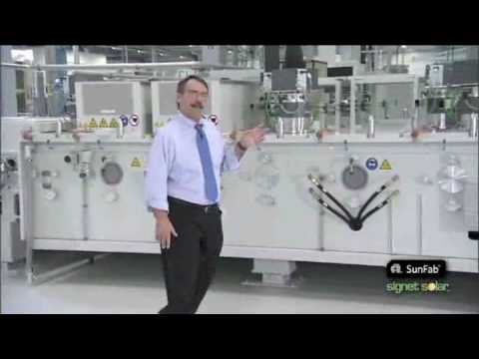
Large-area PECVD a-Si:H deposition

Slide 10
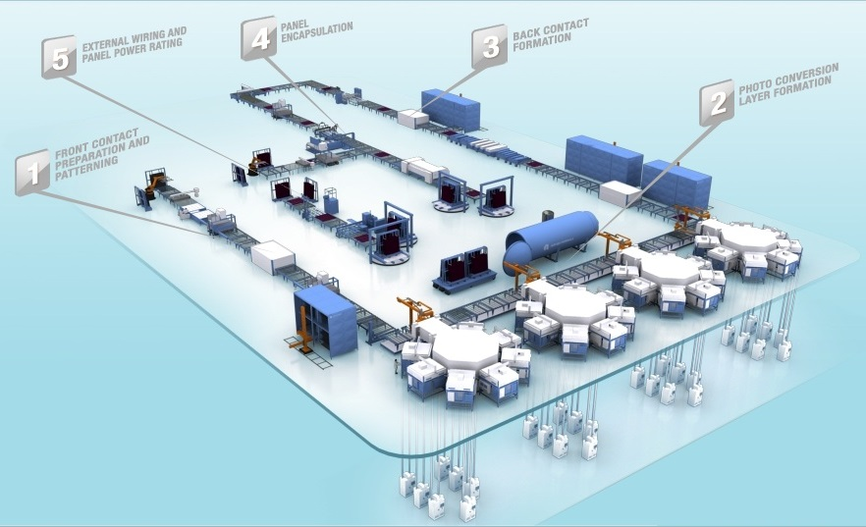

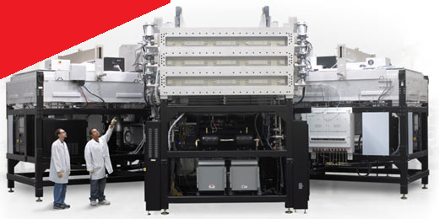
Large-area PECVD a-Si:H deposition
Applied SunFab Thin Film Line
Glass substrate size: 5.7 m²
Notes:
Each line contains four seven-chamber PECVD systems

Slide 11
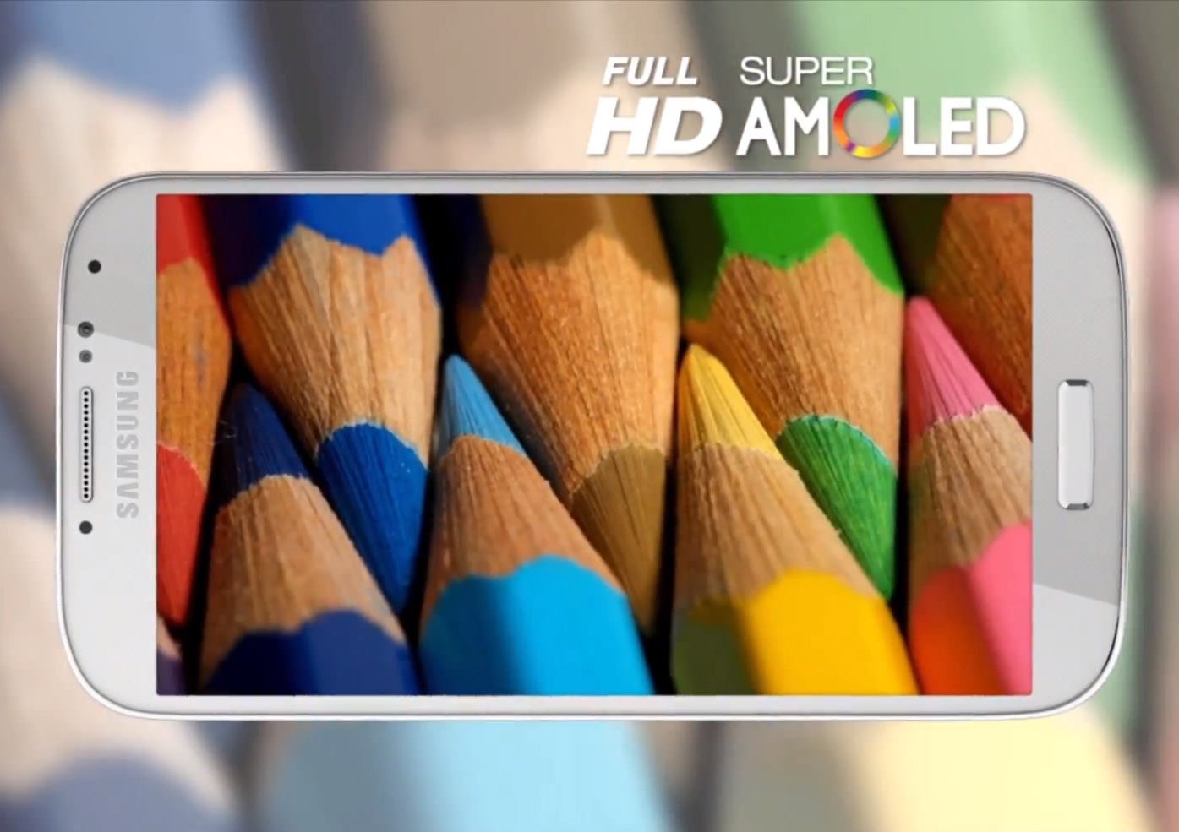
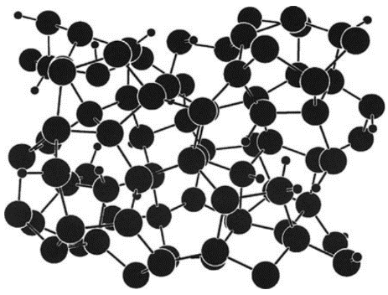
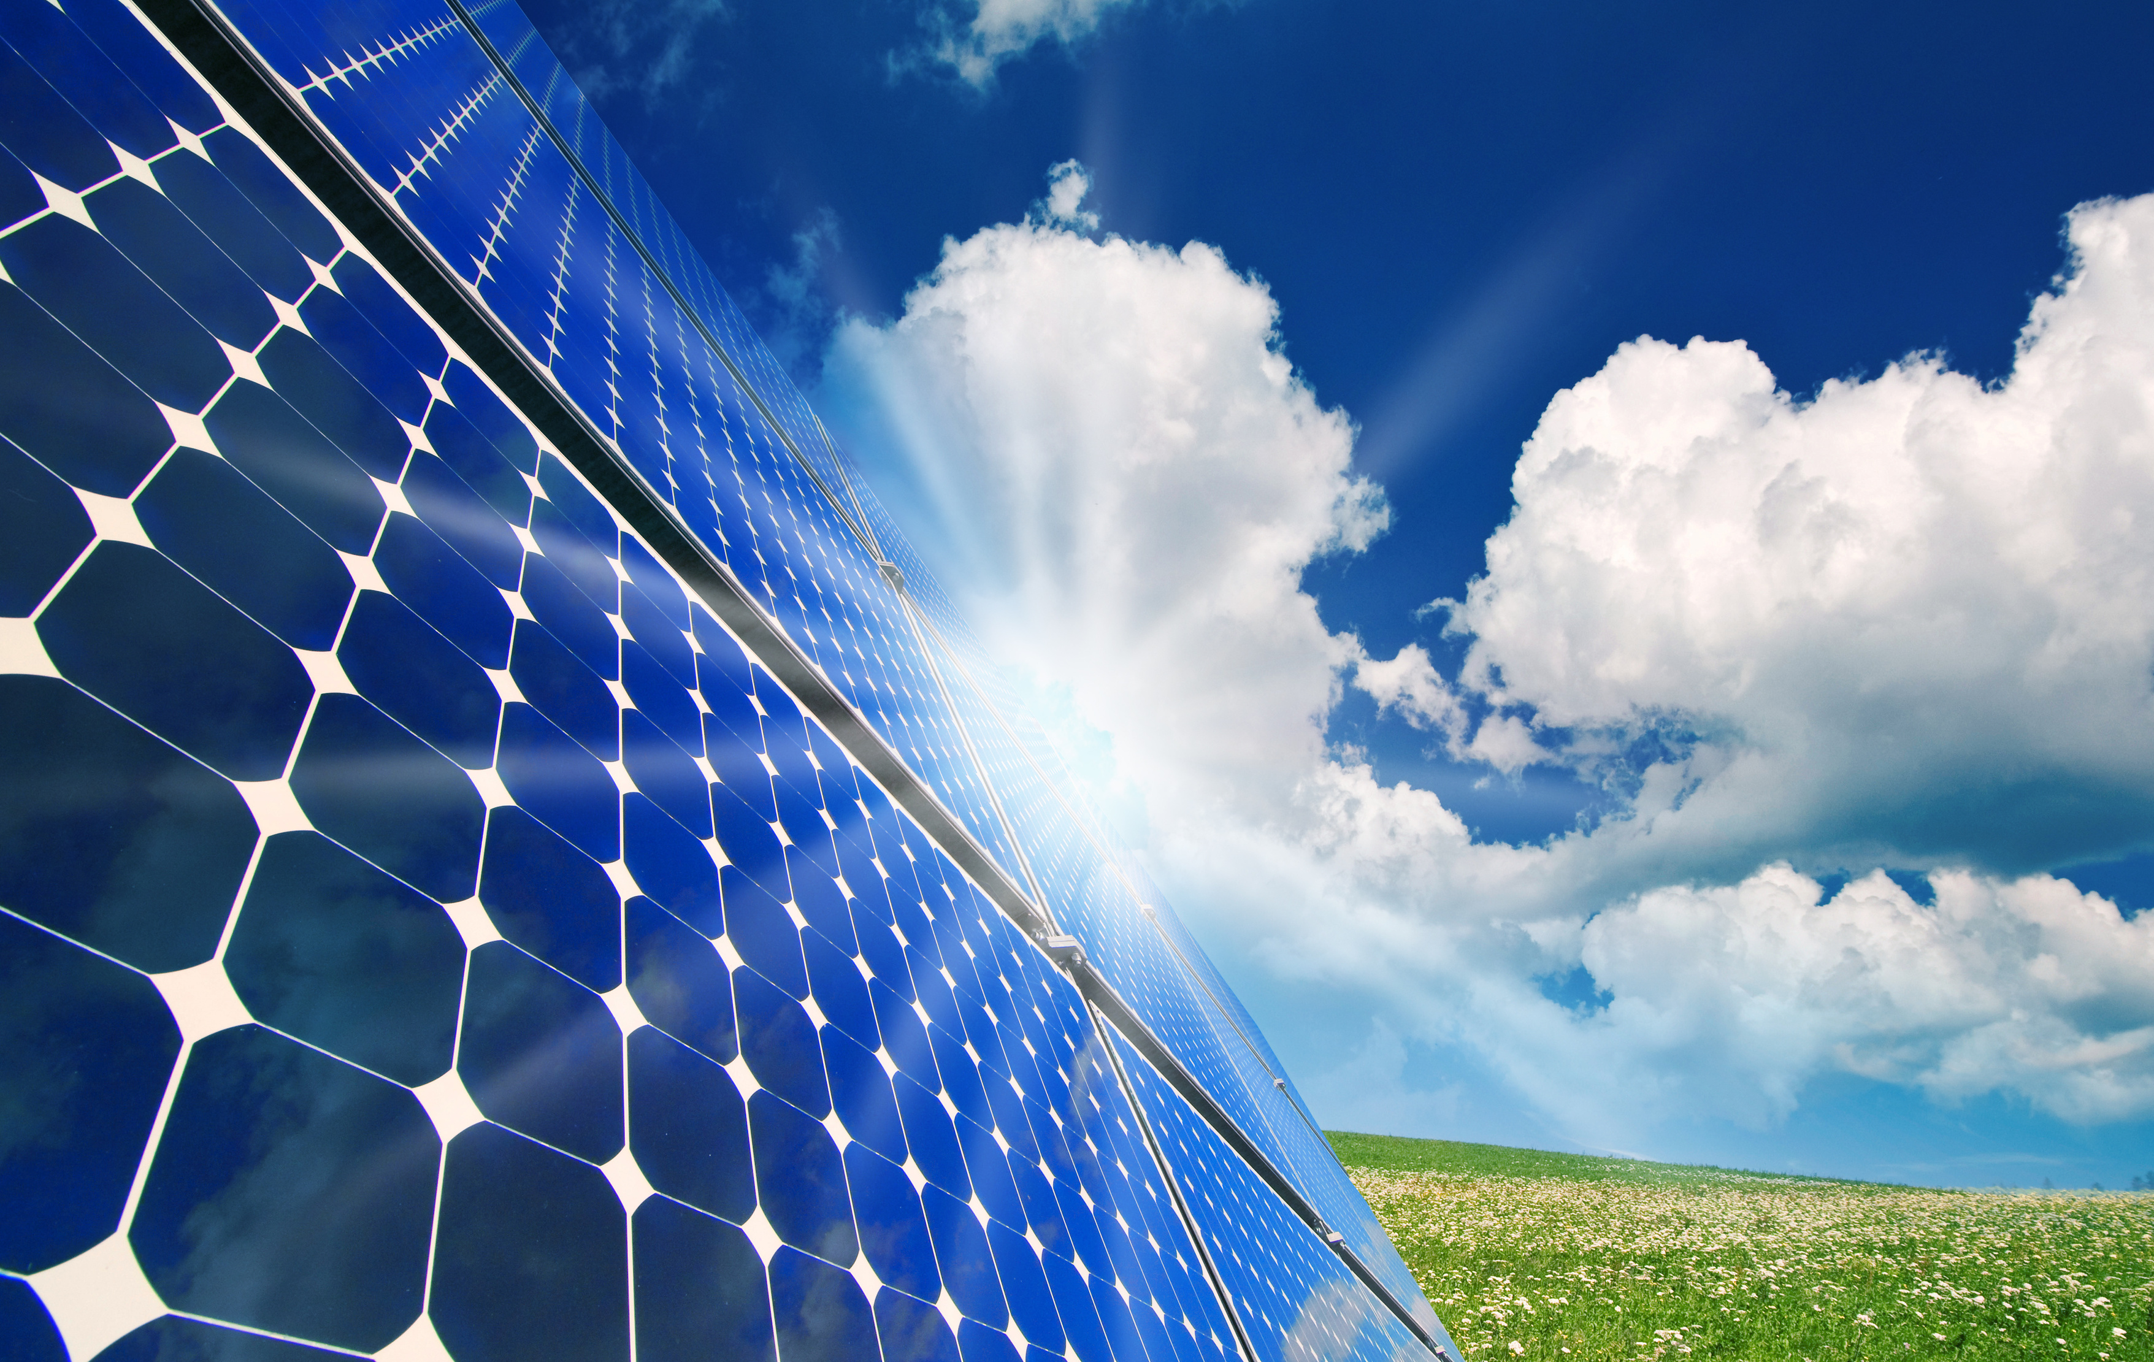
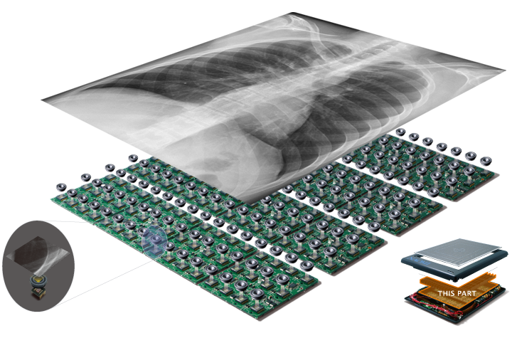
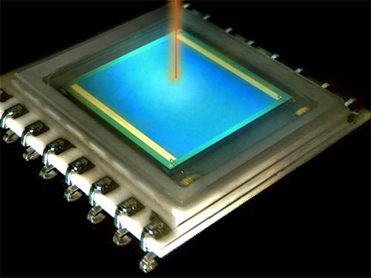
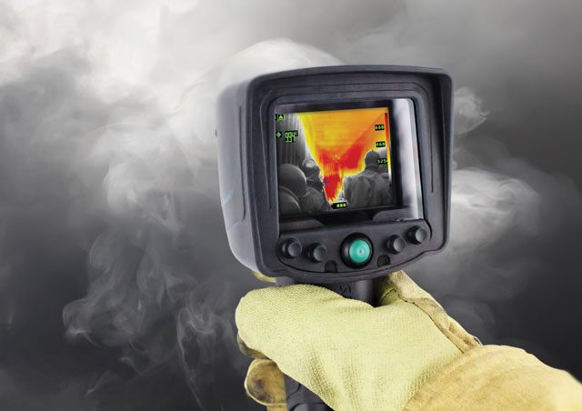
Active matrix display
Amorphous silicon macroelectronics
Solar cell
X-ray imager
Position sensitive detector
IR bolometer

Slide 12
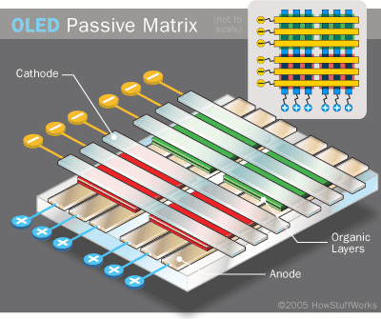
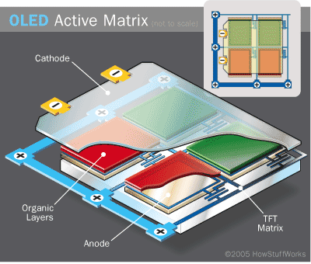
Passive matrix vs. active matrix (AM) display
Passive matrix: m + n control signals address an m × n display
Active matrix: each pixel is individually addressed by a transistor
  High refresh rate
  Low cross-talk and superior image resolution

Slide 13
Active Matrix Liquid Crystal Display (AMLCD)
Active Matrix Organic Light Emitting Diode (AMOLED)
Polarizer
Polarizer
Cover glass
Cover glass
Color filter
OLEDs
Liquid crystal
TFT backplane
TFT backplane
Polarizer
Thin film transistors (TFTs) are made of a-Si or low-temperature poly-silicon (LTPS)
Back light
Notes:
Advantages of OLED over LCD: power consumption (no wasted light); better viewing angle; flexibility
Every pixel (actually color subpixel) of an Active Matrix OLED (AMOLED) is made of a TFT transistor, a cathode and an emissive layer. It is customary to include a mirror layer under the TFT to enhance emission on the output direction. This setup has a problem: light coming from outside can get into the device, go through all the layers and be reflected by the mirror. This reduces dramatically the contrast. Placing a CIRCULAR polarizer on top (actually, a linear polarizer plus a quarter wave plate), the ambient light becomes circularly polarized inside the device, e.g. right-handed. The mirror inverts the handiness i.e., from right-handed to left-handed upon reflection. Then reflected light is then cut off by the top circular polarizer.

Slide 14
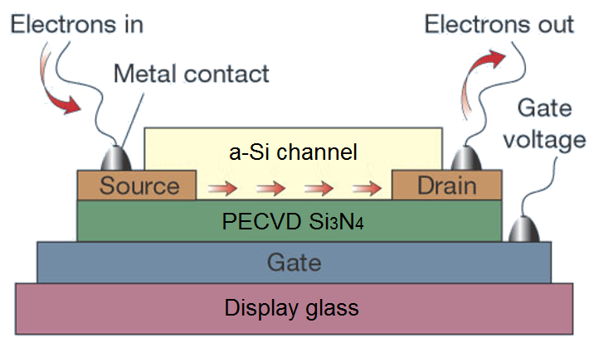
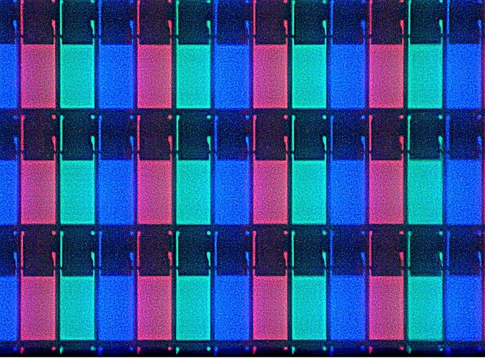
a-Si / LTPS thin film transistors
Increasing gate voltage
Current
AMLCD display under microscope
Source-Drain voltage
Applied gate voltage modulates a-Si / LTPS channel conductance and the TFT on/off state
Si₃N₄ and a-Si can be deposited using the same PECVD system
Display glass: flat glass produced by down-draw fusion process
Images from Wikimedia Commons, Nature 428, 269 (2004)

Slide 15
LTPS vs. a-Si
Characteristic | a-Si | LTPS (low-temperature poly-silicon)
Mobility (cm²/V/s) | ~ 1 | ~ 100
Preparation Method | PECVD | Post-deposition annealing of a-Si | Excimer laser annealing (ELA) of a-Si
Processing Temperature | 350 °C | 600 °C | > 1500 °C
Resolution | Low | > 500 ppi
Cost | Low | Relatively high
Low-temperature poly-silicon (LTPS) exhibits improved electronic properties compared to a-Si:H
Notes:
a-Si precursor must contain low concentrations of H to perform excimer laser crystallization; hydrogen can be removed by thermal treatments or laser pre-treatment
Unlike a-Si TFTs, LTPS TFTs eliminates the tape-automated-bonding (TAB) IC driver package (whose pitch limits the resolution of a-Si TFTs) to achieve narrower display edge; LTPS TFTs can integrate the driver IC directly onto the glass substrate

Slide 16
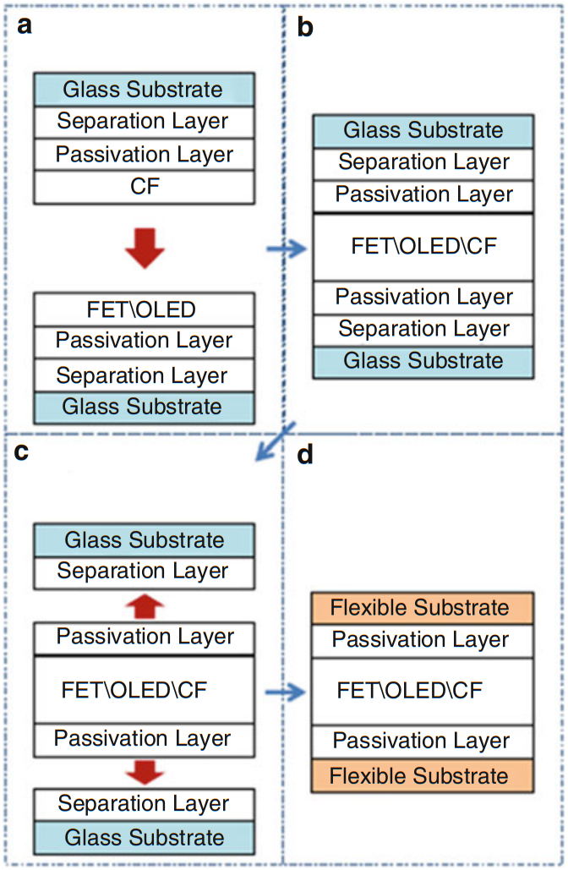
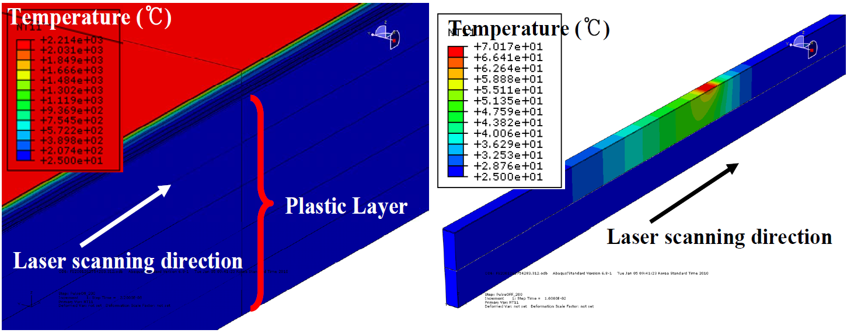
LTPS-TFT process for flexible display
2200 °C
70 °C
Highly localized heating during ELA prevents damage to plastic substrates
M. Kim et al., "16.2: World‐Best Performance LTPS TFTs with Robust Bending Properties on AMOLED Displays." SID 42, 194-197 (2011)
Y. Jimbo et al., "25.1: Tri‐Fold Flexible AMOLED with High Barrier Passivation Layers," SID 45, 322-325 (2014)
Notes:
Delamination of the flexible display from handler substrate can be accomplished by either laser lift-off or mechanical de-bonding;
The display uses a neutral plane design to ensure flexibility of the TFT layer
CF: color filter

Slide 17
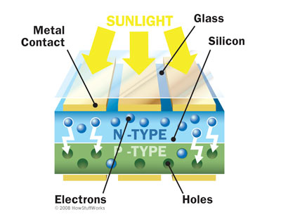
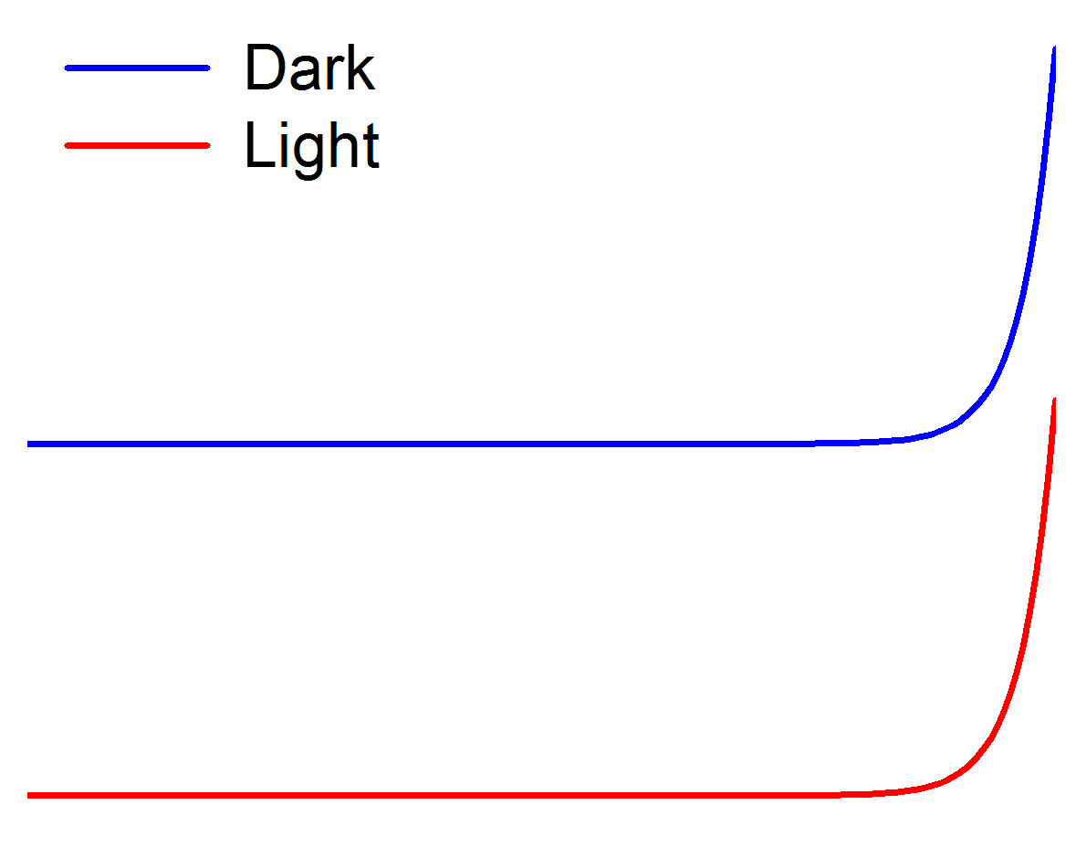
Basic solar cell structure
I
0
V
I_{SC} : short circuit current
I_{s} : diode saturation current

Slide 18
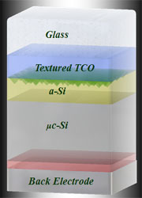
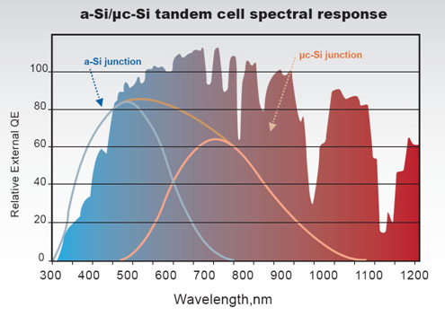
Thin film a-Si:H as a solar absorber
Large-area, high-throughput deposition
High absorption: reduced material consumption
Monolithic silicon tandem structures
Low cost (?)
http://www.nexpw.com/Technology/Technology_stt

Slide 19
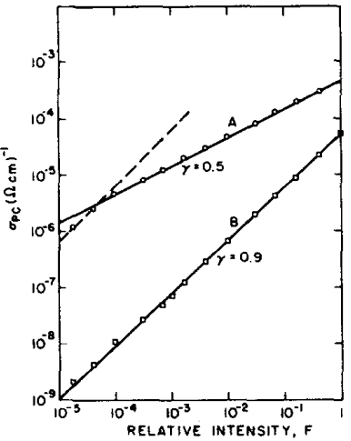
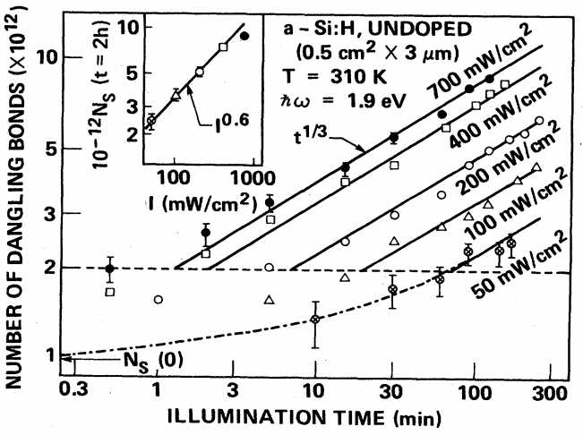
Staebler-Wronski effect
Light-induced degradation of hydrogenated a-Si and nano-crystalline Si materials
Defect generation
Annealing can partially reverse the effect
Before light exposure
After light exposure
Appl. Phys. Lett. 31, 292 (1977); Phys. Rev. B 32, 23 (1985)
Notes:
Defect generation rate explained using the H collision model: Phys. Rev. B 59, 5498 (1999)

Slide 20
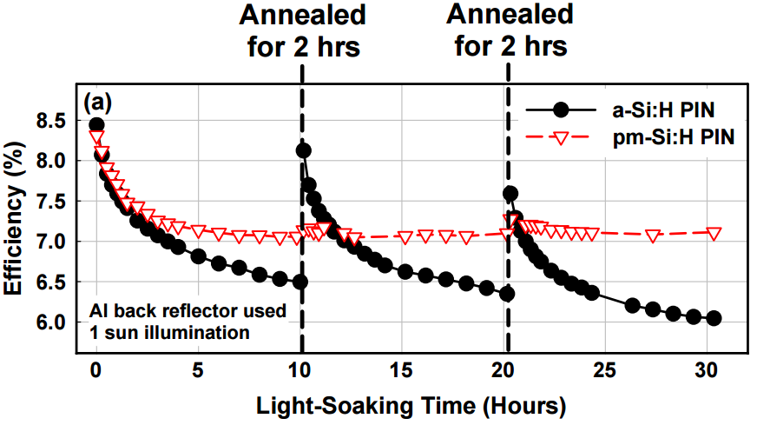
Staebler-Wronski effect
Light-induced degradation of hydrogenated a-Si and nano-crystalline Si materials
Defect generation rate
Annealing can partially reverse the effect
K. Kim, Diss. Ecole Polytechnique X (2012).

Slide 21
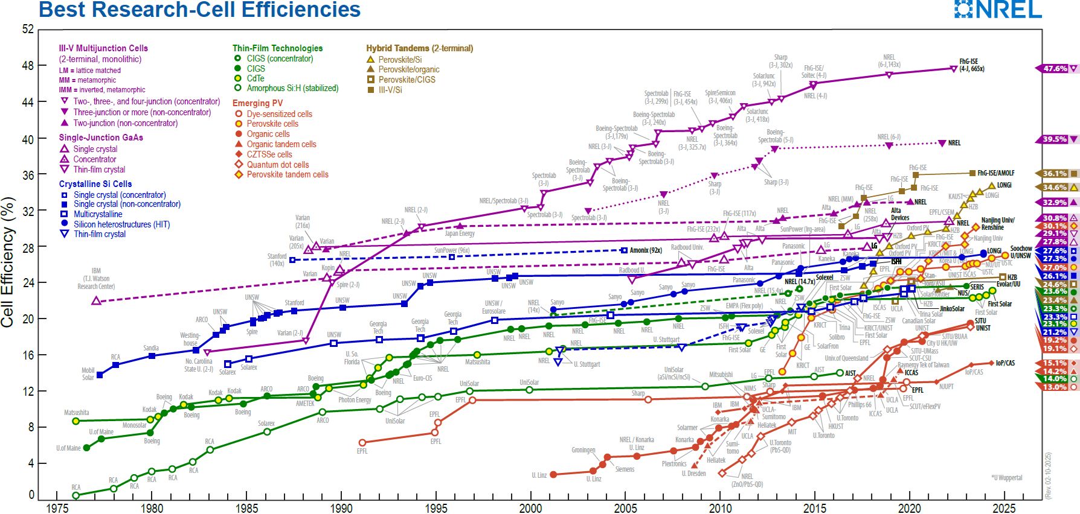

Slide 22
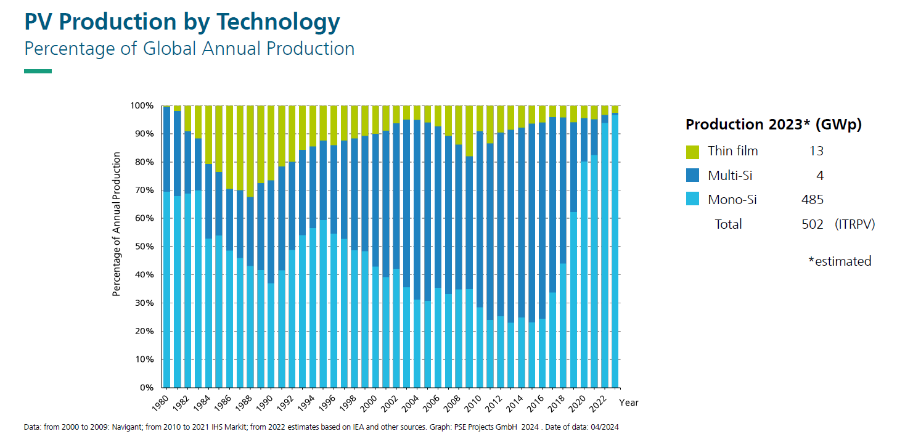
© Photovoltaics Report — Fraunhofer ISE

Slide 23
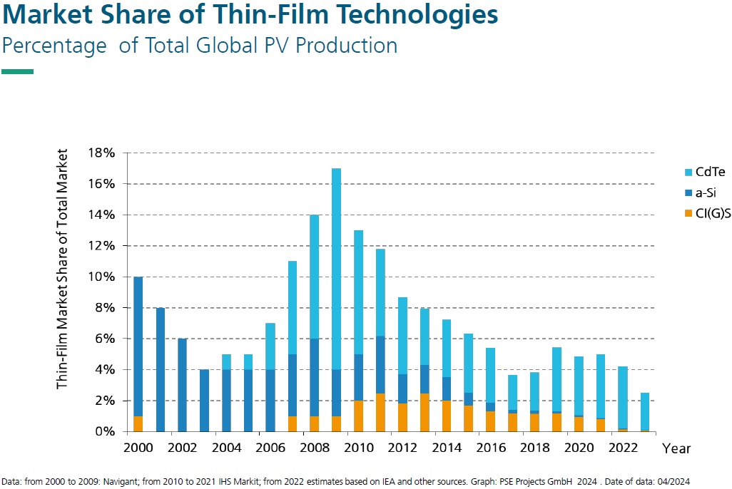
Thin-Film technology contributed in year 2023 with about 2.5% to the total PV-market
© Photovoltaics Report — Fraunhofer ISE

Slide 24
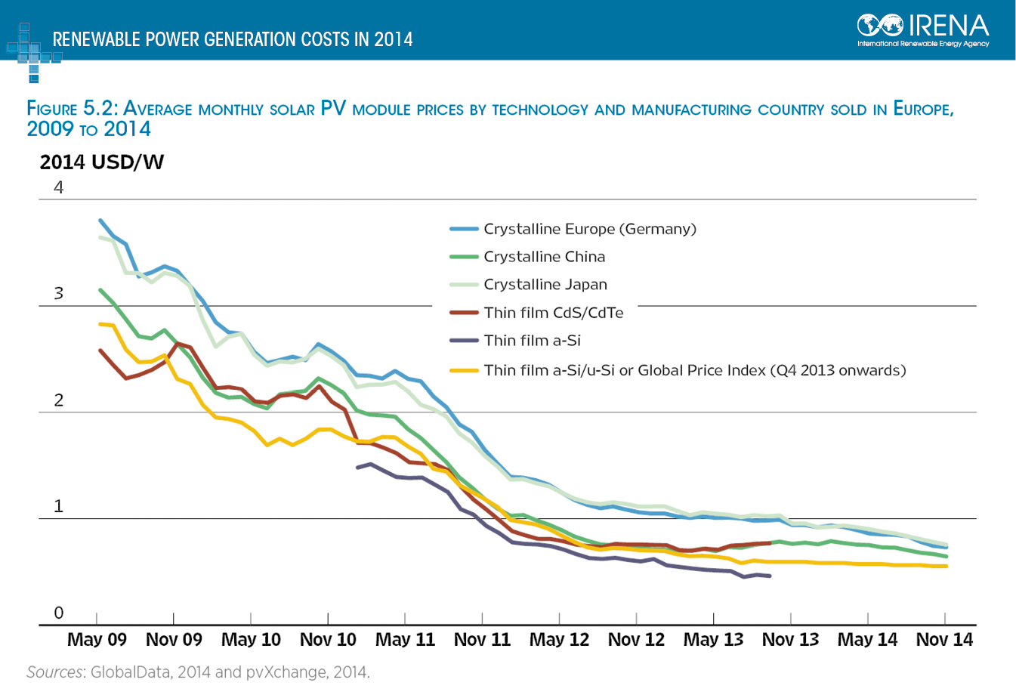

Slide 25
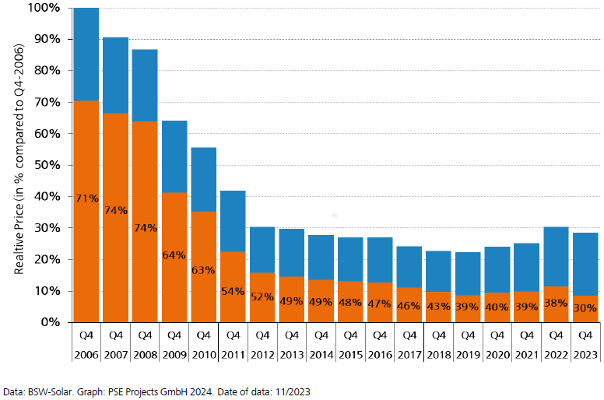
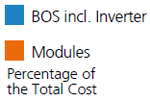
Average price for rooftop systems in Germany
© Fraunhofer ISE

Slide 26
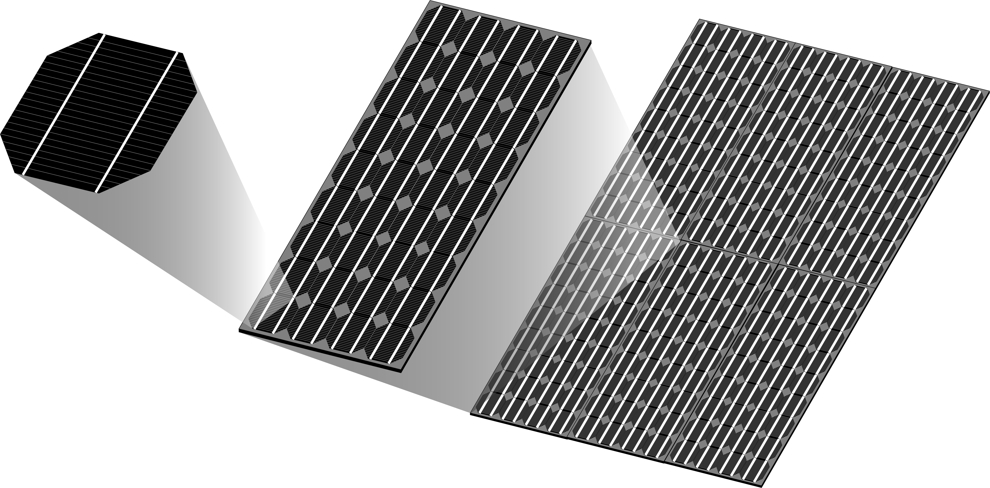
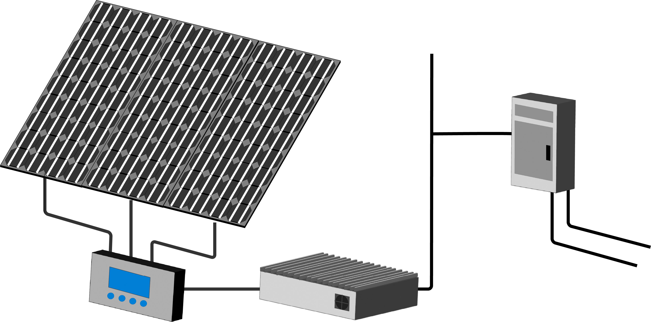
From cell to system
Cell
Module
To AC Loads
Array
System
DC-AC Power Inverter
Power to
and from grid
Charge Controller /
Protection

Slide 27
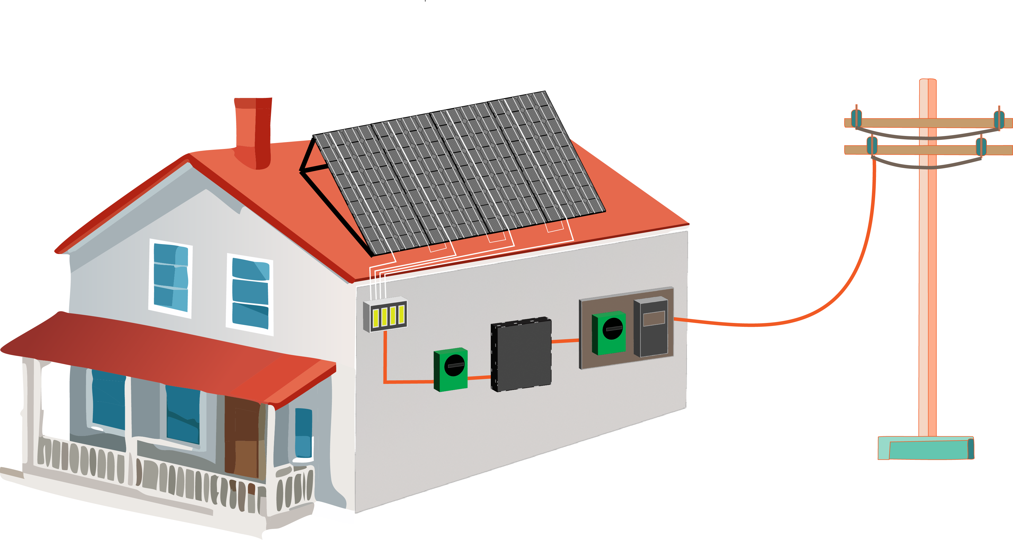
Balance of system (BOS) hardware
PV Modules
Mounting Frame
Power Grid
AC Cabling
Meter
Junction Box
Inverter
Switchboard
DC Cabling
Main Switch Solar Supply
Solar Array Isolator
BOS encompasses all components of a PV system excluding the PV modules, such as the inverter, mounting system, switches, wiring and installation work, etc.

Slide 28
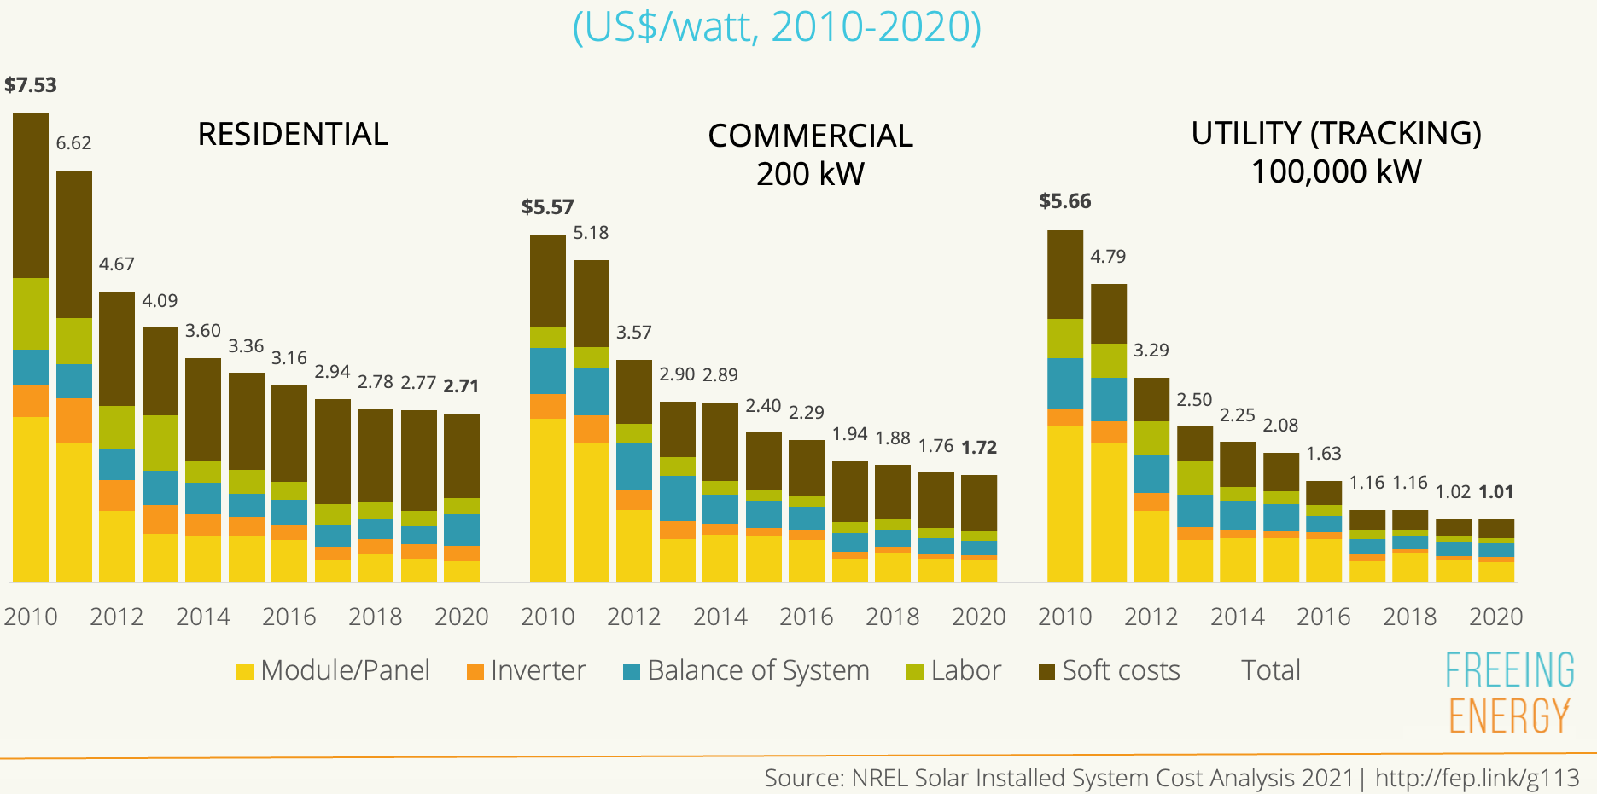
PV cost reduction: where and how?
Balance of system (BOS) costs is the key to further solar system cost reductions

Slide 29
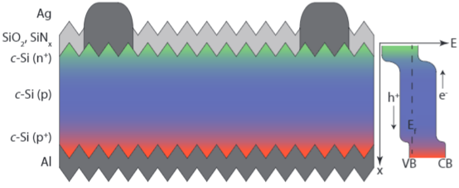
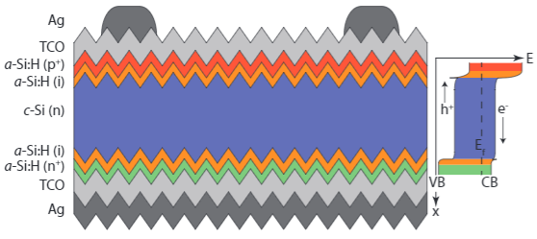
Silicon heterojunction (SHJ) cells
Si diffuse junction cell
SHJ reduces recombination at contact surfaces
H from a-Si:H passivates c-Si surface
Si heterojunction cell
Green 2, 7 (2012)

Slide 30
Summary
Basic properties of a-Si and a-Si:H
  Dangling bonds and hydrogenation
  Electronic properties: Fermi level pinning, factors affecting drift mobility and optical absorption
Active matrix display based on TFTs
  Comparison of a-Si and LTPS
a-Si solar cells
  Staebler-Wronski effect

Slide 31
Further Readings
Springer Handbook of Electronic and Photonic Materials
  Ch. 25: Amorphous Semiconductors: Structural, Optical, and Electrical Properties
  Ch. 26: Amorphous and Microcrystalline Silicon
  Springer Link (paste link to a browser window)
Technology and Applications of Amorphous Silicon
  R. A. Street, Springer (2000)
  Springer Link (paste link to a browser window)

