Slide 1
MIT 3.156/3.46
Photonic Materials and Devices
11: Photovoltaics
Juejun (JJ) Hu
hujuejun@mit.edu

Slide 2
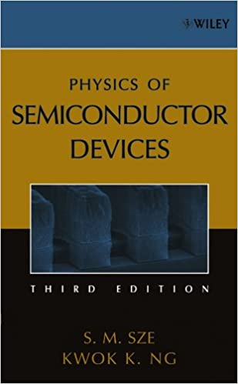
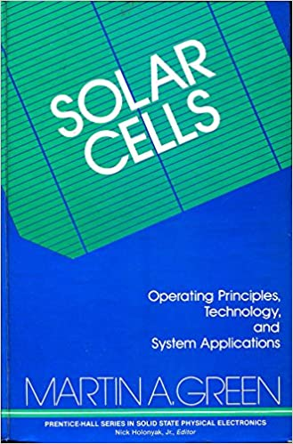
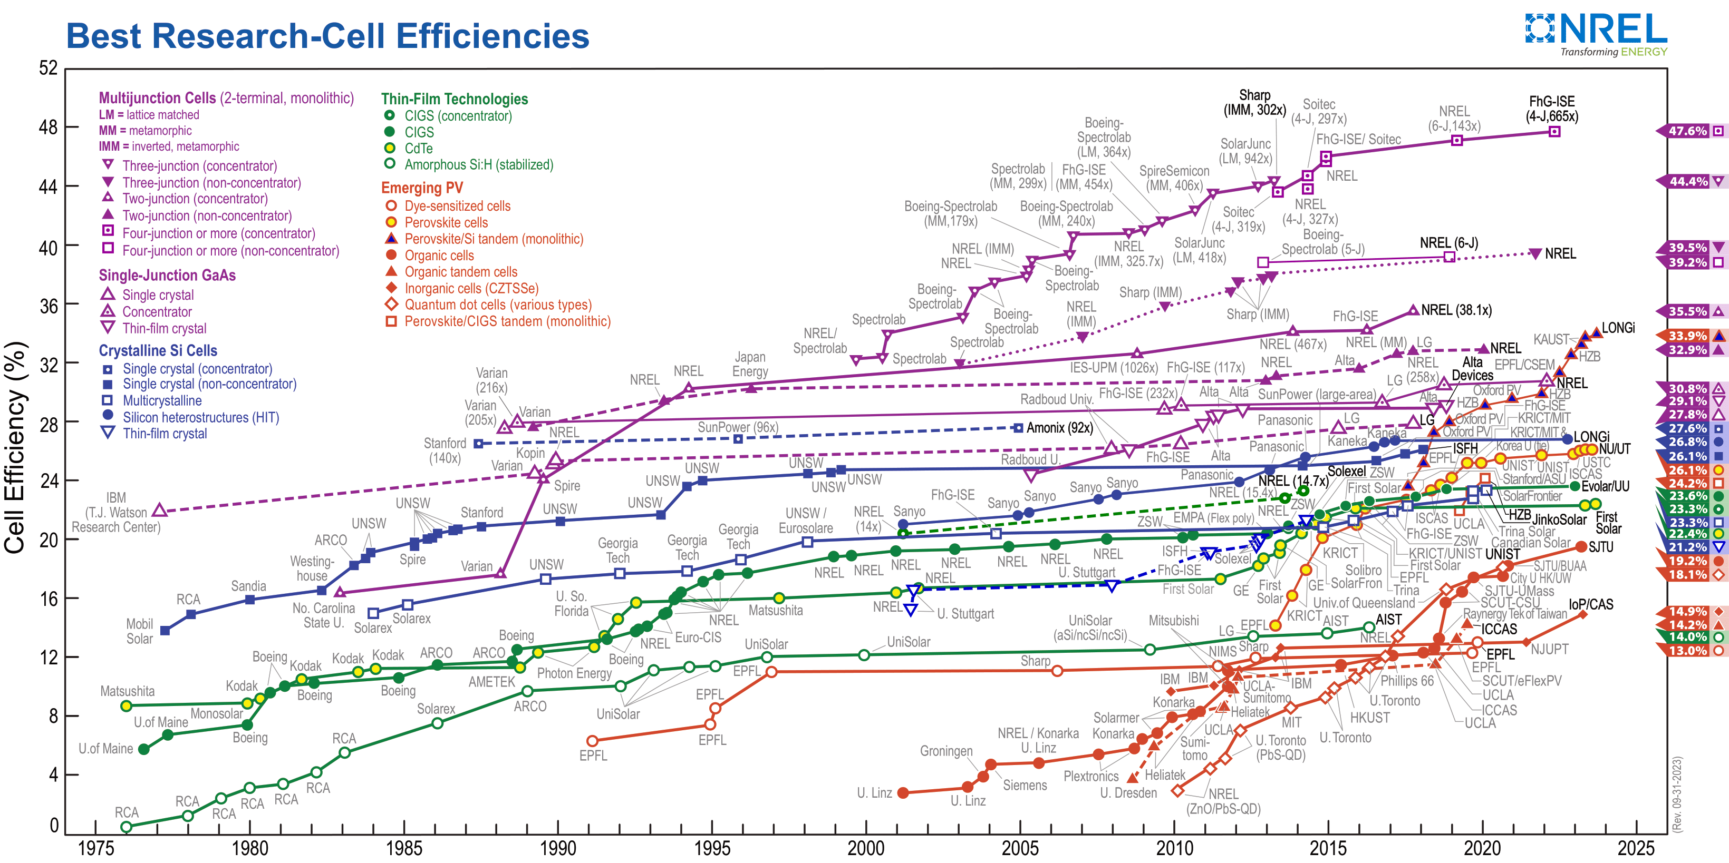
References
Physics of Semiconductor Devices
  Ch. 10
Solar cells: Operating Principles, Technology and System Applications
  Martin Green
Best Research-Cell Efficiency Chart
  NREL

Slide 3
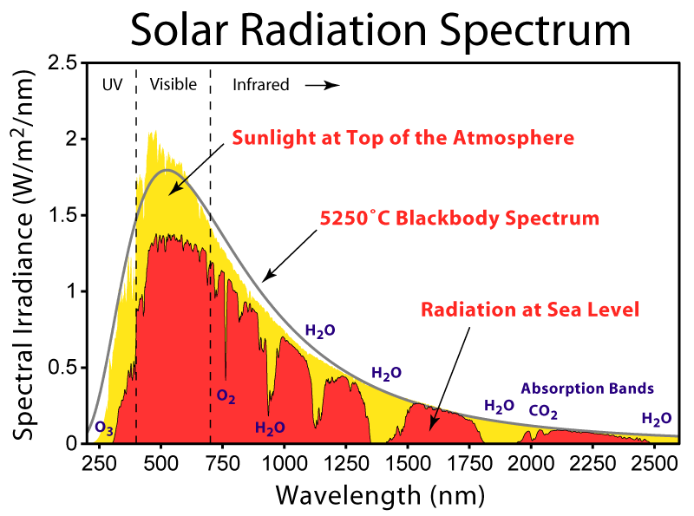
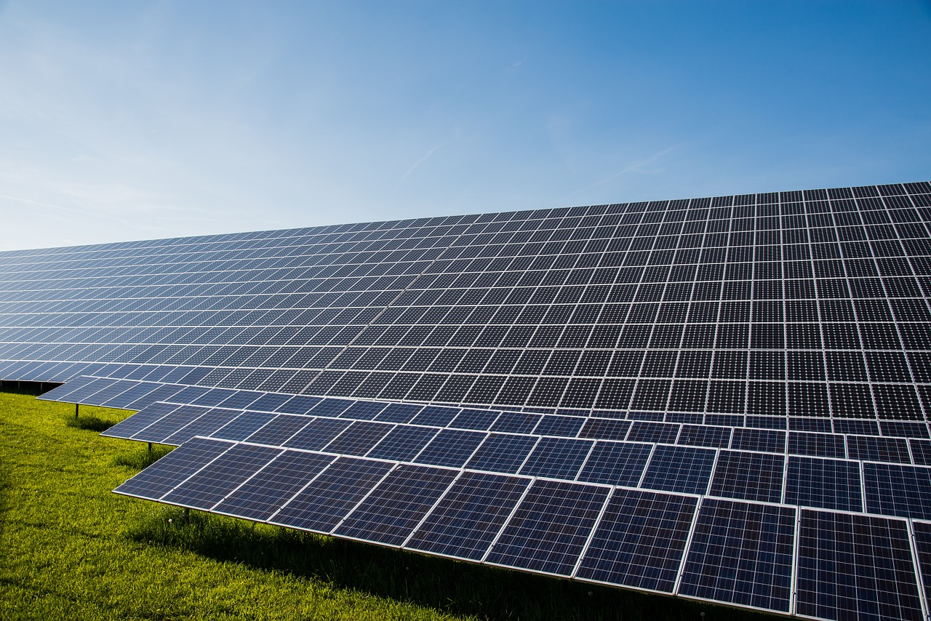
Photovoltaics (PV)
The average power incident upon the continental United States is ~ 500 times the national consumption
Broadband light source
Large area
Cost

Slide 4
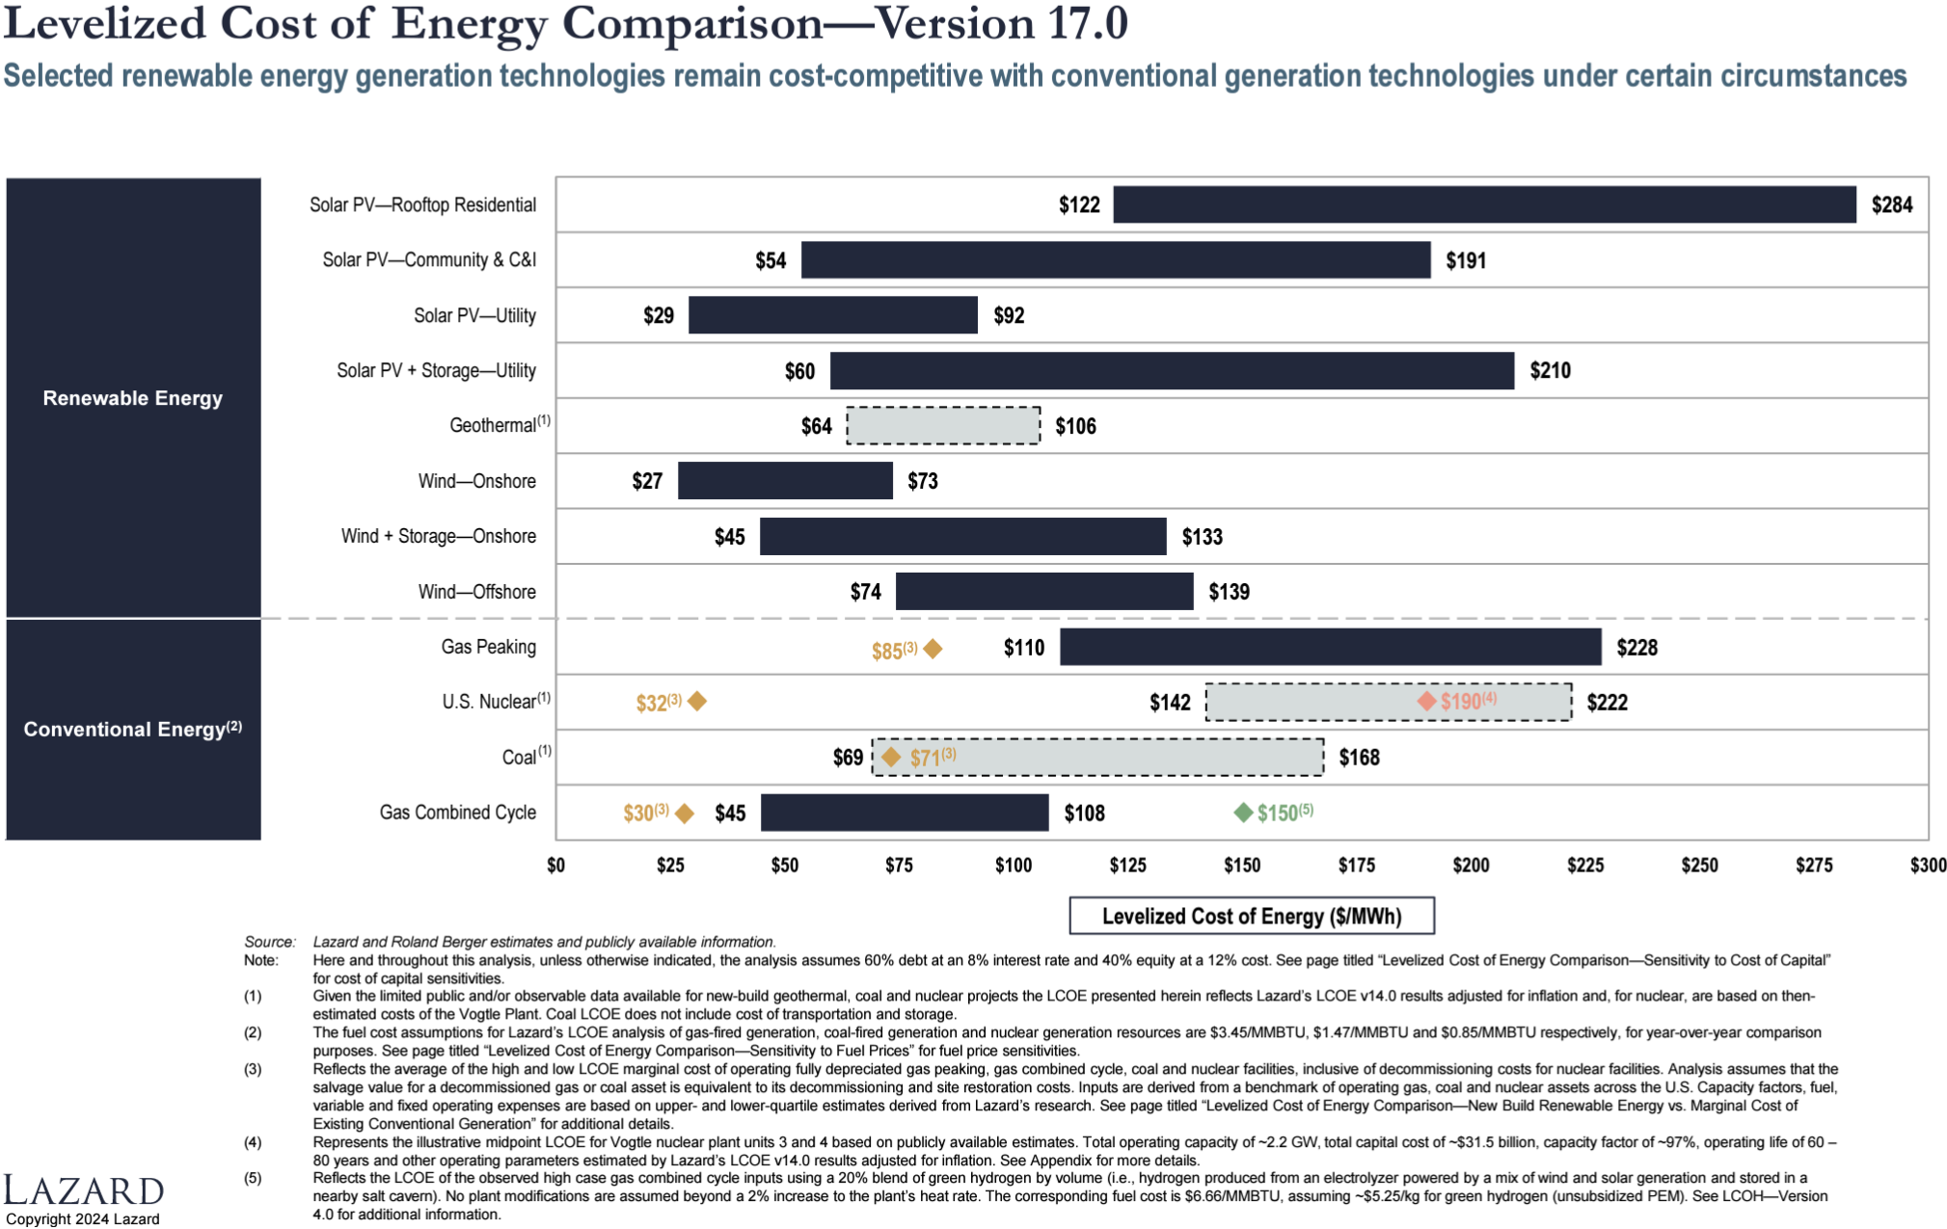
PV: a cost-effective renewable energy source
The cost of utility-scale solar is competitive with the marginal cost of coal, nuclear and natural gas

Slide 5
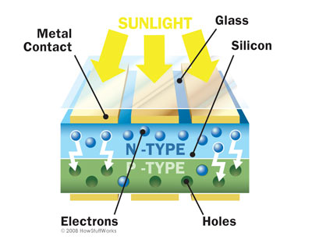
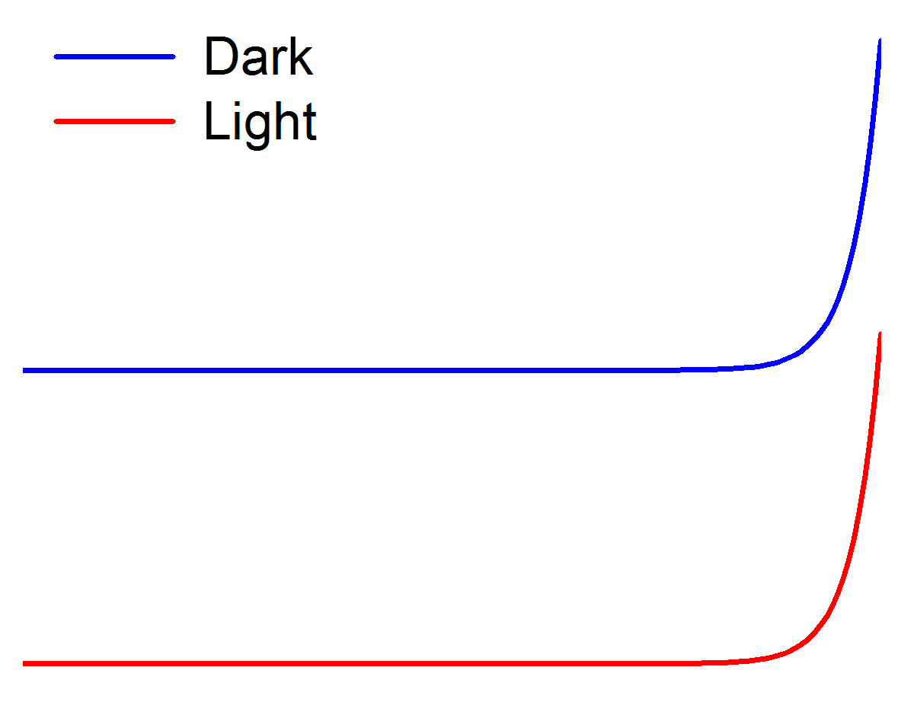
Basic solar cell structure
I
0
V
I_{SC} : short circuit current
I_{s} : diode saturation current

Slide 6
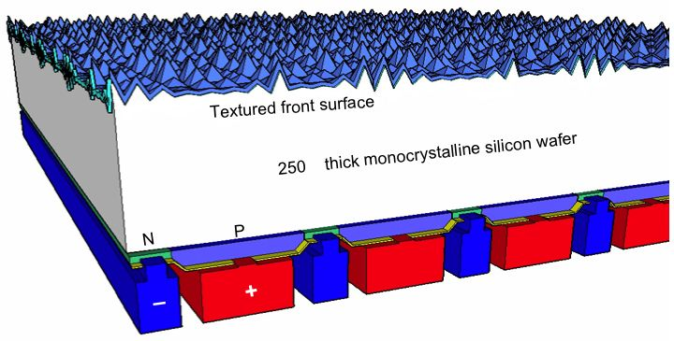
Other types of solar cells designs
All-back-contact c-Si cell
  Eliminates front contact shading
  Single-side contacts simplify cell stringing
250 μm
Thin film poly-crystalline cells
  CuIn_{x}Ga_{1-x}Se (CIGS)
  CdTe
  CuZnSnSe/S (CZTS)
CuInSe₂
Substrate
Superstrate configuration
Substrate configuration

Slide 7
Key performance metrics
Short circuit current: number of absorbed photons
I
0
V
solar spectral irradiance
quantum efficiency
solar cell area
Saturation current: semiconductor material quality
electron/hole lifetime
diffusion coefficients
intrinsic carrier density

Slide 8
Key performance metrics (cont’d)
Open circuit voltage: split of quasi-Fermi levels
Energy conversion efficiency and Fill Factor (FF)
I
0
V
Differentiate with respect to voltage to obtain the maximum power:

Slide 9
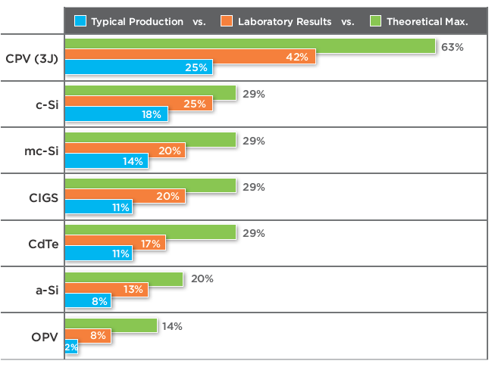
Efficiencies of different solar cells
“$1 per W Photovoltaic Systems,” DOE ARPA-E white paper

Slide 10
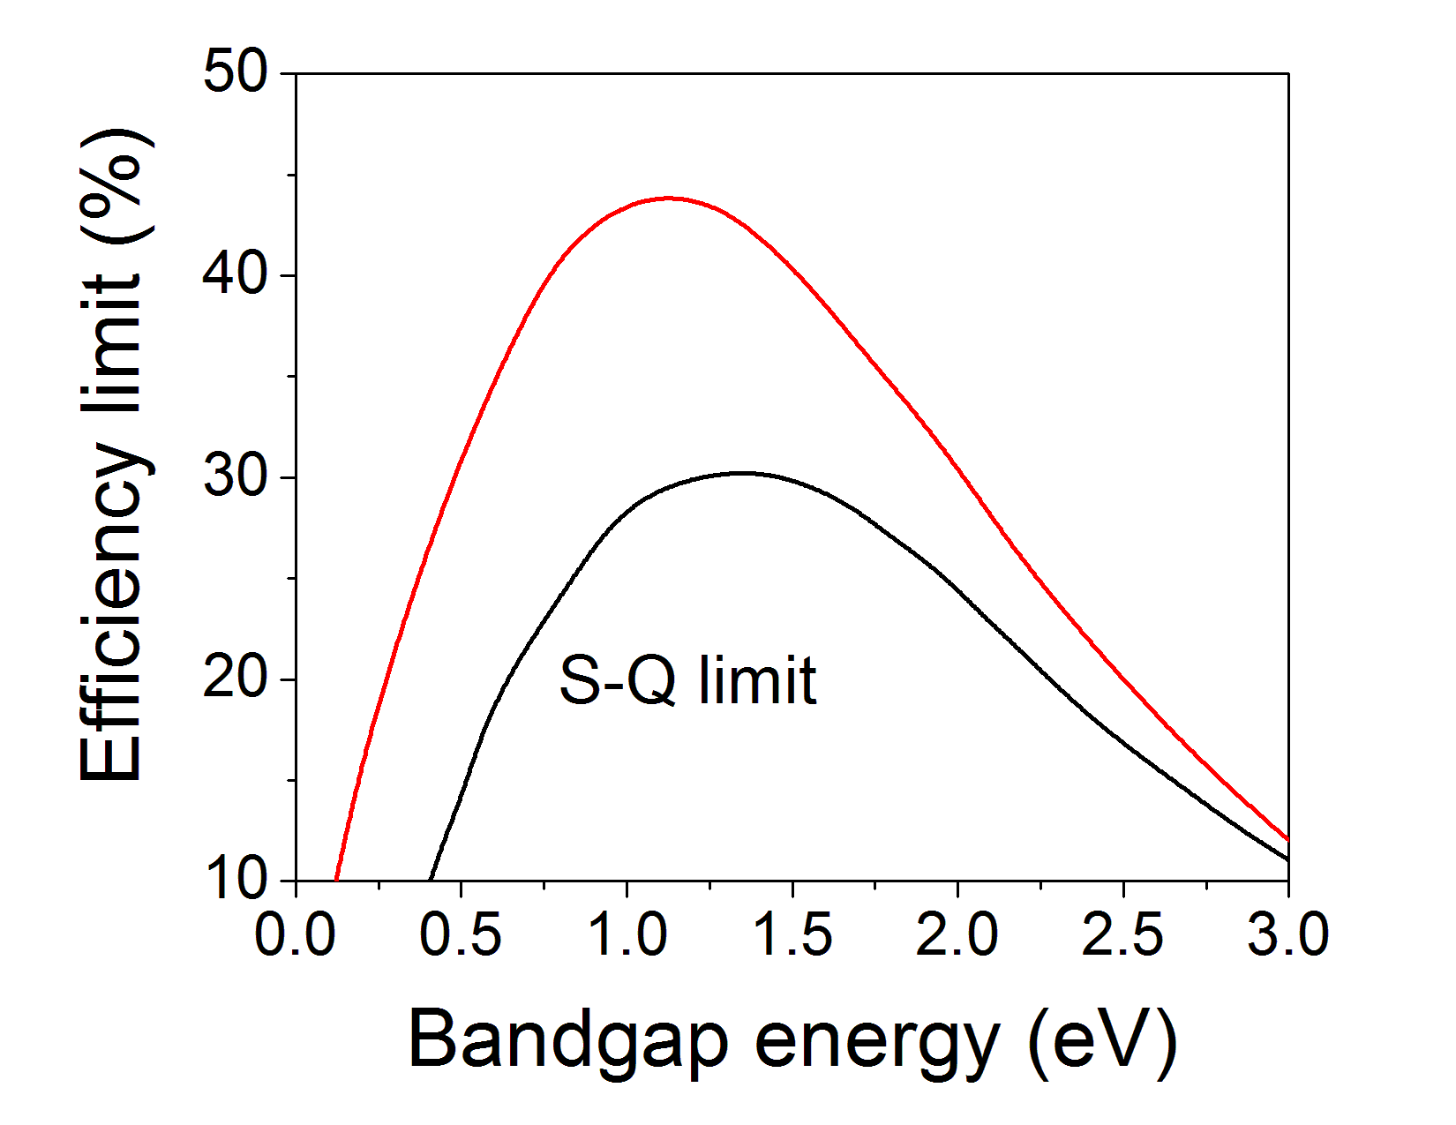
Shockley-Queisser limit in single-junction cells
Energy loss mechanisms
  Sub-bandgap photon loss
  Carrier thermal relaxation
  Voltage V_{OC} loss (eV_{OC} < E_{g})
  FF < 1
1) and 2) only
2)
conduction band
Shockley-Queisser (S-Q) limit under one-sun illumination
3)
1)
W. Shockley and H. Queisser, J. Appl. Phys. 32, 510-519 (1961)
2)
valence band

Slide 11
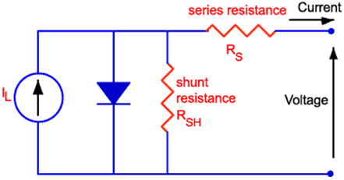
Other efficiency limiting factors and mitigation
Carrier recombination
  Radiative recombination: photon recycling
  Non-radiative recombination: material quality improvement
Shunt resistance and series resistance
  Contact resistance reduction
  Processing optimization
Surface reflection
  Surface texturing
  Anti-reflection coatings
Poor band edge absorption
  Light trapping

Slide 12
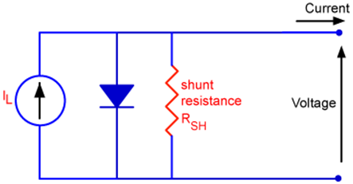
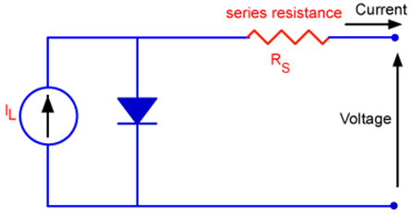
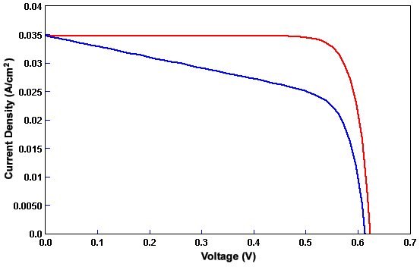
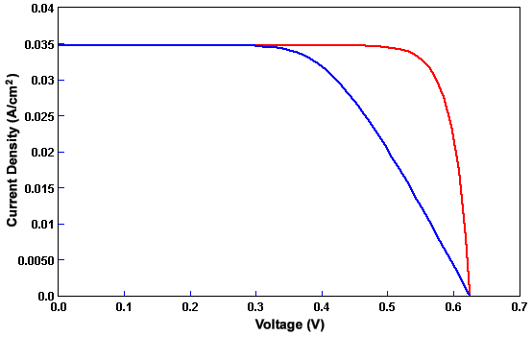
Impact of shunt and series resistance
Simulation results quoted from Pveducation.org

Slide 13
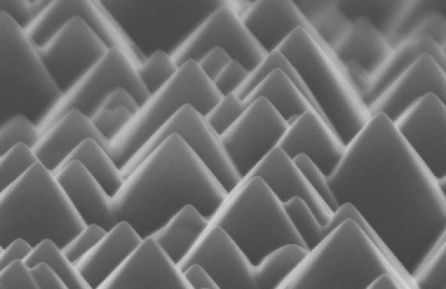
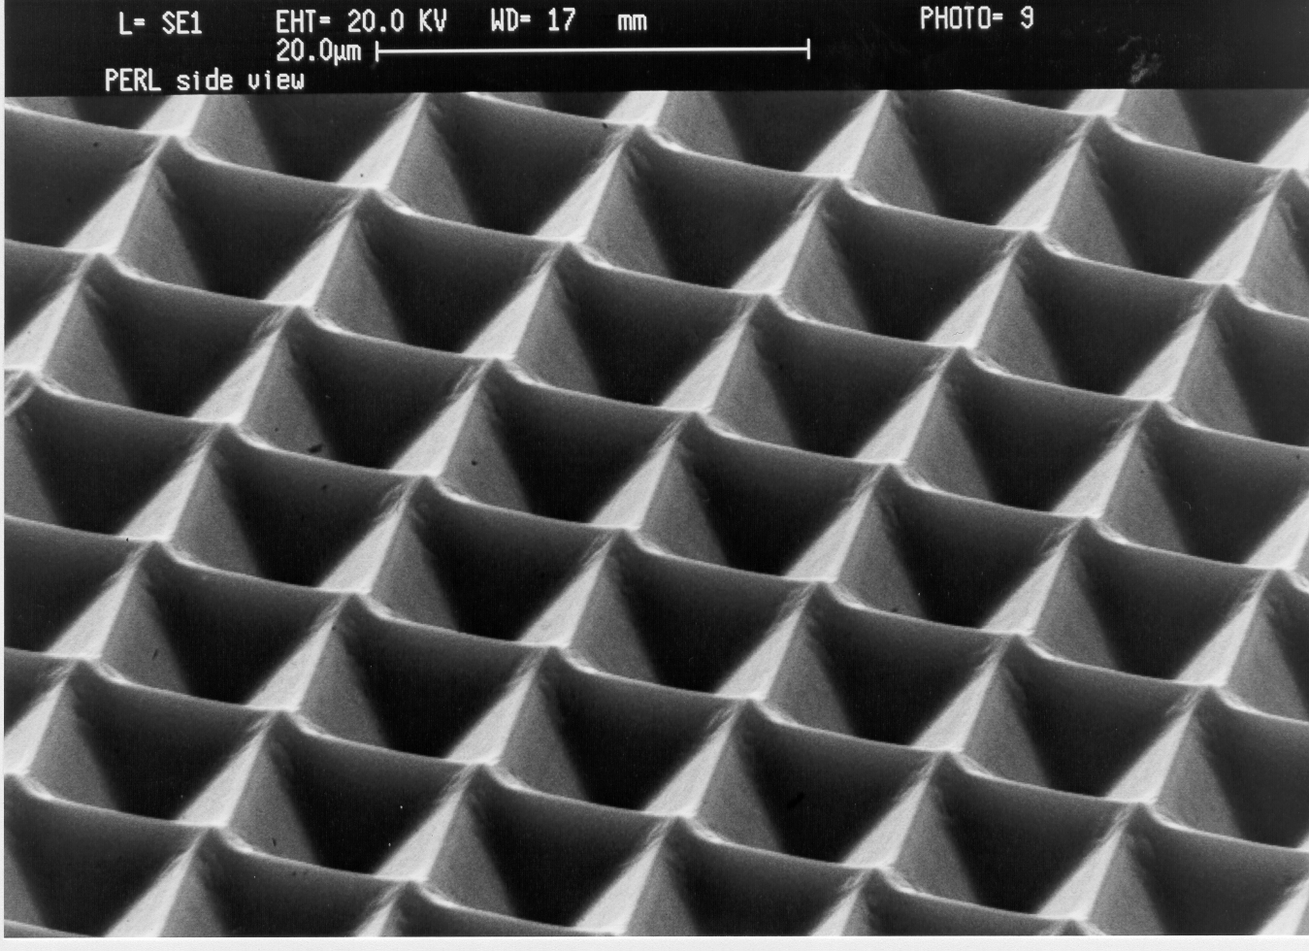
Surface reflection mitigation
Reflectance on planar Si surface:
Surface texturing by anisotropic wet etching: multiple reflections increases absorption
70.5°
Random texture on c-Si
Inverted pyramid texture

Slide 14

Light trapping: the Lambertian (4n²) limit
The upper limit for absorption enhancement factor in a thin film solar cell (with respect to single pass absorption) is given by 4n²
Assumptions
  Ergodicity
  Isotropic radiation
  Weak absorption limit
Inadequacies
  The ergodicity condition
  is violated in periodic
  grating structures
  Solar radiation has
  a small divergence
  angle of 0.534°
Isotropic scattering
d
Maximum absorption 4n² × αd
J. Opt. Soc. Am. 72, 899 (1982)
Appl. Phys. Lett. 98, 011106 (2011)
Opt. Express 18, A366 (2010)
Opt. Express 20, A496 (2012)

Slide 15

Understanding light trapping using wave optics
Absorption occurs during mode propagation
Cell
x
Diffraction couples light into waveguided modes in the solar cell slab
Waveguided modes leak back to free space when the phase matching condition is met
Consider a 1-D grating light trapping structure

Slide 16
Understanding light trapping using wave optics
Consider normal incidence:
To reduce phase-matched leakage channels back to free space, the number of N’s satisfying the above condition should be minimized
To achieve maximal light trapping enhancement at λ₀, the grating period should be smaller than λ₀
Only one leakage channel N = 0

Slide 17
Beyond the S-Q limit: spectrum splitting & tandem cells
Dichroic mirrors
Cell 1
Cell 2
Cell 3
Cells with band gap matched to the reflected bands
E_{g1} > E_{g2} > E_{g3}
Current matching:
  Since each sub-cell is connected in series, suitable band gaps must be chosen such that the design spectrum will balance the current generation in each of the sub-cells
X. Wang et al., Prog. Photovolt: Res. Appl. 20, 149-165 (2012).
J. McCambridge et al., Prog. Photovolt: Res. Appl. 19, 352-360 (2011).

Slide 18
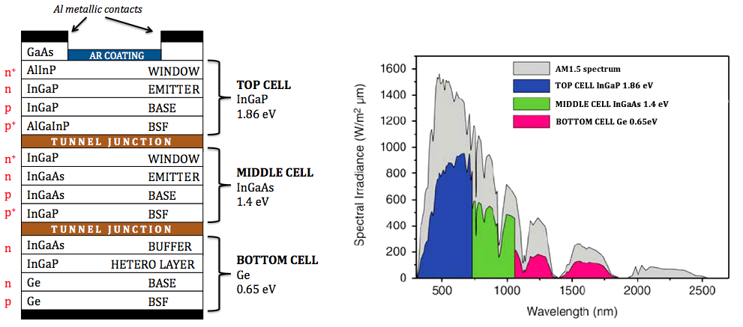
Tandem cell design example
N. Yastrebova et al., technical white paper: ”High-efficiency multi-junction solar cells: current status and future potential” (2008)

Slide 19
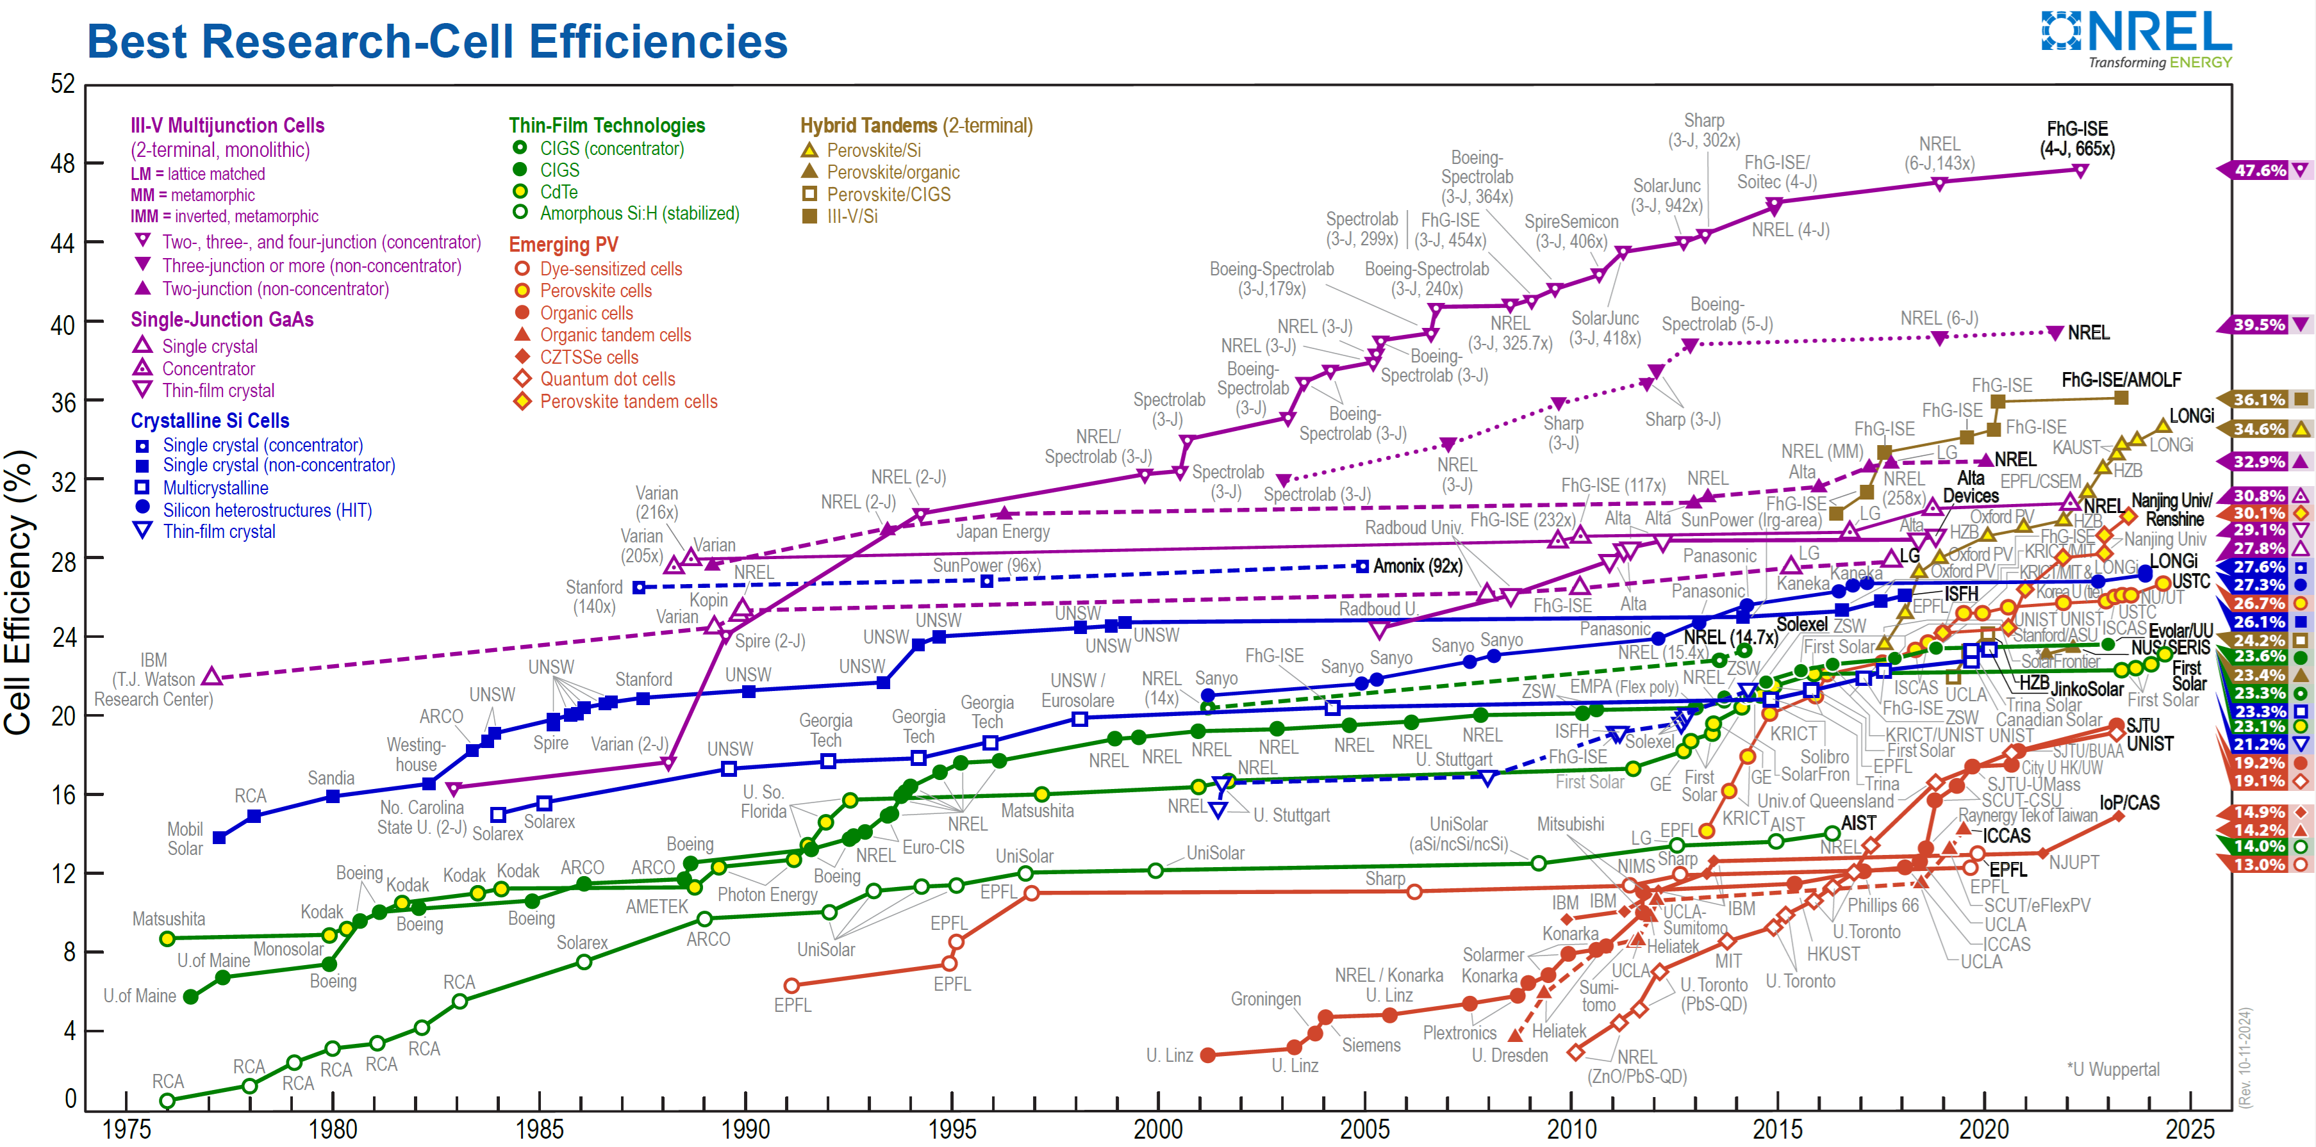
Tandem cells mark the efficiency records

Slide 20
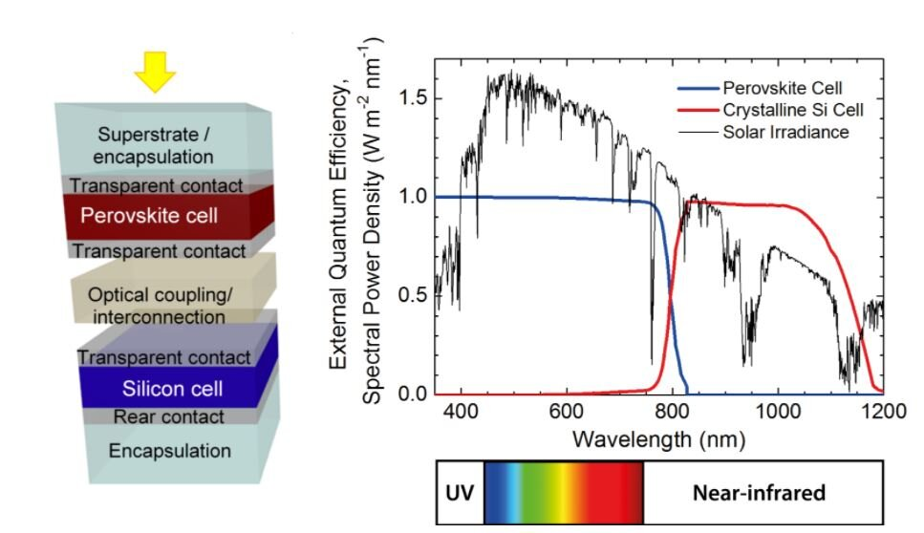
Perovskite/silicon tandem solar cells
https://www.fluxim.com/perovskite-silicon-tandem-solar-cell-simulation

Slide 21
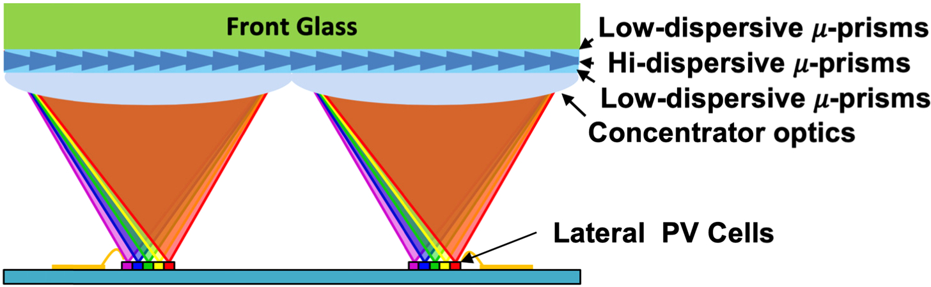
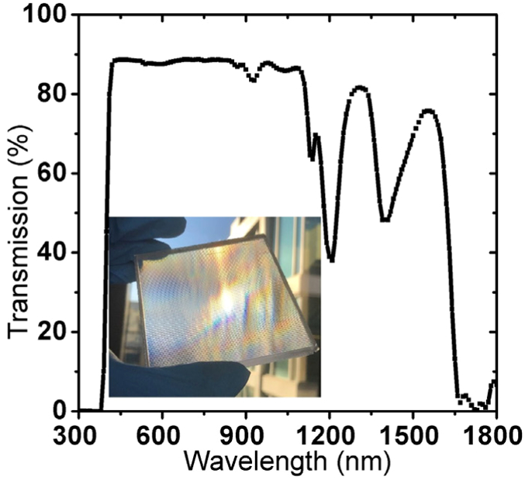
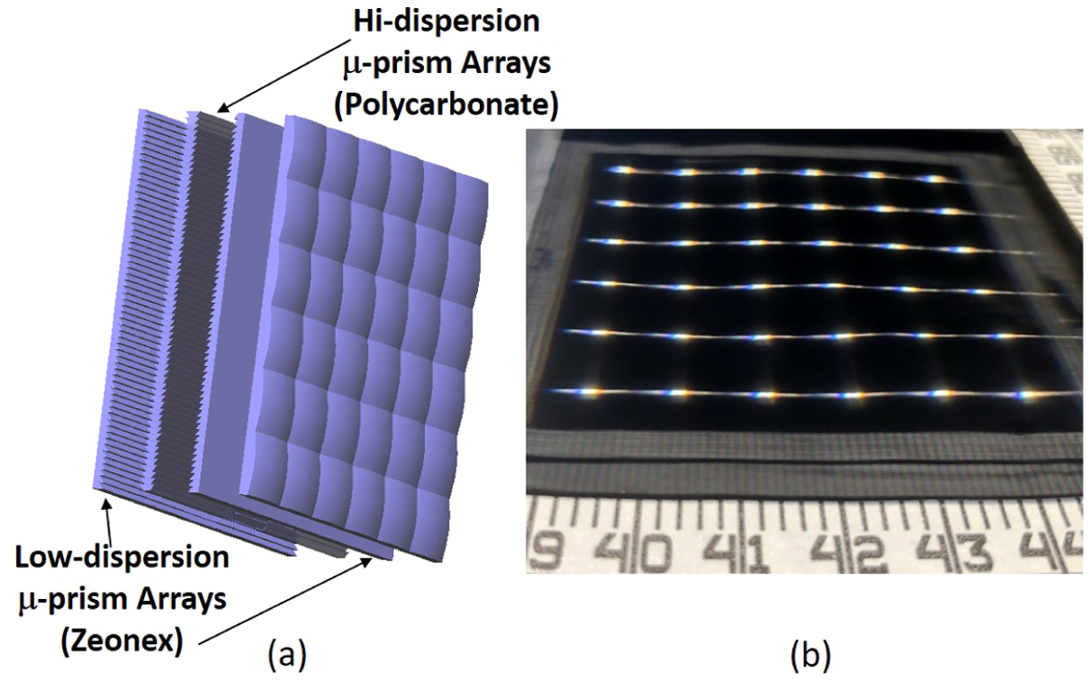
Laterally arrayed multi-junction cells
No current matching constraint
Opt. Lett. 44, 3274 (2019)

Slide 22
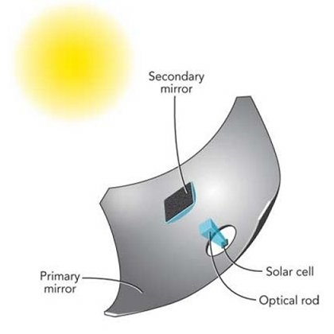
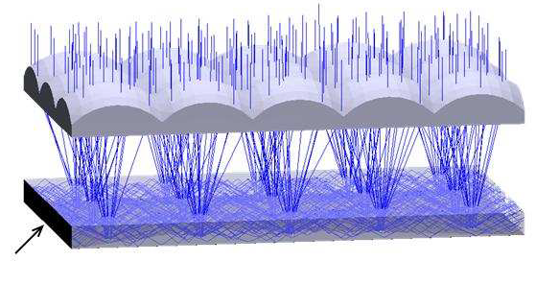
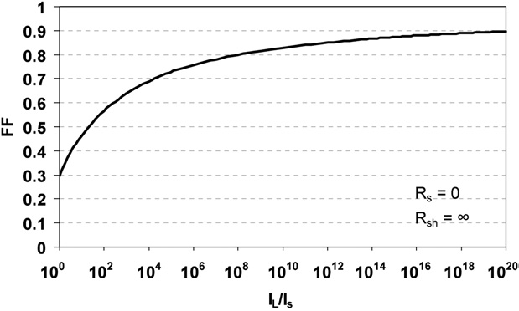
Concentrator photovoltaics (CPV)
Reduced capital expense for solar cells
Increased V_{OC} with high photon flux
  Large carrier concentration increases
  the quasi-Fermi level separation
Fill factor boost
Capital investment for additional optics
Requires active tracking
Aggravated heating issue
Micro-concentrators
“III-V multijunction solar cells for concentrating photovoltaics,” Energy Environ. Sci. 2, 174-192 (2009).
"Planar micro-optic solar concentrator," Opt. Express 18, 1122-1133 (2010).

Slide 23
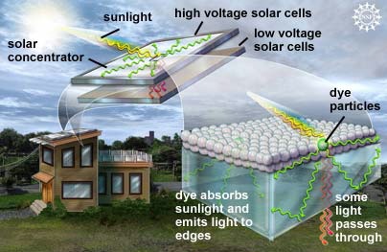
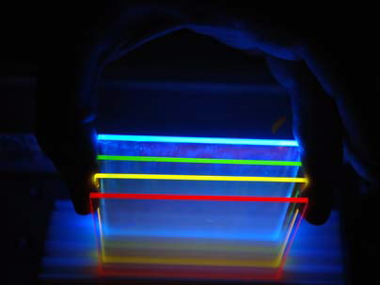
Luminescent solar concentrators (LSC)
Leakage
LSC with fluorescent emitters
Small, efficient solar cells
LSC: transparent slab embedded with luminescent emitters (organic dyes or quantum dots)
Luminescent light is waveguided in the LSC slab and eventually collected by solar cells mounted along the slab edge
Efficiency limiting factors: dye/QD re-absorption, luminescence leakage out of the escape cone
Appl. Opt. 18, 3090 (1979)
Opt. Express 16, 21773 (2008)

Slide 24
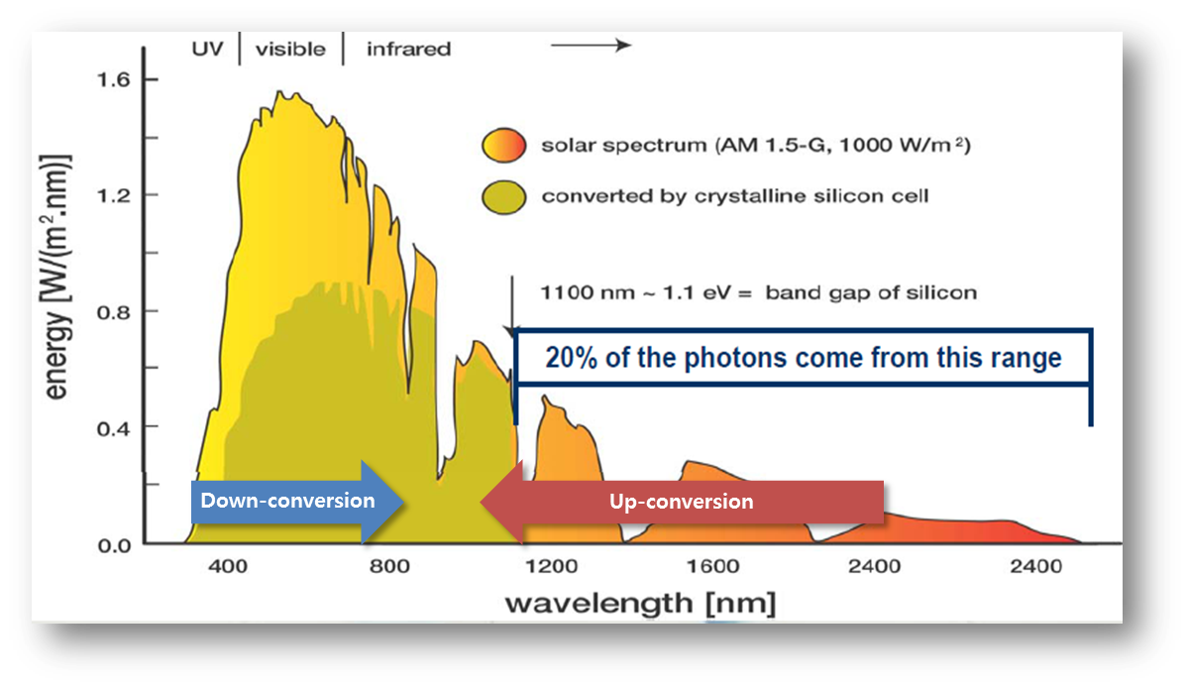
Beyond the S-Q limit: downconversion & upconversion
One high energy photon → multiple electron-hole pairs
  Multi-excitation generation: quantum dots
  Fluorescent downconversion: quantum cutting in rare earth ions
Two low energy photons → one electron-hole pair
  Upconversion: e.g. rare earth ions
  Two photon absorption
T. Trupke et al., J. Appl. Phys. 92, 1668 (2002).
B. Richards, Sol. Energy Mater. Sol. Cells 90, 1189-1207 (2006).
A. Shalav et al., Sol. Energy Mater. Sol. Cells 91, 829 (2007).

Slide 25

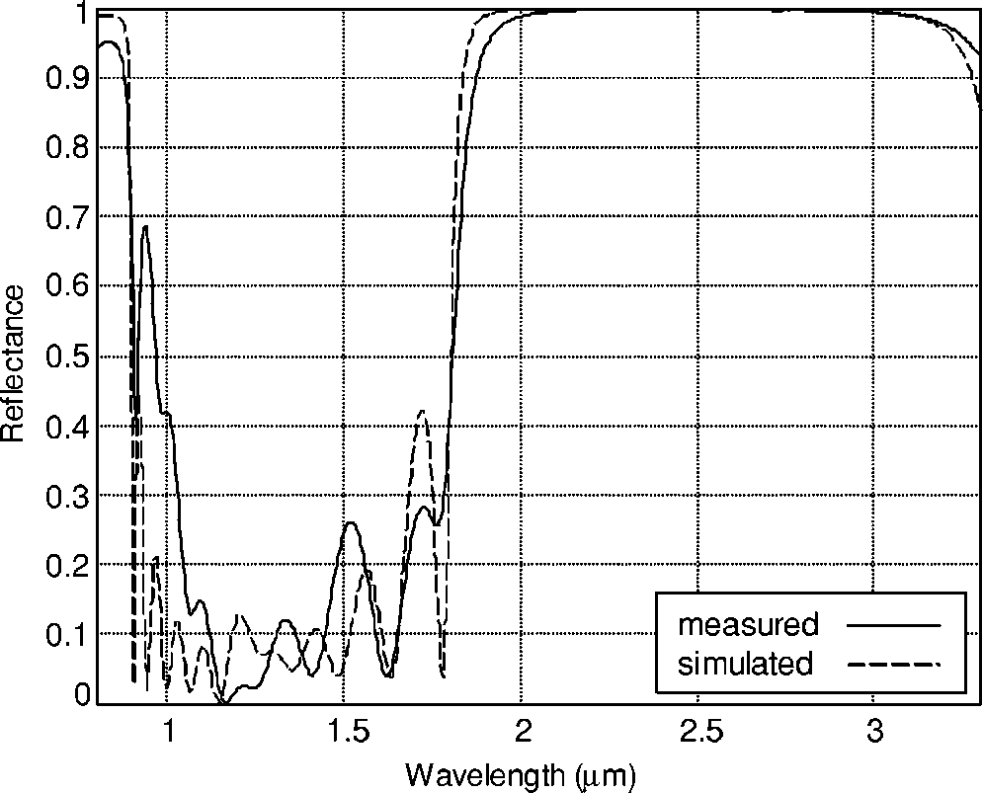
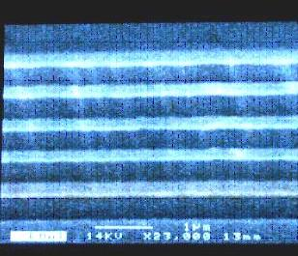
Beyond the S-Q limit: thermophotovoltaics (TPV)
Thermal emitter
Spectral filter
Solar cell
Cell materials GaSb, Ge:
smaller band gap to capture photons from thermal emitter (T < 2000 K)
DBR filter
J. Appl. Phys. 97, 033529 (2005).

Slide 26
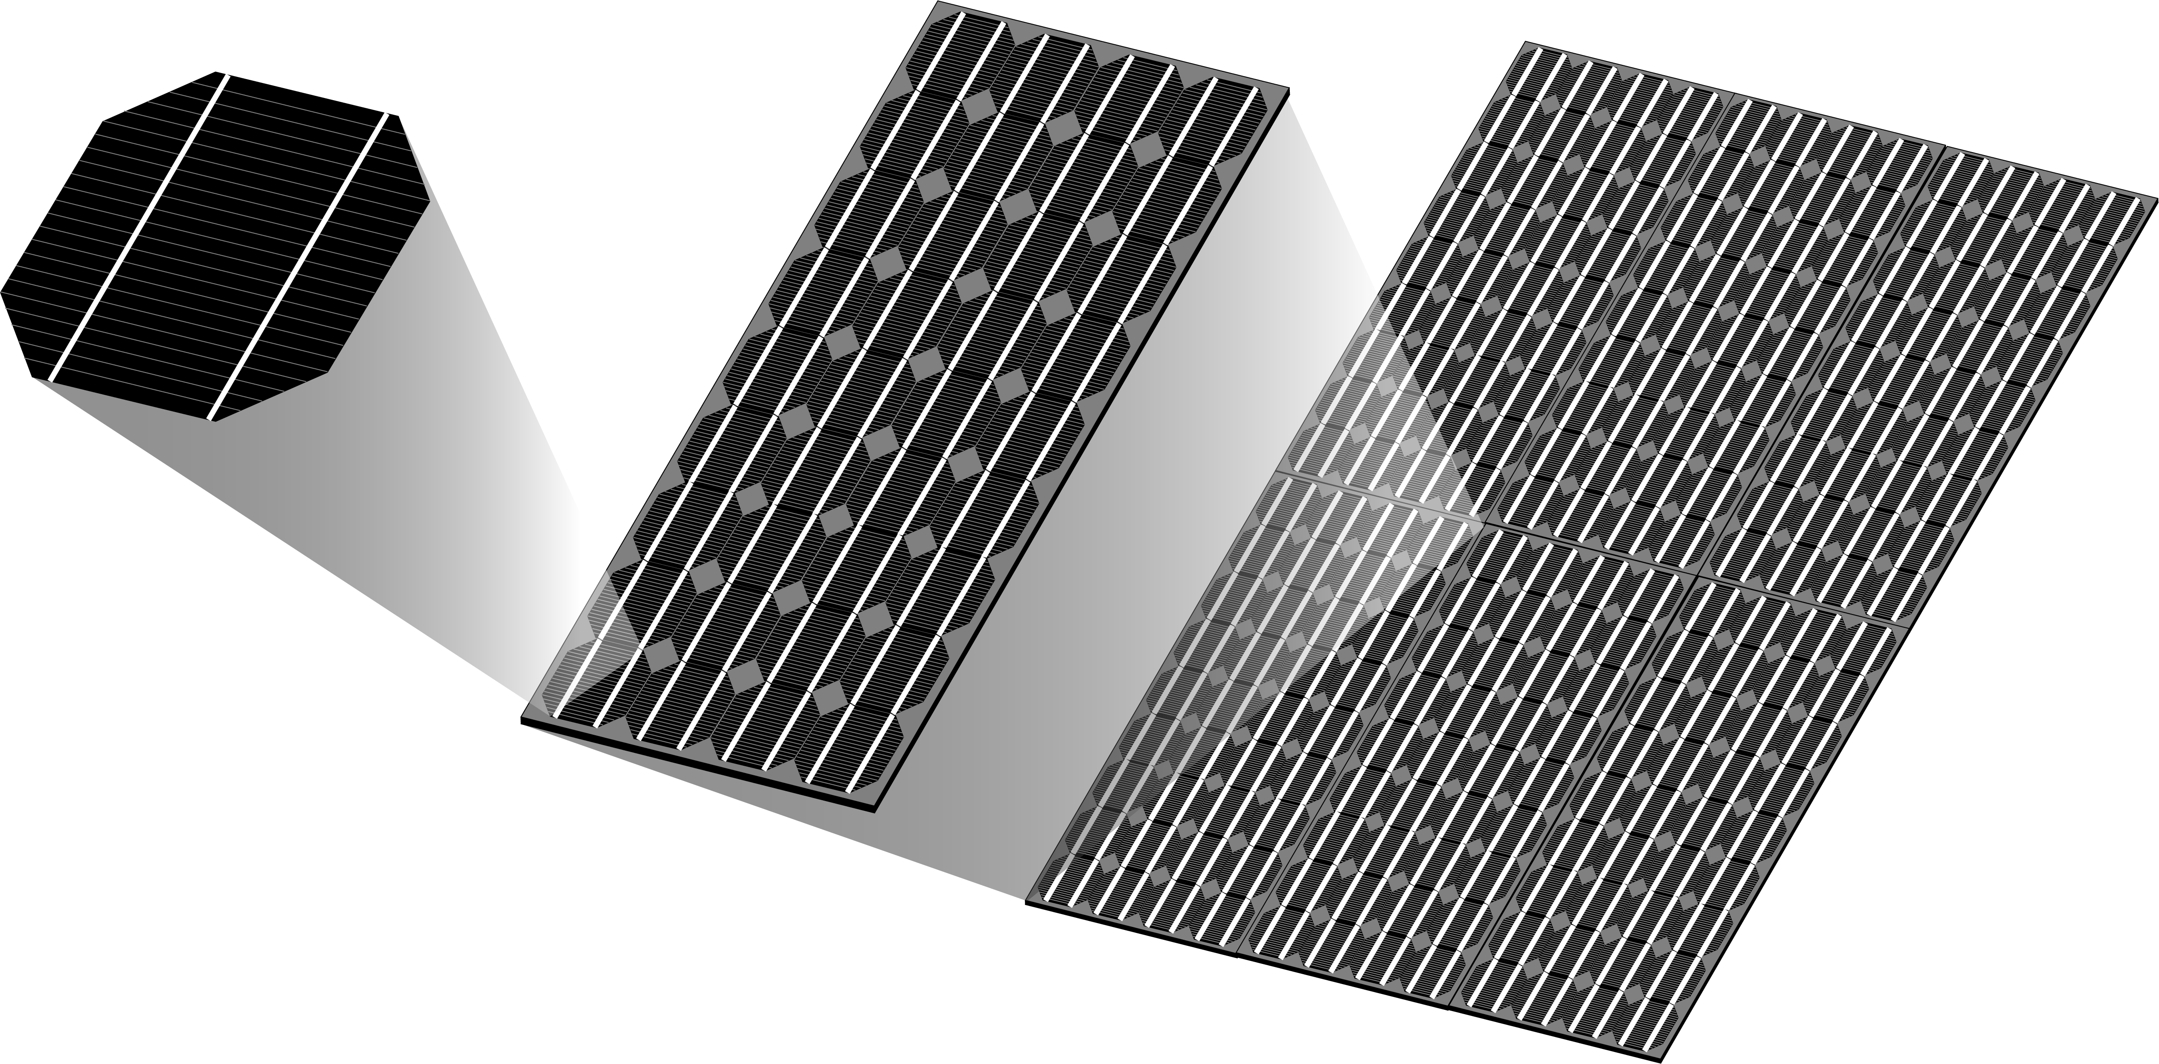
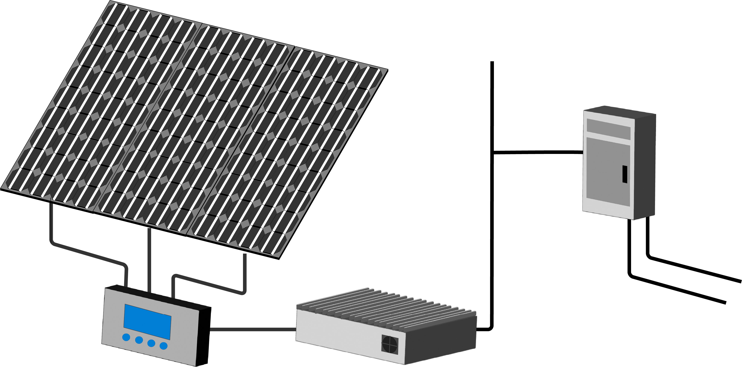
From cell to system
Cell
Module
To AC Loads
Array
System
DC-AC Power Inverter
Power to
and from grid
Charge Controller /
Protection

Slide 27
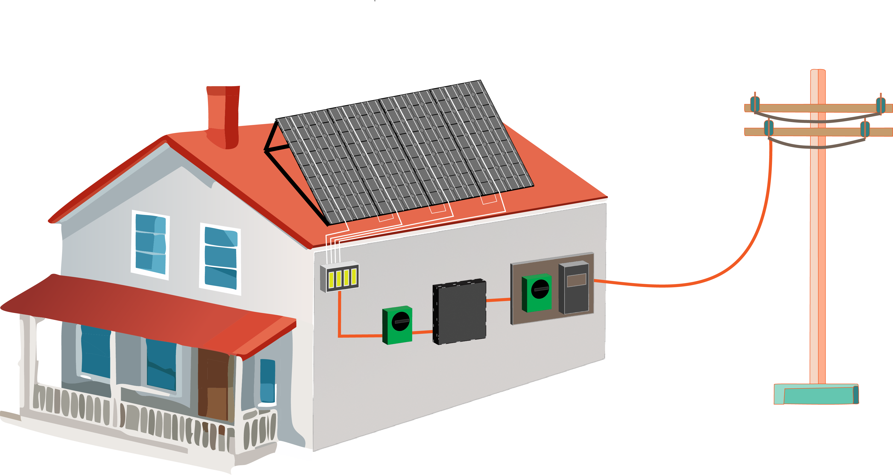
Balance of system (BOS) hardware
PV Modules
Mounting Frame
Power Grid
AC Cabling
Meter
Junction Box
Inverter
Switchboard
DC Cabling
Main Switch Solar Supply
Solar Array Isolator
BOS encompasses all components of a PV system excluding the PV modules, such as the inverter, mounting system, switches, wiring and installation work, etc.

Slide 28
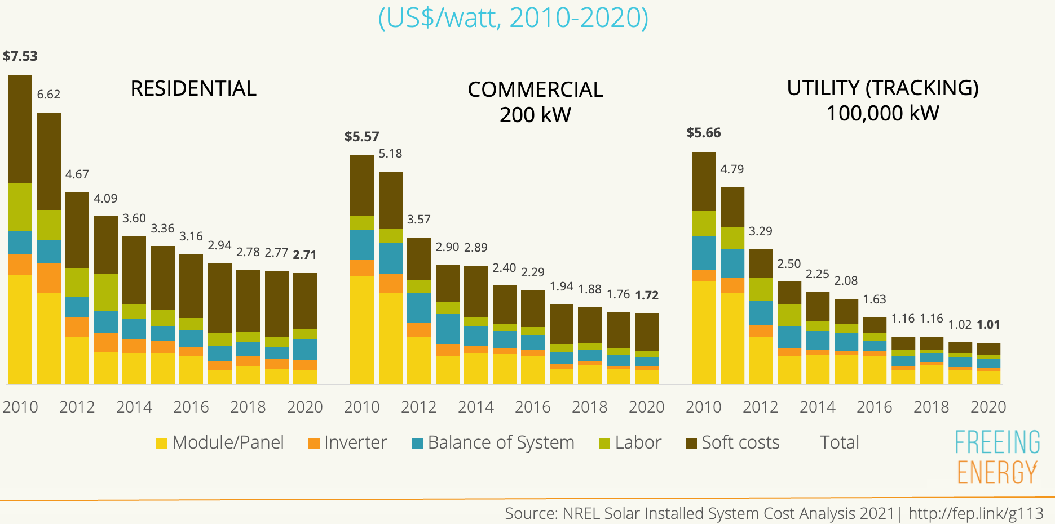
PV cost reduction: where and how?
Balance of system (BOS) costs is the key to further solar system cost reductions

Slide 29
List of symbols
I – electric current
V – voltage
I_{s} – diode saturation current
k_{B} – Boltzmann constant, 1.38 × 10⁻²³ m²·kg·s⁻²·K⁻¹
T – thermodynamic temperature
I_{SC} – short circuit current
A – solar cell area
η – quantum efficiency
λ / λ₀ – free-space wavelength
E_{eλ} – solar spectral irradiance

Slide 30
List of symbols
ћ – reduced Planck constant, 1.055 × 10⁻³⁴ J·s
ω – angular frequency of light
n_{i} – intrinsic carrier density
N_{A} / N_{D} – acceptor / donor concentration at the p / n side of a diode
D_{n} / D_{p} – diffusion coefficient of electrons / holes
τ_{n} / τ_{p} – electron / hole lifetime
E_{g} – band gap energy
e – elementary charge, 1.602 × 10⁻¹⁹ C
E_{Fn} / E_{Fp} – quasi-Fermi level for conduction / valence band

Slide 31
List of symbols
V_{OC} – open circuit voltage
P – output power
FF – fill factor
P_{m} – maximum power output
V_{m} / I_{m} – voltage / current corresponding to maximum power output
R_{SH} – shunt resistance
R_{S} – series resistance
R – reflectance
n – refractive index of absorber material

Slide 32
List of symbols
k₀ – wave vector of incident light
k_{slab} – wave vector of light trapped in the solar cell slab
k_{out} – wave vector of light escaped from the solar cell slab
G – reciprocal lattice vector of light trapping gratings
Λ – period of light trapping gratings

