Slide 1
MSEG 803 Equilibria in Material Systems 12: Solution Theory
Prof. Juejun (JJ) Hu
hujuejun@udel.edu

Slide 2
Gibbs theorem
1
Solid 1 consisting of N₁ atoms on N₁ lattice sites
Solid 2 consisting of N₂ atoms on N₂ lattice sites
Solid solution with the same lattice structure and completely random distribution of atoms
Inter-atomic force are the same for all three types of atomic pairs: 1-1, 2-2, and 1-2
2
1+2

Slide 3
Gibbs theorem
1
Ideal (random) solid solution
Entropy of mixing
2
1+2
Notes:
The entropy of mixing is also consistent with the informational theory definition of entropy

Slide 4
Gibbs theorem for ideal gas
Entropy of mixing ideal gases (at the same T and P):
Derivation: # of spatial “sites” m >> # of molecules n for ideal gas (classical limit of quantum statistics)
T, P, n₁
T, P, n₂
Same T and P :

Slide 5
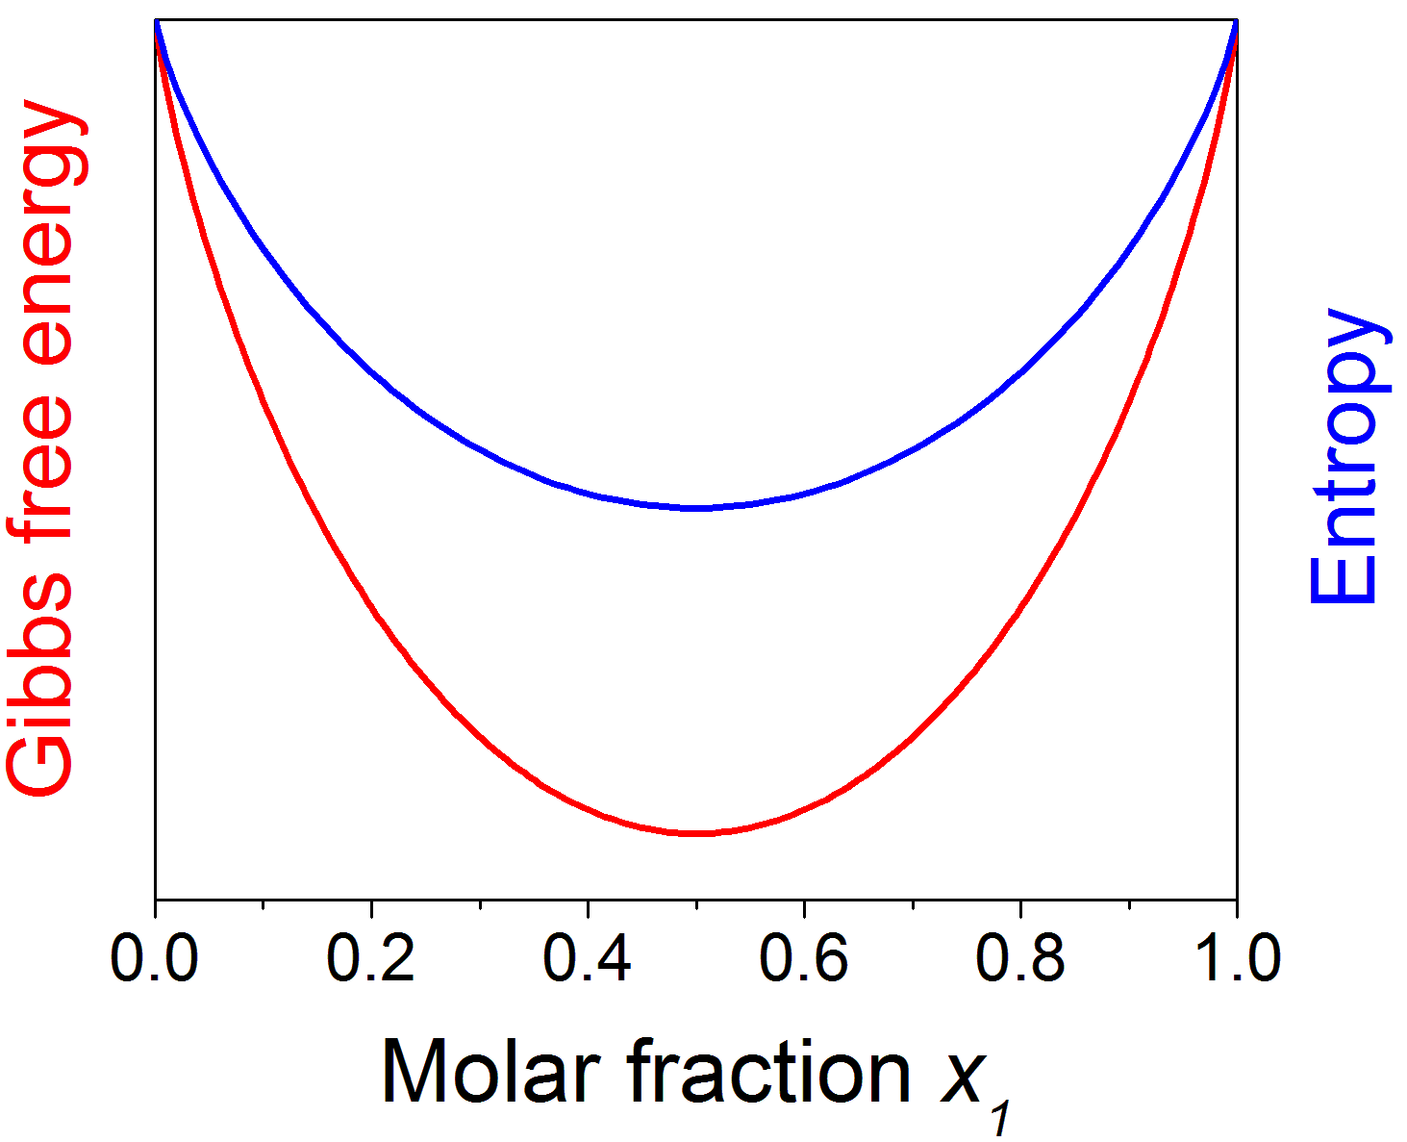
Ideal solid solutions
Inter-atomic force is the same for all types of bonds
Random mixing is always preferred!

Slide 6
Regular binary solution theory
Assumptions:
Random distribution of atoms
Bond energy between 1-2 is different from those of 1-1 and 2-2
negative enthalpy of mixing: 1-2 type of hetero-polar bond energetically favorable
positive enthalpy of mixing: 1-1 and 2-2 types of homopolar bonds preferred
1
2
Site i
Site j

Slide 7
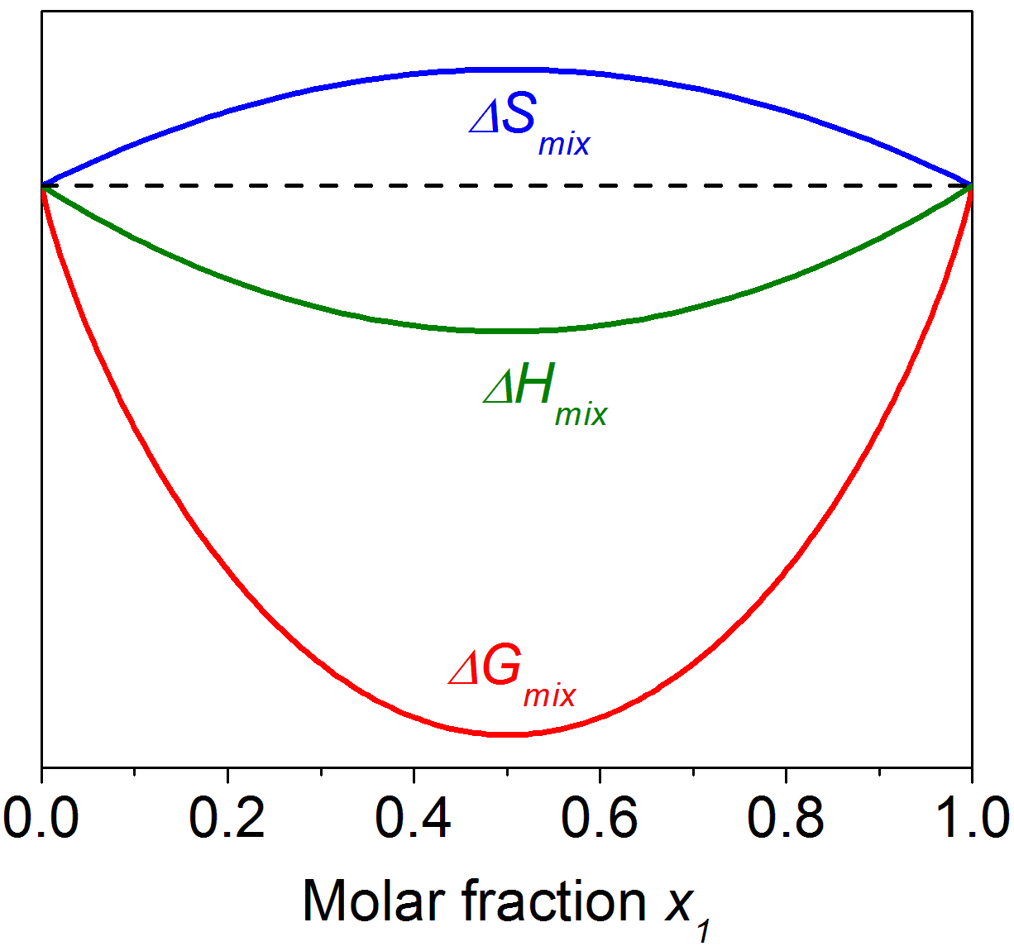
Negative enthalpy of mixing

Slide 8
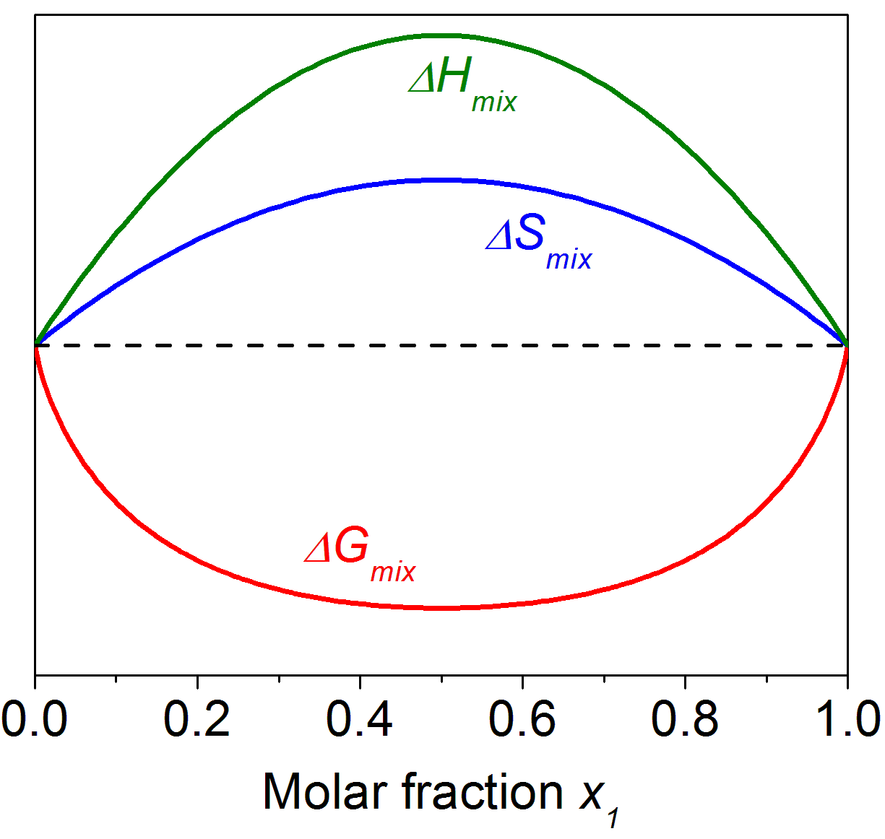
Positive enthalpy of mixing (high T)

Slide 9
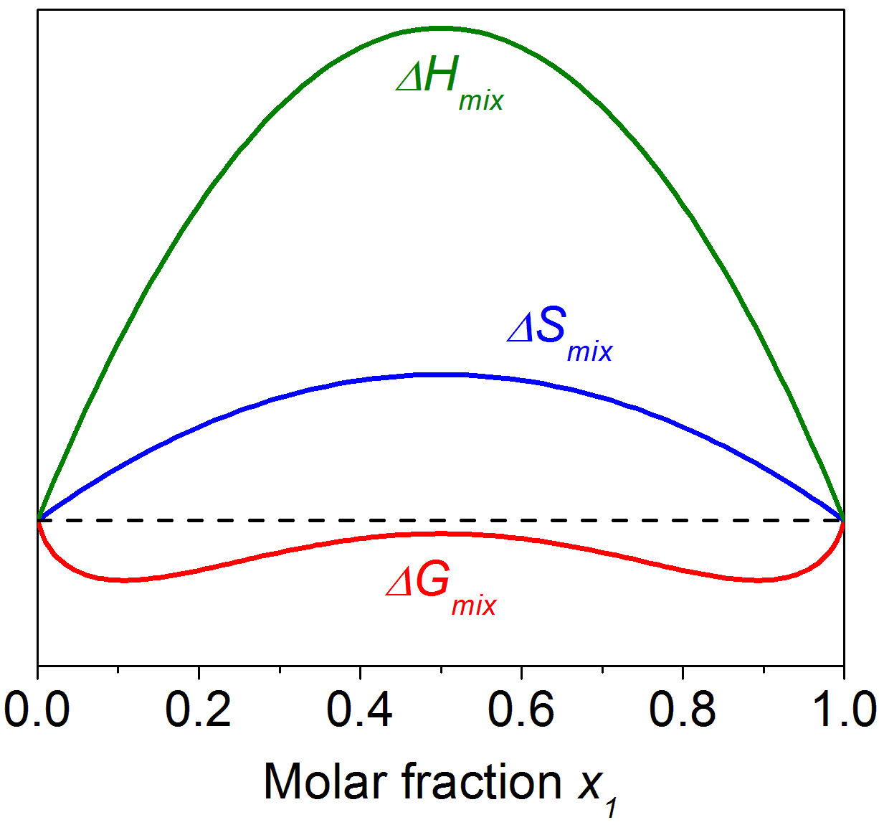
Positive enthalpy of mixing (intermediate T)

Slide 10
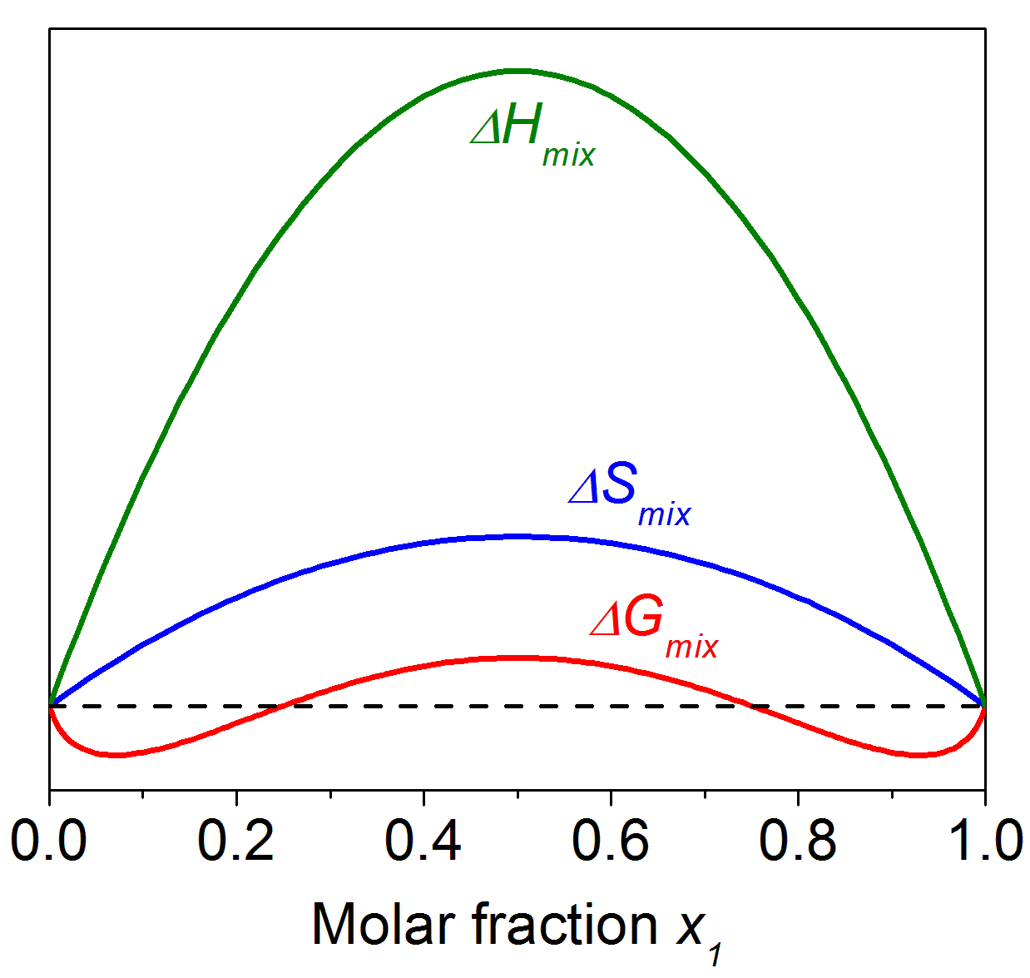
Positive enthalpy of mixing (low T)

Slide 11
The intercept rule
The chemical potentials of components 1 and 2 are given by the intercept of the tangent line of the Gibbs free energy curve
G
μ₁
G(x₁, x₂)
μ₂
x₁
Pure 2
x₁, x₂
Pure 1

Slide 12
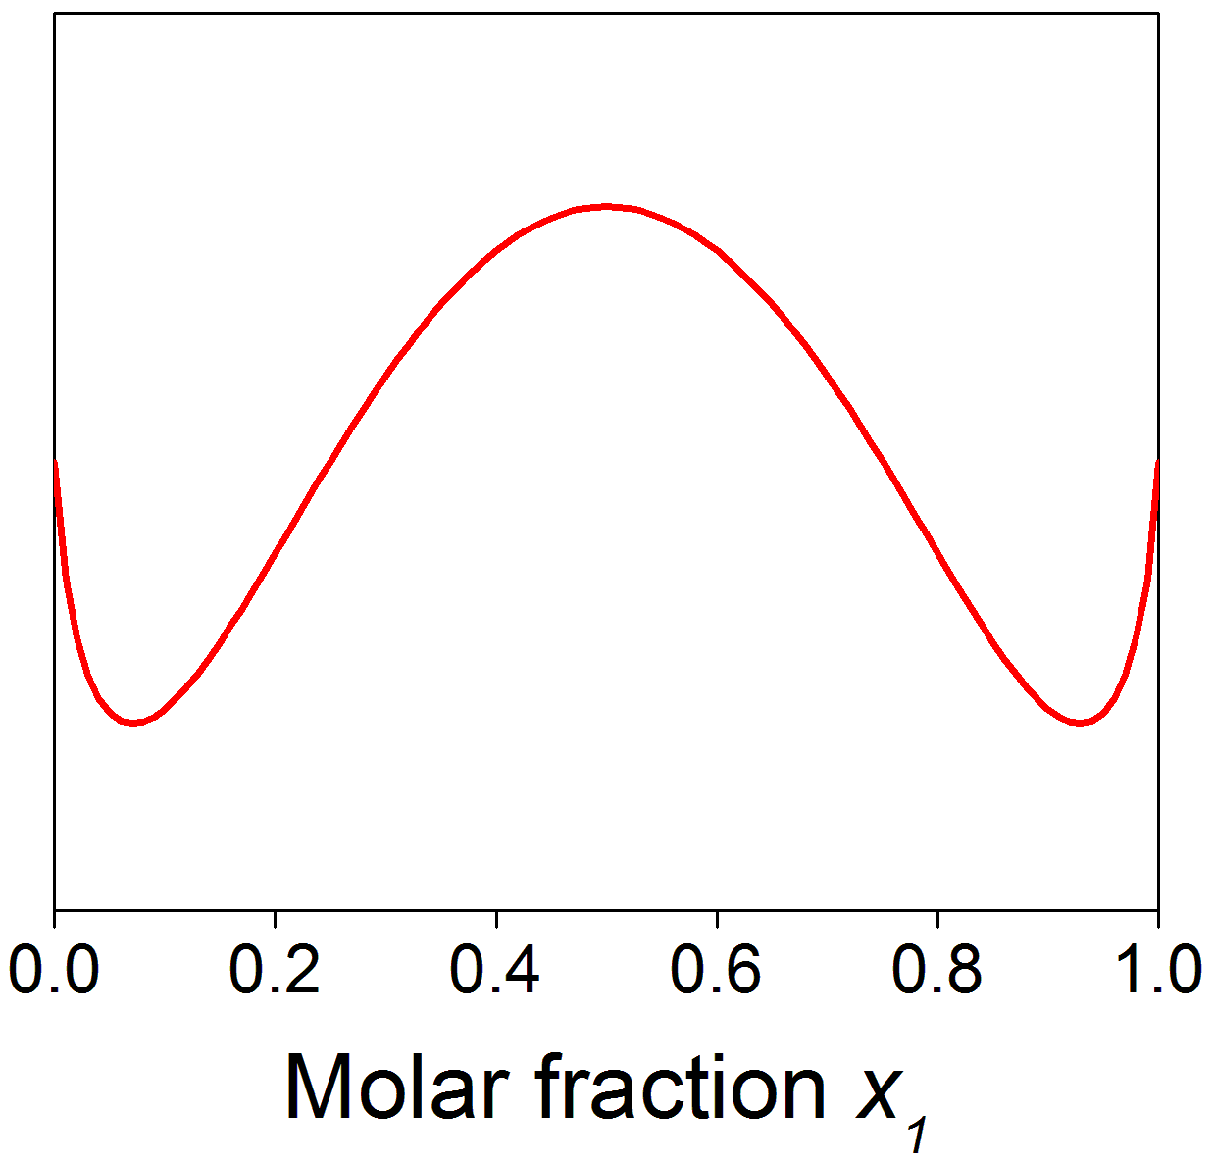
Phase composition determination
The composition of phases are determined by the common tangent lines on the Gibbs free energy curve
Minimization of G
The curve is generally asymmetric for non-ideal solution solutions
ΔG_{mix} at T = T₀
α
β
μ₂
μ₁
x_{1,α}
x_{1,β}

Slide 13
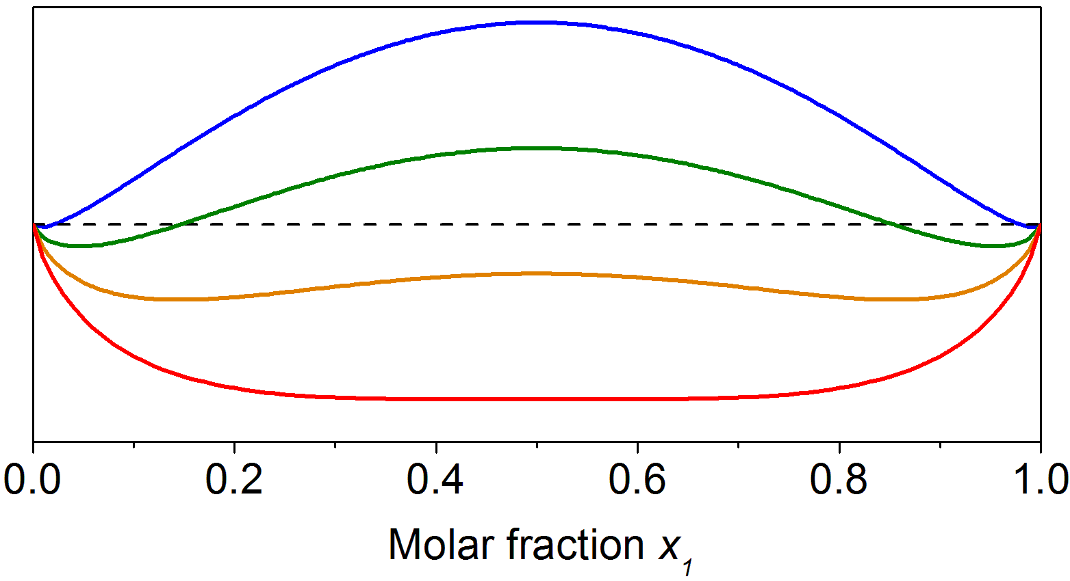
Miscibility gap
Phase diagram
Miscible region
Convex G curve: miscible solution
Gibbs free energy
Concave G curve: phase separation
Notes:
Miscibility gap: the bond energy gain of homopolar bond formation dominates over the entropy of mixing

Slide 14
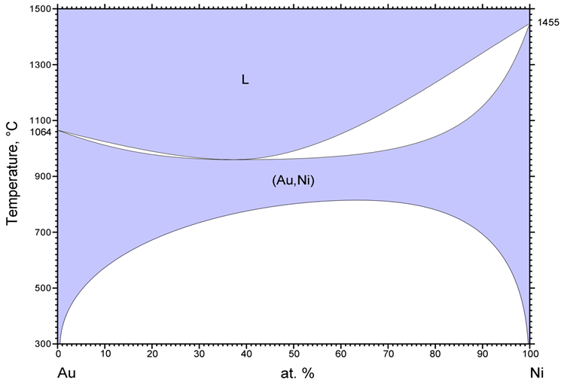
Miscibility gap in Au-Ni alloy phase diagram

Slide 15
Short range order (SRO)
Regular solution theory: random distribution of atoms
Probability of forming 1-2 is the same as that of forming 1-1 and 2-2 bonds
Large negative enthalpy of mixing
Bond energy of 1-2 bonds is much larger than average bond energy of 1-1 and 2-2 bonds
Heteropolar bonds strongly preferred over homopolar bonds
SRO maximizes the number of 1-2 hetero-polar bonds
Binary phase with SRO at low T (ΔH_{mix} dominates the contribution to ΔG_{mix})
1
2
Site i
Site j

Slide 16
Short range order (SRO)
B2 ordering in BCC structures (atom 1 and 2 molar ratio 1:1)
Ordering in molar ratio 1:1 FCC structures is impeded by tetrahedral units

Slide 17
Short range order (SRO)
T
T
Miscibility gap due to positive ΔH_{mix}
SRO phase
x₁
x₁
Experimental validation of SRO phase formation vs. miscibility gap due to positive ΔH_{mix}
Structural characterization
Calorimetry measurement

Slide 18
Completely miscible solid/liquid solution
G (at T = T₁)
T
T₁
l
s
l
s
x₁
x₁
Pure 2
Pure 1
Pure 2
Pure 1
Liquid and solid phases each has its own G curve
Liquid phase has molar lower Gibbs free energy at high T

Slide 19
Completely miscible solid/liquid solution
G (at T = T₂)
T
s
l
μ₁
l
T₂
μ₂
s
x₁
x₁
Pure 2
x_{1,l}
x_{1,s}
Pure 1
Pure 2
x_{1,l}
x_{1,s}
Pure 1
Liquid and solid phases each has its own G curve
Equilibrium phase composition is determined by the common tangent line

Slide 20
Completely miscible solid/liquid solution
G (at T = T₃)
T
l
l
s
s
x₁
T₃
x₁
Pure 2
Pure 1
Pure 2
Pure 1
The term is larger (less negative) for
solids; thus at low T solid becomes the stable phase

Slide 21
Eutectic phase diagram
G (at T = T₁)
T
T₁
α
β
l
l
α
β
x₁
x₁
Pure 2
Pure 1
Convex liquid phase Gibbs free energy curve lies everywhere below the G curves of α and β phases: homogeneous liquid phase l

Slide 22
Eutectic phase diagram
G (at T = T₂)
T
α
β
l
l
T₂
α
β
x₁
x₁
Pure 2
Pure 1
Compositions of l, α and β phases are determined by the common tangents

Slide 23
Eutectic phase diagram
G (at T = T₃)
T
α
β
l
l
T₃
α
β
x₁
x₁
Pure 2
Pure 1
Compositions of l, α and β phases are determined by the common tangent
Three phases share a common tangent at eutectic T

Slide 24
Eutectic phase diagram
G (at T = T₄)
T
α
l
l
β
α
β
T₄
x₁
x₁
Pure 2
Pure 1
Compositions of α and β phases are determined by the common tangent

