Slide 1
MSEG 803 Equilibria in Material Systems 5: Maxwell Relations & Stability
Prof. Juejun (JJ) Hu
hujuejun@udel.edu

Slide 2
Second order derivatives
Heat capacity
Coefficient of thermal expansion
Isothermal compressibility
Isotropy:
Notes:
The subscripts in the partial derivatives are neglected as we know that the natural variables of G are T and P

Slide 3
Maxwell relations
LHS: volume change as a function of temperature (thermal expansion)
RHS: entropy change as a function of pressure
Connects two seemingly unrelated quantities!
General form

Slide 4
Maxwell relations in single component simple systems
Energy representation
Note the sign difference for terms involving P in the U representation
Notes:
7 types of fundamental equations, 3 Maxwell relations for each type: a total of 21 Maxwell relations

Slide 5
Second order derivatives
Of all second order derivatives, only 3 can be independent, and any given derivative can be expressed in terms of an arbitrarily chosen set of 3 basic derivatives
The conventional choice:
3 physical observables in the Gibbs potential representation

Slide 6
Procedures for reducing derivatives
If the derivative contains any potentials, bring them to the numerator and eliminate using the differential form of fundamental equations
If the derivative contains the chemical potential, bring it to the numerator and eliminate by means of the Gibbs-Duhem relation: dμ = -sdT + udP
If the derivative contains the entropy, bring it to the numerator. If one of the Maxwell relations now eliminates the entropy, invoke it. If the Maxwell relations do not eliminate the entropy take the deriative of S with respect to T. The numerator will then be expressible as one of the specific heats (c_{v} or c_{P})
Bring the volume to the numerator. The remaining derivative will be expressible in terms of α and κ_{T}
c_{v} can be eliminated by the equation: c_{v} = c_{P} - Tvα²/κ_{T}
Notes:
Express a quantity that is difficult to measure practically in experimental measurables

Slide 7
Some useful relations

Slide 8
Connecting C_{V} and C_{P}
Molar heat capacity:

Slide 9
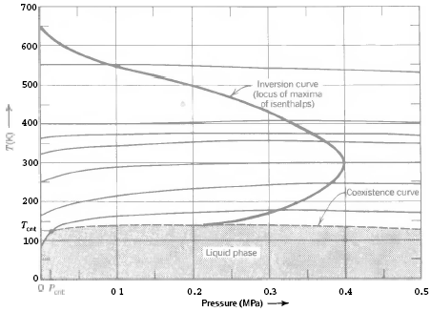
Joule-Thomson (throttling) process
Isenthalpic curves
Inversion temperature:
Inversion point:
P > P_{inv}, J-T process leads to heating
P < P_{inv}, J-T process leads to cooling

Slide 10
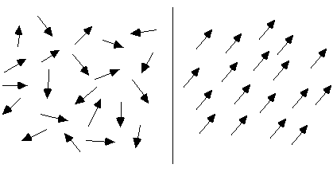
Magnetic systems
Quasi-static magnetic work: HdM
M is an unconstrainable parameter!
Fundamental equation:
Unmagnetized
(H = 0)
Magnetized
(H > 0)
thermal expansion
Magnetostriction and piezomagnetic effect:

Slide 11
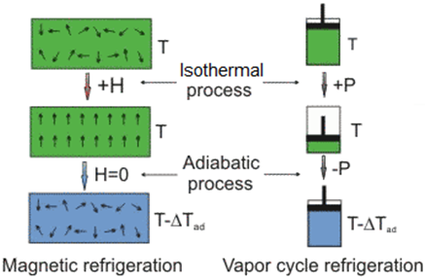
Magnetic refrigeration
S
H = 0
H = H₁
T
0
Fundamental equation:
Note that here H denotes the field not enthalpy
Notes:
In magnetic systems, the controlled variable is always H

Slide 12
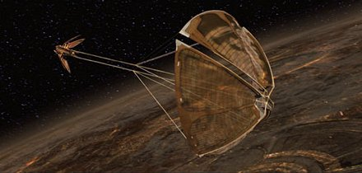

Optomechanical force in science fictions: solar sail
Count Dooku’s solar sailer:
Star Wars Episode II: Attack of the Clones

Slide 13
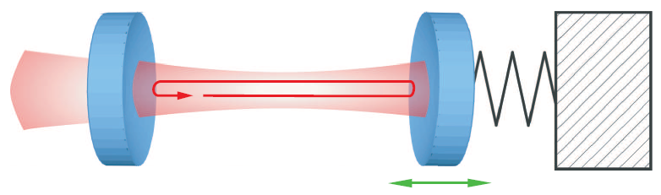
Optomechanical force
x
Photons confined in a resonant cavity (bouncing back and forth between two mirrors)
Fundamental equation:
Optomechanical force exerted by photons on the movable mirror:
Notes:
Similar to magnetic systems, the constrained variable for photons of a cavity mode can only be the photon number N. Practically the photon frequency in a cavity cannot be fixed when the mirrors are moving even if a single-frequency pump laser is used!
The subtlety here is that the photon energy plays the role of “chemical potential”. This situation is distinctively different from blackbody radiation where the photon number is not conserved and the chemical potential of photons vanishes. The key difference is that photons in a cavity are not in thermal equilibrium (non-interacting in the thermodynamic sense) with the cavity (e.g. the mirrors) and have a well-defined frequency specified by the geometry of the cavity. Thus the photon number is a conserved quantity given the closed cavity assumption.

Slide 14
The sign of α, C_{V} and κ_{T}
α can either be positive or negative
Positive α: most materials
Negative α: liquid water (< 4 °C), cubic zirconium tungstate, quartz (over certain T range)
C_{V} and κ_{T} are positive in stable TD systems
δQ
dV
If C_{V} < 0, thermal fluctuation will be amplified leading to instability
If κ_{T} < 0, volume fluctuation will be amplified leading to instability

Slide 15
Stability criteria
Molar entropy s
Ext. var. x
x₀ - Δx
x₀
x₀ + Δx
Stability:
General criterion:
Notes:
The stability criterion can be generalized to other TD potential functions, see Callen section 8-2

Slide 16
Stable thermodynamic function
Molar entropy s
E
A to B, E to F: stable
F
G
D
C to D: locally unstable
B
B to C, D to E: locally stable, globally unstable
C
Ext. var. x
A
The stable thermodynamic function S is the envelope of tangents everywhere above the underlying function S
The line BGE corresponds to inhomogeneous mixtures of the two phases B and E: 1st order phase transition

Slide 17
Le Chatelier-Braun principle
If a chemical system at equilibrium experiences a change in concentration, temperature, volume, or partial pressure, then the equilibrium shifts to counteract the imposed change and a new equilibrium is established.
Indirectly induced secondary processes also act to attenuate the initial perturbation

