Slide 1
MSEG 803
Equilibria in Material Systems
7: Statistical Interpretation of S
Prof. Juejun (JJ) Hu
hujuejun@udel.edu

Slide 2
Thermal interactions: heat transfer
600 mental copies of macroscopically identical systems
E
3ε
ε
2ε
300
300
150
150
ε
300
0
Thermal interactions (heat transfer/diabatic interactions): the energy levels remain unchanged
The relative number of systems in the ensemble which are distributed over the fixed energy levels is modified

Slide 3
Mechanical interactions: work
600 mental copies of macroscopically identical systems
E
5
5
3ε
ε
30
30
2ε
300
300
50
50
50
ε
190
190
0
Mechanical interactions (work/adiabatic interactions): the energy levels are modified due to change of external parameters (some state functions, e.g. volume, magnetic field, etc.)

Slide 4
General interactions
Ensemble average of system energy:
First law of TD:
Quasi-static work:
Mean generalized force:
Work: energy level change
Heat: population distribution change

Slide 5
Example: particle in a box
Energy levels:
Heat transfer: population distribution over levels changes, i.e. the “box” is held unchanged and only the quantum numbers n_{x}, n_{y}, and n_{z} change
Mechanical work: dimension change of the “box” leading to modification of the energy levels
where n_{x} and n_{y} are integers (quantum numbers)

Slide 6
Example: ideal gas
DOS:
U, T, V
Heat transfer
Mechanical work
U + dU,
T + dT,
V + dV
U + dU,
T + dT, V

Slide 7
Equilibrium condition in isolated systems
N, V_{i}
DOS of a composite isolated system consisting of sub-systems:
x_{i}: external parameters
y_{i}: internal constraints (usually extensive variables of sub-systems)
Example: ideal gas in a cylinder with a partition
  Internal constraint y: mole number in the sub-systems
  Accessible states only include those satisfy the constraint, i.e. all gas molecules have to reside on the left side of the partition

Slide 8
Equilibrium condition in isolated systems
Remove constraint
N, V_{i}
N, V_{f} > V_{i}
Removal of constraint(s) leads to increased (or possibly unchanged) number of accessible states and re-distribution of some extensive parameter(s)
Probability of the system remaining in the constrained states:
Example: ideal gas in a cylinder with a partition
  Accessible states now include all states where gas molecules are free to distribute in the entire cylinder
Notes:
Assuming that there are N gas molecules (10^23 order of magnitude) and the partition divides the cylinder in half, the number of accessible states after removal of the constraint increases by 2^N times!

Slide 9
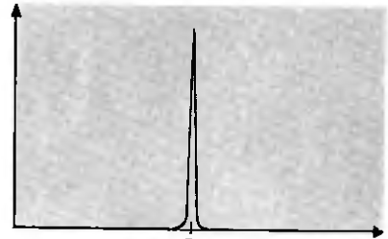
Equilibrium condition in isolated systems
N₁, V₁
N₂, V₂
Probability of parameter y taking the value between y and y + dy
If some constraints of an isolated system are removed, the parameters of the system tend to re-adjust themselves in such a way that Ω approaches maximum:

Slide 10
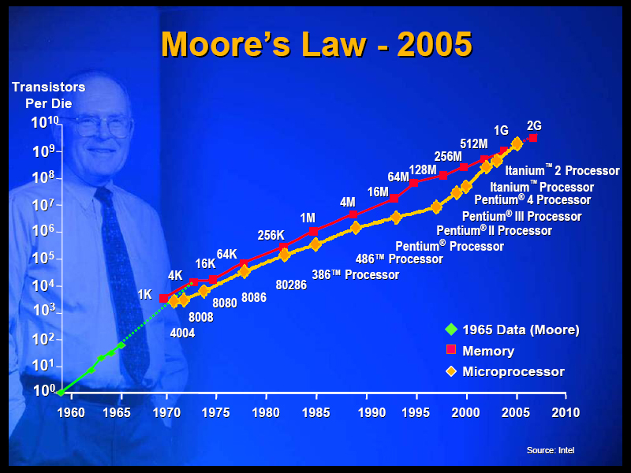
Fluctuations
Random deviations from statistical mean values
Exceedingly small in macroscopic systems
Fluctuations can be significant in nanoscale systems
A transistor (MOSFET) with a gate length of 50 nm contains only ~ 100 electrons on average in the channel. Fluctuation of one single electron can lead to 40% change of channel conductance!
From Transport in Nanostructures by D. Ferry and S. Goodnick

Slide 11
Statistical interpretation of entropy
The function S has the following property: the values assumed by the extensive parameters in the absence of an internal constraint are those that maximize S over the manifold of constrained equilibrium states.
Entropy:
An isolated system tends to evolve towards a macroscopic state which is statistically most probable (i.e. a macroscopic state corresponding to the maximum number of microscopic accessible states)

Slide 12
Thermal equilibrium
Isolated composite system
A
B
δQ
Two sub-systems separated by a
rigid, diathermal wall
Apply the maximum principle of Ω
Notes:
Internal energy is represented by the letter U in Callen and the letter E in Reif

Slide 13
Partition of energy
f: degrees of freedom (DOF) of a system
The average energy per degree of freedom is ~ 0.5kT
Equipartition theorem of classical mechanics: the mean value of each independent quadratic term in energy (DOF) is
E₀: ground state energy

Slide 14
Dependence of DOS on external parameters
Ω as a function of volume
Ω as a function of extensive parameter x of the system
p
E + dE
q
E
where y is the conjugate intensive variable of the system

Slide 15

The 3rd law of thermodynamics
At absolute zero (T = 0 K), the system is “frozen” into its quantum mechanical ground state
where Ω is the degeneracy of the ground state
The Third Law of Thermodynamics
by Katharine A. Cartwright (2010)
watercolor on paper
26" x 20”

Slide 16
Connections between TD and statistical mechanics
Thermodynamics
First law of TD:
Second law of TD:
in isolated systems
Third law of TD:
Statistical mechanics
First law of TD:
Second law of TD:
in isolated systems
Third law of TD:
System is frozen in its
ground state when T = 0
i.e.
i.e.
when

