Slide 1
Waiting in Line to Vote
Charles Stewart III
MIT
For the Presidential Commission on Election Administration
June 28, 2013

Slide 2
Lines are costly
Lines are not universal
Queuing theory helps organize thinking about improvements
Research on effective strategies is thin

Slide 3
Long lines discourage voting
Voting and Registration Supplement (VRS) of the Current Population Survey
  500k eligible voters failed to vote because of inconvenient hours or polling place locations, or lines too long
Cooperative Congressional Election Study (CCES)
  730k non-voters due to long lines at the polls
Survey of the Performance of American Elections (SPAE)
  740k non-voters cite lines as a major factor

Slide 4
Long lines discourage voting
Voting and Registration Supplement (VRS) of the Current Population Survey
  500k eligible voters failed to vote because of inconvenient hours or polling place locations, or lines too long
Cooperative Congressional Election Study (CCES)
  730k non-voters due to long lines at the polls
Survey of the Performance of American Elections (SPAE)
  740k non-voters cite lines as a major factor

Slide 5
Long lines can reduce voter confidence
Q: How confident are you that your vote was counted as intended?*
Election day voters |  |  | Early voters
Waited 10 minutes or less | Waited an hour or more |  | Waited 10 minutes or less | Waited an hour or more
68% | 47% |  | 69% | 54%
*% saying very confident
Source: SPAE 2012

Slide 6
Long lines can reduce voter confidence
Q: How confident are you that votes in your county or town were counted as intended?*
Election day voters |  |  | Early voters
Waited 10 minutes or less | Waited an hour or more |  | Waited 10 minutes or less | Waited an hour or more
56% | 32% |  | 57% | 48%
*% saying very confident
Source: SPAE 2012

Slide 7
Long lines can reduce voter confidence
Q: How confident are you that votes in your state were counted as intended?*
Election day voters |  |  | Early voters
Waited 10 minutes or less | Waited an hour or more |  | Waited 10 minutes or less | Waited an hour or more
46% | 23% |  | 43% | 34%
*% saying very confident
Source: SPAE 2012

Slide 8
Long lines can reduce voter confidence
Q: How confident are you that votes nationwide were counted as intended?*
Election day voters |  |  | Early voters
Waited 10 minutes or less | Waited an hour or more |  | Waited 10 minutes or less | Waited an hour or more
24% | 13% |  | 23% | 21%
*% saying very confident
Source: SPAE 2012

Slide 9
Long lines can reduce voter confidence
Q: How confident are you that your vote was counted as intended?*
Respondent did not wait at all to vote
Five states with shortest lines | Five states with longest lines
63% | 23%
*% saying very confident
Source: SPAE 2012

Slide 10
Lines impose monetary costs
13.1 minutes average to vote

105.2 million in-person voters

Slide 11
Lines impose monetary costs
13.1 minutes average to vote

105.2 million in-person voters
23 million hours waiting

Slide 12
Lines impose monetary costs
13.1 minutes average to vote

105.2 million in-person voters
23 million hours waiting

$23.67 average hourly earnings

Slide 13
Lines impose monetary costs
13.1 minutes average to vote

105.2 million in-person voters
23 million hours waiting

$23.67 average hourly earnings
$544 million

Slide 14
Basic Facts
 | 2008 | 2012
Not at all | 36.8% | 37.3%
Less than 10 minutes | 27.6% | 31.8%
10-30 minutes | 19.0% | 18.4%
31-60 minutes | 10.3% | 8.6%
More than one hour | 6.3% | 3.9%
Average (min.) | 16.7 | 13.3
N | 18,836 | 30,124
Source: CCES, 2008 and 2012

Slide 15
Basic Facts
 | 2008 | 2012
Not at all | 36.8% | 37.3%
Less than 10 minutes | 27.6% | 31.8%
10-30 minutes | 19.0% | 18.4%
31-60 minutes | 10.3% | 8.6%
More than one hour | 6.3% | 3.9%
Average (min.) | 16.7 | 13.3
N | 18,836 | 30,124
110 minutes on average
Source: CCES, 2008 and 2012

Slide 16
Basic Facts
 | 2008 | 2012
Not at all | 36.8% | 37.3%
Less than 10 minutes | 27.6% | 31.8%
10-30 minutes | 19.0% | 18.4%
31-60 minutes | 10.3% | 8.6%
More than one hour | 6.3% | 3.9%
Average (min.) | 16.7 | 13.3
N | 18,836 | 30,124
31% of total time waiting
Source: CCES, 2008 and 2012

Slide 17
Geography of Waiting
Source: CCES and SPAE, 2012

Slide 18
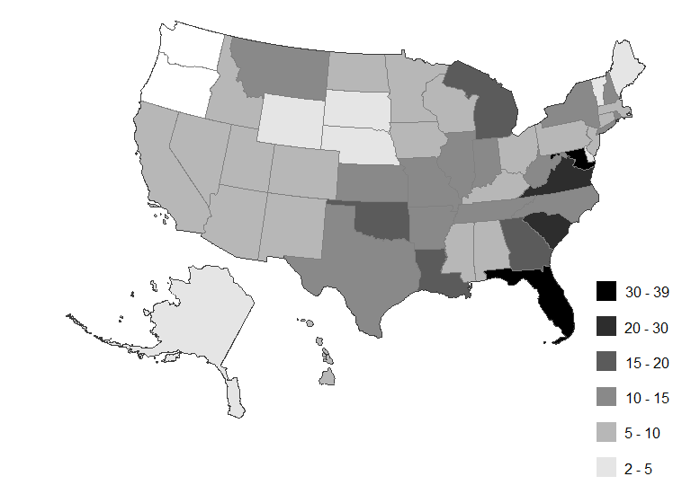
Geography of Waiting
Source: CCES and SPAE, 2012

Slide 19
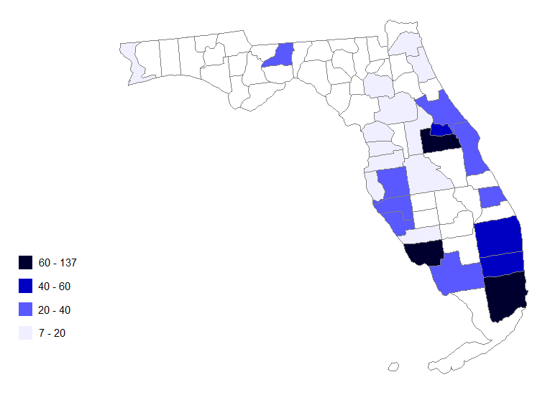
Variation within States
Source: CCES and SPAE, 2012

Slide 20
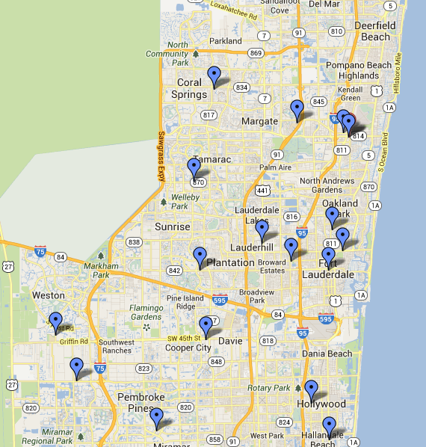
Variation within Counties
Source: Broward County
SOE Web site

Slide 21
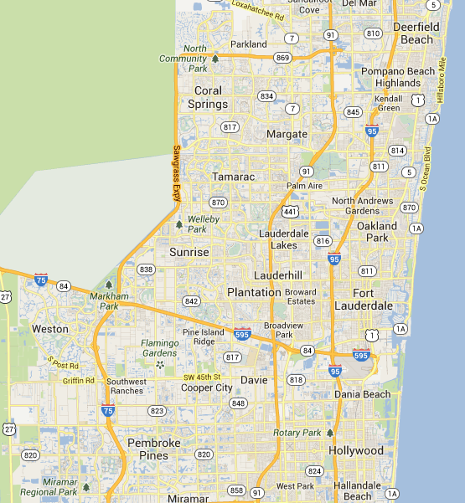
Variation within Counties
14 min
Source: Broward County
SOE Web site

Slide 22
Variation within Counties
157 min.
14 min
Source: Broward County
SOE Web site

Slide 23
Variation within Counties
86
74
58
157 min.
14 min
65
48
44
88
77
26
61
51
61
100
128
Source: Broward County
SOE Web site
46

Slide 24
State-Level Persistence
Source: CCES and SPAE, 2012

Slide 25
The Demography of Waiting
Early voters = 18 minutes
Election Day voters = 12 minutes
Source: CCES, 2012

Slide 26
The Demography of Waiting
Race | Avg.
White | 11.6
Black | 23.3
Hispanic | 18.7
Asian | 15.4
Native American | 13.3
Mixed | 13.6
Other | 13.3
Middle Eastern | 11.7
Source: CCES and SPAE, 2012

Slide 27
The Demography of Waiting
9.5
7.1
5.0
0.8

Slide 28
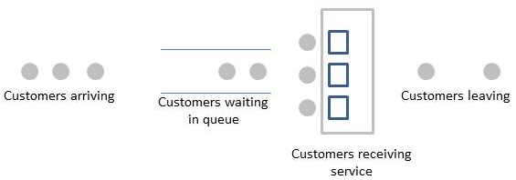
Queuing Theory

Slide 29
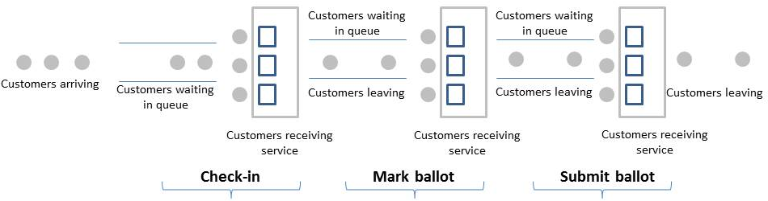
Queuing Theory

Slide 30
Queuing Theory Prescriptions
Reduce the number of voters coming to the polling place
Increase the number of service points
Reduce average transition times
  .

Slide 31
Queuing Theory Prescriptions
Reduce the number of voters coming to the polling place
  Increase vote-by-mail
  Increase early in-person voting
  Make Election Day a holiday
Increase the number of service points
  Increase the number of precincts
  Increase the number of poll workers
  Increase the number of machines
  Favor paper over DREs
Reduce average transaction times
  Increase information to voters
  Increase the functionality of electronic poll books
  Decrease the length of ballots

Slide 32
Queuing Theory Prescriptions
Reduce the number of voters coming to the polling place
  Increase vote-by-mail
  Increase early in-person voting
  Make Election Day a holiday
Increase the number of service points
  Increase the number of precincts
  Increase the number of poll workers
  Increase the number of machines
  Favor paper over DREs
Reduce average transaction times
  Increase information to voters
  Increase the functionality of electronic poll books
  Decrease the length of ballots
The empirical evidence suggests the opposite

Slide 33
Queuing Theory Prescriptions
Reduce the number of voters coming to the polling place
  Increase vote-by-mail
  Increase early in-person voting
  Make Election Day a holiday
Increase the number of service points
  Increase the number of precincts
  Increase the number of poll workers
  Increase the number of machines
  Favor paper over DREs
Reduce average transaction times
  Increase information to voters
  Increase the functionality of electronic poll books
  Decrease the length of ballots
Mixed research evidence/ popular reform

Slide 34
Queuing Theory Prescriptions
Reduce the number of voters coming to the polling place
  Increase vote-by-mail
  Increase early in-person voting
  Make Election Day a holiday
Increase the number of service points
  Increase the number of precincts
  Increase the number of poll workers
  Increase the number of machines
  Favor paper over DREs
Reduce average transaction times
  Increase information to voters
  Increase the functionality of electronic poll books
  Decrease the length of ballots
The trend has been the opposite

Slide 35
Queuing Theory Prescriptions
Reduce the number of voters coming to the polling place
  Increase vote-by-mail
  Increase early in-person voting
  Make Election Day a holiday
Increase the number of service points
  Increase the number of precincts
  Increase the number of poll workers
  Increase the number of machines
  Favor paper over DREs
Reduce average transaction times
  Increase information to voters
  Increase the functionality of electronic poll books
  Decrease the length of ballots
Emerging literature on machine allocation

Slide 36
Queuing Theory Prescriptions
Reduce the number of voters coming to the polling place
  Increase vote-by-mail
  Increase early in-person voting
  Make Election Day a holiday
Increase the number of service points
  Increase the number of precincts
  Increase the number of poll workers
  Increase the number of machines
  Favor paper over DREs
Reduce average transaction times
  Increase information to voters
  Increase the functionality of electronic poll books
  Decrease the length of ballots
Appears to be happening for other reasons

Slide 37
Queuing Theory Prescriptions
Reduce the number of voters coming to the polling place
  Increase vote-by-mail
  Increase early in-person voting
  Make Election Day a holiday
Increase the number of service points
  Increase the number of precincts
  Increase the number of poll workers
  Increase the number of machines
  Favor paper over DREs
Reduce average transaction times
  Increase information to voters
  Increase the functionality of electronic poll books
  Decrease the length of ballots
8-12 secs./item

Slide 38
Conclusions
No magic bullet, like 2000
Chronic and one-off events are likely different.
Understand why states with similar demographics have wildly different line lengths (Calif. [7 min.] vs. Fla. [39 min.])
Support efforts to help local governments deal with “normal challenges”

