Slide 1
Election Administration: A Review of the Literature and a Strategy for Further Research
Nathaniel Persily Senior Research Director

Slide 2
How Far We Have Come
2000 Election and Help America Vote Act represent a watershed in the study of the mechanics of U.S. election system.
Immediate focus turned to questions of “residual votes” – ballots cast but not counted as votes – due to technological malfunction, especially by punch card machines.
Since 2000, substantial decline in residual votes due to improved balloting technology: In 2008, residual vote rate was near 1%.
However….

Slide 3
Problems Remain
Despite technological improvement, votes get lost “in the system” at other points in the process:
Registration problems that prevent voters from voting
Wait times that burden voters and discourage turnout
Military, Oversees and Absentee Ballots that are never received, correctly or timely cast, or counted
Provisional ballots that fail to be counted
Ballot design that causes voters to misvote or undervote
Language Difficulties that lead to registration and voting failures
Unaccommodated Disabilities that lead to greater difficulty in registering and voting

Slide 4
Goals Identified in Executive Order
Promote the efficient administration of elections:
To ensure that eligible voters have the opportunity to cast their ballots without undue delay
To improve the experience of voters facing other obstacles in casting their ballots, such as members of the military, overseas voters, voters with disabilities, and voters with limited English proficiency.

Slide 5
Specified Factors that Affect the Achievement of the Goals of the EO
Promote the efficient administration of elections:
To ensure that eligible voters have the opportunity to cast their ballots without undue delay
Management of polling place, poll workers and voter rolls
Voting machine capacity and technology
Ballot simplicity and voter education
Provisional ballots
To improve the experience of voters facing other obstacles in casting their ballots
Members of the military
Overseas voters
Voters with disabilities
Voters with limited English proficiency
Absentee voters
Victims of natural disasters or emergencies

Slide 6
Data and Research Challenges
No census of all eligible voters to evaluate their voting experience or reasons for not voting.
Highly decentralized and spotty data provision at local level on the basics of voting and elections (total ballots, machine error rates, etc.).
No national repository or reporting standard for election data.
Difficulty in defining and assessing effect of single factor in geographically variant “election ecosystems”

Slide 7
Research and Data Sources
Therefore, we rely on:
Sample surveys of the population, such as
Census Current Population Survey Election and Voting Supplement (CPS or EVS)
Cooperative Congressional Election Survey (CCES)
Survey of the Performance of American Elections (SPAE)
Surveys of election administrators
Election Assistance Commission (EAC) Surveys: Election Administration and Voting Survey (EAVS)
State-specific datasets
Data provided by national associations of election administrators
Incident reports from groups and campaigns
Qualitative research: e.g., interviews with election administrators

Slide 8
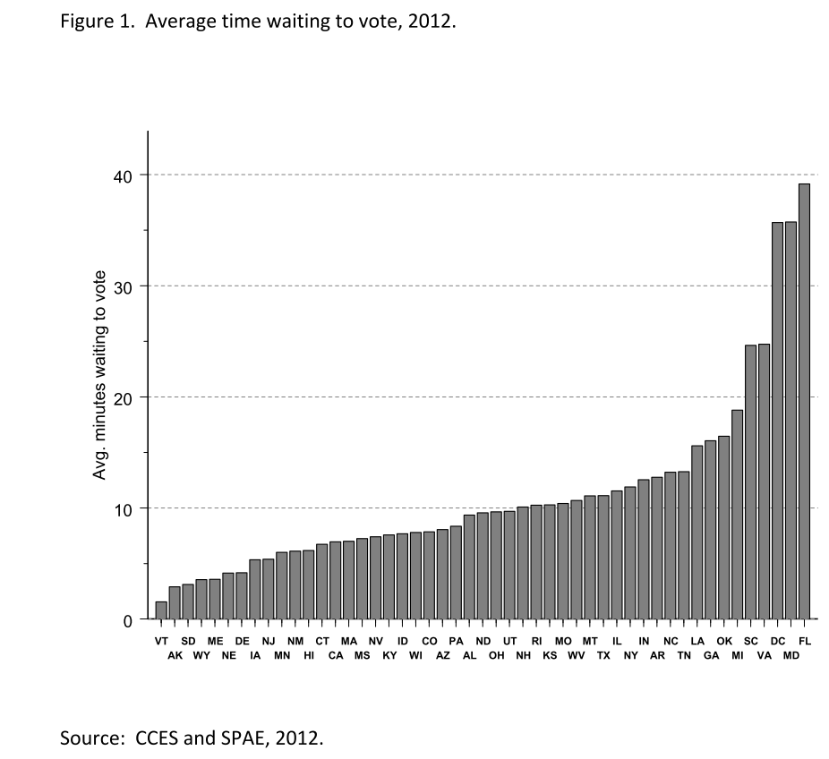
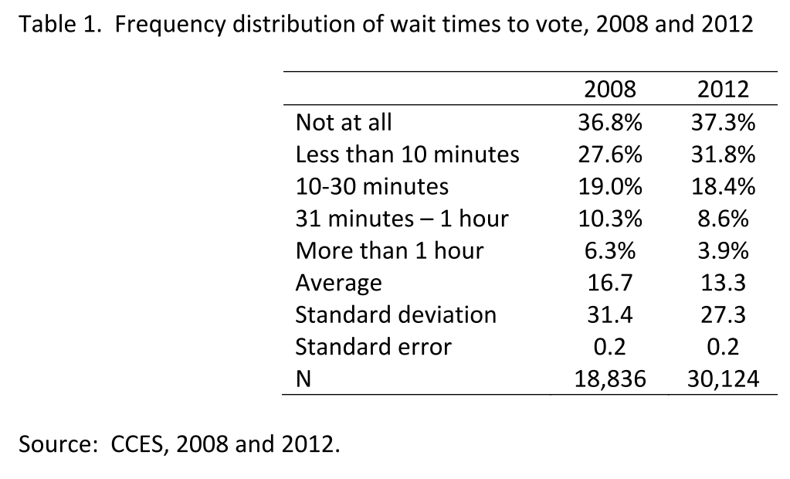
Waiting to Vote
Although most voters do not wait in long lines, several million voters waited for more than two hours in 2012.
Source: Charles Stewart, Waiting to Vote in 2012

Slide 9
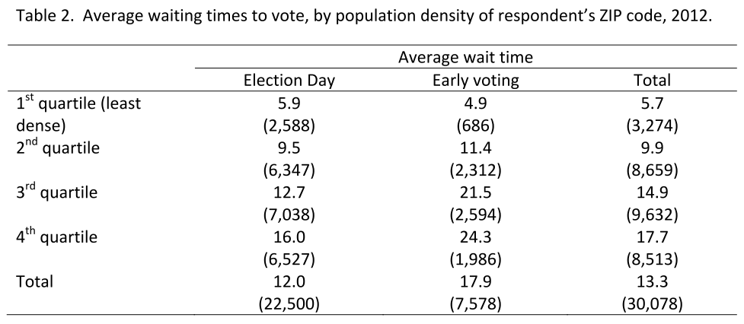
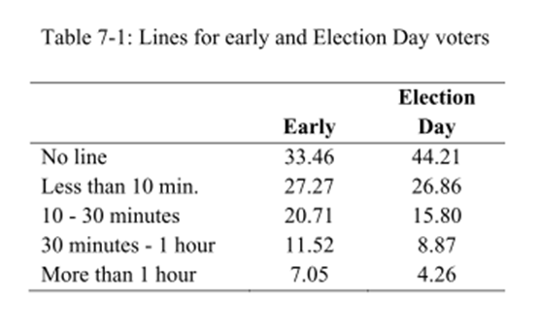
Who waits longer to vote?
Early voters
Urbanites
Racial minorities
People who live in jurisdictions that had wait times four years earlier
Source: Stewart (2013)

Slide 10
Potential Causes for Long Waits
Large numbers of people arriving to vote at the same time.
Too few points of service
Length of time it takes to vote

Slide 11
Factors that Can Influence Wait Times
1. Large numbers of people arriving to vote at the same time
Length of voting period
Length and schedule for voting on election day(s)
Alternative ways to vote
2. Too few points of service
Polling places
Pollworkers
Pollbooks
Voting machines/ballots
3. Length of time it takes to vote
Time it takes to check someone in, confirm registration status, print/distribute a ballot, vote the ballot, and confirm vote.
Complexity, usability and length of ballot
Inaccuracies and lack of usability of poll books and registration lists
Voter or pollworker confusion

Slide 12
At what stage in the voting process do people wait

Slide 13
Poll workers and Polling Places
878,000 poll workers (in 43 reporting states) and 132,000 polling places; roughly seven per polling place (EAVS 2008)
Training:
Requirement vary considerably by jurisdictions 18 states leave poll-worker training entirely to local jurisdictions, 22 develop training materials for every jurisdiction, and 10 have training programs that combine state-mandated curriculums with local training programs. (Pew (2007)
Recruitment:
Harder in large counties than in smaller (NaCo 2006)
Source of recruitment varies by jurisdiction size with political parties more likely to recruit as jurisdiction gets smaller. (NaCo 2006)
Roughly 45% of jurisdictions report difficulty in recruiting sufficient pollworkers (2010 EAVS)
Pay:
Varies considerably by jurisdiction: $85 to $225 for 12 to 16 hour days (Pew 2007)

Slide 14
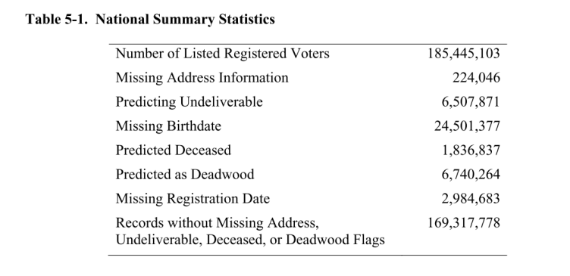
Pollbooks and Registration Lists
Ansolabehere and Hersh (2013) (2010 data)

Slide 15
Accurate lists as bedrock for polling place efficiency
Usability and accuracy of registration lists/poll books feed into polling place management:
Longer waits as pollworkers struggle to match names
More provisional ballots if names do not match lists
Greater likelihood of late or unmailed absentee ballots if addresses are inaccurate

Slide 16
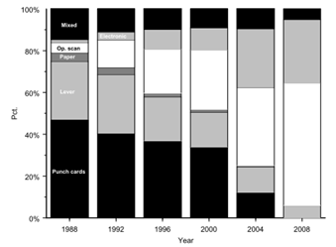
Shifts in Voting Technology (EDS)
Mixed blessing: Shift to electronic voting lowers residual votes but also, all else equal, is associated with longer wait times. (Stewart 2013)

Slide 17
Ballot Usability: length and complexity
Reductions in lost votes due to technological improvement offset somewhat due to design problems
Ballot length – average general election ballots have 14 contests plus referenda
Typical ballots have between 11 and 90 contests including referenda
Most items on the ballot are local (about 70% of the contests) (NIST 2006)
Referenda word count and reading level – on average, each referendum is 100-150 words long, written without regard to reading level (NIST 2006)
Rejections due to usability: Over 400,000 absentee and provisional ballots rejected from 2008 to 2010 due to voter errors. (Brennan Center 2012)
NIST 2006

Slide 18
Ballot Usability: design issues
When there is / are | Voters
split contests across columns | overvote
responses on both sides of names | overvote
formatting is inconsistent or too consistent | undervoting
instructions are complicated or lacking | make mistakes
no instructions for for correcting ballots | lost votes
multiple contests on the same screen | undervote

Slide 19
Voter Education
Atkinson in Burden and Stewart (2013)

Slide 20
Provisional Ballots
Both a solution and a problem:
prevent outright disfranchisement
but high rates of casting and rejection may signify something awry in the electoral system.
2,100,000 provisionals in 2008; 62% were counted (1.7% of all votes counted). (EAC 2008)
Four states account for 2/3 of provisional ballots: Arizona, California, New York and Ohio.
States use provisional ballots for different reasons: Higher rates (4x) of provisional voting and acceptance among states that had provisional voting pre-HAVA and (3x) that give provisionals to voters who requested an absentee ballot

Slide 21
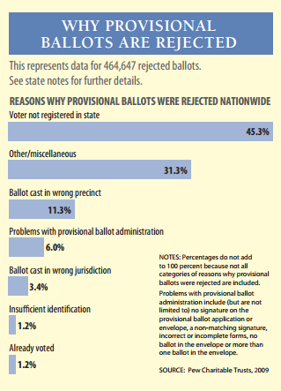
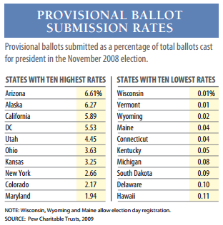
Provisional Ballots

Slide 22
To improve the experience of voters facing other obstacles in casting their ballots:
Members of the military
Overseas voters
Absentee ballots
Voters with disabilities
Voters with limited English proficiency
Victims of natural disasters or emergencies

Slide 23
Military Voting Problems
Difficulty registering at correct address
Twice as likely to experience registration problems as general population
77% registered (FVAP 2008) but often at wrong address
Difficulty receiving ballots on time
17% of registered active duty military said they requested an absentee ballot but did not receive it. (FVAP 2008)
Difficulty casting ballot (wildly different estimates)
FVAP (2008): 54% of military personnel cast ballots
13.7% of UOCAVA voters cast ballots.
Difficulty returning ballot on time
91% of the general population returned absentee ballots, but that percentage fell to 62% of military personnel (FVAP 2008, pre-MOVE Act)
Difficulty in getting ballots counted
6% of UOCAVA votes not counted (compared to 2% of domestic absentee ballots).

Slide 24
Reasons for UOCAVA Ballot Rejection – Before and After MOVE Act

Slide 25
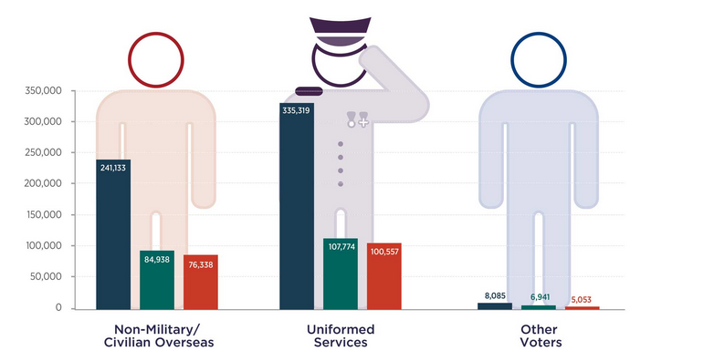
UOCAVA Ballots Transmitted, Submitted, Counted
Source: EAC (2010)

Slide 26
Remaining Obstacles for Military and Overseas Voters
Confusion among election officials post-MOVE as to whether voters must re-register for each election.
Installation Voting Assistance Offices (IVAOs) – Inspector General unable to contact half of them.
States inconsistent as to whether Federal Write-in Absentee Ballot (FWAB) constitutes registration application as well, and whether it counts for state as well as federal elections.
Low awareness of existence of FWAB – (roughly 40% of UOCAVA voters unaware)
81% of overseas voters still use post as way of transmitting vote. (OVF 2012)

Slide 27
Losing Votes By Mail: Domestic or Overseas

Slide 28
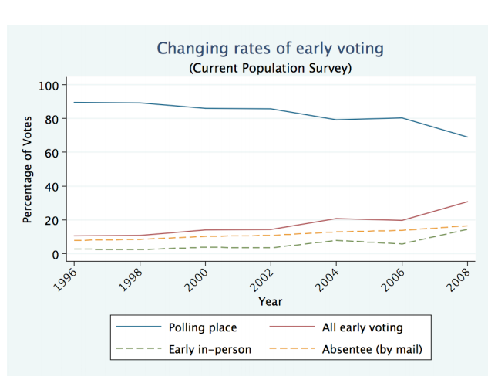
A Trend Away from Election-Day Polling Place Voting

Slide 29
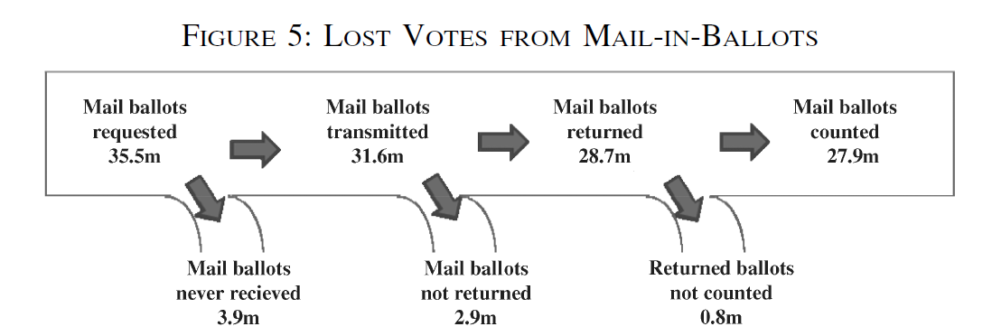
Absentee Ballot Problems
7.6 million lost absentee votes in 2008 (Stewart 2010)
Greater potential for design errors and voter mistakes – on application, ballot, and envelope.
Affects polling place lines and number of provisional ballots as those registered absentee show up on election day.
Source: Stewart (2013)

Slide 30
Absentee voting more popular among voters with disabilities
Asked of all respondents (voters and non-voters)(Schur 2013)
If you wanted to vote in the next Disability No disability
election, how would you prefer
to cast your vote?
In person at polling place 58% 68%
By mail 25% 14%
On the Internet 10% 16%
By telephone 5% 2%
Don’t know 2% 1%
=> People with disabilities are less likely to prefer voting at polling place, but still a majority want to do so.

Slide 31
Low Voter Turnout Among Disabled
Disability turnout gap of 4-21 percentage points in 12 surveys over 1992-2010 – 3 million disabled nonvoters in 2008
Lower turnout is only partly explained by standard voting predictors: resources (education and income), recruitment, and feelings of political efficacy
Barriers to voting by disabled (2008):
73.7% of polling places had some barrier to accessibility for voters with disabilities in 2008 (mostly outside or at the building entrance)
50% of polling places had one or more potential impediments in the path from parking area to building entrance
Source: Schur (2013)

Slide 32
Reported difficulties among those voting at polling place in 2012
Disability No disability
Finding or getting to polling place 6% 2%
Getting inside polling place (e.g., steps) 4% 0%
Waiting in line 8% 4%
Reading or seeing ballot 12% 1%
Understanding how to vote or use voting eqt. 10% 1%
Communicating with election officials 2% 1%
Writing on the ballot 5% 0%
Operating the voting machine 1% 1%
Other type of difficulty 4% 1%
Any of above 30% 8%
Source: Schur et al 2013

Slide 33
Limited English Proficiency (LEP) Voters
Of those who do not register to vote, between 1.4% and 1.7% cite difficulties with English as the reason. (CPS)
Areas with high levels of LEP voters report higher rates of provisional balloting.
On average, officials in jurisdictions with high shares of language minorities estimated that 5.5% of the voters needed assistance, but in reality the number was 10.9%. (Tucker 2005)
14% of covered jurisdictions (under the VRA) provided voters neither oral nor written assistance. (Tucker 2005)

Slide 34
Strategy for Further Research
Four hearings around the country to gather input from the public, with particular need concerning areas about which little research exists (e.g., natural disasters and voting).
Outreach at meetings of election officials (IACREOT, NASS, NASED, Election Center).
Meetings with interest groups, stakeholders and experts in respective areas of executive order.
Mine new survey data set to be released this summer (e.g., EAC surveys)
Seek out and analyze additional datasets from states and localities.
Gathering of public input through Commission website: www.supportthevoter.gov

