Slide 1
The Future?
Many-to-Many
or
How We Learned to Stop Worrying,
and Love Human Restlessness
Edward Perez, Product Manager
Hart InterCivic, Austin, Texas

Slide 2
1. the approach
focus on the human needs
Notes:
Those of you who saw Hart’s presentation at NIST in February know how we are trying to focus on human-centered design in our new voting system.
This is the same thing we see the PCEA doing…whether it’s long lines, voter services, etc., etc…so we applaud that.
These are the same kinds of things we are trying to do with our new election system.

Slide 3
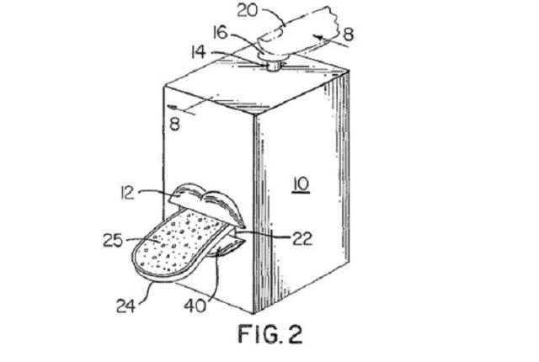
Notes:
Human inventions vary greatly in their utility…some are a little stranger than others.

Slide 4
human-centered design
focus on human needs
usability, adaptability, transparency
assume that humans
will be fickle and creative
and try to get ready for that
Notes:
Even if we don’t know what’s next, we still believe in human-centered design…
And the challenge is that humans are constantly changing, and constantly creating.

Slide 5
2. the solutions
many-to-many
Notes:
Stay focused on the human needs
Stay flexible about how they evolve
Get right with what you’re hearing from the users…
And what we are hearing is a desire for more inputs, more access…like going from the brick-and-mortar of retail stores to the restless, dynamic world wide web…

Slide 6
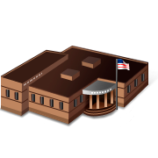
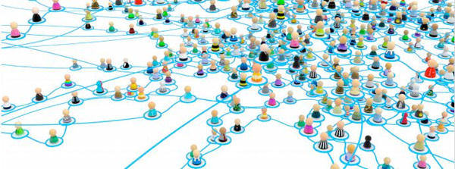
Notes:
In the next section, I want to paint a picture for you…going from a point-to-point, static understanding of what it means to “go vote”….versus a many-to-many model.

Slide 7
The next logical step in the technological revolution connecting people anytime, anywhere is to connect inanimate objects.
This is the vision underlying the Internet of things: anytime, anywhere, by anyone and anything.
- International Telecommunication Union, Geneva, 2005
Notes:
Today, there is this notion of an internet of things…the devices that are connected are not simply computers, but phones, other devices, smart buildings, and so on…

Slide 8
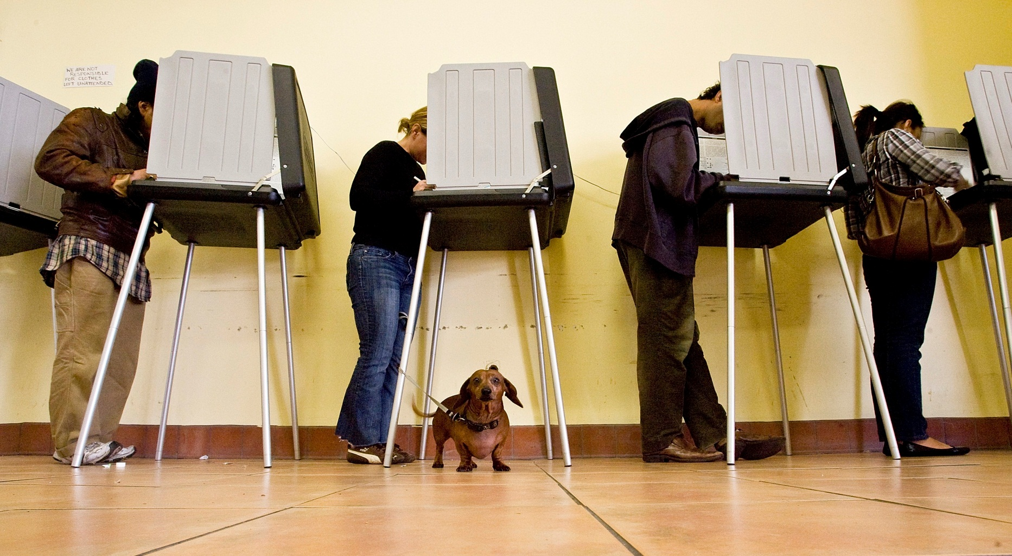
Notes:
Today, much of the way we think about voting looks like this…

Slide 9
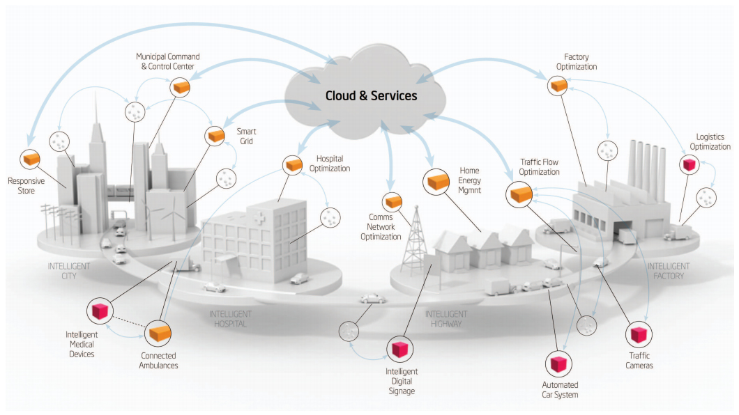
Notes:
But the fact is that more and more,
the way people think about public services, and voting in particular, looks like this…

Slide 10
many-to-many
more participation, more devices, more modalities
Notes:
This is what we see people clamoring for.
All too often in our industry, the discussion is on much smaller, narrow questions…paper vs. DRE; paper trail, or not; by-mail elections; Early Voting
The crowd sourced ideas are much, much bigger…
This is the face of restlessness and creativity.

Slide 11
Information Technology & Innovation Foundation
Home-based access
Use home computers to download & mark ballots
Online rating systems for polling places, like “Yelp”
Online voter education profiles for receipt of VEO materials in different formats
Online polling place accessibility information
Ridesharing to facilitate carpools to voting locations
Barcodes to transfer voting choices
Drive-thru voting
iPad/Tablet voting
Smartphone apps, to enable mobile voting from anywhere in the world
Remote voting options
Portable election “kiosks” in care facilities (e.g., tablets)
Online interactive voters’ guides
Automated deadline reminders via phone, text or email (absentee ballots, Election Day voting)
Use familiar technology to vote (phones, ATMs, televisions)
Online wait times for polling places
Mobile voting vans
Online poll worker training
Notes:
Information Technology & Innovation Foundation

Slide 12
usability
adaptability
transparency
access
innovation
openness
Notes:
What all of these share – and what the PCEA, and many “Government 2.0” initiatives are driving at – is really just another way of stating the central human needs…they all speak to a desire for access, innovation, and openness

Slide 13
3. the challenges
catching up to the pace of change
Notes:
Now we need to get our standards, our laws, and our institutions in line with the possibilities

Slide 14
Getting the standards in line with innovation
Diversity of devices vs. flattening thrust of complex standards
Fewer configurations, or many?
Getting our laws in line with innovation
Laws can either support or restrict new methods of participation
Changing outdated/unusable ballot designs
Voter access (registration, convenience voting, etc.)
Allowing new kinds of technology
Right-sizing the technology
Competing values – access, security, usability, cost, etc.

Slide 15
Recommendations - Technology
Certify what’s necessary – no more, no less. Enlarge & clarify distinction between “election management“ vs. “voting system.”
Facilitate the use of cost-effective transferable technologies. Allow the incorporation of more commercial-off-the-shelf hardware, in a traceable, safe, cost-effective way, without requiring full re-certification.
Devise procedures for software modifications. Consider methods to safely and reliably enable incremental changes to be made to certified software applications (i.e. de minimis changes).
Leave design to the technologists. Aim for standards that do not over-prescribe specific solutions, which can increase cost and complexity; identify problems to be prevented, rather than specific implementations.
Notes:
At Hart, as much as we are trying to look ahead, the freedom to innovate is still hampered in some significant areas…
And everyone misses out when the standards & the laws are out of step with the pace of change…
If you are a vendor selling uncertified election technology, you are stopping short of all the learning that comes with having to commercialize a full voting system.
And if you are a vendor that is selling a certified voting system, you are likely living with the pains of long technology lifecycles and stifled innovation.

Slide 16
usability
adaptability
transparency
technology by the many,
for the many
access
innovation
openness

Slide 17
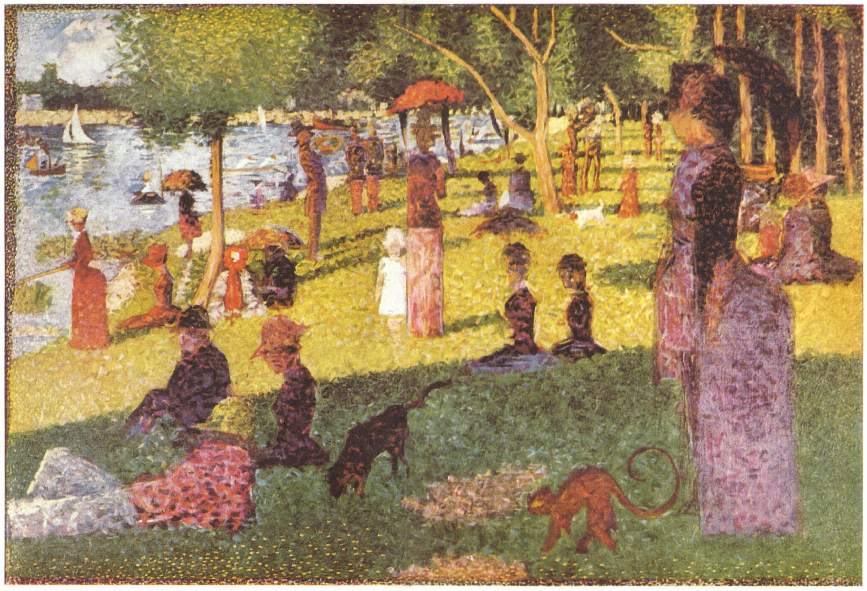
Notes:
Too often, we’re focusing on small, narrow things…when we really need is a full, rich picture of all the possibilities.

Slide 18
many is a beautiful thing

Slide 19
thank you
eperez@hartic.com

