Slide 1
Presentation by Kansas Secretary of State Kris W. Kobach
Presidential Commission on Election Administration
September 20, 2013

Slide 2
Photo ID and Electronic Poll Books
and
Interstate Voter Registration
Data Crosscheck

Slide 3
Interstate Voter Registration
Data Crosscheck

Slide 4
National Voter Registration Act of 1993
Section 2 Findings and Purposes
(b) Purposes
(1) to establish procedures that will increase the number of eligible citizens who register to vote in elections for Federal office;
(2) to make it possible for Federal, State, and local governments to implement this subchapter in a manner that enhances the participation of eligible citizens as voters in elections for Federal office;
(3) to protect the integrity of the electoral process; and
(4) to ensure that accurate and current voter registration rolls are maintained.

Slide 5
From the Federal Election Commission’s guide: Implementing the National Voter Registration Act of 1993:
The features (of the National Voter Registration Act) include a requirement that states “conduct a general program” the purpose of which is “to protect the integrity of the electoral process by ensuring the maintenance of an accurate and current voter registration roll for elections for Federal office”

Slide 6
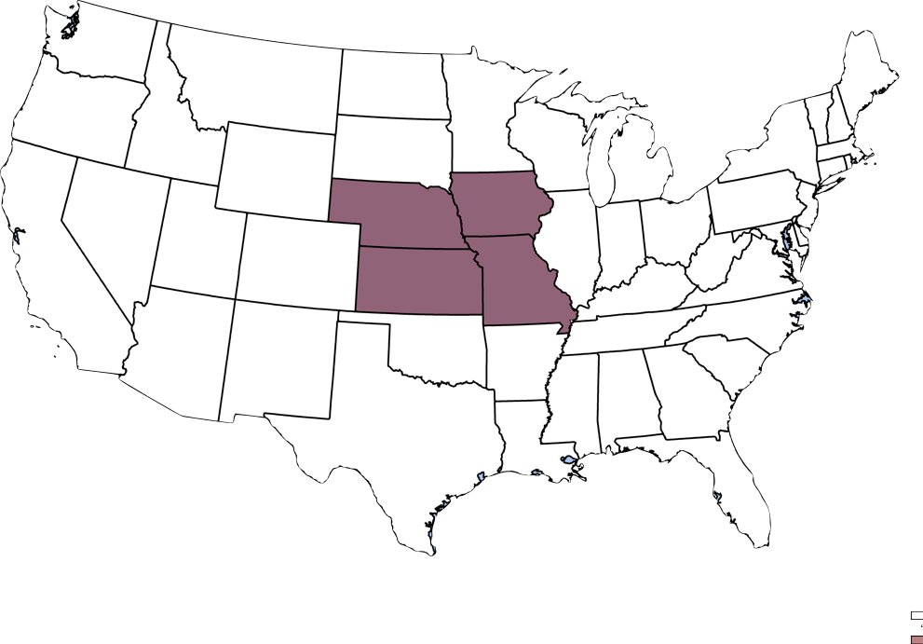
2006 Interstate Crosscheck

Slide 7
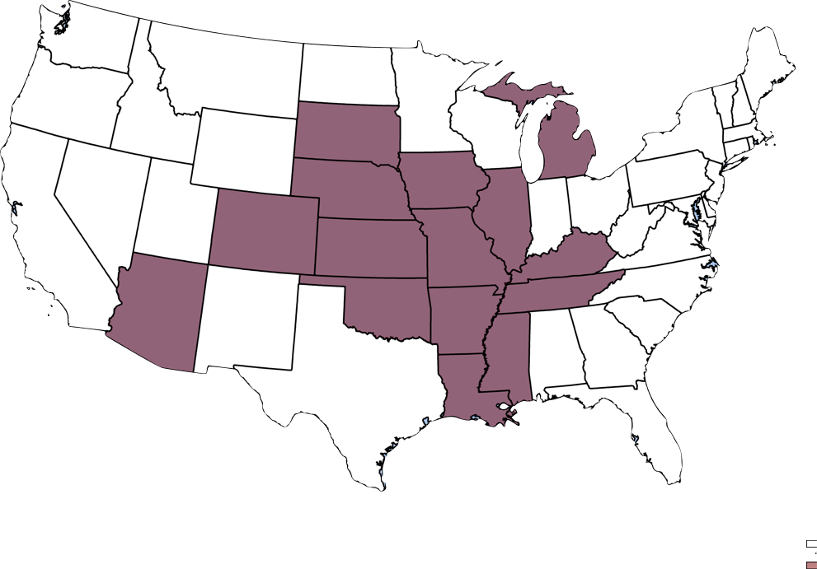
2012 Interstate Crosscheck

Slide 8
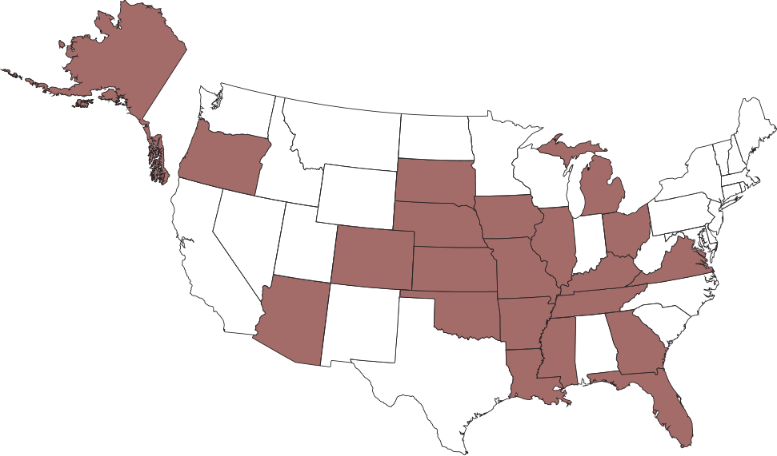
2013 Interstate Crosscheck

Slide 9
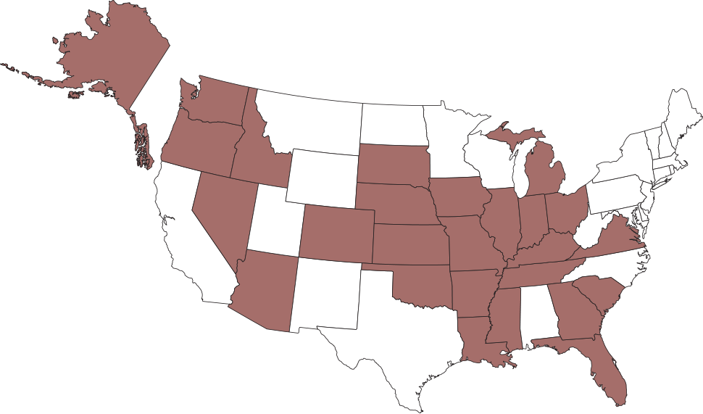
2014 Interstate Crosscheck

Slide 10
2013 Crosscheck Program—Number of Records Compared
Alaska | 513,126 | Michigan | 7,450,820
Arizona | 3,713,607 | Mississippi | 2,077,096
Arkansas | 1,638,069 | Missouri | 4,119,984
Colorado | 3,629,559 | Nebraska | 1,167,533
Florida | 10,466,039 | Ohio | 8,011,975
Georgia | 6,117,582 | Oklahoma | 2,116,364
Illinois | 8,574,144 | Oregon | 2,636,511
Iowa | 2,122,030 | South Carolina | 3,106,420
Kansas | 1,753,183 | South Dakota | 583,495
Kentucky | 3,136,712 | Tennessee | 3,590,439
Louisiana | 2,918,581 | Virginia | 5,434,434
Total Records: 84,877,703

Slide 11
Interstate Crosscheck Data Format
Field | Format | Example
Status | A=Active; I=Inactive | A
Date_Generated | YYYY/MM/DD | 2010/01/01
First_Name |  | Bob
Middle_Name |  | Alan
Last_Name |  | Jones
Suffix Name |  | Jr
Date_of_Birth | YYYY/MM/DD | 1940/06/16
Voter_ID_Number |  | 123456
Last_4_SSN |  | 7890
Mailing Address | Line 1 Line 2 City State Zip | 123 Anywhere St...
County |  | Allen
Date_of_Registration | YYYY/MM/DD | 1970/01/01
Voted_in_2010 | Y=did vote; N=did not vote | Y
Interstate Crosscheck Data Format
Fields
Status (“A” – Active, “I” – Inactive)
Date_Generated
First_Name
Middle_Name
Last_Name
Suffix_Name
Date_of_Birth (YYYY/MM/DD Example: “2010/01/01”)
Voter_ID_Number
Last four social security number
Mailing Address (if no mailing address, provide residential address)
Address line 1 Address line 2 City State Zip
County
Date_of_Registration (YYYY/MM/DD Example: “1970/01/01”)
Voted_in_2010 (“Y” – they did vote, or “N” – they did not vote, or “” – data not available)
Comma delimited ASCII file with double quote text qualifiers and {CR} {LF} row delimiters.
Example: “A”, “2010/01/01 12:00:00 AM” , “Bob” , “Alan”, “Jones” , “” , “1940/06/16” , “123456” , “7890” , “123 Anywhere St” , “Apt 201” , “Anytown” , “KS”, “12345” , “County”, “1958/06/17” , “Y”
The file is encrypted and password protected and uploaded to the secure FTP site.

Slide 12
How does it work?
Each state pulls data on January 15 each year using prescribed data format
Upload data to secure FTP site (hosted by Arkansas)
Kansas IT department pulls data, runs comparison, uploads results to FTP site
Each state downloads results from FTP site, processes them according to state laws & regulations
Kansas deletes all other states’ data

Slide 13
First: John
Middle: Q.
Last: Public
DOB: 01/01/1975
SSN: 1234
State: Kansas
First: John
Middle:
Last: Public
DOB: 01/01/1975
SSN: 1234
State: Colorado
Potential match

Slide 14
2013 |  | Grid of Potential Duplicate Registrants Within States by DOB LastName FirstName
 |  | Number of rows | Invalid or Null Dates of Birth | Duplicate Voter IDs | Voters with more than 1 row | ALASKA | ARIZONA | ARKANSAS | COLORADO | FLORIDA | GEORGIA | ILLINOIS | IOWA | KANSAS | KENTUCKY | LOUISIANA | MICHIGAN | MISSISSIPPI | MISSOURI | NEBRASKA | OHIO | OKLAHOMA | OREGON | SOUTH CAROLINA | SOUTH DAKOTA | TENNESSEE | VIRGINIA | COMPARED WITH OTHER 21
1 | ALASKA | 513,126 | 607 |  | 37 |  | 3608 | 701 | 4,550 | 2,849 | 2,821 | 1,796 | 707 | 701 | 1,187 | 752 | 2,372 | 632 | 1,443 | 441 | 1,879 | 943 | 3,667 | 1,192 | 393 | 1,060 | 1,863 | 35,557
2 | ARIZONA | 3,713,607 | 0 | 0 | 3,925 | 3,608 |  | 3,949 | 33,374 | 16,947 | 12,674 | 22,106 | 7,317 | 4,710 | 6,801 | 2,561 | 33,117 | 2,941 | 9,817 | 4,522 | 19,314 | 5,742 | 18,253 | 5,561 | 3,407 | 4,906 | 12,933 | 234,560
3 | ARKANSAS | 1,638,069 | 20 | 0 | 2,077 | 701 | 3,949 |  | 5,645 | 7,991 | 8,174 | 8,090 | 2,458 | 3,282 | 4,193 | 6,889 | 5,800 | 7,656 | 13,281 | 1,223 | 5,391 | 10,264 | 1,983 | 3,353 | 585 | 7,276 | 4,298 | 112,482
4 | COLORADO | 3,629,559 | 0 | 0 | 2,109 | 4,550 | 33,374 | 5,645 |  | 26,177 | 18,342 | 24,314 | 10,473 | 12,040 | 7,401 | 5,451 | 18,970 | 3,940 | 14,884 | 10,699 | 18,083 | 10,824 | 16,503 | 7,862 | 5,136 | 7,362 | 17,792 | 279,822
5 | FLORIDA | 10,466,039 | 0 | 0 | 7,832 | 2,849 | 16,947 | 7,991 | 26,177 |  | 107,892 | 50,792 | 7,009 | 6,674 | 27,347 | 12,319 | 44,412 | 12,394 | 18,866 | 3,631 | 53,503 | 7,425 | 8,065 | 34,944 | 2,098 | 25,940 | 50,422 | 527,697
6 | GEORGIA | 6,117,582 | 175 | 0 | 6,828 | 2,821 | 12,674 | 8,174 | 18,342 | 107,892 |  | 34,920 | 5,269 | 5,983 | 22,583 | 21,778 | 32,548 | 19,639 | 15,782 | 2,940 | 36,484 | 6,917 | 6,335 | 62,479 | 1,313 | 40,578 | 45,305 | 510,756
7 | ILLINOIS | 8,574,144 | 158,294 | 30 | 86,495 | 1,796 | 22,106 | 8,090 | 24,314 | 50,792 | 34,920 |  | 32,676 | 6,688 | 18,791 | 5,833 | 53,106 | 12,268 | 45,387 | 4,514 | 39,111 | 5,711 | 8,886 | 12,299 | 1,746 | 13,769 | 21,077 | 423,880
8 | IOWA | 2,122,030 | 10 | 0 | 596 | 707 | 7,317 | 2,458 | 10,473 | 7,009 | 5,269 | 32,676 |  | 4,318 | 3,079 | 1,374 | 6,784 | 1,777 | 11,113 | 11,519 | 5,966 | 2,211 | 2,879 | 2,474 | 5,234 | 2,702 | 4,011 | 131,350
9 | KANSAS | 1,753,183 | 10 | 0 | 1,115 | 701 | 4,710 | 3,282 | 12,040 | 6,674 | 5,983 | 6,688 | 4,318 |  | 2,768 | 1,427 | 4,522 | 1,459 | 33,646 | 4,915 | 5,211 | 8,660 | 2,615 | 2,509 | 1,104 | 2,415 | 4,363 | 120,010
10 | KENTUCKY | 3,136,712 | 37 | 0 | 3,300 | 1,187 | 6,801 | 4,193 | 7,401 | 27,347 | 22,583 | 18,791 | 3,079 | 2,768 |  | 4,704 | 17,663 | 5,463 | 9,140 | 1,286 | 56,995 | 3,444 | 3,282 | 9,858 | 691 | 22,311 | 14,174 | 243,161
11 | LOUISIANA | 2,918,581 | 0 | 58,027 | 1,016 | 752 | 2,561 | 6,889 | 5,451 | 12,319 | 21,778 | 5,833 | 1,374 | 1,427 | 4,704 |  | 5,902 | 18,927 | 5,275 | 906 | 6,966 | 3,152 | 2,475 | 5,023 | 330 | 4,654 | 7,967 | 124,665
12 | MICHIGAN | 7,450,820 | 6 | 83 | 63,024 | 2,372 | 33,117 | 5,800 | 18,970 | 44,412 | 32,548 | 53,106 | 6,784 | 4,522 | 17,663 | 5,902 |  | 8,260 | 12,772 | 2,705 | 54,200 | 4,734 | 7,722 | 13,985 | 1,518 | 18,306 | 18,201 | 367,599
13 | MISSISSIPPI | 2,077,096 | 214 | 0 | 11,482 | 632 | 2,941 | 7,656 | 3,940 | 12,394 | 19,639 | 12,268 | 1,777 | 1,459 | 5,463 | 18,927 | 8,260 |  | 5,920 | 936 | 6,951 | 2,861 | 1,522 | 5,143 | 369 | 17,588 | 6,530 | 143,176
14 | MISSOURI | 4,119,984 | 7 | 0 | 4,694 | 1,443 | 9,817 | 13,281 | 14,884 | 18,866 | 15,782 | 45,387 | 11,113 | 33,646 | 9,140 | 5,275 | 12,772 | 5,920 |  | 5,248 | 14,245 | 9,391 | 5,246 | 6,150 | 1,538 | 8,100 | 10,701 | 257,945
15 | NEBRASKA | 1,167,533 | 2 | 0 | 351 | 441 | 4,522 | 1,223 | 10,699 | 3,631 | 2,940 | 4,514 | 11,519 | 4,915 | 1,286 | 906 | 2,705 | 936 | 5,248 |  | 2,747 | 1,474 | 1,792 | 1,276 | 3,397 | 1,265 | 2,429 | 69,865
16 | OHIO | 8,011,975 | 0 | 0 | 17,833 | 1,879 | 19,314 | 5,391 | 18,083 | 53,503 | 36,484 | 39,111 | 5,966 | 5,211 | 56,995 | 6,966 | 54,200 | 6,951 | 14,245 | 2,747 |  | 5,527 | 7,457 | 21,859 | 1,548 | 17,912 | 27,035 | 408,384
17 | OKLAHOMA | 2,116,364 | 15,094 | 0 | 6,389 | 943 | 5,742 | 10,264 | 10,824 | 7,425 | 6,917 | 5,711 | 2,211 | 8,660 | 3,444 | 3,152 | 4,734 | 2,861 | 9,391 | 1,474 | 5,527 |  | 2,784 | 3,065 | 584 | 3,624 | 4,554 | 103,891
18 | OREGON | 2,636,511 | 860 | 35 | 655 | 3,667 | 18,253 | 1,983 | 16,503 | 8,065 | 6,335 | 8,886 | 2,879 | 2,615 | 3,282 | 2,475 | 7,722 | 1,522 | 5,246 | 1,792 | 7,457 | 2,784 |  | 2,958 | 1,201 | 3,199 | 6,741 | 115,565
19 | SOUTH CAROLINA | 3,106,420 | 0 | 348 | 33,018 | 1,192 | 5,561 | 3,353 | 7,862 | 34,944 | 62,479 | 12,299 | 2,474 | 2,509 | 9,858 | 5,023 | 13,985 | 5,143 | 6,150 | 1,276 | 21,859 | 3,065 | 2,958 |  | 758 | 12,972 | 30,001 | 245,721
20 | SOUTH DAKOTA | 583,495 | 19,467 | 2 | 5,403 | 393 | 3,407 | 585 | 5,136 | 2,098 | 1,313 | 1,746 | 5,234 | 1,104 | 691 | 330 | 1,518 | 369 | 1,538 | 3,397 | 1,548 | 584 | 1,201 | 758 |  | 735 | 1,135 | 34,820
21 | TENNESSEE | 3,590,439 | 580 | 365,724 | 6,755 | 1,060 | 4,906 | 7,276 | 7,362 | 25,940 | 40,578 | 13,769 | 2,702 | 2,415 | 22,311 | 4,654 | 18,306 | 17,588 | 8,100 | 1,265 | 17,912 | 3,624 | 3,199 | 12,972 | 735 |  | 17,047 | 233,721
22 | VIRGINIA | 5,434,434 | 0 | 126 | 5,830 | 1,863 | 12,933 | 4,298 | 17,792 | 50,422 | 45,305 | 21,077 | 4,011 | 4,363 | 14,174 | 7,967 | 18,201 | 6,530 | 10,701 | 2,429 | 27,035 | 4,554 | 6,741 | 30,001 | 1,135 | 17,047 |  | 308,579
 |  | 84,877,703 |  |  |  | 35,557 | 234,560 | 112,482 | 279,822 | 527,697 | 510,756 | 423,880 | 131,350 | 120,010 | 243,161 | 124,665 | 367,599 | 143,176 | 257,945 | 69,865 | 408,384 | 103,891 | 115,565 | 245,721 | 34,820 | 233,721 | 308,579

Slide 15
2013 Crosscheck Program—Number of Potential Matches
Based on match of First Name, Last Name, DOB
Alaska | 35,557 | Michigan | 367,599
Arizona | 234,560 | Mississippi | 143,176
Arkansas | 112,482 | Missouri | 257,945
Colorado | 279,822 | Nebraska | 69,865
Florida | 527,697 | Ohio | 408,384
Georgia | 510,756 | Oklahoma | 103,891
Illinois | 423,880 | Oregon | 115,565
Iowa | 131,350 | South Carolina | 245,721
Kansas | 120,010 | South Dakota | 34,820
Kentucky | 243,161 | Tennessee | 233,721
Louisiana | 124,665 | Virginia | 308,579
Total Potential Matches: 5,033,206
These totals count the matching records in both states.

Slide 16
Success in Kansas
Double Votes from 2008 and 2010 Referred to Prosecution Discovered through Interstate Crosscheck Program
2008 | 2010
Kansas - Kentucky | Kansas – Arkansas (2)
Kansas - Colorado | Kansas – Colorado (5)
Kansas - Kansas | Kansas – Iowa
 | Kansas – Louisiana
 | Kansas – Nebraska
 | Kansas - Oklahoma

Slide 17
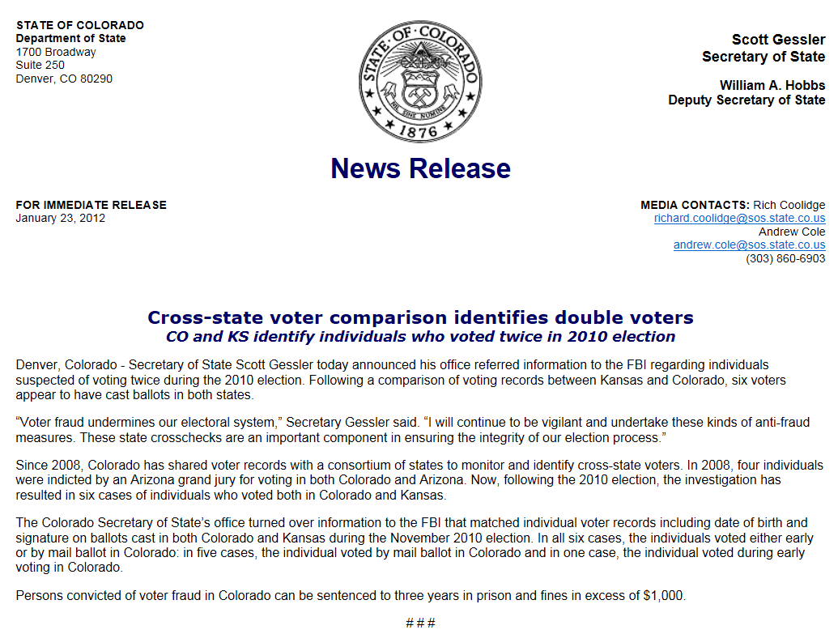
Success in other states - Colorado
Four individuals indicted for voting in Colorado and Arizona in first year of participation
Six additional cases of double voting referred to FBI in 2012

Slide 18
What does it cost to participate?
$0

Slide 19
How Can a State Join the Crosscheck?
Chief State Election Official signs the Memorandum of Understanding (MOU)
CSEO assigns two staff members: - one election administration person - one IT person
Staff members will: - participate in annual conference call and email - pull VR data in January - receive cross check results and process - instruct local elections officials (respond to requests for addresses, signatures on poll books, etc.)

Slide 20
Photo ID and
Electronic Poll Books

Slide 21
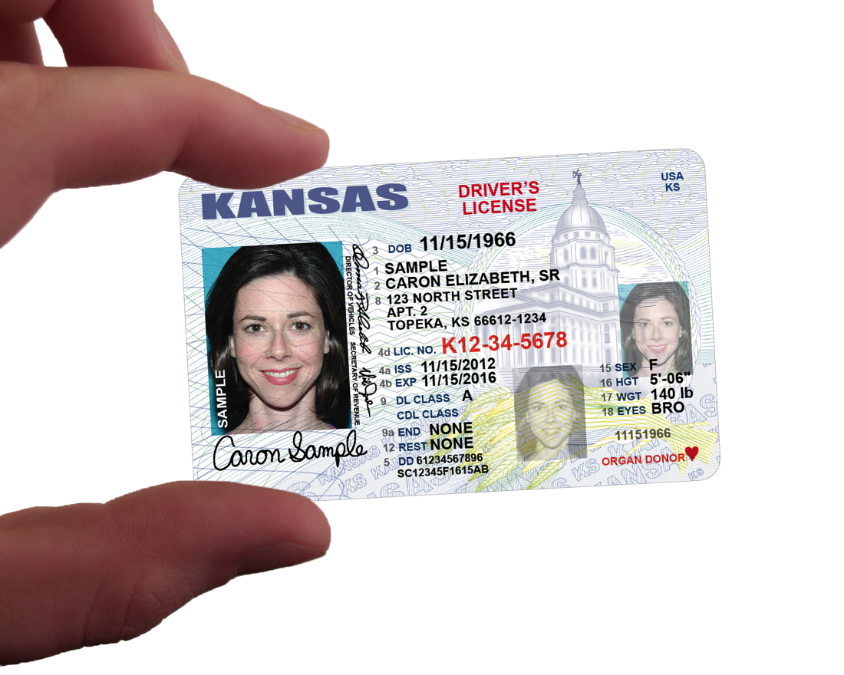

Slide 22
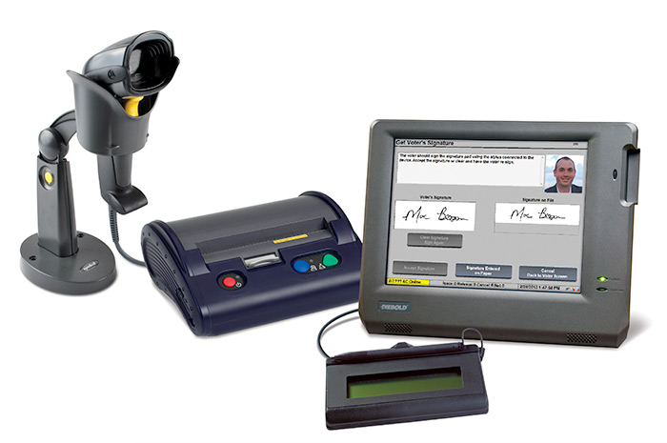

Slide 23
