Slide 1

MIT Licensing Office Statistics FY2021
54 staff (full-time employees)
Invested $24M in IP protection
(a reduction of $2M from FY2020)

Slide 2
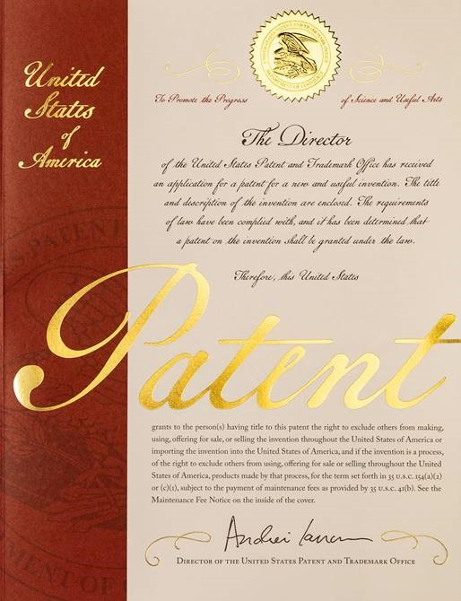
What is a Patent?
A grant by the government that allows you to exclude others from “making, using, selling, offering for sale, or importing” your invention for a period of 20 years.
The US is now a First Inventor to File country.

Slide 3
Types of US Granted Patent Rights
1. Utility patent
        Machine – robot, motor, circuit
        Process – method of manufacturing
        Article of Manufacture – frying pan, hair comb
        Composition of Matter – chemical compound
        Length of patent term is 20 years from the filing date
2. Design patent
        Ornamental design, appearance
        Length of patent term is 15 years from the date of grant
3. Plant patent
        New and distinct variety of plant that can be asexually reproduced (excluding tubers)
        Length of patent term is 20 years from the filing date

Slide 4
Provisional Application
Expires after 12 months from the filing date
Establishes an early filing date
The strength of the provisional application depends on the construction
Limited in its use

Slide 5
What’s Required to Obtain a Patent?
The invention must be:
1. Novel
      Cannot have been described in a printed publication, or in public use, on sale or otherwise available
2. Useful
      Solution to a problem
3. Not obvious
      Cannot have been obvious to one skilled in the art

Slide 6
Requirements for Patentability
Novelty
The disclosure rules:
For the U.S.
  There is a 1 year grace period after a public disclosure by an inventor in which to file a patent.
For the rest of the world
  Absolute novelty is required
  Must file before first public disclosure
  Oral disclosure counts!
* Note: grace period under the Paris convention, 1883: Once you have a US patent on file, it is okay to make public disclosures. The rest of the world gives us 12 months from the US filing date to file applications in other countries.

Slide 7
Requirements for Patentability (Cont.)
Usefulness
Usually not difficult to establish
Not Obvious
Subjective, often difficult to establish
Would one skilled in the field of the invention who has not seen the invention find it obvious?
Factors to consider:
  Commercial success attributable to inventive feature?
  Filling a long-felt need?
  Doing what others said could not be done or would not work?

Slide 8
Non-US Patents
Paris Convention
  Twelve-month grace period is given following the US patent filing
  (it assumes novelty of US)
Patent Cooperation Treaty (PCT)
  Covers most countries
  Buys time – delays expense
  Used to manage risk
National filings (expensive)
  Translations
  Annuities

Slide 9
Patenting Process @ MIT
Invention report (Technology Disclosure Form)
  Documents date of invention, provides no protection
Literature and patent search is performed
Patent application prepared and filed
Patent Office responds ("Office Action")
  It may take well over a year to receive first “office action” rejecting most, if not all, claims
Reply to Patent Office
  Usually results in additional “final office action” rejecting some of the claims
Patent allowed
Patent issued
  Typically 3 years after application was filed
Duration: 20 years from the date the non-provisional application was filed
Note: There is no "patent protection" until the patent issues.

Slide 10
Important Points
A patent permits the owner to prohibit someone from using the invention without a “license”
  License sets the terms under which the licensee can practice the patented invention including upfront fees, royalties on sales, application limitations, geography, duration, etc.
Having a patent doesn't necessarily allow the patent owner the right to use the invention
The use of any invention may infringe someone else's patent

Slide 11
Patent Example
Stool
A piece of furniture intended to be used by a person for sitting comprising
a horizontal platform supported by three or more vertically disposed rods which fix the platform at a height more than 12 inches and less than 30 inches above a horizontal surface parallel to the horizontal platform.
Chair
A piece of furniture intended to be used by a person for sitting comprising
a horizontal platform supported by three or more vertically disposed rods which fix the platform at a height more than 12 inches and less than 30 inches above a horizontal surface parallel to the horizontal platform, and
a vertical element attached to one side of the horizontal surface against which a seated person may place his/her back for comfort.

Slide 12
Enforcement
Infringement | Defenses
Unauthorized making, using, offer of sale, selling, or importing | That the entity does is not infringing, and/or invalidity of the patent
Patent owner may sue for: ✓ an injunction ✓ damages ($$$) ✓ ITC ban on imports | Common Defenses: ✓ Invalidity defense ✓ Citing prior art (relating to the claim) * among others

Slide 13
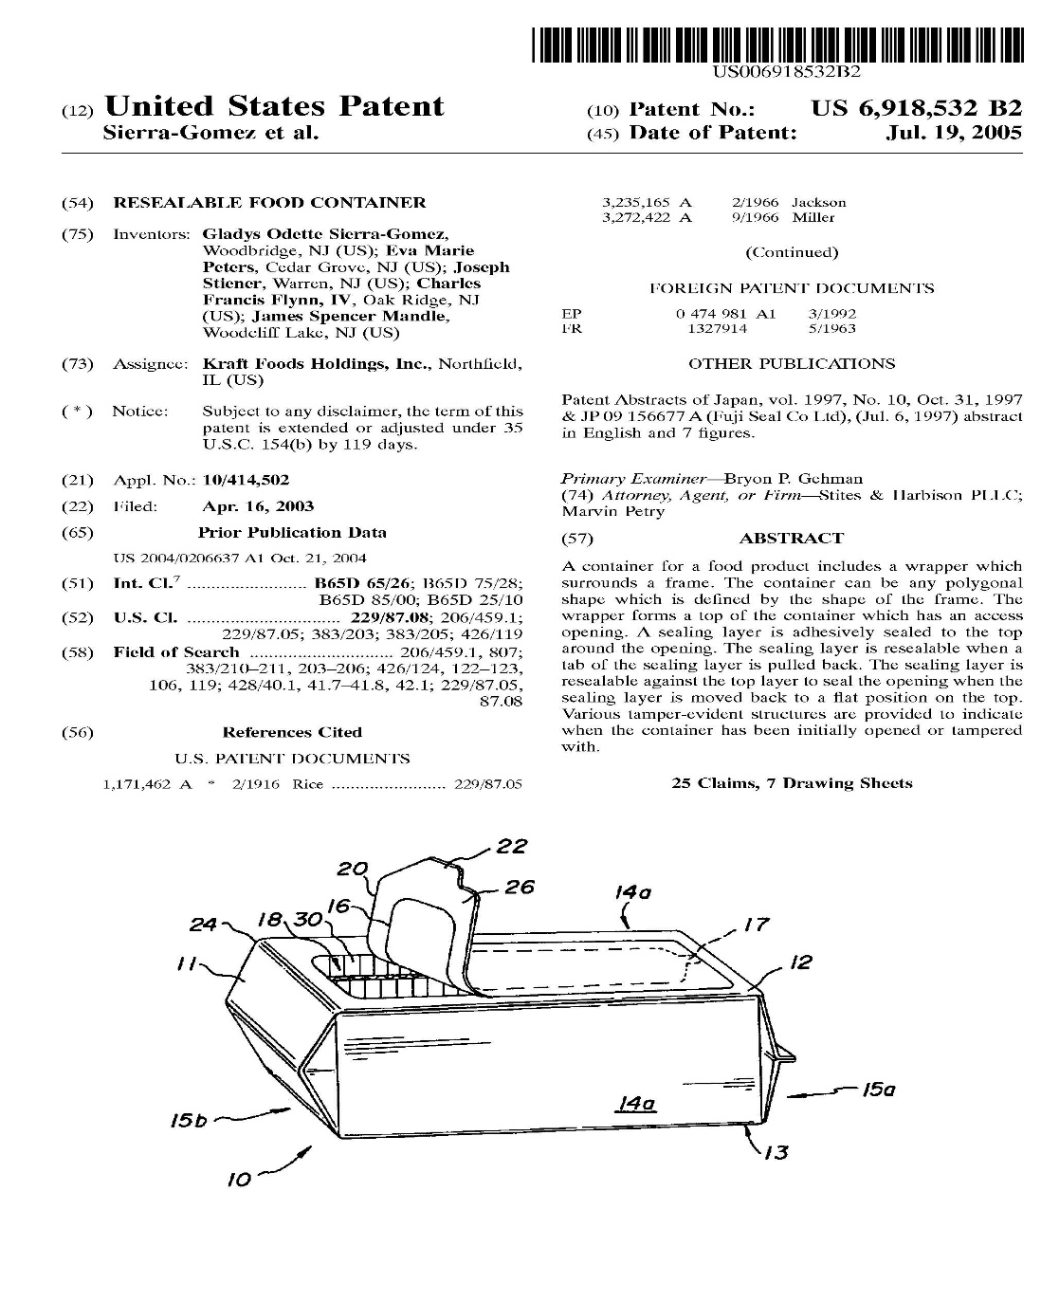
Kraft Snack ‘n Seal Patent
Kraft sued Kellogg for infringement
Kellogg counterclaimed the invalidity of the Kraft patent for obviousness
CAFC affirmed the invalidity for obviousness

Slide 14
Claim 1
A polygonal shaped food container comprising:
a frame defining the polygonal shape of the container,
said container having a top, a bottom and sides connecting the top and bottom,
the frame containing a food product comprised of discrete food articles;
a wrapper surrounding said frame,
said wrapper forming the top, sides and bottom of the container;
said top having an access opening sufficiently large to provide hand access to substantially all of the discrete food articles contained within the frame,
such that substantially any one of the discrete food articles can be accessed and removed individually through said access opening; and
a sealing layer, adhesively sealed to said top around said opening,
said sealing layer including a starter portion located near a side of the top which can be grasped by a user,
said sealing layer being releasable when said starter portion is pulled in a direction away from said side to in turn pull and thereby release at least a portion of said sealing layer to provide the hand access to said top access opening and
reclosable against said top to seal said opening when said sealing layer is moved back against the said top.

Slide 15
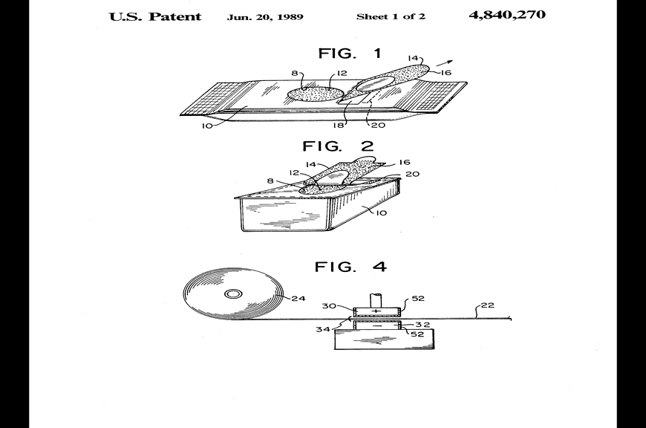
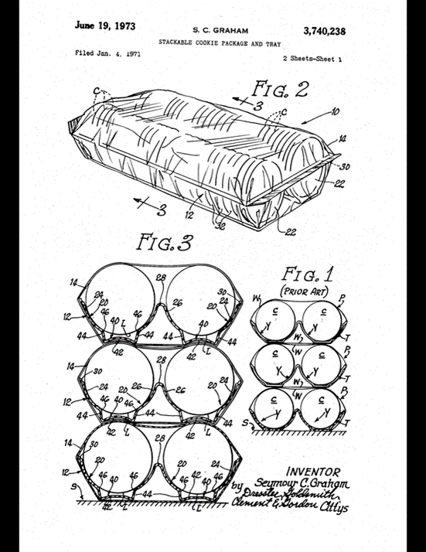
Prior Art
Resealable “Wet Wipe” Dispenser
Cookie Package and Tray

Slide 16
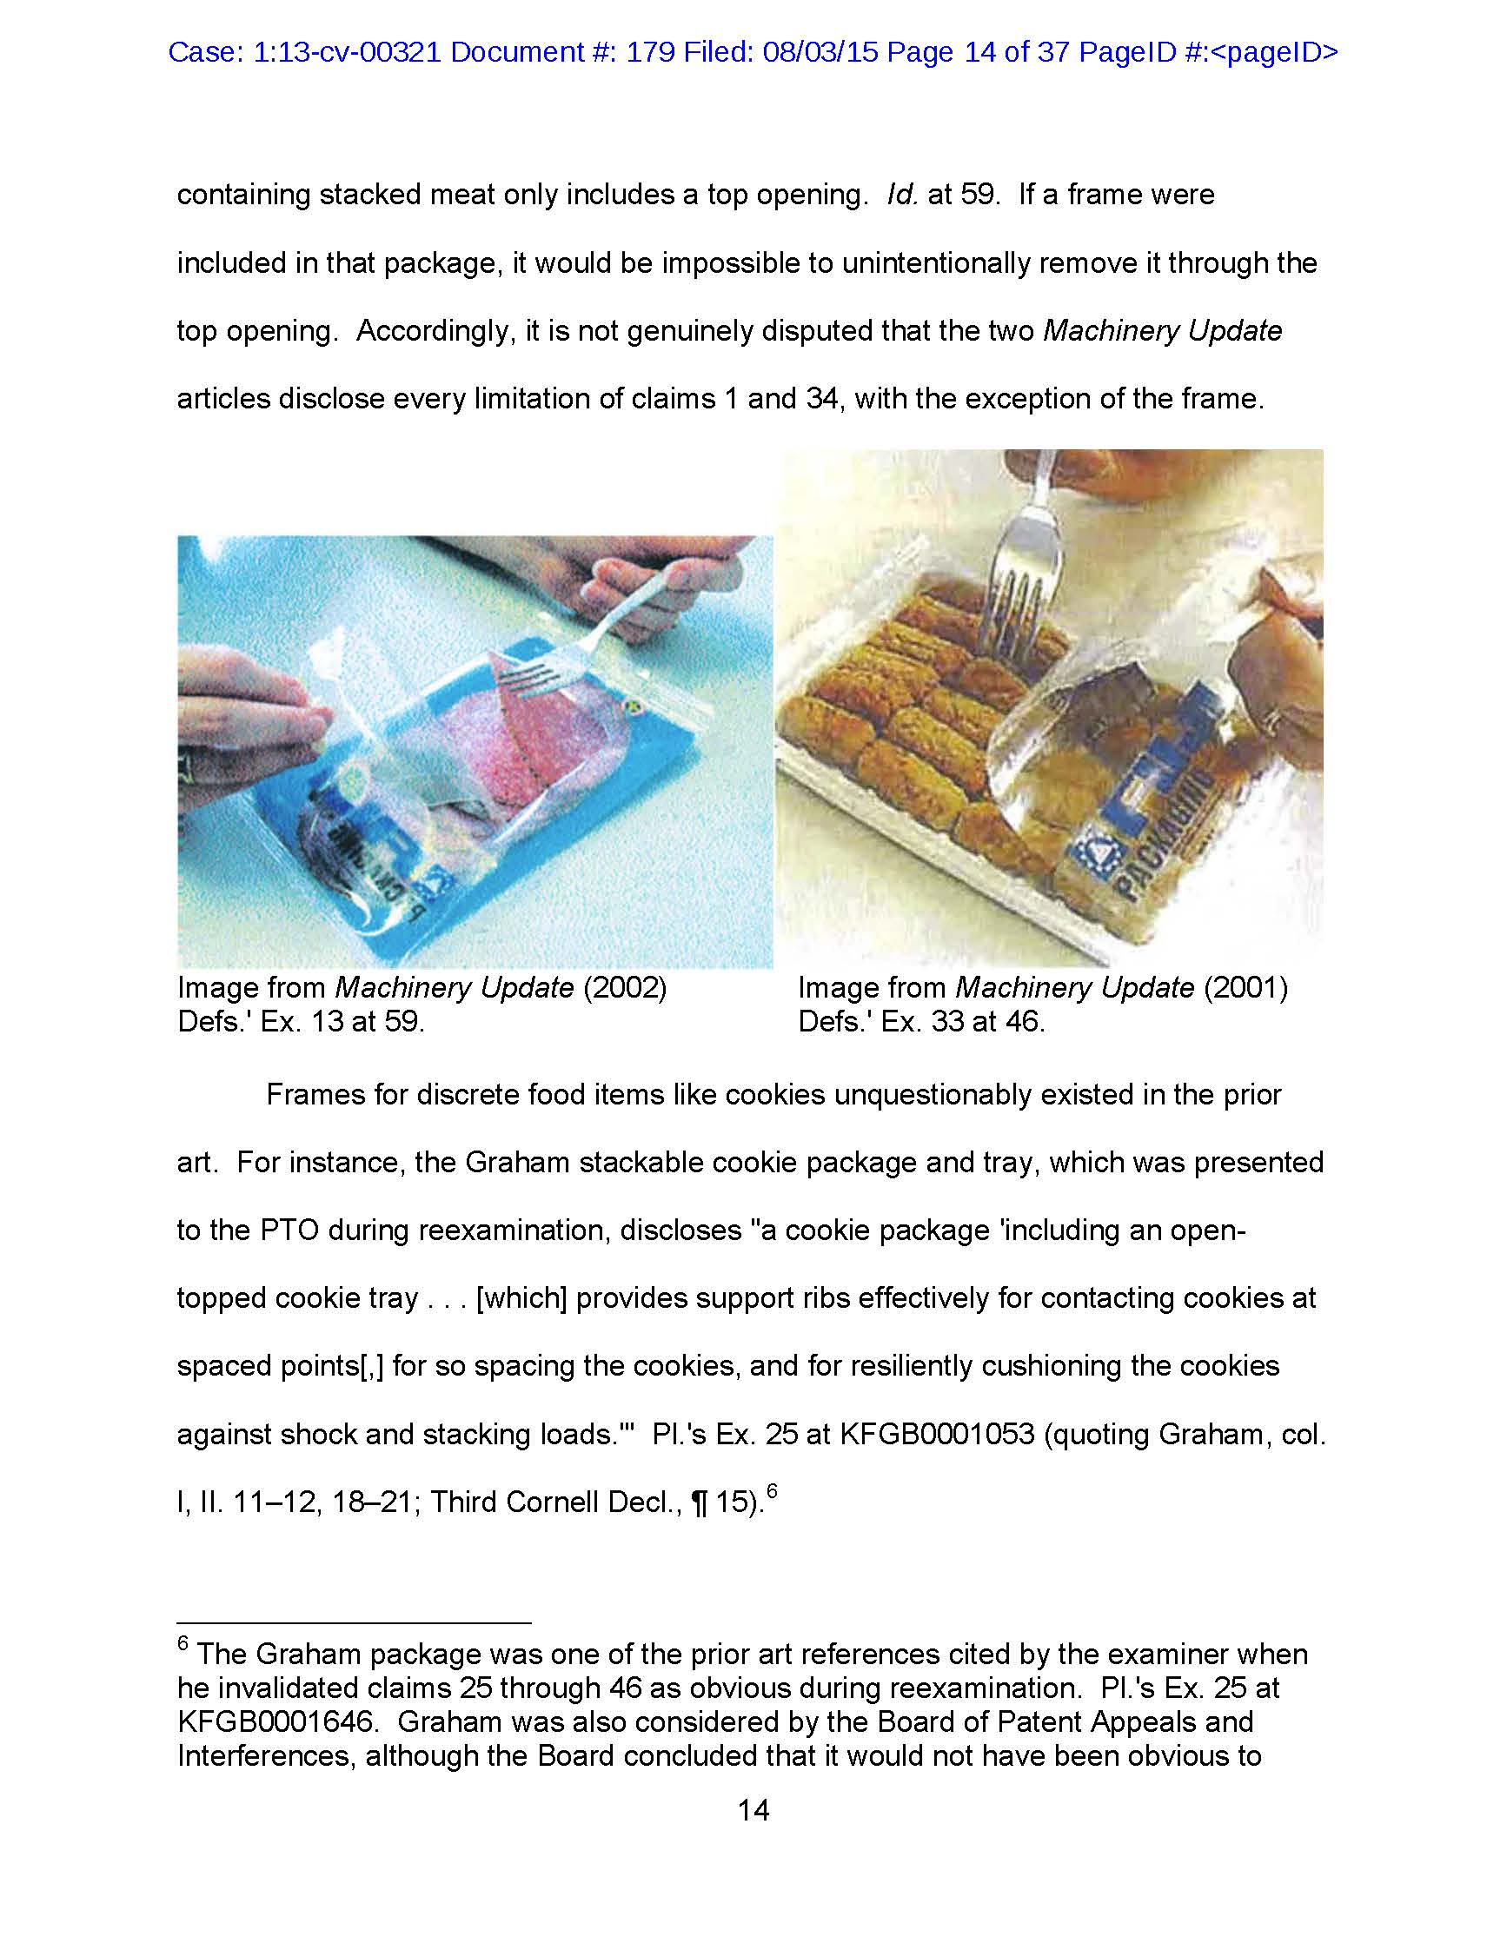
References ultimately used

Slide 17
MIT Policy
MIT owns the patent or copyright except when:
  Not invented under sponsored research, and
  No significant use of MIT administered funds or MIT facilities were made
If industrially sponsored, sponsor(s) has the right to request a license.
  Non-exclusive license is essentially free; exclusive license, if available, is royalty-bearing
If government sponsored, MIT notifies sponsor of invention disclosure and
MIT must decide if it will file a patent application within two years.
  If “yes”, government gets a royalty-free, government-purposes license
  If “no”, MIT waives its ownership right to the government agency that sponsored research;
  the agency may decide to file a patent application on behalf of the US government
After recovery of costs and 15% to fund the Technology Licensing Office (TLO),
inventors receive one-third of the license revenue

Slide 18
MIT TLO Mission
Our mission is to move innovations and discoveries from the lab to the marketplace for the benefit of the public and to amplify MIT's global impact. We cultivate an inclusive environment of scientific and entrepreneurial excellence, and bridge connections from MIT's research community to industry and startups, by strategically evaluating, protecting, and licensing technology.

Slide 19
Strategically Evaluate
Primary objective: move innovations from lab to marketplace
FY2021 Stats:
730 new invention disclosures
Evaluate the invention:
  Meet with inventors
  Ask for Prior Art search or patentability review from attorney
  Research the market/technology area
Determine the best path to achieve the primary objective:
  Seek patent protection
  Publish the work
  Keep the work “quiet” until further development
  Open Source
  Waive invention back to inventors
  Etc.

Slide 20
Protect
Primary objective: move innovations from lab to marketplace
Best way to protect an invention is to seek patent protection!
  If TLO’s goal is the primary objective above, why would TLO seek
  patent protection that allows MIT to prevent others from using the invention?
  Isn’t that counterproductive?
  New product development is expensive
    Cost to develop new drug ~$1Billion
    New battery startup estimates ~$1.6Billion in development costs
  New product development is risky!
    90% of new startups fail
  Investors prefer investing in companies with patent protection
    High risk, high reward
Patents = an advantage in the marketplace, which companies need in order to
justify development costs
FY2021 Stats:
358 US patent applications filed
435 US patents issued
40% of issued US patents are licensed

Slide 21
License
Primary objective: move innovations from lab to marketplace
Types of companies TLO licenses to:

Slide 22
License, cont.
Primary objective: move innovations from lab to marketplace
TLO requests business plan from ALL interested licensees
Negotiate term sheet (mostly financial terms)
Draft license, negotiate (often includes attorneys)
Execute license
Maintain license
  Progress reports
  Follow up on diligence items
  Royalty reports
  Amendments
  Etc.
Termination (Voluntary termination by MIT or by Company,
or natural expiration once patents expire)
FY2021 Stats:
103 license agreements executed
24 startup companies founded on MIT IP

Slide 23
Example Elements of a License
FY2021 Stats:
$87.4 M in gross licensing income
$35.3M in equity proceeds
$13.8M in patent reimbursements
519 active revenue generating licenses
4 licenses generated >$2M
8 additional licenses generated >$500K
Field of Use
Exclusivity
License Issue fee
Royalty rate
Sublicensing
License maintenance fees
Equity
Milestone fees
Patent cost reimbursement
Diligence requirements

Slide 24
Where Does the Revenue Go?
15% to TLO as administrative fee
Retain unreimbursed patent expenses
Of the remaining 85%:
  1/3 to Inventors
  1/3 to Departments
  1/3 to General Fund
Depending on the situation, may share
MIT revenue with joint owners, foundations, and sponsors
FY2021 Stats:
$25.7M was distributed to:
1,291 inventors
89 DLCs
55 other entities

Slide 25
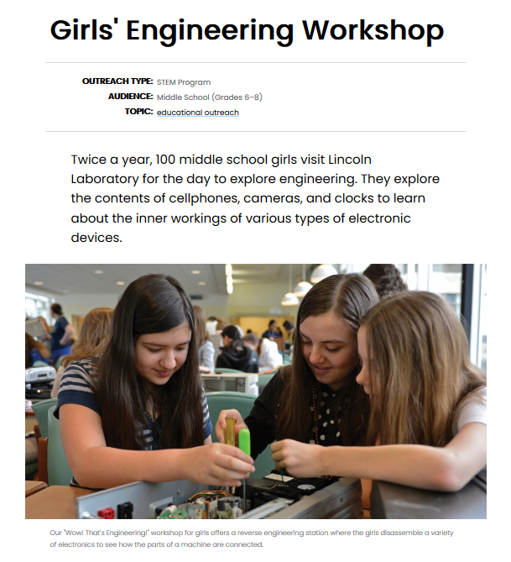
Department Resource Example
Lincoln Labs uses their department share to support programs like this one

Slide 26











Success Stories

Slide 27
Thank you

Slide 28
Contacts
Laura Lapsley (Senior IP Paralegal), llapsley@mit.edu
Jonathan Hromi (Assistant Director, IP), jhromi@mit.edu
Caitlyn Ward (Senior Technology Licensing Associate), ceward@mit.edu
Kate Beriont (Senior Technology Licensing Associate), kberiont@mit.edu
http://tlo.mit.edu/

