Slide 1
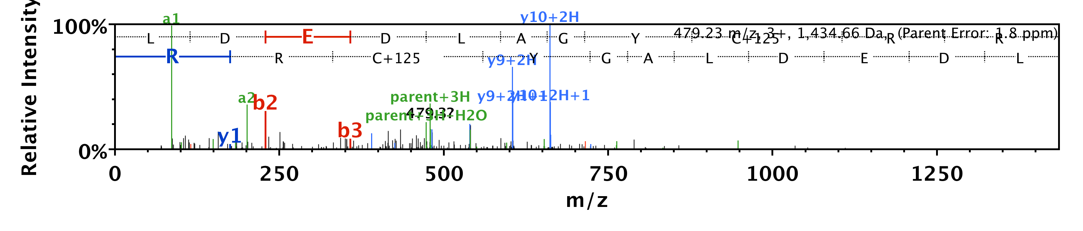
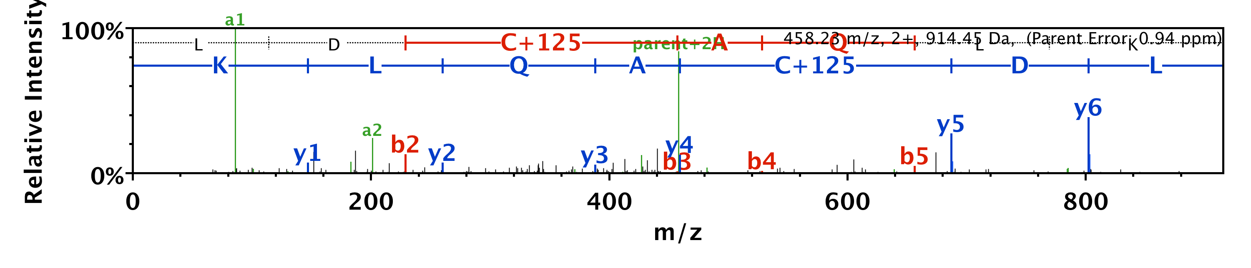
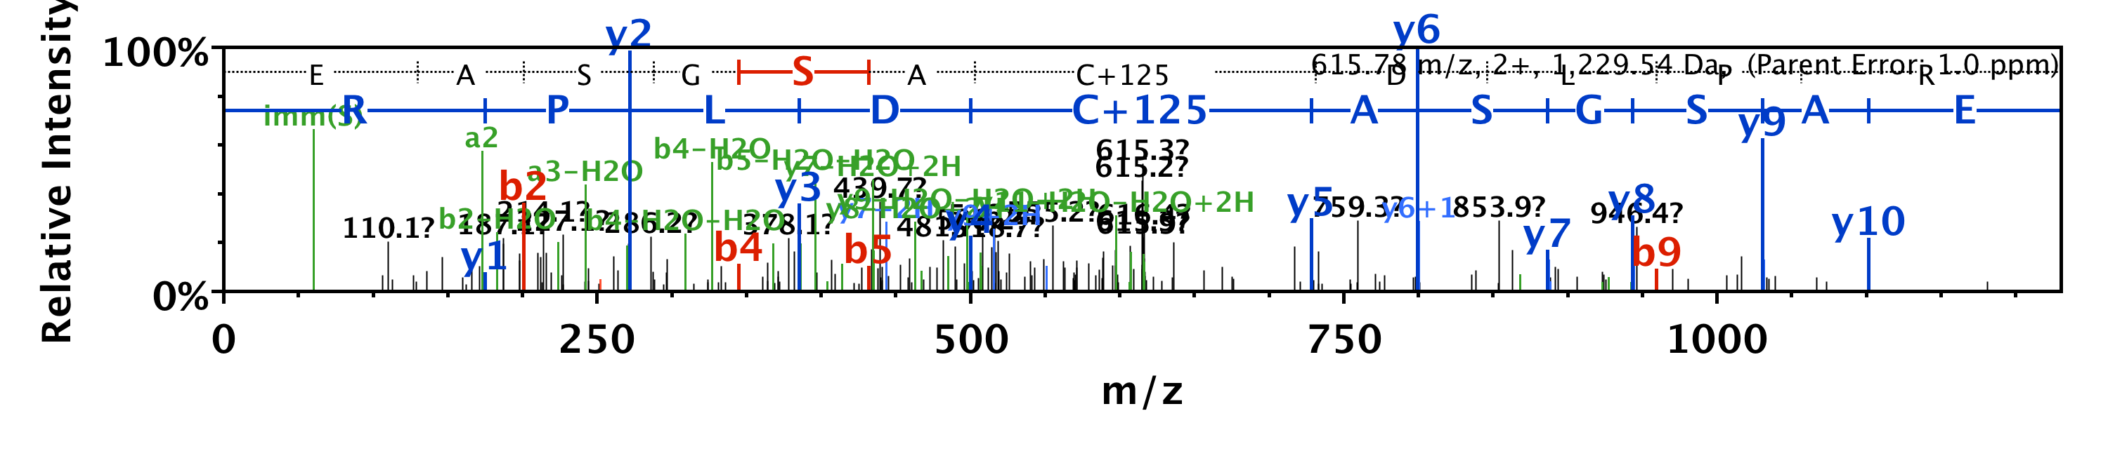
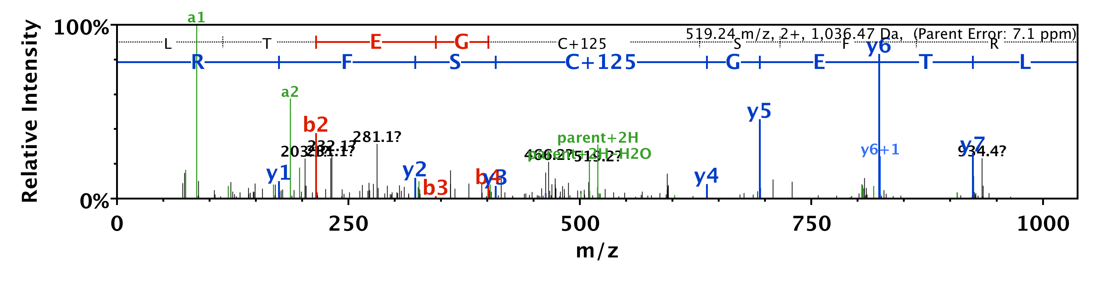
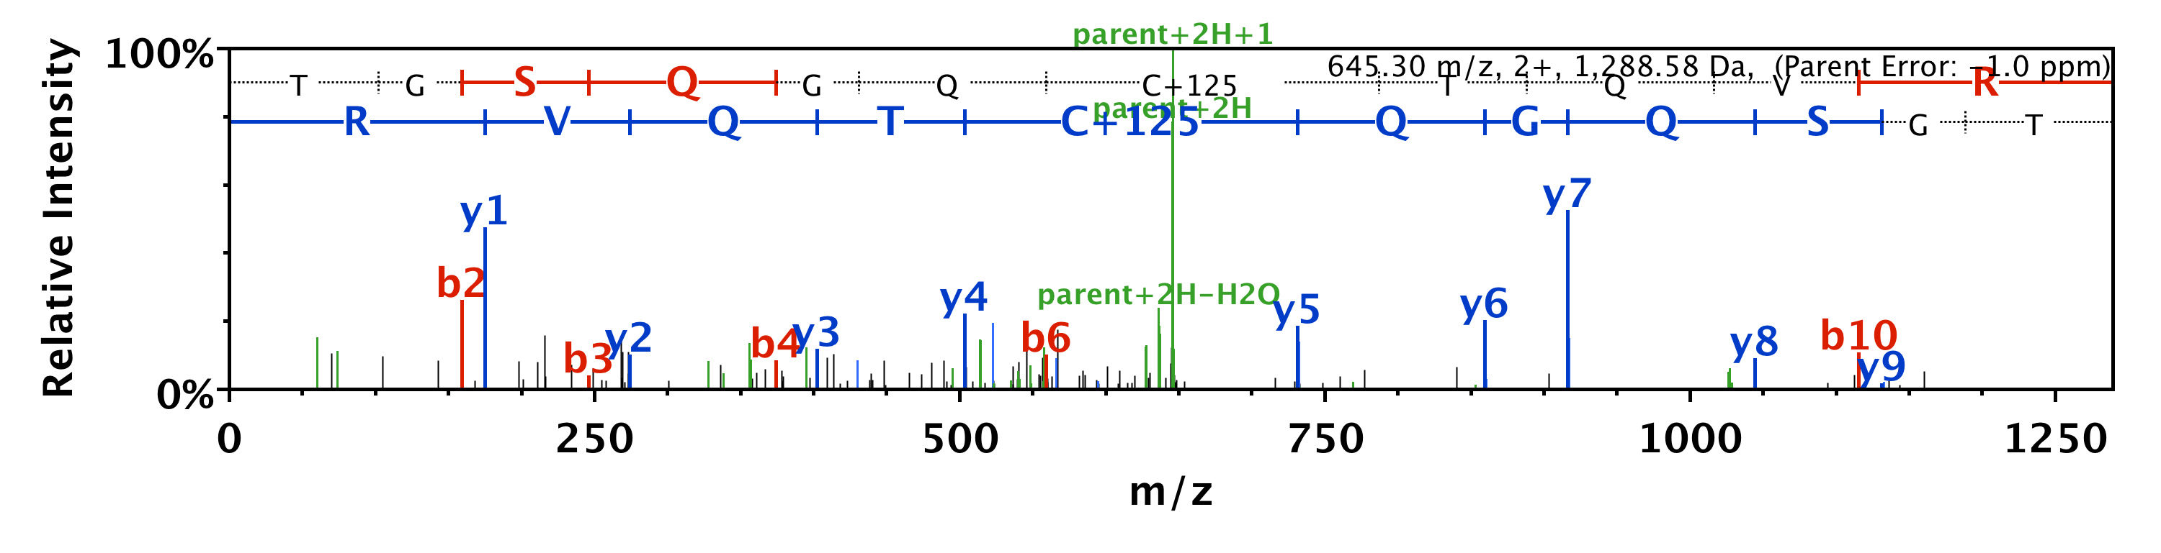
LDEDLAGY C# RR
LD C# AQLKEK
EASGSA C# DLPR
LTEG C# SFR
TGSQGQ C# TQVR

Slide 2
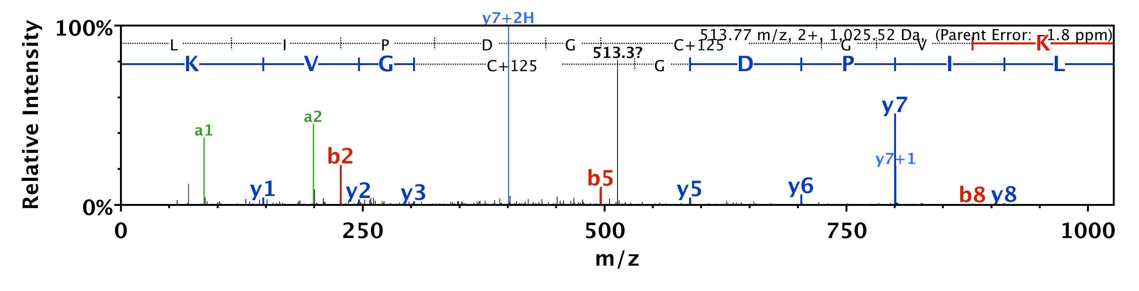
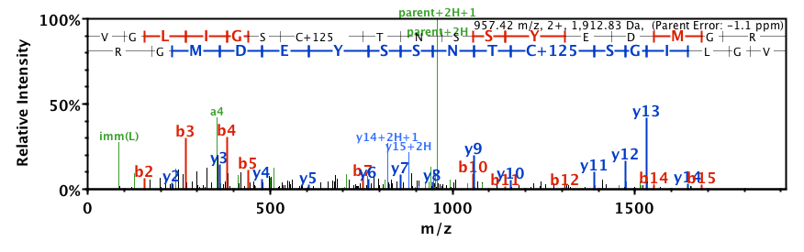
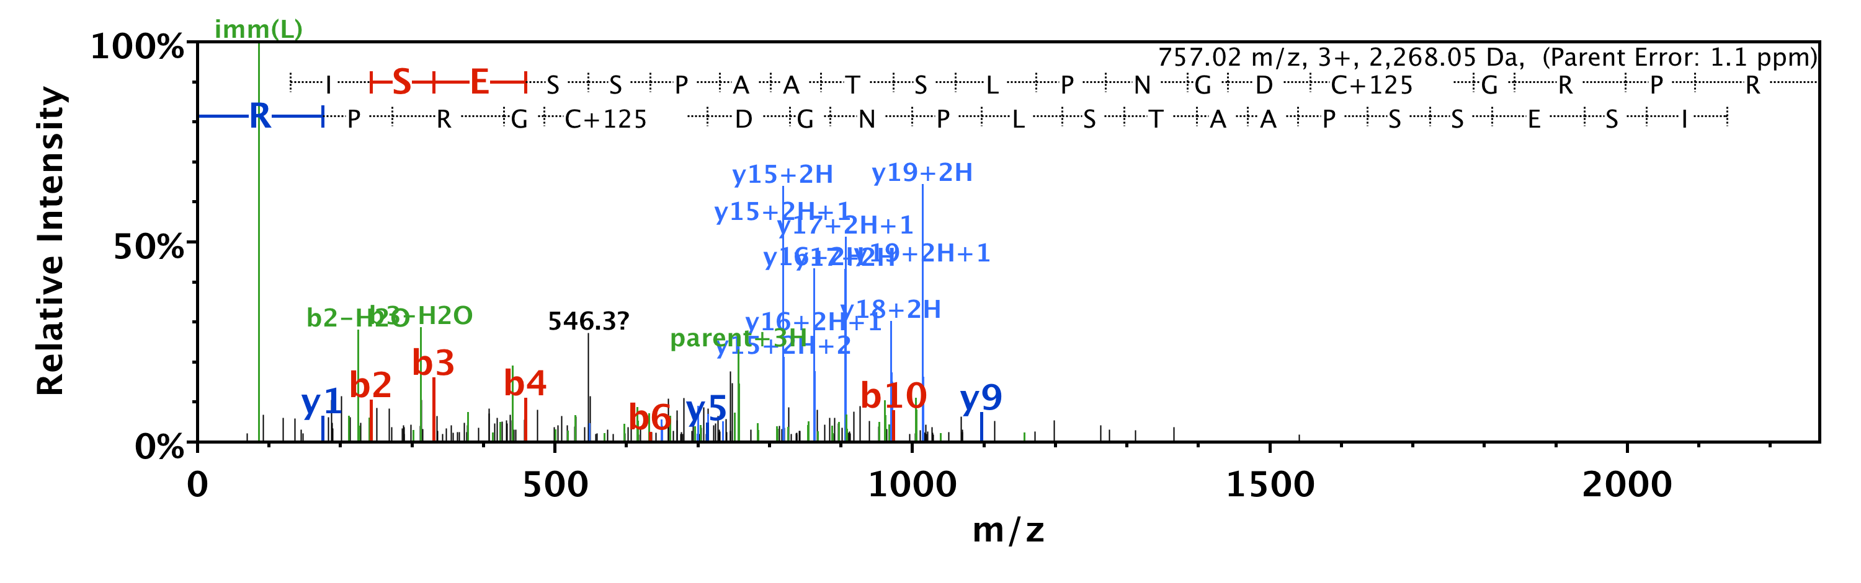
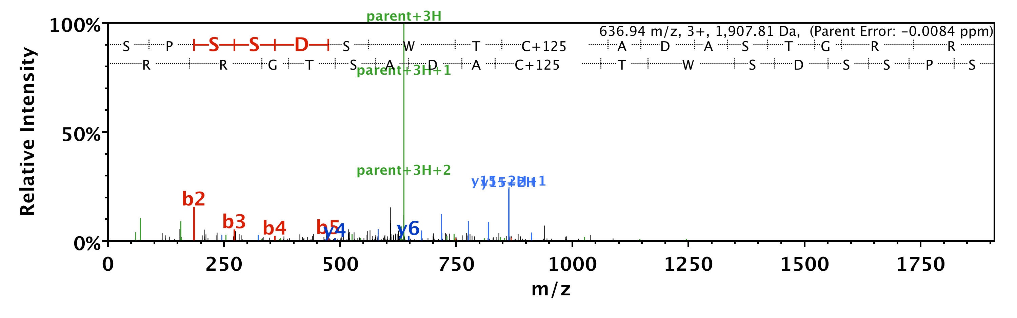
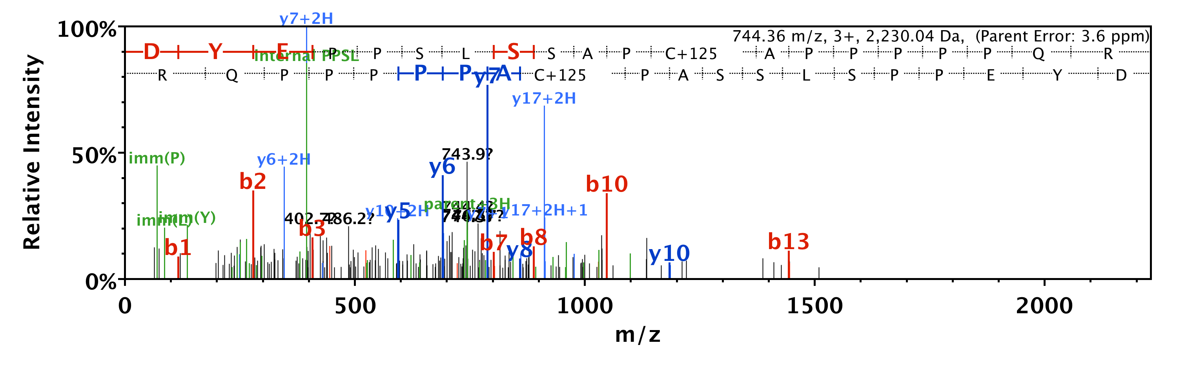
LIPDG C# GVK
VGLIGS C# TNSSYEDMGR
SISESSPAATSLPNDG C# GRPR
SPSSDSWT C# ADASTGRR
DYEPPSLSSAP C# APPPPPQR

Slide 3
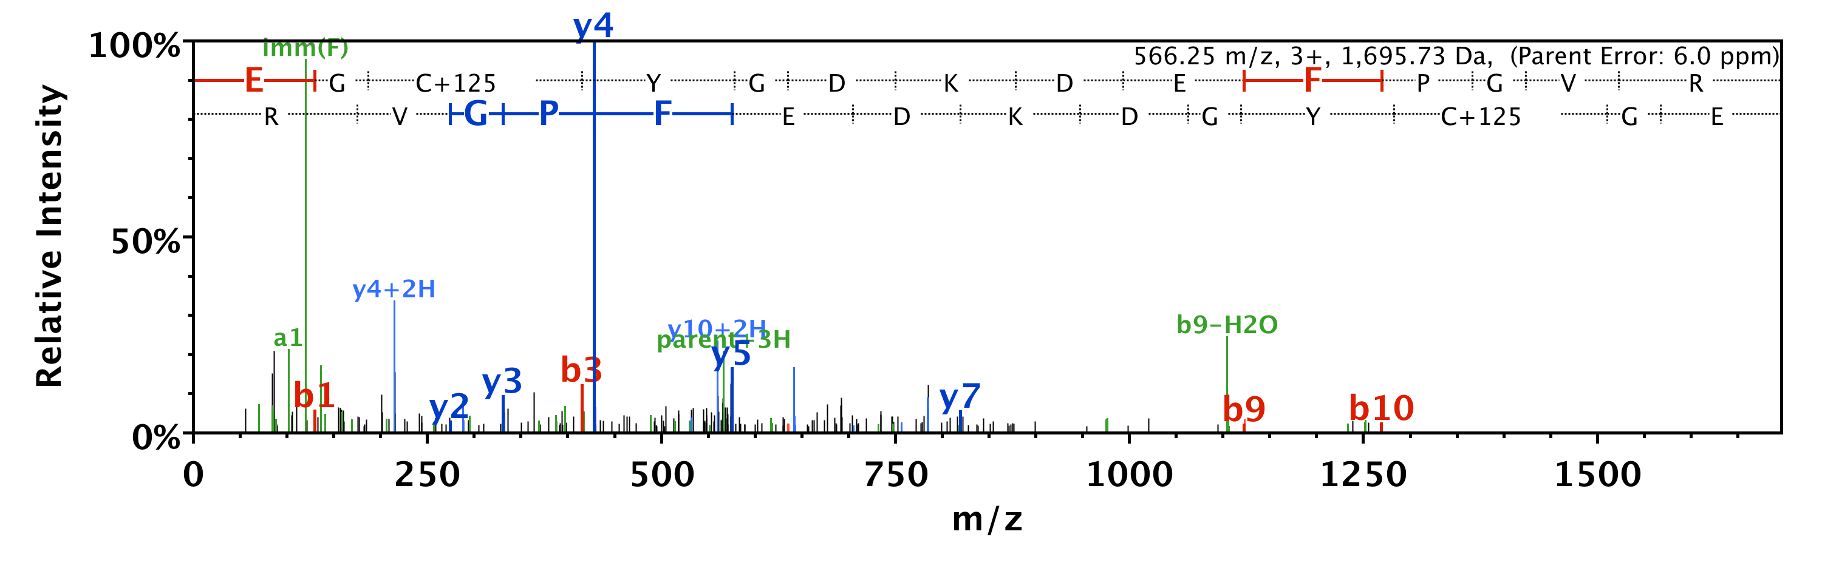
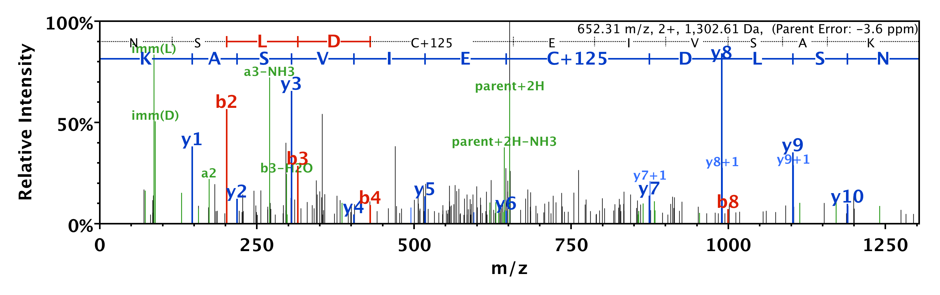
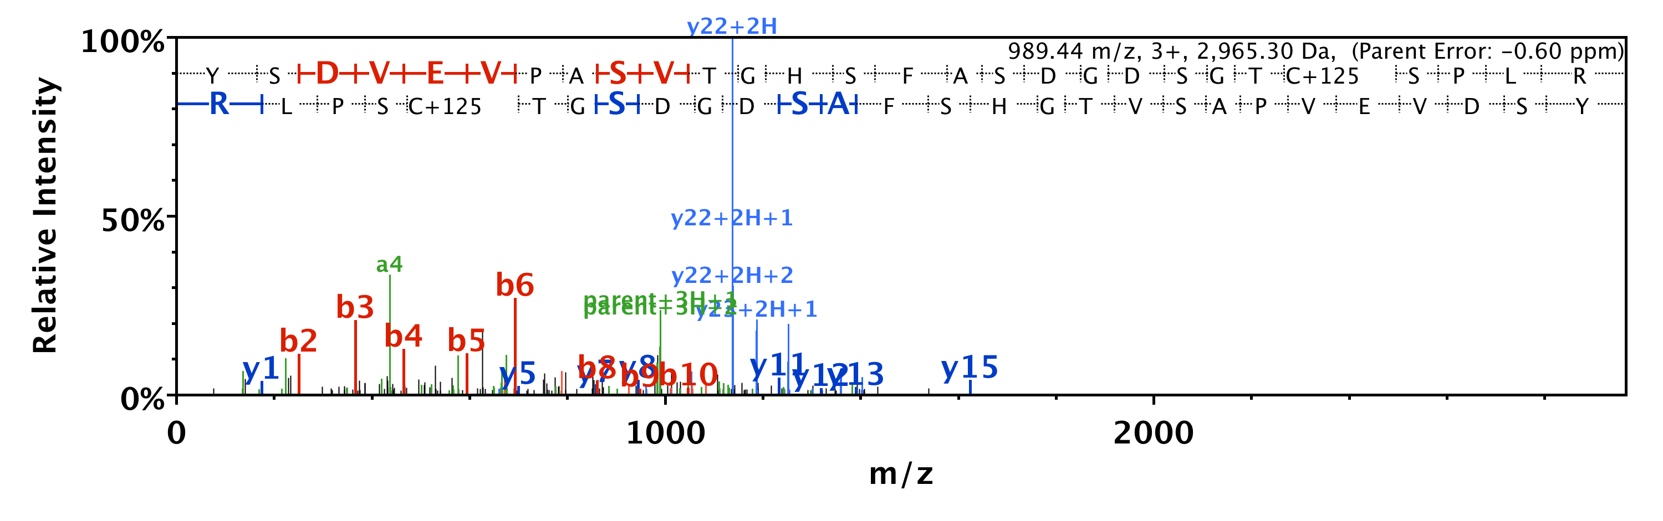
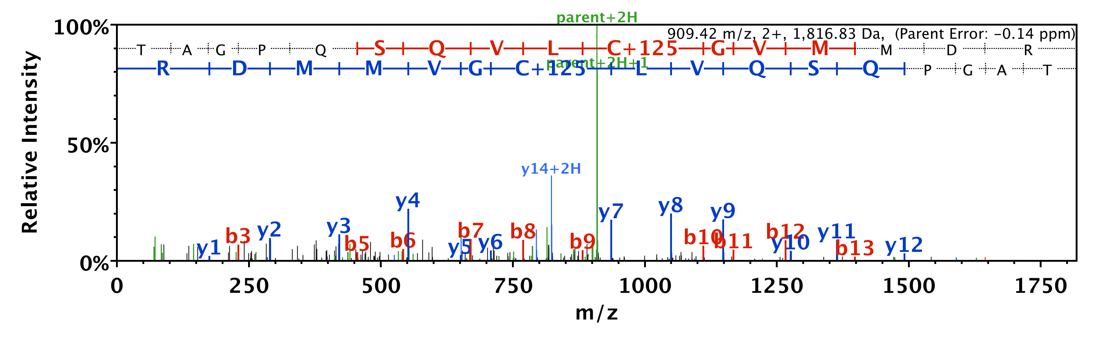
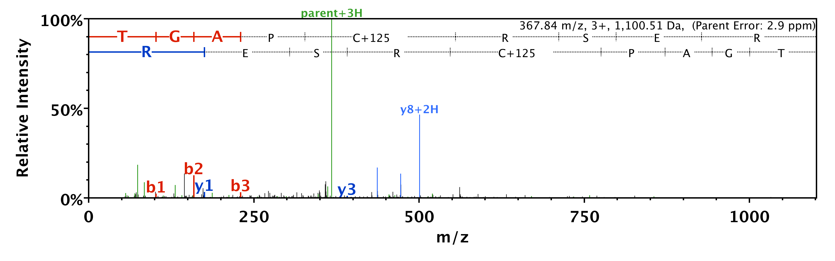
EG C# YGDKDEFPGVR
NSLDC# EIVSAK
YSDVEVPASVTGHSFASDGDSGT C# SPLR
TAGPQSQVL C# GVMMDR
TGAP C# RSER

Slide 4
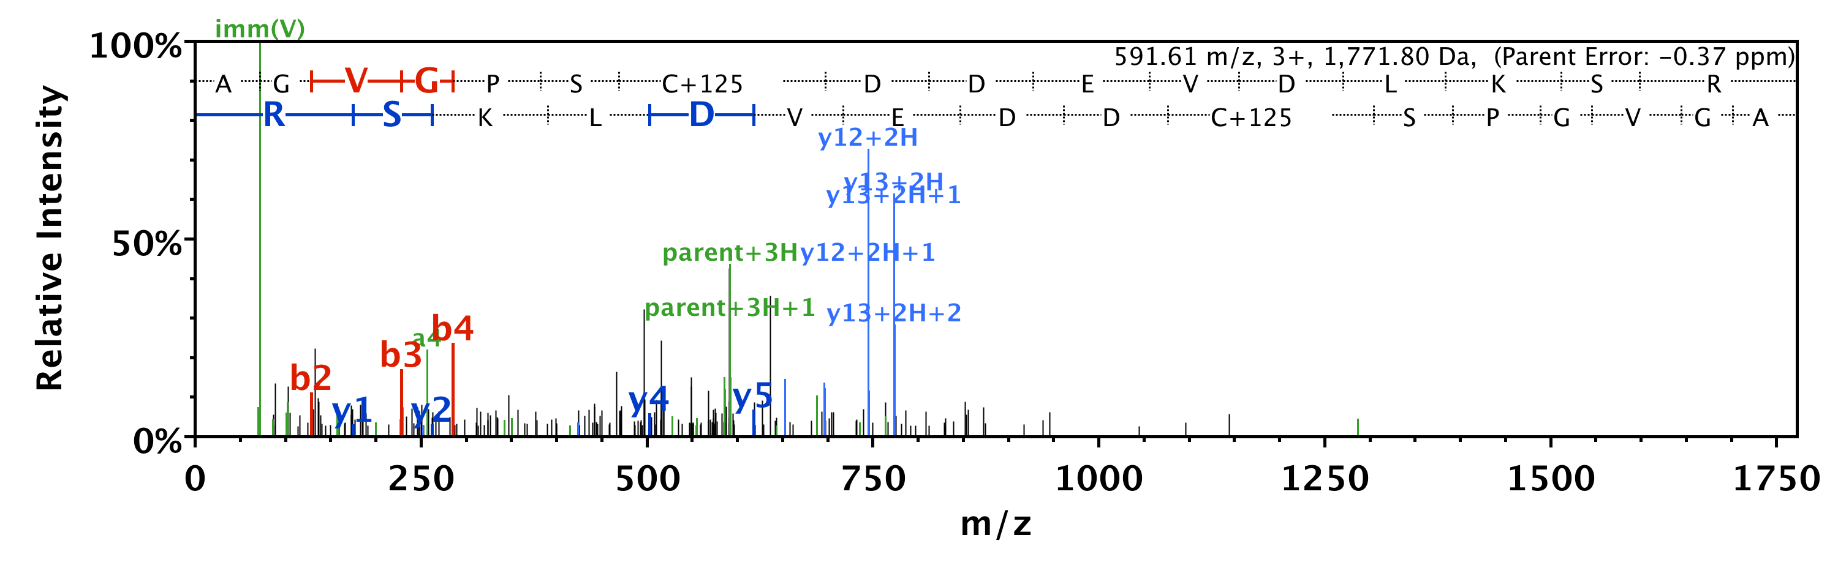
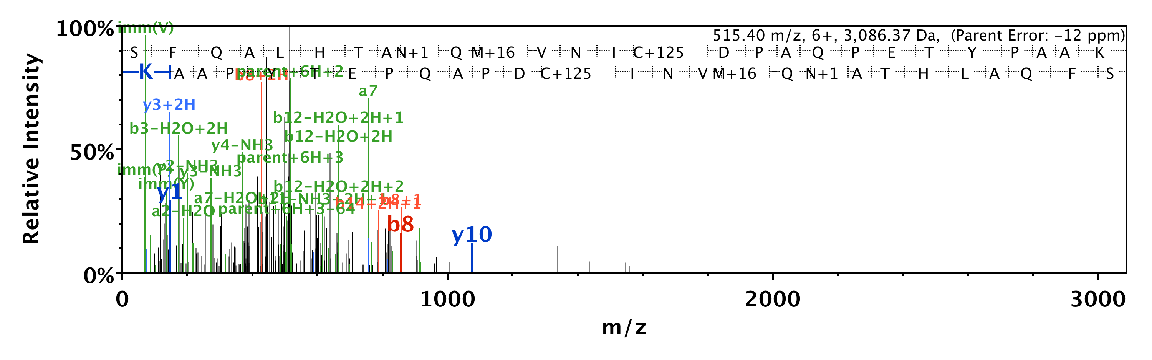
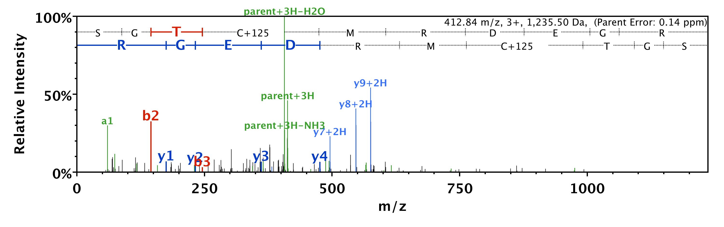
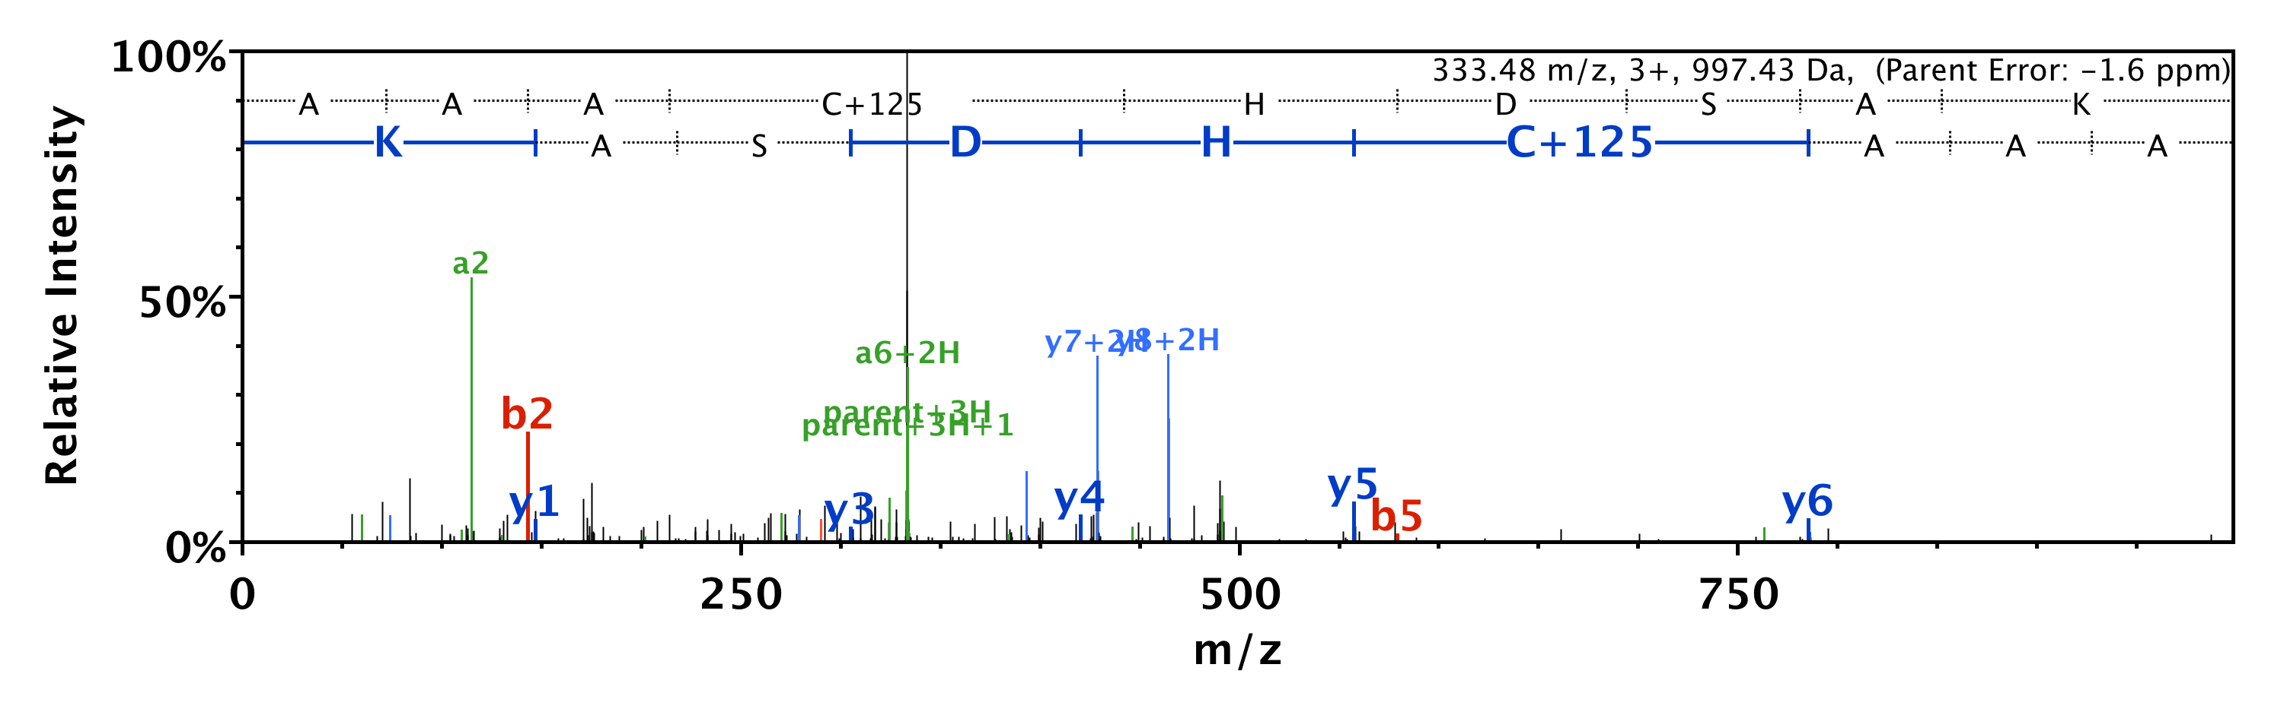
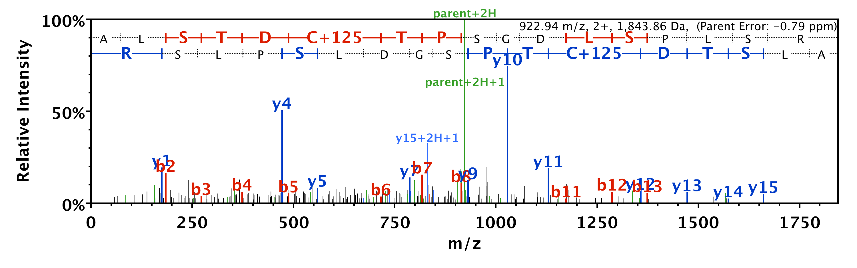
AGVGPS C# DDEVDLKSR
SFQALHTANQMVNI C# DPAQPETYPAAK
SGT C# MRDEGR
AAA C# HDSAK
ALSTD C# TPSGDLSPLSR

Slide 5
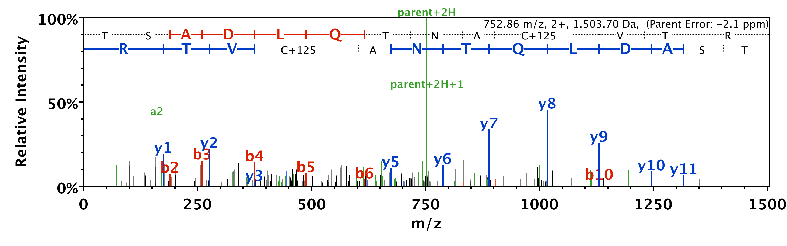
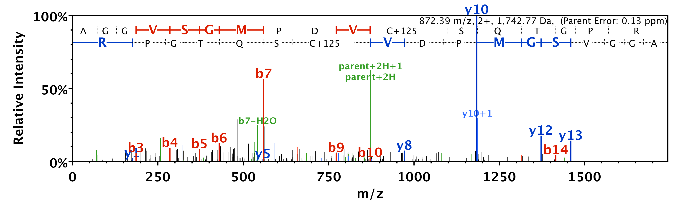
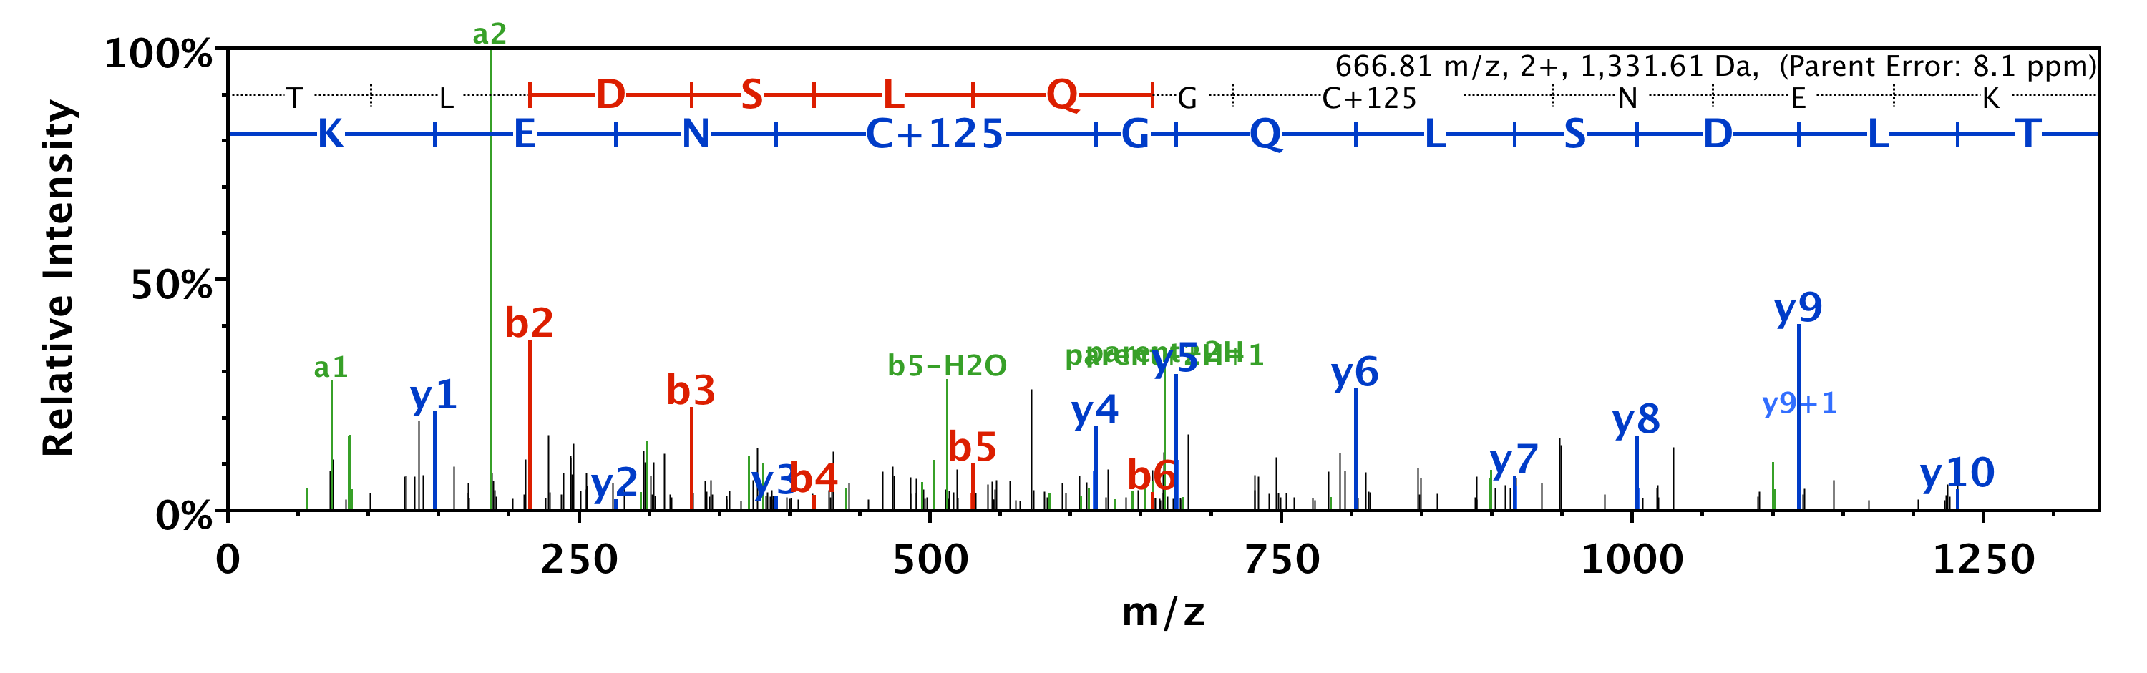
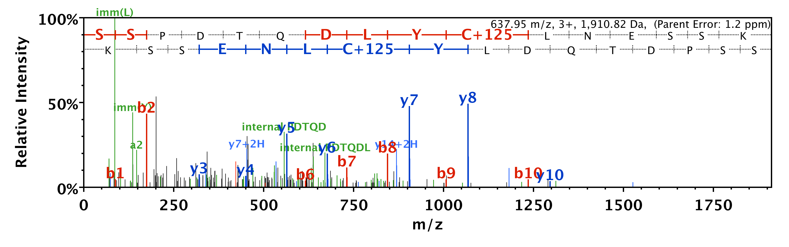
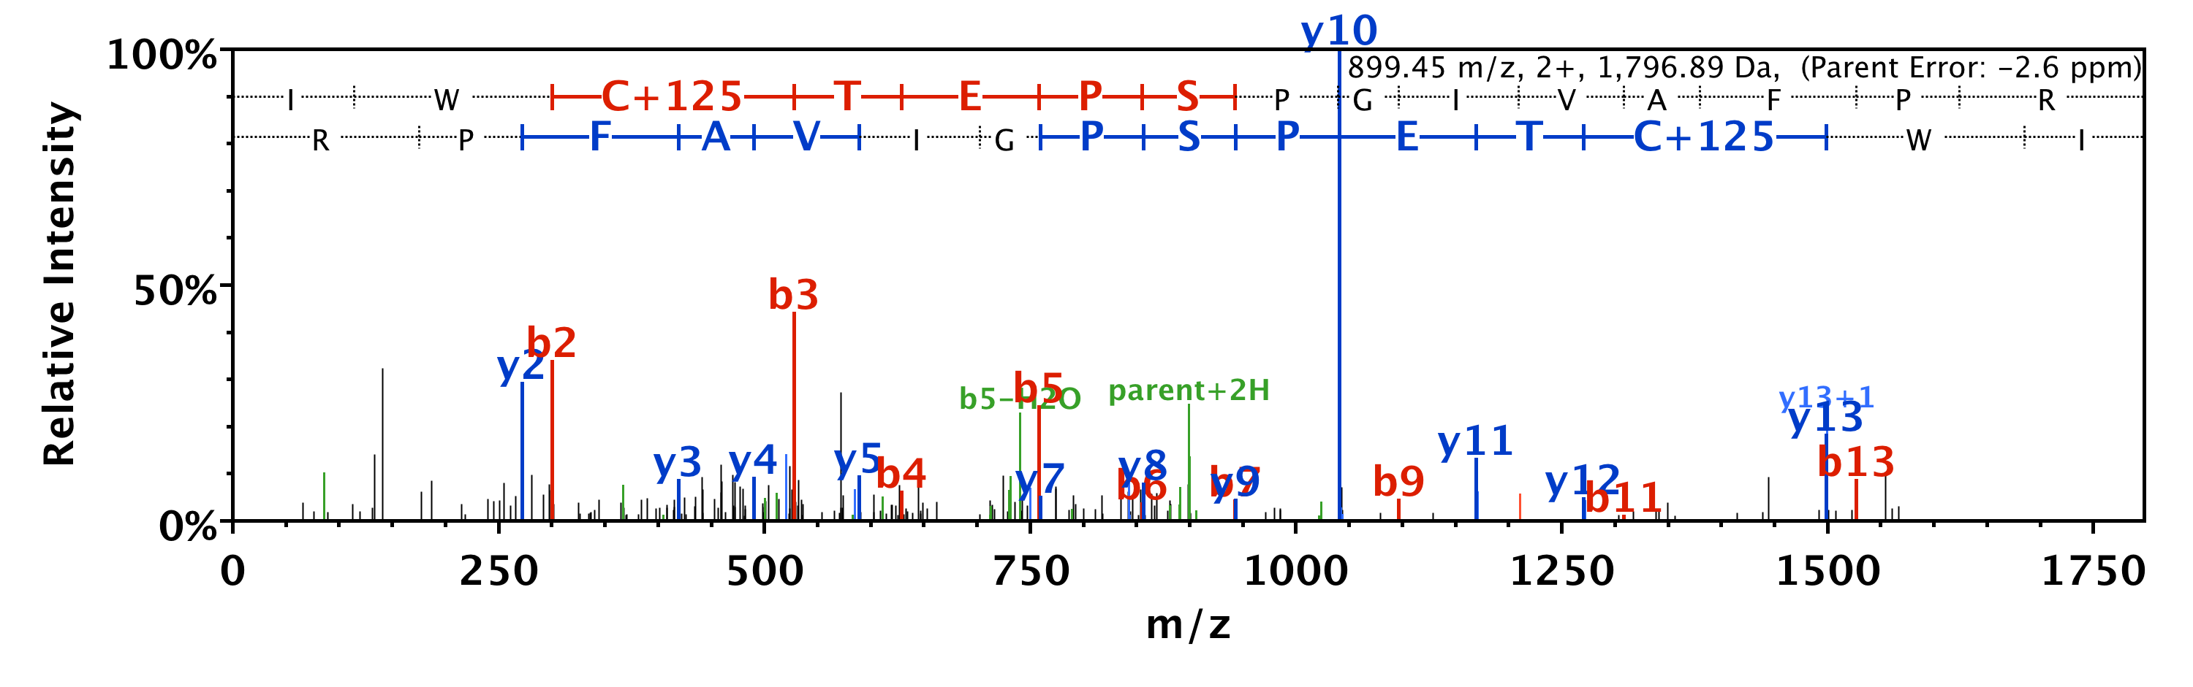
TSADLQTNA C# VTR
AGGVSGMPDV C# SQTGPR
TLDSLQG C# NEK
SSPDTQDLY C# LNESSK
IW C# TEPSPGIVAFPR

Slide 6
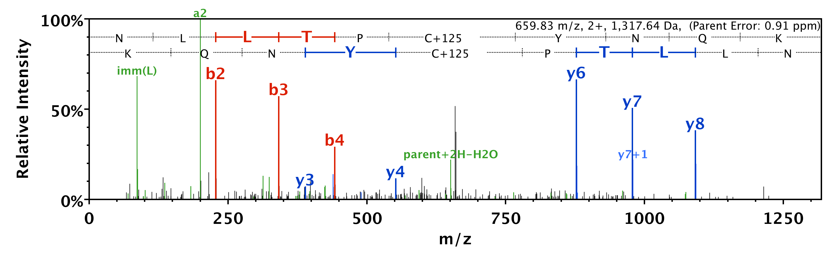
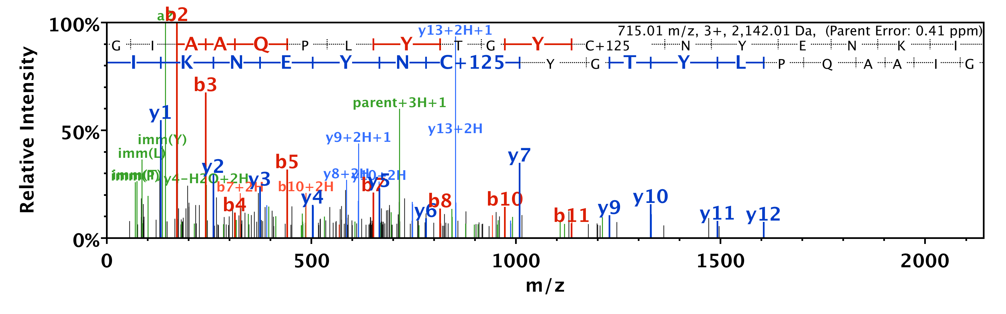
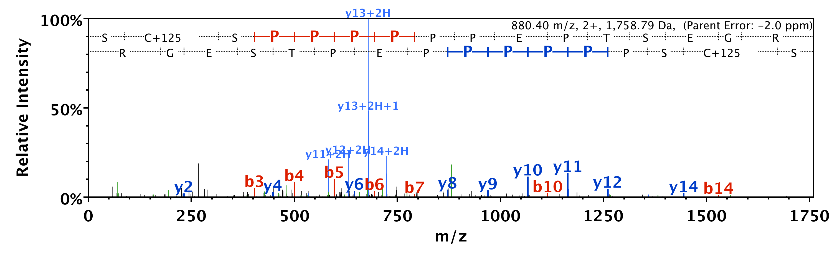
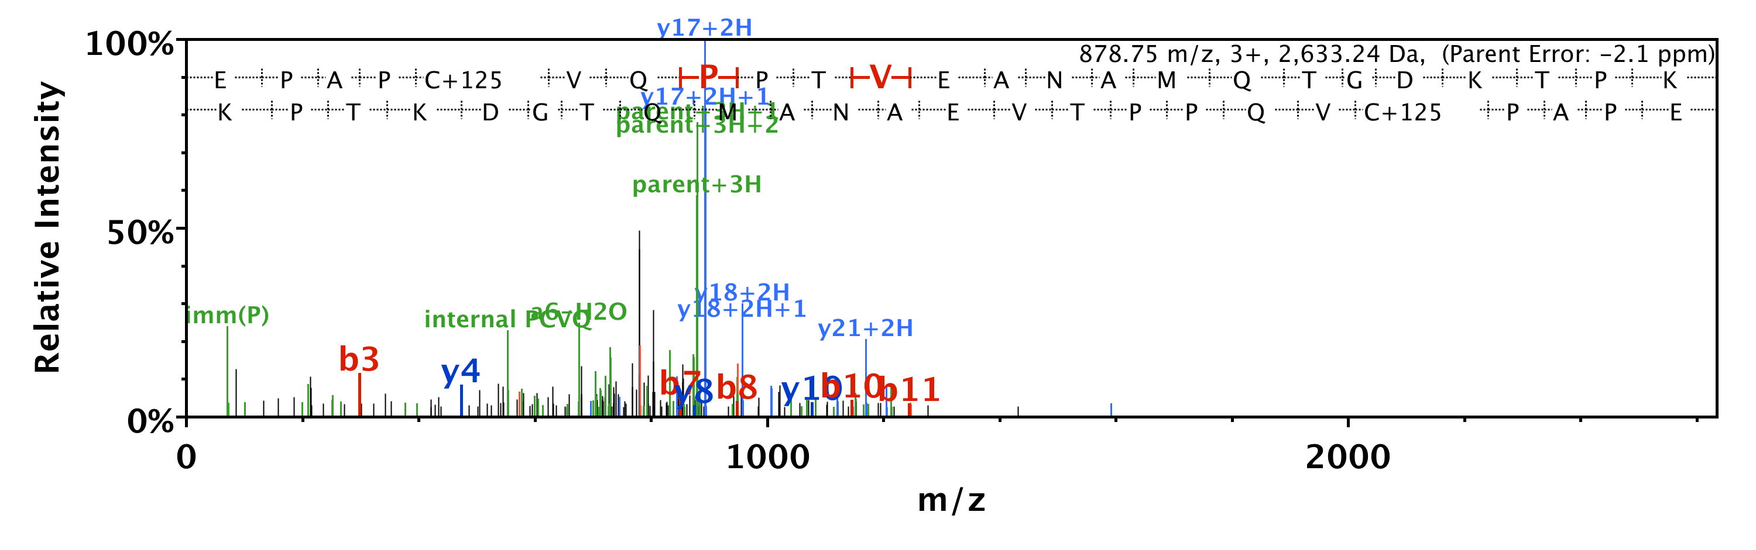
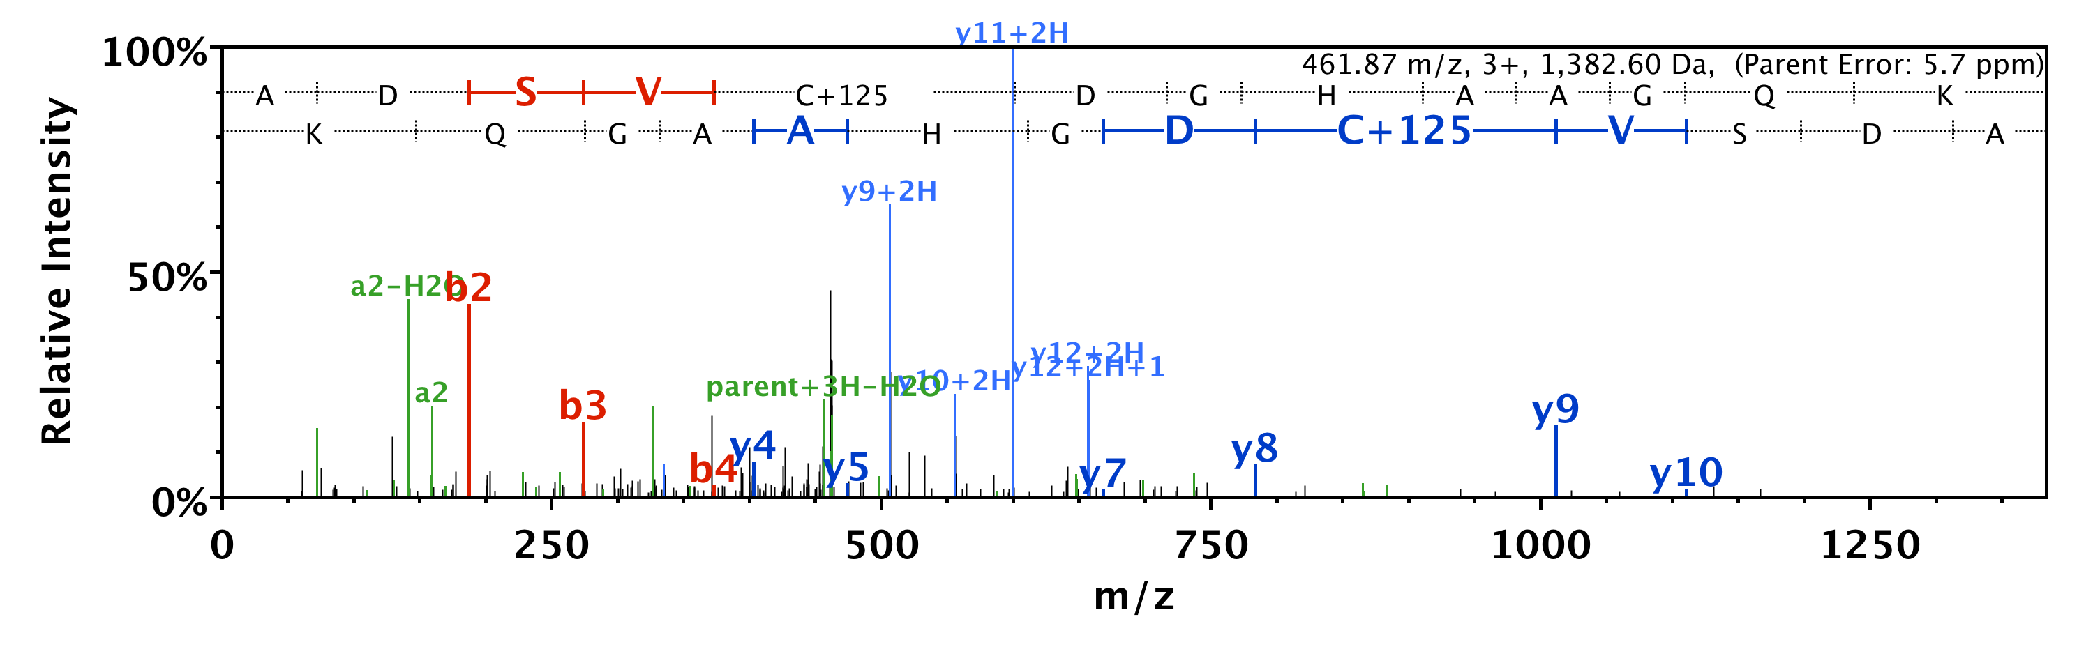
NLLTP C# YNQK
GIAAQPLYTGY C# NYENKI
S C# SPPPPPPEPTSEGR
EPAP C# VQPPTVEANAMQTGDKTPK
ADSV C# DGHAAGQK

Slide 7
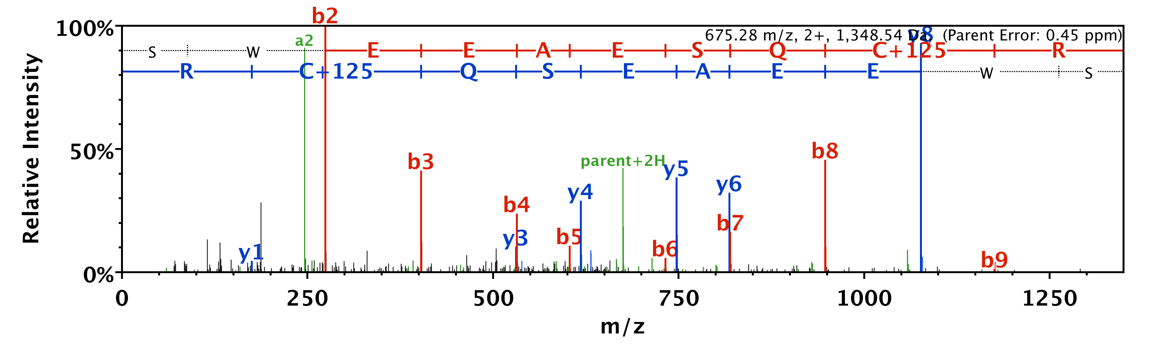
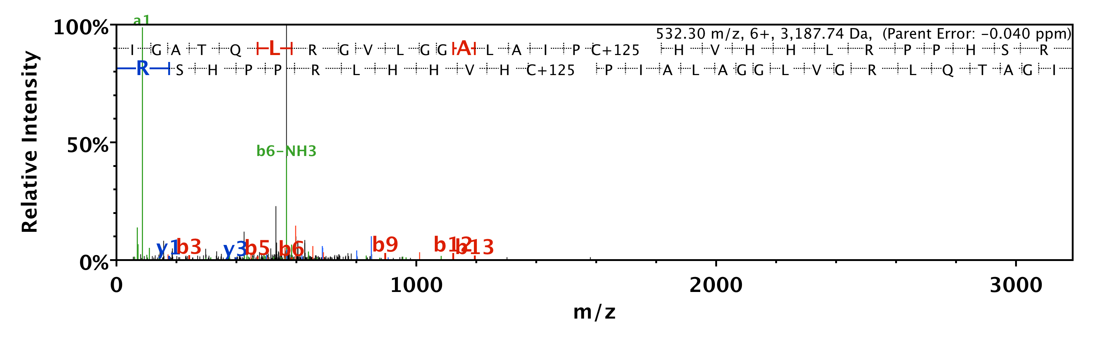
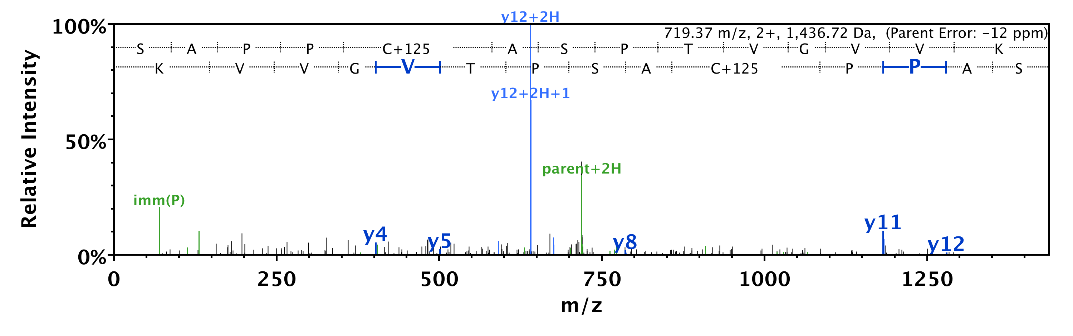
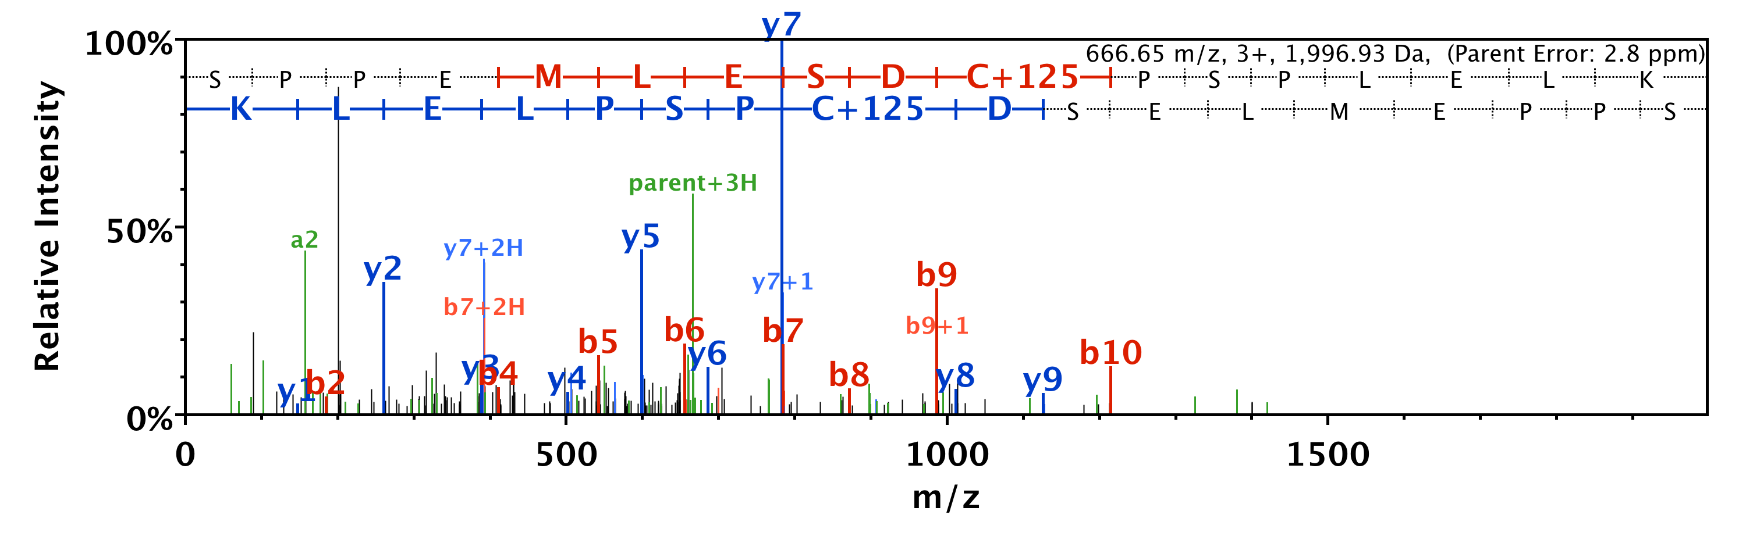
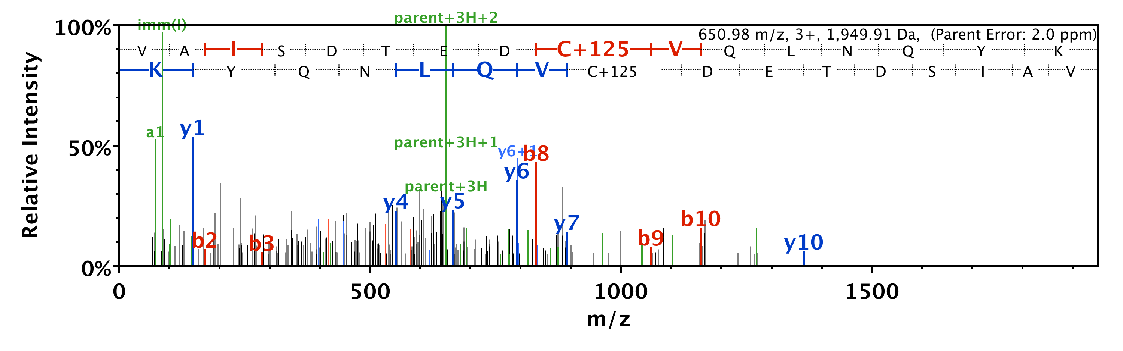
SWEEAESQ C# R
IGATQLRGVLGGALAIP C# HVHHLRPPHSRR
SAPP C# ASPTVGVVK
SPPEMLESD C# PSPLELK
VAISDTED C# VQLNQYK

Slide 8
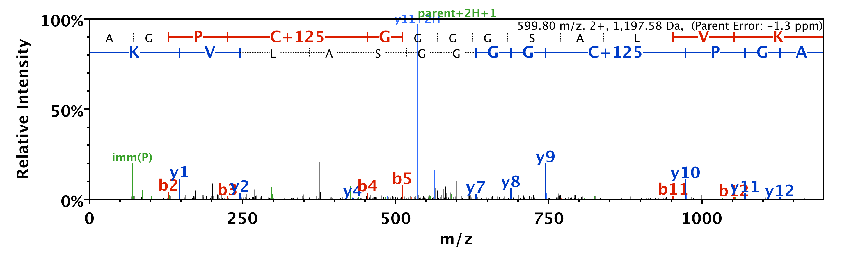
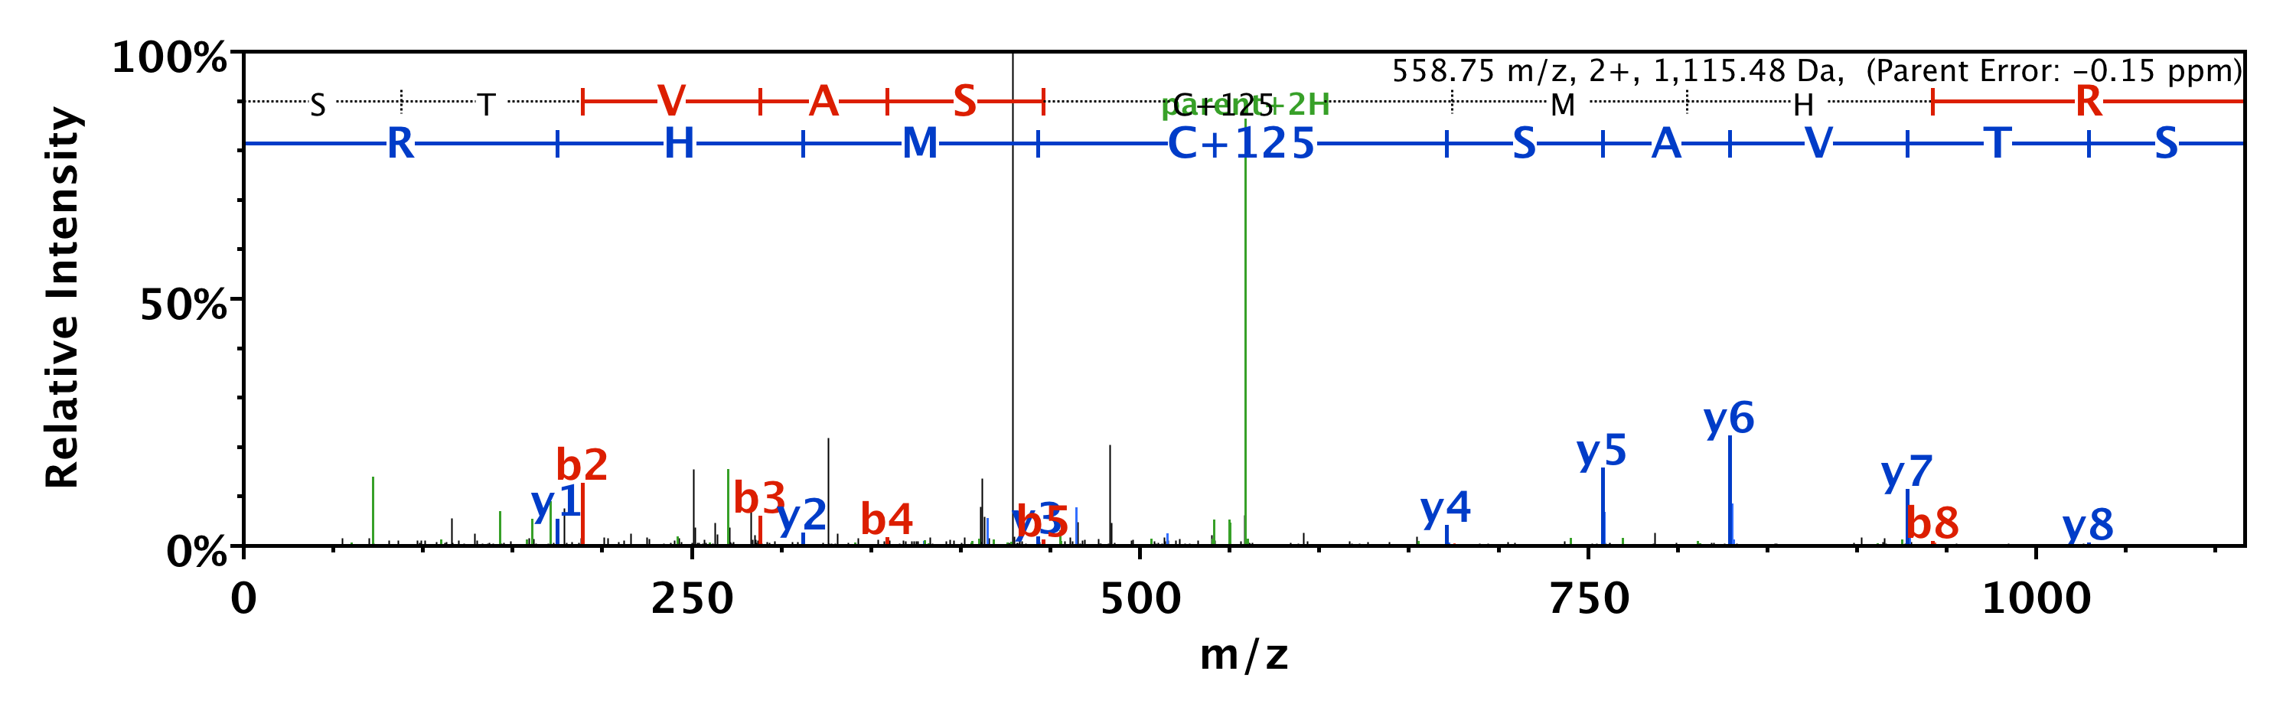
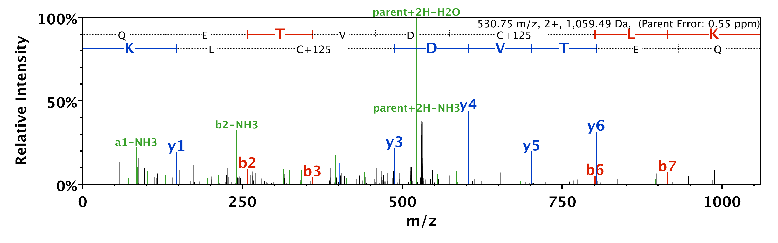
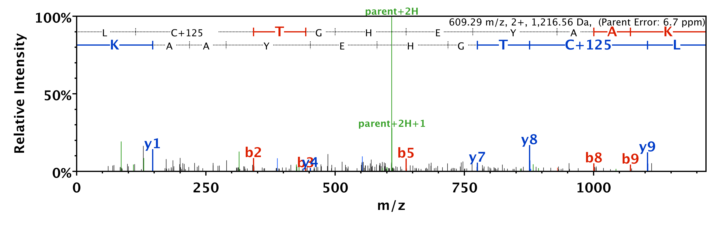
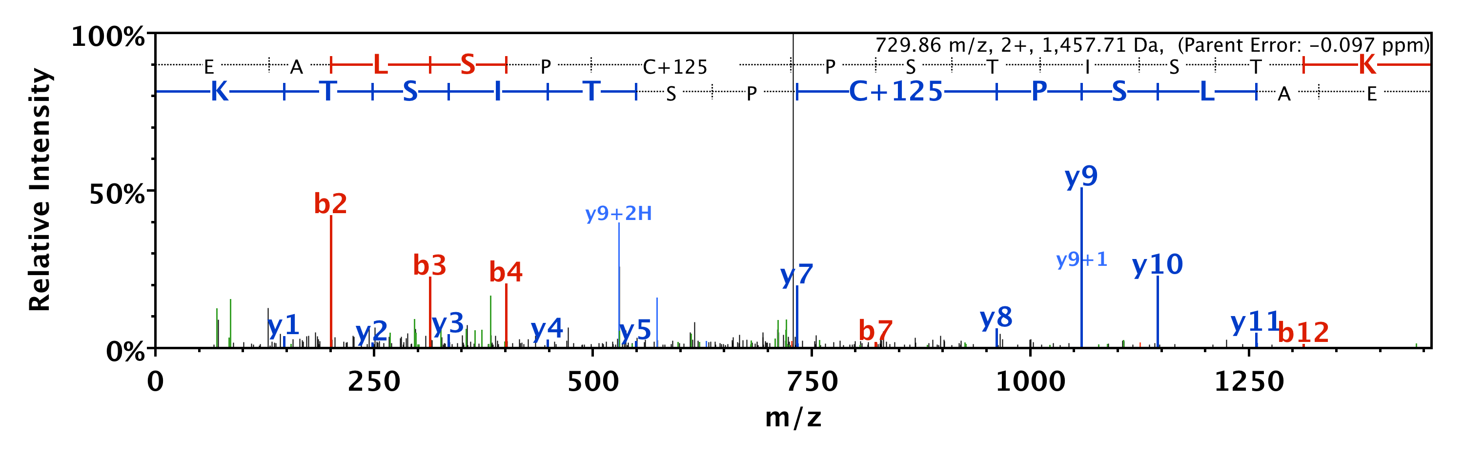
AGP C# GGGGSALVK
STVAS C# MHR
QETVD C# LK
L C# TGHEYAAK
EALSP C# PSTISTK

Slide 9
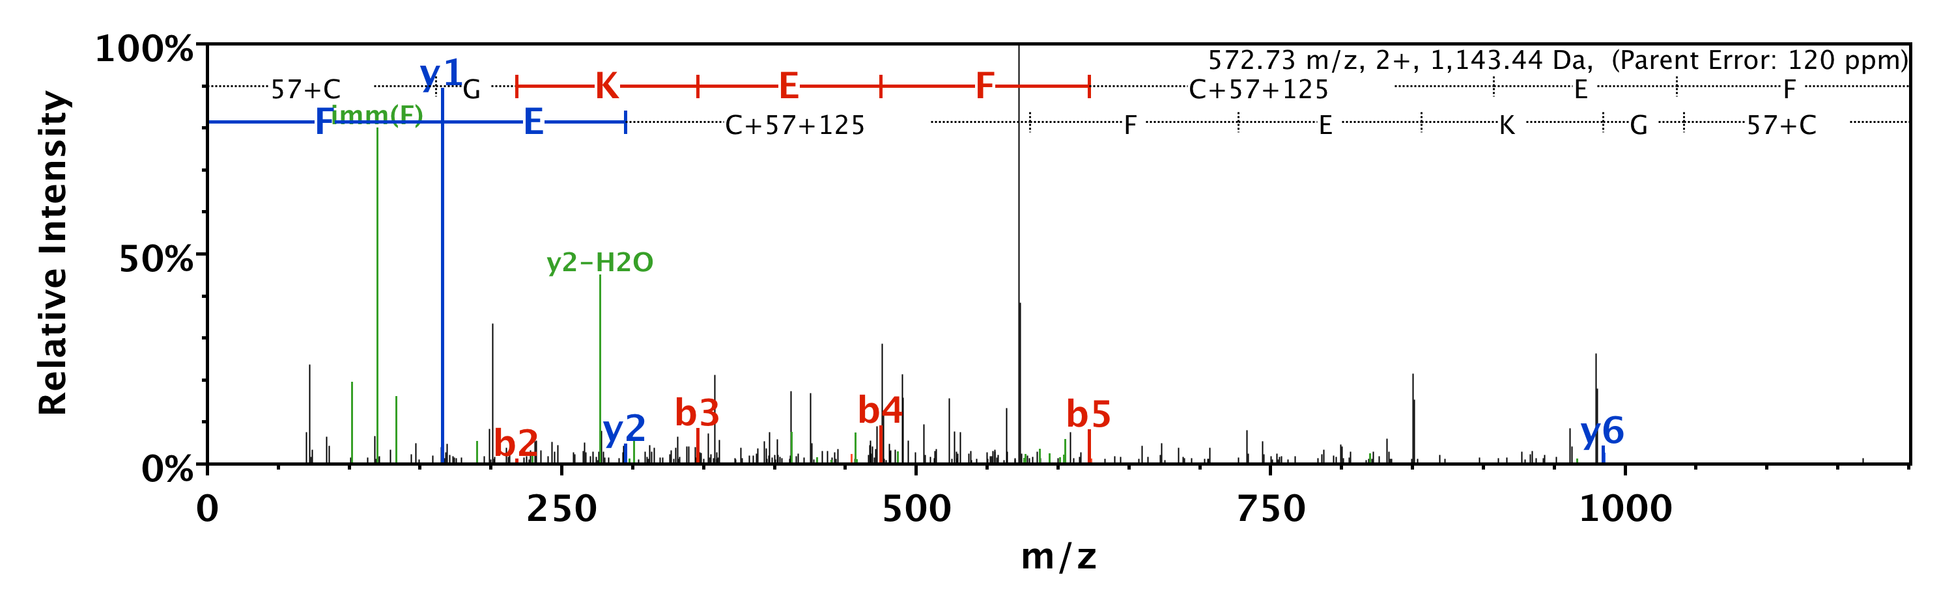
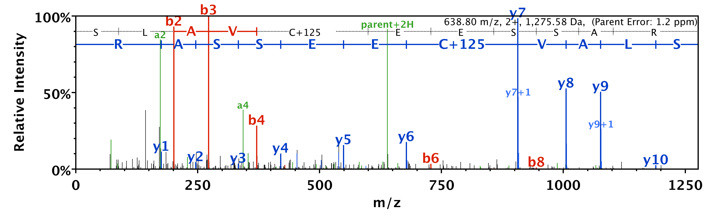
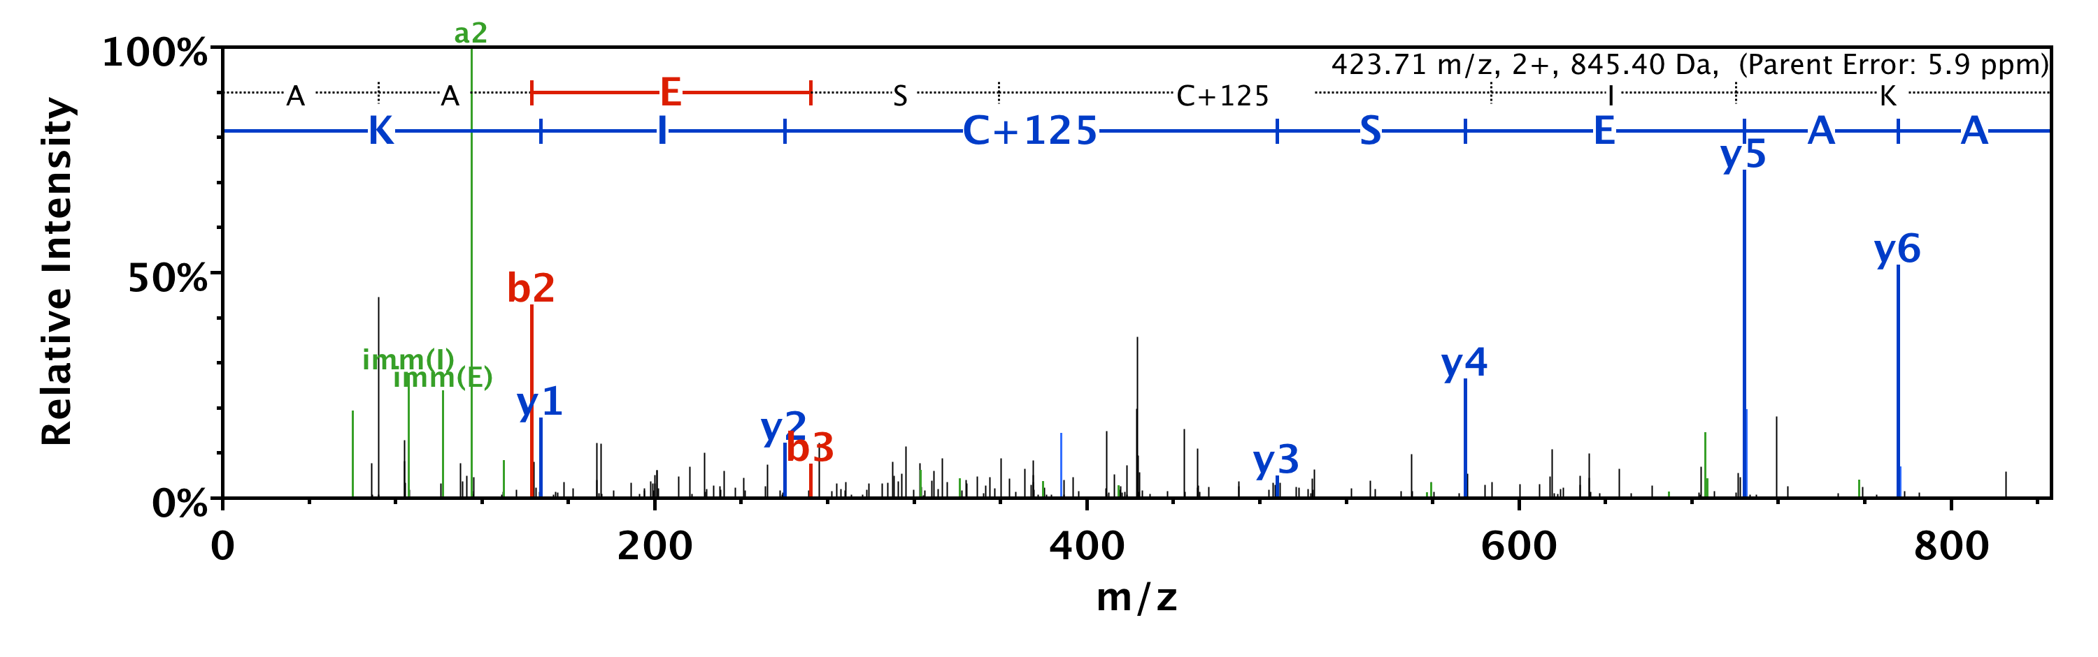
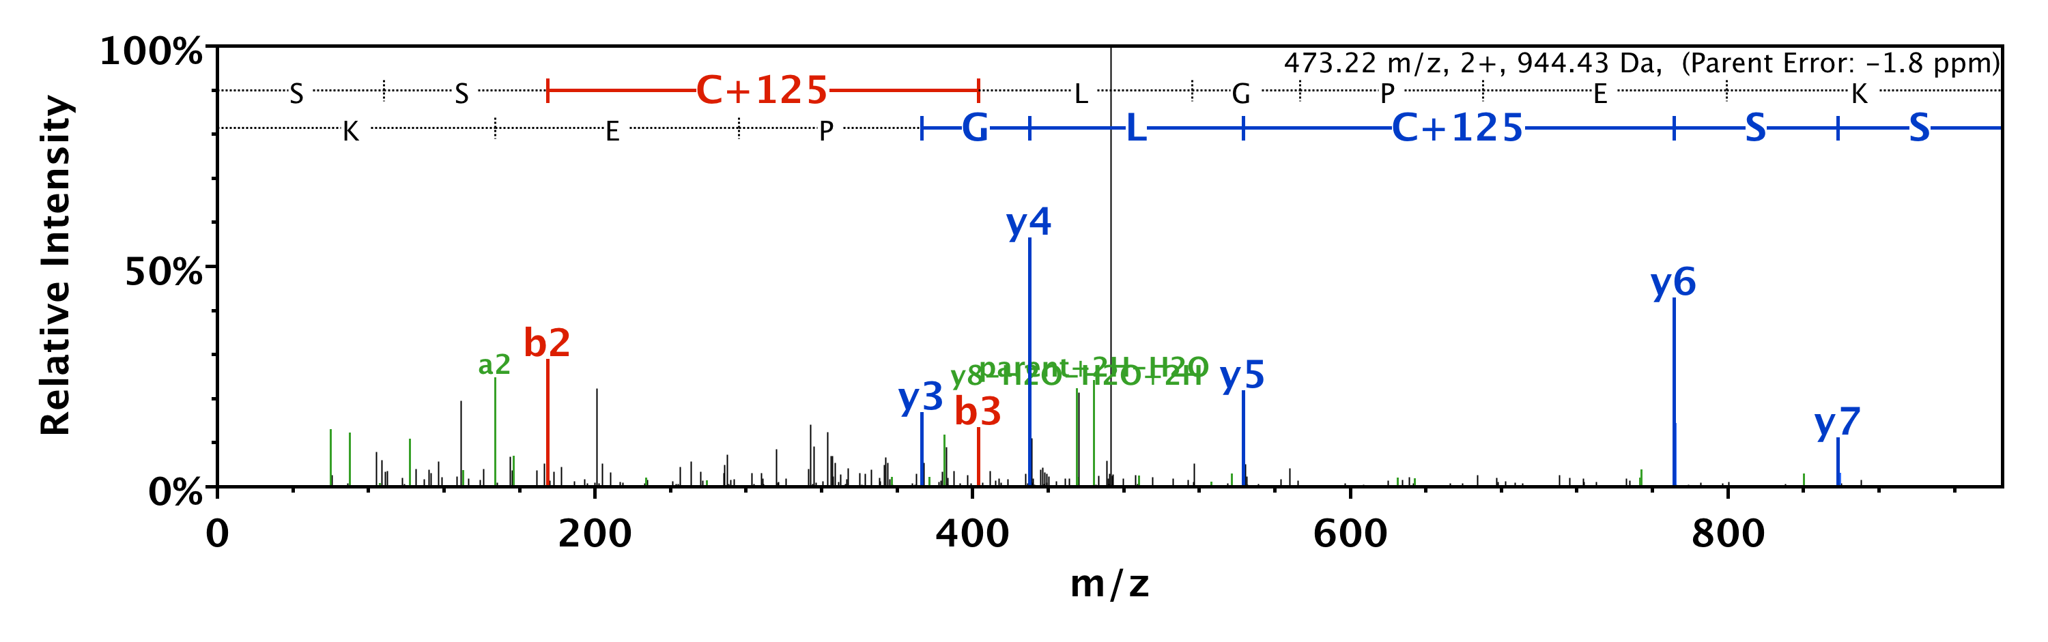
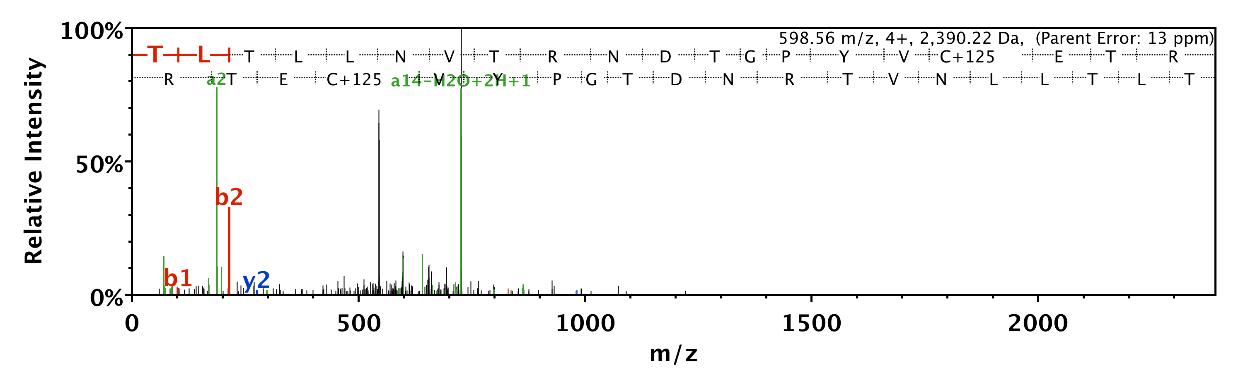
C# GKEF C# EF
SLAV C# EESSAR
AAES C# IKSTVK
SS C# LGPEK
TLTLLNVTRNDTGPYV C# ETR

Slide 10
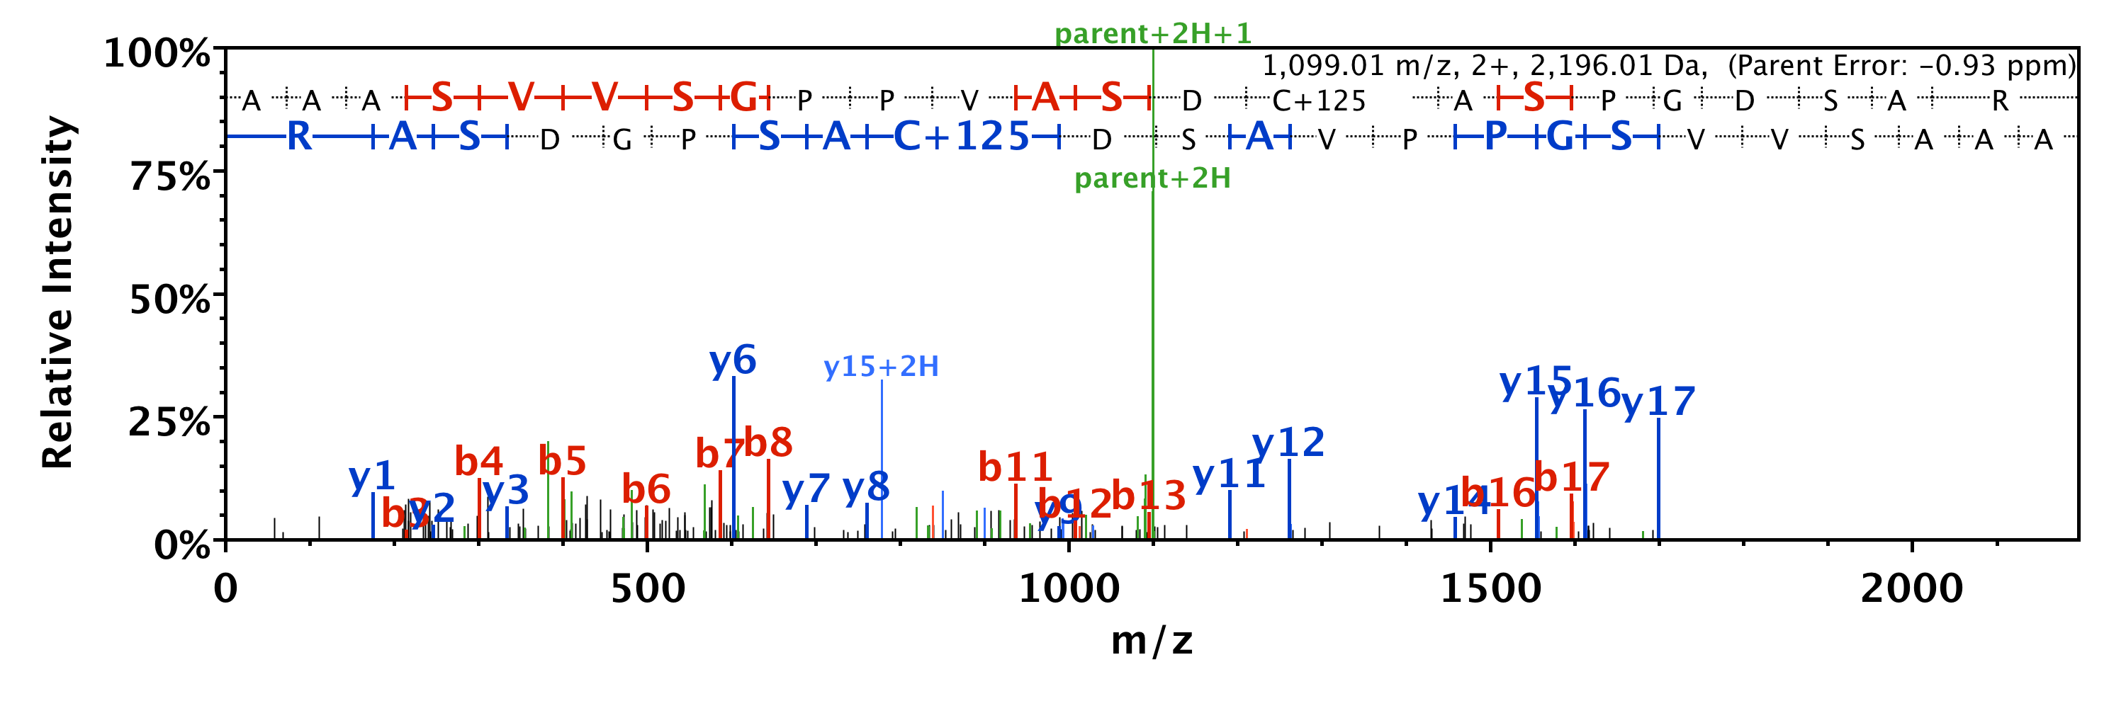
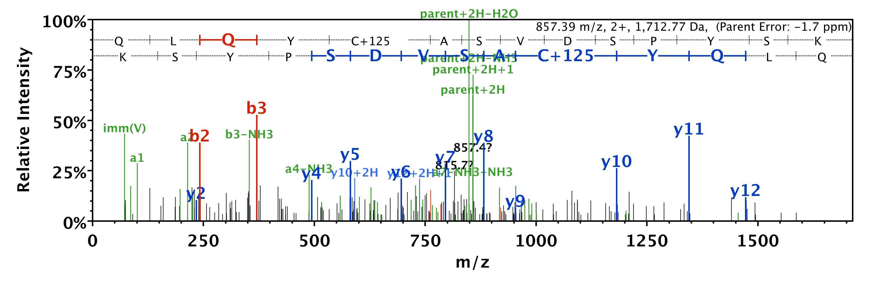
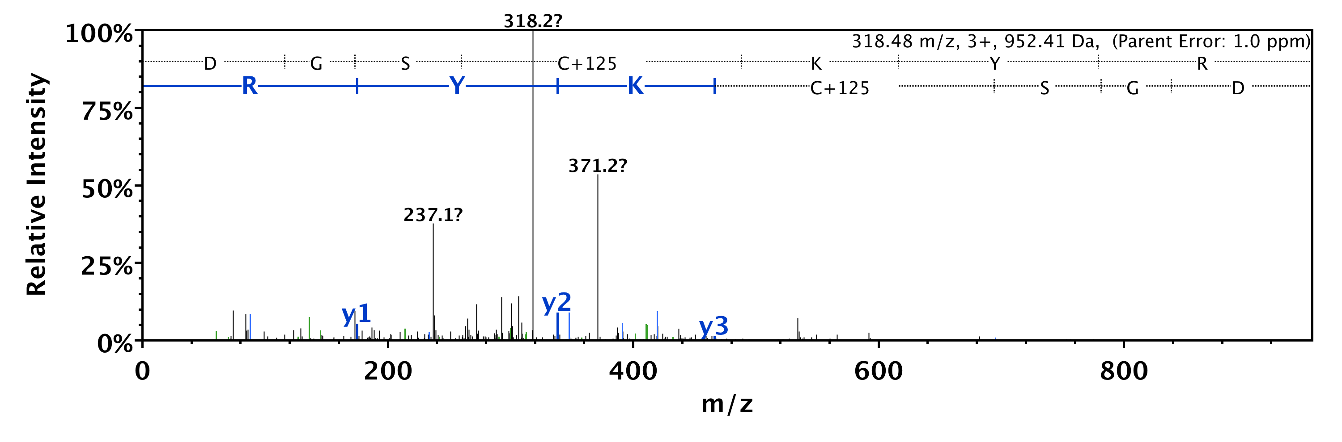
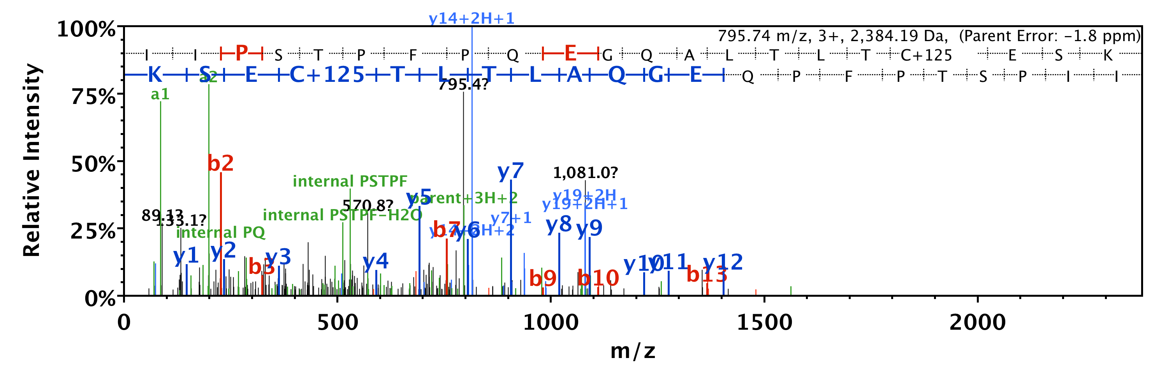
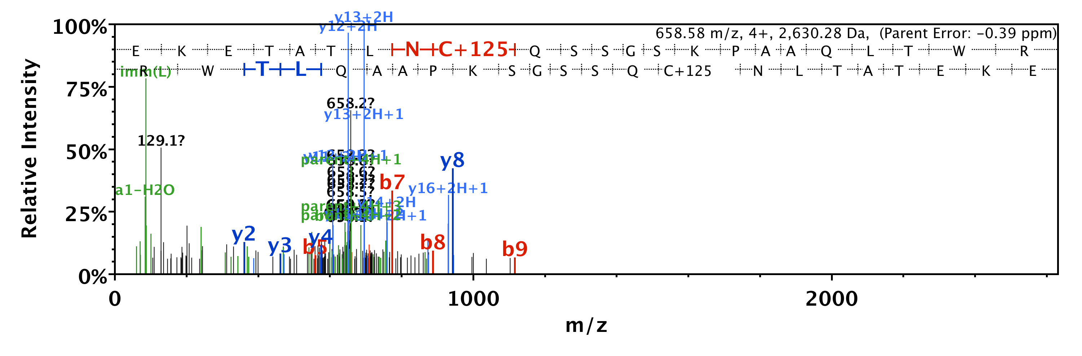
AAASVVSGPPVASD C# ASPGDSAR
QLQY C# ASVDSPYSK
DGS C# KYR
IIPSTPFPQEGQALTLT C# ESK
EKETATLN C# QSSGSKPAAQLTWR

Slide 11





EQAVEGGEVELS C# LVPR
TSEVN C# YR
SQEAGASG C# STEAK
STS C# TTSLASQGER
APPPSLTD C# IGTVDSR

Slide 12





LEGGKGDQDDLGVN C# LQNNLT
KEDGDTI C# SGPGMSDPR
MLPDKD C# R
MNGQVV C# AVPHNLESK
KAIPPG C# GDEPEEEDESILDTVIK

Slide 13





AALEQP C# EGSLTRPK
VSLN C# R
VQGELSESN C# GAMPR
S C# SSPVFSR
SELS C# APK

Slide 14





VIHE C# QQR
LEL C# DNR
DH C# VAHK
EH C# EQLEK
GGDVSV C# EWYR

Slide 15





AYDYVE C# PVTGAR
C# FQPPIHQSLATT C#
E C# SLSPK
nSMRE C# R
C# STPEEIKKR

Slide 16





VSVQY C# DVLHkk
GLYDGPV C# EVSVTPK
MYPGQGPFDT C# ED C# VGHPQGK
AEEDVEPE C# IMEK
SAG C# AAYMAPER

Slide 17





TKETN C# ESDRER
LAV C# GNPATSQPVTSSNHSSR
TGEP C# VAELTEENFQR
AAAPAPEEEMDE C# EQALAAEPK
HYAHTD C# PGHADYVK

Slide 18





ESPPLLPLGTP C#
LLGDVS C# R
SQDVAISPQQQ C# SK
TFQD C# YSSK
TAAGYGDFSEPLEV

Slide 19





C# LEENNGVDKR
SAD C# SVEEEPWKRE
NRP C# QPPPPPTLPPPSLATPLSR
S C# KSELPSSAPGGGGV
VDMP C# SSKVDIVSPGGDNAGSLR

Slide 20





TGAP C# RSER
LVTGDRNNSS C# R
SDPYHATTGPLSPSKD C# GSPK
LSTAS C# PTPK
SG C# GLTR

Slide 21





YQE C# DSR
NTVP C# QKR
VDSTT C# LFPVEEK
TLD C# EPK
IVSNAS C# TTN C# LAPLAK

Slide 22





TTSFAES C# KPVQQPSAFGSMK
S C# SEVR
SVGVN C# EkMPK
MV C# DVVSR
SLPQPQKVNSILG C# SQ

Slide 23





QKEYK C# GDLVFAK
LLQ C# DPSSASQF
SME C# NLEEAR
C# SPTEAAVR
SFNRNE C#

Slide 24





ISDNGPYE C# HVGaIYDR
LTVHEGQELALG C# LAQTK
GAGP C# SPGLER
TVEYAP C# R
VE C# VGSEGASEGIVLPLVSSNSGPR

Slide 25





SWTWPEGPEQTLH C# EAR
C# EAINAR
C# VATNAHGTDSR
LDDLD C# PR
A C# LDDSYASGEGLKR

Slide 26





QLVYEADG C# SPHGTLK
NVGTGLVGAPA C# GDVMK
LQAGIDL C# ETR
GAQNAD C# PK
TRDLP C#

Slide 27





TS C# RLSGSLGAGS C# R
TK C# EEIk
ATGHSGGG C# ISQGQSYDTDKGR
S C# SKDPSGAHPSVR
I C# Q C# LEGHIQ C# R

Slide 28





TP C# AETPAEPVDWAFAQR
QN C# LSSR
SVPDDYR C# GK
GQVPGHASQGTQAVESS C# SK
DNAL C# ENAR

Slide 29





DTAF C# VDSK
TSPAPDILSLPEDP C# LGPR
SM C# APLPVAAQSTTLPSLSGR
C# EASAVPAPDFEWYRDDTR
EQSGKYE C# K

Slide 30





NAEGSTVT C# TGSIR
TVA C# NR
IVSSKDY C# VTANSK
TDFFEDENGQR?
VVEQM C# VTQYQK

Slide 31





SAPSIPKENFS C# LTR
QTETGEGSV C# QR
SASASPLTP C# SAPR
SAP C# GSLAFSGDR
APISLSQDPSPPLNGSTTS C# GPDRR

Slide 32





TIKSP C# DSGYSYETIEK
TIKTPEDGGYT C# EITEK
SALRDAY C# SEEKELK
SPDTSAY C# YETMEK
TPQASTYSYETSDR C# YTTEK

Slide 33





MP C# FPIESKEEEDKAEQAK
SLYSEPFKE C# PKVEKPSVQSSKPK
LSNVAPP C# ILRKNPPSAR
EAT C# QPSGTRPEDIEK
TY C# YDLR

Slide 34




TPGAAASGAAAASEDGS C# G C# LPNPGTFEE C# HRK
GVSV C# ETE C# TDMGLR
LPENTPP C# QQVDQPK
VLTENVI C# GkSGVT C# SR
Mucin-6 placeholder
TSASIGSL C# ADAR

Slide 35





TTI C# GK
VI C# TSR
ALVGDEAELP C# R
SMDPS C# TR
AVTEGAQAVEEPSI C#

Slide 36





T C# DESSF C# K
NVDKNDEAEYV C# IAENK
TDEGTYR C# EGR
LSDSGRYD C# EAASR
QGEDAEVV C# R

Slide 37





LD C# QVQGRPQPEITWR
QMAEIQSTAGVKPS C# SK
LLQ C# DPSSAGQF
GTVL C# GPPPAVENASLVGVR
FDAY C# FR

Slide 38



AQ C# QR
Neurocan placeholder
MAALEQ C# LSEP
TADDG C# LENAPDTAEFSR
SGGRPEEYEGEYQ C# FAR
DNILIE C# EAK

Slide 39




SGE C# GRKGPGPGGPGGAGGAR
SGE C# GR
DSTGTYT C# VAR
ENIVIQ C# EAK

Slide 40





DQAGEYE C# SAENDVSFPDVKK
LLQ C# DPSSASQF
LTLEDSGTYE C# R
SENKNEGQDAMMY C# K
AEDSGEYH C# VYHFVSAPK

Slide 41





EQSGEYE C# SASNDVAAPVVR
C# IEENNGVDKR
GAWTLAGVTSWGLG C# GRSWRNnAR
VA C# IAMEK
ALNVEPDGTGLT C# SLAPNILSQ

Slide 42





DFTPV C# TTELGR
ITVQVEPV C# GVGVVPK
T C# NISVGR
HEVTI C# NYESANPADHR
EQAM C# LER

Slide 43






Slide 44






Slide 45






Slide 46






Slide 47






Slide 48






Slide 49






Slide 50






Slide 51






Slide 52






Slide 53






Slide 54






Slide 55






Slide 56






Slide 57






Slide 58






Slide 59






Slide 60






Slide 61






Slide 62





