Slide 1
Introduction to Poker
Originally created by Albert Wu,
Harvard ‘16/poker legend
Modified slightly by Leigh Marie Braswell

Slide 2
Overview
Why Poker?
Types of Games
Gameplay
Winning at Poker (preview)
Pot Odds (preview)
Betting Strategy (preview)

Slide 3
Why Poker?
Teaches us to become process-oriented instead of results-oriented
Teaches emotional discipline
Teaches chip management
It’s fun! ☺

Slide 4
Types of Games
Gameplay
  No-Limit Hold’em (NLHE)
  Limit Hold’em
  Pot Limit Omaha
Game Structure
  Tournaments
    Deepstack, hyper, turbo, etc. (we will play on PokerStars)
  Cash Games
    Will be discussing strategy but NOT playing for real $$$$
    However feel free to bet money playing Fantasy Football online, since that’s a game of skill

Slide 5
Gameplay
Games are characterized by their blinds (SB / BB)
You buy-in for a certain amount, which becomes your “stack.” A “standard” stack in NLHE is 100BB.
Games typically have 6-9 players. A 9-handed game is called a “full ring,” and 6-handed or below is called “short-handed.”

Slide 6
Gameplay
Games are divided into units called “hands”
In each hand, one player pays the SB and another player pays the BB. After each hand, the SB and BB “rotate” counterclockwise, and then we play another hand.
I will show an example of a full “hand” below
In every hand, we accumulate money into what we call the “pot” (stack of chips in middle of table)

Slide 7
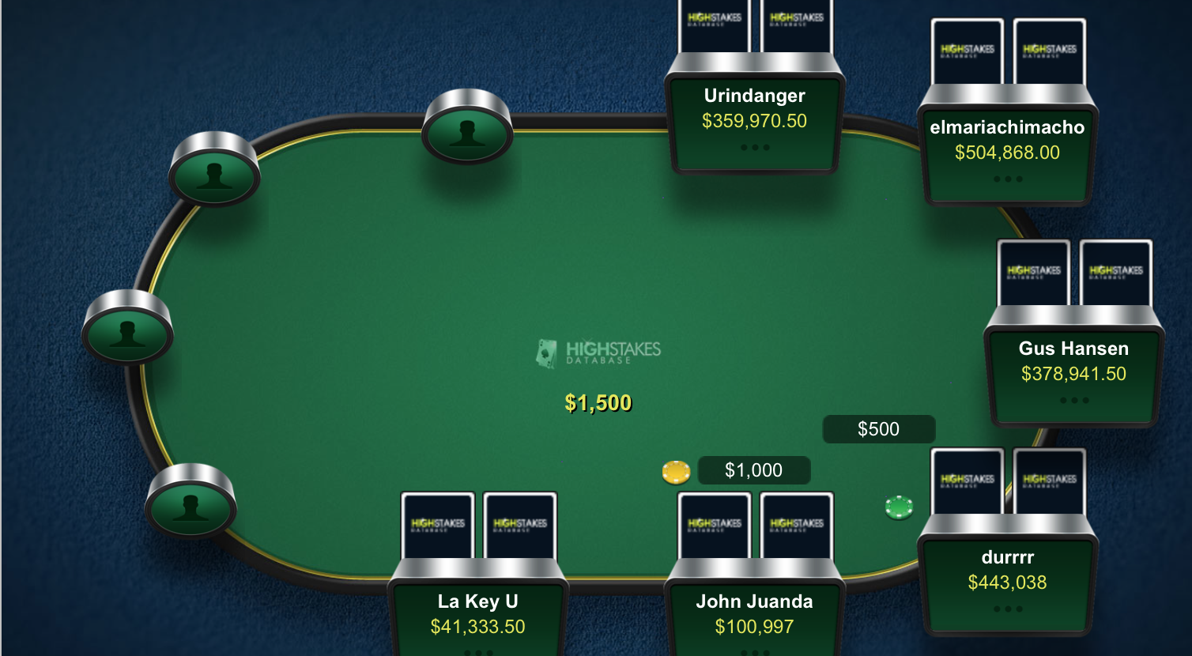
Gameplay (Preflop)
Hijack
Cutoff
Button
Under the Gun (UTG)
Big Blind
Small Blind

Slide 8
Gameplay (Preflop)
Action starts on UTG, proceeds counterclockwise, and ends on the BB
Each player has three options:
  Fold: give up the opportunity of playing the hand
  Call: have the opportunity to play the hand. Match the last raise or the BB if there were no previous raises.
  Raise: have the opportunity to play the hand. Put in more money than the previous amount. Action continues until we are able to go through a whole cycle back to the last raiser.
    Minimum raise is at least as much as previous bet or raise in the same round.

Slide 9
Gameplay (Postflop)
There are three postflop betting “streets”, called the flop, turn, and river.
On each street, action start on the SB and goes counterclockwise to the BTN.
  Who has the advantage here, SB or BTN?
  Said to be “have position”

Slide 10
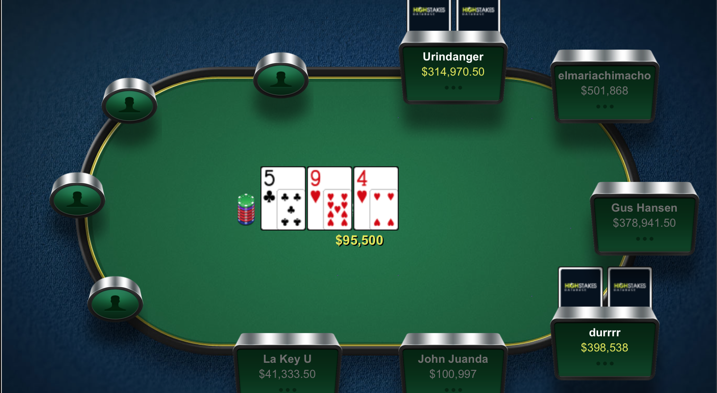
Gameplay (Flop)

Slide 11
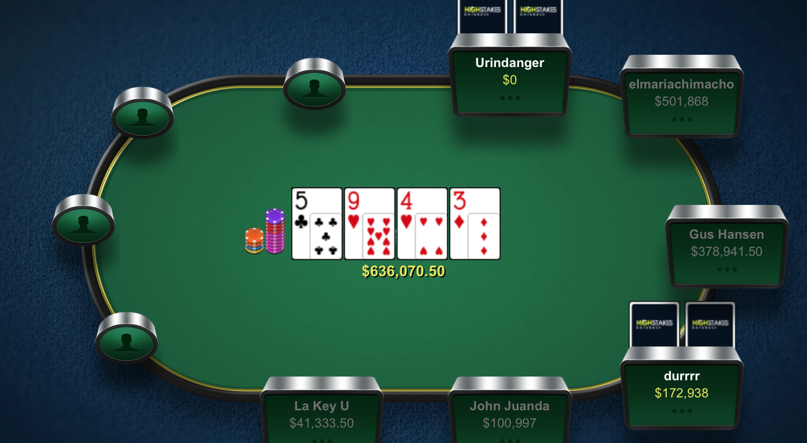
Gameplay (Turn)

Slide 12
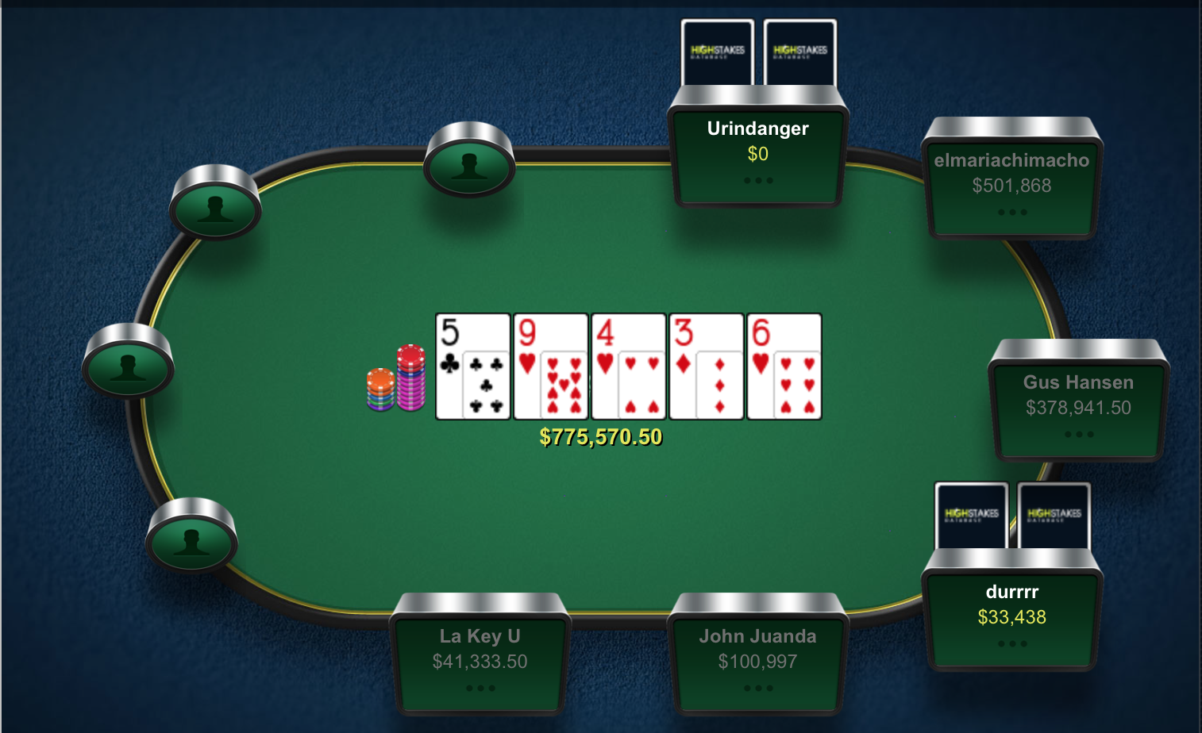
Gameplay (River)

Slide 13
Gameplay (Postflop)
On each street, if no bets have happened in front of a player, he/she can:
  Check: do not put more money in the pot
  Bet: put money in the pot. Others who want to stay in must at least match that money.
If someone has bet or raised in front of a player, he/she can:
  Fold: relinquish the opportunity of winning a hand, but don’t put any more money in
  Call: match the previous bet/raise amount, still have an opportunity of winning hand
  Raise: put more money in than the previous bettor. Anyone must now match your bet, fold, or re-raise, and the betting round ends when it gets back to you (unless someone else raises).
Notes:
MENTION:
“check raising”– deceptive play (used against aggressive opponents or when you want to slow play)
“all in”– special kind of raise

Slide 14
Gameplay (Postflop)
At any point, if everybody folds except for one player, that player wins the pot.
If there are two or more people in the pot after the river, there is a showdown. The person with the “best hand” (we will define this later) at showdown wins the pot.

Slide 15
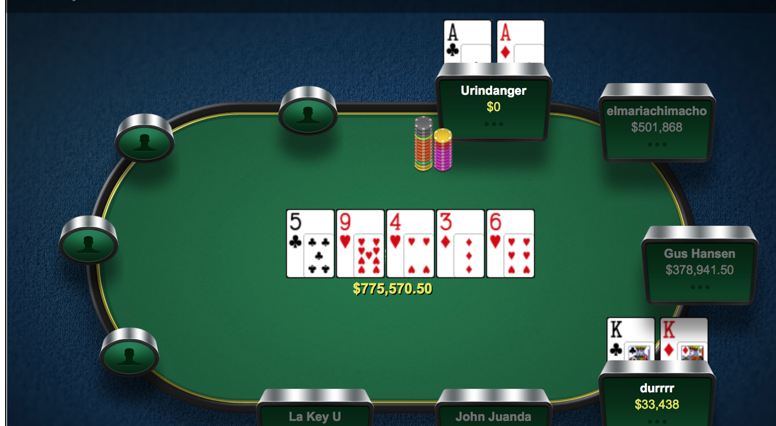
Gameplay (Showdown)

Slide 16
Gameplay (Showdown)
“Best Hand”
Of the five community cards and your two hole cards, form the best possible 5-card hand
The person with the best possible 5-card hand wins the showdown.

Slide 17
Gameplay (Showdown)
Order of Hands
Hand | Description
Straight Flush | Five cards of consecutive rank, same suit
Quads (4 of a kind) | Four cards the same rank
Full House (boat) | Three cards the same, another two cards the same
Flush | Five cards of the same suit
Straight | Five cards with consecutive rank
Trips | Exactly three cards with the same rank
Two Pair | Two pairs of two cards with the same ranks
Pair | Exactly two cards the same rank
High Card | No two cards the same rank

Slide 18
Gameplay (Example 1)
Player 1: As10s
Player 2: 7c6h
Flop: Ac 7h 2d
Turn: 3s
River: 2s
Who has the best hand on every street?

Slide 19
Gameplay (Example 2)
Player 1: As10s
Player 2: 7c6h
Flop: Ac 7h 6d
Turn: 3h
River: 3s
Who has the best hand on every street?

Slide 20
Gameplay (Example 3)
Player 1: As10s
Player 2: 7c6h
Flop: 9s 7h 7s
Turn: 3h
River: 2s
Who has the best hand on every street?

Slide 21
Gameplay (Example 4)
Player 1: As10s
Player 2: 7c6h
Flop: Ac 8h 5h
Turn: 3h
River: 3s
Who has the best hand on every street?

Slide 22
Winning at Poker (preview)
The goal of poker is to win as many chips as possible, in general
How do we do this? Maximize the expectation of every decision we make
I will now talk about two concepts that are key to making positive-EV decisions, pot odds and betting strategy
Will will cover this in more detail in class

Slide 23
Pot Odds
The simplest way to see this is a situation in which we can only call or fold
Let’s say the river has been dealt. There is $50 in the pot. Our opponent bets $25. At least how often do we have to be winning to make this call?

Slide 24
Pot Odds
The simplest way to see this is a situation in which we can only call or fold
Let’s say we are on the river. There is $50 in the pot. Our opponent bets $25. At least how often do we have to be winning to make this call?
Answer: at least 25% of the time
p(75) - (1-p)(25) > 0, p > 1/4

Slide 25
Pot Odds on Earlier Streets
Let’s say we can only call or fold on the turn. Assume there will be no bets on the river. The pot is currently $40 before the turn is dealt.
  Player 1: As6s
  Player 2: 9h7h
  Flop and Turn: 9s 8s 3h 2d
Player 2 bets $20 on the turn. Should Player 1 call? What if Player 2 bet $40?

Slide 26
Pot Odds on Earlier Streets
What is the probability that Player 1 wins the pot, i.e., how many “outs” does he have to win?
Any Ace, any spade: 3 + 9 = 12
There are 44 cards left, so there is a 12/44 = 27.27% chance of winning
So, Player 1 should call if Player 2 bets $20 into a pot of $40, but not if Player 2 bets $40

Slide 27
Pot Odds on Earlier Streets
Counting “outs” is important, since it gives us an idea of the pot odds we have
In general, the probability of hitting an “out” on the next street is 2%
Sometimes, we need to discount outs.
Notes:
MENTION:
Discounted outs: outs not fully counting the cards that would improve the hand but not improve it to the best hand/might improve opposing hand more… Multiply or subtract

Slide 28
Pot Odds on Earlier Streets
Note that we have made an important assumption: no bets on the river.
This ignores something called “implied odds,” the amount of money you can win after you make your hand.
Let’s look at the earlier hand again:

Slide 29
Pot Odds on Earlier Streets
Let’s say we can only call or fold on the turn. Now, we can bet the river. The pot is currently $40 before the turn is dealt.
  Player 1: As6s
  Player 2: 9h7h
  Flop and Turn: 9s 8s 3h 2d
If Player 2 bets $40, how much money would you have to make when you make your hand to make the call profitable?

Slide 30
Pot Odds on Earlier Streets
Let’s say we have a 27% chance of winning
To see if the call is profitable, we must have positive expectation:
0.27(80 + x) – 0.73(40) > 0
x > 29.63
So, if we make at least $30 on average when we hit our flush, the call of $40 is profitable.

Slide 31
Pot Odds on Earlier Streets
What factors increase implied odds?
  You and your opponent having large percentages of your stack to bet on the turn/river
  How disguised your hand is (typically straight draws are more hidden than flush draws)
  Unobservant/“loose” opponents
  How “good” your opponent’s hand is

Slide 32
Betting Strategy
We can win hands (make money) in two ways: by making everybody else fold before showdown, or having the best hand at showdown
This suggests two reasons for bets:
  Bluff: To make “better hands” fold, i.e., make people fold when their hands have correct odds to call
  Value bet: To make “worse hands” call, i.e., make people call when their hands do not have correct odds to call
  GOLDEN RULE OF POKER: don’t forget!

Slide 33
Betting Strategy (Sizing)
Because of an emphasis on giving opponents incorrect odds for decisions, we always size our bets in relation to the pot
Typically, when we bet 1/2 – 1 pot every street, we deny a “drawing” (dangerous) hand correct odds to call us down.

Slide 34
Betting Strategy (Example)
There will be no bets on the river. The pot is currently $40 before the turn is dealt.
  Player 1: As6s
  Player 2: 9h7h
  Flop and Turn: 9s 8s 3h 2d
We are Player 2. How much should we bet on the turn?

Slide 35
Betting Strategy (Example)
We know that Player 1 has about a 27% chance of drawing to a better hand
We want to bet an amount $x that denies Player 1 the correct odds to call:
  0.27(40 + x) – 0.73x < 0
  x > 23.47
So, we want to bet at least $23.50. Betting 2/3 pot (about $27) would work about as well.

Slide 36
Betting Strategy (Bluffing)
The pot is currently $10K before the river is dealt. Player 1 and Player 2 both have $20K remaining.
  Player 1: As6s
  Player 2: 9h7h
  Flop, Turn, and River: 9s 8s 3h 2d Kc
We are Player 1. Under what conditions should we bluff?

Slide 37
Betting Strategy (Bluffing)
As Player 1, we don’t have a pair. If there have been previous bets, we likely do not have the best hand, so we can only win with a bluff.
Let us consider 3 bluff sizes: $5K (half-pot bet), $10K (pot-sized bet), $20K (2 PSB)

Slide 38
Betting Strategy (Bluffing)
As Player 1, we don’t have a pair. If there have been previous bets, we likely do not have the best hand, so we can only win with a bluff.
Let us consider 3 bluff sizes: $5K (half-pot bet), $10K (pot-sized bet), $20K (2 PSB)
We need to consider pot-odds for bluffs as well, based on the probability that our opponent folds

Slide 39
Betting Strategy (Bluffing)
5K bluff on river. Let p be the probability that opponent folds:
10p – 5(1-p) > 0, p > 1/3
So, if the opponent folds at least 1/3 of the time to a half PSB, bluffing is better than checking.
For PSB bluffs, we need p > 1/2, and for 2PSB bluffs we need p > 2/3.

Slide 40
Betting Strategy (Bluffing)
We should choose the bet size that maximizes expectation given how often we think our opponent will fold to different-sized bets.
How can we know how often our opponent will fold?
  Value-betting / bluffing frequency ratio
  How convincing our “story” is

